Slide 1
Study on the Tail Distribution of Stock Returns: From Empirical Analysis to Factor Explanations
Chartered Financial Data Scientist (CFDS)
CFDS-11 – Project Presentation - Pierre Nibéron
Notes:
Welcome to my presentation on the tail distribution of stock returns. We have about 50 slides to cover in 15 minutes. Some are just for visualization purpose and I’ll go swiftly through them. The complete presentation is on my GitHub as well as the code.

Slide 2
Contents
Motivation
Problem Description
Data
Analysis
Conclusion
Limits of log-return, welch t-test, ….
Extreme Value Theory ? (https://en.wikipedia.org/wiki/Extreme_value_theory)

Slide 3
Motivation
On Fat-Tails
Mention by Dr. Sikandar Siddiqui during CFDS lessons
Personal IT Background going into finance
Describing and finding explanatory models
Reading literature on the subject
Using the tools learned during CFDS course
Initiation to existing financial models (CAPM, Fama-French, …)
“large changes tend to be followed by large changes, of either sign, and small changes tend to be followed by small changes.” - Benoit B. Mandelbrot, 1963
Notes:
More about finance and statistics than IT and coding. I wanted to reflect that. I wanted to reuse what we learned and learn more during the project. We will go through CAPM, Fama & French, Momentum which I had no knowledge off, 6 months before.

Slide 4
Problem Description
First Part : Description and statistical testing
Do we observe fat tails which would not exist under normal assumptions ? Arithmetic vs. Log, Skewness, Kutorsis, JB and visualization
What do these tails look like? Are they symmetrical? 99.9th percentile, clustering, t-test, f-test and visualization
Second Part : Model and explanatory power
CAPM
Fama-French Three factors model
Carhart’s Momentum
Sentiment
Notes:
We’ve already seen that we observe fat tails, but I wanted to re-explore it and show it my way. Using visualization and reusing the tools used during the CFDS. I also started to see discrepancies in the tools and processes, like arithmetic returns vs log returns, when analysing the tails. It’s a common theme in my presentation. I failed numerously during the analysis, because of poor logic on my side and because the tools I used were not made for the extreme values. But that’s one goal of my presentation. To see how things fail in the extremes.
First part is about describing and playing around characteristics of the distribution of returns. Allowed me to reuse what I learned. Second part is about applying models and see if they hold in the tails. About learning new things and a genuine interest in finding an explanatory model for extreme values.

Slide 5
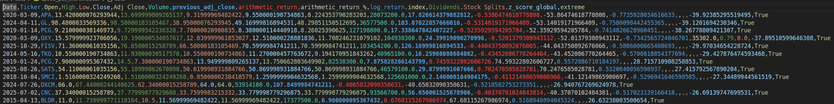
Data
S&P500 stock list from wikipedia
Daily stock prices from 01.01.2010 to 01.05.2026
yFinance api (data from yahoo finance website)
Risk free rate, T-Bill 3 month from FRED’s website
Fama-French dataset from panda_datareader library
News headlines from kaggle (see link in sentiment analysis part)
Notes:
Disclaimer, I cleaned the data to the best of my effort, but by lack of competence on my side, or lack of actual data, there might be some discrepancies remaining. I took a dataset large enough to hope for these discrepancies to remain as noise in my analysis.

Slide 6
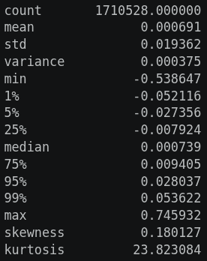
Whole set description
Arithmetic-Returns stats table:
Jarque-Berra
JB statistic: 40458666.05
p-value: 0.00e+00
Notes:
This is the stats summary on the whole set of S&P500 arithmetic returns. Leptokurtic, positively skewed, take note of it as well as the max value. Interesting to not that the mean and median are slightly positive. The JB test significantly reject normality.

Slide 7
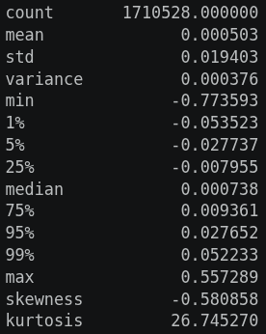
Whole set description
Log-Returns stats table: (check skewness and max, effect of the log)
Jarque-Berra
JB statistic: 51077412.92
p-value: 0.00e+00
Notes:
This is the stats summary on the whole set of S&P500 logarithmic returns. Leptokurtic, negatively skewed. Interesting to not that the mean and median are slightly positive. The JB test significantly reject normality.
We start to see the difference between arithmetic and logarithmic returns. (I did not see it at first but later the discrepancies made me question it and go back.) Log flattens extreme positive returns.

Slide 8
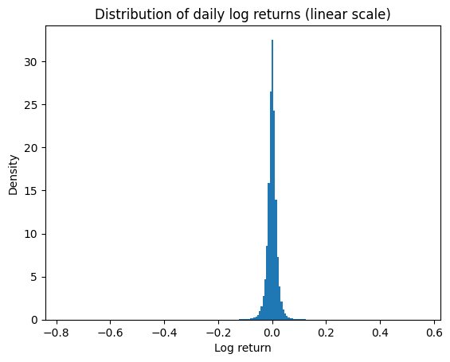
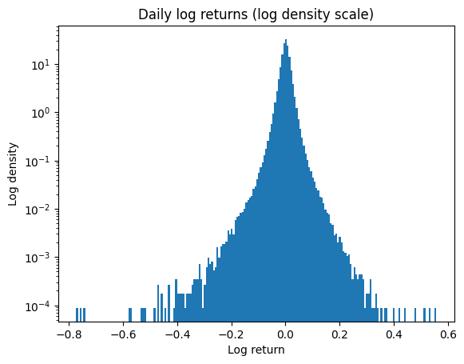
Whole set visualization
Notes:
For visualizations, I juggle a bit between arithmetic and logarithmic depending on the use case.

Slide 9
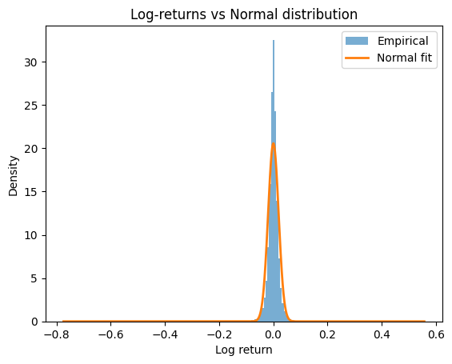
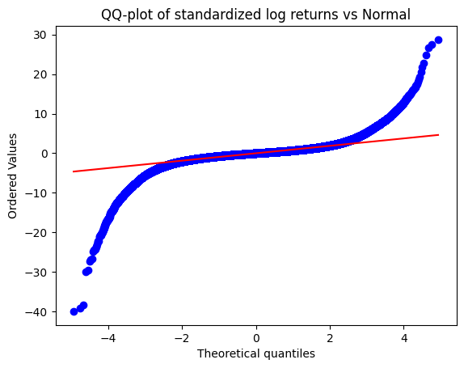
Whole set visualization
Notes:
QQ plot is a plot of two distribution against each other. Here on the y-axis the empirical return distribution and on the x-axis the theoretical normal distribution.

Slide 10
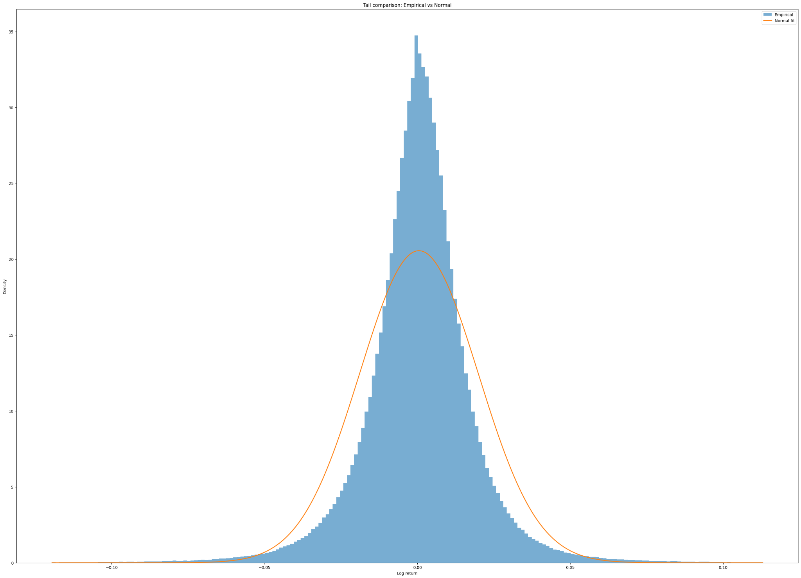
Whole set visualization
Notes:
The normal is in orange.

Slide 11
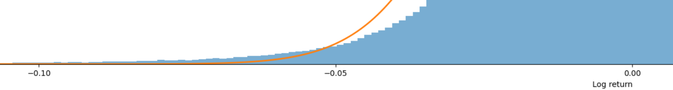
Whole set visualization

Slide 12
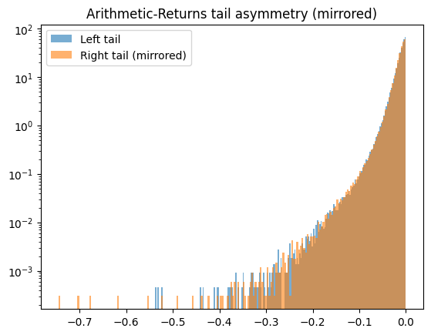
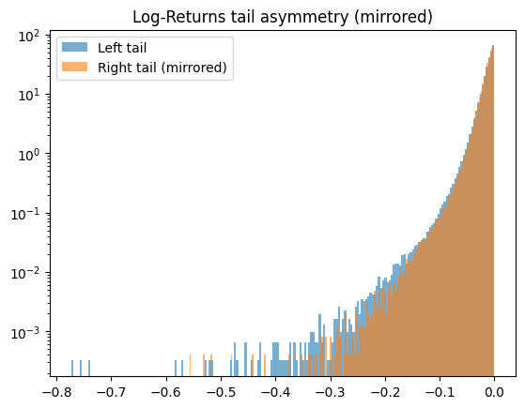
Whole set visualization
Notes:
I tried a bit of mirroring to have a feel of how both sides are distributed. We see the arithmetic vs log return discrepancies.

Slide 13
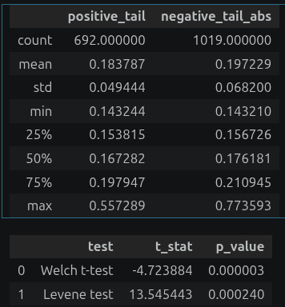
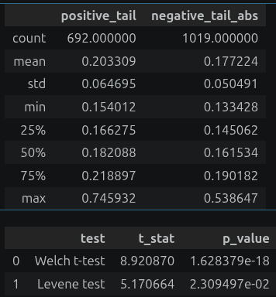
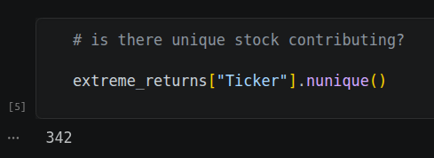
Top 0.1% description
Do the two top 0.1% have the same statistical resemblance? Check both return definition, log_return (left), arithmetic_return (right) Extreme Value Theory and Generalized Pareto Distribution territory.
Notes:
To single out the extremes I decided to cutoff only the top 0.1% absolute return values. At 0.999 quantile the value is 0.143683 in terms of log return. No impact with the arithmetic return.

Slide 14
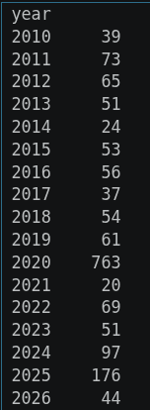
Approach-2 (time clustering)
Top 0.1% daily returns clustered by years

Slide 15
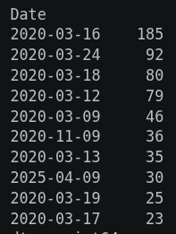
Approach-2 (time clustering)
Top 0.1% daily returns clustered by days, ordered, head(10)

Slide 16
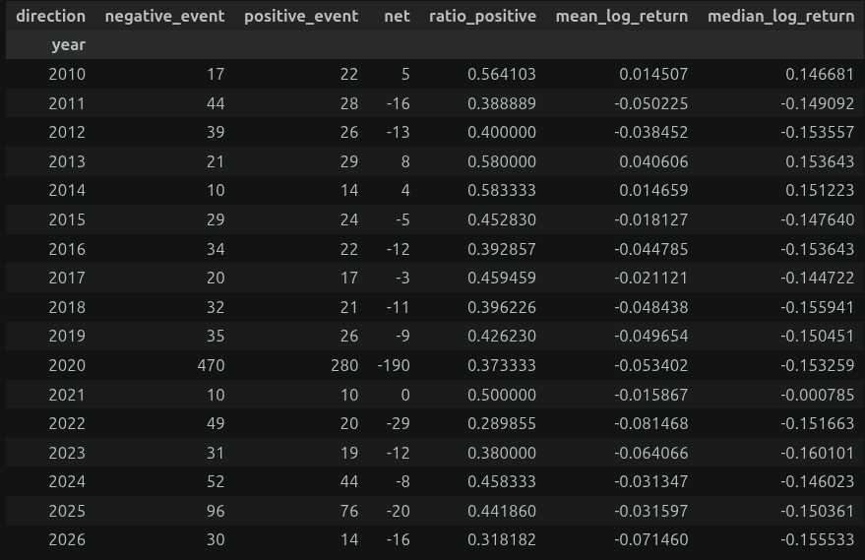
Approach-2 (time clustering)
What years were good / bad for the top 0.1%?

Slide 17
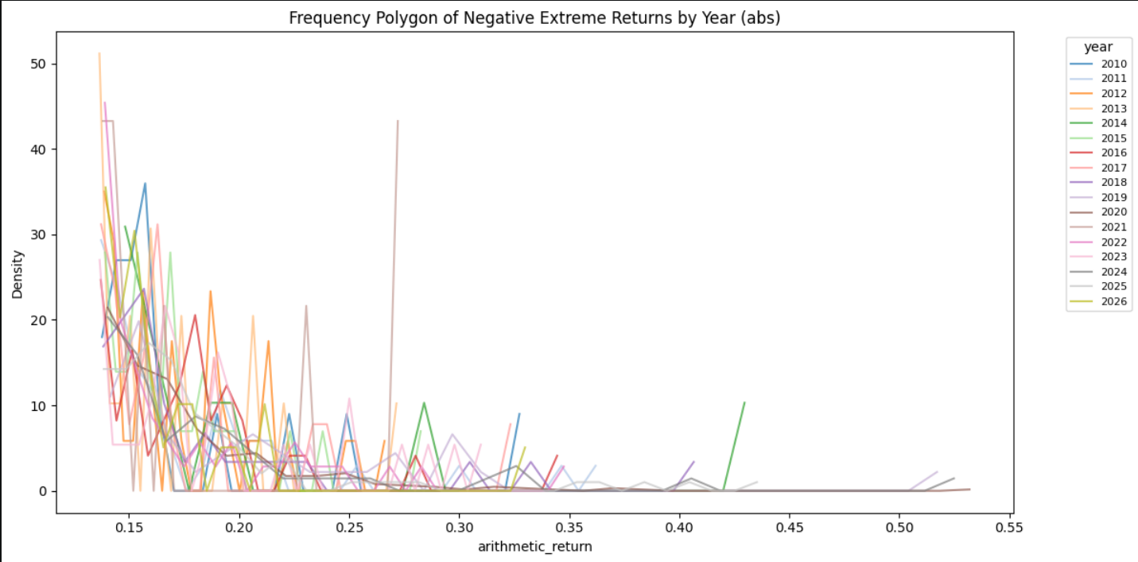
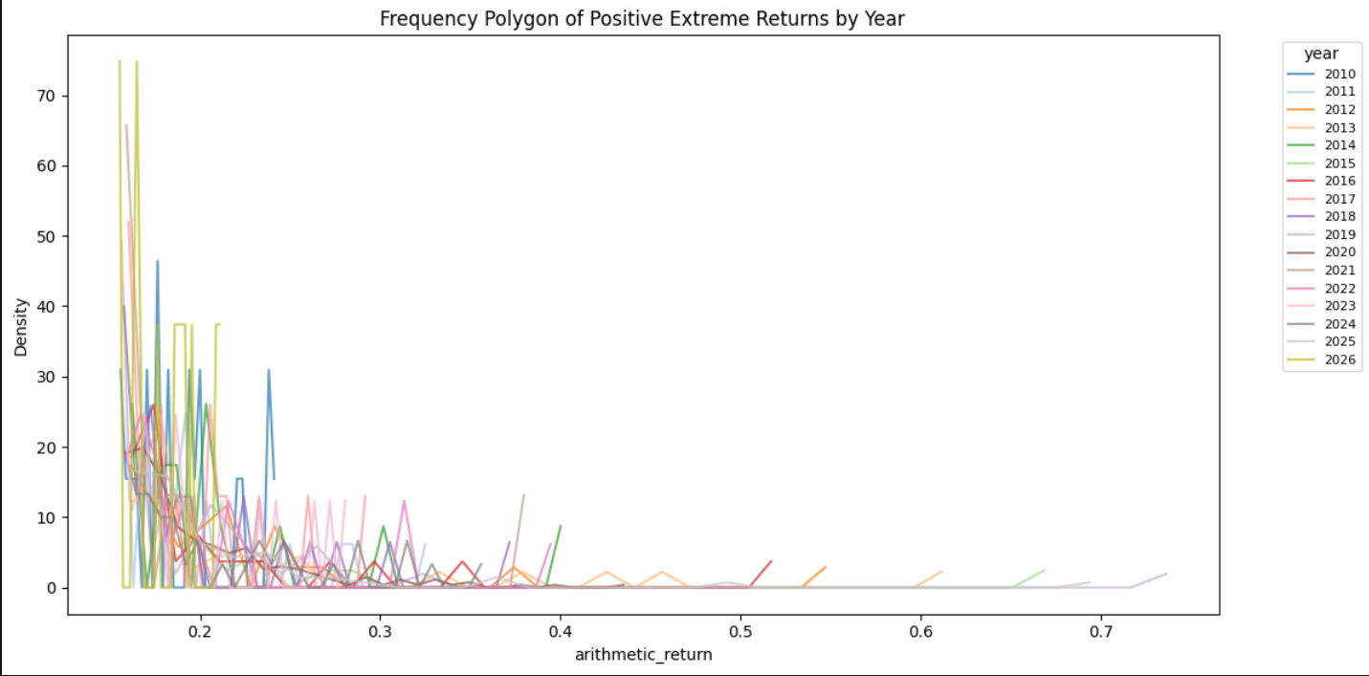
Approach-2 (time clustering)
What does it look like? (Arithmetic returns to not crush the extremes positives)

Slide 18
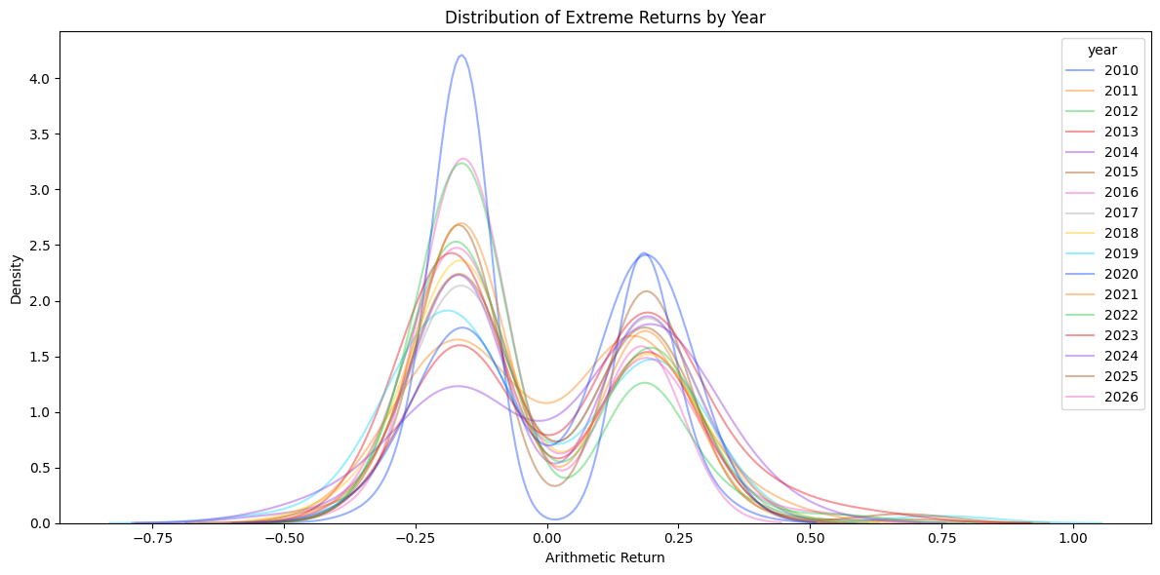
Approach-2 (time clustering)
What does it look like? (Arithmetic returns to not crush the extremes positives)

Slide 19


Approach-2 (time clustering, statistical testing)
Do the top 0.1% mean across years are statistically different within each positive extreme and negative extreme? log_return (left), arithmetic_return (right)
Less impact of return definition because we are comparing positive / positive and negative / negative. Extreme Value Theory and Generalized Pareto Distribution territory.

Slide 20
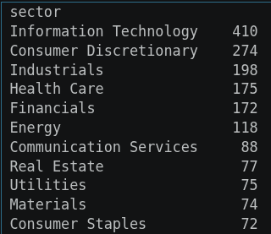
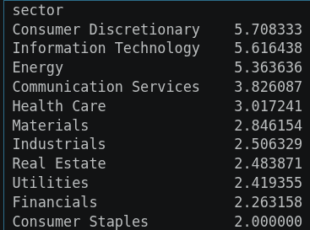
Approach-2 (sector clustering)
Top 0.1% daily returns clustered by sectors, ordered
Raw count and normalized (events/nbr_stocks) count.

Slide 21
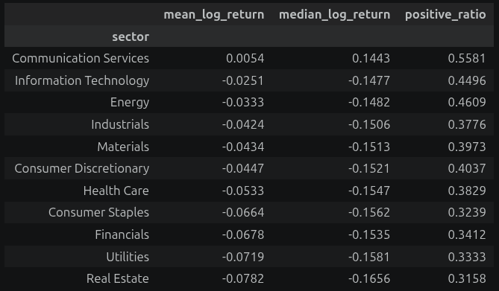
Approach-2 (sector clustering)
What sectors performed best in the top 0.1%?

Slide 22
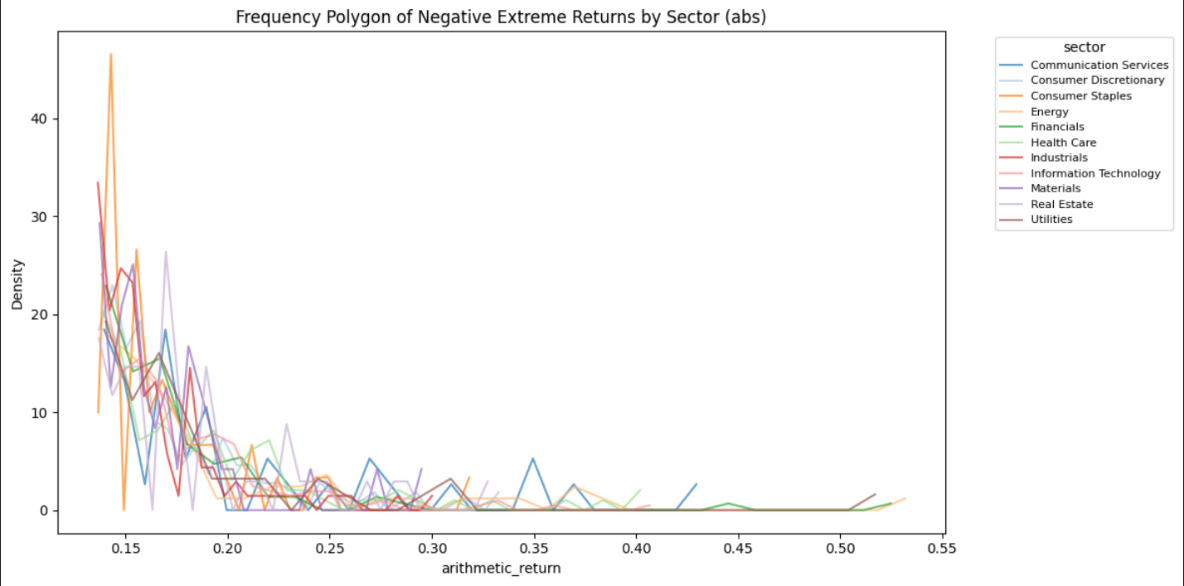
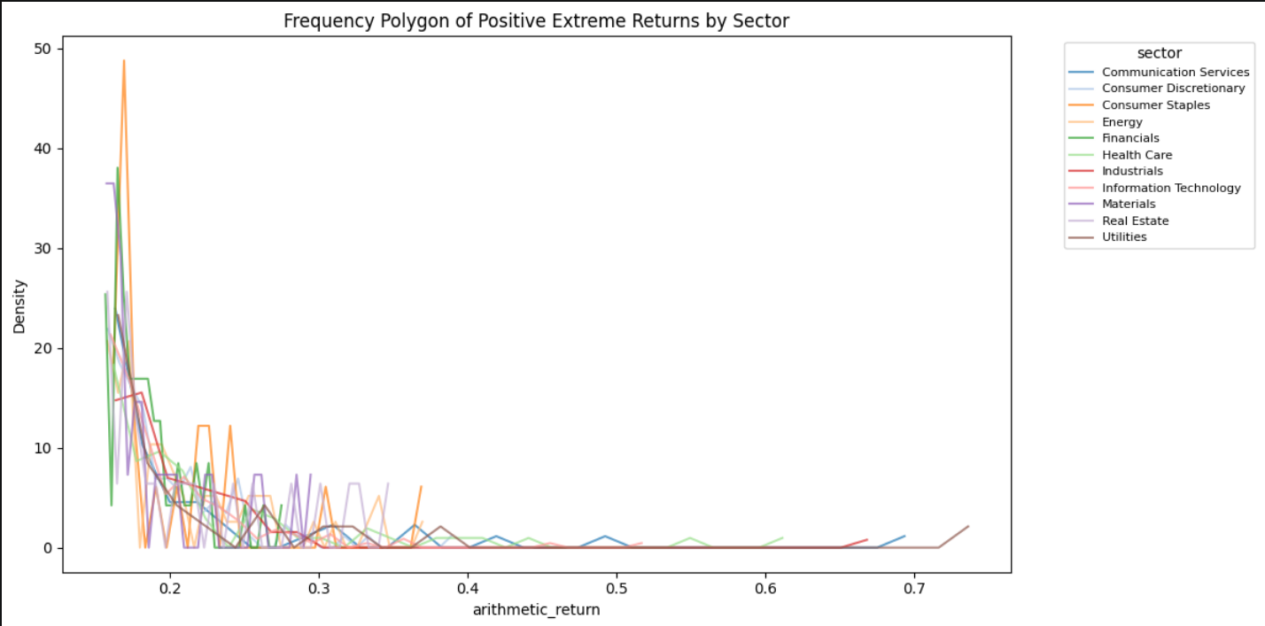
Approach-2 (sector clustering)
What does it look like? (Arithmetic returns to not crush the extremes positives)

Slide 23
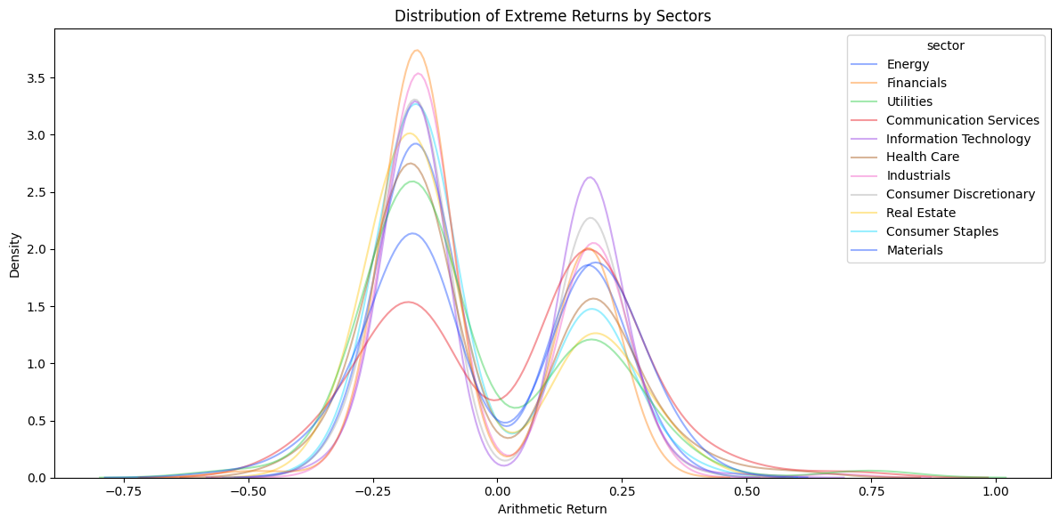
Approach-2 (sector clustering)
What does it look like? (Arithmetic returns to not crush the extremes positives)

Slide 24


Approach-2 (sector clustering,statistical testing)
Do the top 0.1% mean across sectors are statistically different within each positive extreme and negative extreme? log_return (left), arithmetic_return (right)
Less impact of return definition because we are comparing positive / positive and negative / negative. Extreme Value Theory and Generalized Pareto Distribution territory.

Slide 25
Approach-3 (CAPM)
Does a model built on normal assumptions break down precisely where normality breaks down? CAPM : Ri​−Rf​=α+β(Rm​−Rf​) Ri​ — the return of your stock (or portfolio)
Rm — the return of the market (S&P500 index)
Rf — the risk-free rate (DTB3, the 3-month T-bill)

Slide 26
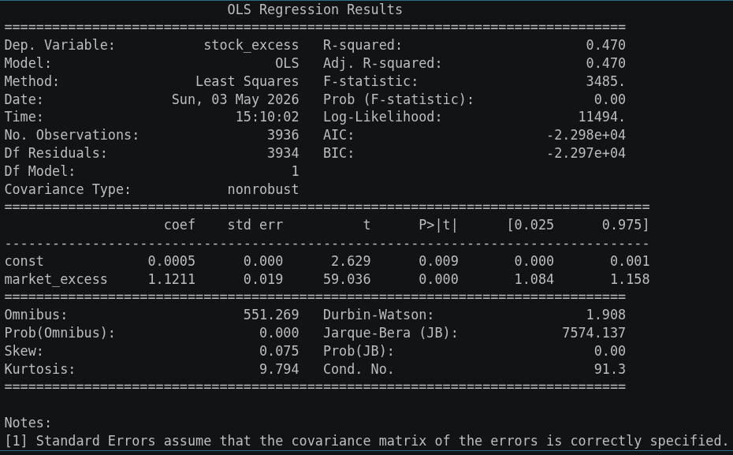
Approach-3(CAPM)
Build a simple OLS for CAPM on AAPL to test.

Slide 27
Approach-3(CAPM)
Beta = 1.12 and highly significant (t = 59, p ≈ 0). AAPL moves slightly more than the market — a 1% market move corresponds to a 1.12% AAPL move on average. This makes intuitive sense for a large-cap tech stock.
R² = 0.47 means 47% of AAPL's daily return variance is explained by the market alone. For a single factor model on a single stock, that is respectable. The remaining 53% is idiosyncratic — company-specific news, earnings, product launches etc.
Alpha = 0.0005 and significant (p = 0.009). This is small but tells you AAPL generates a tiny daily excess return above what CAPM predicts — annualized that is roughly 0.0005 × 252 ≈ 12.6% annual alpha. That is actually substantial and reflects AAPL's well-documented outperformance over this period.
The Warning Signs — And This Is Key For Your Project
Look at the bottom of the output. This is where it gets really interesting:
Jarque-Bera = 7574, p ≈ 0 — the residuals are overwhelmingly non-normal. CAPM assumes normally distributed residuals and this is rejected with extreme force.
Kurtosis = 9.79 — the residuals have fat tails. A normal distribution has kurtosis of 3. You are at nearly 10.
This means CAPM is not just leaving 53% of variance unexplained — it is leaving the extreme part of that variance unexplained in a structured, non-random way. Which is exactly what your tail regression will demonstrate next.

Slide 28
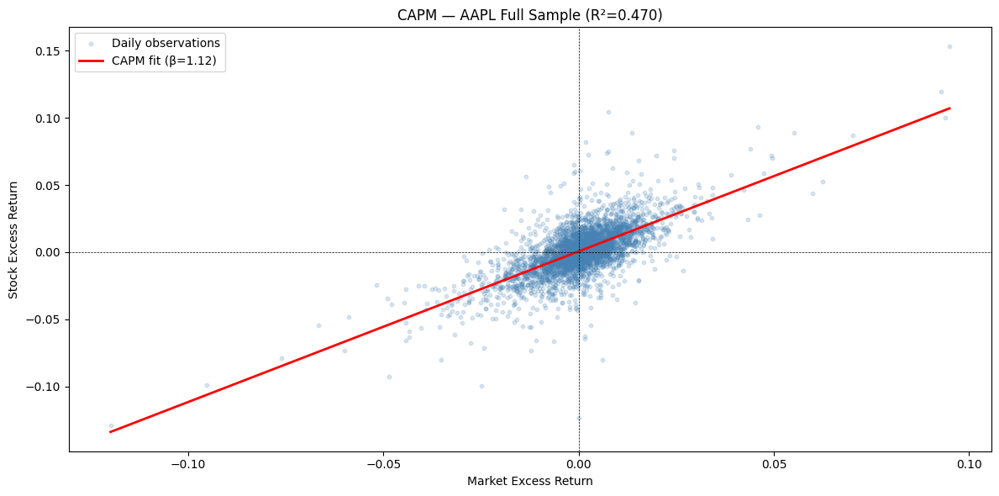
Approach-3(CAPM)

Slide 29
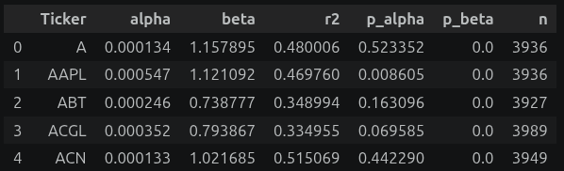
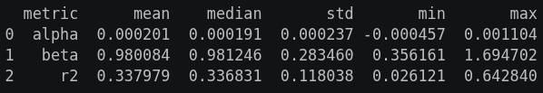
Approach-3(CAPM)
Do the CAPM regression on each individual stock for the whole set and summarize.

Slide 30
Approach-3(CAPM)
Beta Median beta = 0.98, almost exactly 1.0. This is completely expected — you are working with S&P500 constituents, which by construction are the market. The std of 0.28 shows meaningful dispersion though — some stocks are much more sensitive than others (max 1.69, min 0.36).
R²
Median R² = 0.337 means the market factor explains about 34% of individual stock return variance on average. This is actually the canonical result in the literature — CAPM captures the systematic component reasonably well but leaves the majority of variance unexplained. AAPL at 0.47 is actually above average, reflecting how closely mega-caps track the index.
Alpha
Only 9.2% of stocks show significant alpha at the 5% level. Under CAPM, alpha should be zero for all stocks, so in a pure sense this looks like CAPM is doing its job — 90.8% of stocks have no statistically detectable excess return. However there are two nuances worth noting:
The mean alpha = 0.0002 per day, which annualizes to roughly 0.0002 × 252 ≈ 5%. Small individually but economically meaningful
9.2% is still almost double what you'd expect by chance at the 5% significance level — if CAPM were perfectly true, you'd expect exactly 5% false positives by definition

Slide 31
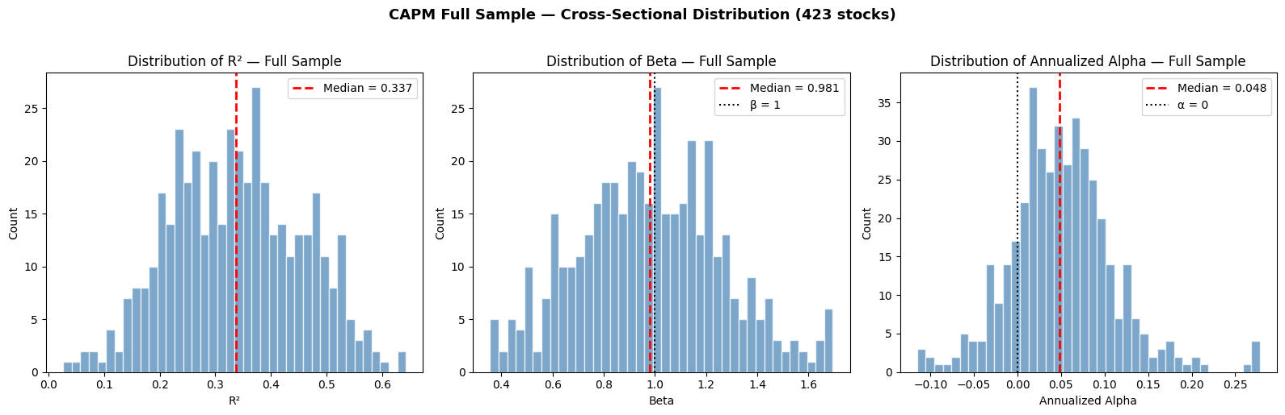
Approach-3(CAPM)

Slide 32
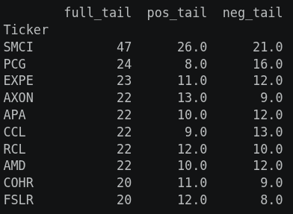
Approach-3(CAPM, top 0.1%)
Now test the CAPM on the top 0.1%. We first try with one ticker (“SMCI”) before looping and aggregating.

Slide 33
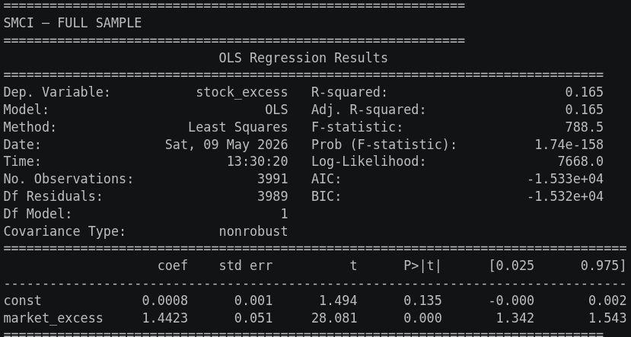
Approach-3(CAPM, top 0.1%)
Now test the CAPM on the top 0.1%. We first try with one ticker (“SMCI”) before looping and aggregating.

Slide 34
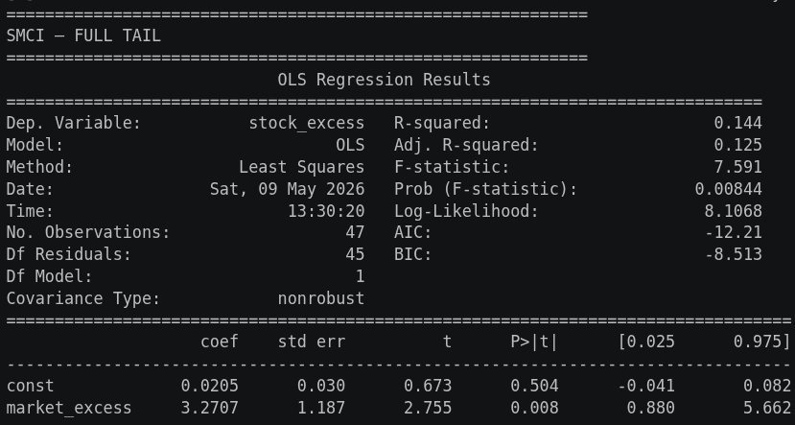
Approach-3(CAPM, top 0.1%)
Now test the CAPM on the top 0.1%. We first try with one ticker (“SMCI”) before looping and aggregating. Doing the OLS on the full tail is actually a mistake. (Mixing artifacts.)

Slide 35
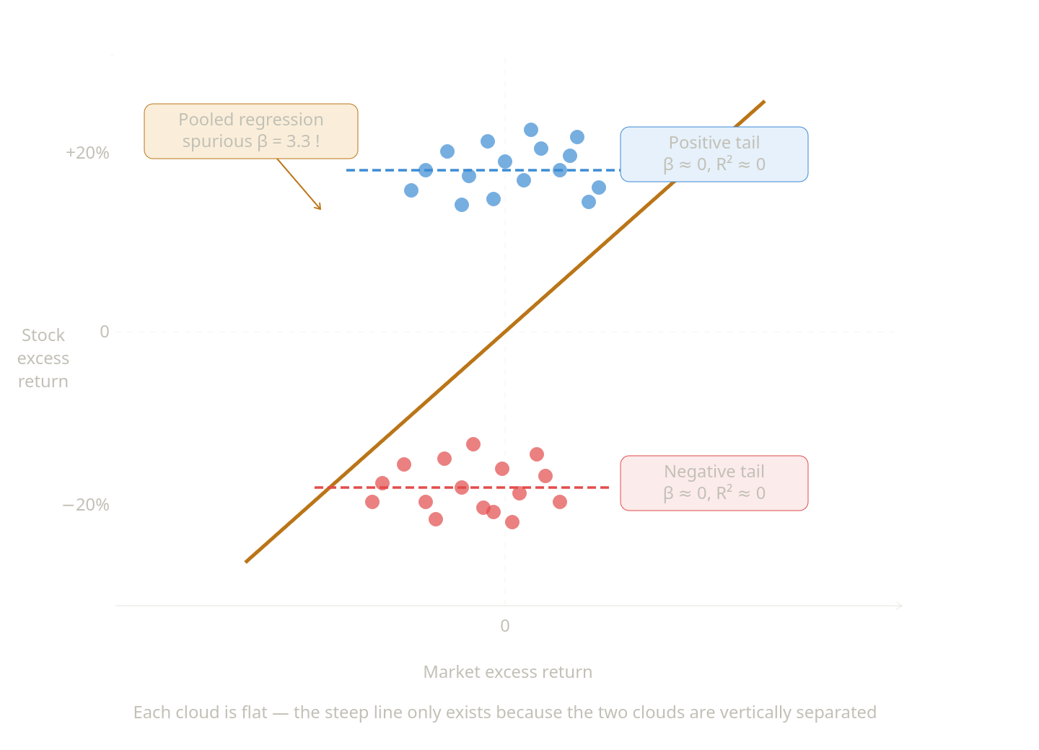
Approach-3(CAPM, top 0.1%)
Now test the CAPM on the top 0.1%. We first try with one ticker (“SMCI”) before looping and aggregating. Doing the OLS on the full tail is actually a mistake. (Mixing artifacts.)

Slide 36
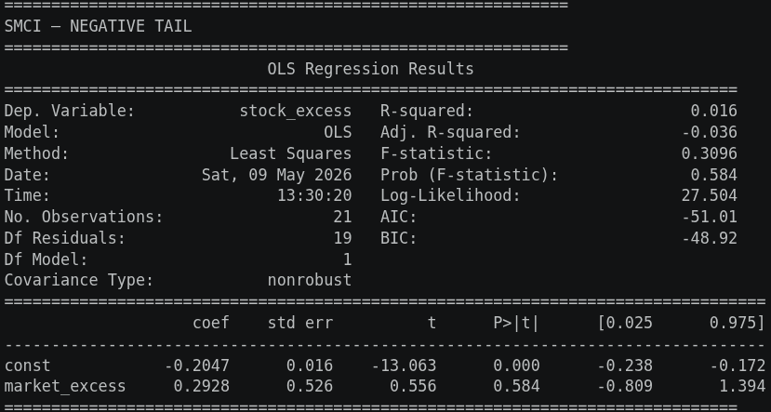
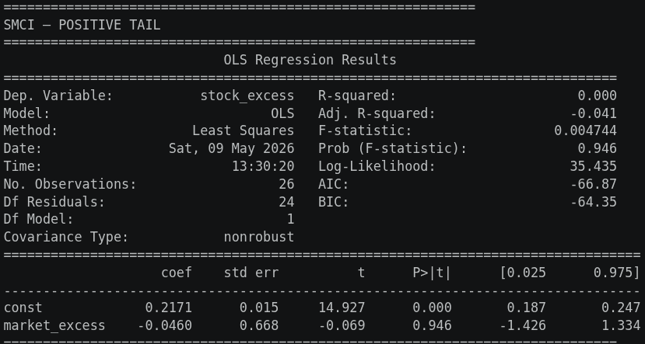
Approach-3(CAPM, top 0.1%)
Now test the CAPM on the top 0.1%. We first try with one ticker (“SMCI”) before looping and aggregating.

Slide 37
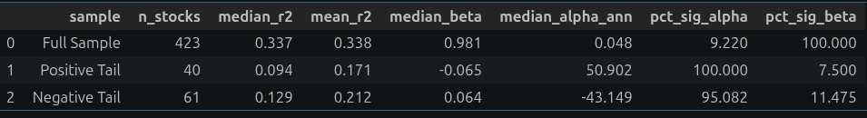
Approach-3(CAPM, top 0.1%)
Now test the CAPM on the top 0.1%. Here, separating on both tails. Minimum of 5 extreme obs. per ticker for the OLS.
pct_sig_alpha & pct_sig_beta = percentage of stock where alpha or beta had a significant p-value (>0.05).

Slide 38
Approach-3(CAPM, top 0.1%)
Now test the CAPM on the top 0.1%. Here, separating on both tails. Minimum of 5 extreme obs. per ticker for the OLS.
CAPM shows no correlation between stock excess and market excess in the tails !

Slide 39
Approach-4 (FF3)
Does a model built on normal assumptions break down precisely where normality breaks down? FF3 : Ri​−Rf​=α+β(Rm​−Rf​)+βSMB​⋅SMB+βHML​⋅HML Ri​ - the return of your stock (or portfolio)
Rm - the return of the market (S&P500 index)
Rf - the risk-free rate (DTB3, the 3-month T-bill)
SMB - Small minus Big (market cap factors)
HML - High minus Low (book to market ratio)

Slide 40
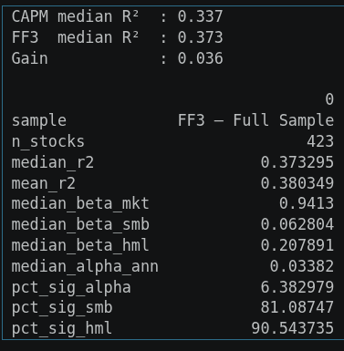
Approach-4 (FF3)
FF3 on the whole set of S&P500 from 01.01.2010

Slide 41
Approach-4 (FF3)
FF3 on the whole set of S&P500 from 01.01.2010
FF3 adds statistically significant factor loadings for 80-90% of stocks
But the R² improvement is limited because the S&P500 universe mutes the size premium
Alpha is still present — something remains unexplained
The real test is whether FF3 does better in the tails than CAPM did

Slide 42
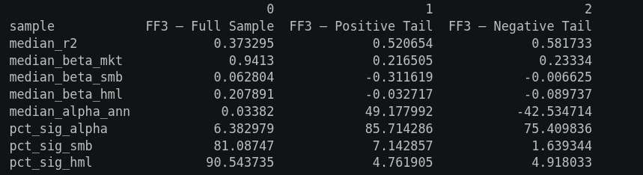
Approach-4 (FF3)
FF3 for the top 0.1%. R2 Increases ! ... but no, it is overfit.

Slide 43
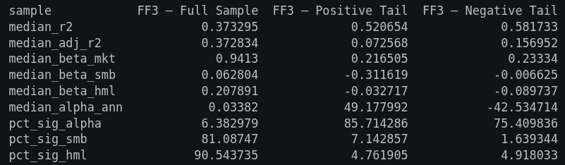
Approach-4 (FF3)
FF3 for the top 0.1%. With adjusted R2.
Neither CAPM nor FF3 can explain extreme returns. Adding size and value factors absorbs some alpha but the vast majority of tail behavior remains idiosyncratic and unexplained by systematic factors.

Slide 44
Approach-5 (Momentum)
Do extreme returns have a persistence component to them? The case for momentum also known as the Carhart 4 factors model.
Ri−Rf=α+βm(Rm−Rf)+βSMB⋅SMB+βHML⋅HML+βUMD⋅UMD Ri​ - the return of your stock (or portfolio)
Rm - the return of the market (S&P500 index)
Rf - the risk-free rate (DTB3, the 3-month T-bill)
SMB - Small minus Big (market cap factors)
HML - High minus Low (book to market ratio) UMD - Up minus Down (long time winners vs long time losers)

Slide 45
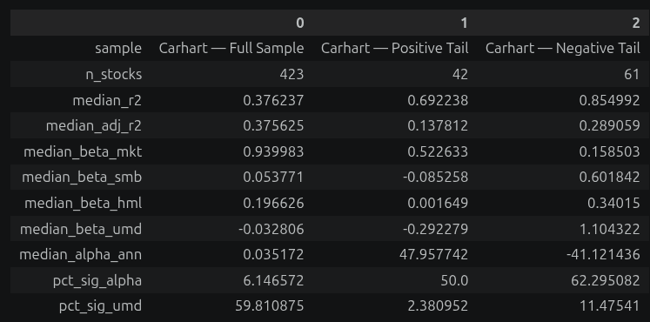
Approach-5 (Momentum)
Adjusted R2 doubles in the tails and the percentage of stocks with a significant alpha is halved ! Rallies go against momentum. Crashes follow it. The UMD significance tells us that it explains crashes better than rallies.

Slide 46
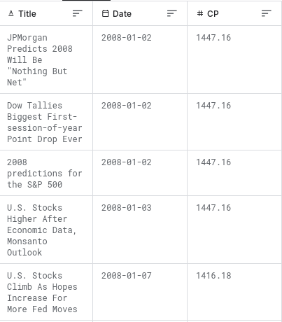
Approach-6 (Sentiment)
Does market sentiment explain these extreme returns? (using a proxy of financial news headlines) Kaggle S&P 500 with Financial News Headlines (2008–2024)

Slide 47
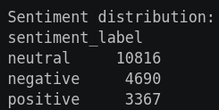
Approach-6 (Sentiment)
Does market sentiment explain these extreme returns? FinBERT for NLP analysis : Hugging Face FinBERT
FinBERT is a pre-trained NLP model to analyze sentiment of financial text. It is built by further training the BERT language model in the finance domain, using a large financial corpus and thereby fine-tuning it for financial sentiment classification. Financial PhraseBank by Malo et al. (2014) is used for fine-tuning.

Slide 48
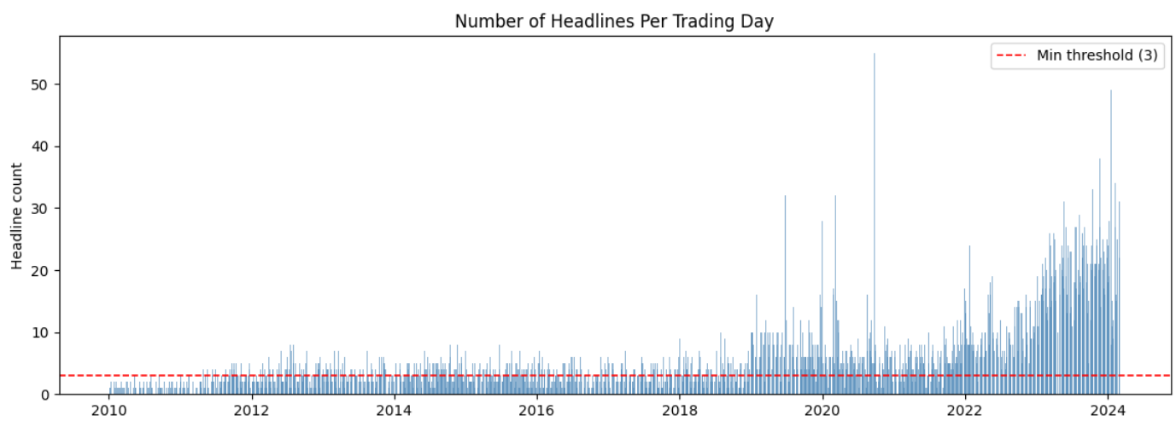
Approach-6 (Sentiment)
Does market sentiment explain these extreme returns? But limitations of the dataset… (sparsity and cutoff)

Slide 49
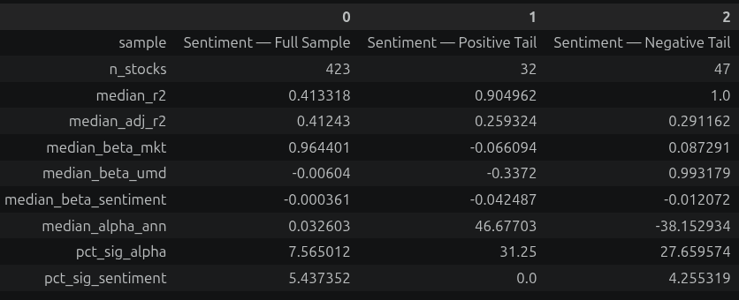
Approach-6 (Sentiment)
Does market sentiment explain these extreme returns?
Sentiment explains nothing but why does the significance of alpha diminishes?

Slide 50
Point 1
Sub-point 1
Sub-point 2
Sub-point 3
Point 2
Sub-point 1
Sub-point 2
Example:
Text

Slide 51
Point 1
Sub-point 1
Sub-point 2
Sub-point 3
Point 2
Sub-point 1
Sub-point 2

Slide 52
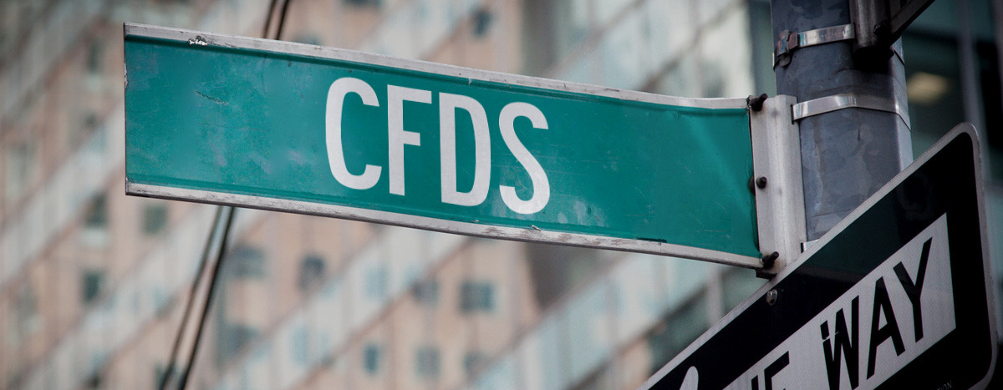
Questions?

