Slide 1
Study on the Tail Distribution of Stock Returns: From Empirical Analysis to Factor Explanations
Chartered Financial Data Scientist (CFDS)
CFDS-11 – Project Presentation - Pierre Nibéron
Notes:
Welcome to my presentation on the tail distribution of stock returns.
The complete presentation, as well as the code, is on my GitHub.

Slide 2
Contents
Motivation
Research Plan
Data
Part 1 - Description:
Whole S&P500 description
Tails description
Time clustering
Sector clustering
Part 2 - Modeling:
CAPM
Fama-French 3 factors
Carhart’s
Sentiment
Conclusion
Notes:
Here is the content we will cover.
We will go through my main motivations to cover this problem.
There will be a quick word on the research plan as well as the dataset used.
The presentation will be in two parts.
The first one is mostly description while the second part is about modeling.

Slide 3
Motivation
On Fat-Tails
Mention by Dr. Sikandar Siddiqui during CFDS lessons
Personal IT Background going into finance
Describing and finding explanatory models
Reading literature on the subject
Using the tools learned during CFDS course
Initiation to existing financial models (CAPM, Fama-French, …)
“large changes tend to be followed by large changes, of either sign, and small changes tend to be followed by small changes.” - Benoit B. Mandelbrot, 1963
Notes:
I choose to study fat tails because there was a mention on the non-normality of stock returns during the first lesson of CFDS which picked my curiosity.
Also, as I have more of a background in IT, I wanted to learn more about the finance side of things.
It seemed to be the perfect opportunity to learn, build and test common financial models.
As well as reuse the tools we learned during the CFDS training.

Slide 4
Research Plan
First Part : Description and statistical testing
Do we observe fat tails which would not exist under normal assumptions ? Arithmetic vs. Log, Skewness, Kutorsis, JB and visualization
What do these tails look like? Are they symmetrical? 99.9th percentile, clustering, t-test, f-test and visualization
Second Part : Model and explanatory power
Do factor models explain extreme returns as well as they explain the full distribution? CAPM, Fama-French Three factors model, Carhart’s Momentum, Sentiment
Notes:
We’ve already seen that we observe fat tails, but I wanted to re-explore it and show it my way.
I want to show them visually and take the time to test things around it.
For this purpose, I splitted my presentation in two halves.
The First part is about describing the characteristics of the distribution of returns. The Second part is about applying models and see if they hold in the tails.
During this research, I started to see discrepancies in the tools and processes I used.
For example, arithmetic returns vs log returns, when analysing the tails.
Because of that, I failed numerously during the analysis, sometimes because of poor logic on my side and sometimes because the tools I used were not made for the extreme values.
But that’s one goal of my presentation. To see how things behave in the extremes.

Slide 5
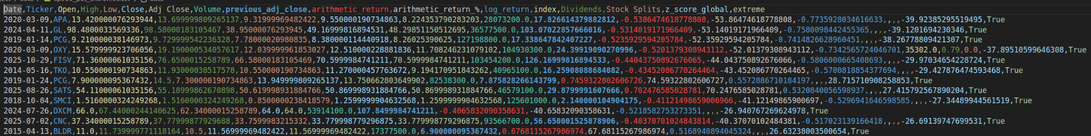
Data
S&P500 stock list from wikipedia
Daily stock prices from 01.01.2010 to 01.05.2026
yFinance api (data from yahoo finance website)
Risk free rate, T-Bill 3 month from FRED’s website
Fama-French dataset from panda_datareader library
News headlines from kaggle (see link in sentiment analysis part)
Notes:
The dataset is a classical set of S&P500 daily close prices from the 1st of january 2010 to 1st of may 2026.
I also used the Fama and French open source dataset.
I used the risk free rate from the federal bank of saint louis.
And finally, a news headline dataset from Kaggle.

Slide 6
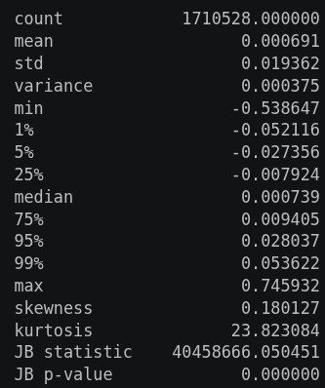
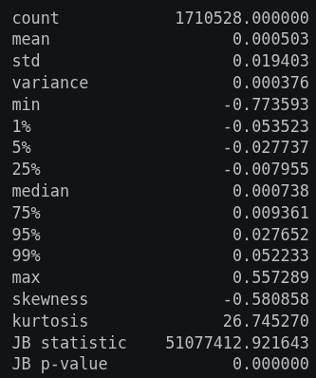
Whole set description
Arithmetic-Returns stats table:
Log-Returns stats table:
The log return definition, compared to the arithmetic one, flattens extreme positive returns and increase extreme negative returns
Notes:
These are stat tables done on the same S&P500 data set. However, on the left, it is the arithmetic return definition and on the right, the logarithmic return definition.
Please note the first and second arrows, the min and max values for both distribution. Please also note the impact on the skewness which changes signs.
The log return definition, compared to the arithmetic one, flattens extreme positive returns and increase extreme negative return.
Also note, at the bottom of each table that the Jarque-Berra test statistics rejects normality, as expected.

Slide 7
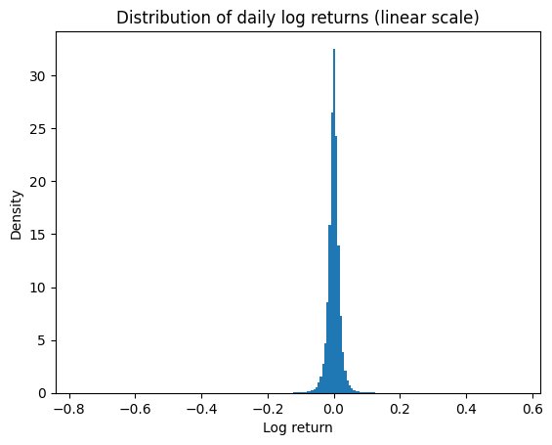
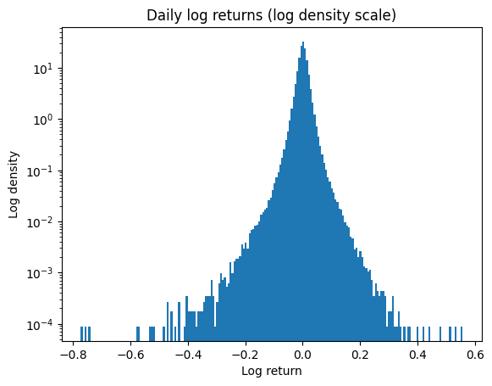
Whole set visualization
Notes:
Here are visualizations of stock returns density as bar chart plot.
A quick disclaimer here, I juggle a bit between arithmetic and logarithmic for the ease of visualization.
The return definitions are in the graphs titles.

Slide 8
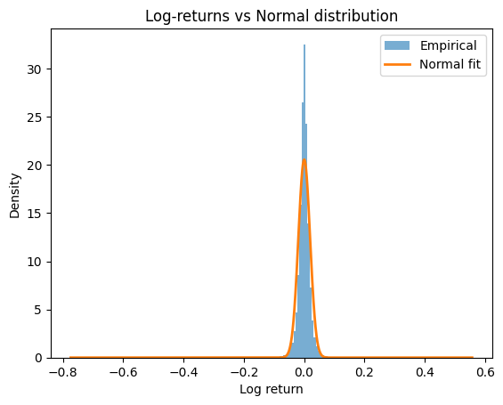
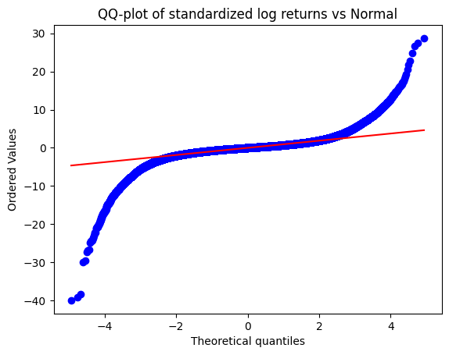
Whole set visualization
Notes:
Here is a QQ plot, on the left.
It is a plot of two distribution against one another. On the y-vertical-axis is the empirical return distribution and on the x-horizontal-axis is the theoretical normal distribution. The orange line would be a plot of a normal against a normal. We clearly see the tails deviating from normal values.
On the right it is the density distribution against the normal in orange.

Slide 9
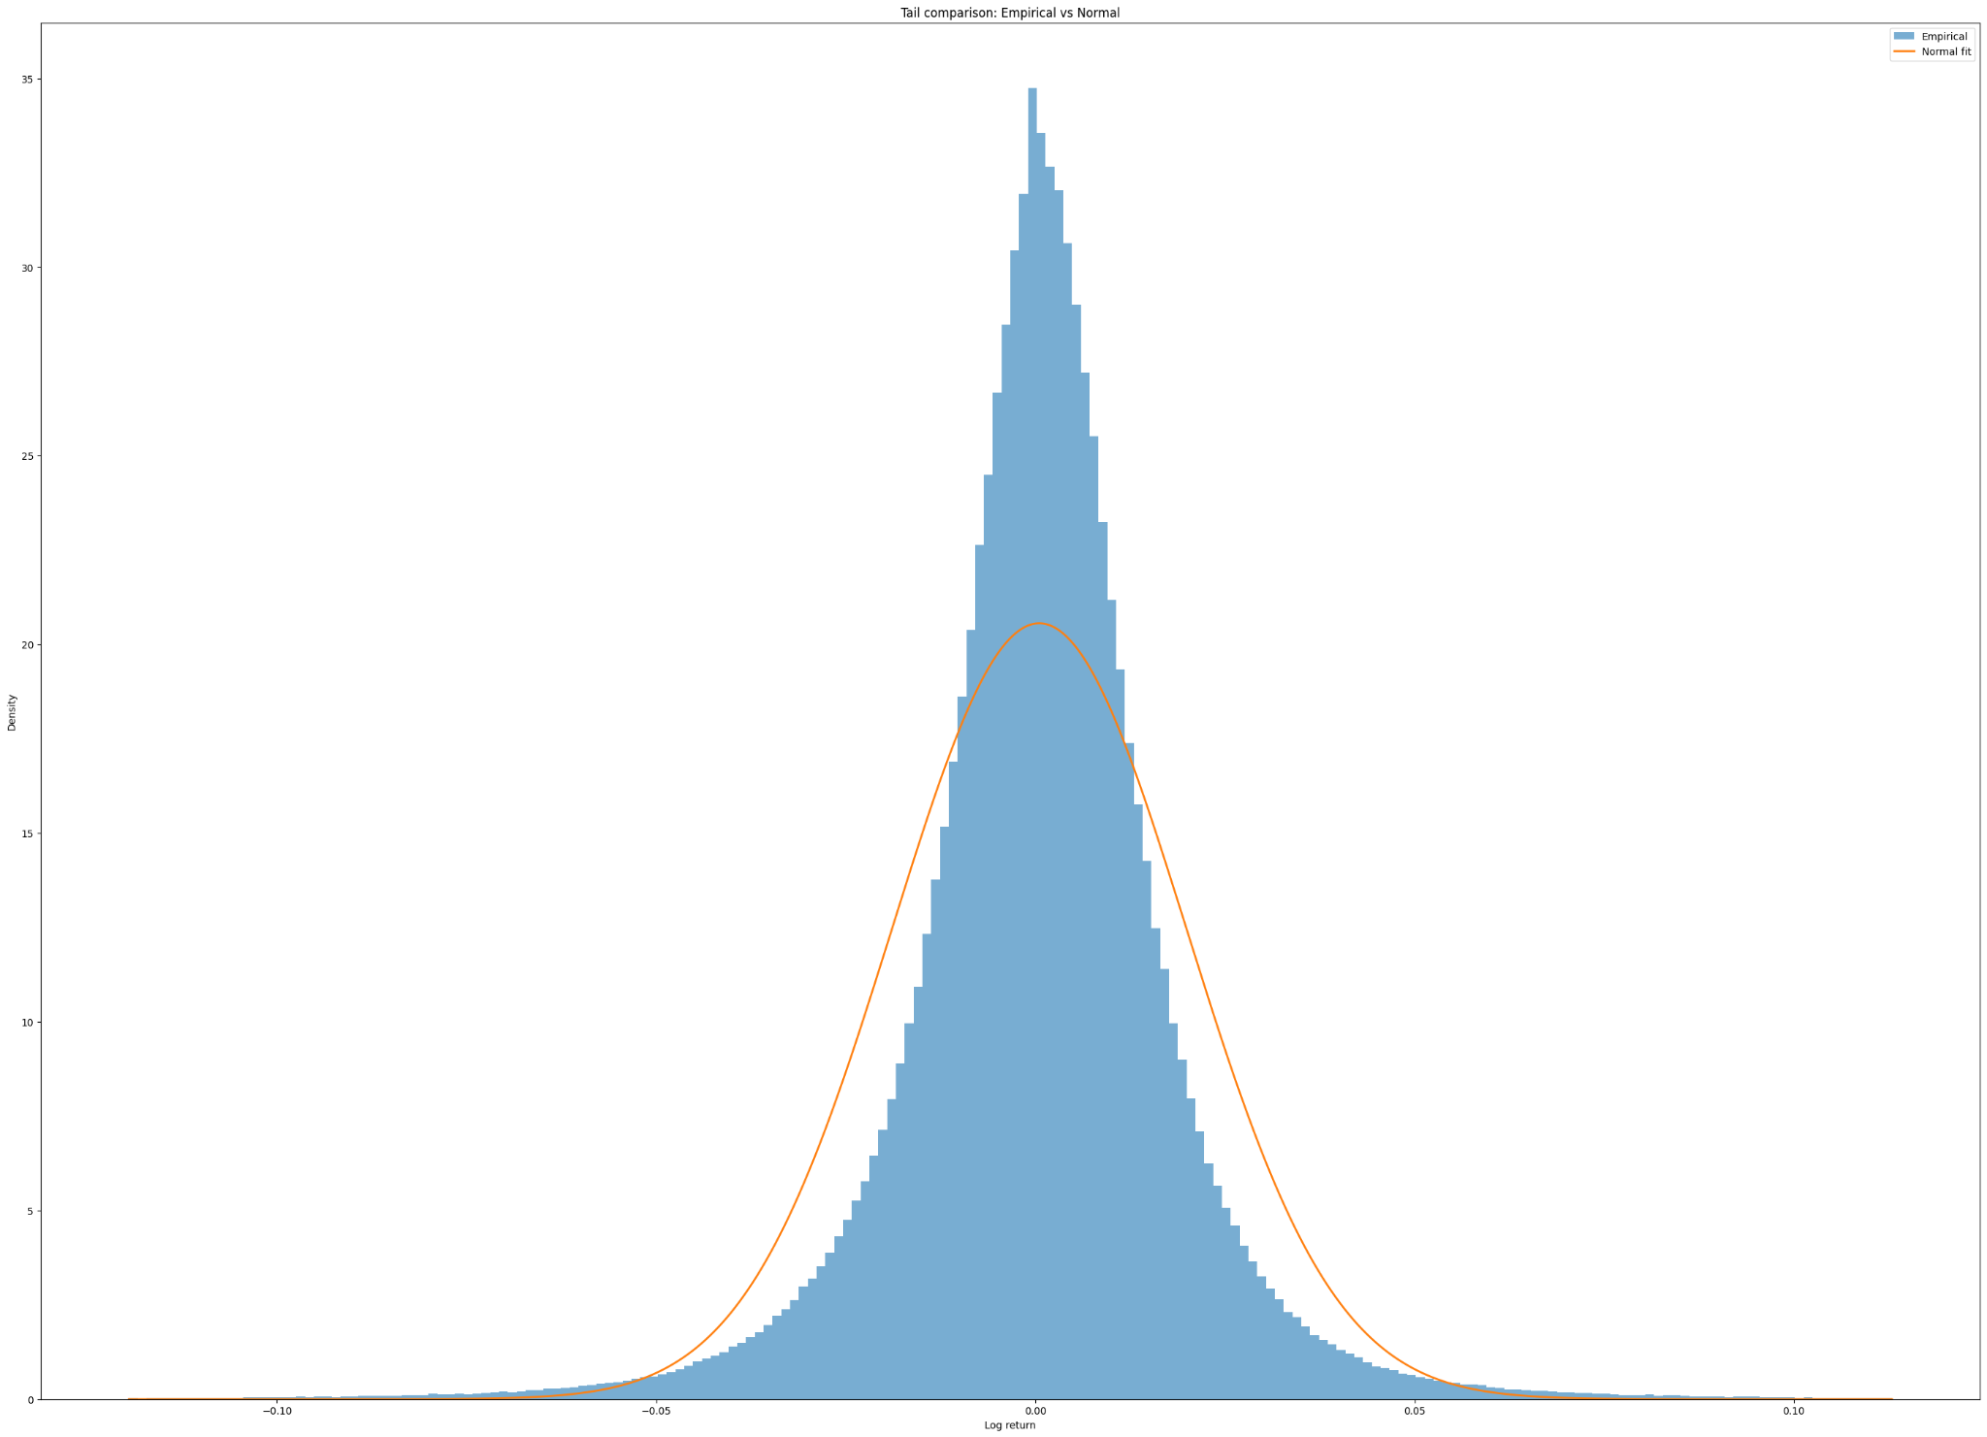
Whole set visualization
Notes:
Same as the last graph but zoomed in.

Slide 10
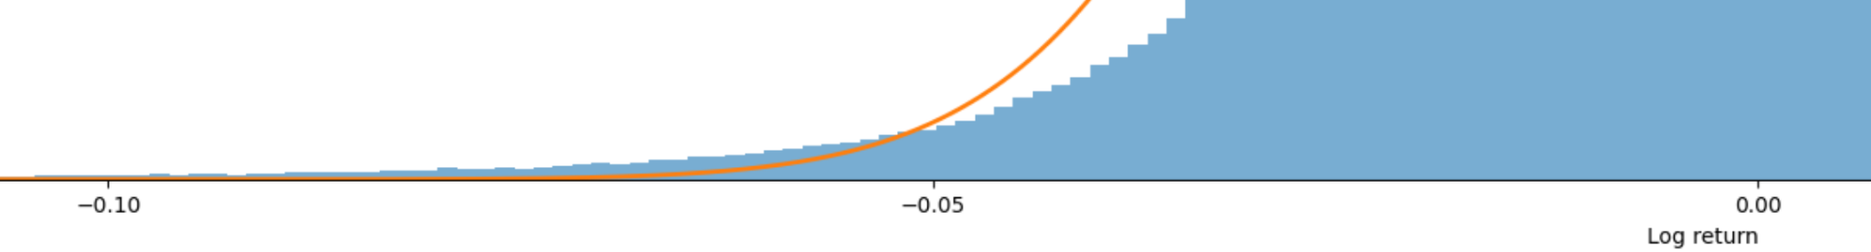
Whole set visualization
Notes:
Here we zoom on the negative tail to see the mismatch.

Slide 11
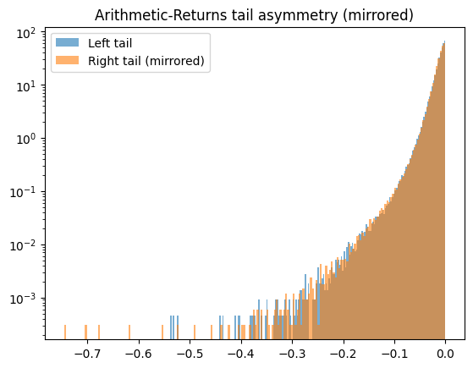
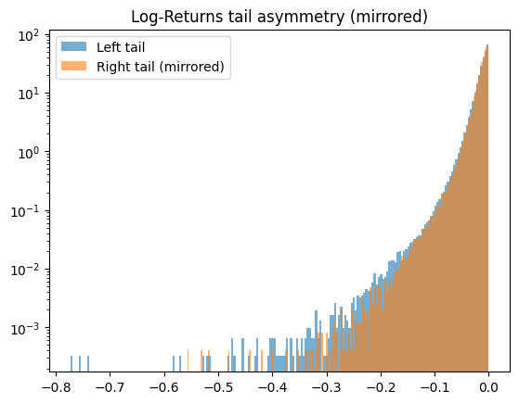
Whole set visualization
Again, we see the differences between return definitions in the extreme values.
Notes:
I tried a bit of mirroring to have a feel of how both sides are distributed.
On the left, this is the arithmetic return distribution mirrored on itself.
On the right, this is the log return distribution mirrored on itself.
We see again that the extremes are not alike.

Slide 12
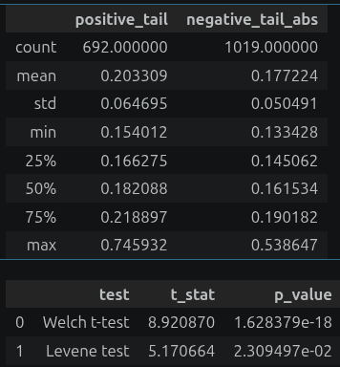
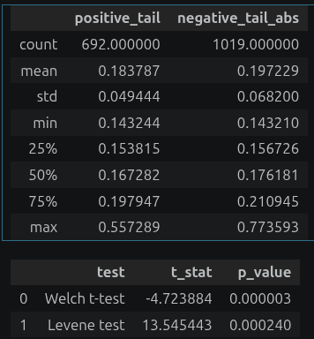
Top 0.1% description
Do the two top 0.1% have the same statistical resemblance? Check both return definition, arithmetic_return (left), log_return (right)
More extreme negative events. H0 rejected for equal means and variances between positive and negative extreme distributions
Notes:
To single out the extremes I decided to cutoff only the top 0.1% absolute return values.
This gives a threshold return value at 0.1436. About a 14% daily return.
FIrst observation is that the positive tail has 692 records while the negative one has about 1000, which is about 50% more negative events.
Then I tested the statistical resemblance of both tails with a Welch t-test and Levene test ( robust F-Test ).
It rejects the null hypothesis of equal means and equal variances with a significance well below 5 %.

Slide 13
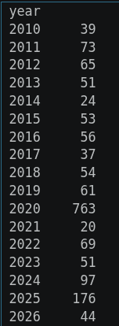
Top 0.1%, time clustering
Top 0.1% daily returns clustered by years
Notes:
Then, I tried to do some clustering to see how the data is distributed.
I started with time clustering and just tried with yearly clustering of extreme events.
With the exception of 2020 (for the covid) and 2025 (with the infamous tariffs), the count of extremes of all kind seem consistent across years.

Slide 14
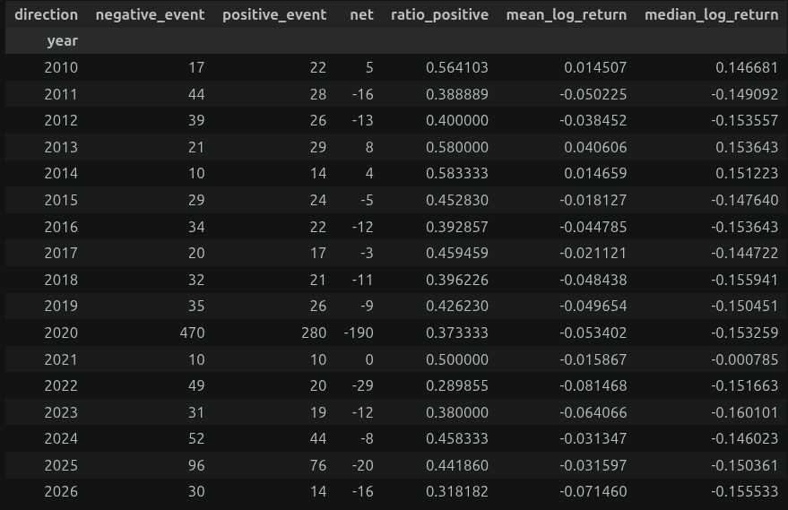
Top 0.1%, time clustering
What years were good / bad for the top 0.1%?
Most years have more negative events. Most years have a negative mean and median log return.
Notes:
Here is an in depth decomposition to see what years were good or bad.
Most years have more negative events. As you can see in the “Net” column, the fourth one.
Most years have a negative mean and negative median log return. As you can see in the two last columns.

Slide 15
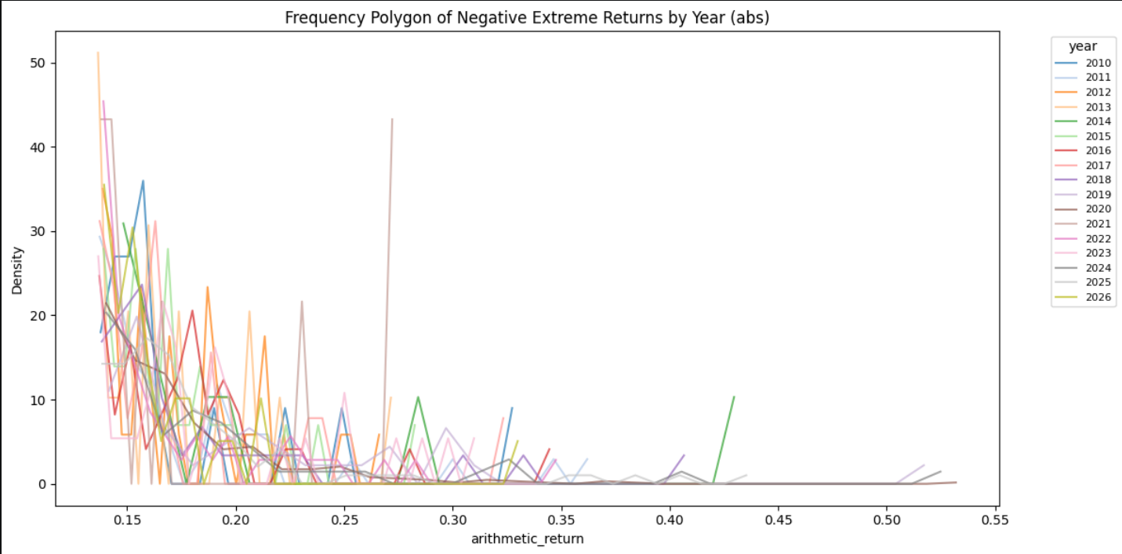
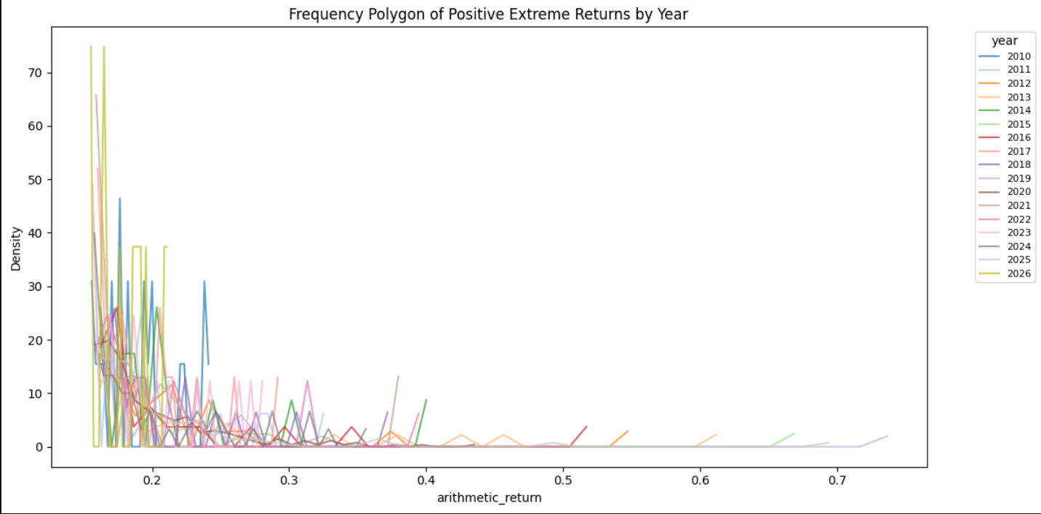
Top 0.1%, time clustering
What does it look like? (Arithmetic returns to not crush the extremes positives)
Notes:
First try at visualization with a line chart which was noisy and messy.
On the left, you have the negative events, and on the right the positive extreme events.

Slide 16
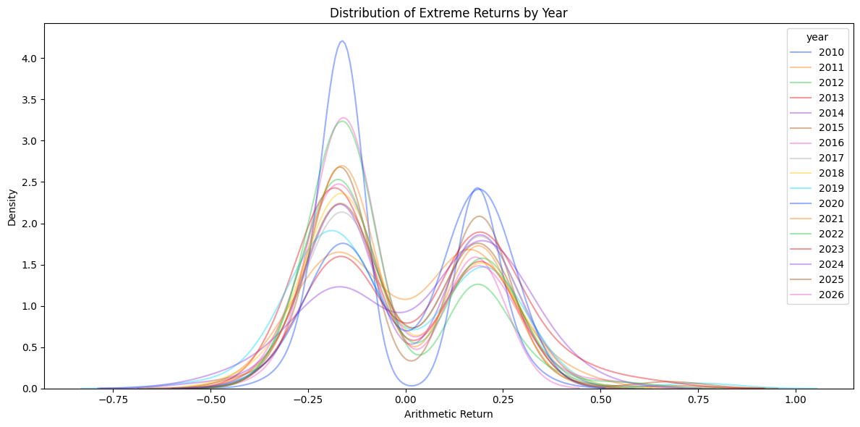
Top 0.1%, time clustering
What does it look like? (Arithmetic returns to not crush the extremes positives)
Notes:
KDEplot. Kernel Density Estimation plot. They work kind of like a bar graph but smoothed out with a kernel estimation function.
More of a qualitative representation than a quantitative one. But less noisy and so, easier to read.

Slide 17


Top 0.1%, time clustering
Do the top 0.1% mean across years are statistically different within each positive extreme and negative extreme? arithmetic_return (left), log_return (right)
Less impact of return definition because we are comparing positive / positive and negative / negative. Extreme Value Theory and Generalized Pareto Distribution territory.
H0 is not rejected with a p<0.05 significance value. Year over year, the distribution of extreme events does not differ in equality of means.
Notes:
Seeing the previous slides, I wanted to know if a specific year was really different from the others.
Like if there was a “Crash or a rally year”.
I tested with a Welch-ANOVA the different groups.
H0 is not rejected with a 5% significance level.
There is no difference in the equivalence of means between yearly distribution of extreme events.
A quick disclaimer here, some years have less than 20 extreme events which is a bit shaky for this ANOVA.
So, I think it would need further testing. Also because we are in the tails specifically, I am not sure of the robustness of a test like the welch-ANOVA.

Slide 18
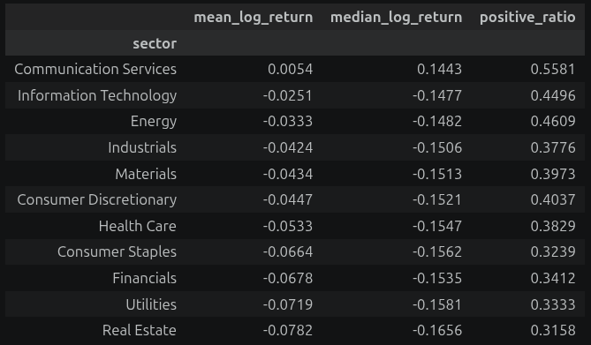
Top 0.1%, sector clustering
What sectors performed best in the top 0.1%? Ordered table.
Notes:
After time clustering, I moved on sector clustering. To see if specific sectors stand out.
Communication services is the only sector with a positive mean and median.

Slide 19
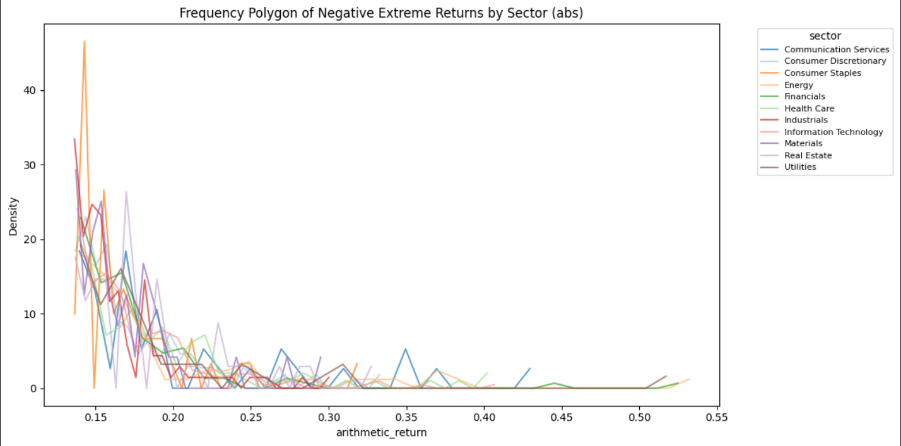
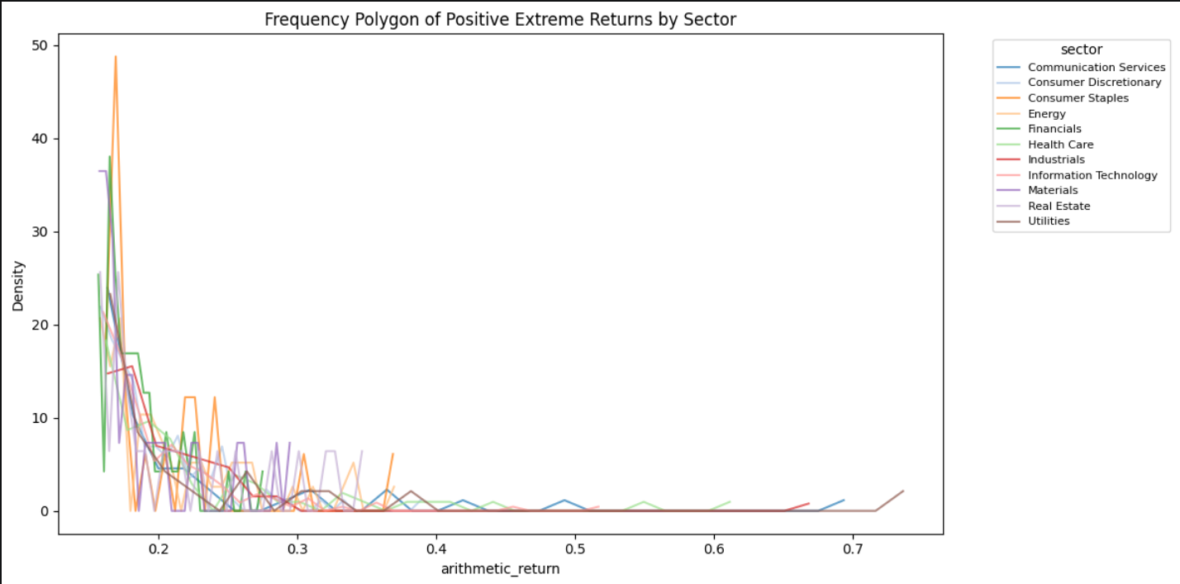
Top 0.1%, sector clustering
What does it look like? (Arithmetic returns to not crush the extremes positives)
Notes:
I did the same as with time clustering and tried to visualize these sectors with a line graph but it is messy.

Slide 20
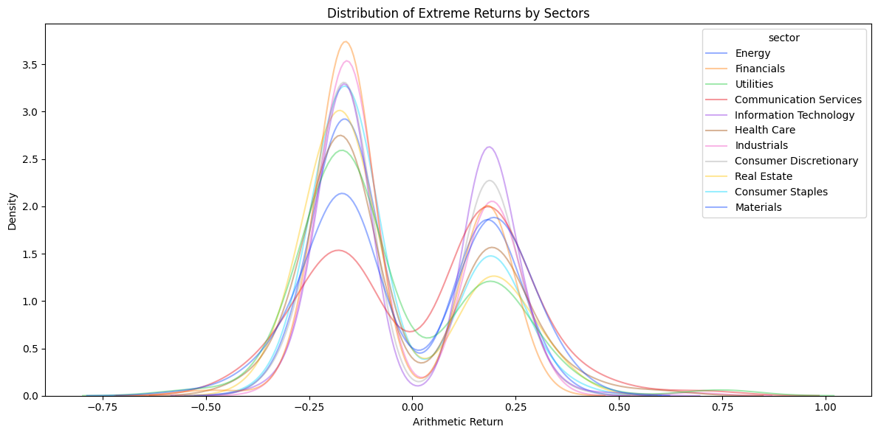
Top 0.1%, sector clustering
What does it look like? (Arithmetic returns to not crush the extremes positives)
Notes:
This is a KDEplot. The same as with time clustering.

Slide 21


Top 0.1%, sector clustering
Do the top 0.1% mean across sectors are statistically different within each positive extreme and negative extreme? log_return (right), arithmetic_return (left)
Less impact of return definition because we are comparing positive / positive and negative / negative. Extreme Value Theory and Generalized Pareto Distribution territory.
H0 is rejected with a p<0.05 significance value. Statistical equality of mean is not preserved over sectors. Most probably because of the Communication Services sector.
Notes:
Same analysis as the time clustering.
The consideration still stands on the results that should be further tested because of the GPD territory.
This time, we reject H0, most probably because of the communication services sector which had a positive mean.

Slide 22
CAPM Modeling
Do factor models explain extreme returns as well as they explain the full distribution? CAPM : Ri​−Rf​=α+β(Rm​−Rf​) Ri​ — the return of your stock (or portfolio)
Rm — the return of the market (S&P500 index)
Rf — the risk-free rate (DTB3, the 3-month T-bill)
Notes:
So far I was describing the whole set, then the tails, then clustering by years and sectors to have a feel for the distribution.
Now, we move onto modelling, to see if the model still holds in the tails as much as the full distribution.
We start with one of the simplest model. Capital Asset Pricing Model. Developed in the 1960s by William Sharpe and based on Modern Portfolio Theory.
It creates a linear relationship between the movement of the market and the movement of the asset.

Slide 23
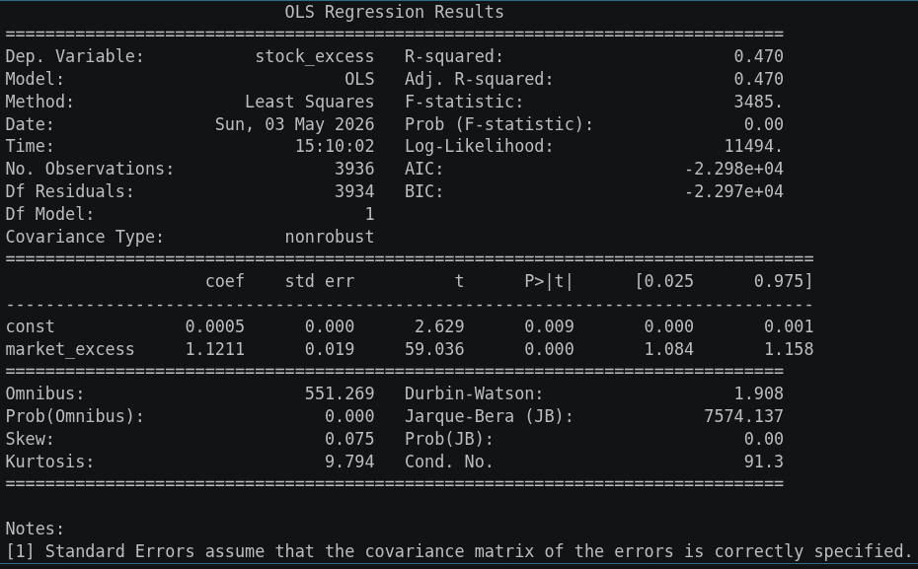
CAPM Modeling
Build a simple OLS for CAPM on AAPL to test.
Notes:
Here is a quick test on apple returns to get familiar with the technique.
This model as basically a linear regression with one constant alpha and one parameter beta, the market excess.
The r-squared indicates that the model explains 47% percent of the variance in apple daily returns, with the constant and the market excess coefficient being statistically significant.

Slide 24
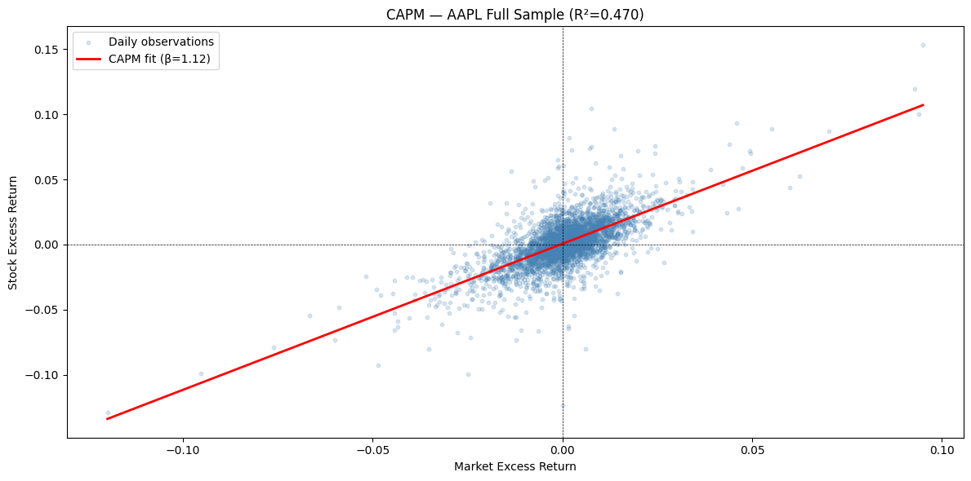
CAPM Modeling
Notes:
I visualized it to understand what I was doing.
So, this is CAPM modeling.

Slide 25
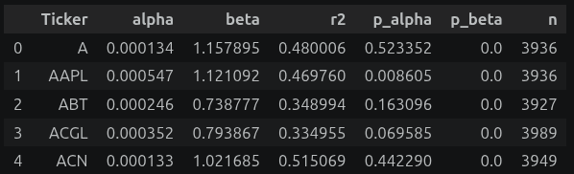
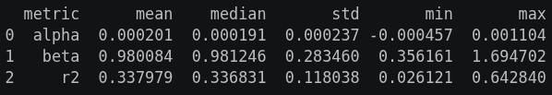
CAPM Modeling
Loop on each ticker :
Summary :
On average, on the S&P500 for the last 15 years, CAPM explains 34% of a stock excess return against market return
Notes:
Here, I loop on each ticker on the whole set, not just the tails and do a CAPM regression and then I store the alpha, beta and r-squared for each and summarize it.
The top table is the loop on each ticker. The bottom table is the summary.
So, on average, for the S&P500 for the last 15 years, CAPM explains 34% of a stock excess return against market return.

Slide 26
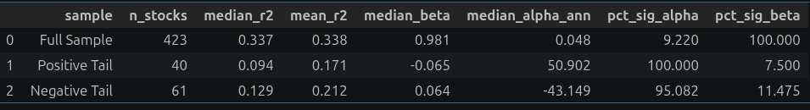
CAPM Modeling for the top 0.1%
Now test the CAPM on the top 0.1%. Here, separating both tails.
pct_sig_alpha & pct_sig_beta = percentage of stock where alpha or beta had a significant p-value (>0.05).
CAPM shows very little correlation between stock excess return and market return in the tails compared to the full set !
Notes:
Here, I loop on all stocks in the extreme. Then I aggregate.
The first line is the full sample that we’ve already seen.
The second line is a CAPM regression on the extreme positive events
The third line is a CAPM regression on the extreme negative events
With an r-squared of 9% in the positive tail and 13% in the negative tail, CAPM performs worse in the tails than in the full distribution.

Slide 27
3F Modeling for the top 0.1%
Do factor models explain extreme returns as well as they explain the full distribution? FF3 : Ri​−Rf​=α+β(Rm​−Rf​)+βSMB​⋅SMB+βHML​⋅HML Ri​ - the return of your stock (or portfolio)
Rm - the return of the market (S&P500 index)
Rf - the risk-free rate (DTB3, the 3-month T-bill)
SMB - Small minus Big (market cap factors)
HML - High minus Low (book to market ratio)
Notes:
Now we try the same for the Fama and French three factor model.
It is an extension of the CAPM model designed in 1992 by Eugene Fama and Kenneth French
The methodology will be the same as with the CAPM.

Slide 28
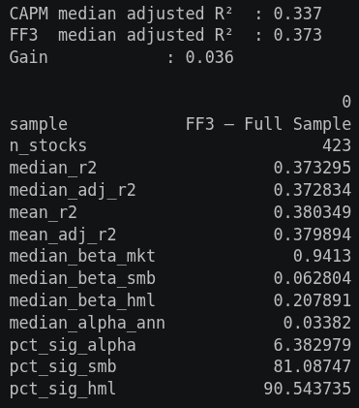
3F Modeling for the top 0.1%
FF3 on the whole set of S&P500 from 01.01.2010
Notes:
Here, is the three factor modeling on the whole set.
I switched to adjusted R-squared because we add more explanatory variable.
R² is at 37% (we were at 33% with CAPM) but improvement is limited because the S&P500 universe mutes the size premium.
The real test is whether three factor model does better in the tails than CAPM did.

Slide 29
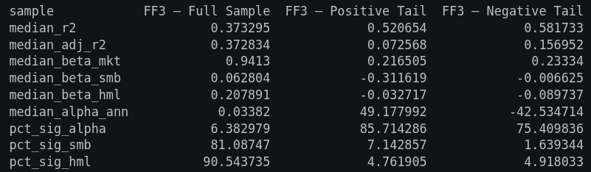
3F Modeling for the top 0.1%
FF3 for the top 0.1%. With adjusted R2.
Neither CAPM nor FF3 seems good to explain extreme returns. The vast majority of tail behavior remains idiosyncratic and unexplained by systematic factors.
Notes:
The positive tail has an r-squared of 7%, the negative tail, 16%.
Slight increase of 3% for the negative tail, and an actual decrease of 2% for the positive tail compared to CAPM.

Slide 30
Momentum for the top 0.1%
Do extreme returns have a persistence component to them? The case for momentum also known as the Carhart 4 factors model.
Ri−Rf=α+βm(Rm−Rf)+βSMB⋅SMB+βHML⋅HML+βUMD⋅UMD Ri​ - the return of your stock (or portfolio)
Rm - the return of the market (S&P500 index)
Rf - the risk-free rate (DTB3, the 3-month T-bill)
SMB - Small minus Big (market cap factors)
HML - High minus Low (book to market ratio) UMD - Up minus Down (long time winners vs long time losers)
Notes:
Same methodology with Carhart 4 factor model. Developed later in 1997 by Mark Carhart as an extension of 3F.
Also known as the MOM, monthly momentum factor.
I read on the wikipedia website that the four factor model is commonly used as an active management and mutual fund evaluation model.
So, how will it fare?

Slide 31
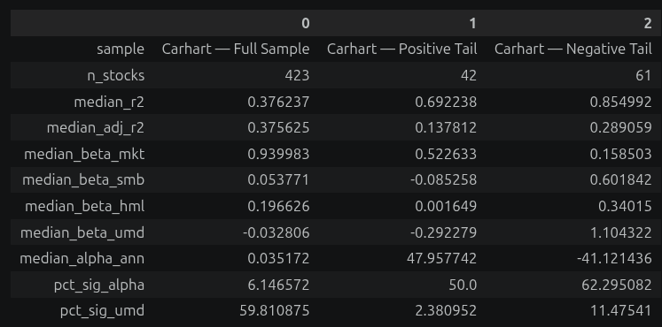
Momentum for the top 0.1%
Adjusted R2 doubles in the tails !
Rallies go against momentum. Crashes follow it.
The UMD significance tells us that it explains crashes better than rallies.
Notes:
Adjusted R2 doubles in the tails compared to 3F model!
The momentum coefficient for the positive tail is negative at -0.29 while it is positive at 1.10 for the negative tail.
Meaning that Rallies go against momentum. Crashes follow it.
But the statistical significance of the coefficient, at the bottom of the table, is really low overall with 2% and 11% and just slightly higher for the negative tail.

Slide 32
Sentiment for the top 0.1%
Does market sentiment explain these extreme returns? (using a proxy of financial news headlines) Ri−Rf=α+βm(Rm−Rf)+βSMB⋅SMB+βHML⋅HML+βUMD⋅UMD+βSENT⋅SENT Ri​ - the return of your stock (or portfolio)
Rm - the return of the market (S&P500 index)
Rf - the risk-free rate (DTB3, the 3-month T-bill)
SMB - Small minus Big (market cap factors)
HML - High minus Low (book to market ratio) UMD - Up minus Down (long time winners vs long time losers)
SENT - minus 1 for low sentiment, plus 1 for high sentiment
Notes:
Now we try to add a market sentiment coefficient to our model.
The hypothesis is that these extreme returns are irrational movement induced by extreme sentiment among traders.
Also a disclaimer here but due to the difficulties to find free historical sentiment data. This indicator is on the market level, not stock level.

Slide 33
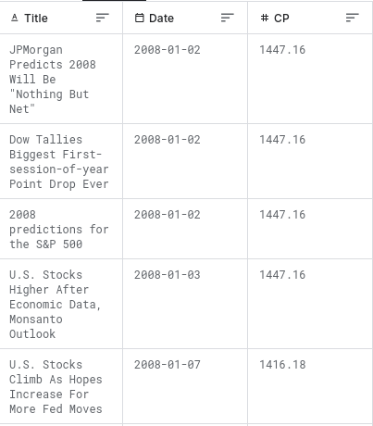
Sentiment for the top 0.1%
Does market sentiment explain these extreme returns? (using a proxy of financial news headlines) Kaggle S&P 500 with Financial News Headlines (2008–2024)
Notes:
I used a Financial news headlines from kaggle
Not great but one of the best I found as open source on the internet.
You can see an example of the dataset on the slide.

Slide 34
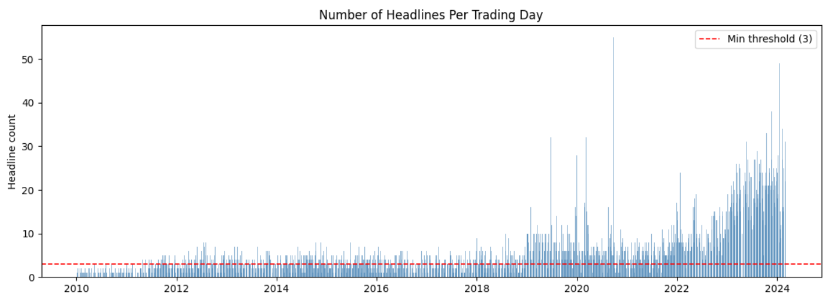
Sentiment for the top 0.1%
Does market sentiment explain these extreme returns? But limitations of the dataset… (sparsity and cutoff)
Notes:
Here is a visualisation of the news headline count by day.
We have very sparse headlines number in the first years. And does not go to 2026.
So I had to also cutoff the return dataset accordingly.

Slide 35
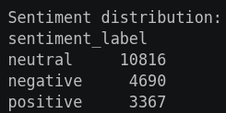
Sentiment for the top 0.1%
Does market sentiment explain these extreme returns? FinBERT for NLP analysis : Hugging Face FinBERT
FinBERT is a pre-trained NLP model to analyze sentiment of financial text. It is built by further training the BERT language model in the finance domain, using a large financial corpus and thereby fine-tuning it for financial sentiment classification. Financial PhraseBank by Malo et al. (2014) is used for fine-tuning.
Notes:
To label the headlines with a sentiment I used FinBERT.
It is an encoder, which creates an embedding, with a linear classifier at the end to give a score.
I installed FinBERT in local to give a score between -1 extremely negative to +1, extremely positive sentiment for each headlines. And then I aggregated by date. This gives a market sentiment for the day.

Slide 36
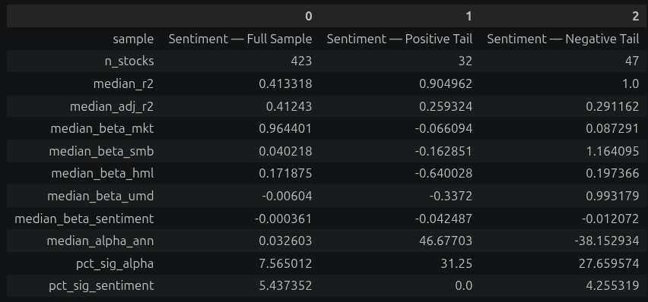
Sentiment for the top 0.1%
Does market sentiment explain these extreme returns?
The increase in R-squared with such low sentiment coefficient statistical significance is shaky. This definition of sentiment does not add any explanatory power.
Notes:
On the total set, the adjusted R-squared increases a bit from 0.37 to 0.41 compared to the momentum model.
However, there is only 5 percent of significant sentiment beta, on the full sample.
Is it a sign of multicollinearity or overfit?
The positive tail r-squared jumps from 13% to 26% but with a significance of the sentiment which is null.
Again, Is it a sign of multicollinearity or overfit?
The negative tail r-squared barely changed. The significance of the sentiment is also really low.

Slide 37
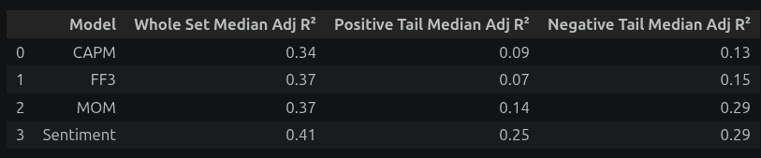
Modeling Summary
Overall, the models perform worse in the tails than in the whole set.
Notes:
On this summary, we see that overall these models are worse in the tails compared to the full set.

Slide 38
Conclusion
Overall returns on the S&P500 do exhibit fat tail behavior.
Definition of returns, log vs. arithmetic, start to really matter in the tails.
Positive tail and negative tail are not symmetrical. Neither in count nor magnitude.
Extremes distribution seem to be consistent across years.
Extremes distribution do not seem to be consistent across sectors. (Probably due to the Communication Services outlier. To be tested.)
Modeling in the tails performs worse than on the full set of returns.
Factors have very low statistical significance (p<0.05) in the tails overall.
Crashes, negative tail, seem to be best explained using CAPM and momentum.
Rallies, positive tail, seem to have very shaky significance with the models used overall.
I learned about extreme value theory and generalized pareto distributions while making this presentation. So, there is an exploration of these tools to be done next time.
Notes:
To end this presentation, I will conclude on the following :

Slide 39
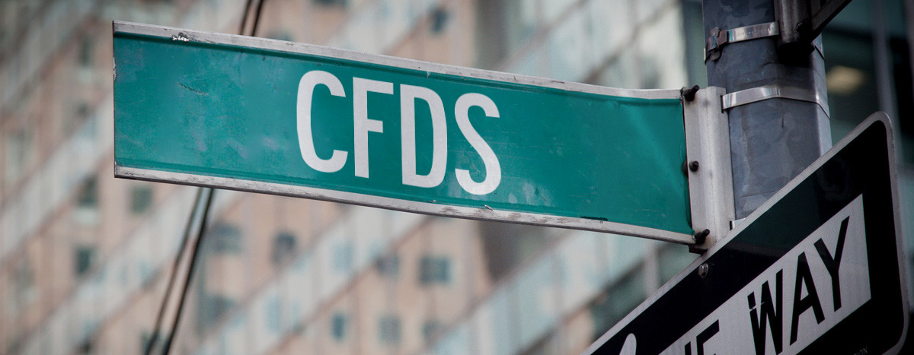
Questions?

