Slide 1
Study on the Tail Distribution of Stock Returns: From Empirical Analysis to Factor Explanations
Chartered Financial Data Scientist (CFDS)
CFDS-11 – Project Presentation - Pierre Nibéron

Slide 2
Contents
Motivation
Problem Description
Data
Approach-1, whole set
Approach-2, top 0.1%
Results
Conclusion
Extreme Value Theory ? (https://en.wikipedia.org/wiki/Extreme_value_theory)

Slide 3
Motivation
On Fat-Tails
Mention by Dr. Sikandar Siddiqui during CFDS lessons
Personal IT Background going into finance
Describing and finding explanatory models
Reading literature on the subject
Using the tools learned during CFDS course
Initiation to existing financial models (CAPM, Fama-French, …)
“large changes tend to be followed by large changes, of either sign, and small changes tend to be followed by small changes.” - Benoit B. Mandelbrot, 1963

Slide 4
Problem Description
First Part : Description and statistical testing
Do we observe fat tails which would not exist under normal assumptions ? Arithmetic vs. Log, Skewness, Kutorsis, JB and visualization
What do these tails look like? Are they symmetrical? 99.9th percentile, t-test, f-test and visualization
Second Part : Model and explanatory power
CAPM
Fama-French Three factors model
Momentum and sentiment

Slide 5
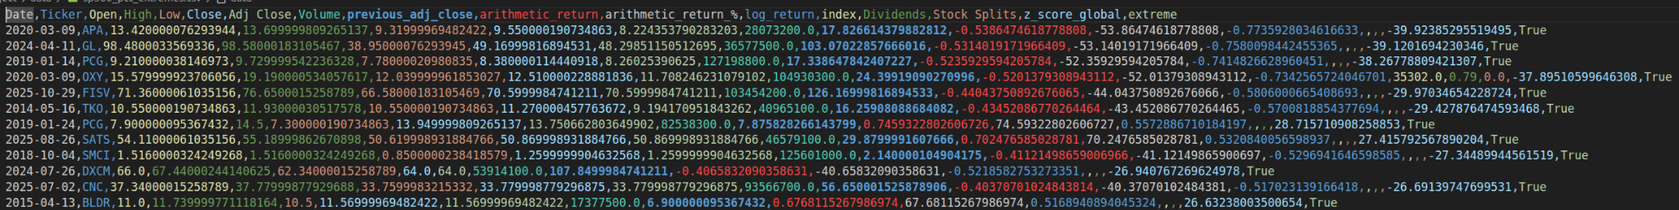
Data
S&P500 stock list from wikipedia
Daily stock prices from 01.01.2010 to today
yFinance api (data from yahoo finance website)
Corporate actions (yFinance api)
Transformation to obtain returns
Flags at a certain threshold

Slide 6
Approach-1
S&P500 whole dataset
Statistics
Visualization

Slide 7
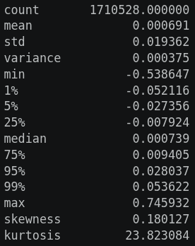
Approach-1
Arithmetic-Returns stats table:
Jarque-Berra
JB statistic: 40458666.05
p-value: 0.00e+00

Slide 8
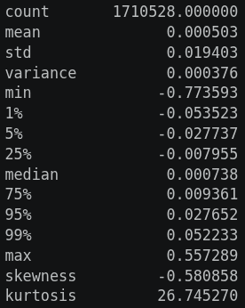
Approach-1
Log-Returns stats table: (check skewness and max, effect of the log)
Jarque-Berra
JB statistic: 51077412.92
p-value: 0.00e+00

Slide 9
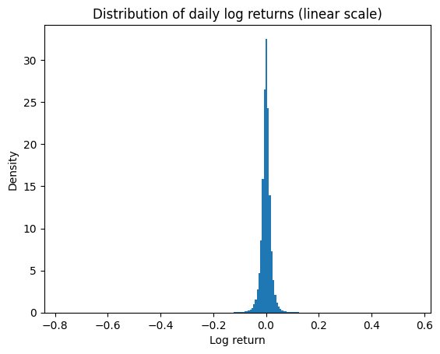
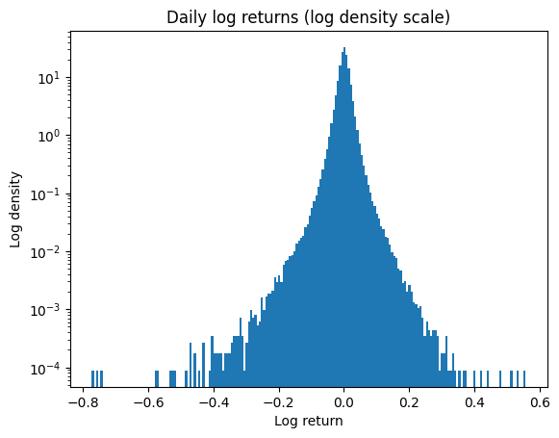
Approach-1

Slide 10
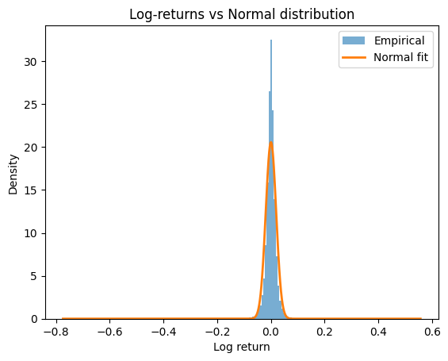
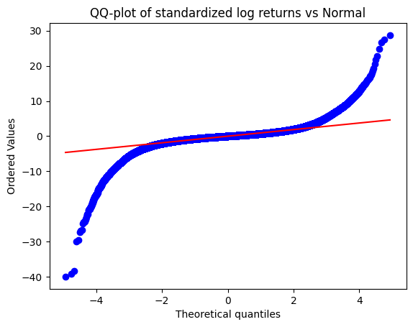
Approach-1

Slide 11
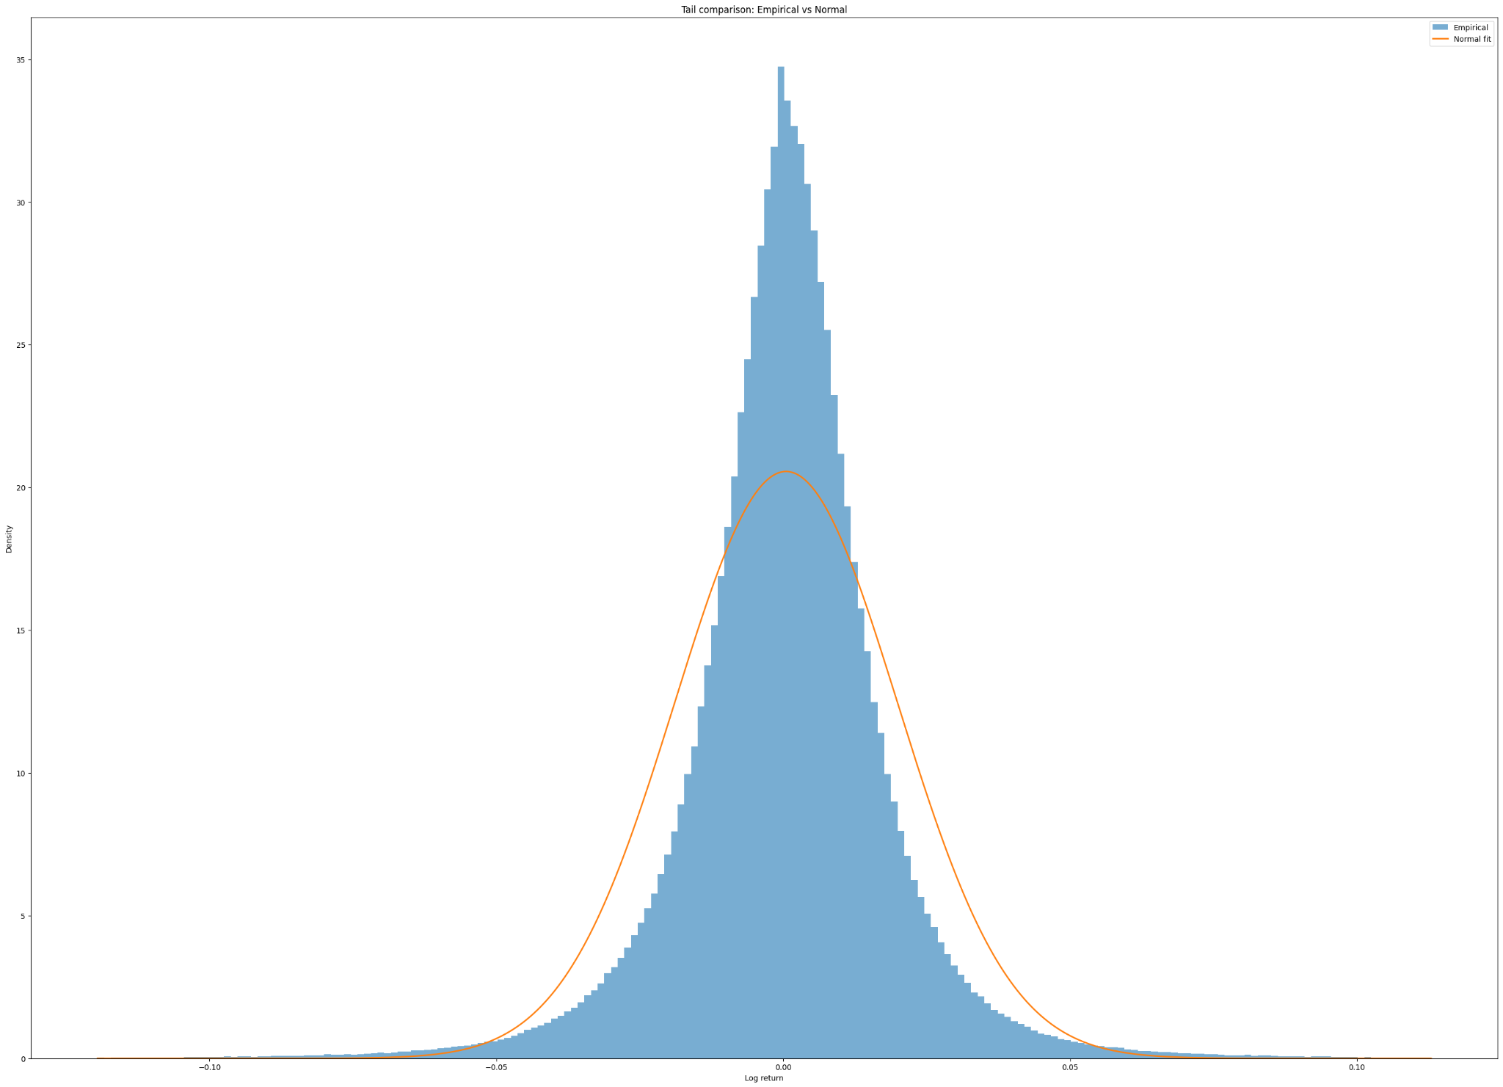
Approach-1

Slide 12
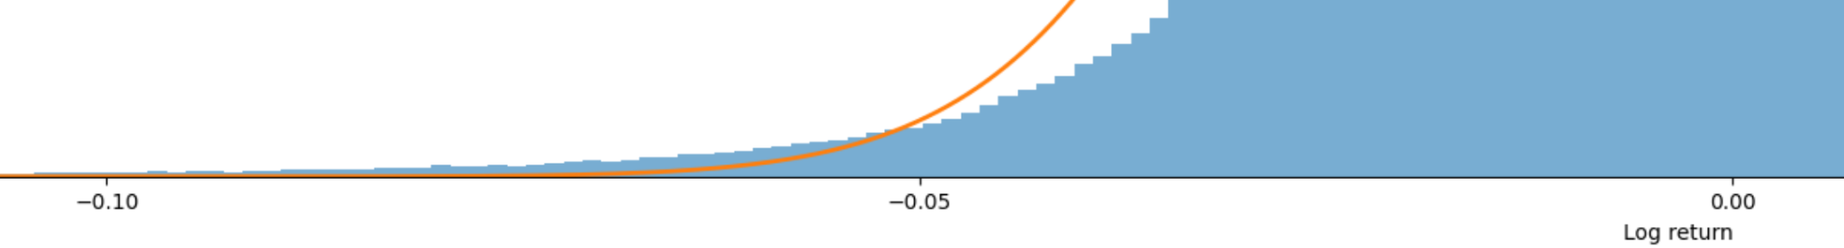
Approach-1

Slide 13
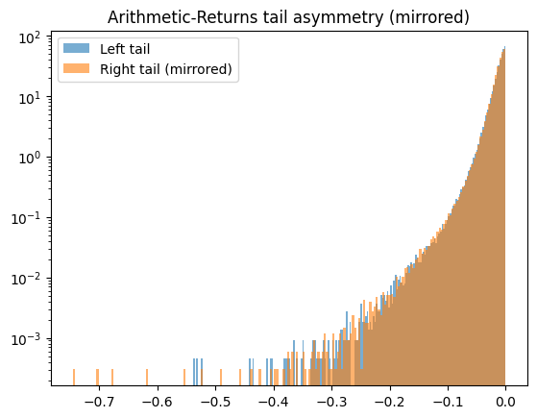
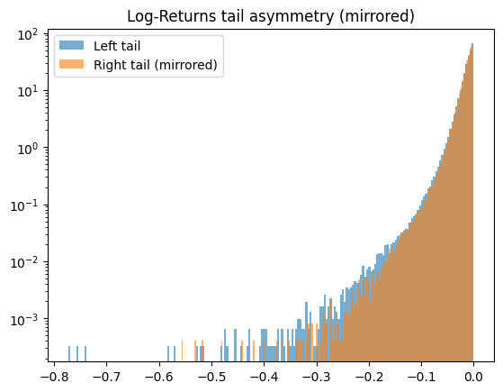
Approach-1

Slide 14
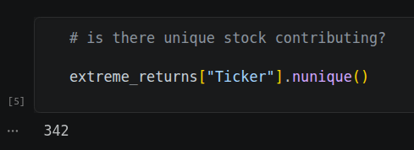
Approach-2
Analysis of the top 0.1%
Clustering
Time clustering
Sectors
Modeling
CAPM
Three factors

Slide 15
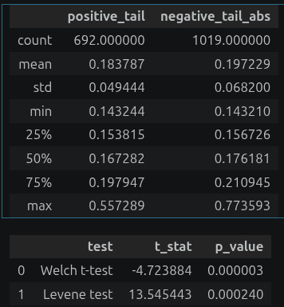
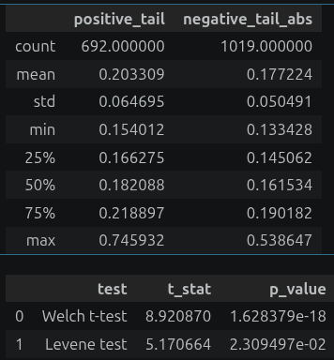
Approach-2(statistical tests)
Do the two top 0.1% have the same statistical resemblance? Check both return definition, log_return (left), arithmetic_return (right)

Slide 16
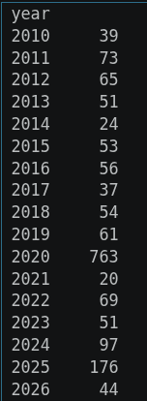
Approach-2 (time clustering)
Top 0.1% daily returns clustered by years

Slide 17
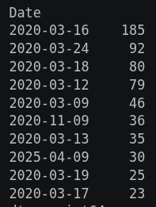
Approach-2 (time clustering)
Top 0.1% daily returns clustered by days, ordered, head(10)

Slide 18
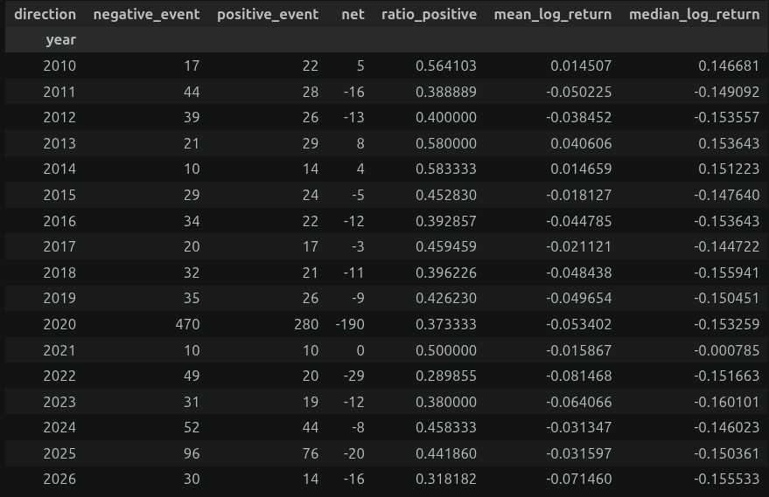
Approach-2 (time clustering)
What years were good / bad for the top 0.1%?

Slide 19
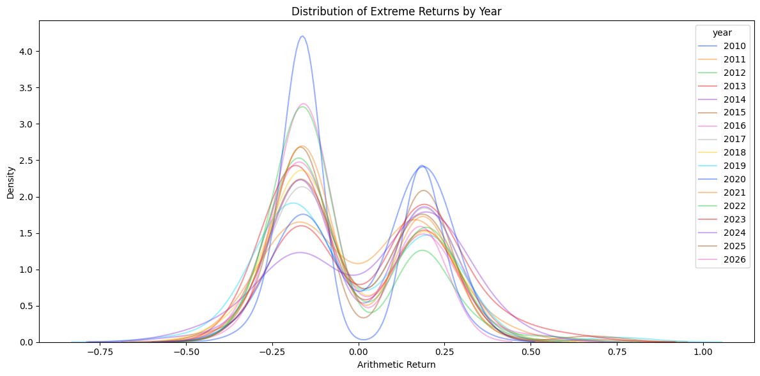
Approach-2 (time clustering)
What does it look like? (Arithmetic returns to not crush the extremes positives)

Slide 20
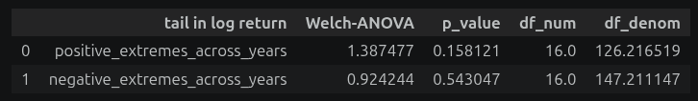
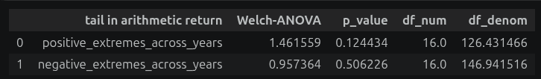
Approach-2 (time clustering, statistical testing)
Do the top 0.1% mean across years are statistically different within each positive extreme and negative extreme? log_return (left), arithmetic_return (right)
Less impact of return definition because we are comparing positive / positive and negative / negative.

Slide 21
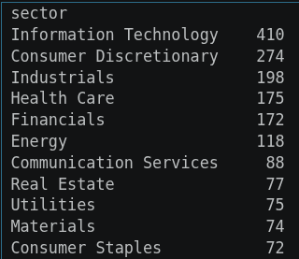
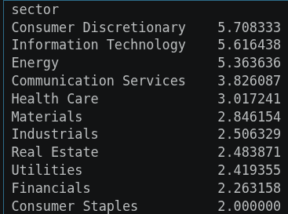
Approach-2 (sector clustering)
Top 0.1% daily returns clustered by sectors, ordered
Raw count and normalized (events/nbr_stocks) count.

Slide 22
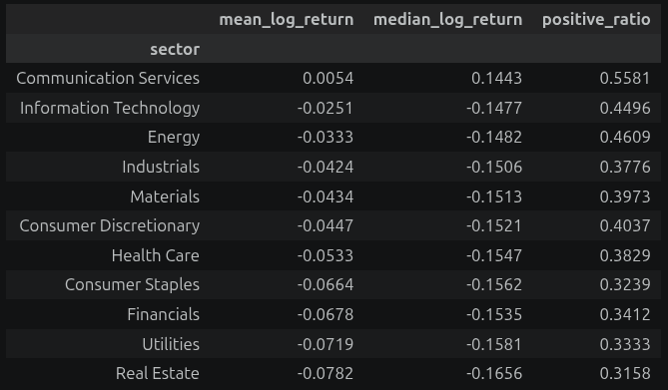
Approach-2 (sector clustering)
What sectors performed best in the top 0.1%?

Slide 23
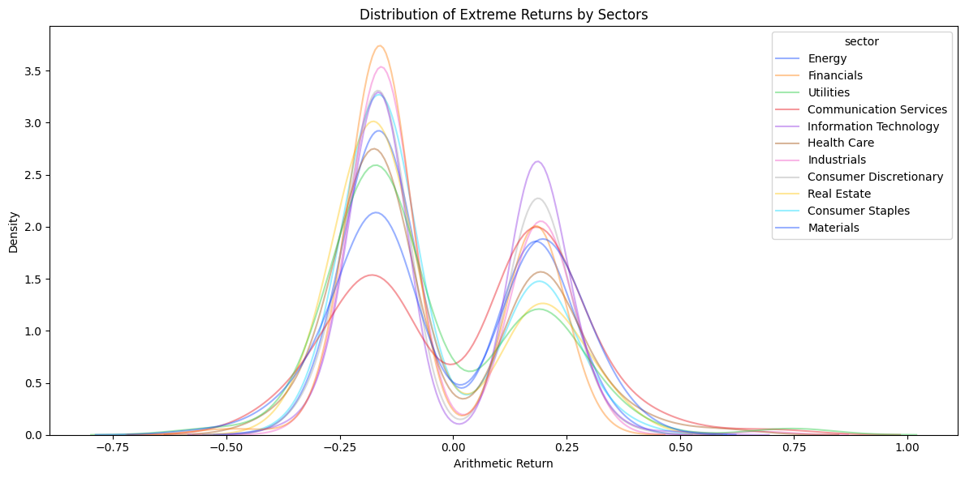
Approach-2 (sector clustering)
What does it look like? (Arithmetic returns to not crush the extremes positives)

Slide 24
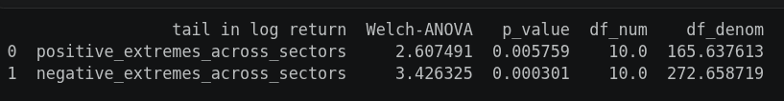

Approach-2 (sector clustering,statistical testing)
Do the top 0.1% mean across sectors are statistically different within each positive extreme and negative extreme? log_return (left), arithmetic_return (right)
Less impact of return definition because we are comparing positive / positive and negative / negative.

Slide 25
Point 1
Sub-point 1
Sub-point 2
Sub-point 3
Point 2
Sub-point 1
Sub-point 2
Example:
Text

Slide 26
Point 1
Sub-point 1
Sub-point 2
Sub-point 3
Point 2
Sub-point 1
Sub-point 2
Example:
Text

Slide 27
Point 1
Sub-point 1
Sub-point 2
Sub-point 3
Point 2
Sub-point 1
Sub-point 2

Slide 28

Questions?

