Slide 1


Classifiez automatiquement des biens de consommation

Slide 2
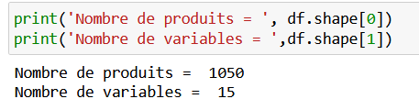
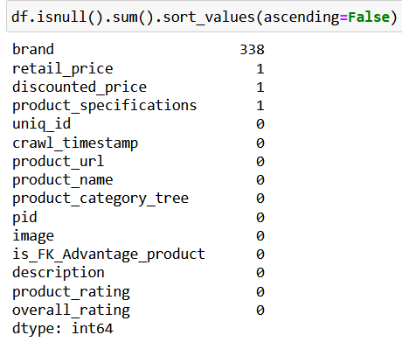

Base de données

Slide 3


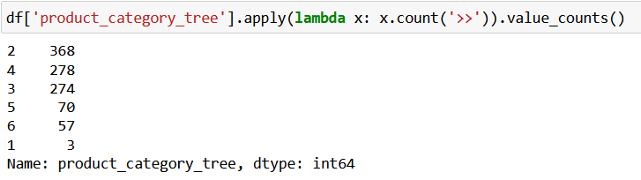
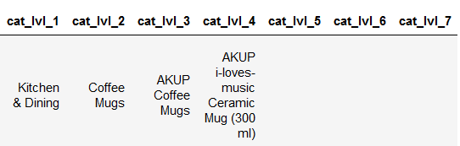
Features TEXT (category)

Slide 4
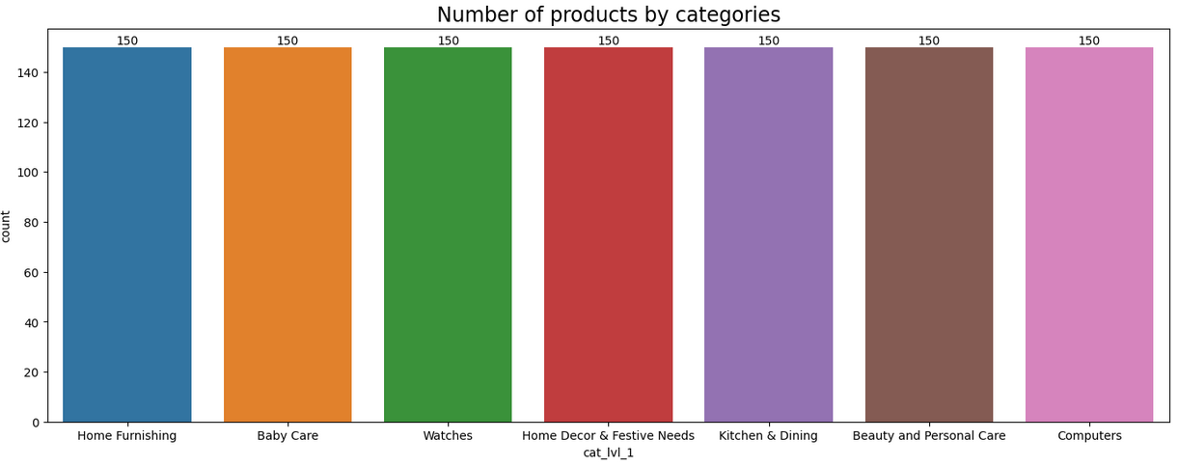
Features TEXT (category)

Slide 5

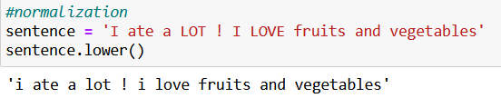
Features TEXT (cleaning sentences)

Slide 6
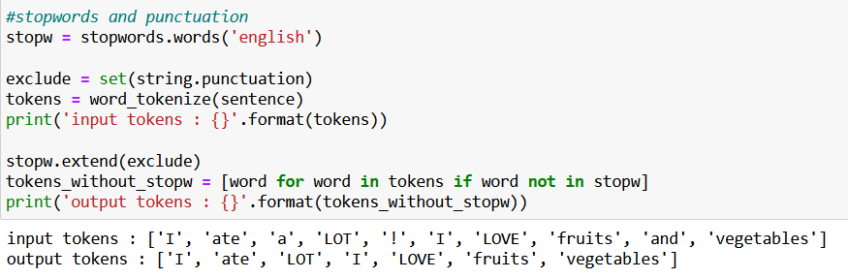
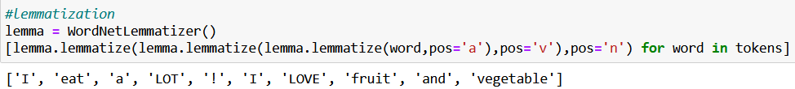
Features TEXT (cleaning sentences)

Slide 7
Features TEXT (models)
Les différents modèles utilisés :
CountVectorizer
TF_IDF
Word2Vec
BERT
USE

Slide 8
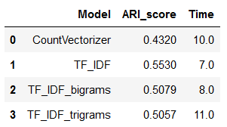
Features TEXT (Count & TF_IDF)
CountVectorizer
TfidfVectorizer

Slide 9
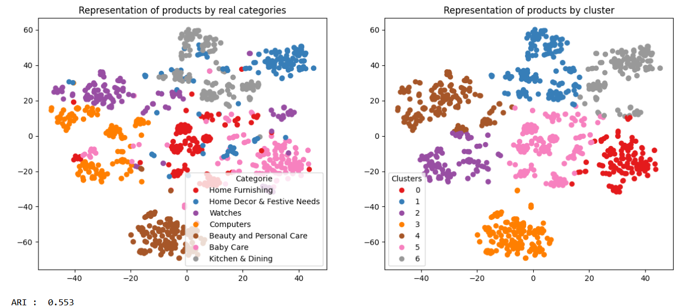
Features TEXT (TF_IDF)

Slide 10
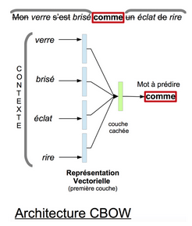
Features TEXT (Word2Vec)

Slide 11
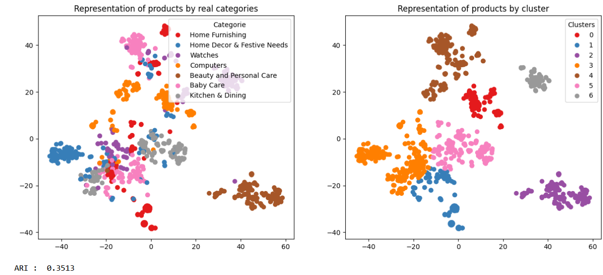
Features TEXT (Word2Vec)

Slide 12
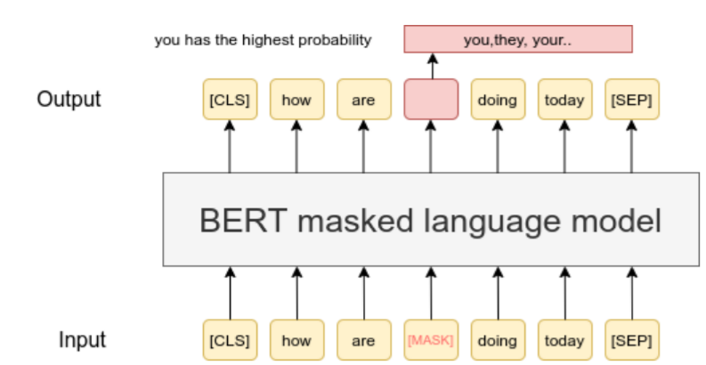
Features TEXT (BERT)

Slide 13
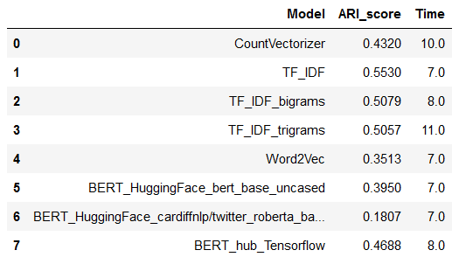
Features TEXT (BERT)

Slide 14
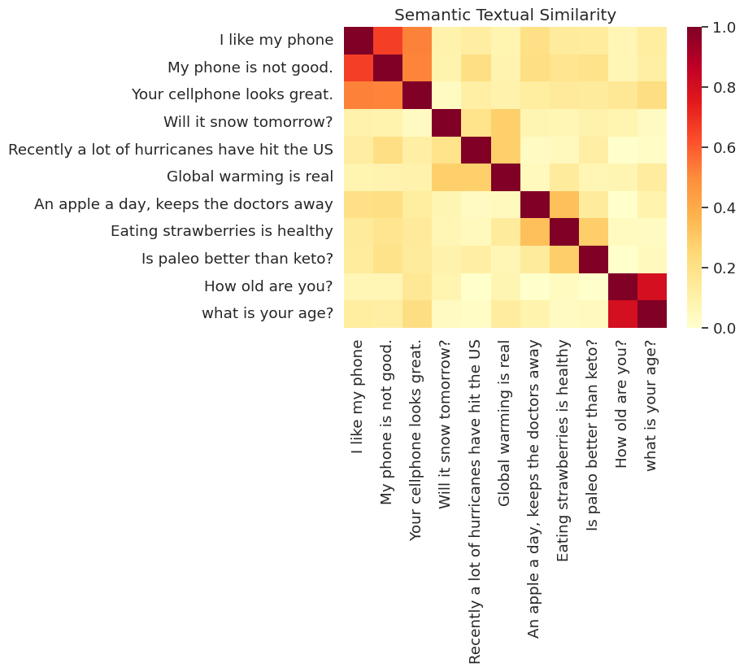
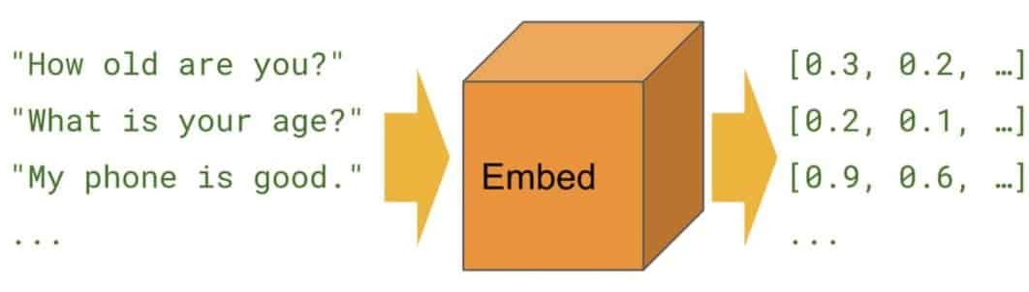
Features TEXT (USE)

Slide 15
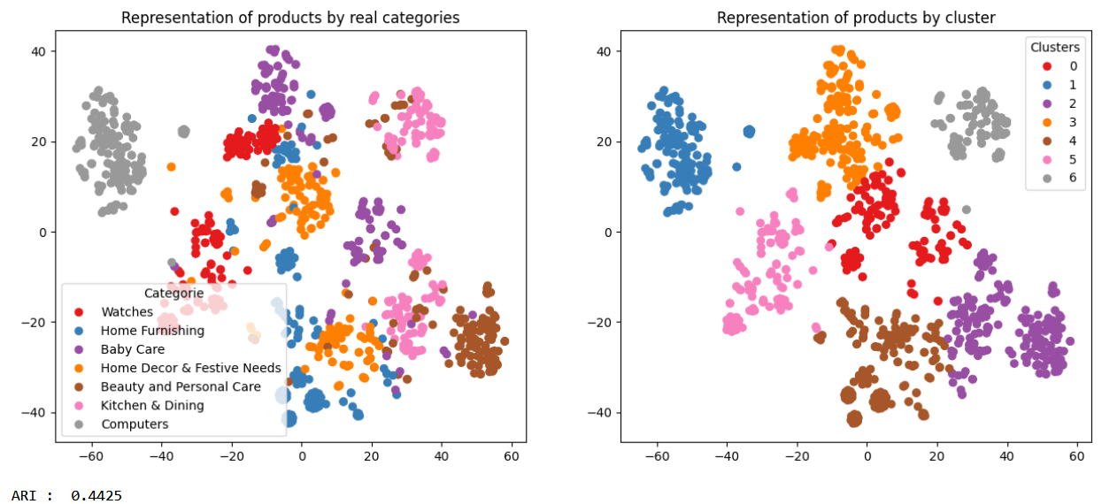
Features TEXT (USE)

Slide 16
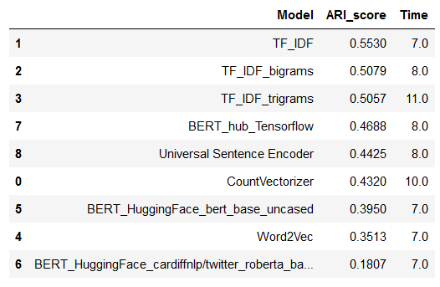
Features TEXT (models)

Slide 17
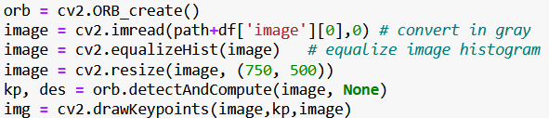
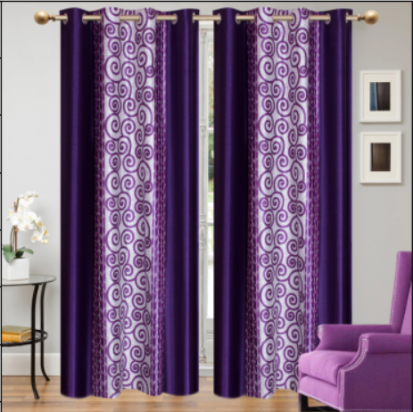
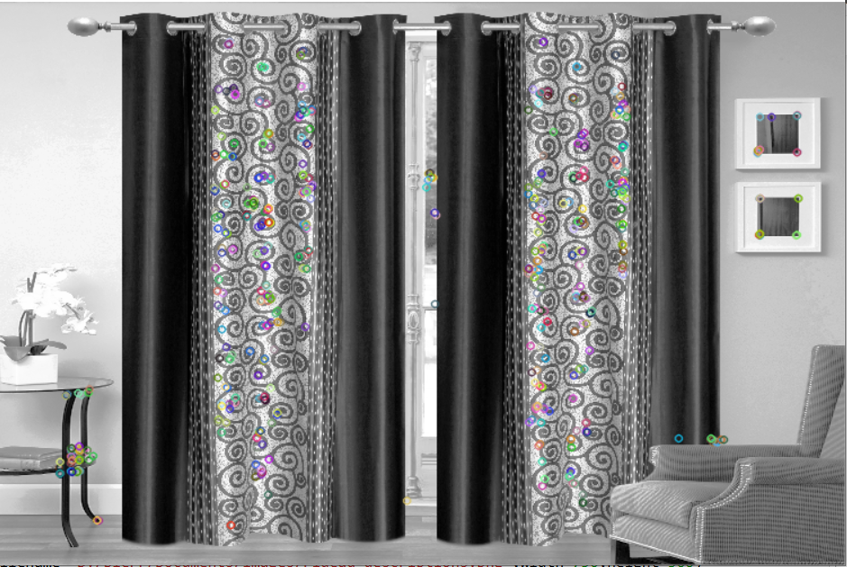
Features IMAGE (ORB)

Slide 18
Features IMAGE (ORB)
Méthologie :
- création des descripteurs de chaque image
- création des clusters de descripteurs
- création des features des images
- réduction de dimension
- analyse visuelle

Slide 19
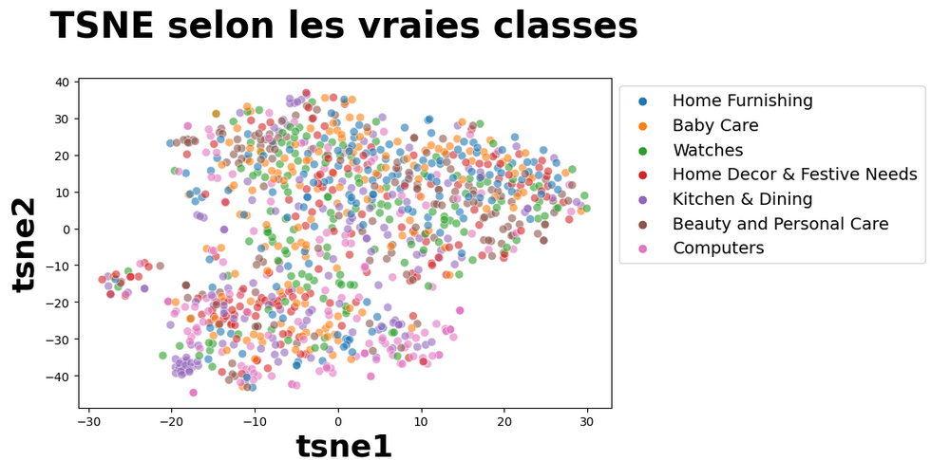
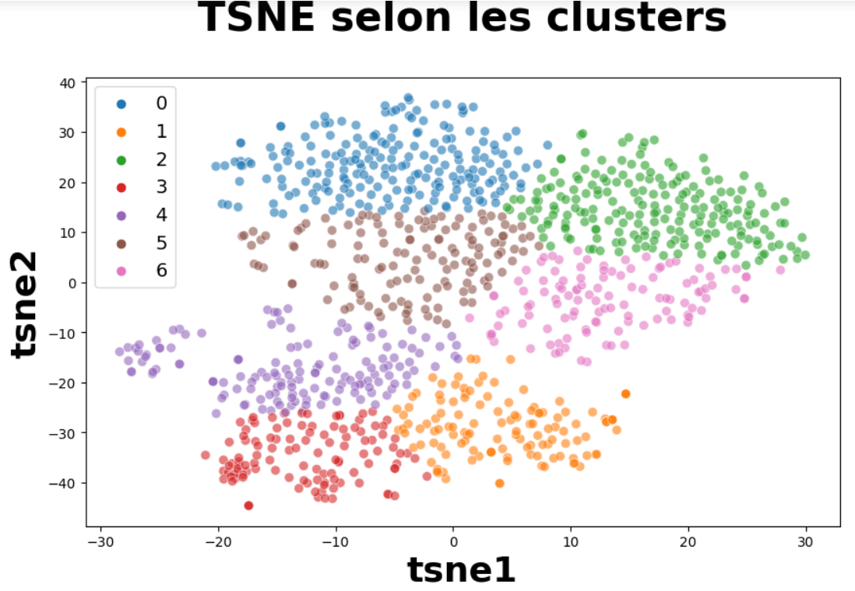

Features IMAGE (ORB)

Slide 20
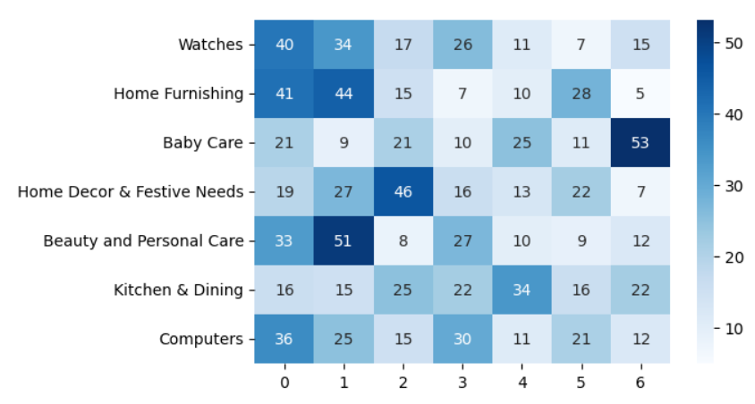
Features IMAGE (ORB)

Slide 21
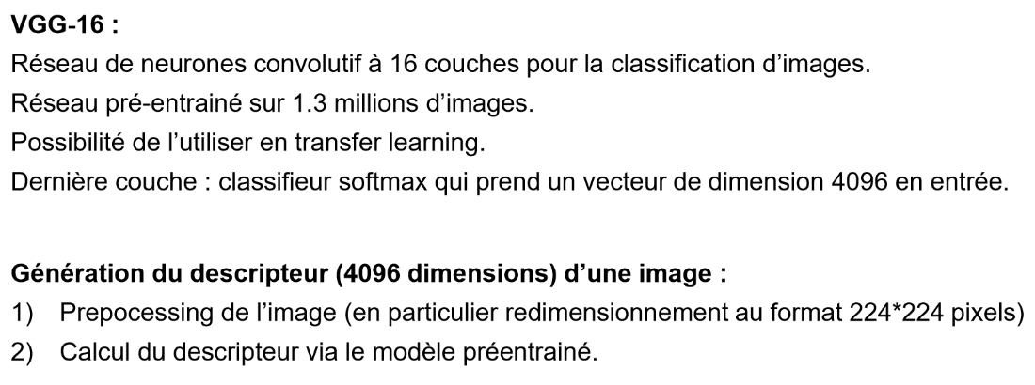
Features IMAGE (VGG16)

Slide 22
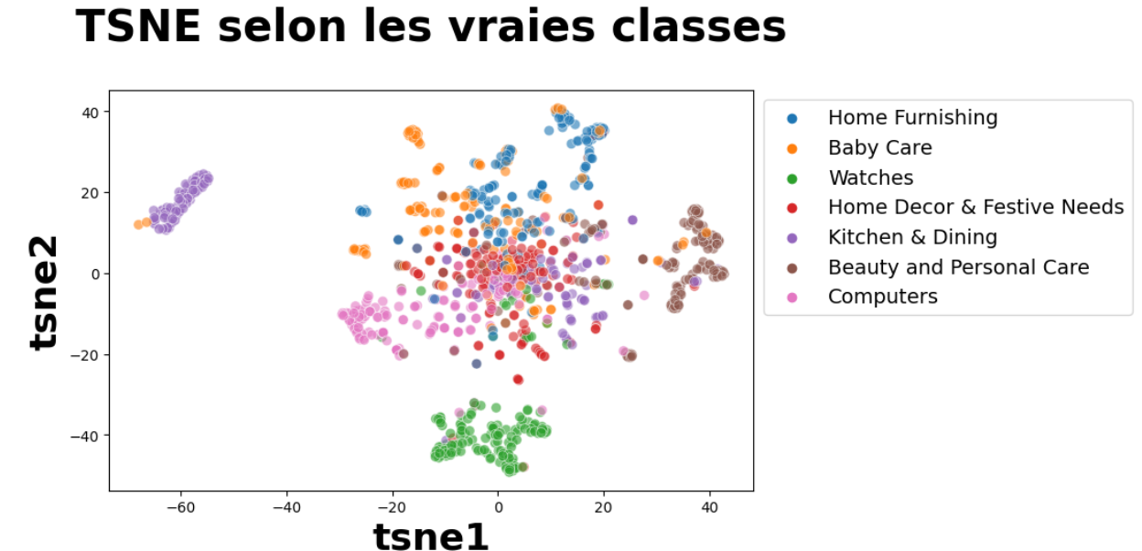
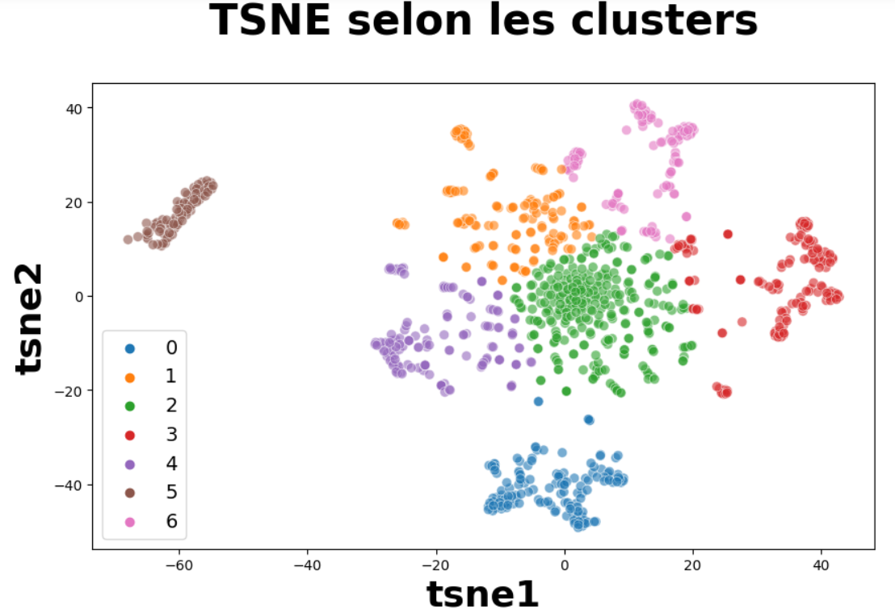
Features IMAGE (VGG16)

Slide 23
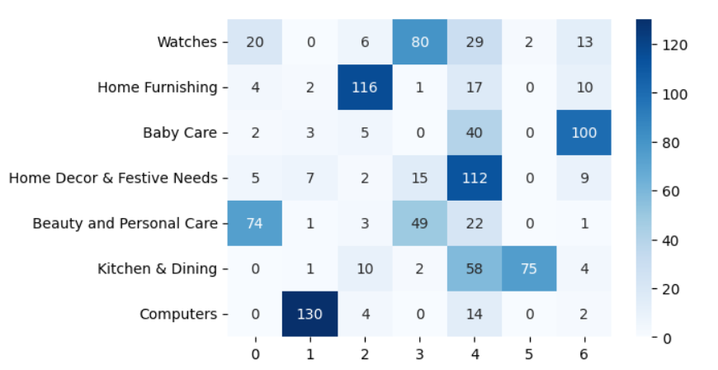
Features IMAGE (VGG16)

Slide 24
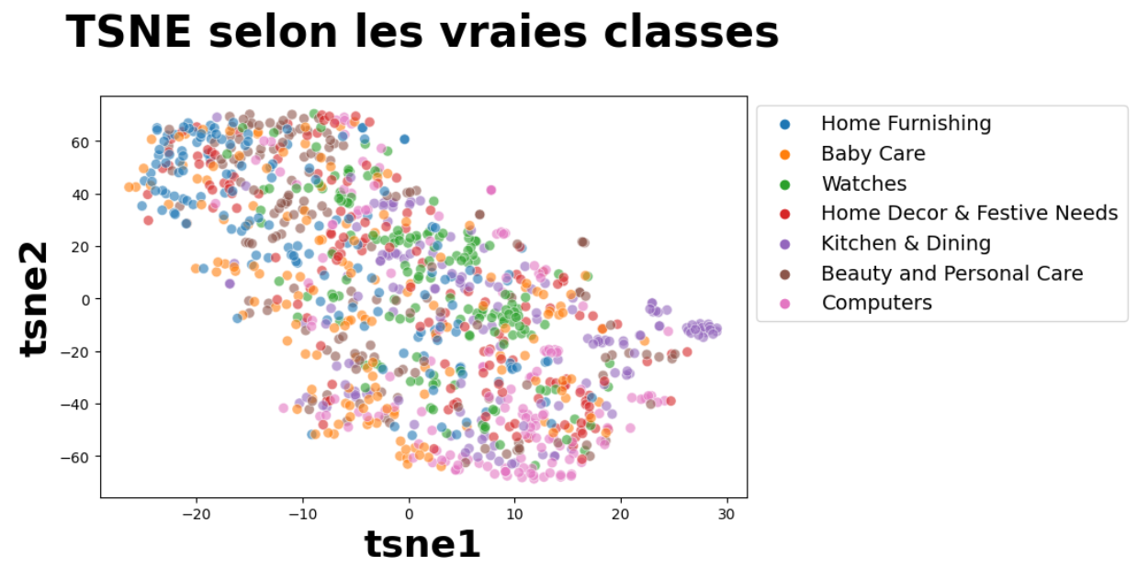
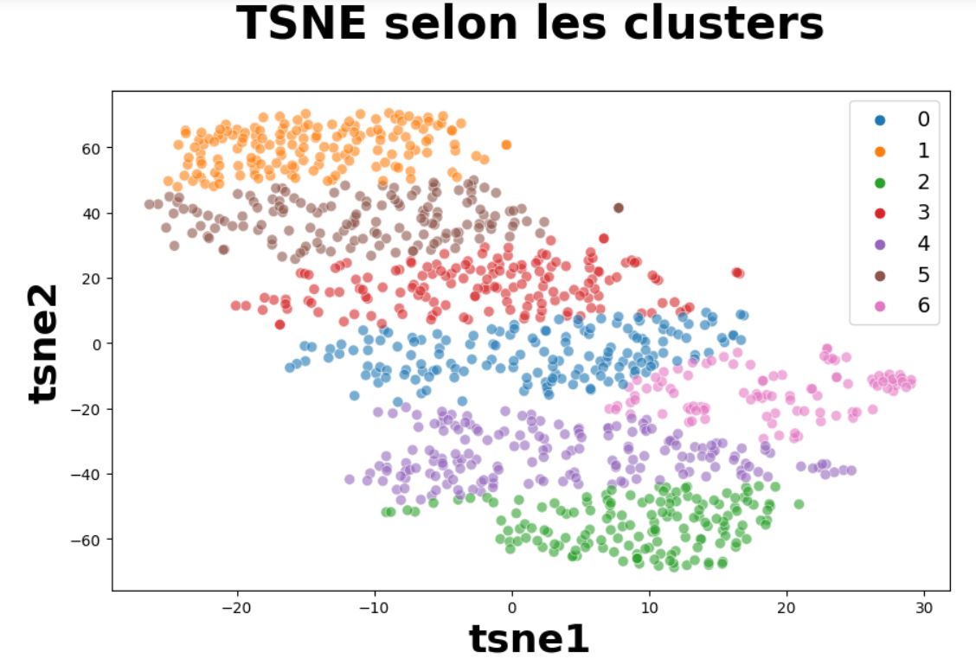
Features IMAGE (Xception)

Slide 25
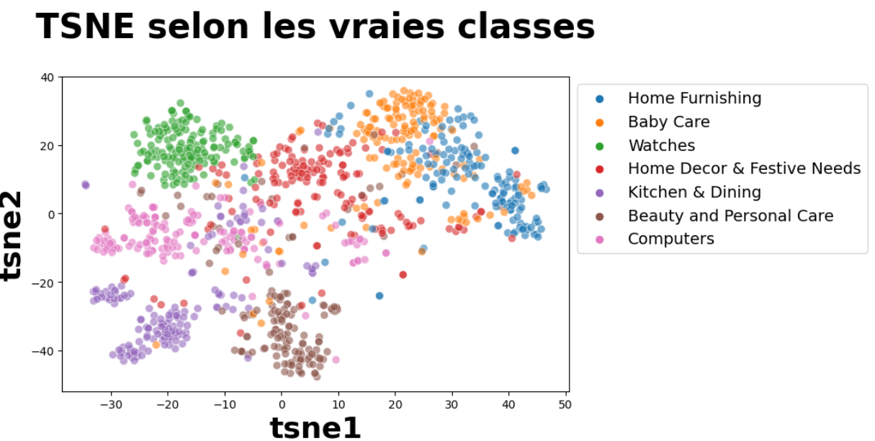
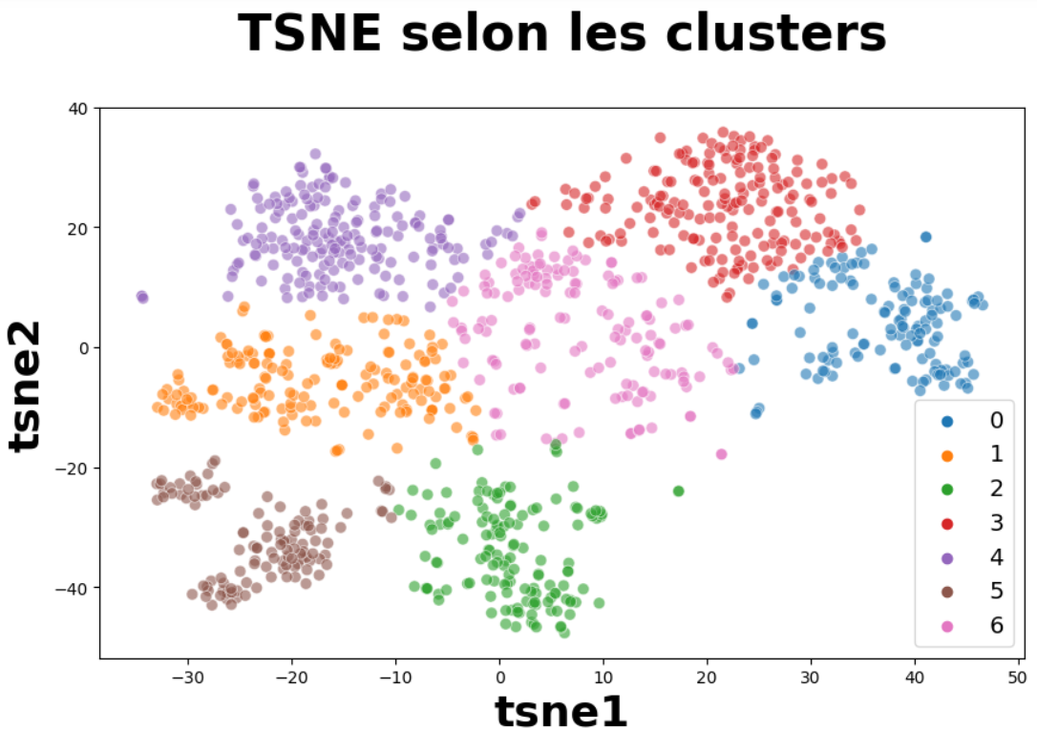
Features IMAGE (RESNET50)

Slide 26
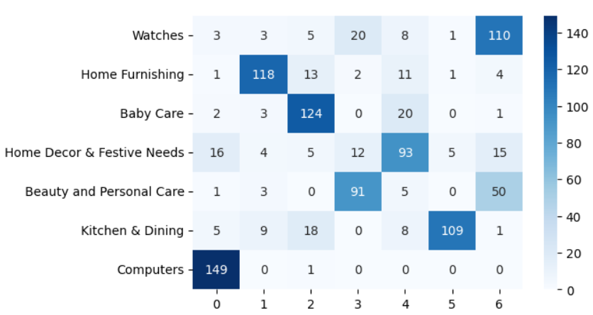
Features IMAGE (RESNET50)

Slide 27
Conclusion
Features TEXT
Features IMAGE
Faisabilité d’un moteur de classification ?

