Slide 1
Artificial Lattice

Slide 2
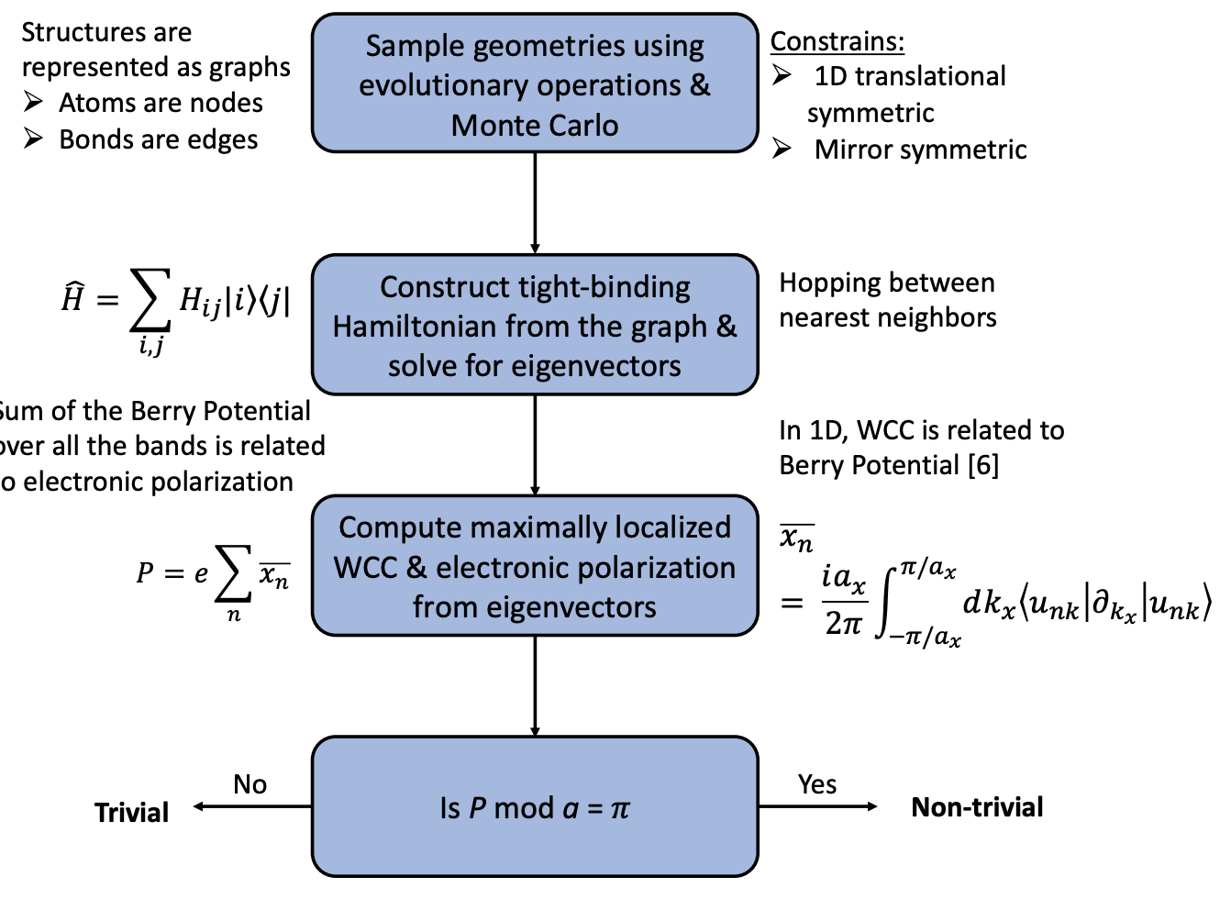

Slide 3
High throughput screening of GNR geometries
Lines sampling
Adding swap moves to sample more structures
Lots of data – scope for neural network; Mathew working on it

Slide 4
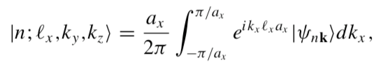
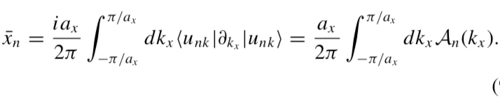


Hybrid Wannier Charge Centers localized in 1D.
Because a gauge choice resulting in WFs being smooth and periodic in reciprocal space is not always possible in higher dimensions
$P mod\left(a\right)=0,$ 𝜋
Zak phase is quantized at 0 and 𝜋 for systems with inversion/mirror symmetry (Mei-Yin Chou, Nano Lett 2018)
In 1D, WCC can redefined in terms of Berry Potential

