Slide 1
Artificial Lattice

Slide 2
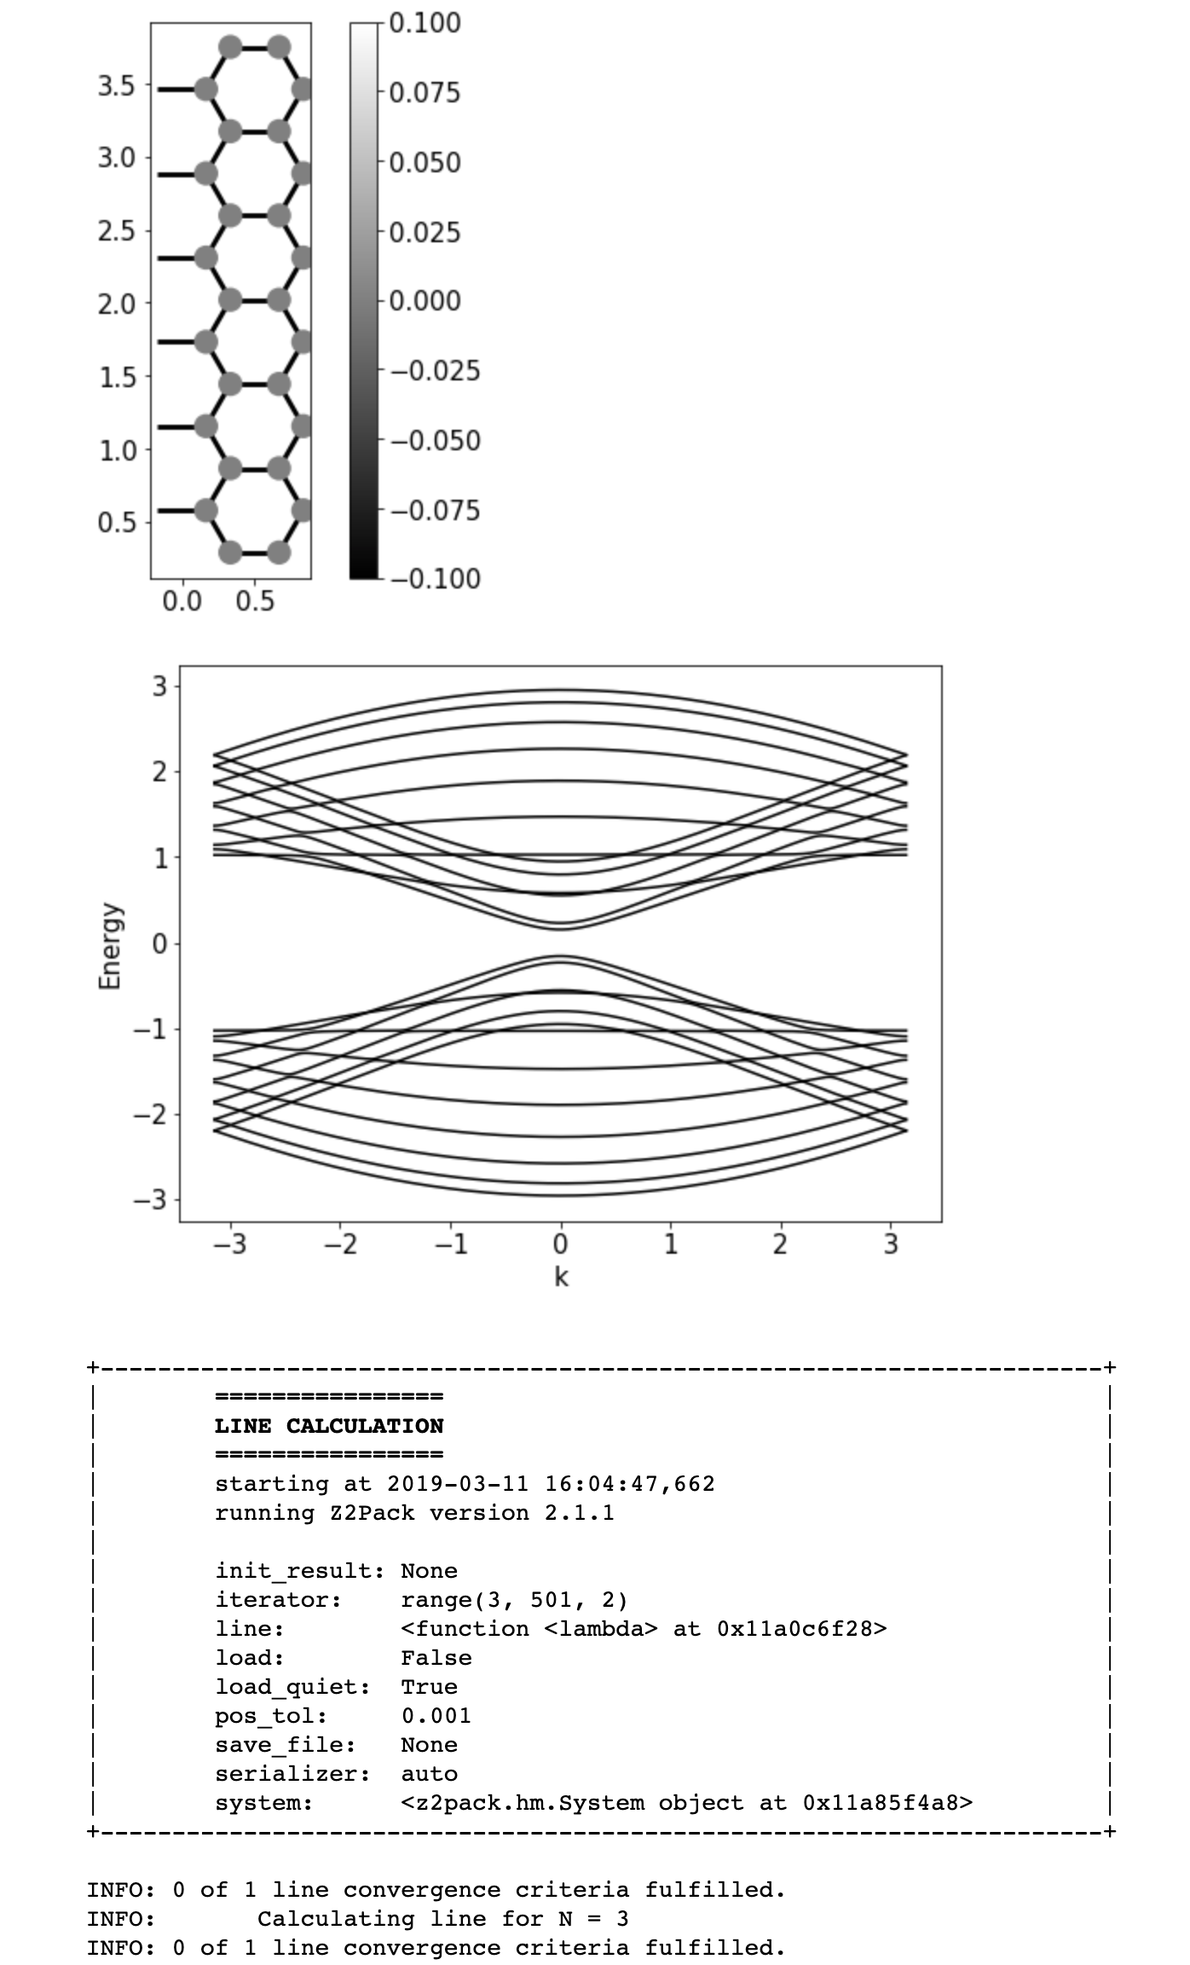
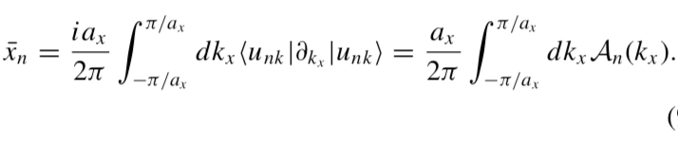


Theory behind Z2 from Z2pack
In 1D, WCC can redefined in terms of Berry Potential
$P mod\left(a\right)=0 or$ 𝜋
If 0 then topologically trivial
𝜋 then topologically non-trivial

Slide 3
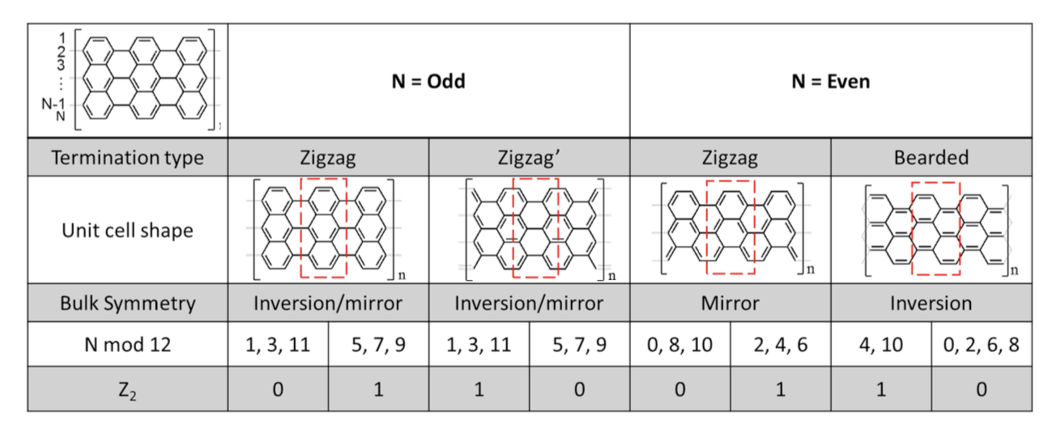
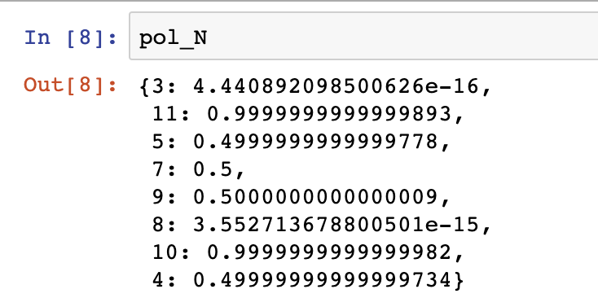

$P mod\left(a\right)=0 or$ 𝜋
If 0 then topologically trivial
𝜋 then topologically non-trivial

