Slide 1
Adapting Anomaly Detection to Textual Representations
Pierre Fihey
S2A, LTCI – Télécom Paris
9 Novembre 2026

Slide 2

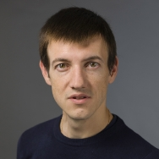
In this talk
Enhancing Two-Step Textual Anomaly Detection through Anisotropy Mitigation
Pierre Fihey, Matthieu Labeau, Pavlo Mozharovskyi — ACL 2026
A Geometry-Aware Depth Function for Robust Unsupervised Textual Anomaly Detection
Pierre Fihey, Matthieu Labeau, Pavlo Mozharovskyi — Findings of EMNLP 2026
Matthieu Labeau Pavlo Mozharovskyi
Lecturer - MLIA, ISIR, Sorbonne Université Professor, S2A, LTCI — Télécom Paris
Project: ANR JCJC CFTextAD
Common Framework for Textual Anomaly Detection

Slide 3
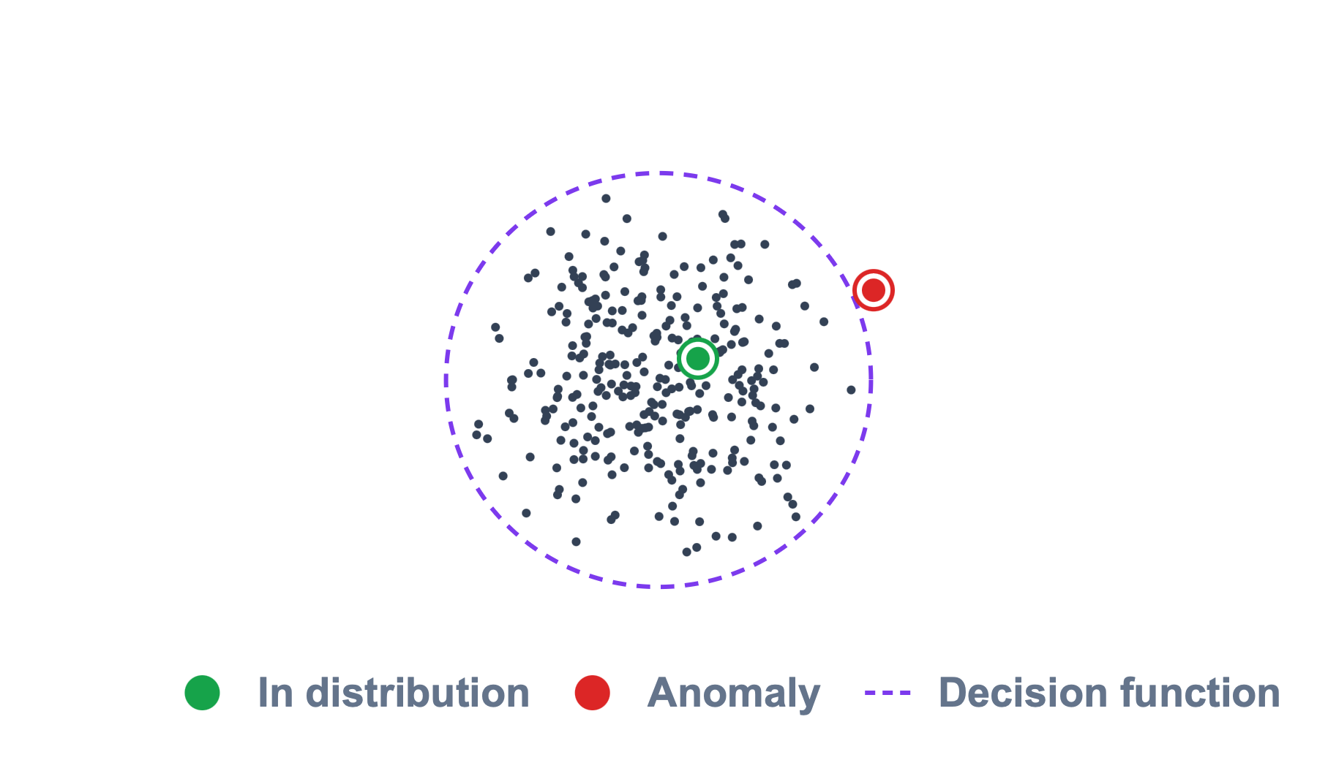
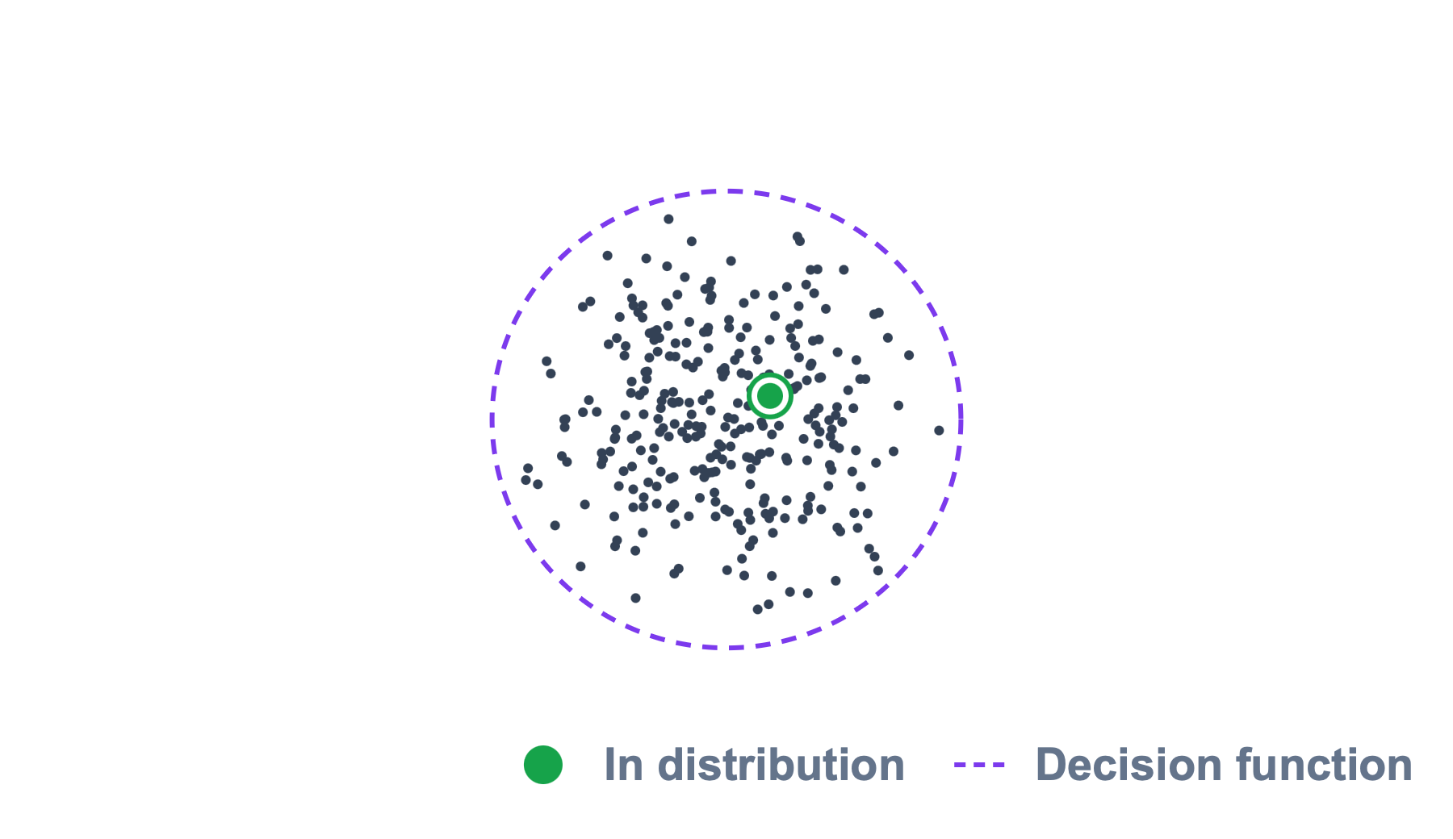
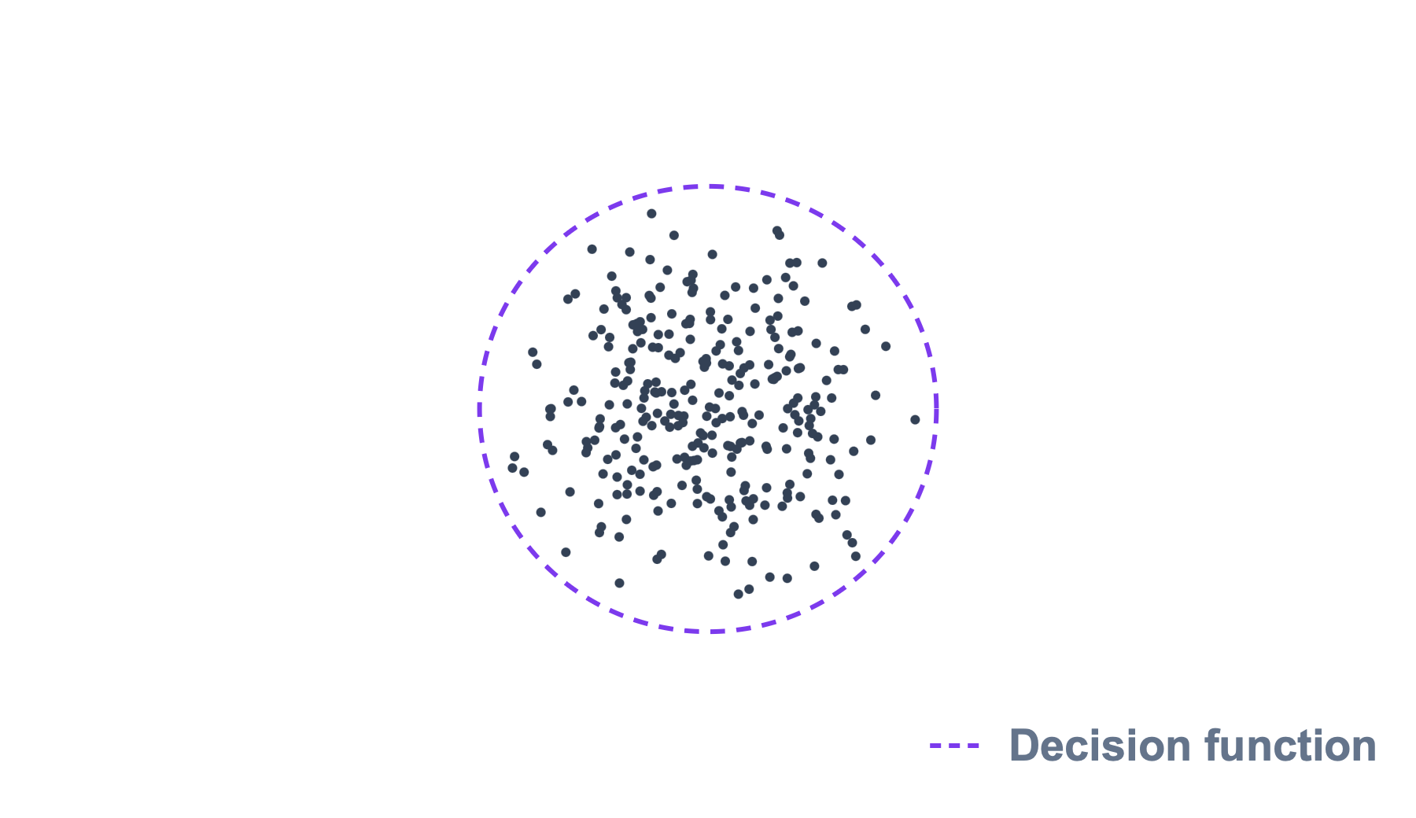
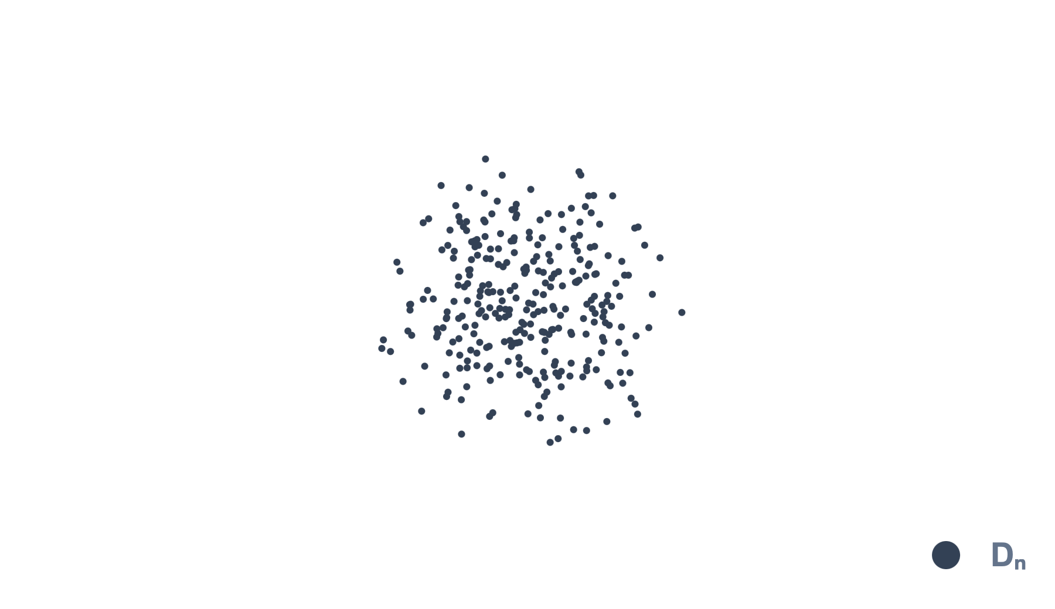
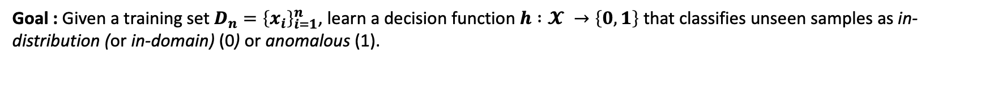
Textual Anomaly Detection
Goal : Given a training set $D_{n}={\left\{x_{i}\right\}}_{i=1}^{n}$, learn a decision function $h :𝓧 →\left\{0,1\right\}$ that classifies unseen samples as in-distribution (or in-domain) (0) or anomalous (1).
Possible applications:
  Emerging topic detection
  Dataset auditing (e.g., LLM-generated annotations)
  Detecting LLMs anomalous reasoning
Main challenge : No supervisions on anomalies.
  Often seen as semi-supervised (Ruff et al, 2021) as training set is assumed to contain only normal data.

Slide 4
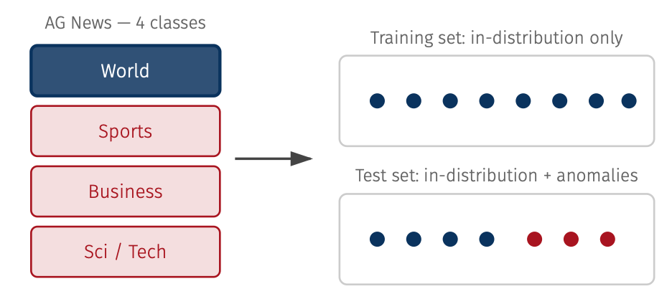
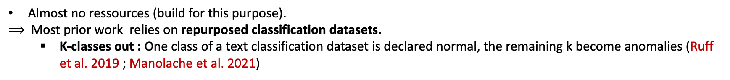
Experimental setting
Almost no ressources (build for this purpose).
$⟹$Most prior work relies on repurposed classification datasets.
  K-classes out : One class of a text classification dataset is declared normal, the remaining k become anomalies (Ruff et al. 2019 ; Manolache et al. 2021)
Evaluation metric : Area Under the ROC Curve
  Threshold-independant : Choosing the best threshold is a hard problem in itself (Khosla and Gangadharaiah 2022).
  Robust to class imbalance.

Slide 5
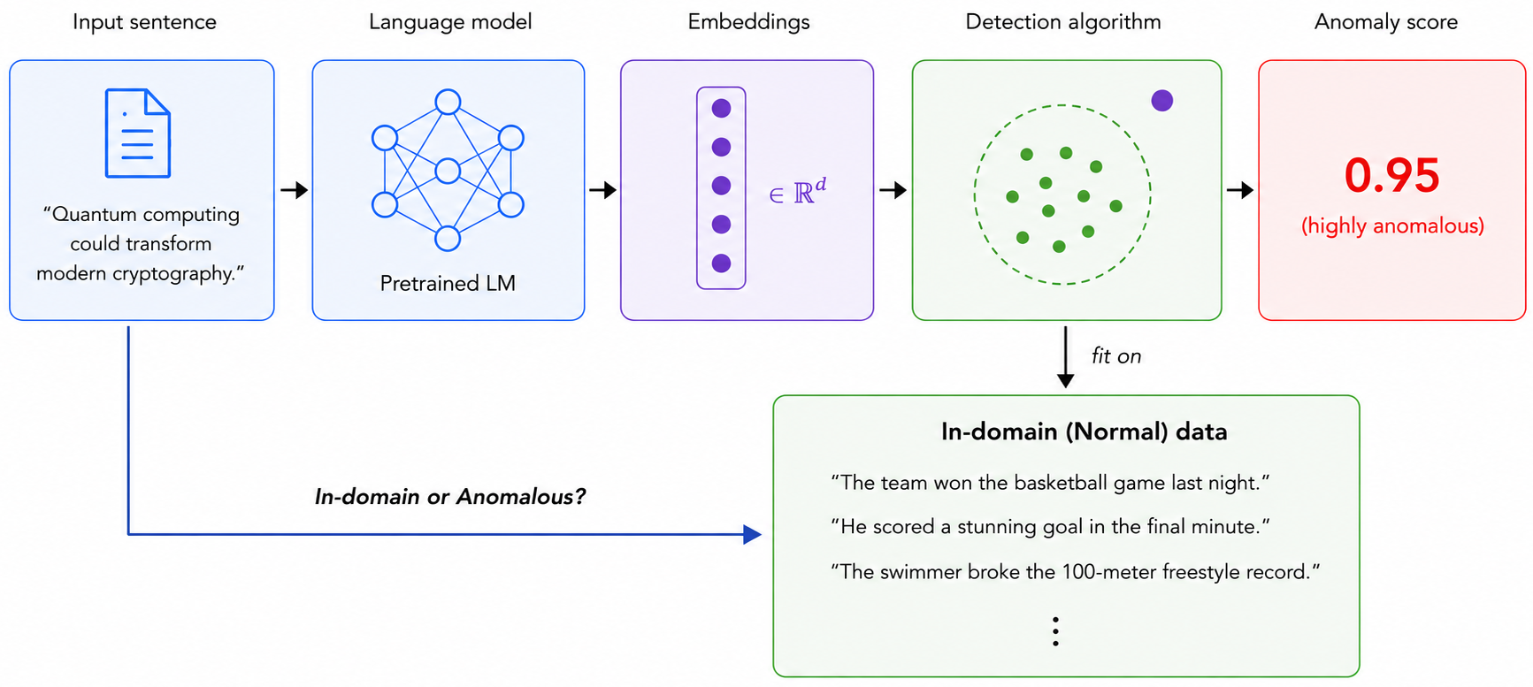
TAD : Two-stage framework
Early approches : Standalone models (AD models are fully trained on the normal data) : CVDD (Ruff et al. 2019 ) ; DATE (Manolache et al. 2021).
Development of recent embedding models : Two stage framework became the dominant approach.
Step 1
Step 2

Slide 6
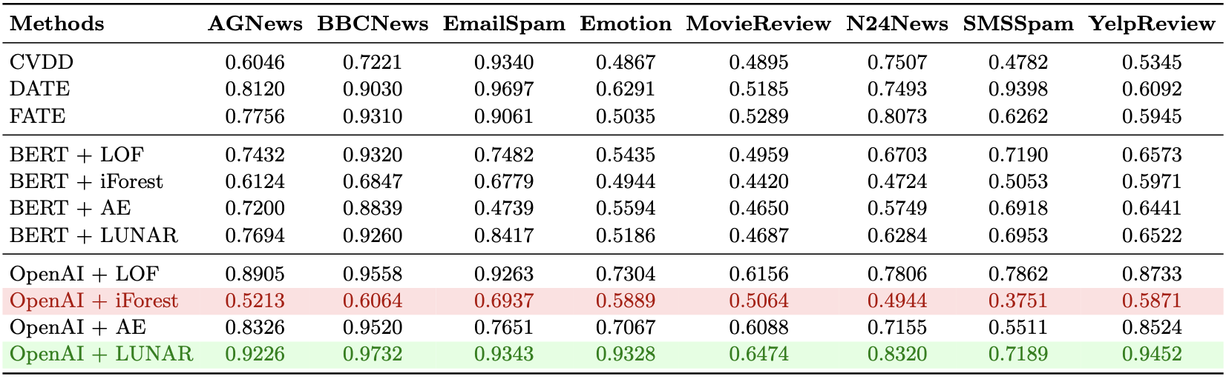
TAD : Recent benchmarks
AUROC across 8 datasets (Li et al. 2024)
Strong performance gains from two-stage frameworks leveraging LLM embeddings.
Large performance disparities across anomaly detection methods.
Necessity to carefully select the detection algorithms depending on the considered setting (language model, dataset...).

Slide 7
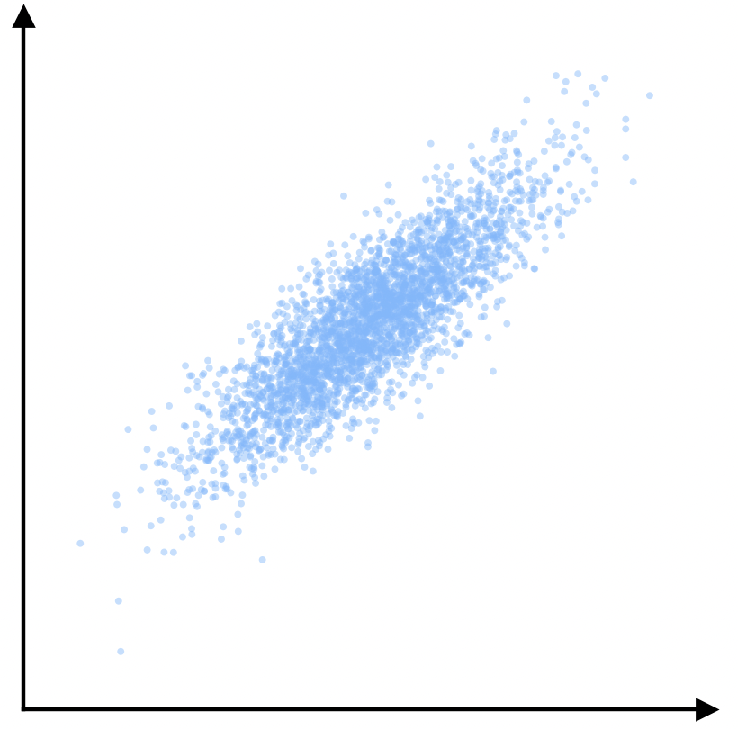
Anisotropy in Textual Embeddings
Hypothesis : Some detection algorithms are more sensitive to embeddings anisotropy than others.
Embeddings anisotropy : concentration along a few dominant directions.
First highlighted in contextual words embeddings (Ethayarajh, 2019).
  Extended to sentence embeddings (Li et al., 2020).
Anisotropic embedding space
Extensively studied in retrieval literature:
Standard metrics such as cosine similarity and Euclidean distance are strongly affected by space anisotropy.
  Distance and Similarity-based tasks are particularly impacted.
  Authors introduced various approaches to mitigate anisotropy.

Slide 8
Anisotropy : Mitigation methods
BERT-flow (Li et al. 2020) : trains a normalizing flow on top of frozen BERT encoder.
  Normalising flow : invertible mapping from the embedding space to an isotropic Gaussian distribution.
    Significant performance gains in Similarity tasks.
Whitening : Linear transformation that decorrelates dimensions and normalizes their variances.
  PCA-whitening (Su et al., 2021) : Whitening performed in the PCA coordinate system.
    Matches above results while reducing cost and improving speed.
  Soft-ZCA whitening (Diera et al. 2024) : shrinkage parameter interpolating between no and full decorrelation.
    Improve results on semantic code search.
Outlier-dimension removal (Hämmerl et al. 2023) : Remove dimensions with unusually high activations.
  Also show the comparative advantage of similarity-trained models.
    Produce more isotropic embeddings (contrastive learning) (Gao et al. 2021).

Slide 9
Paper 1 : Research questions
Enhancing Two-Step Textual Anomaly Detection through Anisotropy Mitigation (ACL 2026)
  Q1 : Do similarity-trained models improve textual anomaly detection over their backbones ?
    We compared similarity-trained models against their backbones with various detectors.
  Q2 : Does directly mitigating anisotropy improve it, independently of the encoder ?
    Through post-processing methods ?
      We evaluate anisotropy mitigation methods across every model-detector pair.
    Through fine-tuning ?
      Experimented with various objectives on several models…
      …but very limited performance gains, and inconsistent across settings.

Slide 10
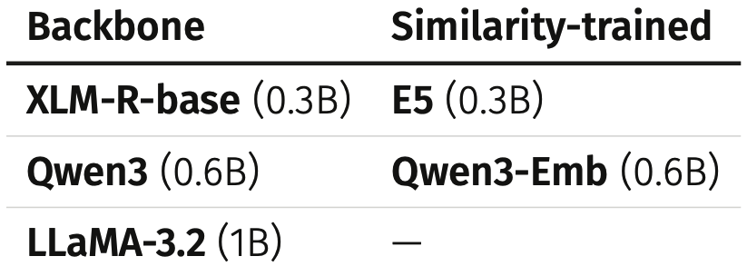
Paper 1 : Experimental settings
Q1 : Evaluation of 5 language models...
  Lightweight, open-source models
  On backbones, we aggregate last layer representations
… accross 7 detection algorithms :
  Distance-based : KNN, Local Outlier Factor (LOF), LUNAR
  Model-based : GMM, AE, OC-SVM
  Isolation Forest recursively partitions the space to find anomalies.
Q2 : 6 Anisotropy mitigation methods :
  Bertflow, Removing dominant directions (2 configurations), whitening, pca-whitening, zca-whitening…
Data :
  Adaptation of the classification datasets from the MTEB benchmark (Muennighoff et al., 2023) to the anomaly detection setting.
    8 Languages : English, French, Spanish, Portuguese, Italian, German, Thai and Hindi.
    4 tasks : Toxicity detection, Sentiment analysis, Intent classification, Topic classification.

Slide 11
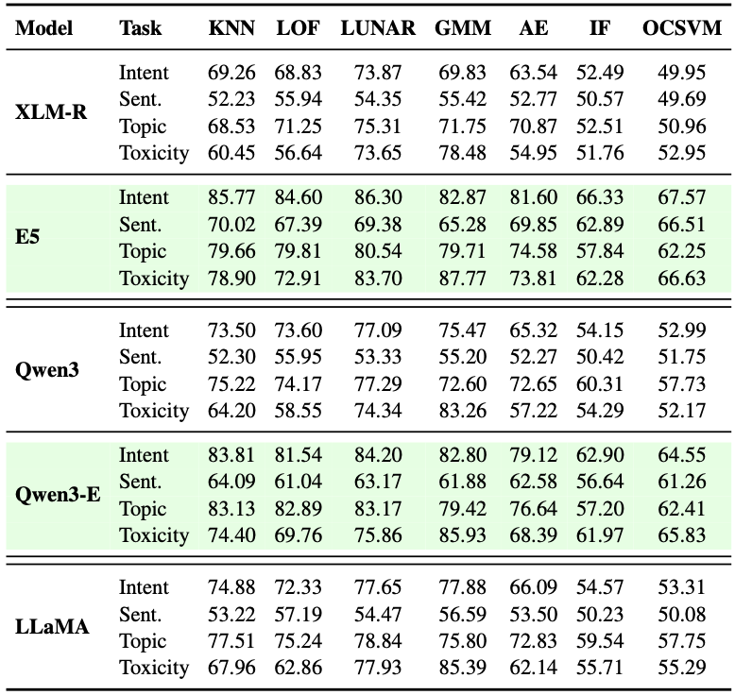
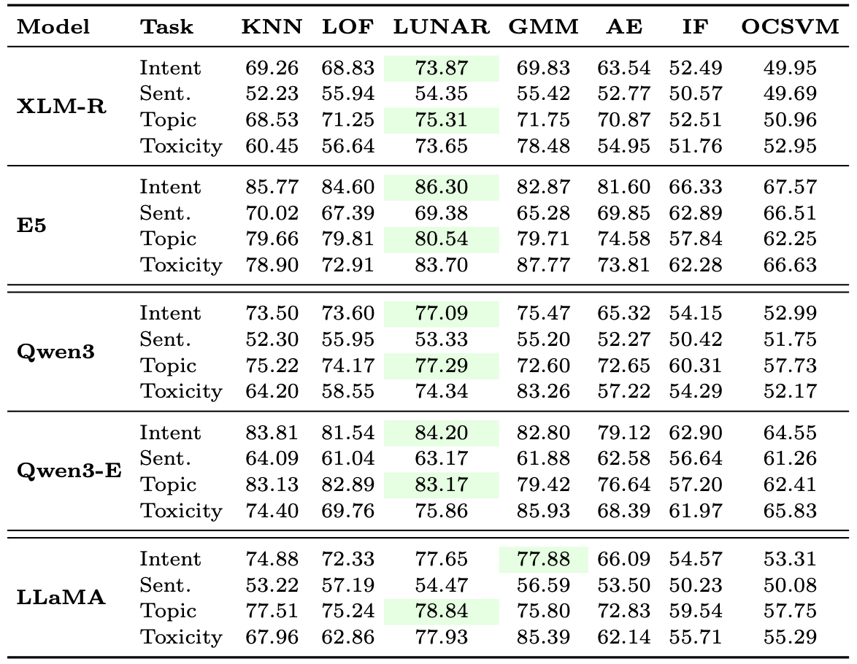
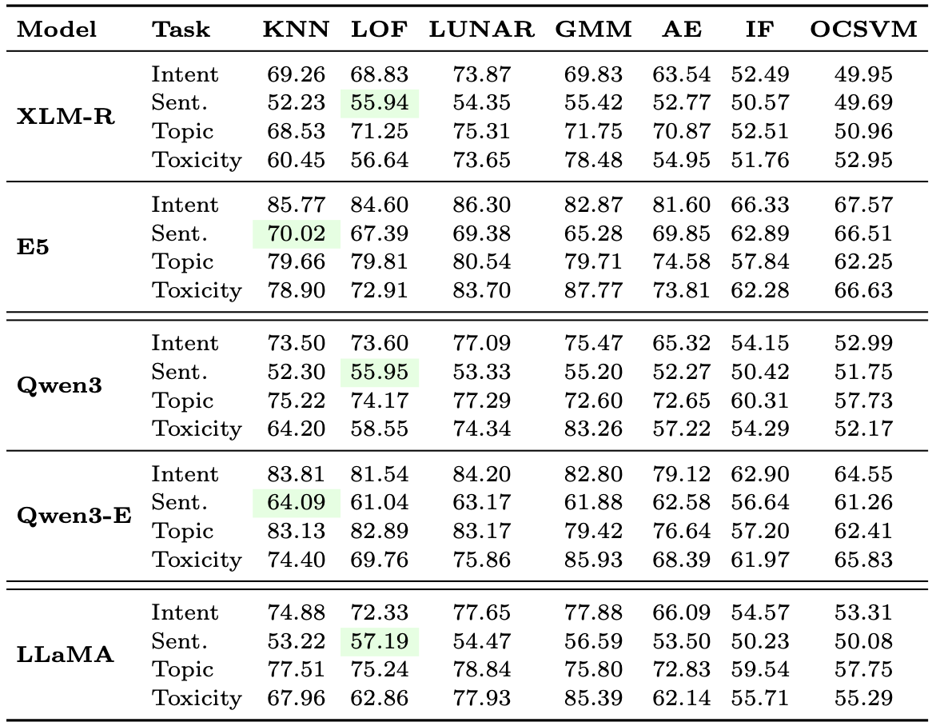
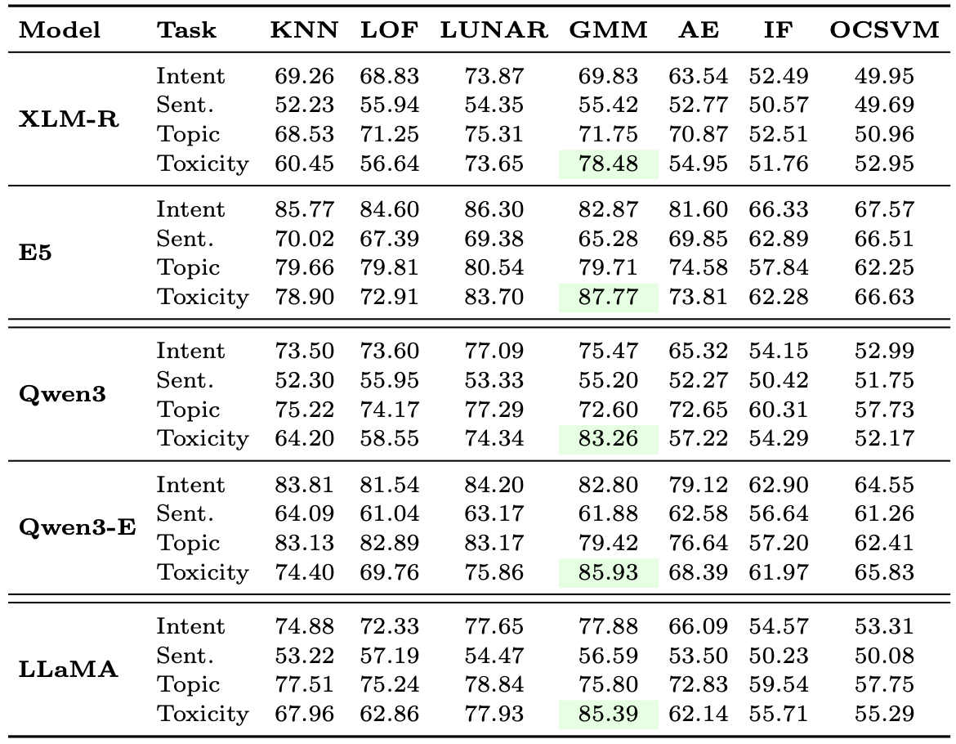
Paper 1 : On similarity-trained encoders
Similarity models perform better :
  Outperform their backbone models.
  E5 at 0.3B beats Llama at 1B.
Still strong disparities :
  LUNAR performs the best on intent and topic for most models.
  GMM on toxicity for all models.
  Sentiment split between KNN and LOF.
  Poor performances of OCSVM, IF and AE.
No single model-detector pair wins across tasks.
Mean AUROC across languages organised by detectors

Slide 12
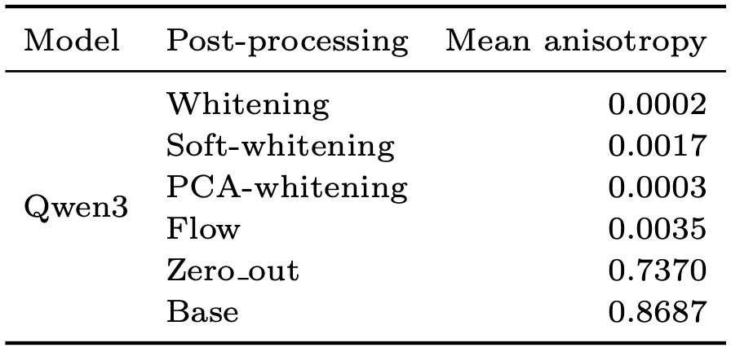
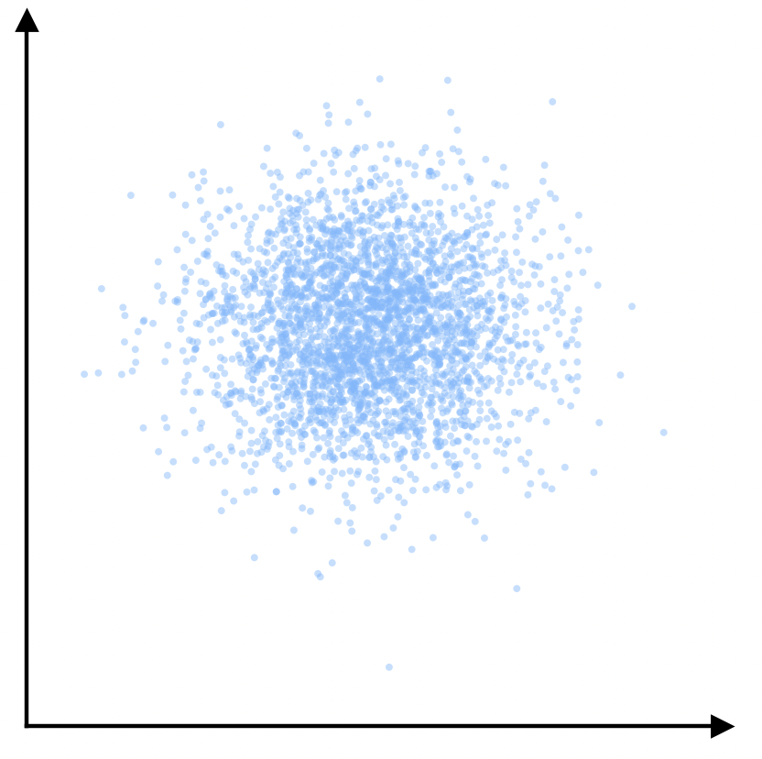
Paper 1 : Anisotropy Mitigation
Evaluation of the main post-processing methods from the literature:
Significant improvements from BertFlow and especially Whitening transformation.
Whitening Transformation: Reduces embedding anisotropy by decorrelating features and enforcing unit variance.
Whitening
Average anisotropy scores by post-processing methods on Qwen3 representations.

Slide 13
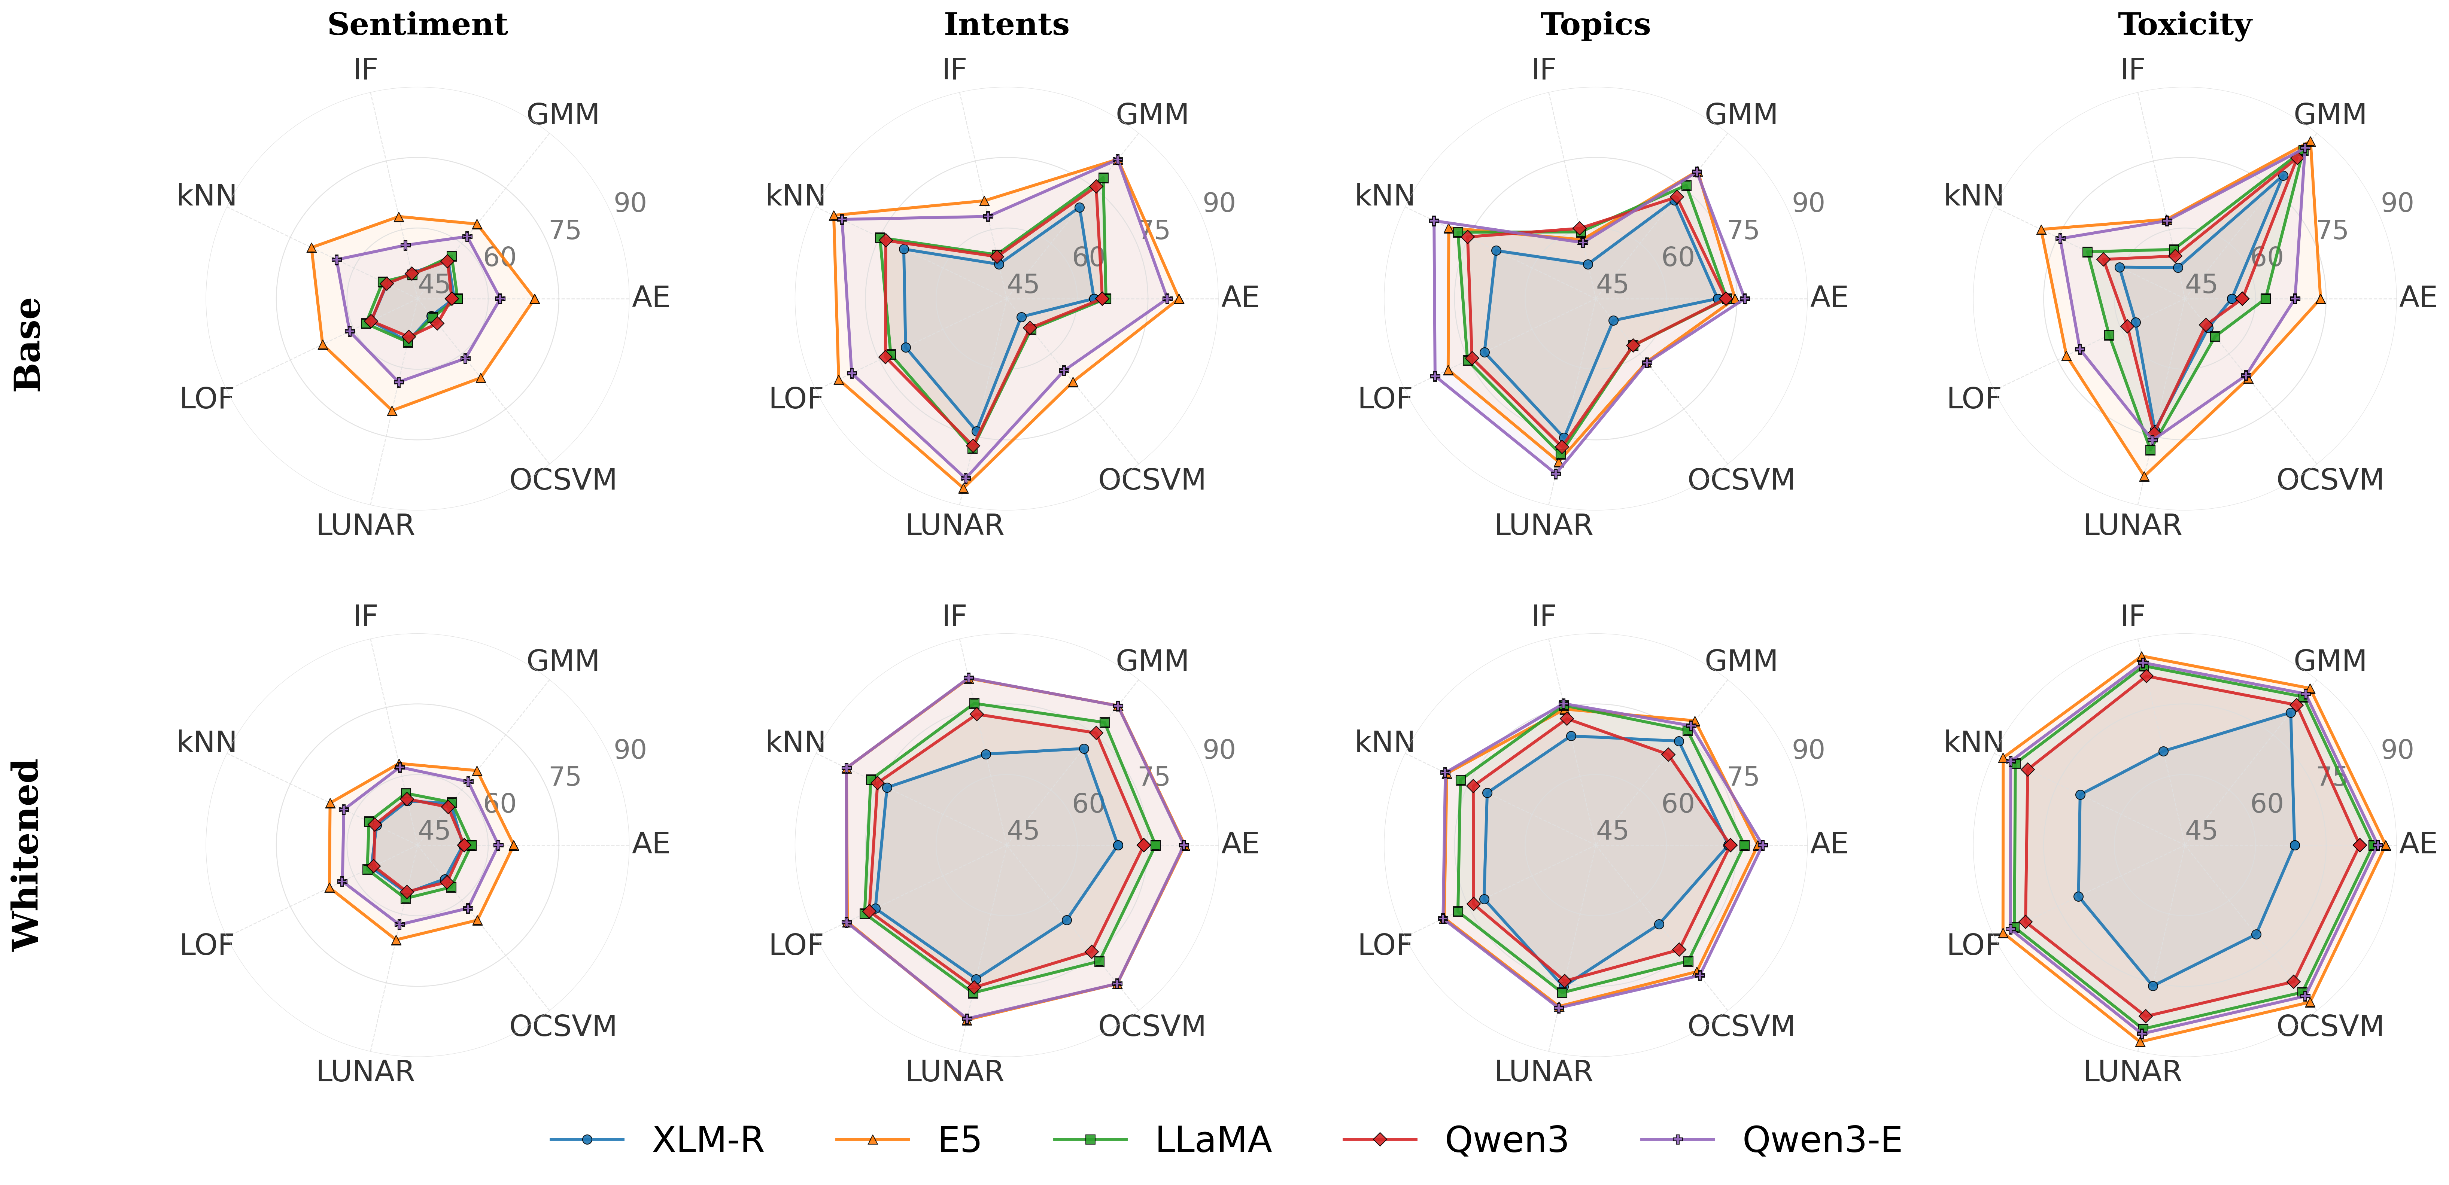
Paper 1 : On whitening
Radar plots showing the AUROC of each embedding model acreoss detection algorithms
Whitening removes the dependance on detector choice :
  Almost perfectly homogeneous performance across detection algorithms.
  IF and OC-SVM see huge performance improvement, LUNAR and GMM are barely affected.
  Enables a more generalizable pipeline by reducing sensitivity to detector choice.

Slide 14
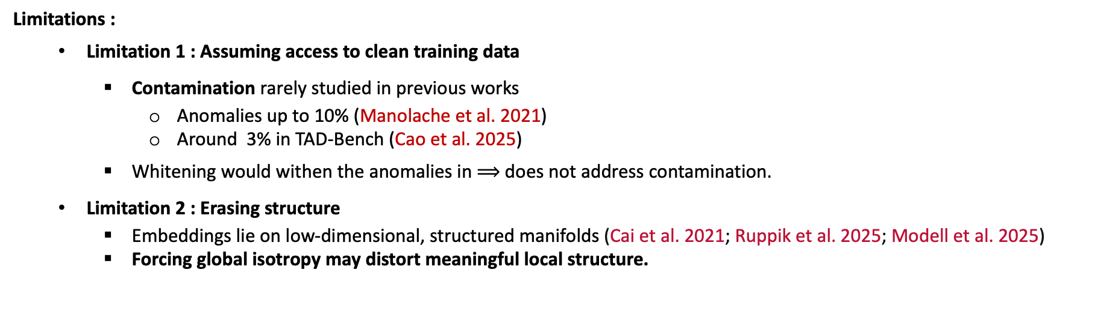
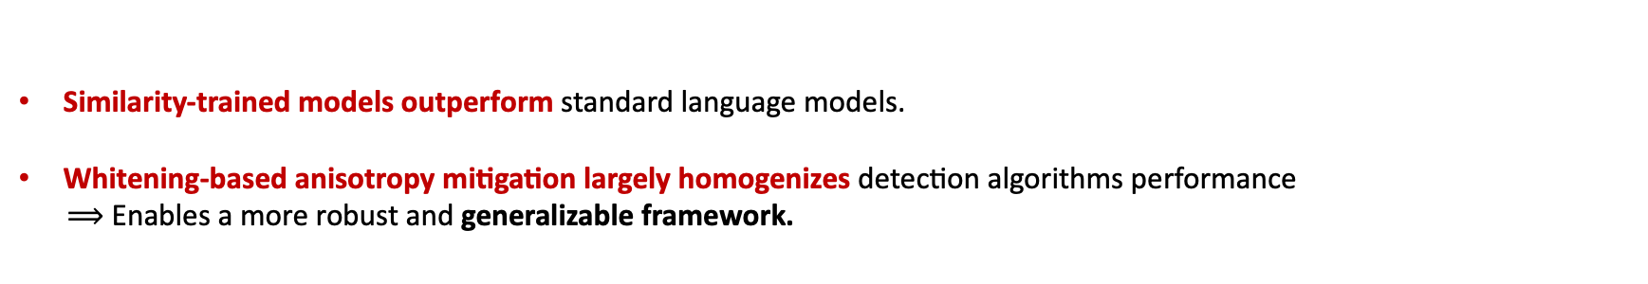
Paper 1 : Conclusion
Similarity-trained models outperform standard language models.
Whitening-based anisotropy mitigation largely homogenizes detection algorithms performance
$⟹$ Enables a more robust and generalizable framework.
Limitations :
  Limitation 1 : Assuming access to clean training data
    Contamination rarely studied in previous works
      Anomalies up to 10% (Manolache et al. 2021)
      Around 3% in TAD-Bench (Cao et al. 2025)
    Whitening would withen the anomalies in $⟹$ does not address contamination.
  Limitation 2 : Erasing structure
    Embeddings lie on low-dimensional, structured manifolds (Cai et al. 2021; Ruppik et al. 2025; Modell et al. 2025)
    Forcing global isotropy may distort meaningful local structure.
How to adress these limitations ? Find a detector able to both :
  Resist contamination.
  Capture the srutucture of these manifolds.

Slide 15
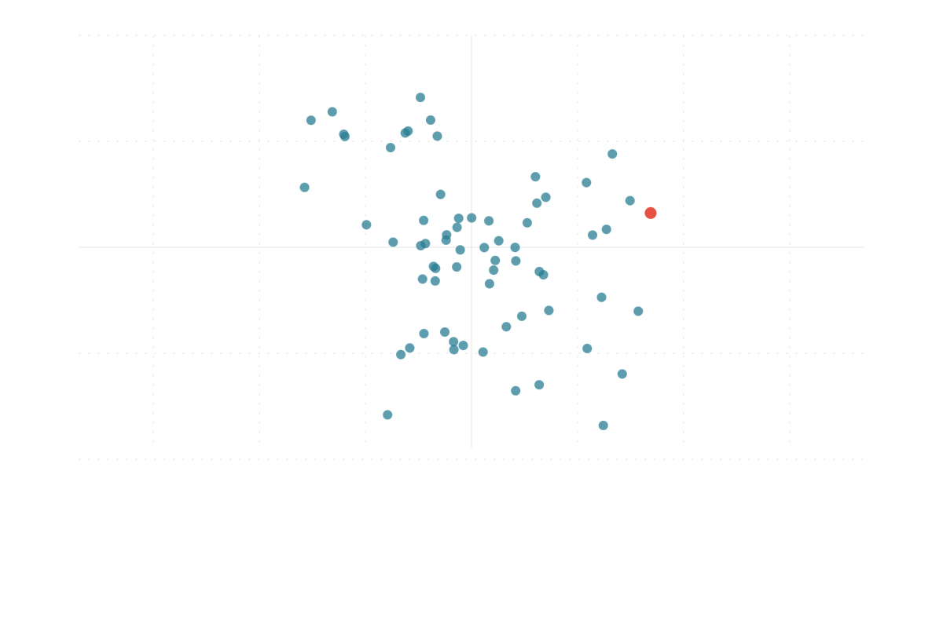
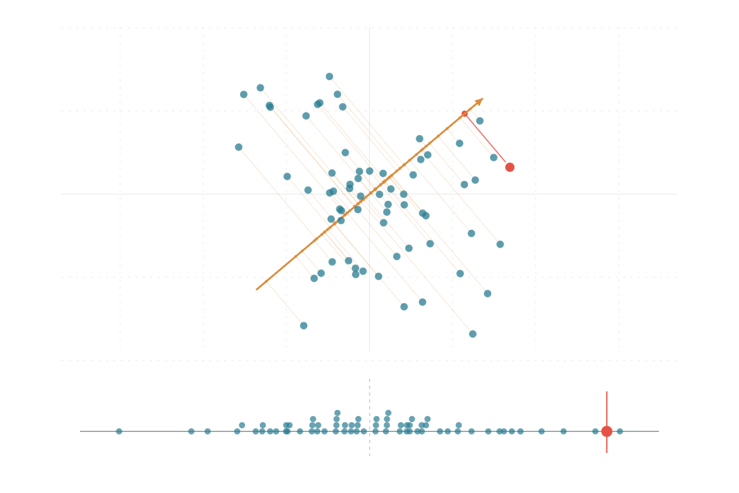
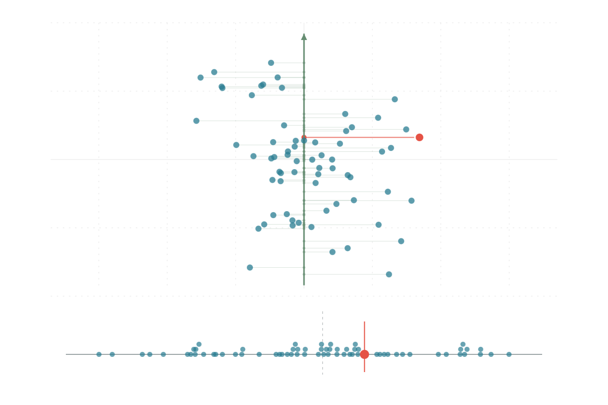
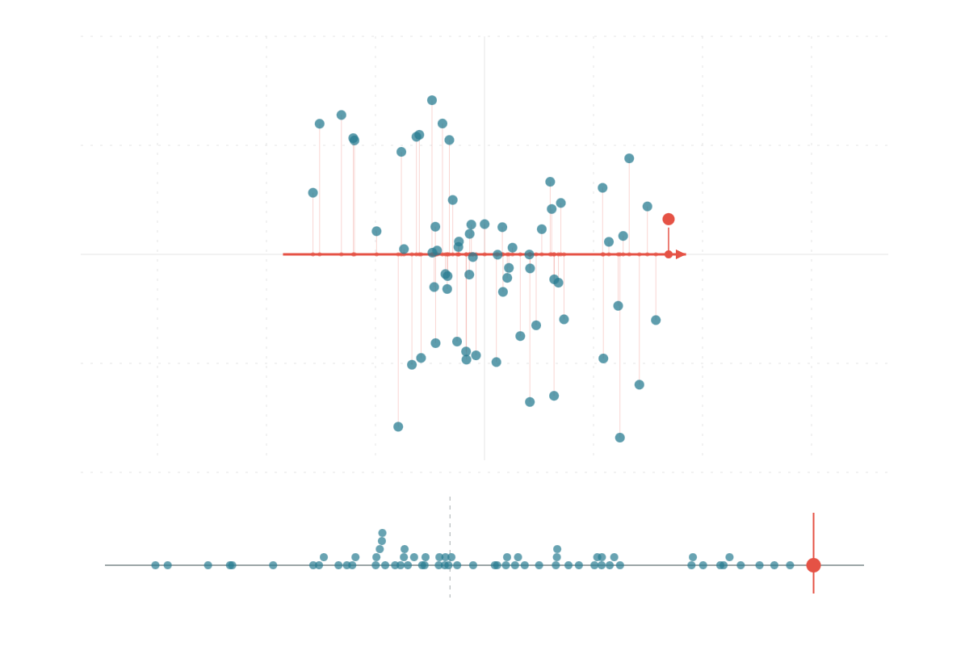
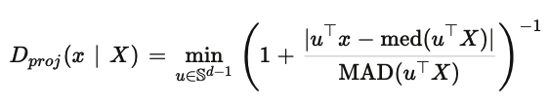
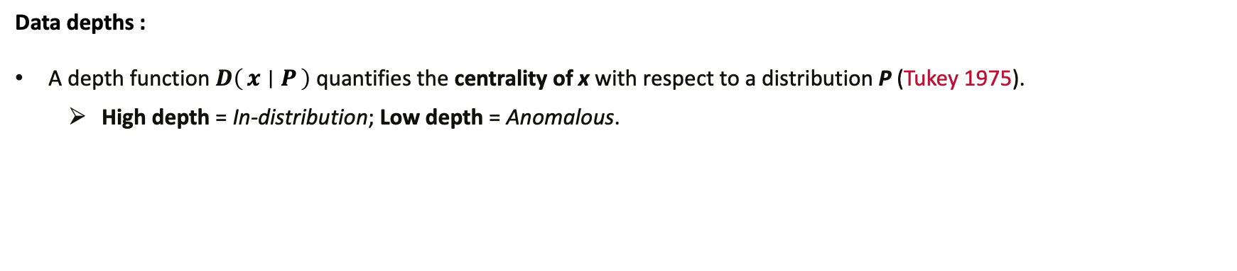
Paper 2 : Data depths
A Geometry-Aware Depth Function for Robust Unsupervised Textual Anomaly Detection (Findings of EMNLP 2026)
Instead of transforming the embedding space, we intervene on the detector.
  We turn to data depths, as functions able to satisfy our contraints.
Data depths :
A depth function $D\left(x ∣ P\right)$ quantifies the centrality of x with respect to a distribution P (Tukey 1975).
  High depth = In-distribution; Low depth = Anomalous.
Example : Projection depth is the worst deviation from the projected median over all directions.

Slide 16
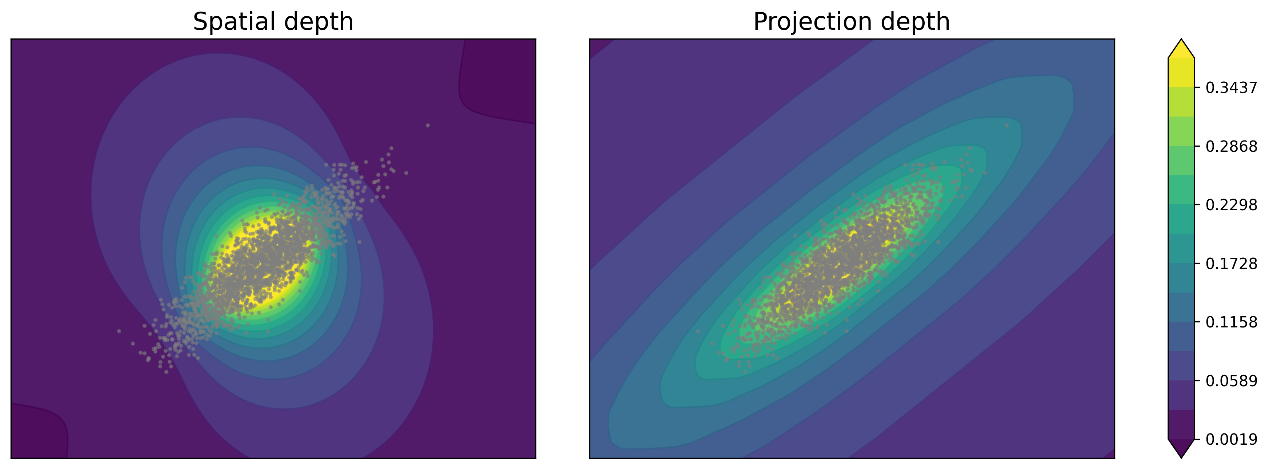
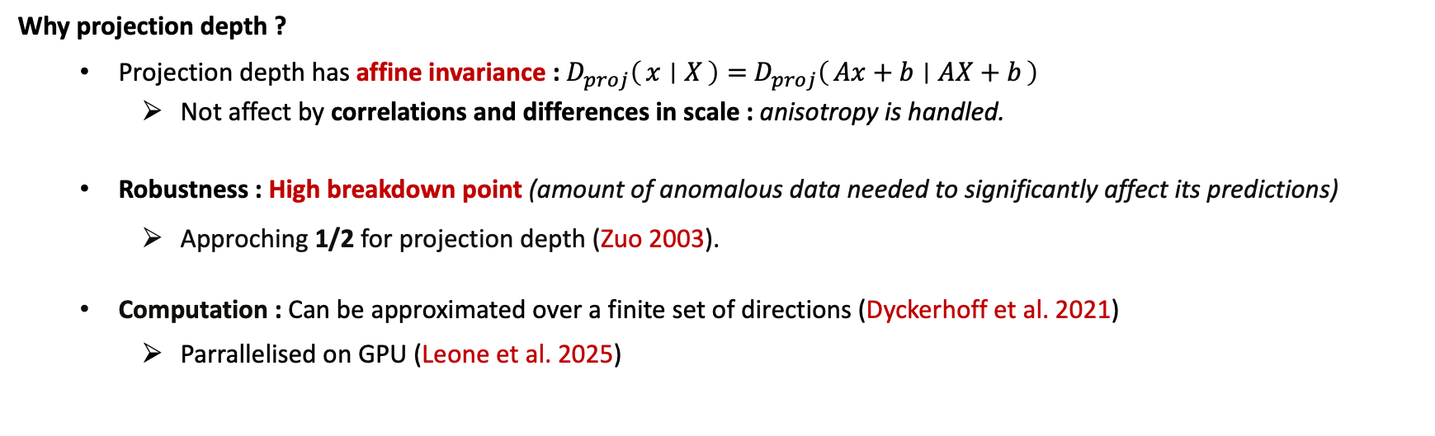
Paper 2 : Depths properties
Why projection depth ?
  Projection depth has affine invariance : $D_{proj}\left(x ∣ X\right)=$ $D_{proj}\left(Ax+b ∣ AX+b\right)$
    Not affect by correlations and differences in scale : anisotropy is handled.
  Robustness : High breakdown point (amount of anomalous data needed to significantly affect its predictions)
    Approching 1/2 for projection depth (Zuo 2003).
  Computation : Can be approximated over a finite set of directions (Dyckerhoff et al. 2021)
    Parrallelised on GPU (Leone et al. 2025)
Spatial vs. Projection depth on a elliptic gaussian distribution

Slide 17

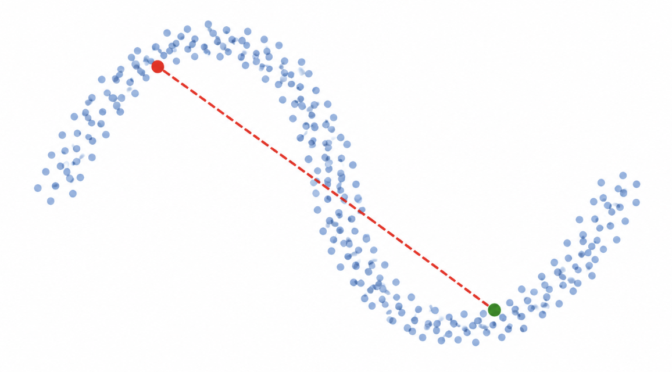
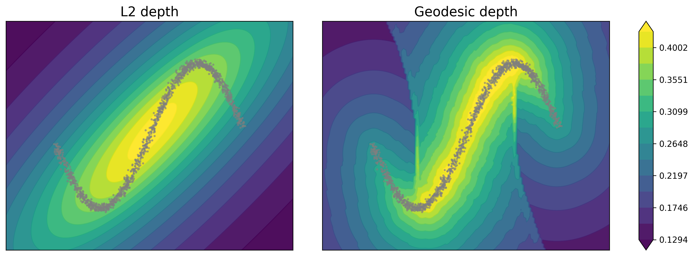
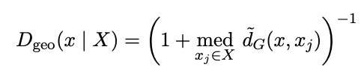
Paper 2 : Geodesic depth
The L2 depth is an expectation-based depth :
  Global distance aggregation provides robustness, unlike instance-based detectors relying on local neighbourhoods.
Limitation : Embeddings lie on low dimensional, structured manifolds.
  Euclidean and cosine distance cannot capture the intrinsic geometry of these manifolds.
Our geodesic depth
We use geodesic distance, approximated by shortest paths on k-NN graph (Tenenbaum et al. 2000)
L2 vs. Geodesic depth on a noisy nonlinear manifold

Slide 18
Paper 2 : Experimental setting
Experiments on :
  4 classification datasets : AGNews, BBCNews, 20NewsGroup, N24News.
    Robustness evaluation: contamination rate varied from 0% to 40%.
  4 language models : 2 similarity-trained (E5, Qwen3-E) ; 2 standard language models (Qwen3, Llama)
Baselines :
  7 detectors of paper 1 (KNN, LOF, LUNAR, AE, IF, OCSVM, GMM)
  + COPOD : Measures extremeness along each dimension using tail probabilities (similar intuition to Projection Depth).

Slide 19
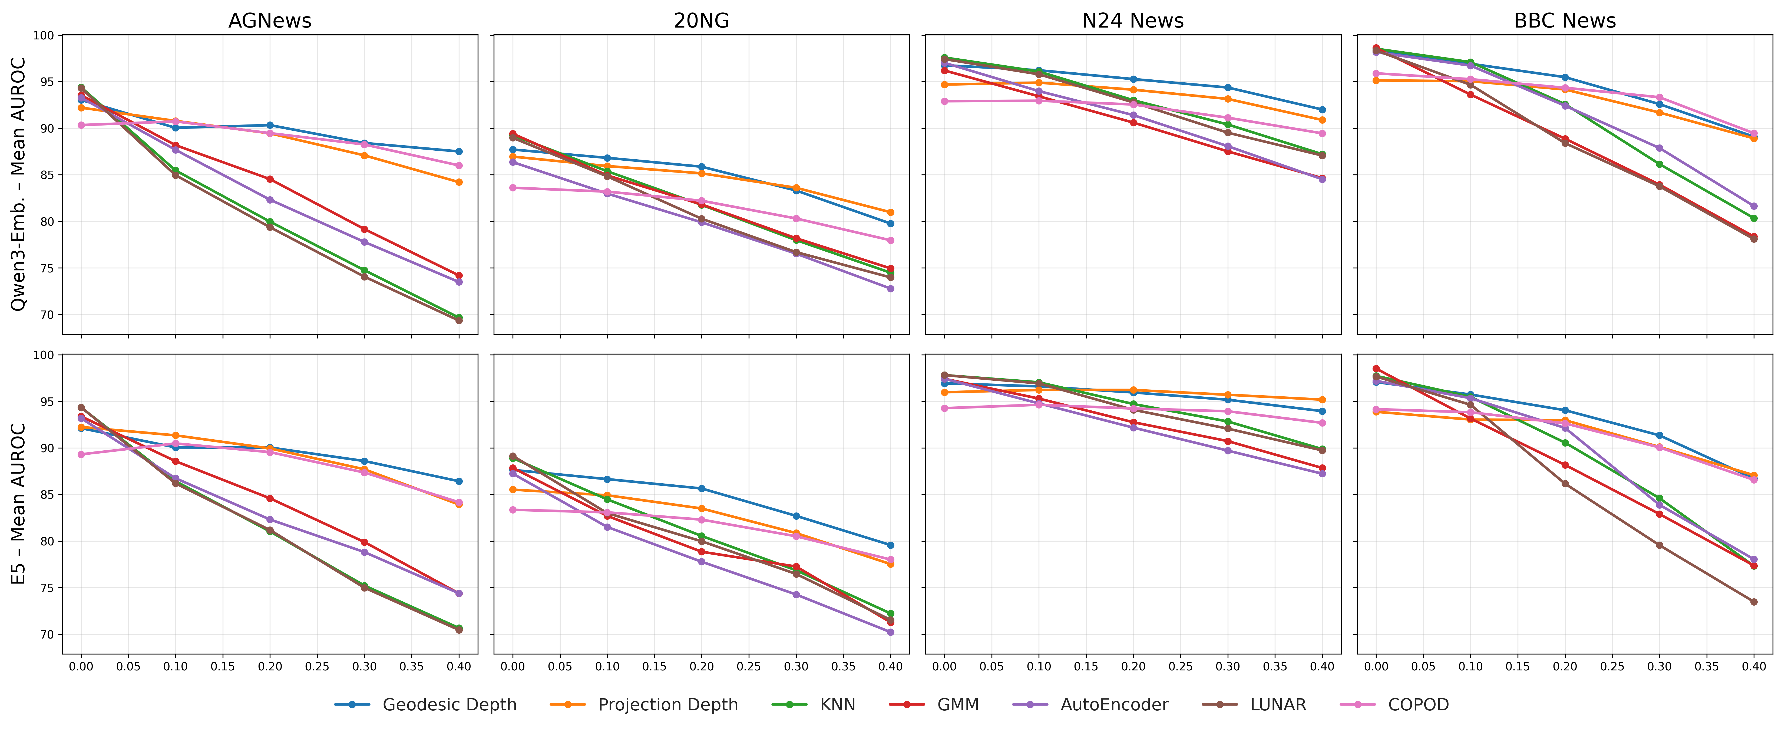
Paper 2 : Robustness to contamination
On similarity-trained embeddings : On perfectly clean data, baselines are best.
  Depths get better when contamination reaches 10%, with the gap widening.
  COPOD (conceptually close to projection depth) holds up.

Slide 20
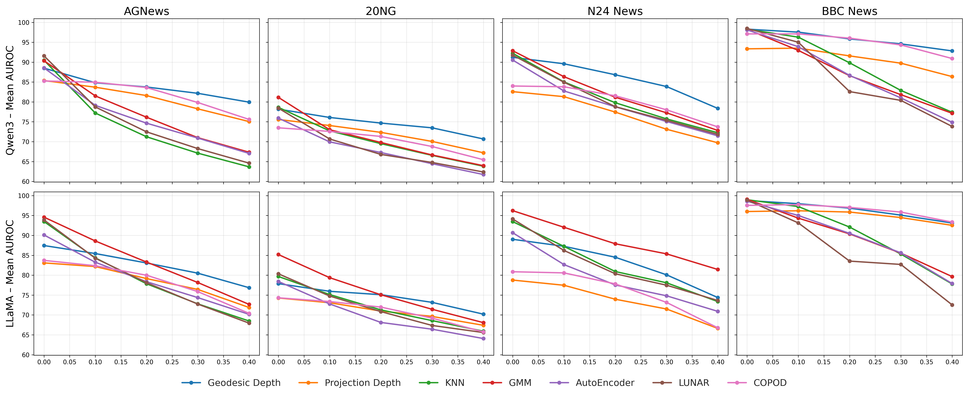
Paper 2 : Robustness to contamination
On LLM embeddings : Projection depth drops significantly, while the geodesic depth remains well adapted.
  Consistent with the manifold analysis: LLM embeddings show higher anisotropy and lower intrinsic dimensionality.
    Geodesic depth better adapts to this low-dimensional, curved structure.

Slide 21
Paper 2 : Conclusion and what’s next
Conclusion :
Depths fit well to the unsupervised (contaminated) setting : affine invariance and robustness.
The geodesic depth adapts to the manifold structure of embedding spaces while holding under severe contamination.
What’s next ?
  Leveraging Textual Anomaly Detection to analyze LLM internal dynamics.
    Considering the trajectory in the hidden space for backdoor detection.
  Improve news summarization by detecting novelties in news corpus.
Thank you !

Slide 22
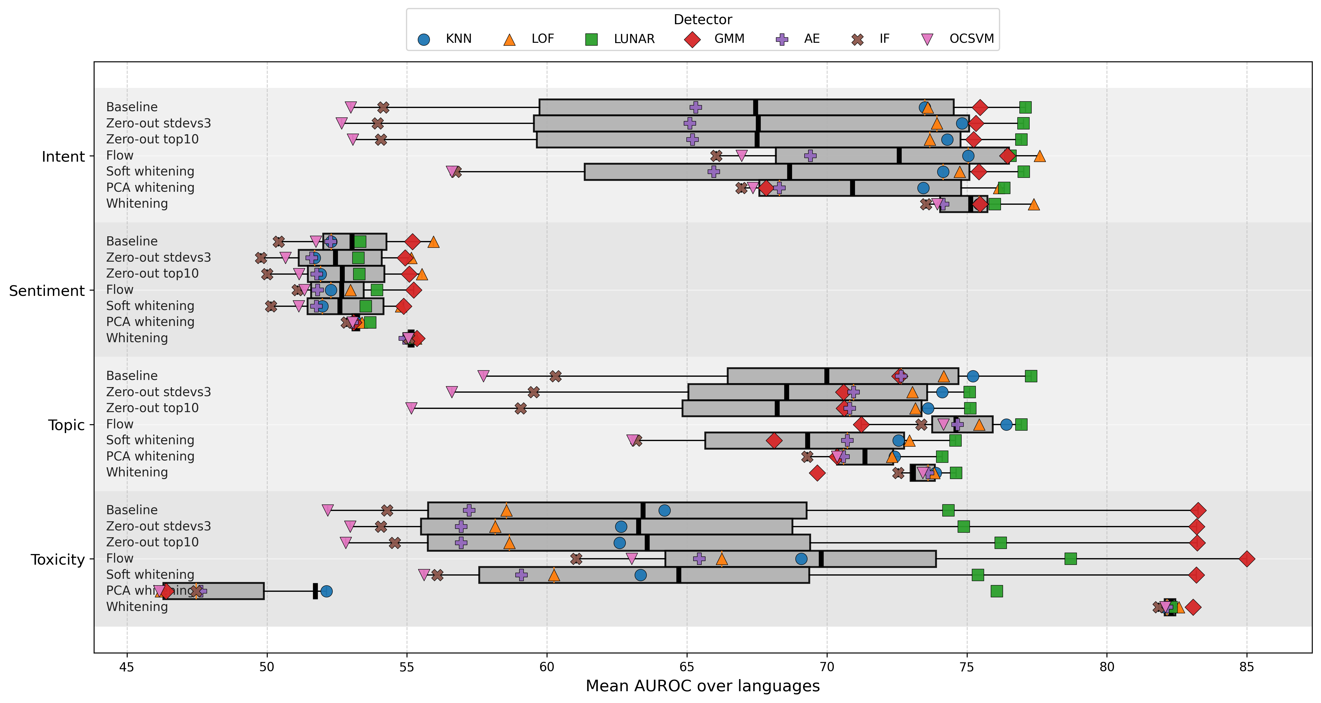
Appendix : On other anisotropy mitigation methods
Boxplots of AUROC performance across post-processing methods applied to Qwen3, aggregating results over detectors and tasks
Whitening clearly gathers together performances.
May reduce the performance of best detector for the domain
  … but this best-performing detector change for each domain !

Slide 23
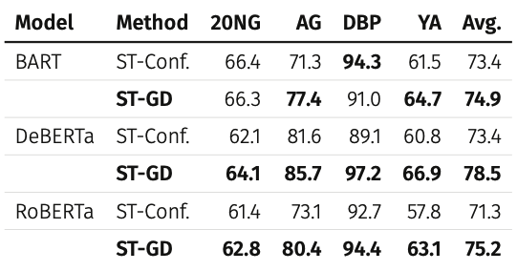
Proof of concept paper 2 : Centrality for pseudo-label selection
Gera et al. (2022) : Zero-shot self-training
  Zero-shot classification : nli model predicts a class for each sample.
  Pseudo-label selection : select the 100 most confident prediction for each class.
  Self-training : Fine-tune the model on the selected pseudo-labeled examples.
Our approach : replace confidence-based selection (step 2) with centrality-based selection.
  We select the 100 samples with the highest geodesic depth as pseudo-labels.
Centrality beats confidence on three models and most datasets.

