Slide 1
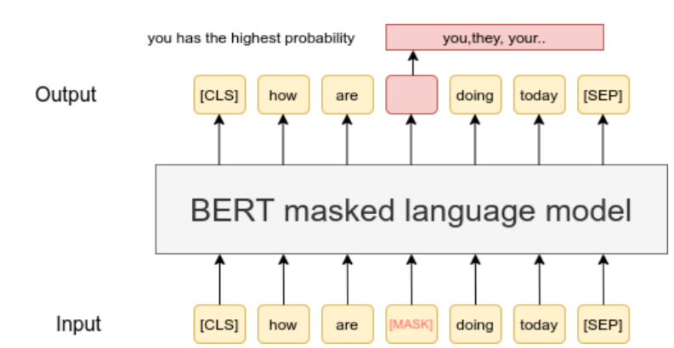
From https://www.sbert.net/examples/unsupervised_learning/MLM/README.html

Slide 2
Truth
Masked input
There
There
is
is
a
a
Candidates
lot
MASK
Lot | Multiplicity | Myriad | Host | …
of
of
possibilities
possibilities
in
in
life
life

Slide 3
There
is
a
Candidates
MASK
Lot | Multiplicity | Myriad | Host | …
True token rank : 1
of
possibilities
in
life

Slide 4
There
There
18
18
is
is
5
5
a
a
3
3
lot
sea
1
1000
of
of
2
2
possibilities
possibilities
8
8
in
in
5
5
life
life
9
9

Slide 5
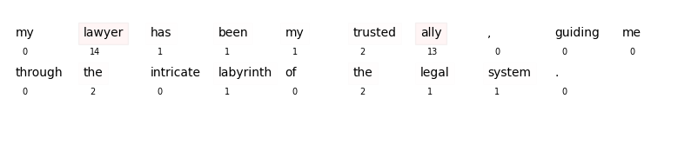
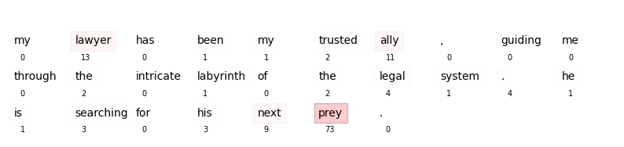
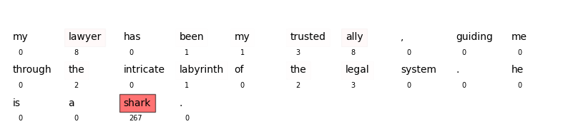
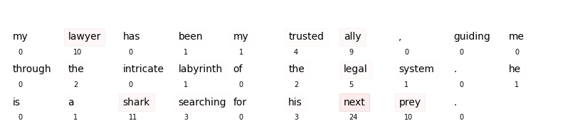
Baseline (no surprise)
Example 1 : surprise
Huge semantic gap on one word
Example 2 : no surprise
Extended metaphor

