Slide 1

ESILV - Python for data analysis - devoir 2021
Last and first names: koye jean-david alexandre
centa pierre

Slide 2
Table of contents
Dataset Overview
Machine learning
API Transformation
Conclusion and Discussion

Slide 3
Dataset Overview
The first step was to download and open our dataset. The dataset was not neat and needed some arrangement before we could start using it. All the features were in one cell (instead of being in a single column)for each row and the target variable wasn’t well defined.
As you can see among the files submitted, we have the original one and the final dataset that was ready to be explored.
Our dataset is about block classification. We got 5473 observations for 11 attributes. It’s defined by measurements such as the length or the area. All our attributes are numerical (integers and continuous)
We also have no missing values. The target variable has 5 distinct classes numerated from 1 to 5.

Slide 4
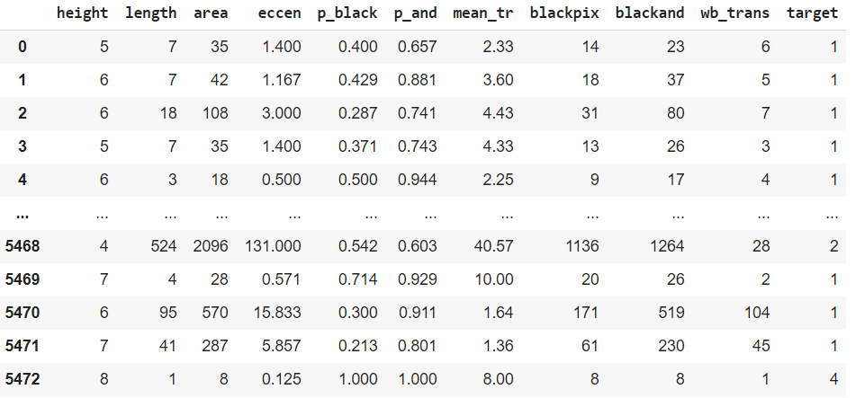
Dataset Overview
We first checked the data distribution insight for the target variable.
The target variable contains 5 distinct observations with the 1st one that is over 90% of the total distribution,
We did some data visualization in order to check attributes correlations. This helped us to know the attributes that have an impact on the target variable. It also help to see the variable that are not important In our dataset. The correlation heatmap is a best way to visualize it. It gives us a full overview of all the attributes relationships.
The heatmap gives us information such as : the highest correlation is blackand and blackpix (0.96) => In other words, the total number of black pixels in the original bitmap of the block and after the RLSA are highly related
the height is the most important factor to determine the target.

Slide 5
Machine learning
We have 10 features and a target representing classes. The problem is therefore a classification problem with more than 2 classes.
As we have a target with some discrete values only, we conclude that we are facing a supervised classification problem. So, we can try three different types of machine learning methods:
-Logistic Regression but we are not in a binary case, so it does not seem appropriate
-Discriminant Analysis as we have gaussian-like distributions
-Classification tree and improving methods
We can also try unsupervised classification models, such as knn which is a clustering algorithm.

Slide 6
Machine learning
To apply the machine learning algorithms, we need to split and train the dataset. The main rule is the 70% train 30% test . We drop the target variable then train the whole dataset and test the results with the test split.
We performed grid searches In order to find the best values of hyper parameters to tune each model. The grid searches were done with 10 fold cross validations, to ensure the results were not biaised by the choice of the training set
First we applied Linear and Quadratic Discriminant Analysis. For this first cases it seems tuning hyper parameters didn’t have a significant impact on the results.
The same interpretation was noticed for the quadratic discriminant analysis.

Slide 7
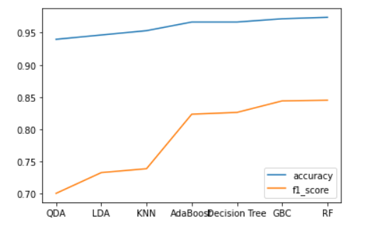
Machine learning
As for the K nearest Neighbours, the hyper parameters variation was meaningful.
We saw a better performance for k for f1 and accuracy seems to be k=1
We added some other types of classification algorithms such as Decision tree, and boosting methods based on trees such as Adaboost or Gradientboost. We also tried a random forest model.
The main objective was to find between all the models, the one having the best accuracy and the best f1 (recording the precision/recall tradeoff)
Based on that we found RandomForest Classifier seemed to be the best fitting one

Slide 8
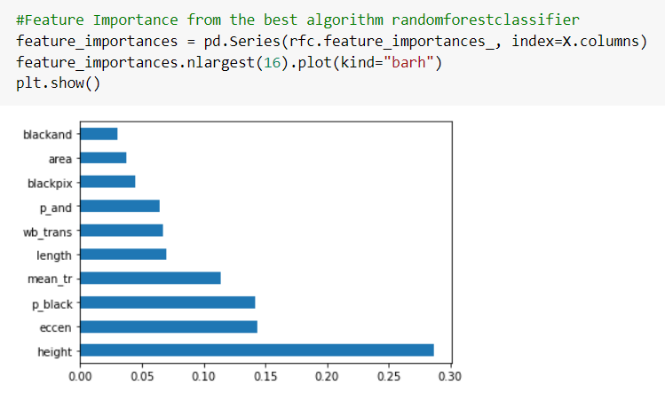
Machine learning
After checking the algorithms performance, we did some feature importance based on the best algorithm. It reveals that the most important feature to the target variable were height, mean_tr and eccen.
That means they have the highest relationship with the target variable.

Slide 9
API Transformation
We chose Flask over Django for our API transformation
Both frameworks are suitable for rapid development of web apps, although Django is considered to have the steeper learning curve. Flask provides the most flexibility in terms of customisation, however Django has a larger existing community of users and so offers more support.
Flask is a tool for learning web development fundamentals and best practices along with the core pieces of a web framework that are common to almost all frameworks. Flask is lighter and much more explicit than Django.

Slide 10
API transformation
To transform the model into an API ,we create 2 html files. The first is the home.html. That enables us to input the values for each attribute.
We then enter those values and click on predict. That now tells us the output of our prediction.
The 2nd file is called after.html and deals with what we just said above. It returns the output of the prediction according to our input.
we also get 3 python files. One that request the api and the 2 others that get the attribute values and allocate them to a single instance.
The

Slide 11
Conclusion and Discussion
According to our results we can conclude that we fulfilled the tasks. The data visualization was basically about showing the data distribution. Due to the fact that we only have numerical data we couldn’t give a lot of insights.
Through machine learning we got the best algorithm we found : random forest tuned by gridsearch. From it we made some feature importance simulation and got the best features to consider.
The API transformation was made by using html and Flask.
The most difficult challenge among all was to implement the API.

