Slide 1
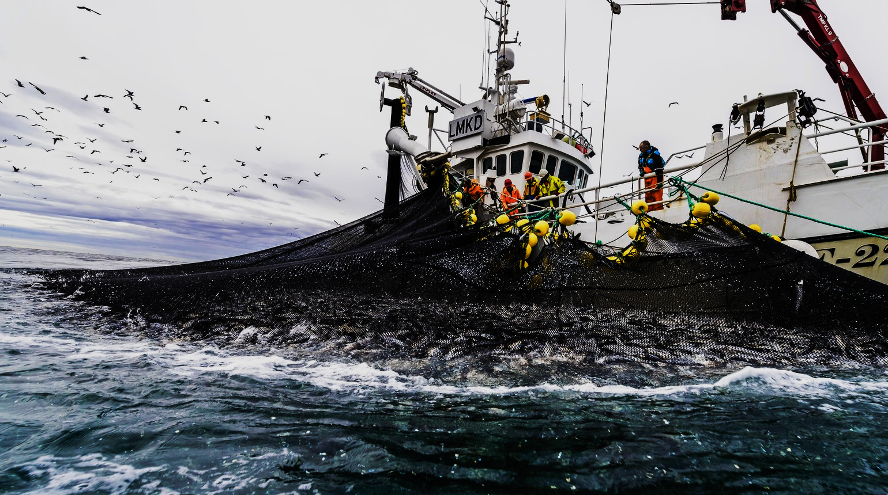

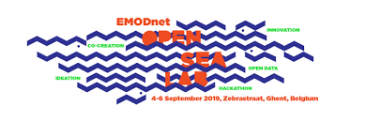
Where not to fish?
A dynamic mapping of sensitive and polluted fishing areas
PyFish team: Edward Clark, Thomas Gardner, Everardo González Ávalos, Evgeny Ivanov and Pierrot Van der Aa

Slide 2
Title

Slide 3
Title

Slide 4
Title

Slide 5
Title

Slide 6
Title

Slide 7
Thank you for your attention
PyFish team: Edward Clark, Thomas Gardner, Everardo González Ávalos, Evgeny Ivanov and Pierrot Van der Aa

