Slide 1

P06 - Production Scheduling Optimization: project status
CSD COURSE · UNICAM MASTER'S DEGREE
Milestone M0 · 06 November
P1
AI and data
Leonardo Pierucci
P2
Backend and DB
Alessio Brutti
P3
Frontend
Mattia Brizi
Supervisor Prof. Flavio Corradini
Notes:
Good morning everyone. We are the team of project P06, AI Scheduling, for the CSD course of the UNICAM Master's degree.
Today is 6 November 2026 and this presentation coincides with Milestone 0, the validation with the professor. So the goal is to show you where the project stands, the architectural choices we have made, and to collect your feedback on a few open points.
The team has three people. P1 works on AI and data, P2 on backend and database, P3 on the frontend.
We have about ten minutes: first the project and the plan, then architecture, domains and datasets, and finally the API contracts.

Slide 2
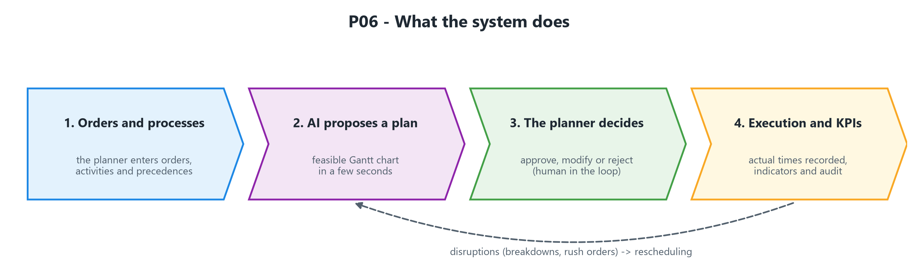
AI proposes the plan, the planner decides
Section 1 · The project
The problem
Assign tasks to resources over time, respecting precedences, capacity and calendars.
Valid across domains
Domain profiles adapt the model to factory, public administration and projects.
Always a feasible plan
If the AI fails, fallback algorithms take over.
P06 · AI Scheduling ·
Milestone M0 · 6 Nov 2026 ·
Supervisor Prof. Flavio Corradini
2
Notes:
Let's start with what the system does.
Our solution is a web application. The planner enters orders and processes, the AI proposes a plan, that is a Gantt chart, in a few seconds, and a person approves, edits or rejects it. This is the "human in the loop" approach: the AI proposes, but the decision stays with the human.
Besides orders and processes, the planner enters resource calendars – maintenance windows and staff leave – directly in the Gantt view, and can lock activities before rescheduling. In a later step, orders can also be described in natural language.
If something goes wrong during execution, for example a breakdown or an urgent order, we reschedule: that is the dashed loop at the bottom of the diagram.
The problem is a classic one: assign tasks to resources (machines, people, rooms) over time, respecting precedences, capacity, calendars and skills, while trying to reduce delays, makespan and setup times.
The system is generic with respect to the domain thanks to "domain profiles": factory, public administration, projects. What changes are the active constraints and the objective weights, not the model.
Finally, the plan is always feasible and always available: if the AI fails or is not confident enough, fallback algorithms take over.

Slide 3
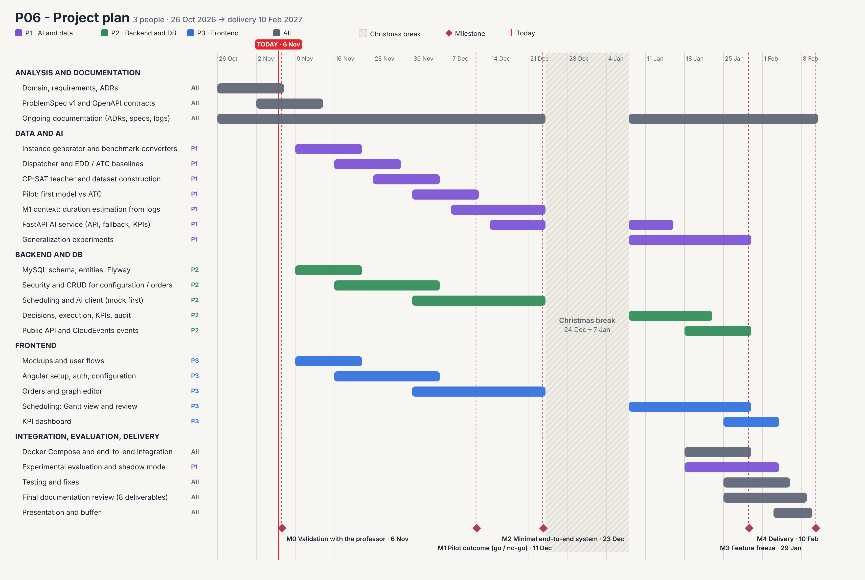
Three parallel lanes, delivery on 10 Feb 2027
Section 2 · Gantt and current status
Three parallel lanes
from 9 Nov: P1 AI and data, P2 backend and DB, P3 frontend
Christmas break
24 Dec to 7 Jan, no tasks scheduled
Milestone 1 on 11 Dec
pilot outcome (go / no-go), 12 days before the minimal end-to-end system (Milestone 2, 23 Dec)
P06 · AI Scheduling · Milestone M0 · 6 Nov 2026 · Supervisor Prof. Flavio Corradini
3
Notes:
This is the project plan, from 26 October 2026 to 10 February 2027, in five macro-phases.
Analysis and documentation, 26 October to 13 November, involves everyone: domain, requirements and ADRs until 6 November, then ProblemSpec v1 and the OpenAPI contracts from 2 to 13 November.
Then three parallel lanes start on 9 November. Data and AI, P1, until 29 January: instance generator and benchmark converters, dispatcher and EDD/ATC baselines, CP-SAT teacher and dataset, pilot of the first model against ATC, M1 duration estimation, FastAPI service, generalization experiments.
Backend and DB, P2, until 29 January: MySQL schema and Flyway, security and CRUD, scheduling and AI client, first with a mock, then decisions, execution, KPIs and audit, and the public API.
Frontend, P3, until 3 February: mockups and flows, React setup, auth and configuration, orders and graph editor, Gantt and review, KPI dashboard.
The last phase, from 18 January to 9 February, is integration, evaluation and delivery: end-to-end Docker Compose, experimental evaluation and shadow mode, tests, final documentation with the 8 deliverables, and the presentation.
There is a Christmas break between 19 December and 10 January with no activity.
The milestones are the diamonds: Milestone 0 on 6 November, today; Milestone 1 on 11 December, the pilot outcome with a go/no-go; Milestone 2 on 23 December, minimal end-to-end system; Milestone 3 on 29 January, feature freeze; Milestone 4 on 10 February, delivery.

Slide 4
Analysis is closing, the three lanes start on 9 Nov
Section 2 · Gantt and current status
Today, 6 Nov
Analysis and documentation
26 Oct – 13 Nov
documentation then continues until delivery (10 Feb)
Development in 3 lanes
9 Nov – 3 Feb
Integration and delivery
18 Jan – 10 Feb
Done
Domain analysis
Architecture and Gantt
Dataset catalogue and draft API contracts
In progress
ProblemSpec v1 and final OpenAPI, by 13 Nov
From 9 Nov
Instance generator (P1)
DB schema (P2)
Frontend mockups (P3)
P06 · AI Scheduling · Milestone M0 · 6 Nov 2026 · Supervisor Prof. Flavio Corradini
4
Notes:
Where we are today. At the top is the progress bar: we are in the Analysis and documentation phase, which closes on 13 November.
What we have done: the domain analysis, the architecture diagram in UML components, the research and catalogue of datasets with their licenses, the Gantt, now at version 4 and aligned with the architecture, and a draft of the API contracts and of the ProblemSpec.
In progress: ProblemSpec v1 and the final OpenAPI specs, which we close by 13 November.
From 9 November the three streams start in parallel: the instance generator for P1, the database schema for P2 and the frontend mockups for P3.
We can work in parallel because the API contract, the ProblemSpec, decouples frontend, backend and AI. The backend will use a mock of the AI until Milestone 2, when we will have the minimal end-to-end system.
The main risk is the pilot on 11 December: it decides whether the AI model beats the ATC rule. If it does not, we have a plan B based on dispatching rules and CP-SAT.

Slide 5
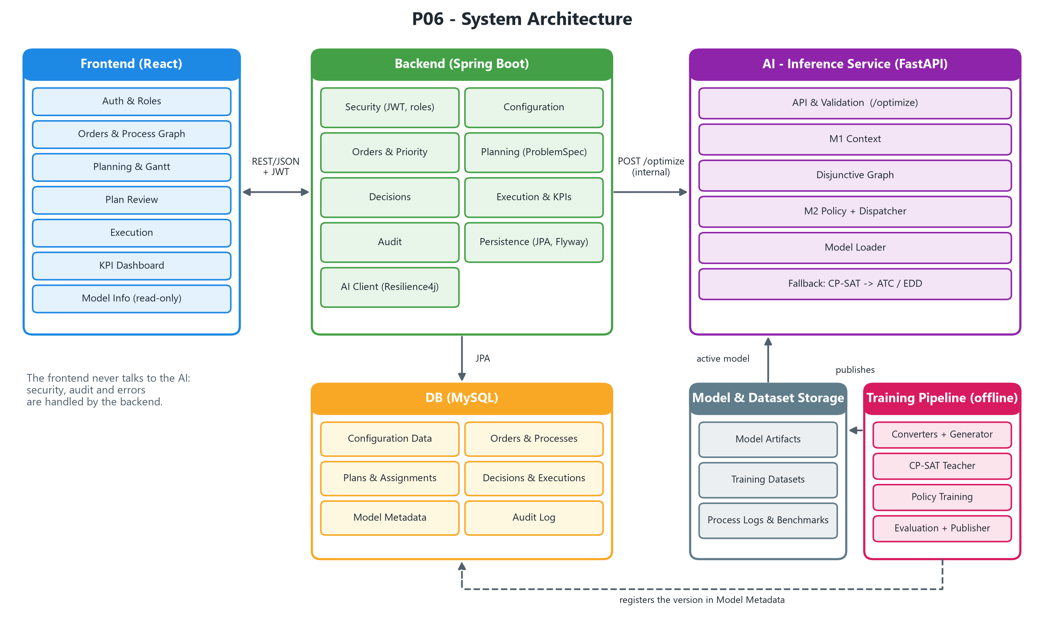
Four blocks, each with its own technology
Section 3 · Architectural choices
Technology by role
Python for ML and OR-Tools, Java and Spring for security and data, React for the interface
The frontend never talks to the AI
Authentication, permissions, audit and errors stay in the backend
Offline training, online inference
Training takes hours, inference answers in seconds
P06 · AI Scheduling · Milestone M0 · 6 Nov 2026 · Supervisor Prof. Flavio Corradini
5
Notes:
The architecture has four blocks. The React frontend talks to the Spring Boot backend over REST/JSON with JWT. The backend talks to the AI Inference Service, written in Python with FastAPI, through an internal REST call, /optimize. The backend also reads and writes the MySQL database through JPA.
Separately, the AI Training Pipeline runs offline: it produces models and datasets that go into the Model and Dataset Storage, and it registers the versions in the database.
Why this choice? First, each block has its own technology and responsibility: Python for machine learning and OR-Tools, Java and Spring for security and persistence, React for the interface.
Second, the frontend never talks to the AI. Authentication, permissions, audit and error handling live in one single place, the backend.
Third, offline training is separated from online inference: training takes hours, inference has to answer in a few seconds.

Slide 6
The backend isolates the AI and traces every decision
Section 3 · Architectural choices
Backend modules (Spring Boot)
Security (JWT, roles)
Configuration
Orders & Priority
Planning
Decisions
Execution & KPI
Audit
AI Client
Complete ProblemSpec
Planning builds a complete JSON: the AI does not know the database.
Resilient AI Client
Resilience4j with timeout, retry and circuit breaker: a slow AI does not block the backend.
Audit and shadow mode
Every plan is reproducible; the AI plan runs in parallel without being applied.
P06 · AI Scheduling · Milestone M0 · 6 Nov 2026 · Supervisor Prof. Flavio Corradini
6
Notes:
The backend is organized in modules: Security, with JWT and the roles planner, operator and admin; Configuration; Orders and Priority; Planning; Decisions; Execution and KPI; Audit; and the AI Client.
Planning builds a ProblemSpec, a self-contained JSON. The AI does not know the database: it receives everything it needs in the request.
The AI Client uses Resilience4j, with timeout, retry and circuit breaker, so a slow AI cannot block the backend.
Audit is mandatory: input, model version, output and the human decision are all traced, so every plan can be reproduced. This matters especially for public administration.
We use MySQL with Flyway. Plans and KPIs are stored as JSON because they vary between domains.
Finally, shadow mode: the AI plan is computed in parallel to the real one without being applied, so we can measure the benefit without any risk.
Staff leave is personal data: reasons are visible only to authorized roles.

Slide 7
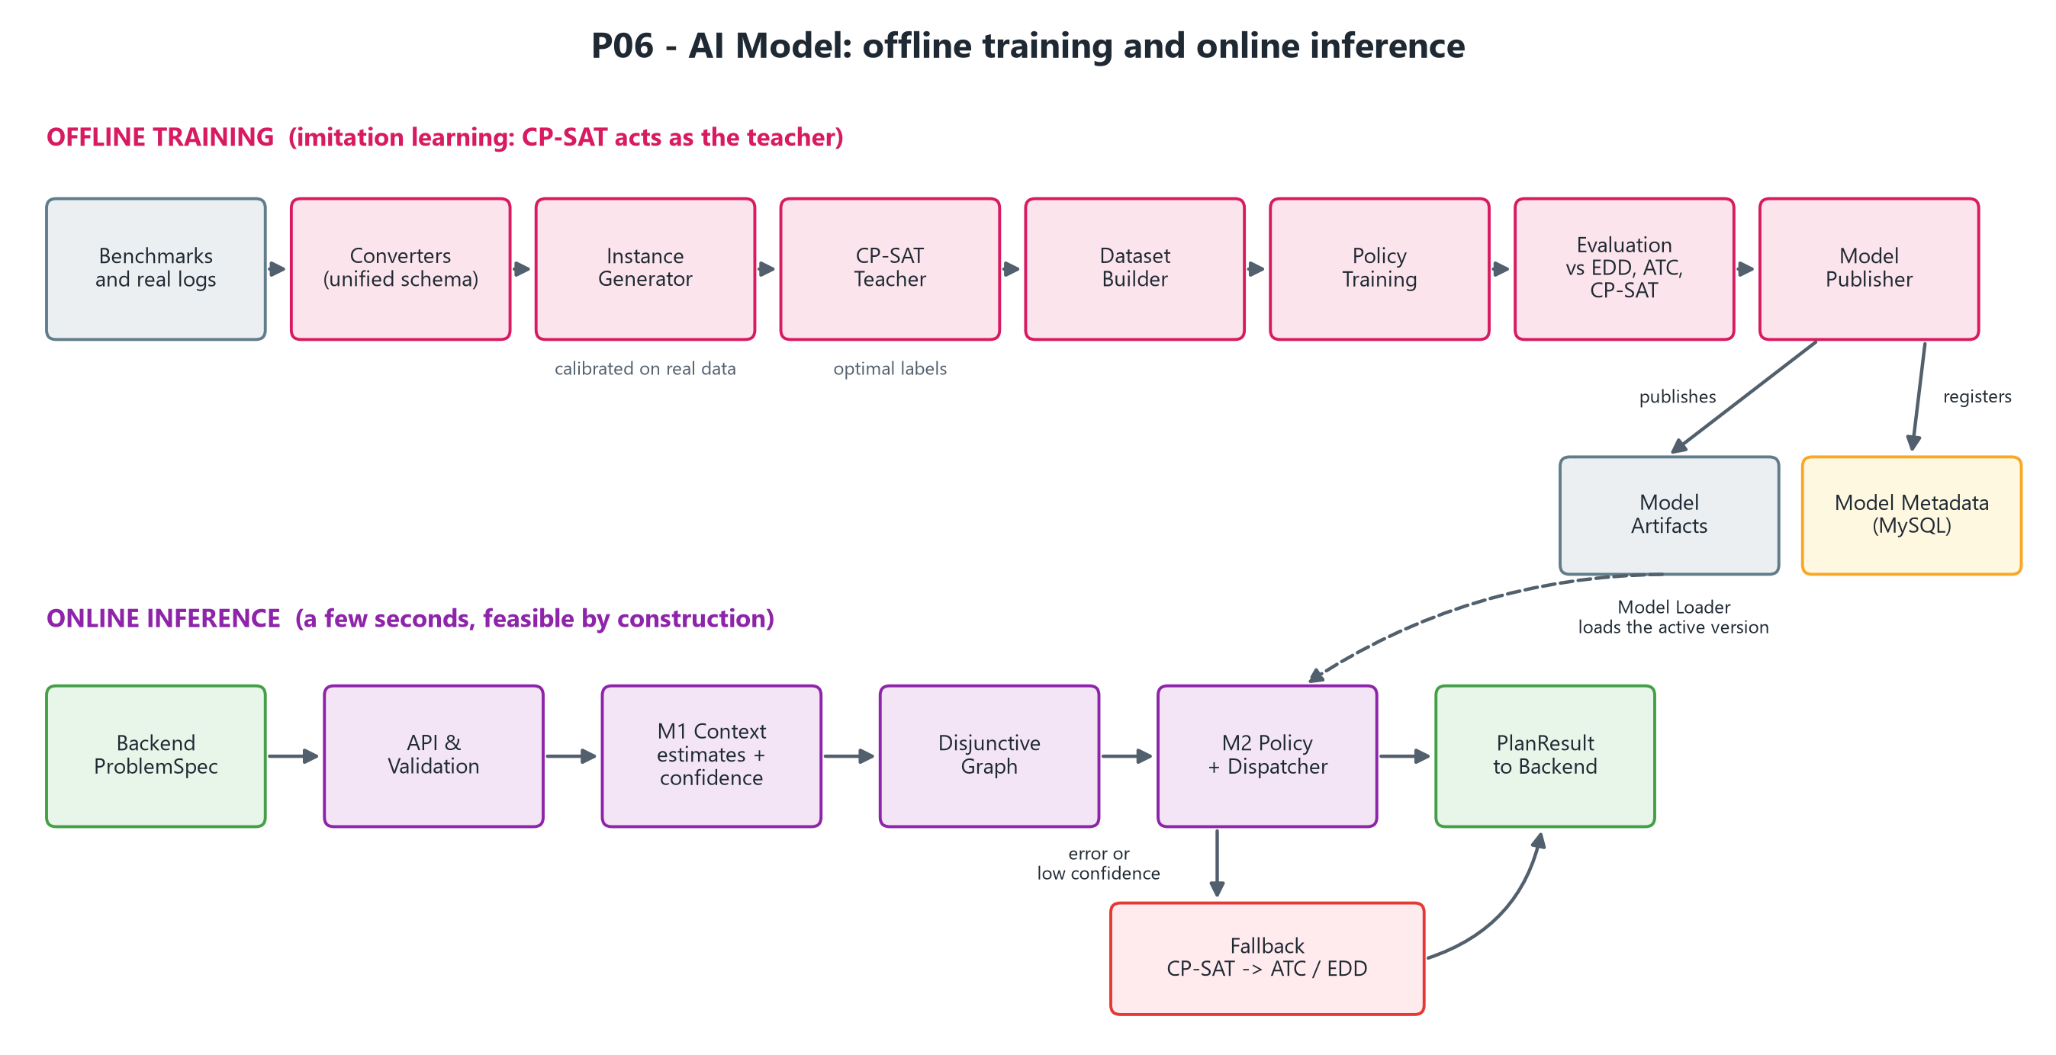
The model imitates CP-SAT and decides in milliseconds
Section 3 · Architectural choices
M1 and M2
M1 estimates durations, setups and confidence and turns preferences into objective weights; M2 picks the next task to schedule
Imitation learning
CP-SAT acts as teacher for M2 on synthetic instances; M1 learns from real event logs
Release rule
A model goes to production only if it beats EDD and ATC
P06 · AI Scheduling · Milestone M0 · 6 Nov 2026 · Supervisor Prof. Flavio Corradini
7
Notes:
Here is the AI model. The online pipeline has these steps: validation, M1 Context, disjunctive graph, and M2 Policy with the Dispatcher.
M1 Context estimates missing durations and setups, chooses the objective weights and computes a confidence value.
M2 Policy is a ranking model: at each step it chooses which task to schedule among the valid candidates, and the Dispatcher applies the choice. The plan is therefore feasible by construction.
Training is done by imitation learning. CP-SAT, from OR-Tools, acts as the "teacher" on synthetic instances; the model learns to imitate it but decides in milliseconds.
A model goes to production only if it beats, or at least matches, the EDD and ATC rules.
On error or low confidence, a fallback takes over: dispatching rules ATC and EDD. Using CP-SAT as an online fallback is still an open question, because the AI must remain the optimization engine.
The diagram shows two rows: offline training, from generator to CP-SAT teacher, dataset, training, evaluation and publication, and the online inference we just described.

Slide 8
From a sentence to a plan: the AI stack
Section 3 · Architectural choices
LLM input
An open-weight LLM (7–12B, running locally) turns a natural-language description into a ProblemSpec. The planner confirms it before planning.
M1 Context
Neural network with quantile regression: estimates durations and setups with a confidence value, and turns the planner's preferences into objective weights.
M2 Policy
Neural ranking policy (MLP, then GNN on the disjunctive graph), trained on GPU by imitating CP-SAT. XGBoost as a baseline.
Dispatcher and KPIs
One shared Python module: the Dispatcher simulates several candidate plans, all feasible by construction; the KPIs rank them and the planner chooses. Same simulator and same KPI formulas in training, evaluation and production.
No LLM in the optimization loop: the LLM only prepares the input, trained networks make the decisions.
Where training happens: offline, on our GPU machine; the running system only loads the published model.
Hard constraints (e.g. a machine down on Thursday) are never violated; preferences (e.g. avoid overtime) become objective weights.
P06 · AI Scheduling · Milestone M0 · 6 Nov 2026 · Supervisor Prof. Flavio Corradini
8
Notes:
Here is the AI stack, from a sentence to a plan. There are four blocks, and we go through them in the order the data follows.
First, the LLM input. An open-weight LLM, 7 to 12 billion parameters, runs locally and turns a natural-language description into a ProblemSpec. The planner confirms it before planning. It is an extension in front of the system: it does not replace M1, and the system works without it.
Second, M1 Context: a neural network with quantile regression. It estimates durations and setups, gives a confidence value and turns the planner's preferences into objective weights.
Third, M2 Policy: a neural ranking policy, first an MLP and then a GNN on the disjunctive graph, trained on GPU by imitating CP-SAT. XGBoost is the baseline we compare against.
Fourth, the Dispatcher and the KPIs: one shared Python module for training, evaluation and production. The Dispatcher simulates several candidate plans, all feasible by construction; the KPIs rank them and the planner chooses. The same simulator and the same KPI formulas in training, evaluation and production, so results are comparable.
Training happens offline, on our GPU machine; the running system only loads the published model. Hard constraints, for example a machine down on Thursday, are never violated; preferences, for example avoiding overtime, become objective weights.
The key message: there is no LLM in the optimization loop. The LLM only prepares the input; trained networks make the decisions.

Slide 9
One container per block, one command to start
Section 3 · Architectural choices
internal network
Isolated AI
The ai-service runs in its own container and only loads published models. The training container uses the GPU through the NVIDIA Container Toolkit and runs only on demand.
public network
frontend
backend
ai-service
Persistent data
MySQL and MinIO keep data in volumes; the database is never exposed outside the internal network.
mysql
minio
One command
docker compose up starts the whole system;
docker compose --profile training run training retrains the models. Health checks and environment variables for configuration and secrets.
training
on demand · GPU · PyTorch
publishes versioned model
volume
volume
P06 · AI Scheduling · Milestone M0 · 6 Nov 2026 · Supervisor Prof. Flavio Corradini
9
Notes:
Here is how the system runs: one container per block.
The frontend and the backend are on the public network. The backend is the only block on both networks. The ai-service, MySQL and MinIO are on the internal network, so nothing outside can reach them directly.
The training container is dashed because it is on demand: it starts only when we need to train a model, not in the normal run.
First, isolated AI. The ai-service runs in its own container and only loads published models. The training container uses the GPU through the NVIDIA Container Toolkit and runs only on demand, and it publishes each versioned model to MinIO.
Second, persistent data. MySQL and MinIO keep their data in volumes, so nothing is lost on a restart. The database is never exposed outside the internal network.
Third, one command. docker compose up starts the whole system, and docker compose --profile training run training retrains the models. Health checks tell us when each service is ready, and environment variables carry the configuration and the secrets.

Slide 10
Designed for four domain families, validated on two
Section 4 · Application domains and datasets
Factory
Flexible job shop with alternative resources, sequence-dependent setups and graph-based assembly
Projects
RCPSP, also multi-project and multi-mode
Public sector
Public administration and maintenance: skilled resources, cases like building permits and fines
Extensions
Healthcare (operating rooms) and batch IT (DAG jobs)
Trained and validated on factory and public sector; projects as a generalization test; extensions are supported by the schema but not yet validated. The domain changes through domain profiles, not the model.
P06 · AI Scheduling · Milestone M0 · 6 Nov 2026 · Supervisor Prof. Flavio Corradini
10
Notes:
The system is designed for four application domains, with one general model, but so far it is validated on two.
Factory: flexible job shop with alternative resources, sequence-dependent setups, and assembly with precedences as a graph.
Projects: RCPSP, also multi-project and multi-mode. We use it as a generalization test.
Public administration and maintenance: resources with different skills and case files, for example building permits and traffic fines.
Extensions: healthcare, with operating rooms, and batch IT, with jobs as a DAG. The schema supports them, but they are not yet validated.
The key message: the model is trained and validated on factory and public sector. The domain changes through the "domain profiles", that is the active constraints and the objective weights, not the model.

Slide 11
Synthetic data trains the policy, real logs train the context, benchmarks validate
Section 4 · Application domains and datasets
M2 is trained on synthetic instances labelled by CP-SAT, M1 learns durations from real event logs, public benchmarks only validate.
Domain | Dataset | Role | License
Job shop | Taillard, Adams, Demirkol (TU/e repository) | validation | MIT
Job shop | JSPLIB (162 instances with known optimum) | validation | not found
Flexible | Brandimarte, Hurink, Dauzere-Peres, Barnes, Fattahi, Kacem | validation, tuning | MIT
With setup | Fattahi fjsp_sdst (20 instances) | setup validation | MIT
Assembly | YFJS, DAFJS | validation | MIT
Projects | PSPLIB j30-j120, MPLIB, Patterson | validation, generalization | to be verified
Skills / public | MSLIB (with 7 empirical instances) | public-sector profile tuning | to be verified
Public sector | BPI Challenge 2015, Road Traffic Fines (Italian local police) | M1 training, shadow mode | to be verified on 4TU
Extensions | Alibaba cluster trace, CHOIR and RealLife OR (healthcare) | extension | not stated
P06 · AI Scheduling · Milestone M0 · 6 Nov 2026 · Supervisor Prof. Flavio Corradini
11
Notes:
The table lists the datasets we found. For factory job shop: Taillard, Adams and Demirkol from the TU/e repository, MIT license, and JSPLIB with 162 instances with known optimum, where we did not find a license. For flexible job shop: Brandimarte, Hurink, Dauzere-Peres, Barnes, Fattahi and Kacem, MIT, for validation and tuning. For setups: Fattahi fjsp_sdst, 20 instances, MIT. For assembly: YFJS and DAFJS, MIT.
For projects: PSPLIB j30 to j120, MPLIB and Patterson, for validation and generalization, license to be verified. For skills and public administration: MSLIB, with 7 empirical instances, to tune the public administration profile.
Still for public administration: BPI Challenge 2015 and Road Traffic Fines, from the Italian local police, for M1 training and shadow mode, license to be verified on 4TU. For extensions: Alibaba cluster trace, CHOIR and RealLife OR for healthcare.
MIT licenses are in green. For courts, warehouses and real factory logs there are no reliable public datasets, so we only use the generator. Licenses not yet verified must be clarified before use: this is required by deliverable 3.
To read the formats we use the Python package psplib, MIT license.
The key message of this slide: M2 is trained on synthetic instances labelled by CP-SAT, M1 learns durations from real event logs, and public benchmarks only validate.

Slide 12
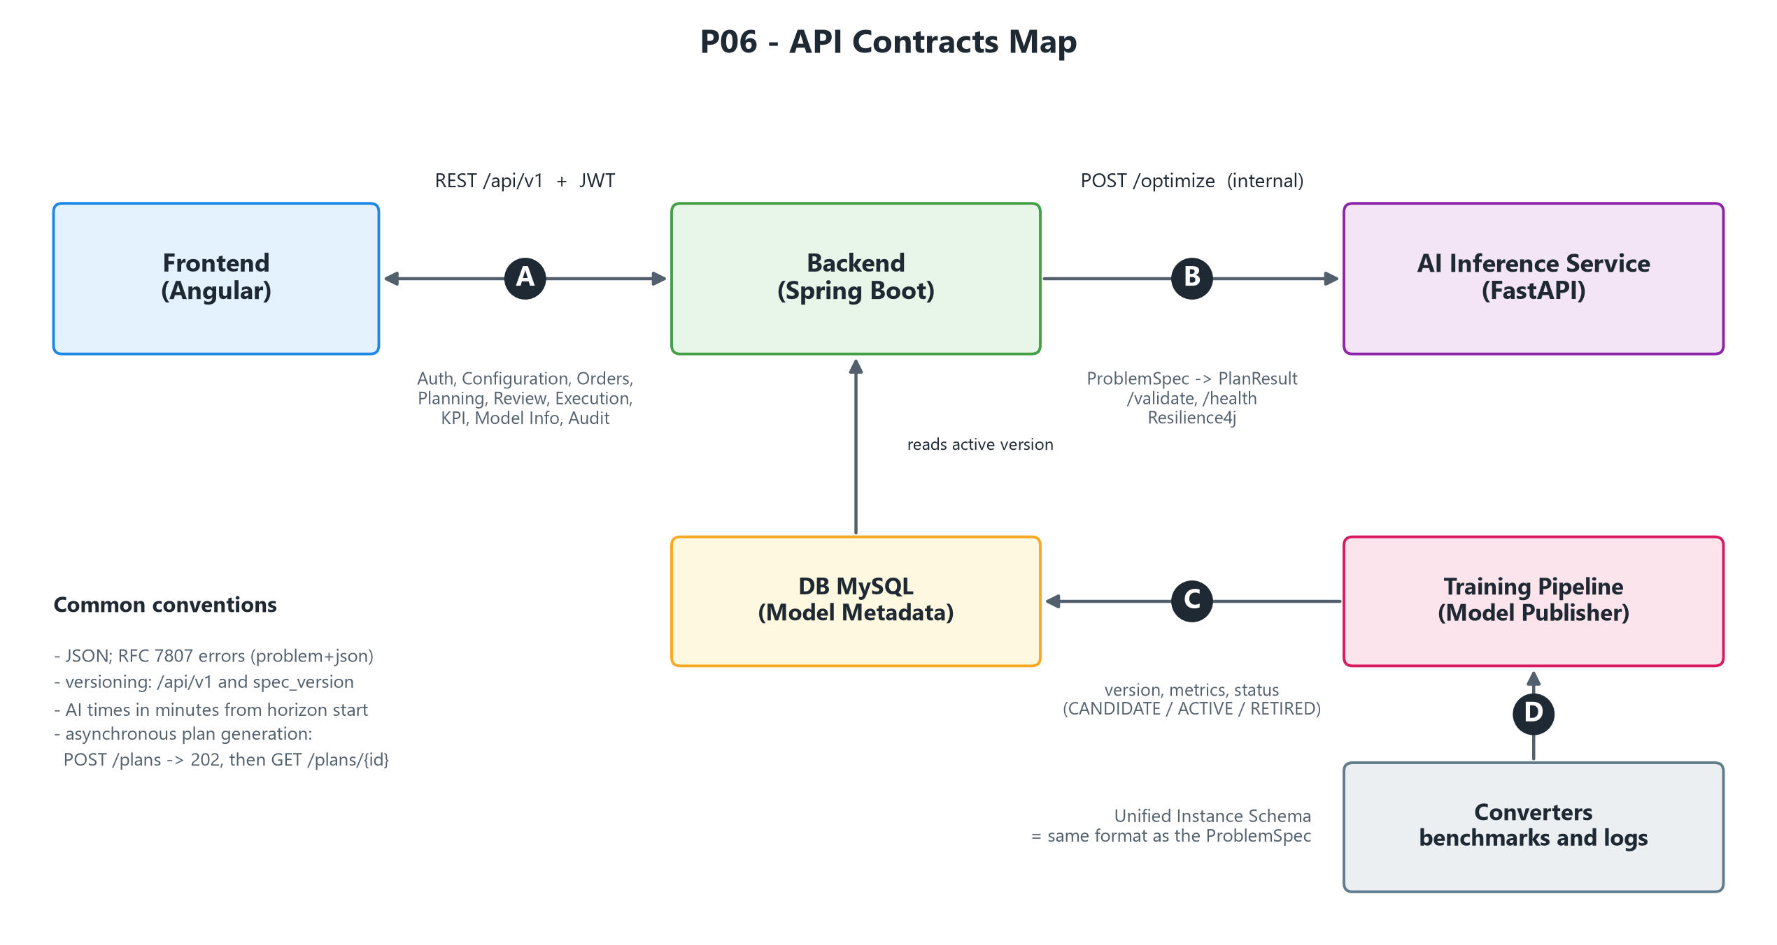
Four contracts connect the system blocks
Section 5 · API contracts
A · Public API
REST /api/v1 with JWT, roles PLANNER, OPERATOR and ADMIN
B · Optimization
POST /optimize: ProblemSpec in, PlanResult out. Internal only
POST /kpi recomputes KPIs of manually edited plans. POST /parse turns a natural-language prompt into a ProblemSpec (extension).
C and D · Models and data
Model versions in the DB; single instance schema
P06 · AI Scheduling · Milestone M0 · 6 Nov 2026 · Supervisor Prof. Flavio Corradini
12
Notes:
This is the map of the contracts, labelled A to D.
A is the public API from frontend to backend: REST under /api/v1, with JWT and the roles PLANNER, OPERATOR and ADMIN. The groups are Auth, Configuration, Orders and Process Graph, Planning and Gantt, Plan Review, Execution and KPI, Model Info, read-only, and Audit.
B is the optimization API from backend to AI: POST /optimize, which takes a ProblemSpec and returns a PlanResult, plus /validate and /health. It is internal and never exposed to the frontend.
Two more calls on this contract. POST /kpi recomputes the KPIs of plans that the planner has edited manually. POST /parse turns a natural-language prompt into a ProblemSpec: it is an extension, and the planner confirms the result before planning.
C is model registration: the Model Publisher writes version, metrics and status into the database.
D is the single instance schema: the benchmark converters produce the same format as the ProblemSpec, so training, evaluation and production all use the same structure.
Common conventions: JSON, errors following RFC 7807, versioning with /api/v1 and spec_version.

Slide 13
One ProblemSpec request, an always feasible plan
Section 5 · API contracts
Request: ProblemSpec
Response: PlanResult
{
"request_id": "…",
"horizon": 4320,
"objective_weights": { … },
"resources": [{"id": "M1", "windows": […]}],
"jobs": [{"release": 0, "due": 900, "weight": 2}],
"activities": [{"modes": [{"resource": "M1",
"duration": null}]}],
"precedences": [["A1", "A2"]],
"setup_times": […], "fixed_assignments": […],
"options": {"time_limit_ms": 5000, …}
}
{
"status": "OK | FALLBACK | INFEASIBLE",
"solver": "POLICY | ATC | EDD",
"model_versions": { … },
"confidence": 0.82,
"assignments": [{"activity": "A1",
"resource": "M1", "start": 0, "end": 120}],
"context_adjustments": [ … ],
"kpis": { … }
}
Always feasible
the plan respects all constraints
Within the time limit
the answer arrives on time
Minutes from horizon
all times are relative
Idempotent call
thanks to request_id
Public API is asynchronous: POST /plans returns 202, then GET /plans/{id}.
P06 · AI Scheduling · Milestone M0 · 6 Nov 2026 · Supervisor Prof. Flavio Corradini
13
Notes:
The central contract is /optimize. On the left, an excerpt of the request, the ProblemSpec: horizon, objective weights, resources with availability windows, jobs with release, due date and weight, activities with alternative resource and duration modes, where a null duration means "estimated by M1", then precedences, setup times, fixed assignments for rescheduling, and options such as time limit, fallback chain and minimum confidence.
On the right, the response, the PlanResult: status, which can be OK, FALLBACK or INFEASIBLE; the solver used, POLICY, ATC or EDD; model versions; confidence; the assignments with activity, resource, start and end; the adjustments made by M1; and the KPIs.
The guarantees: the plan is always feasible; the response arrives within the time limit; all times are in minutes relative to the horizon; and the request_id makes the call idempotent.
One note: plan generation on the public API side is asynchronous. POST /plans returns 202, then the client reads the result with GET /plans/{id}.

Slide 14
Where we stand and what comes next
Closing
Key takeaways
The AI proposes, the planner decides: every plan is feasible, traced and reviewable.
Trained networks make the decisions: CP-SAT is only the teacher of M2 during training, M1 learns from real event logs.
One schema (ProblemSpec) connects frontend, backend, AI, datasets and training.
Four service containers plus storage: the whole system starts with one command, training runs on demand.
Next steps
9 Nov – the three lanes start (generator, DB schema, mockups)
13 Nov – ProblemSpec v1 and final OpenAPI
11 Dec – Milestone 1: pilot outcome, does the model beat ATC?
23 Dec – Milestone 2: minimal end-to-end system
Dataset licenses verified before use (deliverable 3)
P06 · AI Scheduling · Milestone M0 · 6 Nov 2026 · Supervisor Prof. Flavio Corradini
14
Notes:
To close: the AI proposes and the planner decides; trained networks take the decisions, with CP-SAT used only as the teacher of M2 and M1 learning from real event logs; one schema ties every block together; and the whole system runs in containers.
Next steps: the three lanes start on 9 November, the contracts are frozen on 13 November, the pilot on 11 December decides whether the model beats ATC, and on 23 December we expect the minimal end-to-end system. Dataset licenses will be verified before use.
Thank you, questions?

Slide 15
Thank you for your attention
CSD COURSE · UNICAM MASTER'S DEGREE
Questions and feedback welcome
Supervisor Prof. Flavio Corradini
Notes:
That is all from us. Thank you for your attention: we are happy to take questions and to collect feedback on the open points.

