Slide 1
Instructor Materials Chapter 2: Configure a Network Operating System
CCNA Routing and Switching
Introduction to Networks v6.0
Notes:
Cisco Networking Academy Program
Introduction to Networks v6.0
Chapter 2: Configure a Network Operating System

Slide 2
Instructor Materials – Chapter 2 Planning Guide
This PowerPoint deck is divided in two parts:
Instructor Planning Guide
Information to help you become familiar with the chapter
Teaching aids
Instructor Class Presentation
Optional slides that you can use in the classroom
Begins on slide # 19
Note: Remove the Planning Guide from this presentation before sharing with anyone.
Notes:
2

Slide 3
Introduction to Network 6.0 Planning Guide
Chapter 2: Configure a Network Operating System
Notes:
Introduction to Network Planning Guide
Chapter 2: Configure a Network Operating System

Slide 4
Chapter 2: Activities
What activities are associated with this chapter?
Page # | Activity Type | Activity Name | Optional?
2.0.1.2 | Class Activity | It is Just an Operating System | Optional
2.1.2.3 | Class Activity | Accessing Devices | -
2.1.3.1 | Video Demonstration | Console Session PC to 2960 Switch | -
2.1.3.3 | Video Demonstration | IOS CLI Primary Command Modes | -
2.1.3.4 | Video Demonstration | Navigating Between IOS CLI Modes | -
2.1.4.3 | Video Demonstration | Context-Sensitive Help & Command Syntax Check | -
2.1.4.5 | Video Demonstration | Hot Keys and Shortcuts | -
2.1.4.6 | Packet Tracer | Navigating the IOS | Optional
2.1.4.7 | Lab | Establishing a Console Session with Tera Term | Recommended
2.2.1.2 | Syntax Checker | Configuring Hostnames | Recommended
The password used in the Packet Tracer activities in this chapter is: PT_ccna5
Notes:
4

Slide 5
Chapter 2: Activities
What activities are associated with this chapter?
Page # | Activity Type | Activity Name | Optional?
2.2.2.3 | Syntax Checker | Configuring Password Encryption | -
2.2.2.4 | Video Demonstration | Securing Access Methods | -
2.2.2.5 | Syntax Checker | Limit Access to a Switch | -
2.2.3.2 | Video Demonstration | Saving Configurations | -
2.2.3.4 | Packet Tracer | Configuring Initial Switch Settings | Optional
2.3.2.2 | Syntax Checker | Verifying Windows PC IP Configuration | -
2.3.2.3 | Video Demonstration | Configuring a Switch Virtual Interface | -
2.3.2.4 | Syntax Checker | Configuring a Switch Virtual Interface | -
2.3.2.5 | Packet Tracer | Implementing Basic Connectivity | Recommended
The password used in the Packet Tracer activities in this chapter is: PT_ccna5
Notes:
5

Slide 6
Chapter 2: Activities
What activities are associated with this chapter?
Page # | Activity Type | Activity Name | Optional?
2.3.3.1 | Video Demonstration | Testing the Interface Assignment | -
2.3.3.2 | Video Demonstration | Testing the End-to-End Connectivity | -
2.3.3.3 | Lab | Building a Simple Network | Optional
2.3.3.4 | Lab | Configuring a Switch Management Address | Recommended
2.4.1.1 | Class Activity | Tutor Me | Optional
2.4.1.2 | Packet Tracer | Skills integration Challenge | Recommended
The password used in the Packet Tracer activities in this chapter is: PT_ccna5
Notes:
6

Slide 7
Chapter 2: Assessment
Students should complete Chapter 2, “Assessment” after completing Chapter 2.
Quizzes, labs, Packet Tracers and other activities can be used to informally assess student progress.
Notes:
7

Slide 8
Chapter 2: Best Practices
Prior to teaching Chapter 2, the instructor should:
Complete Chapter 2, “Assessment.”
The objectives of this chapter are:
Explain the purpose of the Cisco IOS.
Explain how to access a Cisco IOS device for configuration purposes.
Explain how to navigate Cisco IOS to configure network devices.
Describe the command structure of the Cisco IOS software.
Configure hostnames on a Cisco IOS device using the CLI.
Use Cisco IOS commands to limit access to device configurations.
Use Cisco IOS commands to save the running configuration.
Explain how devices communicate across network media.
Configure a host device with an IP address.
Verify connectivity between two end devices.
Notes:
8

Slide 9
Chapter 2: Best Practices (Cont.)
Create a Packet Tracer with a switch (int vlan 1 configured) and a router (int g0/0 configured) so the demonstration can be used throughout the chapter.
Chapter appendix includes a video that introduces Cisco Connection Online.
Make sure all students have a CCO account before the end of course 1, but make sure they realize they will not be able to download an IOS without a SMARTNET account.
A CCO account can also be used to access additional materials at: learningnetwork.cisco.com
Teachers can download an IOS with a Netacad Maintenance agreement. More information can be found on NetSpace (netacad.com) > PROGRAM> EQUIPMENT> NETACAD MAINTENANCE.
Explain that the IOS gives networking hardware its capabilities.
Notes:
9

Slide 10
Chapter 2: Best Practices (Cont.)
TeraTerm Download - http://logmett.com/index.php?/download/free-downloads.html
Mini-USB Console Cable – Driver is needed (http://software.cisco.com/download/release.html?mdfid=282774238&flowid=714&softwareid=282855122&release=3.1&relind=AVAILABLE&rellifecycle=&reltype=latest) and USB to mini-USB cables are needed.
? is a KEY to IOS survival. Teach the students that ? is your friend!
Students need to be aware of error messages when working in the CLI.
When a user presses Enter to complete a command, check to make sure the command was accepted.
Notes:
10

Slide 11
Chapter 2: Best Practices (Cont.)
Explain to the students that this chapter covers three basic concepts required for setting up and testing a network:
Before configuring devices, you must know the functions of the Cisco IOS devices, learn how to communicate with the IOS, and learn how to physically connect to the devices.
Know the basics of device configurations, including securing the device, naming devices, and enabling interfaces.
Know the basic tools for verifying network connectivity, such as ping and traceroute.
Ensure the class knows that a router or a switch runs an IOS. Ask volunteers to explain how access is gained to the IOS.
Devices can be accessed via the console port (a direct physical connection), via Telnet, SSH (a virtual connection), HTTP, or via AUX (telephone modem or ISDN)
Notes:
11

Slide 12
Chapter 2: Best Practices (Cont.)
Write the following configuration modes on the board and ask the class to explain or define these modes:
user EXEC mode
privilege EXEC mode
global configuration mode
Explain to the class that devices come with default names.
Explain that names are not assigned randomly. For example, a router is named “router” by default and a switch is “switch”.
User show running-configuration to see the configuration statement “hostname switch” or “hostname router”.
A networking professional creates a naming convention that spans the company to maintain continuity and prepare for future growth.
Notes:
12

Slide 13
Chapter 2: Best Practices (Cont.)
Display a router interface and demonstrate the modes and their associated prompts.
Demonstrate how to back out from privilege EXEC mode to user EXEC mode with the disable command.
Demonstrate the various forms of context-sensitive Help available.
Demonstrate, with a preconfigured configuration, an end-to-end connection with ping and traceroute.
Reinforce that show commands serve as powerful troubleshooting tools.
Notes:
13

Slide 14
Chapter 2: Best Practices (Cont.)
Make sure students understand “delimiting character”.
Explain that other than physical security of equipment, which is always necessary, there are also ways to use passwords to add additional security. On the board, write the four password types students will learn to configure in the PT Activity.
console password – Password to limit device access using the console connection.
enable password – Password to limit access to the privileged EXEC mode.
enable secret password – Encrypted password to limit access to the privileged EXEC mode.
VTY password – Password to limit device access using Telnet.
Emphasize the use of the copy running-config startup-config or copy run start commands.
Notes:
14

Slide 15
Chapter 2: Best Practices (Cont.)
Emphasize to students that they can use the show run command to see commands, such as hostname and line console 0.
Explain that there are two types of configuration files:
Startup configuration files (startup-config) - These are stored in NVRAM and remain intact if the router is powered off.
Running configuration file (running-config) - Each time a router is booted up, the startup-config is loaded into RAM and becomes the second type of config file, which is the running configuration file. This file will change immediately if an administrator makes a change to a device. This change will cause the running-config to be different from the startup-config. Because the running-config is stored in RAM, if a power cycle takes place without saving the changes from running-config to the startup-config, any changes made will be lost.
Notes:
15

Slide 16
Chapter 2: Best Practices (Cont.)
Write the following definitions on the board and then ask the students to name the command.
Shows the config file in RAM. (show running-config)
This file is immediately changed if you make any changes to the router. (running-config)
This file is in NVRAM and will become the running-config in the event of a power cycle. (startup-config)
Copies the current configuration in RAM to NVRAM. (copy running-config startup-config)
Causes the device to reload the startup-config into RAM. (reload)
Notes:
16

Slide 17
Chapter 2: Additional Help
For additional help with teaching strategies, including lesson plans, analogies for difficult concepts, and discussion topics, visit the CCNA Community at: https://www.netacad.com/group/communities/community-home
Best practices from around the world for teaching CCNA Routing and Switching. https://www.netacad.com/group/communities/ccna-blog
If you have lesson plans or resources that you would like to share, upload them to the CCNA Community in order to help other instructors.
Students can enroll in Packet Tracer Know How 1: Packet Tracer 101 (self-enroll)
Notes:
17

Slide 18


Slide 19
Chapter 2: Configure a Network Operating System
Introduction to Networks v6.0
Notes:
Cisco Networking Academy Program
Introduction to Networks v6.0
Chapter 2: Configure a Network Operating System

Slide 20
Chapter 2 - Sections & Objectives
2.1 IOS Bootcamp
Explain the purpose of Cisco IOS.
Explain how to access a Cisco IOS device for configuration purposes.
Explain how to navigate Cisco IOS to configure network devices.
Describe the command structure of Cisco IOS software.
2.2 Basic Device Configuration
Configure hostnames on a Cisco IOS device using the CLI.
Use Cisco IOS commands to limit access to device configurations.
Use IOS commands to save the running configuration.
2.3 Address Schemes
Explain how devices communicate across network media.
Configure a host device with an IP address.
Verify connectivity between two end devices.
Notes:
20

Slide 21
2.1 IOS Bootcamp
Notes:
Cisco Networking Academy Program
Introduction to Networks v6.0
Chapter 2: Configure a Network Operating System

Slide 22
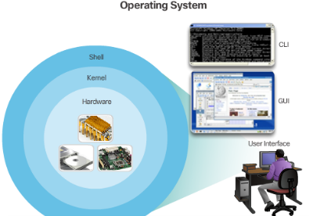
IOS Bootcamp Cisco IOS
Operating Systems
PC OS allows users to interact with the computer
User-computer interaction in PC OSs are often done via mouse, keyboard and monitor
Cisco IOS is also an Operating System
Cisco IOS allows users to interact with Cisco devices.
Cisco IOS enables a technician to:
Use a keyboard to run CLI-based network programs.
Use a keyboard to enter text and text-based commands.
View output on a monitor.
All Cisco networking devices come with a default IOS.
It is possible to upgrade the IOS version or feature set.
Notes:
2.1 – IOS Bootcamp
2.1.1 – Cisco IOS

Slide 23
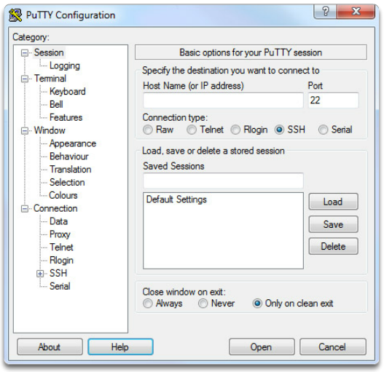
IOS Bootcamp Cisco IOS Access
Access Methods
Console
Auxiliar
Virtual Terminal (Telnet / SSH)
Terminal Emulation Programs
PuTTY
Tera Term
SecureCRT
Notes:
2.1 – IOS Bootcamp
2.1.3 – Cisco IOS Access

Slide 24
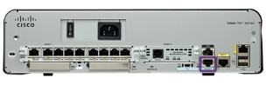
IOS Bootcamp Navigate the IOS
Cisco IOS Modes of Operation
Initial configuration must be done via console connection
Configuration is then done via various CLI command modes.
Primary Command Modes
User EXEC Mode
Privileged EXEC Mode
Configuration Command Modes
The Configure Terminal command enters the Global Configuration Mode.
Sub-configuration modes are accessible from the Privileged EXEC Mode.
Examples are: swtich(config-line)# and switch(config-if)#
Navigate Between IOS Modes
Navigation between modes is also done via commands.
The enable command enters the Privileged EXEC Mode.
The exit commands exits to the parent command mode.
Notes:
2.1 – IOS Bootcamp
2.1.3 – Navigate the IOS

Slide 25
IOS Bootcamp The Command Structure
Basic IOS Command Structure
The general syntax for a command is the command followed by any appropriate keywords and arguments.
Keyword - a specific parameter defined in the operating system
Argument - not predefined; a value or variable defined by the user
IOS Command Syntax
Provides the pattern or format that must be used when entering a command.
The Cisco IOS Command Reference is the ultimate source of information for a particular IOS command.
IOS Help Feature
The IOS has two forms of help available: Context-Sensitive Help and Command Syntax Check.
Hotkeys and Shortcuts
Commands and keywords can be shortened to the minimum number of characters that identify a unique selection.
Line editing keyboard shortcuts such as Ctrl-A are also supported.
Notes:
2.1 – IOS Bootcamp
2.1.3 –The Command Structure

Slide 26
2.2 Basic Device Configuration
Notes:
Cisco Networking Academy Program
Introduction to Networks v6.0
Chapter 2: Configure a Network Operating System

Slide 27

Basic Device Configuration Hostnames
Device Names
Hostnames allow devices to be identified by network administrators over a network or the Internet.
Very important and should also be displayed in the topology.
Configure Hostnames
IOS hostnames should:
Start with a letter
Contain no spaces
End with letter or digit
Use only letters, digits or dashes
Be less than 64 characters in length
Notes:
2.2 – Basic Device Configuration
2.2.1 –Hostnames

Slide 28
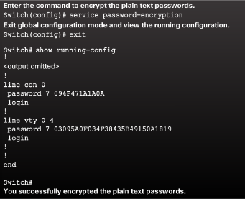
Basic Device Configuration Limit Access to Device Configurations
Secure Device Access
Secure privileged EXEC and user EXEC access with a password.
Secure virtual terminal lines with a password.
Configure Passwords
Use strong passwords.
Avoid re-using passwords
Encrypt Passwords
Cisco IOS displays passwords in plain text by default.
Passwords should be encrypted.
Banner Messages
Important part of the legal process in the event that someone is prosecuted for breaking into a device.
Wording that implies that a login is "welcome" or "invited" is not appropriate.
Often used for legal notification because it is displayed to all connected terminals.
Notes:
2.2 – Basic Device Configuration
2.2.2 –Limit Access to Device Configurations

Slide 29
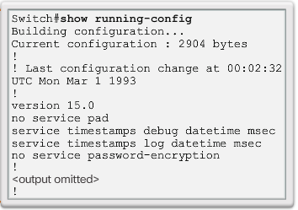
Basic Device Configuration Save Configurations
Save the Running Configuration File
File stored in NVRAM that contains all of the commands that will be used upon startup or reboot
NVRAM does not lose its contents when the device is powered off.
Alter the Running Configuration
File stored in RAM that reflects the current configuration, modifying affects the operation of a Cisco device immediately.
RAM loses all of its content when the device is powered off or restarted.
Capture Configuration to a Text File
Configuration files can also be saved and archived to a text document.
The configuration can then be edited with any text editor and placed back in the device.
Notes:
2.2 – Basic Device Configuration
2.2.3 –Save Configurations

Slide 30
2.3 Address Schemes
Notes:
Cisco Networking Academy Program
Introduction to Networks v6.0
Chapter 2: Configure a Network Operating System

Slide 31
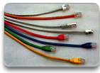
Address Schemes Ports and Addresses
IP Addresses
Each end device on a network must be configured with an IP address.
Enable devices to establish end-to-end communication on the Internet.
The structure of an IPv4 address is called dotted decimal notation and is represented by four decimal numbers between 0 and 255.
IPv6 is the most recent version of IP and the replacement for the more common IPv4.
Interface and Ports
Network communications depend on interfaces and the cables that connect them.
Different types of network media have different features and benefits.
Ethernet is the most common local area network (LAN) technology.
SVI provides a means to remotely manage a switch over a network.
Notes:
2.3 – Address Schemes
2.3.1 – Ports and Addresses

Slide 32
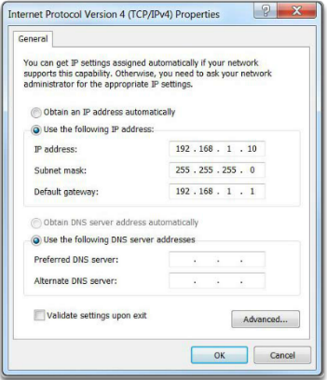
Address Schemes Configure IP Addressing
Manual IP Address Configuration for End Devices
To manually configure an IPv4 address on a Windows host, open the Control Panel > Network Sharing Center > Change adapter settings and choose the adapter.
Next right-click and select Properties to display the Local Area Connection Properties shown in Figure 1.
Automatic IP Address Configuration for End Devices
DHCP enables automatic IPv4 address configuration for every end device that has DHCP enabled. No extra configuration is needed.
Switch Virtual Interface Configuration
To configure an SVI on a switch, use the interface vlan 1 global configuration command. Vlan 1 is not an actual physical interface but a virtual one.
Notes:
2.3 – Address Schemes
2.3.2 – Configure IP Addressing

Slide 33
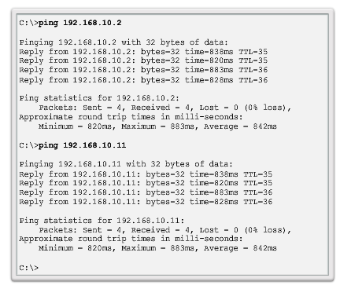
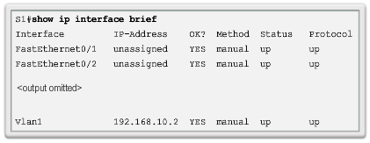
Address Schemes Verifying Connectivity
Interface Addressing Verification
Cisco IOS supports commands to allow IP configuration verification.
End-To-End Connectivity Test
The ping command can be used to test connectivity to another device on the network or a website on the Internet.
Notes:
2.3 – Address Schemes
2.3.3 – Verifying Connectivity

Slide 34
2.4 Chapter Summary
Notes:
Cisco Networking Academy Program
Introduction to Networks v6.0
Chapter 2: Configure a Network Operating System

Slide 35
Chapter Summary Summary
Explain the features and functions of Cisco IOS Software.
Configure initial settings on a network device using the Cisco IOS software.
Given an IP addressing scheme, configure IP address parameters on end devices to provide end-to-end connectivity in a small to medium-sized business network.
Notes:
2.4.1 - Summary

Slide 36
Section 2.1 New Terms and Commands
kernel
shell
Command-line interface (CLI)
Graphical user interface (GUI)
Cisco IOS
Firmware
Console
Out-of-band
SSH
Telnet
Auxiliary port (AUX)
PuTTY
Tera Term
SecureCRT
OS X Terminal
Cisco IOS modes
User EXEC mode
Privileged EXEC mode
Global Configuration Mode
Line configuration mode
Interface configuration mode
enable command
disable command
exit command
end command
Key combination – Ctrl+Z
Context-Sensitive Help
Command Syntax Check
CLI Hot Keys and Shortcuts
Hostnames
Notes:
New Terms and Commands

Slide 37
Section 2.2 New Terms and Commands
hostname name
Strong passwords
enable secret class
line console 0
password cisco
login
line vty 0 15
service password-encryption
banner motd # the message of the day #
Startup configuration
Random Access Memory (NVRAM)
Running configuration
Random Access Memory (RAM)
show running-config
copy running-config startup-config
reload
Notes:
New Terms and Commands

Slide 38
Section 2.3 New Terms and Commands
IPv4 address
Subnet mask
Default gateway
Physical ports
Virtual interface
Copper
Fiber Optics
Wireless
Ethernet
Local Area Network (LAN)
Layer 2 switch
Layer 3 addresses
Switch virtual interface (SVI)
Dynamic Host Configuration (DHCP)
Domain Name System (DNS)
ipconfig command prompt
interface vlan 1
Notes:
New Terms and Commands

Slide 40


