Slide 1
Instructor Materials Chapter 1: Explore the Network
CCNA Routing and Switching
Introduction to Networks v6.0
Notes:
Cisco Networking Academy Program
Introduction to Networks v6.0
Chapter 1: Explore the Network

Slide 2
Instructor Materials – Chapter 1 Planning Guide
This PowerPoint deck is divided in two parts:
Instructor Planning Guide
Information to help you become familiar with the chapter
Teaching aids
Instructor Class Presentation
Optional slides that you can use in the classroom
Begins on slide # 13
Note: Remove the Planning Guide from this presentation before sharing with anyone.
Notes:
2

Slide 3
Introduction to Network 6.0 Planning Guide
Chapter 1: Exploring the Network
Notes:
Introduction to Network Planning Guide
Chapter 1: Exploring the Network

Slide 4
Chapter 1: Activities
What activities are associated with this chapter?
Page # | Activity Type | Activity Name | Optional?
1.0.1.2 | Class Activities | Draw Your Concept of the Internet | Optional
1.1.1.8 | Lab | Researching Network Collaboration Tools | Optional
1.2.1.7 | Interactive Activity | Network Component Representations and Functions | Recommended
1.2.4.4 | Packet Tracer | Help and Navigation Tips | Recommended
1.2.4.5 | Packet Tracer | Network Representation | Optional
1.3.1.3 | Lab | Researching Converged Network Services | Optional
1.3.2.6 | Interactive Activity | Network Architecture Requirements | Recommended
1.4.3.3 | Interactive Activity | Network Security Terminology | Recommended
1.4.4.3 | Lab | Researching IT and Network Job Opportunities | Optional
1.5.1.1 | Class Activities | Draw Your Concept of the Internet Now | Optional
The password used in the Packet Tracer activities in this chapter is: PT_ccna5
Notes:
4

Slide 5
Chapter 1: Assessment
Students should complete Chapter 1, “Assessment” after completing Chapter 1.
Quizzes, labs, Packet Tracers and other activities can be used to informally assess student progress.
Notes:
5

Slide 6
Chapter 1: Best Practices
Prior to teaching Chapter 1, the instructor should:
Complete Chapter 1, “Assessment.”
Explain to students that this chapter will serve as an introduction to networking. Later chapters will go into detail.
Use the discussion feature of netacad.com to encourage student participation.
Section 1.1
Discuss the two opening videos.
What are ways that this connected world affects/includes you?
What else do you think we will be able to do using the network as the platform?
Discuss communication and collaboration tools we all use.
What communications tools do you use to connect with friends?
Notes:
6

Slide 7
Chapter 1: Best Practices (Cont.)
Section 1.1(cont.)
Additional videos and resources for this section.
newsroom.cisco.com/truestories
http://www.cisco.com/c/en/us/products/collaboration-endpoints/telepresence-tx9000-series/index.html
Section 1.2
Discuss examples of types of networks (eg. LAN and WAN).
Home and Small Office Internet Connections
Discuss with the class how they connect to the Internet at home.
Packet Tracer tutorial video
https://www.youtube.com/watch?v=any2NbeSZV4&feature=youtu.be

Slide 8
Chapter 1: Best Practices (Cont.)
Section 1.2 (cont.)
1.2.1.1-1.2.1.6 Important topics
Students must know these icons and the functions of the network devices.
Demonstrate a basic topology and all the icons using Packet Tracer.
1.2.1.6 Reinforce differences between physical and logical topology, this can be confusing for students.
How devices are physically interconnected is the physical topology.
The media access method or the way network access is controlled is based on the logical topology.
1.2.1.6 Show students routers, switches, and samples of the different media.

Slide 9
Chapter 1: Best Practices (Cont.)
Section 1.2 (cont.)
Lab 1.2.4.4 – Optional or instructor demonstration
Lab 1.2.4.5 – Introduce Packet Tracer.
Section 1.3
Clarify and discuss converged networks.
Lab 1.3.1.3 – Possibly do this lab in small groups.
Activity 1.3.2.6 – Good reinforcement of topics in 1.3.2.1-5.

Slide 10
Chapter 1: Best Practices (Cont.)
Section 1.4
Discuss BYOD implementation at your institution.
Challenge students to give examples of “cloud computing”.
Activity 1.4.3.3 – Good reinforcement of topics 1.4.3.1-2.
Direct students to the Cisco Learning Network to learn more information about certifications and create a guest account.
https://learningnetwork.cisco.com/community/certifications
Discuss why students should obtain their CCNA certification.

Slide 11
Chapter 1: Additional Help
For additional help with teaching strategies, including lesson plans, analogies for difficult concepts, and discussion topics, visit the CCNA Community at: https://www.netacad.com/group/communities/community-home
Best practices from around the world for teaching CCNA Routing and Switching. https://www.netacad.com/group/communities/ccna-blog
If you have lesson plans or resources that you would like to share, upload them to the CCNA Community in order to help other instructors.
Students can enroll in Packet Tracer Know How 1: Packet Tracer 101 (self-enroll)
Notes:
11

Slide 12


Slide 13
Chapter 1: Explore the Network
Introduction to Networks v6.0
Notes:
Cisco Networking Academy Program
Introduction to Networks v6.0
Chapter 1: Explore the Network

Slide 14
Chapter 1 - Sections & Objectives
1.1 Globally Connected
Explain how networks affect the way we interact, learn, work, and play.
Explain how host devices can be used as clients, servers, or both.
1.2 LANs, WANs, and the Internet
Explain the use of network devices.
Compare the devices and topologies of a LAN to the devices and topologies of a WAN.
Describe the basic structure of the Internet.
Explain how LANs and WANs interconnect to the Internet.
1.3 The Network as a Platform
Explain the concept of a converged network.
Describe the four basic requirements of a reliable network.
1.4 The Changing Network Environment
Explain how trends such as BYOD, online collaboration, video, and cloud computing are changing the way we interact.
Explain how networking technologies are changing the home environment.
Identify basic security threats and solutions for both small and large networks.
Describe the importance of understanding the underlying switching and routing infrastructure of a network.
Notes:
14

Slide 15
1.1 Globally Connected
Notes:
Cisco Networking Academy Program
Introduction to Networks v6.0
Chapter 1: Explore the Network

Slide 16


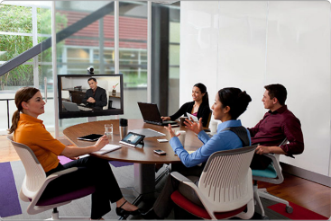
Globally Connected Networking Today
Network has no boundary and supports the way we:
Learn
Communicate
Work
Play
Notes:
1.1 – Globally Connected
1.1.1 – Network Today

Slide 17
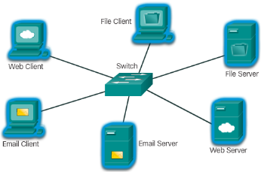
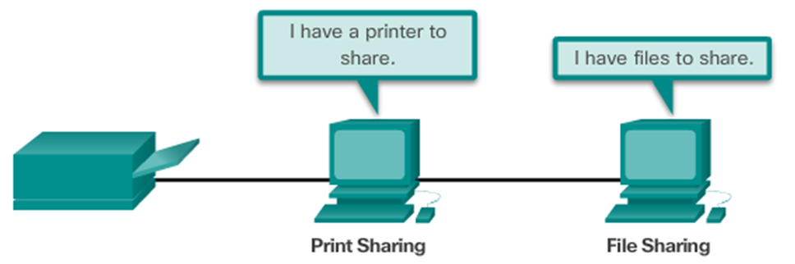
Globally Connected Providing Resources in a Network
Networks of Many Sizes
Small Home / Office Networks
Medium to Large Networks
World Wide Network
Clients and Servers
Clients request and display information
Servers provide information to other devices on the network
Peer-to-Peer
Computers can be both server and client at the same time.
What are the advantages?
What are the disadvantages?
Notes:
1.1 – Globally Connected
1.1.2 – Providing Resources in a Network

Slide 18
1.2 LANs, WANs, and the Internet
Notes:
Cisco Networking Academy Program
Introduction to Networks v6.0
Chapter 1: Explore the Network

Slide 19
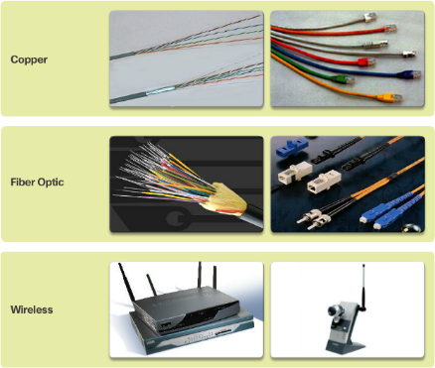
LANs, WANs, and the Internet Network Components
End Devices
Either the source or destination of a message
Name some end devices
Intermediary Network Devices
Connect multiple individual networks to form an internetwork
Connect the individual end devices to the network
Ensure data flows across the network
Provide connectivity
Network Media
Provide the pathway for data transmission
Interconnect devices
Name the three types of media
Notes:
1.2 – LANs, WANs, and the Internet
1.2.1 – Network Components

Slide 20






LANs, WANs, and the Internet Network Components
Network Representations
What do the symbols represent?
Topology Diagrams
Physical
Logical
Notes:
1.2 – LANs, WANs, and the Internet
1.2.1 – Network Components

Slide 21
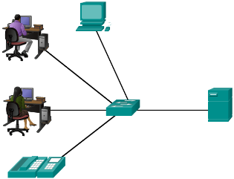
LANs, WANs, and the Internet LANs and WANs
Local Area Networks
Spans across small geographical area
Interconnects end devices
Administrated by a single organization
Provide high speed bandwidth to internal devices
WAN Area Networks
Interconnects LAN
Administrated by multiple service providers
Provide slower speed links between LANS
Can you name more network types?
Notes:
1.2 – LANs, WANs, and the Internet
1.2.2 – LANs and WANs

Slide 22
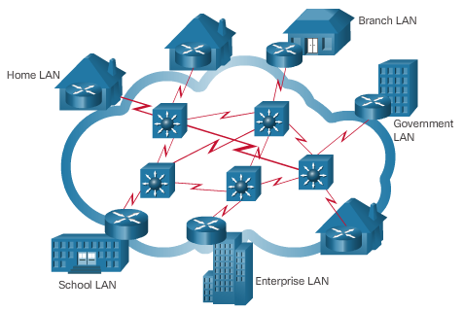
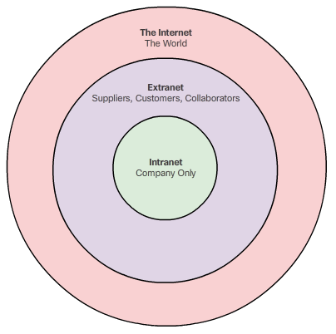
LANs, WANs, and the Internet The Internet, Intranets, and Extranets
The Internet
Worldwide collection of interconnected networks
Not owned by any individual or group
Intranets and Extranets
Notes:
1.2 – LANs, WANs, and the Internet
1.2.3 – The Internet, Intranets, and Extranets

Slide 23
LANs, WANs, and the Internet Internet Connections
Internet Access Technologies
Internet Service Provider (ISP)
Broadband cable
Broadband Digital Subscriber Line (DSL)
Wireless WANs
Mobile Services
Business DSL
Leased Lines
Metro Ethernet
Types of Internet Connections
Home and Small Office
Business
Notes:
1.2 – LANs, WANs, and the Internet
1.2.4 – Internet Connections

Slide 24
1.3 The Network as a Platform
Notes:
Cisco Networking Academy Program
Introduction to Networks v6.0
Chapter 1: Explore the Network

Slide 25
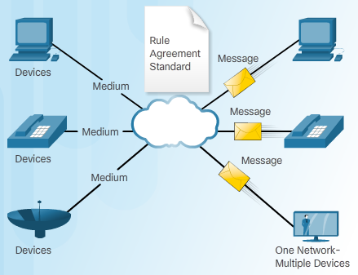
The Network as a Platform Converged Networks
Traditional Separate Networks
Each network with its own rules and
The Converging Network
Capable of delivering data, voice, and video over the same network infrastructure
Notes:
1.3 – The Network as a Platform
1.3.1 – Converged Networks

Slide 26
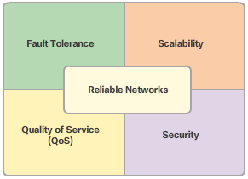
The Network as a Platform Reliable Network
Four Basic Characteristics of Network Architecture
Fault Tolerance
Scalability
Quality of Service (QoS)
Security
Notes:
1.3 – The Network as a Platform
1.3.2 – Reliable Network

Slide 27
1.4 The Changing Network Environment
Notes:
Cisco Networking Academy Program
Introduction to Networks v6.0
Chapter 1: Explore the Network

Slide 28

The Changing Network Environment Network Trends
Top trends include:
Bring Your Own Device (BYOB)
Online Collaboration
Video Communications
Cloud Computing
Notes:
1.4 – The Changing Network Environment
1.4.1 – Network Trends

Slide 29

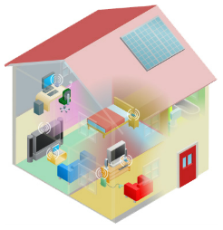
The Changing Network Environment Networking Technologies for the Home
Technology Trends in the Home
Smart home
Powerline Networking
Uses existing electrical wiring to connect devices
Wireless Broadband
Wireless Internet Service Provider (WISP)
Wireless Broadband Service using cellular technology
Notes:
1.4 – The Changing Network Environment
1.4.2 - Networking Technologies for the Home

Slide 30
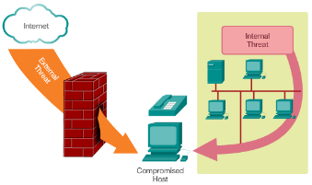
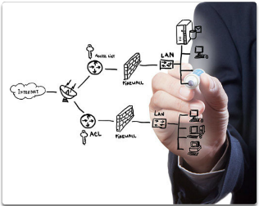
The Changing Network Environment Network Security
Security Threats
Viruses, worms, and Trojan horses
Spyware and adware
Zero-day attacks, also called zero-hour attacks
Hacker attacks
Denial of service attacks
Data interception and theft
Identity theft
Security Solutions
Antivirus and antispyware
Firewall filtering
Dedicated firewall systems
Access control lists (ACL)
Intrusion prevention systems (IPS)
Virtual Private Networks (VPNs)
Notes:
1.4 – The Changing Network Environment
1.4.3 – Network Security

Slide 31
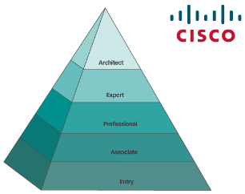
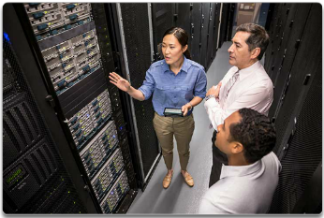
The Changing Network Environment Network Architecture
Cisco Network Architecture
Support technologies and applications
Ensure connectivity across any combination of networks
CCNA
A first step to a networking career
Notes:
1.4 – The Changing Network Environment
1.4.4 – Network Architecture

Slide 32
1.5 Chapter Summary
Notes:
Cisco Networking Academy Program
Introduction to Networks v6.0
Chapter 1: Explore the Network

Slide 33
Chapter Summary Summary
Explain how multiple networks are used in everyday life.
Describe the topologies and devices used in a small to medium-sized business network.
Explain the basic characteristics of a network that supports communication in a small to medium-sized business.
Explain trends in networking that will affect the use of networks in small to medium-sized businesses.
Notes:
1.5.1.3 - Summary

Slide 35


Slide 36
Section 1.1 New Terms and Commands
client
collaborative learning spaces
global communities
human network
network collaboration services
network of networks
peer-to-peer network
server
Notes:
New Terms and Commands

Slide 37
Section 1.2 New Terms and Commands
broadband cable
broadband DSL
business DSL
cable
cellular
dedicated leased line
dial-up telephone
DSL
end devices
extranet
hardware
intermediary devices
internetworking devices
Internet Service Provider (ISP)
Intranet
leased lines
Local Area Network (LAN)
logical topology diagrams
medium
Metropolitan Area Network (MAN)
metro Ethernet
network access devices
network interface card (NIC)
network media
physical port, interface
physical topology diagrams
satellite
security devices
service provider (SP)
software
Storage Area Network (SAN)
TelePresence endpoint
teleworkers
topology diagram
VoIP phones
Wide Area Network (WAN)
Wireless LAN (WLAN)
Notes:
New Terms and Commands

Slide 38
Section 1.3 New Terms and Commands
availability
circuit switched networks
content security
converged network
data confidentiality
data integrity
delay
Denial of Service (DoS)
encrypting data
fault tolerance
hierarchical layered structure
intelligent information network
network architecture
network bandwidth
network congestion
network infrastructure security
packet loss
packet switched networks
packets
Quality of Service (QoS)
queue
redundancy
routing function
scalability
user authentication
Notes:
New Terms and Commands

Slide 39
Section 1.4 New Terms and Commands
access control lists (ACL)
adware
Bring Your Own Deice (BYOD)
cloud computing
data centers
data interception and theft
hacker attacks
identity theft
intrusion prevention systems (IPS)
multiple layers of security
multitasking
online collaboration
person-to-person video calling
powerline networking
server clusters
server farms
smart home technology
spyware
Trojan horses
video conferencing
virtual private networks (VPNs)
virtualization
viruses
wireless broadband service
wireless internet service provider (WISP)
wireless local area networks (WLAN)
worms
zero-day attacks
Notes:
New Terms and Commands

