Slide 1
Multithreading
Traineeship 2020 Pieter Drijkoningen

Slide 2
Inhoud
Intro tot multithreaded software
Basisbegrippen
Building blocks
ExecutorService
Completable Future API
Notes:
<number>

Slide 3
INTRO
Notes:
<number>

Slide 4
Multithreaded software
Concurrent execution
Hogere performantie
Moeilijker
Bugs moeilijk te reproduceren
Notes:
<number>

Slide 5
Waarom dan?
“Writing software is hard, writing concurrent software is even harder”
Singlethreaded software ondenkbaar tegenwoordig
Webservers, GUI applicaties, crawlers, garbage collection,...
Notes:
<number>

Slide 6
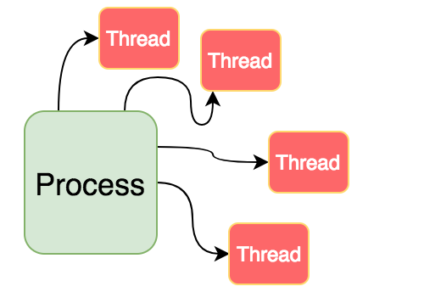
Threads
Basic unit of scheduling
Onderdeel van een proces
Sequentiële uitvoering op 1 processorkern
Hogere throughput
Java:
new Thread(() → doSomething()).start();
Notes:
<number>

Slide 7
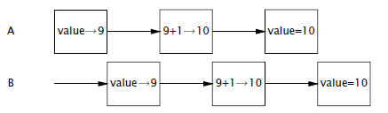
Risico’s - Incorrectness
Interleaving
Race conditions
“Nothing bad ever happens”
Notes:
<number>

Slide 8
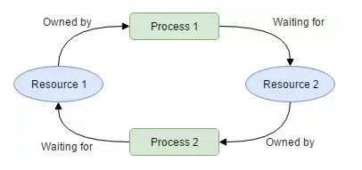
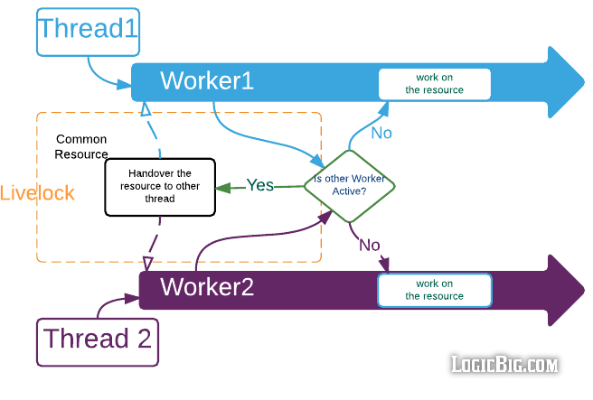
Risico’s - Liveness
“Something good eventually happens”
Deadlock
Livelock
Starvation
Notes:
<number>

Slide 9
Risico’s - Starvation
Eén of meerdere threads krijgen geen CPU tijd
Teveel contention
Notes:
<number>

Slide 10
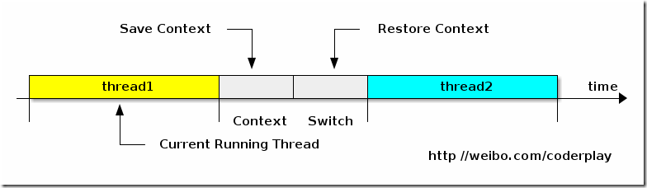
Risico’s - Performance
Overhead
Thread-switching
Synchronisatie
Notes:
<number>

Slide 11
Demo + Oefeningen
Notes:
<number>

Slide 12
Basisbegrippen
Notes:
<number>

Slide 13
Thread-safety
“A class is thread-safe if it behaves correctly when accessed from multiple threads, regardless of the scheduling or interleaving of the execution of those threads by the runtime, and with no additional synchronization or other coordination on the part of the calling code”
- Java Concurrency in Practice
Notes:
<number>

Slide 14
Correct gedrag
Specificatie
Invarianten
Postcondities
public class Counter {
private int count = 0;
public int value() {
return count;
}
public void increment() {
count++;
}
}
Notes:
<number>

Slide 15
State
Waarde van een object
Thread safety = controlled access to shared, mutable state
Notes:
<number>

Slide 16
Stateless
Altijd thread-safe
Merk op: long[] factors is state -> Niet shared -> thread confinement
public class StatelessFactorizer {
public long[] factorize(long i) {
long[] factors = factors(i);
return factors;
}
private long[] factors(long i) {
// Calculate factors
}
}
Notes:
<number>

Slide 17
Stateful
Synchronisatie nodig om thread-safe te zijn
public class CountingFactorizer {
private long count = 0;
public long getCount() { return count; }
public long[] factorize(long i) {
count++;
long[] factors = factors(i);
return factors;
}
}
Notes:
<number>

Slide 18
Compound actions
Read-modify-write (CountingFactorizer)
Check-then-act (LazySingleton)
Atomische operatie
public class LazySingleton {
private LazySingleton instance = null;
public LazySingleton getInstance() {
if (instance == null) {
instance = new LazySingleton();
}
return instance;
}
}
Notes:
<number>

Slide 19
Atomicity
Ondeelbare actie
JDK biedt enkele atomic classes aan
public class AtomicCountingFactorizer {
private AtomicLong count = new AtomicLong();
public long getCount() { return count.get(); }
public long[] factorize(long i) {
count.getAndIncrement();
long[] factors = factors(i);
return factors;
}
}
Notes:
<number>

Slide 20
public class CachingFactorizer {
private AtomicLong lastValue = new AtomicLong();
private AtomicReference<List<Long>> lastFactors = new AtomicReference<>();
public List<Long> factorize(long i) {
if (i == lastValue.get()) {
return lastFactors.get();
}
List<Long> factors = calulateFactors(i);
lastValue.set(i);
lastFactors.set(factors);
return factors; }
}
Notes:
<number>

Slide 21
Locks
Intrinsic/monitor lock
Synchronized block/method
mutex (mutually exclusive)
synchronized (monitor) {
// code goes here
}
public synchronized void someMethod() {
// code goes here
}
public void someMethod() {
synchronized(this) {
// code goes here
}
}
Notes:
<number>

Slide 22
public class CachingFactorizer {
private AtomicLong lastValue = new AtomicLong();
private AtomicReference<List<Long>> lastFactors = new AtomicReference<>();
public synchronized List<Long> factorize(long i) {
if (i == lastValue.get()) {
return lastFactors.get();
}
List<Long> factors = calculateFactors(i);
lastValue.set(i);
lastFactors.set(factors);
return factors; }
}
Notes:
<number>

Slide 23
public class CachingFactorizer {
private AtomicLong lastValue = new AtomicLong();
private AtomicReference<List<Long>> lastFactors = new AtomicReference<>();
public List<Long> factorize(long i) {
synchronized (this) {
if (i == lastValue.get()) {
return lastFactors.get();
}
}
List<Long> factors = factors(i);
synchronized (this) {
lastValue.set(i);
lastFactors.set(factors);
}
return factors; }
}
Notes:
<number>

Slide 24
Critical section
Deel code dat nood heeft aan synchronized access
Is omvat door een locking mechanism
Notes:
<number>

Slide 25
Explicit locks
Advanced API
Reentrancy
Fairness (longest waiting thread)
public class LockDemo {
private Lock lock = new ReentrantLock();
public void someMethod() {
lock.lock();
try { // code goes here }
finally { lock.unlock(); }
}
}
Notes:
<number>

Slide 26
ReadWrite locks
Multiple readers
Single writer
public class ReadWriteLockDemo {
private ReadWriteLock lock = new ReentrantReadWriteLock();
private Lock readLock = lock.readLock();
private Lock writeLock = lock.writeLock();
}
Notes:
<number>

Slide 27
Oefeningen
Notes:
<number>

Slide 28
Building Blocks
Notes:
<number>

Slide 29
Synchronized Collections
Elke public method synchronized
Wel threadsafe, niet performant
Compound actions vereisen nog steeds externe synchronisatie
Collections.synchronizedList(new ArrayList<>());
Collections.synchronizedSet(new HashSet<>());
Collections.synchronizedMap(new HashMap<>());
public Object getLast(List list) {
int lastIndex = list.size() - 1;
return list.get(lastIndex);
}
Notes:
<number>

Slide 30
Concurrent Collections
Java 1.5
java.util.concurrent package
Collection implementaties optimized voor concurrent access
Notes:
<number>

Slide 31
CopyOnWriteArrayList/HashSet
Geen locking voor reads
Bij write wordt een kopie gemaakt
Optimized voor collecties die veel vaker uitgelezen dan aangepast worden
Notes:
<number>

Slide 32
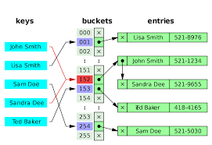
ConcurrentHashMap
Geen locking voor reads
16 concurrent writers mogelijk
Geen custom compound actions mogelijk
put-if-absent, remove-if-equal, replace-if-equal zijn voorzien
Notes:
<number>

Slide 33
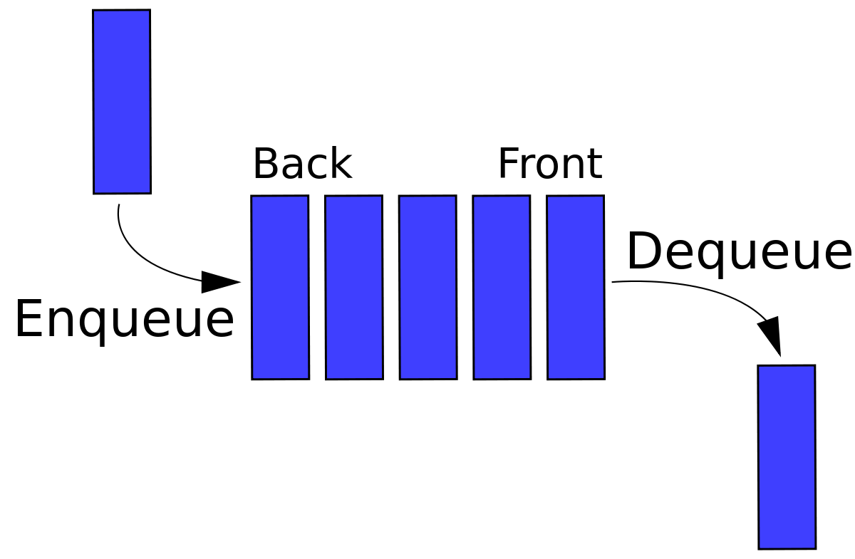
Queue & BlockingQueue
Collectie om elementen te queuen en op andere thread uit te lezen
FIFO
offer() en poll()
put() en take()
Notes:
<number>

Slide 34
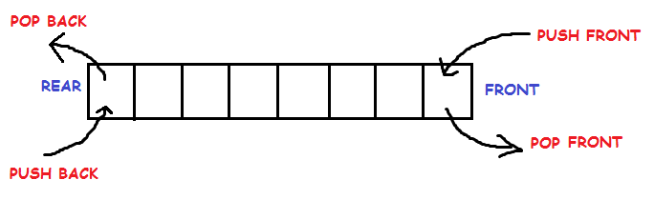
Deque & BlockingDeque
Deque = Double-ended Queue
offerFirst/Last() en pollFirst/Last()
putFirst/Last() en takeFirst/Last()
Notes:
<number>

Slide 35

Synchronizers
Bewaken toegang tot resources
Hebben state en logica om te bepalen of een thread door mag of moet wachten
Notes:
<number>

Slide 36
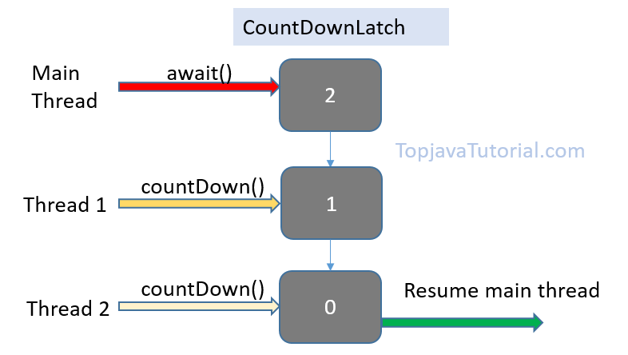
Latch
Gesloten tot een bepaalde terminal state bereikt wordt
Daarna continu open
new CountDownLatch(2);
Notes:
<number>

Slide 37
Semaphore
Beheert een aantal virtual permits
Handig om connection pools af te schermen
Intrinsic lock = semaphore met 1 permit
Semaphore semaphore = new Semaphore(10);
semaphore.acquire();
try {
// some code
} finally {
semaphore.release();
}
Notes:
<number>

Slide 38
Barrier
Om te wachten tot andere threads een bepaald punt bereikt hebben
Barrier action
Simulaties
CyclicBarrier barrier = new CyclicBarrier(2);
new Thread(() -> {
barrier.await();
// more code
}.start();
new Thread(() -> {
barrier.await();
// more code
}.start();
Notes:
<number>

Slide 39
Demo + Oefeningen
Notes:
<number>

Slide 40
Executor Framework
Notes:
<number>

Slide 41
Tasks
Discrete unit of work
Task boundaries
Onafhankelijk
Execution policy
Notes:
<number>

Slide 42
Sequential Execution Policy
Single-threaded
Geen thread-safety nodig
Slechte performantie
public class WebServer {
public static void main(String[] args) {
ServerSocket socket = new ServerSocket(80);
while (true) {
Socket request = socket.accept();
handleRequest(request);
}
}
public static void handleRequest(Socket request) {};
}
Notes:
<number>

Slide 43
Unbounded Thread Creation
Nieuwe thread per task
Submitting los van verwerking
Veel overhead
Instabiel
public class WebServer {
public static void main(String[] args) {
ServerSocket socket = new ServerSocket(80);
while (true) {
Socket request = socket.accept();
new Thread(() -> handleRequest(request)
.start();
}
}
public static void handleRequest(Socket request) {};
}
Notes:
<number>

Slide 44
Thread pooling
Collectie van long-living threads
Threads zijn herbruikbaar
public class WebServer {
public static void main(String[] args) {
ExecutorService executor = Executors.newFixedThreadPool(50);
ServerSocket socket = new ServerSocket(80);
while (true) {
Socket request = socket.accept();
executor.submit( () -> handleRequest(request)).start();
}
}
}
Notes:
<number>

Slide 45
ExecutorService
Abstractie van thread pools
API voor asynchrone tasks
Uitgebreide execution policies:
Max concurrent tasks
Volgorde
Queue size
Task hooks
Ingebouwd shutdown mechanisme
Notes:
<number>

Slide 46
Executors
Factory methods voor ExecutorServices
ExecutorService executor = Executors.newSingleThreadExecutor();
ExecutorService executor = Executors.newFixedThreadPool(4);
ExecutorService executor = Executors.newCachedThreadPool();
ScheduledExecutorService executor = Executors.newScheduledThreadPool(4);
Notes:
<number>

Slide 47
Runnable/Callable/Future
Runnable en Callable zijn abstractie van een asynchrone taak
Callable geeft een resultaat terug
Future is abstractie van het resultaat van een asynchrone operatie
ExecutorService ex = Executor.newSingleThreadExecutor();
Runnable runnable = () -> doSomething();
Future<?> future = ex.submit(runnable);
future.get();
ExecutorService ex = Executor.newSingleThreadExecutor();
Callable<String> callable = () -> return “Hello world!”;
Future<String> future = ex.submit(callable);
String result = future.get();
Notes:
<number>

Slide 48
CompletionService
ExecutorService + BlockingQueue
Resultaat van de taak wordt op queue gezet
ExecutorService executor = Executors.newSingleThreadExecutor();
CompletionService cs = new ExecutorCompletionService(executor);
for (int i = 0; i < 100; i++) {
Callable<Image> callable = () -> loadImage(i);
cs.submit(callable);
}
List<Image> images = new ArrayList<>();
for (int i = 0; i < 100; i++) {
Image image = cs.take();
images.add(image);
}
Notes:
<number>

Slide 49
ThreadPoolExecutor
Standaard implementatie van ExecutorService
Zelf instantiëren -> volledige controle over configuratie
RejectedExecutionPolicy: AbortPolicy (default), DiscardPolicy, CallerRunsPolicy,...
Hooks: beforeExecute(), afterExecute(), terminated()
Notes:
<number>

Slide 50
ThreadPoolExecutor
public class CustomThreadPoolExecutor extends ThreadPoolExecutor {
public CustomThreadPoolExecutor() {
super(2, 2, 0L, SECONDS, new ArrayBlockingQueue<>(4));
}
@Override
public void beforeExecute(Thread t, Runnable r) { // custom logic }
@Override
public void afterExecute(Thread t, Runnable r) { // custom logic }
}
Notes:
<number>

Slide 51
Oefeningen
Notes:
<number>

Slide 52
CompletableFuture API
Notes:
<number>

Slide 53
CompletableFuture API
Java 8
Verbetering op Future interface
Volledig framework voor asynchrone operaties te beheren
Notes:
<number>

Slide 54
CompletableFuture - Callbacks
Future<String> future = new FutureTask(() -> “Hello!”);
future.run();
String result = future.get();
System.out.println(result);
CompletableFuture.supplyAsync(() -> “Hello!”)
.thenAccept(result -> System.out.println(result));
Notes:
<number>

Slide 55
CompletableFuture - Chaining
Future<String> future = new FutureTask(() -> “Hello”);
future.run();
future = new FutureTask(() -> future.get() + “ world!”);
future.run();
System.out.println(future.get());
CompletableFuture.supplyAsync(() -> “Hello!”)
.thenCompose(result -> CompletableFuture.supplyAsync(() -> result + “ world!”))
.thenAccept(result -> System.out.println(result));
Notes:
<number>

Slide 56
CompletableFuture - Combining
FutureTask<String> f1 = new FutureTask(() -> “Hello Alice!”);
FutureTask<String> f2 = new FutureTask(() -> “Hello Bob!);
f1.run();
f2.run();
System.out.println(f1.get());
System.out.println(f2.get());
CompletableFuture<Void> future = CompletableFuture.allOf(
CompletableFuture.supplyAsync(() -> “Hello Alice!”),
CompletableFuture.supplyAsync(() -> “Hello Bob!”)
);
Notes:
<number>

Slide 57
CompletableFuture - Combining
List<CompletableFuture<String>> futures = Arrays.asList(
CompletableFuture.supplyAsync(() -> “Hello Alice!”),
CompletableFuture.supplyAsync(() -> “Hello Bob!”)
);
CompletableFuture.allOf(futures.toArray(new CompletableFuture[0]))
.thenAccept(v -> {
futures.stream()
.map(Future::get)
.forEach(result -> System.out.println(result))
});
Notes:
<number>

Slide 58
CompletableFuture - Exception Handling
Future<String> future = new FutureTask(() -> {
methodThatMightFail();
}
try {
future.get()
} catch (Exception ex) {
// exception handling goes here
}
Notes:
<number>

Slide 59
CompletableFuture - Exception Handling
CompletableFuture.supplyAsync(() -> methodThatMightFail())
.exceptionally(ex -> {
System.out.println(ex.getMessage();
return “default value”);
})
.thenAccept(result -> System.out.println(result);
Notes:
<number>

Slide 60
Oefeningen
Notes:
<number>

Slide 61
Feedback
https://forms.office.com/Pages/ResponsePage.aspx?id=tsPR7Ye-u0OS1HqRHFzuFzf05V3wFXZIsWm671aH0uFUNjQ0Wk5OVlFTOFdTSlNWOVMwTVRMWjFIRS4u
Notes:
<number>

