Slide 1
Statistical Hypothesis Testing Basics
Gladstone Institutes
Reuben Thomas
Associate Director/Staff Scientist @ Bioinformatics Core @ GIDB
09/14/2020

Slide 2
About me
Have been at Gladstone for over 6 years
Led statistical analysis covering a wide range of models on various data sets
Have a engineering and computational/statistical background via Northwestern University, NIH and Cal, Berkeley.

Slide 3
Terms one commonly encounters in hypothesis testing
Null hypothesis versus Alternative hypothesis
P-values
Two-sided test versus One-sided test
Test statistic
Sampling distribution
Type I and Type II errors (Power)
Multiple testing
Assumptions of different tests

Slide 4
Introduction to Hypothesis Testing
We would like to make generalizable claims about an entire target population with data from only a random subset of this population.
Random sampling, appropriate experimental design and Central Limit Theorem allows us to make generalizable claims
Hypothesis testing rests on assuming the skeptical point of view and testing for deviations from this assumption – Null versus Alternative Assumption

Slide 5
How do I choose which statistical test to use?
Response variable
Categorical
X
X
Continuous
X
X
Continuous
Categorical/Factor
Predictor variable

Slide 6
Response:Continuous Predictor: Continuous
Linear regression
Parameter/effect size: slope

Slide 7
How do I choose which statistical test to use?
Response variable
Categorical
X
X
Continuous
X
Continuous
Categorical
Predictor variable

Slide 8
Response:Continuous Predictor: Categorical
T-tests, ANOVA
Parameter/effect size: difference of
means

Slide 9
How do I choose which statistical test to use?
Response variable
Categorical
X
X
Continuous
Continuous
Categorical
Predictor variable

Slide 10
Response:Categorical Predictor: Categorical
Fisher’s test, Chiq-square test, 2x2 tables
Parameter/effect size: odds ratio

Slide 11
How do I choose which statistical test to use?
Response variable
Categorical
X
Continuous
Continuous
Categorical
Predictor variable

Slide 12
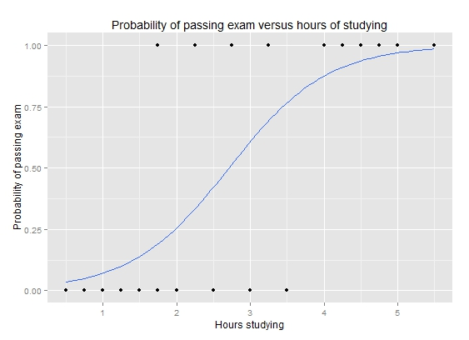
Response:Categorical Predictor: Continuous
Logistic regression
Parameter/effect size: odds ratio
https://upload.wikimedia.org/wikipedia/commons/6/6d/Exam_pass_logistic_curve.jpeg

Slide 13
How do I choose which statistical test to use?
Response variable
Categorical
Continuous
Continuous
Categorical
Predictor variable

Slide 14
Is gene differentially expressed between the two developmental time-points?

Slide 15
Convince a skeptic: Repeat this experiment 1000 times

Slide 16
Central limit theorem allows us to estimate the variation of the location of the distribution

Slide 17
Theoretical distribution of difference in means
Type I error and p-value

Slide 18
Alter underlying variation
sd=14
sd=24
sd=4

Slide 19
Alter the number of replicates
n=4
n=3
n=15

Slide 20
Power to detect a difference of means of -15
Type I and Type II error

Slide 21
Power to detect varying levels of difference in mean differences
Mean diff = -15
Mean diff = -25
Mean diff = -5

Slide 22
Expectations for this workshop

Slide 23
Outline for this workshop

