Slide 1
RNA-seq data analysis: From counts to differentially expressed genes using edgeR-quasi
Gladstone Institutes
Krishna Choudhary
Bioinformatics Core, GIDB
2020

Slide 2
Assumed background
Familiarity with R and RStudio
Familiarity with RNA-seq protocol
Familiarity with basic concepts of hypothesis testing

Slide 3
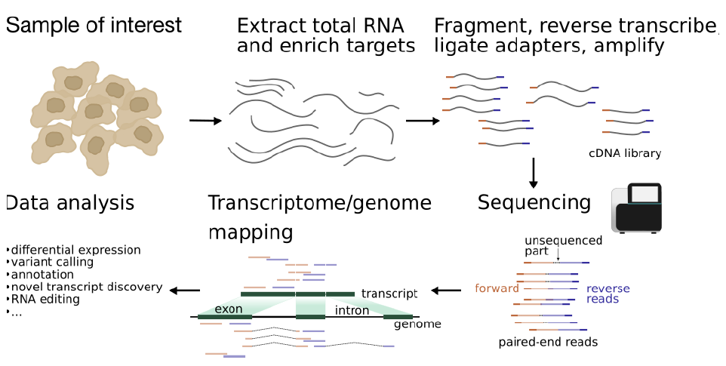
Typical protocol

Slide 4
Experiment design influences data analysis. (should be planned to address relevant questions)
What is the biological question that we seek to answer?
How many tissue types and/or time points to compare?
How deep should we sequence?
Read length?
Which sequencing platform?
Single-end or paired-end?
Pooling?
Biological replicates?
Technical replicates?
Additional considerations?
Not the subject matter today!
Workshop by Reuben Thomas:
Intro to statistics and experimental design.
Reading material:
RNA sequencing data : hitchhiker’s guide
to expression analysis by Berge et al., 2018

Slide 5


Sequencing center
FASTQ
Check quality
Trim adapters
Check quality
Map reads
Check quality
Tally counts
(See link in description for a detailed slide deck on pre-processing.)
Check quality
DGE analysis
The subject matter for today.
Notes:
See Intro to RNA-seq workshop materials at https://github.com/gladstone-institutes/Bioinformatics-Workshops/wiki/Introduction-to-RNA-Seq-Analysis

Slide 6
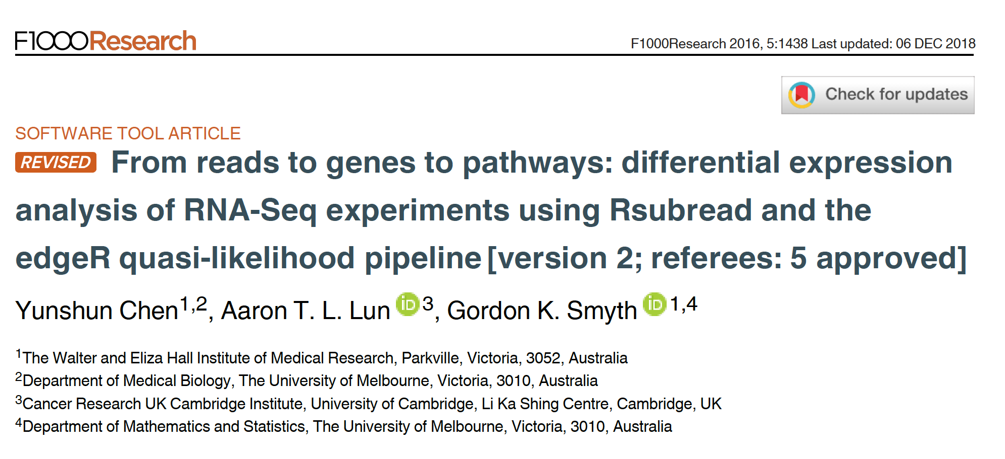
Reference for the workshop
Notes:
Relevant reading for theory:
1. Chen, Yunshun, Aaron TL Lun, and Gordon K. Smyth. "Differential expression analysis of complex RNA-seq experiments using edgeR." Statistical analysis of next generation sequencing data. Springer, Cham, 2014. 51-74.

Slide 7
Outline
Load and reformat the data
Exploratory visualization : MA plot
Create DGElist object and retrieve gene symbols
Filter genes with inadequate information
Normalize counts : What’s under the hood?
Exploratory visualization : MDS and PCA plots
Define and fit a model
Hypothesis testing (four example hypotheses)
Save results as a table and explore in Excel

Slide 8
Dataset
GEO accession: GSE60450
Tissue of origin: Mammary glands of mouse
Cell types: Basal stem-cell enriched cells (B) and committed luminal cells (L)
Biological conditions: Virgin, Lactating and Pregnant
# of groups: 2 cell types x 3 conditions = 6 groups
# of replicates: 2 of each group

Slide 9
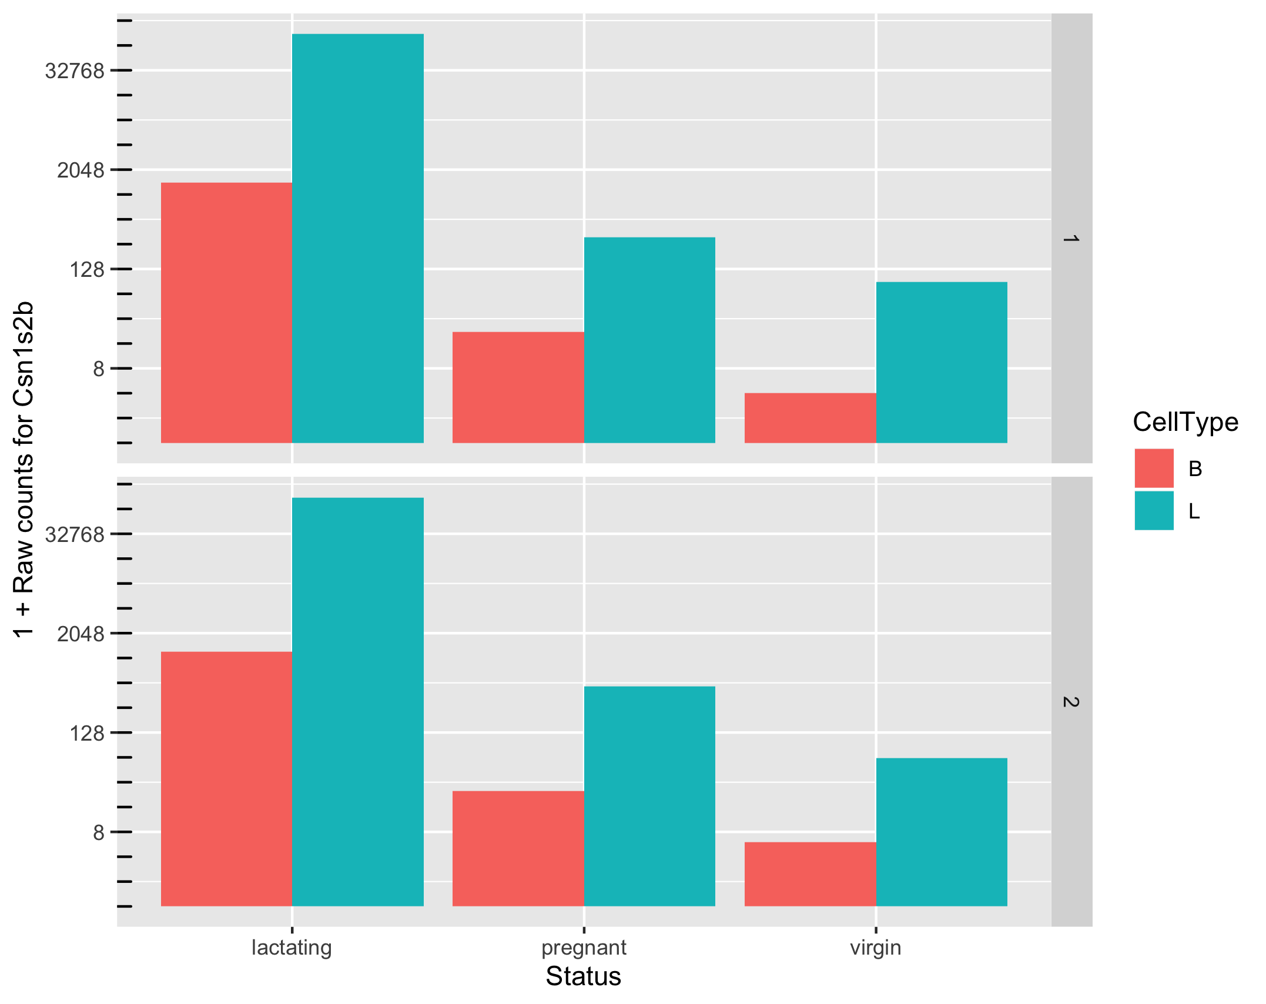
Goal: To identify a set of genes that are differentially expressed
Which comparisons are we interested in?
Example:
B vs L,
B.lactating vs L.pregnant,
...
All of them

Slide 10
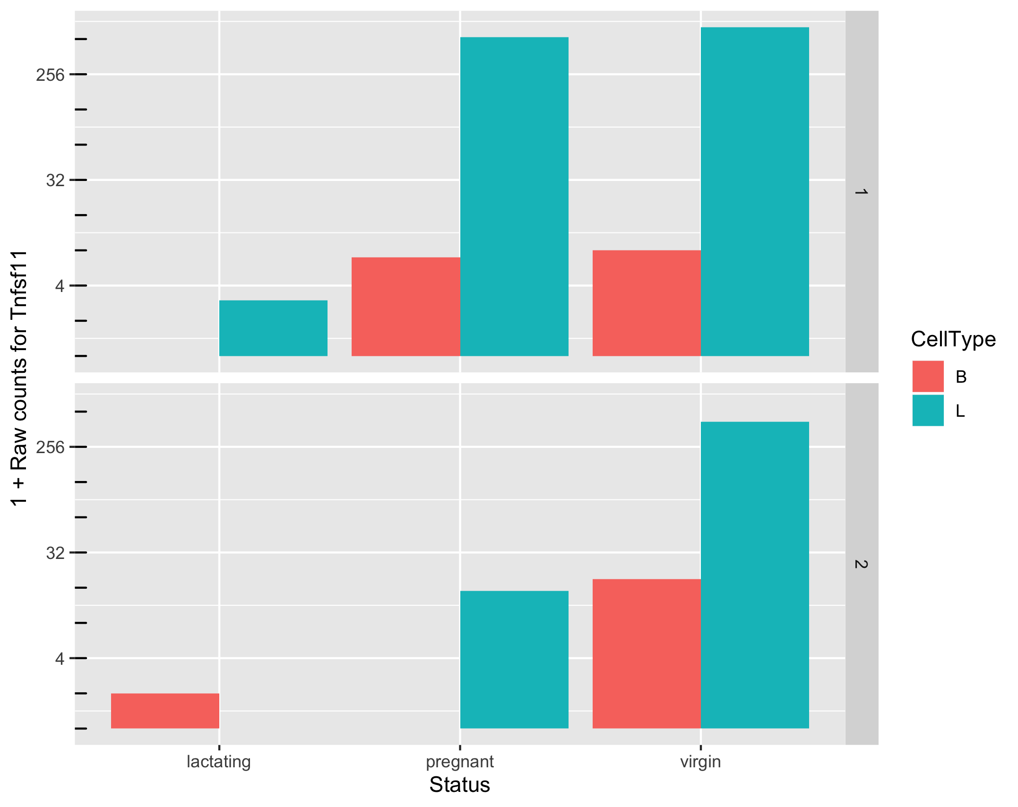
Goal: To identify a set of genes that are differentially expressed
How do we ensure high power for detection and high specificity when faced with noise?
Can we make reliable inferences for genes with very low counts? What should we consider “very low”?

Slide 11
Approach to identify DE genes:
edgeR utilizes a theoretical model that captures some of the known processes leading to noise in counts data. (null model)
Assume that the data is generated according to this model.
Given any observed level of difference in mean expression levels of a gene, compute the probability that the observation will result from the null model. (p value)
If the probability is very low (e.g., p < 0.05), infer that something may be happening that we did not account for in the null model. (e.g., biological processes in L cells for milk production)

Slide 12
Need to correct for multiple testing
P value represents the chance that we may be wrong in calling something significantly differential. Example:
P = 0.01 means 1% chance that we may be wrong.
P = 0.50 means 50% chance that we may be wrong.
More than 20k genes under consideration
=> if a certain difference in expression levels has only 1% chance of happening given the null model, it might be observed for 200 genes even if the null model were true for all the genes.
=> 200+ false positives
Hence, there is a need to adjust the p-values.
The more genes we test, the more we must adjust.
Reduce the number of tests by filtering out “uninteresting” genes.

Slide 13
Factors other than differential gene expression that cause variation in counts
Variation in sequencing depths => Need to normalize counts
Group | Total counts
B.virgin | 23085177
B.virgin | 21628857
B.pregnant | 23919152
B.pregnant | 22490570
B.lactating | 21382233
B.lactating | 19884434
Group | Total counts
L.virgin | 20213223
L.virgin | 21509988
L.pregnant | 22073815
L.pregnant | 21837341
L.lactating | 24638939
L.lactating | 24581591

Slide 14
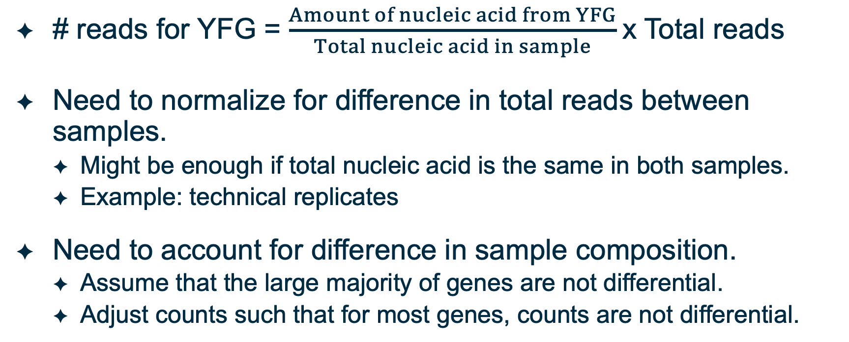
Observed counts depend on total reads sequenced and sample composition
# reads for YFG = $\frac{Amount of nucleic acid from YFG}{Total nucleic acid in sample}$x Total reads
Need to normalize for difference in total reads between samples.
Might be enough if total nucleic acid is the same in both samples.
Example: technical replicates
Need to account for difference in sample composition.
Assume that the large majority of genes are not differential.
Adjust counts such that for most genes, counts are not differential.

Slide 15
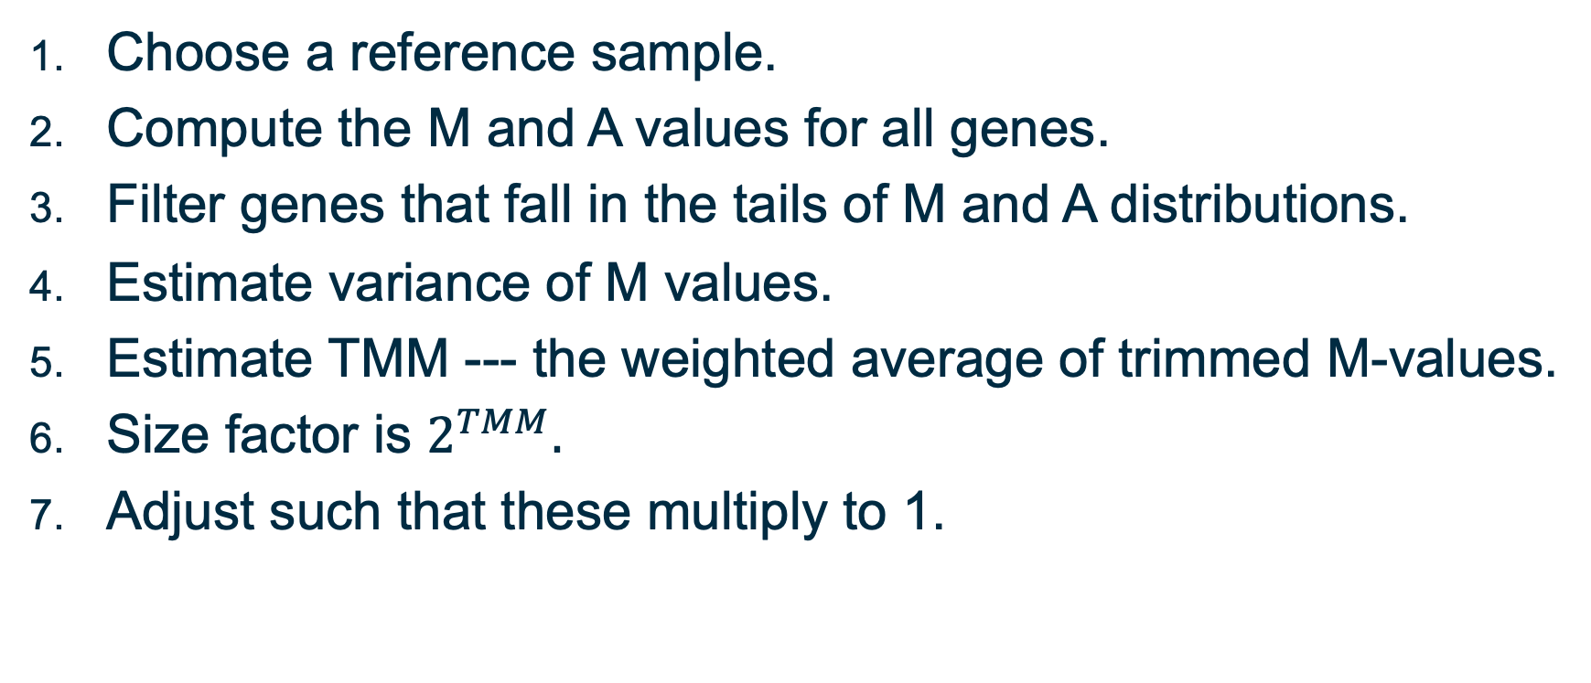
Normalization: Trimmed Mean of M-values
Choose a reference sample.
Compute the M and A values for all genes.
Filter genes that fall in the tails of M and A distributions.
Estimate variance of M values.
Estimate TMM --- the weighted average of trimmed M-values.
Size factor is $2^{TMM}.$
Adjust such that these multiply to 1.
Notes:
To see how the weights are calculated:
$M=\log_{2}\left(\frac{X_{2}}{N_{2}}\right)−\log_{2}\left(\frac{X_{ref}}{N_{ref}}\right)$
$⇒Var\left(M\right)=Var_{2}+Var_{ref},$where $Var_{ref}=Var\left(\log_{2}\left(\frac{X_{ref}}{N_{ref}}\right)\right)$
and $Var_{2}=Var\left(\log_{2}\left(\frac{X_{2}}{N_{2}}\right)\right)$.
Assume $N_{2}$ and $N_{ref}$ are constant.
$$⇒Var_{2}=Var\left(\log_{2}\left(X_{2}\right)\right)$$
$$and, Var_{ref}=Var\left(\log_{2}\left(X_{ref}\right)\right)$$
Note:
a. $Var\left(X\right)=X\left(1−\frac{X}{N}\right)$ if $X$ is binomially distributed.
b. In general, if $Y=aX$, then $Var\left(Y\right)=a^{2}Var(X)$.
c. The slope of $\log_{2}{(x)}$ at some $x_{0}$ is proportional to $\frac{1}{x_{0}}$.
$$⇒Var∝{\left(\frac{1}{X}\right)}^{2}.X\left(1−\frac{X}{N}\right)$$
$=\frac{N−X}{NX}$

Slide 16
Other approaches to normalization
RLE approach by Anders and Huber (2010)
Reference: geometric mean of all samples
Normalization factor: median ratio of each sample to the reference
Identical to TMM approach
See link in description for complete reference
Upper quartile normalization by Bullard et al (2010)
Normalization factor: 75% quantile of the counts for each sample
Not recommended in general
See link in description for complete reference
Notes:
Anders, S, Huber, W (2010). Differential expression analysis for sequence count data. Genome Biology 11, R106.
Bullard JH, Purdom E, Hansen KD, Dudoit S. (2010) Evaluation of statistical methods for normalization and differential expression in mRNA-Seq experiments. BMC Bioinformatics 11, 94.

Slide 17
MDS and PCA plots

Slide 18
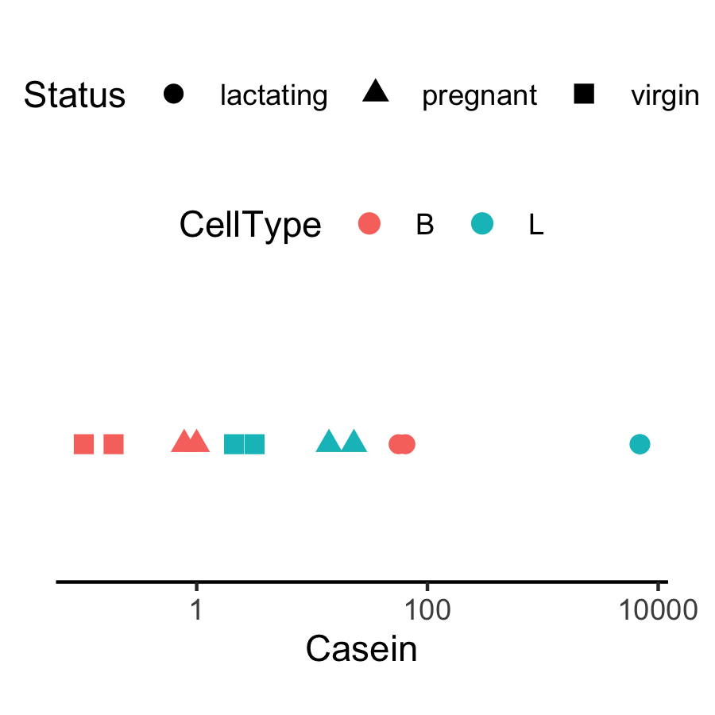
Expression level of Casein varies in a way that is strongly indicative of the effect of CellType and Status.
Why are the B.lactating samples not close to B.virgin and B.pregnant samples?
Could it be due to batch effects?

Slide 19
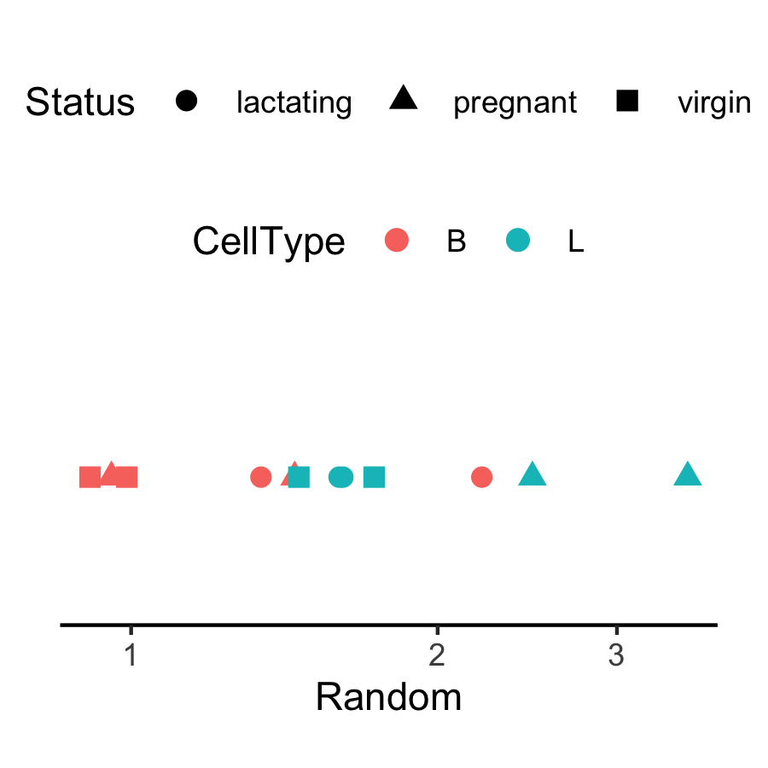
In general, the way expression appears to vary across samples could be dominated by noise, batch effects, real signal, etc.
Notes:
For multidimensional scaling and PCA:
Look up Ali Ghodsi’s lectures on youtube.

Slide 20
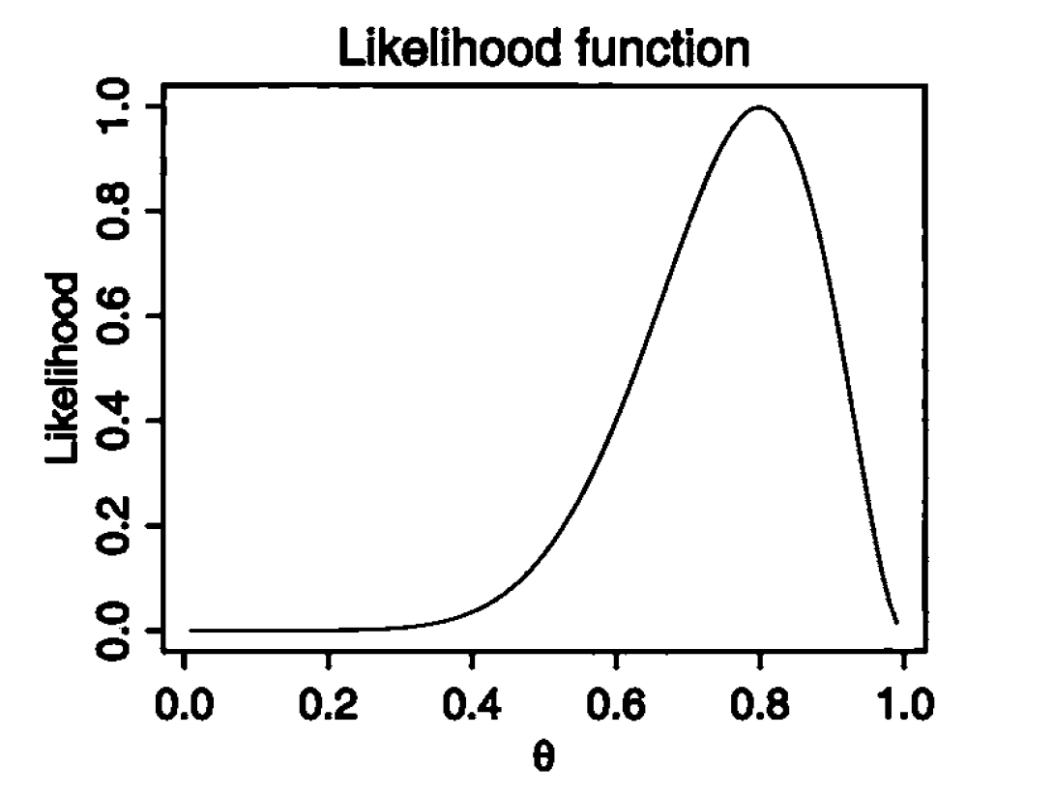
Maximum Likelihood Estimates: What’s the parameter value that makes the observed data the most likely observation?
Let’s run a “thought” experiment:
Say, we randomly pick 10 mRNA molecules from a sample.
We observe that 8 of them come from YFG.
What is the proportion of YFG molecules out of all the mRNAs?
Notes:
Book suggestion: In all likelihood by Yudi Pawitan

Slide 21
Empirical Bayes estimates of dispersion parameters: Learning from the experience of others
For an intuitive explanation by Bradley Efron, see link in description
Original paper: Robbins, Herbert. An Empirical Bayes Approach to Statistics. (see description for complete reference)
Notes:
https://smartech.gatech.edu/bitstream/handle/1853/35125/efron_videostream.html?sequence=8&isAllowed=y
Robbins, Herbert. An Empirical Bayes Approach to Statistics. Proceedings of the Third Berkeley Symposium on Mathematical Statistics and Probability, Volume 1: Contributions to the Theory of Statistics, 157--163, University of California Press, Berkeley, Calif., 1956. https://projecteuclid.org/euclid.bsmsp/1200501653
http://seqanswers.com/forums/showthread.php?t=5591

Slide 22
Upcoming workshops
Intro to Pathway Modeling
Whole Genome Sequence Analysis

Slide 23
Your feedback is important to us!
https://bioinformatics-course-feedback.questionpro.com/
~3 min.

Slide 24
Thank you.

