Slide 1
Statistical Hypothesis Testing Basics
Gladstone Institutes
Reuben Thomas
Associate Director/Staff Scientist @ Bioinformatics Core @ GIDB
09/14/2020

Slide 2
About me
Have been at Gladstone for over 6 years
Led statistical analysis covering a wide range of models on various data sets
Have a engineering and computational/statistical background via IIT Bombay, Northwestern University, NIH and Cal, Berkeley.

Slide 3
This workshop
Very basic introduction to the concepts and terminology of hypothesis testing
Some guidance on choosing tests in relatively simple situations
Hands-on training on implementing statistical tests in R, requires some basic familiarity in working with R/Rstudio

Slide 4
Terms one commonly encounters in hypothesis testing
Null hypothesis versus Alternative hypothesis
P-values
Two-sided test versus One-sided test
Test statistic
Sampling distribution
Type I and Type II errors (Power)
Multiple testing
Assumptions of different tests
Linear models
ANOVA

Slide 5
Typical scenario
Setting: I have generated data from very cool experiment that I hope would resolve a long standing question
Problem: I don’t know how to use my data to conclude in a convincing manner one way or other
Possible solution: Pose the problem as a statistical association problem
Changing something has a consequence on something else of biological relevance
E.g.: Change dose of drug treatment and phenotype changes

Slide 6
Outline
Introduction to hypothesis testing
Define variables
Choosing the right test
Basic concepts in hypothesis testing
Hands-on

Slide 7
Introduction to Hypothesis Testing
We would like to make generalizable claims about an entire target population with data from only a random subset of this population.
Random sampling, appropriate experimental design and Central Limit Theorem allows us to make generalizable claims
Hypothesis testing rests on assuming the skeptical point of view and testing for deviations from this assumption – Null versus Alternative Assumption

Slide 8
Outline
Introduction to hypothesis testing
Define variables
Choosing the right test
Basic concepts in hypothesis testing
Hands-on

Slide 9
Variables
Response: Gene expression, Chicken weight
Predictor: Genotype, treatment, chicken feed
Types: Categorical or Continuous
Categorical – genotype (mutant versus wild-type), disease vs normal
Continuous – age, dose of drug treatment

Slide 10
Outline
Introduction to hypothesis testing
Define variables
Choosing the right test
Basic concepts in hypothesis testing
Hands-on

Slide 11
How do I choose which statistical test to use?
Response variable
Categorical
X
X
Continuous
X
X
Continuous
Categorical/Factor
Predictor variable

Slide 12
Response:Continuous Predictor: Continuous
Linear regression
Parameter/effect size: slope

Slide 13
How do I choose which statistical test to use?
Response variable
Categorical
X
X
Continuous
X
Continuous
Categorical
Predictor variable

Slide 14
Response:Continuous Predictor: Categorical
T-tests, ANOVA
Parameter/effect size: difference of
means

Slide 15
How do I choose which statistical test to use?
Response variable
Categorical
X
X
Continuous
Continuous
Categorical
Predictor variable

Slide 16
Response:Categorical Predictor: Categorical
Fisher’s test, Chiq-square test, 2x2 tables
Parameter/effect size: odds ratio

Slide 17
How do I choose which statistical test to use?
Response variable
Categorical
X
Continuous
Continuous
Categorical
Predictor variable

Slide 18
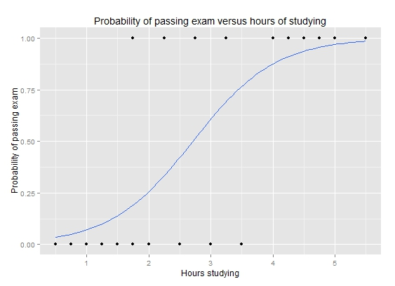
Response:Categorical Predictor: Continuous
Logistic regression
Parameter/effect size: odds ratio
https://upload.wikimedia.org/wikipedia/commons/6/6d/Exam_pass_logistic_curve.jpeg

Slide 19
How do I choose which statistical test to use?
Response variable
Categorical
Continuous
Continuous
Categorical
Predictor variable

Slide 20
Outline
Introduction to hypothesis testing
Define variables
Choosing the right test
Basic concepts in hypothesis testing
Hands-on

Slide 21
Is gene differentially expressed between the two developmental time-points?

Slide 22
Convince a skeptic: Repeat this experiment 1000 times

Slide 23
Central limit theorem allows us to estimate the variation of the location of the distribution

Slide 24
Theoretical distribution of difference in means
Observed difference
Type I error and p-value

Slide 25
Alter underlying variation
sd=14
sd=24
sd=4

Slide 26
Alter the number of replicates
n=4
n=3
n=15

Slide 27
Power to detect a difference of means of -15
Type I and Type II error

Slide 28
Power to detect varying levels of difference in mean differences
Mean diff = -15
Mean diff = -25
Mean diff = -5

Slide 29
Z/T-statistic (Two-sample t-test)

Slide 30
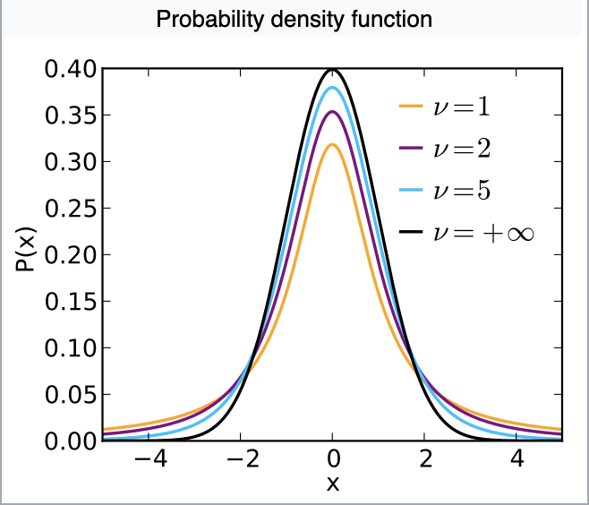
Sampling distribution of T-statistic
Notes:
https://en.wikipedia.org/wiki/Student%27s_t-distribution

Slide 31

U-statistic (Mann Whitney test, two sample test)

Slide 32
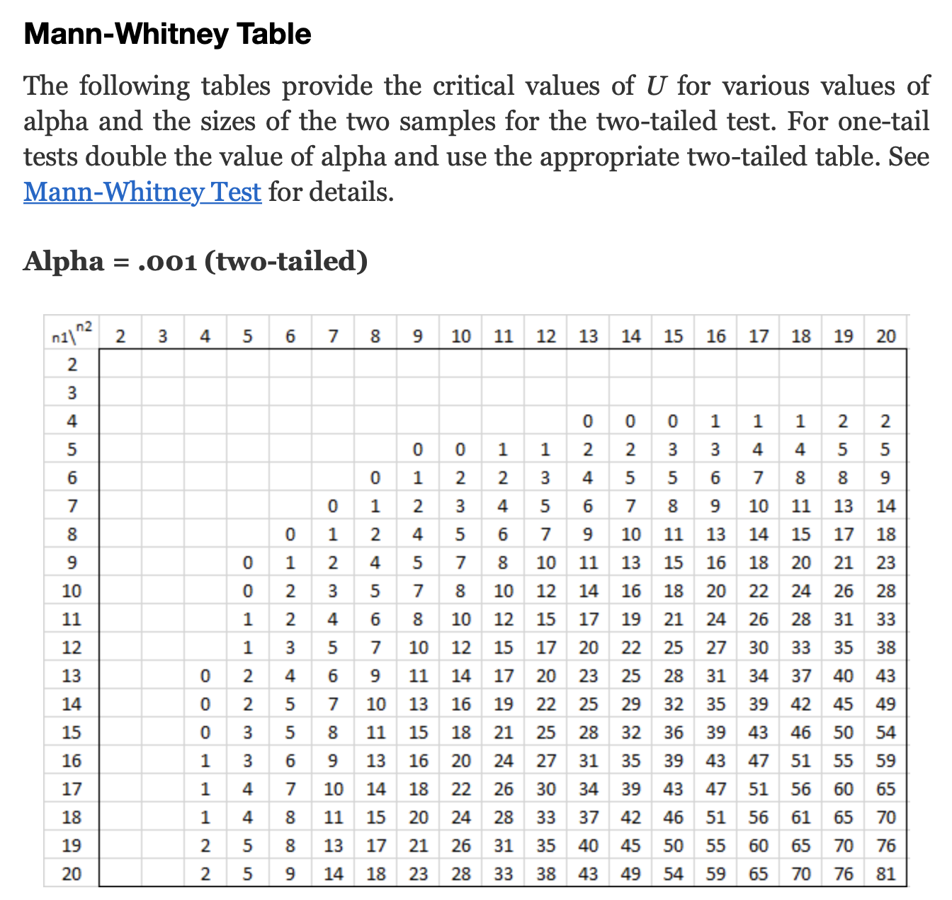
U-statistic sampling distribution in terms of tables
Critical value of statistic
Area of red shaded part=0.001
Notes:
http://www.real-statistics.com/statistics-tables/mann-whitney-table/

Slide 33

F-statistic (ANOVA)

Slide 34
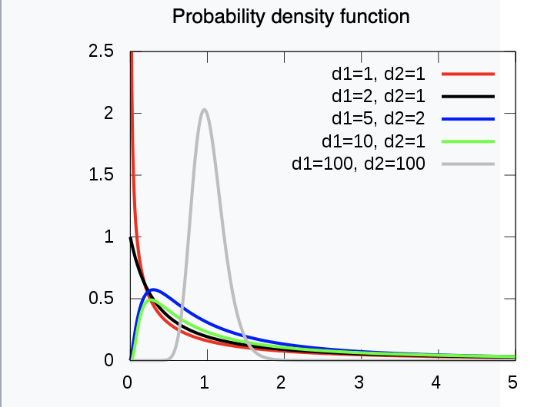
Sampling distribution of the F-statistic
Notes:
https://en.wikipedia.org/wiki/F-distribution

Slide 35
Why do we have so many different tests?
Sampling distribution derived via Central Limit Theorem only valid only if certain assumptions met with underlying data
E.g. of assumptions could be Normality, Equality of variances etc.

Slide 36
Every hypothesis test requires…
Test statistic
Sampling distribution of test statistic under the null hypothesis
A Type I error that will be allowable – fraction of times you are willing to accept a false-positive as a real result
Note: Use of test statistic and associated sampling distribution depends on your data meeting certain assumptions

Slide 37
Outline
Introduction to hypothesis testing
Define variables
Choosing the right test
Basic concepts in hypothesis testing
Hands-on

Slide 38
Please give feedback
Feedback survey: https://www.surveymonkey.com/r/RRTZPTC

Slide 39
Multiple tests

Slide 40
Outline for this workshop

