Slide 1

DMML Project: Laptop Price Regression
Università degli studi di Pisa
Artificial Intelligence and data engineering
Pietrangelo Manco

Slide 2

Introduction
Regression Analysis on Laptop Prices dataset
Predict the price of a configuration
Workflow:
Data inspection, cleaning and integration
Feature Engineering, transformation and reduction
Six different models tuned, trained and evaluated
Statistical test to select the best

Slide 3

The dataset
Kaggle Dataset scraped from a vendor’s website
Uncleaned data, 12 features, 1303 records
Index dropped
7 categorical features
4 numerical features

Slide 4
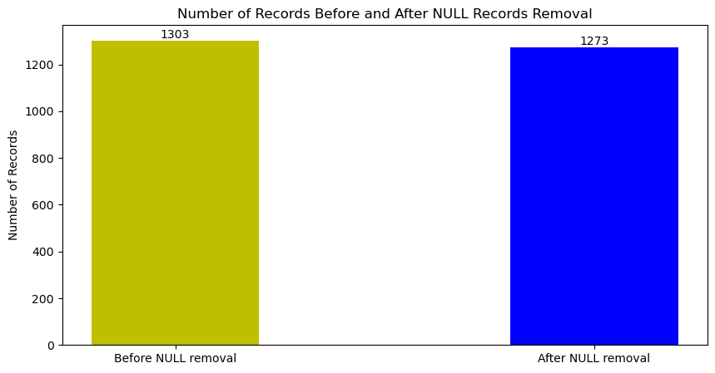
Pre-Processing: Cleaning
NULL records dropped
Unknown or wrong values addressed
Standardization
Categorical features converted to numerical
Name conventions implemented
Price conversion to euros
Unit of measure removed

Slide 5
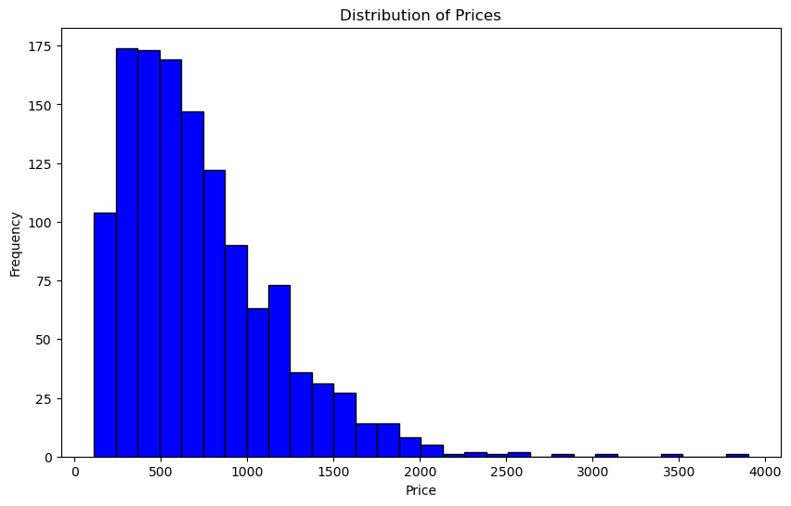
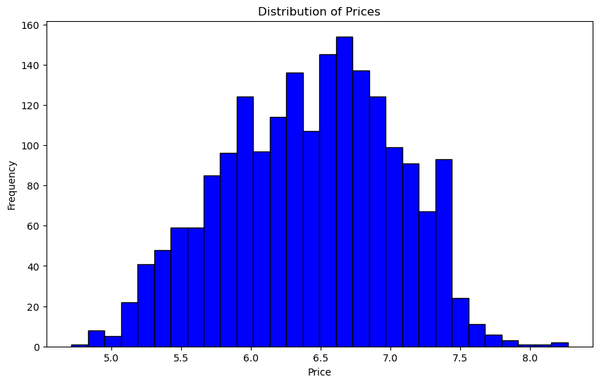
Pre-Processing: Feature Engineering
Split features
Memory, Gpu, Cpu
Merged features
Weight and Inches
Transformed features
ScreenResolution
Logarithmic transformation on target variable (Price)

Slide 6
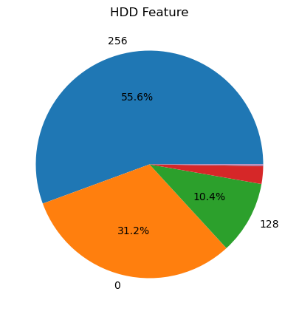
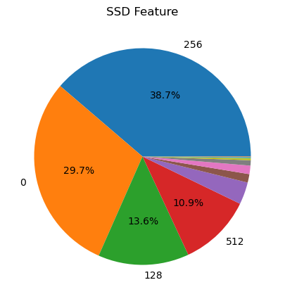
Feature Engineering: Memory
Split in HDD and SSD
Prior cleaning needed
Relevant price difference
NLP techniques

Slide 7
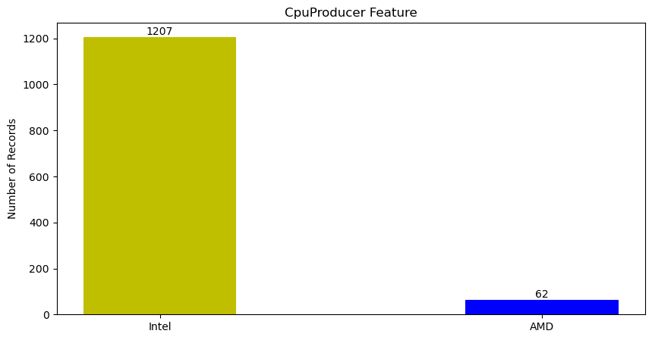
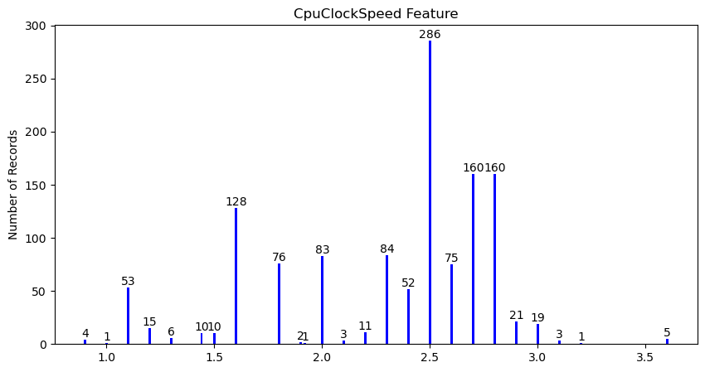
Feature Engineering: Cpu
Among the trickiest features to address
Lots of NLP to extract information
Split in 3
CpuProducer
CpuModel
CpuClockSpeed

Slide 8
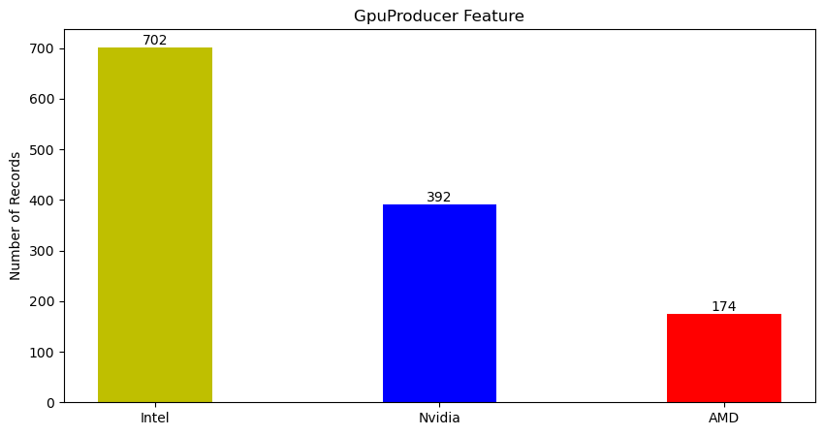
Feature Engineering: Gpu
Similar to Cpu attribute
More difficult to encode
Split in 2
GpuProducer
GpuModel

Slide 9
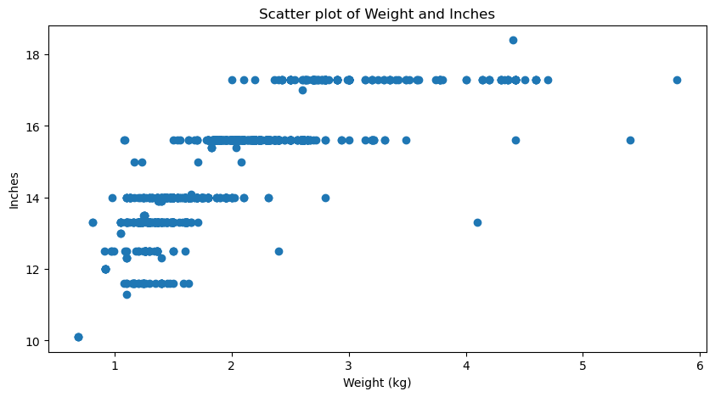
Feature Engineering: Weight and Inches
Weight and Inches features are expected to be correlated
Their correlation was verified
Their product was considered in their place

Slide 10
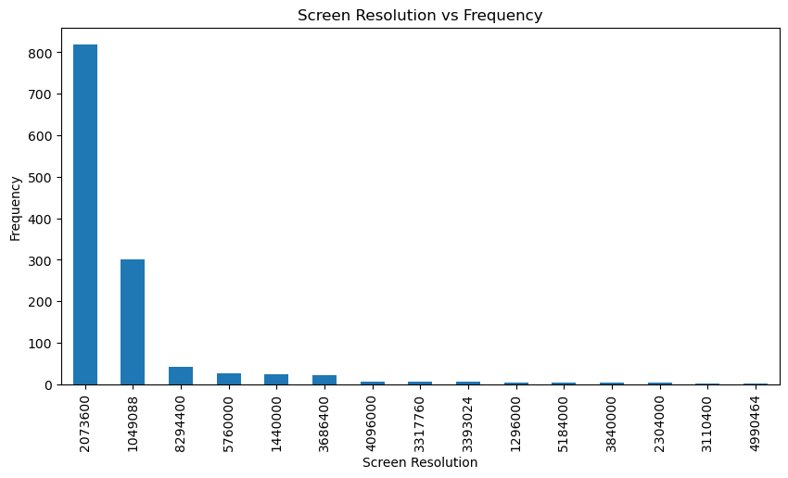
Feature Engineering: ScreenResolution
The important information is the product
AxB form after cleaning
NLP techniques to extract the 2 numbers and compute the product

Slide 11
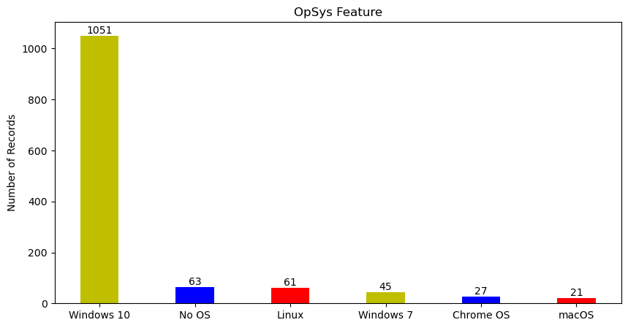
Pre-Processing: Feature Encoding
Categorical features must be transformed in numerical
If order doesn’t matter, one-hot encoding
Company
TypeName
OpSys
CpuProducer
GpuProducer

Slide 12
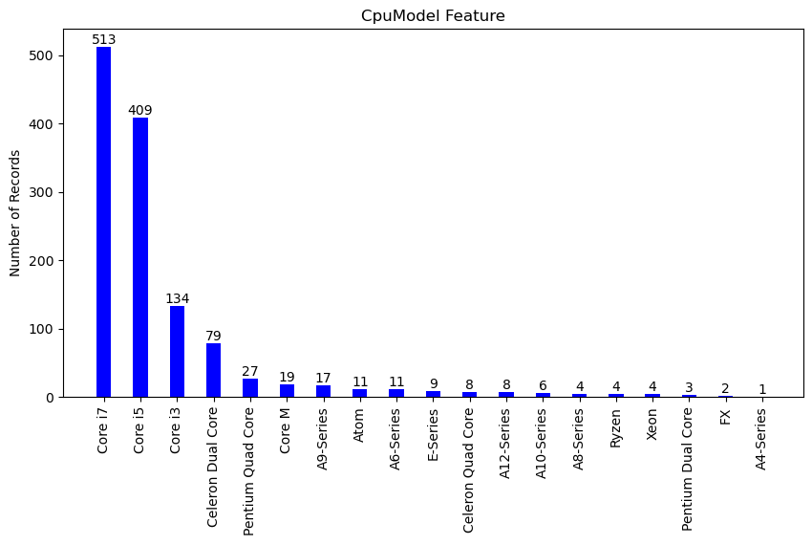
Feature Encoding: CpuModel
CpuModel is expected to be an important feature
Order matters
Manageable number of values: manual ordering
Ranking based on the position in the ordered list

Slide 13
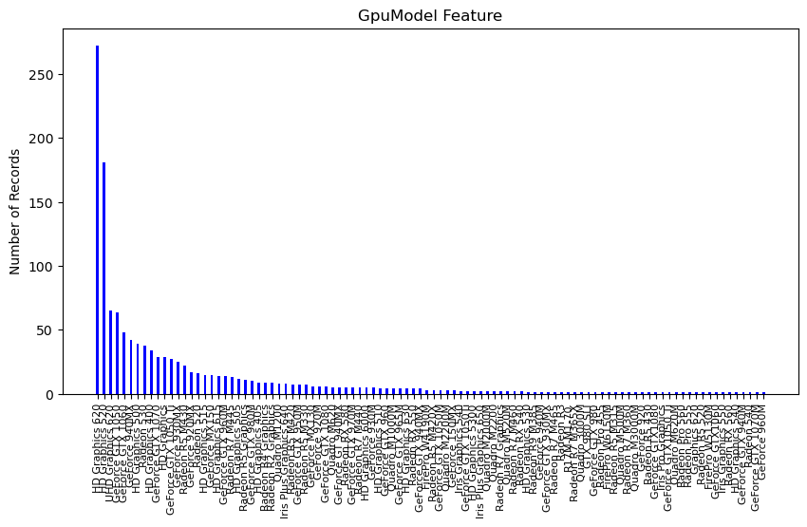
Feature Encoding: GpuModel
Like CpuModel, important feature
Far too many values to manual order
Solution: mean encoding + ranking
Each values was assigned the mean price of its records
Then ranking to avoid leakage

Slide 14
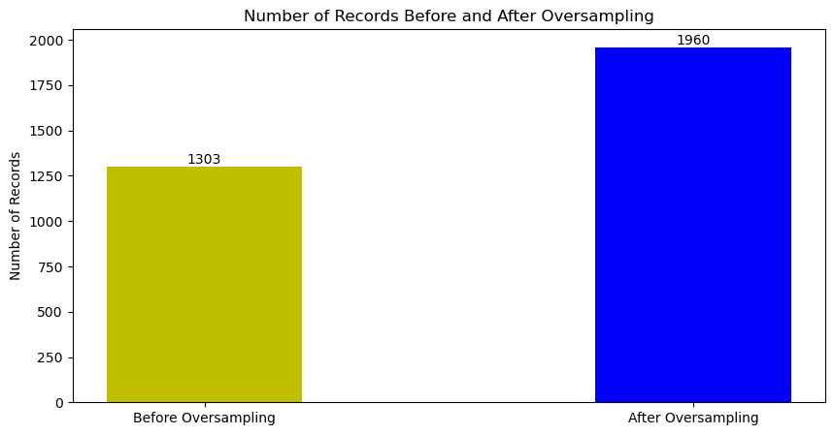
Pre-Processing: Oversampling
Price distribution is very right-skewed
High end laptops’ price may be difficult to predict
SMOGN: smote for regression + gaussian rumor
50% oversampling

Slide 15
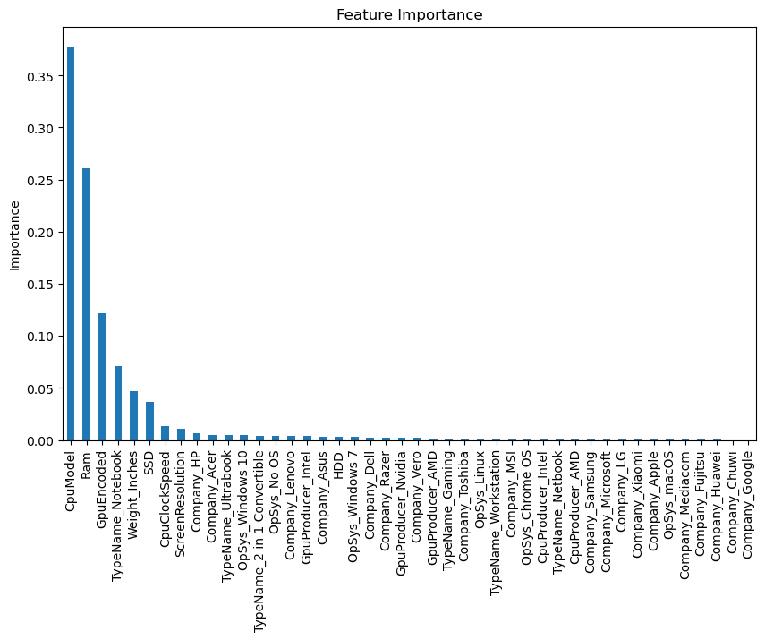
Pre-Processing: Feature Selection
Many features after encoding
RandomTree model to compute importance
Low threshold to keep a feature because of one-hot encoded ones
25 features kept out of 44
CpuModel, Ram and GpuModel are the most important

Slide 16
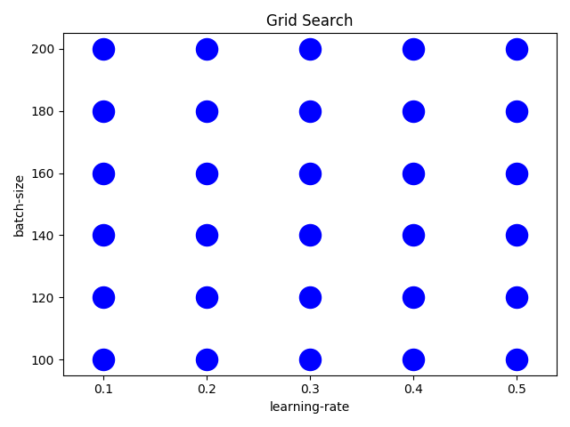
Regression Models Training
RobustScaler
6 models tried
LinearRegression
DecisionTreeRegressor
KNearestNeighboursRegressor
RandomForestRegressor
AdaBoostRegressor
GradientBoostingRegressor
Hyperparameters’ tuned with grid search
Pipeline to prevent leakage

Slide 17
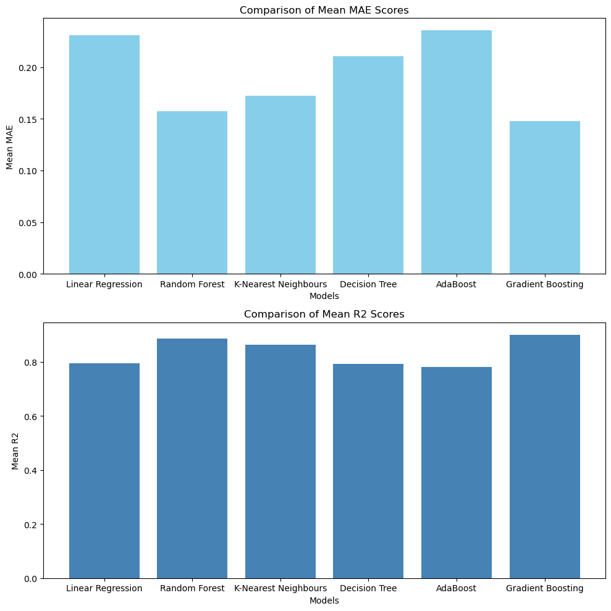
Regression Models Evaluation
10-fold cross validation
Same folds for all models
Mean Absolute Error and R²
Custom evaluation metrics to revert logarithm
Best models are K-Nearest Neighbours, RandomForest and GradientBoosting

Slide 18
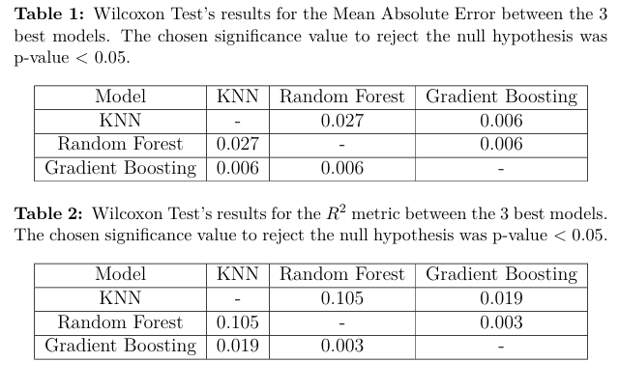
Regression Models Comparison
Wilcoxon test was applied to confront the best models
GradientBoosting is statistically the best
RandomForest is better than KNN according to mean absolute error
Difference between them in R² are due to chance

Slide 19
Thanks for the attention.

