Slide 1

AIRPORT PASSENGERS FLOW
BPR and Performance Analysis
Pietro Ruffo Othman Al-Akhali

Slide 2
Objective
To study the workflow of a typical airport and analyze the time that is required to reach the plane from the entrance point as well as the amount of time spent queuing.
This project will be done using the YASPER tool, which is used to specify and execute models of discrete-step processes.

Slide 3
General Features
High volume of passengers
High-speed
Resilient to stressful scenarios
Coordination with other processes (flights, baggage process etc.)

Slide 4
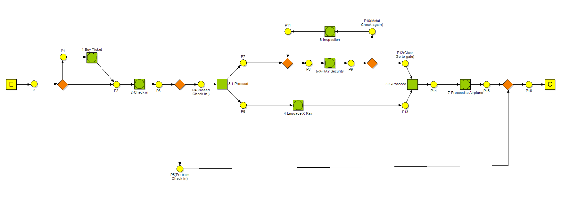

Slide 5
The YASPER Layout shown above illustrates how the project was carried out, and the steps that a passenger would take to reach the plane.
The steps that are taken to reach the plane are:
Buy a ticket (Task 1)
Check in (Task 2)
Go to the security gates (Task 3)
Luggage X-Ray (Task 4)
Security X-ray and Inspection (Task 5 & Task 6)
Proceed to the Airplane (Task 7)

Slide 6
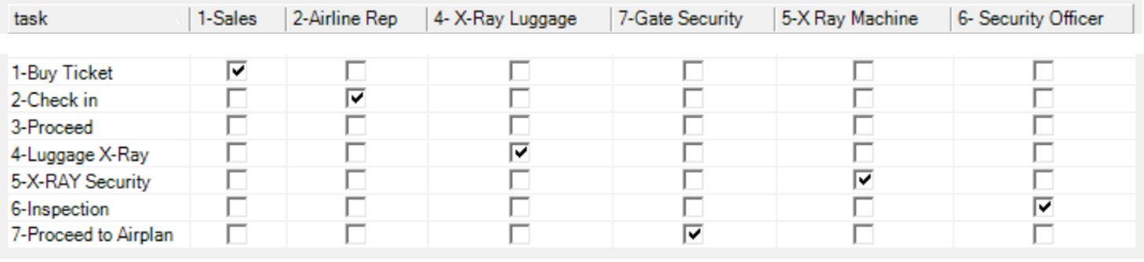
Roles of Tasks

Slide 7
Concepts Applied It will be extremely useful to quickly recap some basic theory concepts behind the software and the methodological tools used for modelling: -CTMC -Ergodic Process -Gamma and Exponential Distribution - Queueing theory -Little’s Theorem -MM1 and MM2

Slide 8
CTMC
A Markov chain is a mathematical system that experiences transitions from one state to another according to certain probabilistic rules. The defining characteristic of a Markov chain is that the probability of transitioning to any particular state is dependent only on the current state and time elapsed.
A Markov chain is a stochastic process, but it differs from a general stochastic process because a Markov chain must be "memory-less." That is, the probability of future actions is not dependent upon the steps that led up to the present state. This is called the Markov property.
A continuous-time stochastic process is called a continuous-time Markov Chain (CTMC) if it has the Markov property.

Slide 9
Ergodic Process
One of the most important properties of a CTMC is ergodicity.
A stochastic process is said to be ergodic if starting conditions do not influence what will happen in the system. By carrying out a long simulation it is possible to “forget” what happened at the beginning of the process. In other words, its statistical properties can be deduced from a single, sufficiently long, random sample of the process.

Slide 10
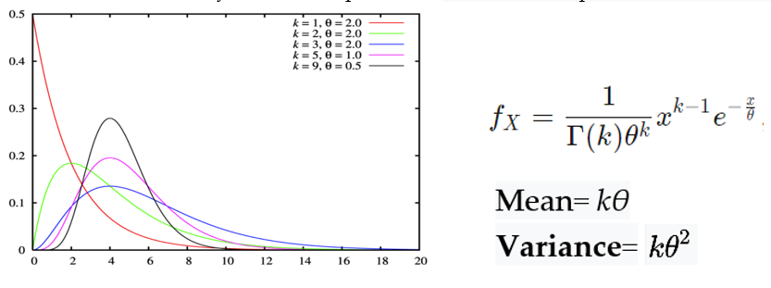
Gamma Distribution
Time will be modelled by using an exponential distribution which is a particular case of the gamma distribution.
The Gamma distribution is widely used in engineering, science, and business, to model continuous variables that are always positive and have skewed distributions (such as time in a poisson process). The parameters k defines the shape while θ indicates the scale.

Slide 11
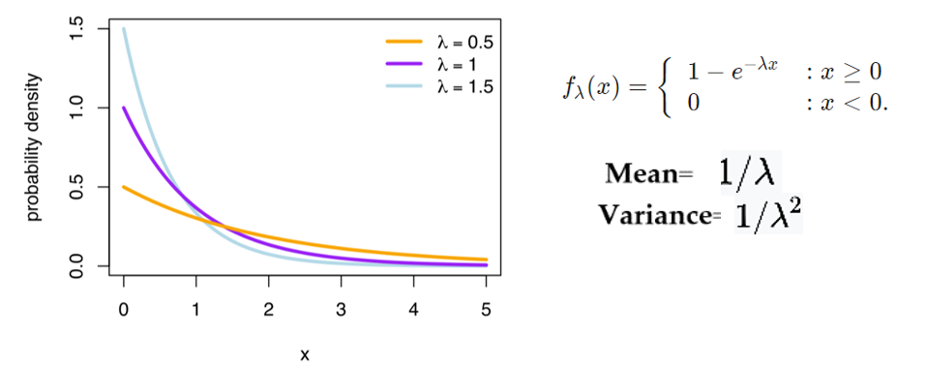
Exponential Distribution
In Yasper the parameter k is equal to 1, this is because by setting mean and standard deviation equal, it will be possible to obtain a negative exponential distribution that has the property of being memoryless as well.

Slide 12
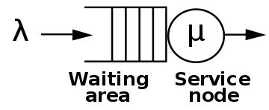
Queueing theory
Queueing theory is the mathematical study of waiting lines, or queues.
The parameters on which the analysis will focus are:
λ = mean arrival rate (expected # arrivals per unit time)
μ = mean service rate for a busy server
1/λ = expected interarrival time
1/μ = expected service time
ρ= λ / μ = utilization factor for the service facility (it must be lower than 0.75, never above 1)
L is the mean # of customers in the system (waiting area plus the service area)
W is the mean time for a customer to go through the system
Lq is the mean # of customers in the queue (waiting area)
Wq is the mean waiting time for a customer in the queue (waiting area)

Slide 13

Little’s Theorem
In queueing theory, Little's theorem states that the long-term average number L of customers in a stationary system is equal to the long-term average effective arrival rate λ multiplied by the average time W that a customer spends in the system. Expressed algebraically the law is:
Although it looks intuitively easy, it is quite a remarkable result, as the relationship is not influenced by the arrival process distribution, the service distribution, the service order, or practically anything else.

Slide 14
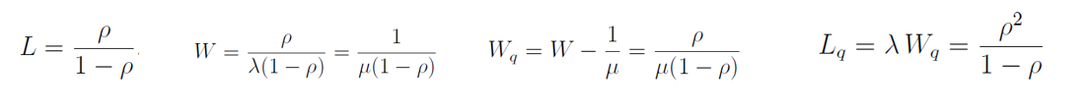
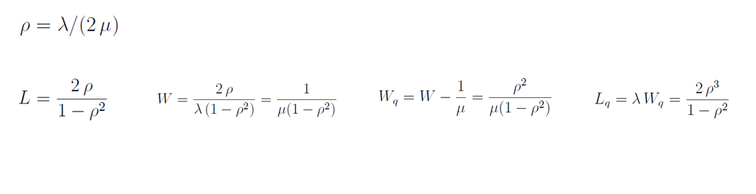
MM1 & MM2
The focus will be on two types of queues MM1 and MM2. Where the first M represents the interarrival time, the second one the service time and 1 and 2 indicates the number of servers.
For MM1 the performance measures will be:
For MM2 the performance measures will be:

Slide 15
PERFORMANCE ANALYSIS

Slide 16
Task 1 - Buying Tickets
Task one in the layout is mainly concerned with buying the ticket before going to the check-in points in the airport.
There is a small probability of customers reaching the airport and buying their own tickets there, which is 15% (while in the 85% of cases they bought it online).
It requires a longer time to buy a ticket since it needs all the details to be entered, as a result it is better to use multiple servers as it makes the work goes faster.
If the process carries with one server the values of ρ become more than 0.75 in most of the possible scenarios of λE .

Slide 18
Task1- MM1
Expected Interarrival Time (Emitor) (seconds) 1/λE | Mean Arrival Rate (Emitor) λE |  | Mean Arrival Rate λ1 | Expected Interarrival Time (seconds) 1/λ1 | Expected Service Time (seconds) 1/μ1 | Mean Service Rate for a Busy Server μ1 | Traffic Intensity ρ1 | Mean # of Customers in the System L1 | Mean time for a customer to go through the system (seconds) W1 | Mean # of Customers in the Queue Lq1 | Mean waiting time for a customer in the queue (seconds) Wq1
35 | 0.029 |  | 0.0042857 | 233.33333 | 300 | 0.003333 | 1.2857 | -4.5 | -1050 | -5.78571 | -1350
40 | 0.025 |  | 0.00375 | 266.66667 | 300 | 0.003333 | 1.1250 | -9 | -2400 | -10.125 | -2700
45 | 0.022 |  | 0.0033333 | 300 | 300 | 0.003333 | 1.0000 | #DIV/0! | #DIV/0! | #DIV/0! | #DIV/0!
50 | 0.020 |  | 0.003 | 333.33333 | 300 | 0.003333 | 0.9000 | 9 | 3000 | 8.1 | 2700
55 | 0.018 |  | 0.0027273 | 366.66667 | 300 | 0.003333 | 0.8182 | 4.5 | 1650 | 3.681818 | 1350
60 | 0.017 |  | 0.0025 | 400 | 300 | 0.003333 | 0.7500 | 3 | 1200 | 2.25 | 900
65 | 0.015 |  | 0.0023077 | 433.33333 | 300 | 0.003333 | 0.6923 | 2.25 | 975 | 1.557692 | 675
70 | 0.014 |  | 0.0021429 | 466.66667 | 300 | 0.003333 | 0.6429 | 1.8 | 840 | 1.157143 | 540
75 | 0.013 |  | 0.002 | 500 | 300 | 0.003333 | 0.6000 | 1.5 | 750 | 0.9 | 450
80 | 0.013 |  | 0.001875 | 533.33333 | 300 | 0.003333 | 0.5625 | 1.28571 | 685.7143 | 0.723214 | 385.7143

Slide 19
Task 1- MM2
 |  |  | Task T1 Buy Ticket MM2
Expected Interarrival Time (Emitor) (seconds) 1/λE | Mean Arrival Rate (Emitor) λE |  | Mean Arrival Rate λ1 | Expected Interarrival Time (seconds) 1/λ1 | Expected Service Time (seconds) 1/μ1 | Mean Service Rate for a Busy Server μ1 | Traffic Intensity ρ1 | Mean # of Customers in the System L1 | Mean time for a customer to go through the system (seconds) W1 | Mean # of Customers in the Queue Lq1 | Mean waiting time for a customer in the queue (seconds) Wq1
35 | 0.029 |  | 0.0042857 | 233.33333 | 300 | 0.003333 | 0.6429 | 2.1913 | 511.3043 | 0.90559 | 211.3043
40 | 0.025 |  | 0.00375 | 266.66667 | 300 | 0.003333 | 0.5625 | 1.64571 | 438.8571 | 0.520714 | 138.8571
45 | 0.022 |  | 0.0033333 | 300 | 300 | 0.003333 | 0.5000 | 1.33333 | 400 | 0.333333 | 100
50 | 0.020 |  | 0.003 | 333.33333 | 300 | 0.003333 | 0.4500 | 1.12853 | 376.1755 | 0.228527 | 76.17555
55 | 0.018 |  | 0.0027273 | 366.66667 | 300 | 0.003333 | 0.4091 | 0.98263 | 360.2978 | 0.164448 | 60.29777
60 | 0.017 |  | 0.0025 | 400 | 300 | 0.003333 | 0.3750 | 0.87273 | 349.0909 | 0.122727 | 49.09091
65 | 0.015 |  | 0.0023077 | 433.33333 | 300 | 0.003333 | 0.3462 | 0.78655 | 340.8403 | 0.094247 | 40.84034
70 | 0.014 |  | 0.0021429 | 466.66667 | 300 | 0.003333 | 0.3214 | 0.71693 | 334.5661 | 0.07407 | 34.56615
75 | 0.013 |  | 0.002 | 500 | 300 | 0.003333 | 0.3000 | 0.65934 | 329.6703 | 0.059341 | 29.67033
80 | 0.013 |  | 0.001875 | 533.33333 | 300 | 0.003333 | 0.2813 | 0.61082 | 325.7688 | 0.048317 | 25.76882

Slide 20
Task 1- Graphic Analysis
From the graph above, it is possible to see that as the interarrival time increases for the task, the value of traffic decreases. In other words, the slower the passengers are the shorter the queues . But it also possible to notice that MM1 and MM2 have very different values, where using MM2 there are no values of ρ above 0.75, which means that using multiple servers help in making the flow faster.

Slide 21
Task 2 - Check in
Task two is about the physical check-in at the airport. Although the expected service time is low (only 60 seconds) it could potentially turn into a bottleneck since each and every passenger entering the airport will go through this step.
This is why MM2 is a better implementation for the process to go smooth.

Slide 23
Task 2-MM1
 |  |  | Task T2 Check in MM1
Expected Interarrival Time (Emitor) (seconds) 1/λE | Mean Arrival Rate (Emitor) λE |  | Mean Arrival Rate λ2 | Expected Interarrival Time (seconds) 1/λ2 | Expected Service Time (seconds) 1/μ2 | Mean Service Rate for a Busy Server μ2 | Traffic intensity ρ2 | Mean # of Customers in the System L2 | Mean time for a customer to go through the system (seconds) W2 | Mean # of Customers in the Queue Lq2 | Mean waiting time for a customer in the queue (seconds) Wq2
35 | 0.029 |  | 0.029 | 35 | 60 | 0.016667 | 1.7143 | -2.4 | -84 | -4.11429 | -144
40 | 0.025 |  | 0.025 | 40 | 60 | 0.016667 | 1.5000 | -3 | -120 | -4.5 | -180
45 | 0.022 |  | 0.022 | 45 | 60 | 0.016667 | 1.3333 | -4 | -180 | -5.33333 | -240
50 | 0.020 |  | 0.020 | 50 | 60 | 0.016667 | 1.2000 | -6 | -300 | -7.2 | -360
55 | 0.018 |  | 0.018 | 55 | 60 | 0.016667 | 1.0909 | -12 | -660 | -13.0909 | -720
60 | 0.017 |  | 0.017 | 60 | 60 | 0.016667 | 1.0000 | #DIV/0! | #DIV/0! | #DIV/0! | #DIV/0!
65 | 0.015 |  | 0.015 | 65 | 60 | 0.016667 | 0.9231 | 12 | 780 | 11.07692 | 720
70 | 0.014 |  | 0.014 | 70 | 60 | 0.016667 | 0.8571 | 6 | 420 | 5.142857 | 360
75 | 0.013 |  | 0.013 | 75 | 60 | 0.016667 | 0.8000 | 4 | 300 | 3.2 | 240
80 | 0.013 |  | 0.013 | 80 | 60 | 0.016667 | 0.7500 | 3 | 240 | 2.25 | 180

Slide 24
Task 2- MM2
 |  |  | Task T2 Check in MM2
Expected Interarrival Time (Emitor) (seconds) 1/λE | Mean Arrival Rate (Emitor) λE |  | Mean Arrival Rate λ2 | Expected Interarrival Time (seconds) 1/λ2 | Expected Service Time 1/μ2 | Mean Service Rate for a Busy Server μ2 | Traffic Intensity ρ2 | Mean # of Customers in the System L2 | Mean time for a customer to go through the system W2 | Mean # of Customers in the Queue Lq2 | Mean waiting time for a customer in the queue Wq2
35 | 0.029 |  | 0.029 | 35 | 60 | 0.016667 | 0.8571 | 6.461538 | 226.1538 | 4.747253 | 166.1538
40 | 0.025 |  | 0.025 | 40 | 60 | 0.016667 | 0.7500 | 3.428571 | 137.1429 | 1.928571 | 77.14286
45 | 0.022 |  | 0.022 | 45 | 60 | 0.016667 | 0.6667 | 2.4 | 108 | 1.066667 | 48
50 | 0.020 |  | 0.020 | 50 | 60 | 0.016667 | 0.6000 | 1.875 | 93.75 | 0.675 | 33.75
55 | 0.018 |  | 0.018 | 55 | 60 | 0.016667 | 0.5455 | 1.552941 | 85.41176 | 0.462032 | 25.41176
60 | 0.017 |  | 0.017 | 60 | 60 | 0.016667 | 0.5000 | 1.333333 | 80 | 0.333333 | 20
65 | 0.015 |  | 0.015 | 65 | 60 | 0.016667 | 0.4615 | 1.172932 | 76.2406 | 0.249855 | 16.2406
70 | 0.014 |  | 0.014 | 70 | 60 | 0.016667 | 0.4286 | 1.05 | 73.5 | 0.192857 | 13.5
75 | 0.013 |  | 0.013 | 75 | 60 | 0.016667 | 0.4000 | 0.952381 | 71.42857 | 0.152381 | 11.42857
80 | 0.013 |  | 0.013 | 80 | 60 | 0.016667 | 0.3750 | 0.872727 | 69.81818 | 0.122727 | 9.818182

Slide 25
Task 2 - Graphic Analysis
The graph above shows the relation between the expected interarrival time to the mean waiting time in a queue per passenger, the chart has two lines one representing MM1 and the other MM2. For a single server there will be a very large waiting time per passenger where it reduces when it goes with two servers, which means that the work is moving smoother.

Slide 26
-AND
Once the check-in has been executed, there are 95% probabilities it has been approved and only 5% chances it has not (e.g. I.D. expired). In the last scenario the passenger’s token will go straight to the collector, leaving the system. In case of a positive outcome, the passenger is allowed to proceed further for the security check of both their body and hand luggage.
This chunk of the process is carried out through three tasks: Luggage X-ray, X-ray Security and Inspection.
-The smartest logical construction for allocate these tasks is the -AND.

Slide 28
Task 4 – Luggage X-ray
At this point the passenger will lean their hand luggage on the conveyor belt to be scanned.
This task will be carried out by a machine with human supervision.
The task itself requires little time to be completed, however, due to the high volume of passengers, one server is not enough and could undermine the stability of the whole process, this is because an MM2 solution guarantees a better performance as the analysis has shown.

Slide 29
Task 4 - MM1
 |  |  | Task T4 Luggage X-RAY MM1
Expected Interarrival Time (Emitor) (seconds) 1/λE | Mean Arrival Rate (Emitor) λE |  | Mean Arrival Rate λ4 | Expected Interarrival Time (seconds) 1/λ4 | Expected Service Time (seconds) 1/μ4 | Mean Service Rate for a Busy Server μ4 | ρ4 | Mean # of Customers in the System L1 | Mean time for a customer to go through the system (seconds) W4 | Mean # of Customers in the Queue Lq4 | Mean waiting time for a customer in the queue (seconds) Wq4
35 | 0.029 |  | 0.027143 | 36.84211 | 40 | 0.025 | 1.0857 | -12.6667 | -466.667 | -13.7524 | -506.667
40 | 0.025 |  | 0.02375 | 42.10526 | 40 | 0.025 | 0.9500 | 19 | 800 | 18.05 | 760
45 | 0.022 |  | 0.021111 | 47.36842 | 40 | 0.025 | 0.8444 | 5.428571 | 257.1429 | 4.584127 | 217.1429
50 | 0.020 |  | 0.019 | 52.63158 | 40 | 0.025 | 0.7600 | 3.166667 | 166.6667 | 2.406667 | 126.6667
55 | 0.018 |  | 0.017273 | 57.89474 | 40 | 0.025 | 0.6909 | 2.235294 | 129.4118 | 1.544385 | 89.41176
60 | 0.017 |  | 0.015833 | 63.15789 | 40 | 0.025 | 0.6333 | 1.727273 | 109.0909 | 1.093939 | 69.09091
65 | 0.015 |  | 0.014615 | 68.42105 | 40 | 0.025 | 0.5846 | 1.407407 | 96.2963 | 0.822792 | 56.2963
70 | 0.014 |  | 0.013571 | 73.68421 | 40 | 0.025 | 0.5429 | 1.1875 | 87.5 | 0.644643 | 47.5
75 | 0.013 |  | 0.012667 | 78.94737 | 40 | 0.025 | 0.5067 | 1.027027 | 81.08108 | 0.52036 | 41.08108
80 | 0.013 |  | 0.011875 | 84.21053 | 40 | 0.025 | 0.4750 | 0.904762 | 76.19048 | 0.429762 | 36.19048

Slide 30
Task 4 – MM2
 |  |  | Task T4 Luggage X-RAY MM2
Expected Interarrival Time (Emitor) (seconds) 1/λE | Mean Arrival Rate (Emitor) λE |  | Mean Arrival Rate λ4 | Expected Interarrival Time (seconds) 1/λ4 | Expected Service Time (seconds) 1/μ4 | Mean Service Rate for a Busy Server μ4 | ρ4 | Mean # of Customers in the System L1 | Mean time for a customer to go through the system (seconds) W4 | Mean # of Customers in the Queue Lq4 | Mean waiting time for a customer in the queue (seconds) Wq4
35 | 0.029 |  | 0.027143 | 36.84211 | 40 | 0.025 | 0.5429 | 1.539352 | 56.71296 | 0.453638 | 16.71296
40 | 0.025 |  | 0.02375 | 42.10526 | 40 | 0.025 | 0.4750 | 1.226796 | 51.65456 | 0.276796 | 11.65456
45 | 0.022 |  | 0.021111 | 47.36842 | 40 | 0.025 | 0.4222 | 1.027644 | 48.67788 | 0.1832 | 8.677885
50 | 0.020 |  | 0.019 | 52.63158 | 40 | 0.025 | 0.3800 | 0.888266 | 46.75082 | 0.128266 | 6.750818
55 | 0.018 |  | 0.017273 | 57.89474 | 40 | 0.025 | 0.3455 | 0.784535 | 45.42042 | 0.093625 | 5.42042
60 | 0.017 |  | 0.015833 | 63.15789 | 40 | 0.025 | 0.3167 | 0.703921 | 44.45817 | 0.070588 | 4.458166
65 | 0.015 |  | 0.014615 | 68.42105 | 40 | 0.025 | 0.2923 | 0.639234 | 43.73706 | 0.054619 | 3.73706
70 | 0.014 |  | 0.013571 | 73.68421 | 40 | 0.025 | 0.2714 | 0.586032 | 43.18132 | 0.043175 | 3.181317
75 | 0.013 |  | 0.012667 | 78.94737 | 40 | 0.025 | 0.2533 | 0.541413 | 42.74316 | 0.034747 | 2.743161
80 | 0.013 |  | 0.011875 | 84.21053 | 40 | 0.025 | 0.2375 | 0.503395 | 42.39112 | 0.028395 | 2.391124

Slide 31
Task 4 – Graphic Analysis
The line graph shows the difference between the mean number of customers queuing for task 4 in MM1 and MM2 as the mean arrival rate changes. In the MM1 implementation the number of customers in the queue skyrockets as the mean arrival rate for task 4 increases, while MM2 shows a more stable situation, always keeping the value on the Y-axis below 0.5.

Slide 32
The Cycle: Task 5 & 6- X- ray Security and Inspection
While the hand luggage is being scanned, the passenger goes through a Security check made up of two tasks. First, the passenger will be asked to pass through the X-Ray to check whether they are carrying metals. In 85% of the cases, no metal is spot and the passenger can pick up their luggage and proceed ahead.
However, in 15% of cases, the X-ray scan will detect something and will beep. At this point, the security officer will inspect their body in detail. Once the inspection is completed the passenger will be asked to go through the X-ray once again. This process can be designed as a cycle, since it could potentially represent an endless loop, the passenger will be allowed to go further only in case the security check has been carried out successfully. Despite the long service time, especially for the inspection, for both of the tasks one server is enough to keep the flow steady without creating a bottleneck.

Slide 33
Task 5- MM1
 |  |  | Task T5 X-RAY Security MM1
Expected Interarrival Time (Emitor) (seconds) 1/λE | Mean Arrival Rate (Emitor) λE |  | Mean Arrival Rate λ5 | Expected Interarrival Time (seconds) 1/λ5 | Expected Service Time (seconds) 1/μ5 | Mean Service Rate for a Busy Server μ5 | ρ5 | Mean # of Customers in the System L5 | Mean time for a customer to go through the system (seconds) W5 | Mean # of Customers in the Queue Lq5 | Mean waiting time for a customer in the queue (seconds) Wq5 | n5
35 | 0.029 |  | 0.031933 | 31.31579 | 20 | 0.05 | 0.6387 | 1.767442 | 55.34884 | 1.128786 | 35.34884 | 1.176471
40 | 0.025 |  | 0.027941 | 35.78947 | 20 | 0.05 | 0.5588 | 1.266667 | 45.33333 | 0.707843 | 25.33333 | 1.176471
45 | 0.022 |  | 0.024837 | 40.26316 | 20 | 0.05 | 0.4967 | 0.987013 | 39.74026 | 0.490281 | 19.74026 | 1.176471
50 | 0.020 |  | 0.022353 | 44.73684 | 20 | 0.05 | 0.4471 | 0.808511 | 36.17021 | 0.361452 | 16.17021 | 1.176471
55 | 0.018 |  | 0.020321 | 49.21053 | 20 | 0.05 | 0.4064 | 0.684685 | 33.69369 | 0.278268 | 13.69369 | 1.176471
60 | 0.017 |  | 0.018627 | 53.68421 | 20 | 0.05 | 0.3725 | 0.59375 | 31.875 | 0.221201 | 11.875 | 1.176471
65 | 0.015 |  | 0.017195 | 58.15789 | 20 | 0.05 | 0.3439 | 0.524138 | 30.48276 | 0.180247 | 10.48276 | 1.176471
70 | 0.014 |  | 0.015966 | 62.63158 | 20 | 0.05 | 0.3193 | 0.469136 | 29.38272 | 0.149808 | 9.382716 | 1.176471
75 | 0.013 |  | 0.014902 | 67.10526 | 20 | 0.05 | 0.2980 | 0.424581 | 28.49162 | 0.126542 | 8.49162 | 1.176471
80 | 0.013 |  | 0.013971 | 71.57895 | 20 | 0.05 | 0.2794 | 0.387755 | 27.7551 | 0.108343 | 7.755102 | 1.176471

Slide 34
Task 5- Graphic Analysis
One server guarantees short waiting time in the queues.

Slide 35
Task 6-MM1
 |  |  | Task T6 Inspection MM1
Expected Interarrival Time (Emitor) (seconds) 1/λE | Mean Arrival Rate (Emitor) λE |  | Mean Arrival Rate λ6 | Expected Interarrival Time (seconds) 1/λ6 | Expected Service Time (seconds) 1/μ6 | Mean Service Rate for a Busy Server μ6 | ρ6 | Mean # of Customers in the System L6 | Mean time for a customer to go through the system (seconds) W6 | Mean # of Customers in the Queue Lq6 | Mean waiting time for a customer in the queue (seconds) Wq6
35 | 0.029 |  | 0.00479 | 208.7719 | 120 | 0.008333 | 0.5748 | 1.351779 | 282.2134 | 0.776989 | 162.2134
40 | 0.025 |  | 0.004191 | 238.5965 | 120 | 0.008333 | 0.5029 | 1.011834 | 241.4201 | 0.508893 | 121.4201
45 | 0.022 |  | 0.003725 | 268.4211 | 120 | 0.008333 | 0.4471 | 0.808511 | 217.0213 | 0.361452 | 97.02128
50 | 0.020 |  | 0.003353 | 298.2456 | 120 | 0.008333 | 0.4024 | 0.673228 | 200.7874 | 0.270875 | 80.7874
55 | 0.018 |  | 0.003048 | 328.0702 | 120 | 0.008333 | 0.3658 | 0.576728 | 189.2074 | 0.210953 | 69.20742
60 | 0.017 |  | 0.002794 | 357.8947 | 120 | 0.008333 | 0.3353 | 0.504425 | 180.531 | 0.169131 | 60.53097
65 | 0.015 |  | 0.002579 | 387.7193 | 120 | 0.008333 | 0.3095 | 0.448231 | 173.7877 | 0.138728 | 53.78768
70 | 0.014 |  | 0.002395 | 417.5439 | 120 | 0.008333 | 0.2874 | 0.403302 | 168.3962 | 0.115907 | 48.39623
75 | 0.013 |  | 0.002235 | 447.3684 | 120 | 0.008333 | 0.2682 | 0.366559 | 163.9871 | 0.098324 | 43.98714
80 | 0.013 |  | 0.002096 | 477.193 | 120 | 0.008333 | 0.2515 | 0.335953 | 160.3143 | 0.084482 | 40.31434

Slide 36
Task 6 – Graphic Analysis
Rho is steady under 0.75 level

Slide 37
-AND vs Sequence
-AND structure is more efficient.

Slide 38
Task 7 - Proceed to Airplane
In the last task before reaching the collector of the system, the passenger goes to the gate of the airplane to check the boarding pass and verify their identity. This happens after passing all the security measures.
This task gets a lambda of the emitter multiplied by the probability of people going successfully through the check in which is 95%.
This last check will require a very short time to be executed and since the passengers are already divided to different flights, it would only require one server to finish the job.

Slide 40
Task 7 - MM1
Expected Interarrival Time (Emitor) (seconds) 1/λE | Mean Arrival Rate (Emitor) λE
35 | 0.029
40 | 0.025
45 | 0.022
50 | 0.020
55 | 0.018
60 | 0.017
65 | 0.015
70 | 0.014
75 | 0.013
80 | 0.013
Mean Arrival Rate λ7 | Expected Interarrival Time (seconds) 1/λ7 | Expected Service Time (seconds) 1/μ7 | Mean Service Rate for a Busy Server μ7 | ρ7 | Mean # of Customers in the System L7 | Mean time for a customer to go through the system (seconds) W7 | Mean # of Customers in the Queue Lq7 | Mean waiting time for a customer in the queue (seconds) Wq7
0.027143 | 36.8421053 | 10 | 0.1 | 0.2714 | 0.372549 | 13.72549 | 0.10112 | 3.72549
0.02375 | 42.1052632 | 10 | 0.1 | 0.2375 | 0.311475 | 13.11475 | 0.073975 | 3.114754
0.021111 | 47.3684211 | 10 | 0.1 | 0.2111 | 0.267606 | 12.67606 | 0.056495 | 2.676056
0.019 | 52.6315789 | 10 | 0.1 | 0.1900 | 0.234568 | 12.34568 | 0.044568 | 2.345679
0.017273 | 57.8947368 | 10 | 0.1 | 0.1727 | 0.208791 | 12.08791 | 0.036064 | 2.087912
0.015833 | 63.1578947 | 10 | 0.1 | 0.1583 | 0.188119 | 11.88119 | 0.029785 | 1.881188
0.014615 | 68.4210526 | 10 | 0.1 | 0.1462 | 0.171171 | 11.71171 | 0.025017 | 1.711712
0.013571 | 73.6842105 | 10 | 0.1 | 0.1357 | 0.157025 | 11.57025 | 0.021311 | 1.570248
0.012667 | 78.9473684 | 10 | 0.1 | 0.1267 | 0.145038 | 11.45038 | 0.018372 | 1.450382
0.011875 | 84.2105263 | 10 | 0.1 | 0.1188 | 0.134752 | 11.34752 | 0.016002 | 1.347518

Slide 41
The above graph shows the relation of Lambda to the mean number of passengers in a queue.
As the value of Lambda7 increases the mean # of customers in queue remain low.

Slide 42

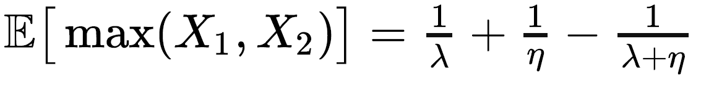
Theory Disclaimer
For the computation of the overall measures the following formulas will be needed:
For cycle (Task 5 & 6) :
Where N represents on average the # times the task is executed and P is the probability the inspection will be carry out (15%).
For the –AND:

Slide 43
Overall Performance Measures
Once the parameters for each task have been computed it is possible to determine two key performance indicators:
Tcycle, the amount of time needed, on average, for a passenger to complete the process;
Wait Time, the mean waiting time for a customer in the queue, along the whole process.

Slide 44
Tcycle
The total time needed for a passenger to go through the whole process is between 200 and 300 seconds for most of the scenarios analyzed, reaching a peak of about 450 seconds during the most stressful situation, meaning a passenger entering the airport each 35 seconds.

Slide 45
Wait Time
Another key aspect this workflow model is able to handle successfully is the time spent in queue. As the process is being stressed, the amount of time a passenger spends queuing increases exponentially, however, it is important to notice that in the most common scenarios it never exceeds 100 seconds, reaching less than 300 seconds during the busiest moments of the day.

Slide 46
Theoretic values vs Simulated Values
The YasperTool offers the opportunity to verify the values obtained using the results of the queuing theory with those resulting from a stochastic process ran on the software. Since the model built contains many estimations, it is better to run a sufficient long simulation (10k tokens).

Slide 47
The rightmost ρ are those with an higher variability, this is because they are the best indicators of the accuracy of the analysis.

Slide 48
The theoretic curves and the simulated ones overlap almost perfectly.

Slide 49
Further Suggestions: IOT
Definition: the interconnection via the Internet of computing devices embedded in everyday objects, enabling them to send and receive data.
In the airport workflow, it is possible to easily implement IOT in both task 2 (Check-in) and task 7 (Proceed to the Airplane).
The idea is to carry on all the check-in online so that the customers, once entered in the airport, simply need to scan their Qr code ticket on the lector and directly proceed to drop their luggage and go to security. This will save the time that is required to do the check-in process.
For task 7, it would be ideal to have electronic gates before the airplane where the boarding passes will have a Qr-code that can be scanned and the doors open automatically to enter the airplane. This will also save more time.
The time that is saved could be utilized these days by dealing with the coronavirus issues, where airports will require more time to do a medical check-up and that time could be allocated by implementing more technology into the workflow of the airports.

Slide 50
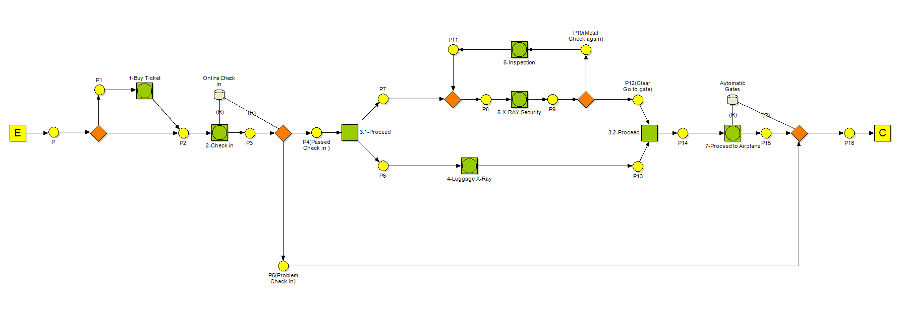

Slide 51
For those tasks it drastically reduces the traffic intensity and the mean waiting time in the queue.

Slide 52
Although IOT has been implemented on just two tasks, it has a positive impact in term of time-saving on the whole process.

Slide 53
Conclusion
The methodological tools we have seen along the whole analysis allow predicting and better planning the ideal workflow structure leading to the best results in terms of efficiency, effectiveness, and smart usage of the resources available.
Moreover, cutting-edge technology, such IoT devices, still offers margin on improvement.

Slide 54
THANKS FOR YOUR ATTENTION

