Slide 1
Market Segmentation Methods
Market Research for Samsung
PIETRO RUFFO LUCA RUBERTO OTHMAN AL-AKHALI MARCO TUCCI
ANTONIO DE SARRO

Slide 2
GOAL
To segment the offer of the store, i.e. to aggregate the products into groups that are homogeneous within them and heterogeneous outside them with regard to certain characteristics:
Creating a decision rule based on the 40 TV models
Using the rule defined to classify new TV models
CHAID & CART

Slide 3
DATASET
Category
Screen
DCR
Refresh Rate (LCD Hz)
Resolution (NatRes)
Price
## 'data.frame': 40 obs. of 6 variables: ## $ Categoria: num 1 1 1 1 1 1 1 1 1 1 ... ## $ Screen : num 19 19 19 22 22 22 26 ... ## $ DCR : num 15 15 15 15 15 15 30 ... ## $ LCD.Hz : num 60 60 60 60 60 60 60 ... ## $ NatRes : num 720 720 720 720 720 ... ## $ Price : num 280 280 330 330 380 ...

Slide 4
Dependent Variable:
Category
Indipendent Variables:
Technical Features and Price

Slide 5
Hierarchical segmentation algorithms
In both procedures the following phases will alternate:
Preliminary treatment of the explanatory variables
Choice of split criteria for each node
Definition of stopping criteria
Node labeling criteria
Specifying the rule for classifying new TV models
Misclassification rate estimation

Slide 6
CHAID (Chi-square automatic interaction detection)
method used when both the independent and dependent variables are qualitative in nature
the degree of heterogeneity between the groups will be based on the chi-square test of independence

Slide 7
Dichotomization
 | Mean | Values
Screen | 38.2 | small, big
DCR | 68.75 | low, high
LCD.Hz | 96 | slow, fast
NatRes | - | 720, 1080
Price | 1272.99 | cheap, expensive
## Category Screen DCR LCD.Hz NatRes Price ## 1 1 small low slow 720 cheap ## 2 1 small low slow 720 cheap ## 3 1 small low slow 720 cheap ## 4 1 small low slow 720 cheap ## 5 1 small low slow 720 cheap ## 6 1 small low slow 720 cheap
## 'data.frame': 40 obs. of 6 variables: ## $ Category: Factor w/ 4 levels "1","2","3","4": 1 1 1 1 1 1 1 1 1 ... ## $ Screen : Factor w/ 2 levels "big","small": 2 2 2 2 2 2 2 2 2 2 ... ## $ DCR : Factor w/ 2 levels "high","low": 2 2 2 2 2 2 2 2 2 2 ... ## $ LCD.Hz : Factor w/ 2 levels "fast","slow": 2 2 2 2 2 2 2 2 2 2 ... ## $ NatRes : Factor w/ 2 levels "720","1080": 1 1 1 1 1 1 1 1 1 1 ... ## $ Price : Factor w/ 2 levels "cheap","expensive": 1 1 1 1 1 1 1 ...

Slide 8
Chi-square test and stopping criteria
Chi-square test:
Finding the covariate most closely related to the dependent variable (highest X-squared, smalles pvalue)
NatRes is selected
Stopping criteria:
Minimum # of units in nodes : 5
Alpha4=0,0002
## X-squared p value ## Screen 29.71534 1.584044e-06 ## DCR 22.14369 6.089109e-05 ## LCD.Hz 17.96143 4.479794e-04 ## NatRes 40.00000 1.065509e-08 ## Price 36.35452 6.301198e-08

Slide 9
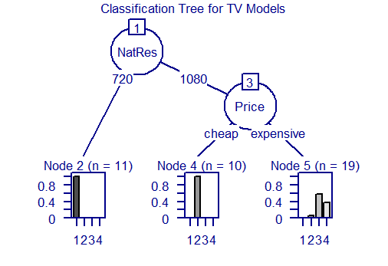
Decision Tree
## Model formula: ## Category ~ NatRes + Price + Screen + DCR + LCD.Hz ## ## Fitted party: ## [1] root ## | [2] NatRes in 720: 1 (n = 11, err = 0.0%) ## | [3] NatRes in 1080 ## | | [4] Price in cheap: 2 (n = 10, err = 0.0%) ## | | [5] Price in expensive: 3 (n = 19, err = 42.1%) ## ## Number of inner nodes: 2 ## Number of terminal nodes: 3

Slide 10
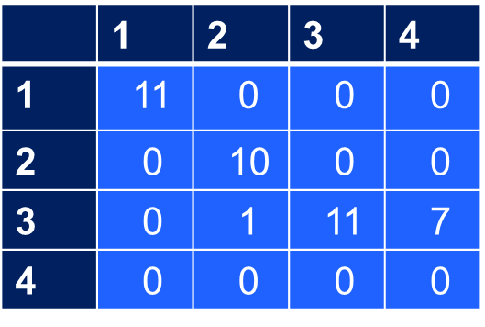
Misclassification Rates and Confusion Matrix
Resubstitution Error Rate:
20%
Miclassification Rate based on cross validation:
20%
Reference
Prediction

Slide 11
CLASSIFICATION TREE
CART (Classification And Regression Tree)
Binary Segmentation Method
Dependent variable: qualitative – independent variables: quantitative and/or qualitative
Reduction of impurity passing from parent node to child nodes
measure of impurity based on the proportions of units, inside a node, which present
a certain category of Y
GINI INDEX
Goals
Build a decision rule, called Classificator, based on the 40 TV models
Use the Classificator built to classify new TV models

Slide 12
DATA PREPARATION FOR THE ALGORITHM
No need to alter the original nature of technical feautures and price’s TV models
NatRes and LCD.Hz: from numeric to factor variables
All the other explanatory variables are kept numeric (discrete e continuous)
## 'data.frame': 40 obs. of 6 variables: ## $ Category: Factor w/ 4 levels "1","2","3","4": 1 1 1 1 1 1 1 1 1 1 ... ## $ Screen : num 19 19 19 22 22 22 26 26 32 32 ... ## $ DCR : num 15 15 15 15 15 15 30 30 30 50 ... ## $ LCD.Hz : Factor w/ 3 levels "60","120","240": 1 1 1 1 1 1 1 1 1 1 ... ## $ NatRes : Factor w/ 2 levels "720","1080": 1 1 1 1 1 1 1 1 1 1 ... ## $ Price : num 280 280 330 330 380 ...
Setting a seed
xerror estimates
based on cross validation
do not change
Setting of control parameters for the algorithm (including its stopping criteria):
minimum size for parent nodes so that these can be split 5
complexity parameter (cp) (with the aim to build the largest tree) 0
number of equally-partitioned subsamples for cross validation 5

Slide 13
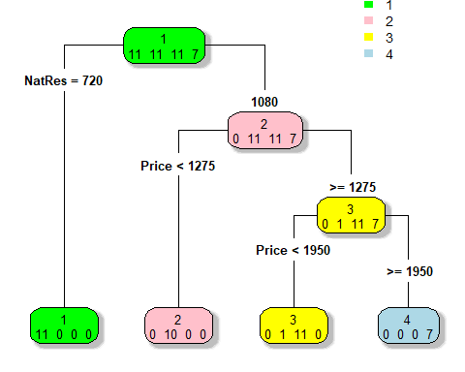
CLASSIFICATOR
## n= 40 ## ## node), split, n, loss, yval, (yprob) ## * denotes terminal node ## ## 1) root 40 29 1 (0.27500000 0.27500000 0.27500000 0.17500000) ## 2) NatRes=720 11 0 1 (1.00000000 0.00000000 0.00000000 0.00000000) * ## 3) NatRes=1080 29 18 2 (0.00000000 0.37931034 0.37931034 0.24137931) ## 6) Price< 1274.99 10 0 2 (0.00000000 1.00000000 0.00000000 0.00000000) * ## 7) Price>=1274.99 19 8 3 (0.00000000 0.05263158 0.57894737 0.36842105) ## 14) Price< 1949.99 12 1 3 (0.00000000 0.08333333 0.91666667 0.00000000) * ## 15) Price>=1949.99 7 0 4 (0.00000000 0.00000000 0.00000000 1.00000000) *

Slide 14
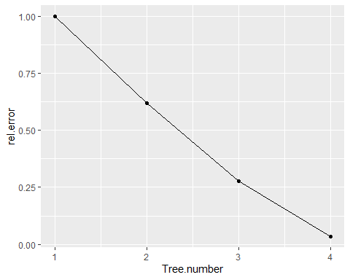
## Call: ## rpart(formula = Category ~ NatRes + Price + DCR + Screen + LCD.Hz, ## data = input_data2, method = "class", control = ctrl2) ## n= 40 ## ## CP nsplit rel error xerror xstd ## 1 0.3793103 0 1.00000000 1.2758621 0.05744252 ## 2 0.3448276 1 0.62068966 1.1034483 0.08723525 ## 3 0.2413793 2 0.27586207 0.4827586 0.10402140 ## 4 0.0000000 3 0.03448276 0.2413793 0.08286631 ## ## Variable importance ## Price Screen DCR NatRes LCD.Hz ## 39 25 18 15 3 ## ## Node number 1: 40 observations, complexity param=0.3793103 ## predicted class=1 expected loss=0.725 P(node) =1 ## class counts: 11 11 11 7 ## probabilities: 0.275 0.275 0.275 0.175 ## left son=2 (11 obs) right son=3 (29 obs) ## Primary splits: ## NatRes splits as LR, improve=10.734480, (0 missing) ## Price < 699.99 to the left, improve=10.734480, (0 missing) ## DCR < 55 to the left, improve= 9.433333, (0 missing) ## Screen < 38.5 to the left, improve= 7.598990, (0 missing) ## LCD.Hz splits as LRR, improve= 4.083838, (0 missing) ## Surrogate splits: ## Price < 699.99 to the left, agree=1.000, adj=1.000, (0 split) ## DCR < 55 to the left, agree=0.975, adj=0.909, (0 split) ## Screen < 29 to the left, agree=0.925, adj=0.727, (0 split)
OUTPUT

Slide 15
Classification Goodness
Confusion Matrix
Misclassification Rates
Reference
 | 1 | 2 | 3 | 4
1 | 11 | 0 | 0 | 0
2 | 0 | 10 | 0 | 0
3 | 0 | 1 | 11 | 0
4 | 0 | 0 | 0 | 7
Prediction
Resubstitution | 2,5%
based on Cross Validation | 10%

Slide 16
CONCLUSION
Let’s compare the results from CHAID and Classification Tree applications.
 | CHAID | Classification Tree
Inpedependet Variables used to split | NatRes, Price | NatRes, Price
# of misclassifications | 8 | 1
Resubstitution Error Rate | 20% | 2.5%
Misclassification Rate based on Cross Validation | 20% | 10%

Slide 17
Thank you
for your attention!

