Slide 1

PERFORMANCE EVALUATION AND APPLICATIONS
Project presentation
Pietro Valente 10811481

Slide 2
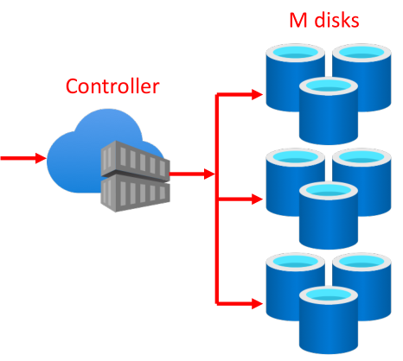
Project specifications
Project B1:
Erasure coding
M total disk
Write on N disk (K data + N-K reliability)
Read only on K disk

Slide 3
Service times for the disks
Matlab:
Calculation of the coefficient of variation (cv) = 0.30
Since cv <1 use of Erlang distribution
Maximum likelihood method to calculate λ
Increase the stage number (k) until μ_{Erlang} = k/λ = μ_{Data}

Slide 4
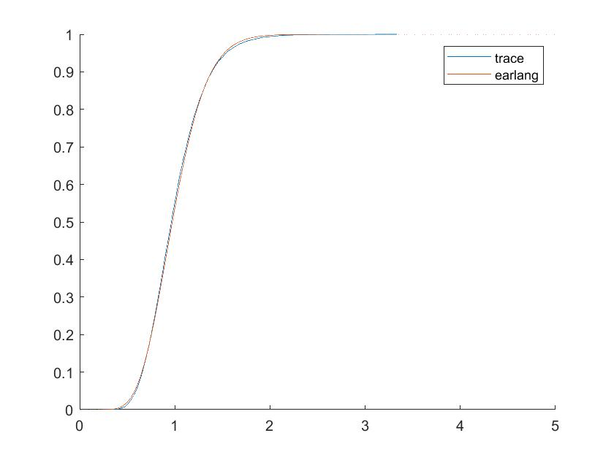
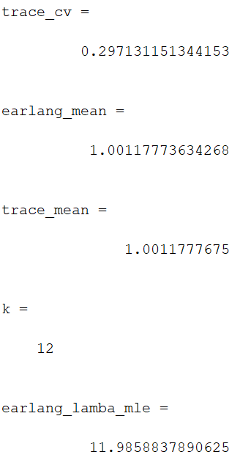
Plot and results

Slide 5
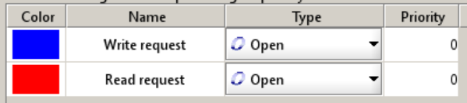
Model design
JMT - JSIMgraph:
Open system, M/E₁₂/10/FCFS
Two classes (Write request/ Read request)
Different arrival rates (exponentially distributed):
300 req/s for read,
80 req/s for write

Slide 6
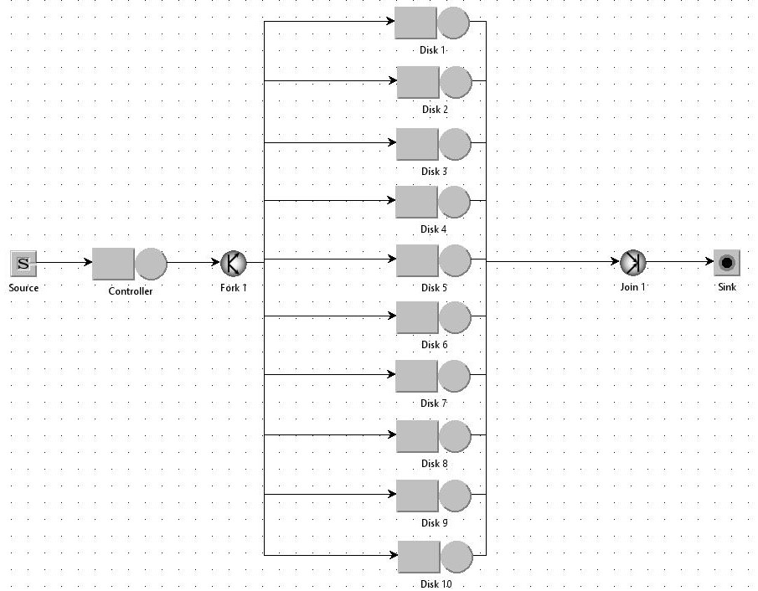
Model design

Slide 7
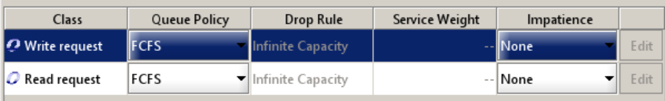
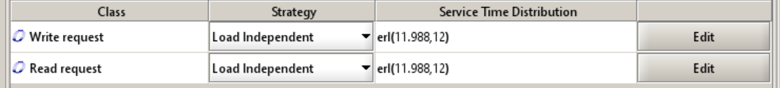
Queue Policy and Disk Service Time Distribution
For all queues, the First-Come First-Served (FCFS) policy was used as it has one of the lowest average and variance on service times
Queues have always been considered unlimited assuming the controller can handle them
The results obtained on Matlab were used as disk service times

Slide 8
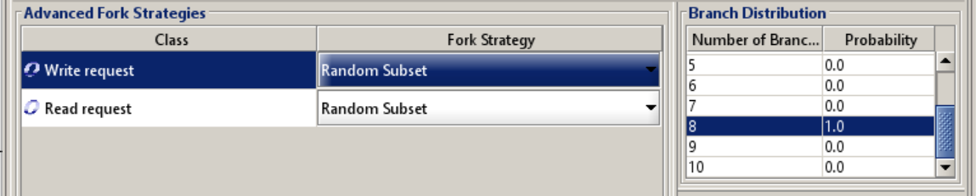
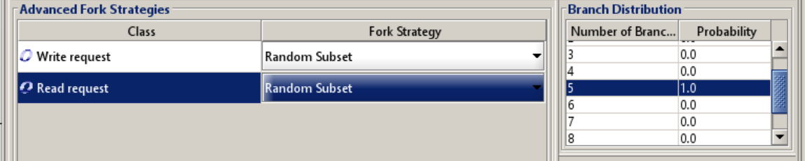
Fork strategies

Slide 9
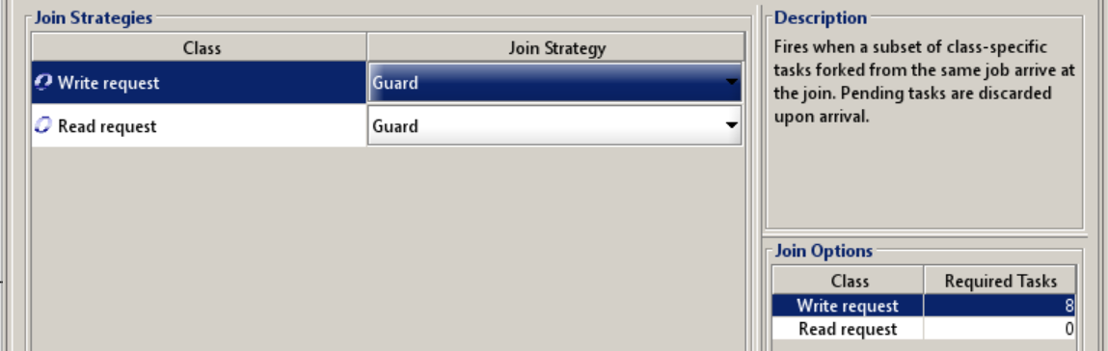
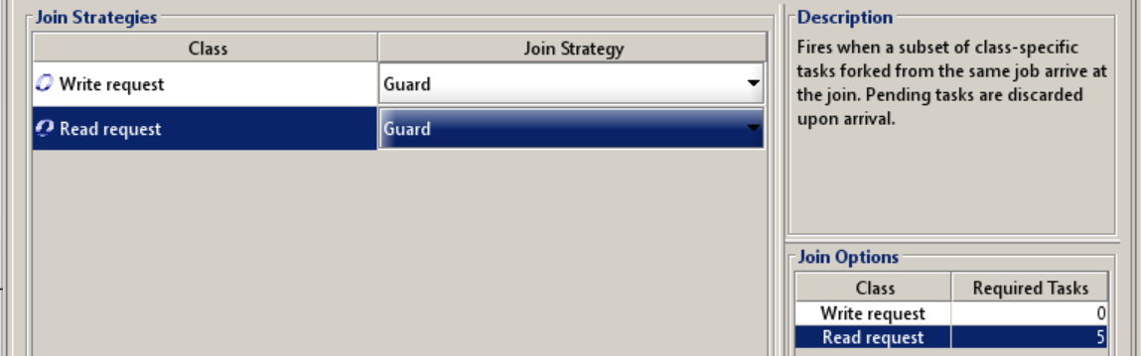
Join strategies

Slide 10
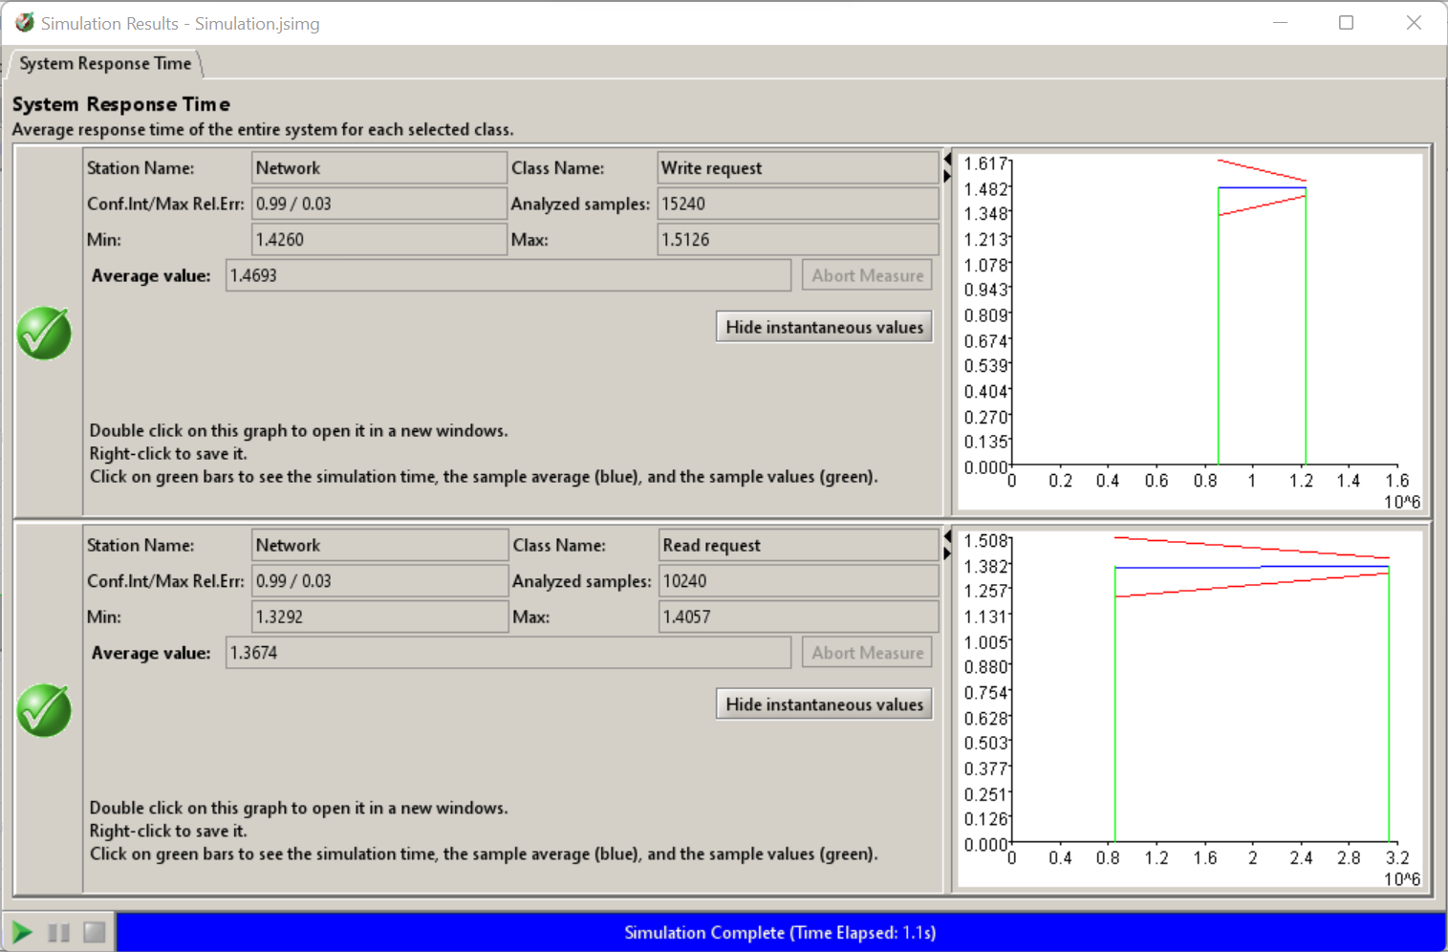
System Response Time

Slide 11
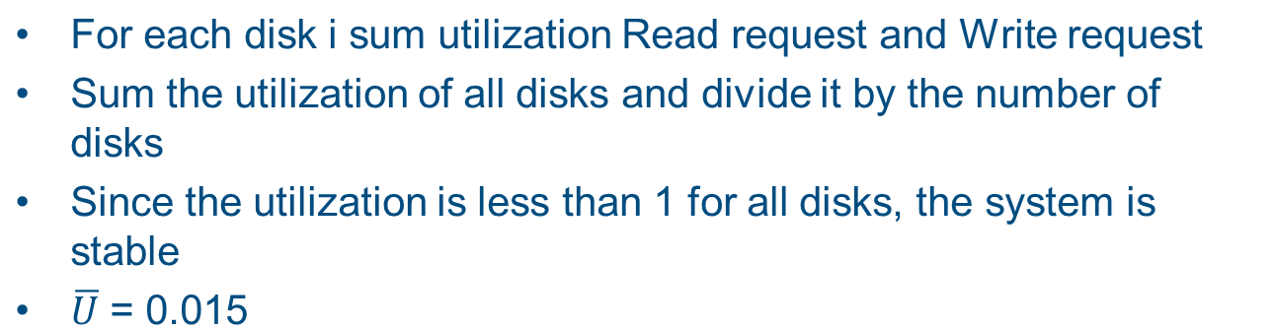
Average Utilization of the Disks

Slide 12
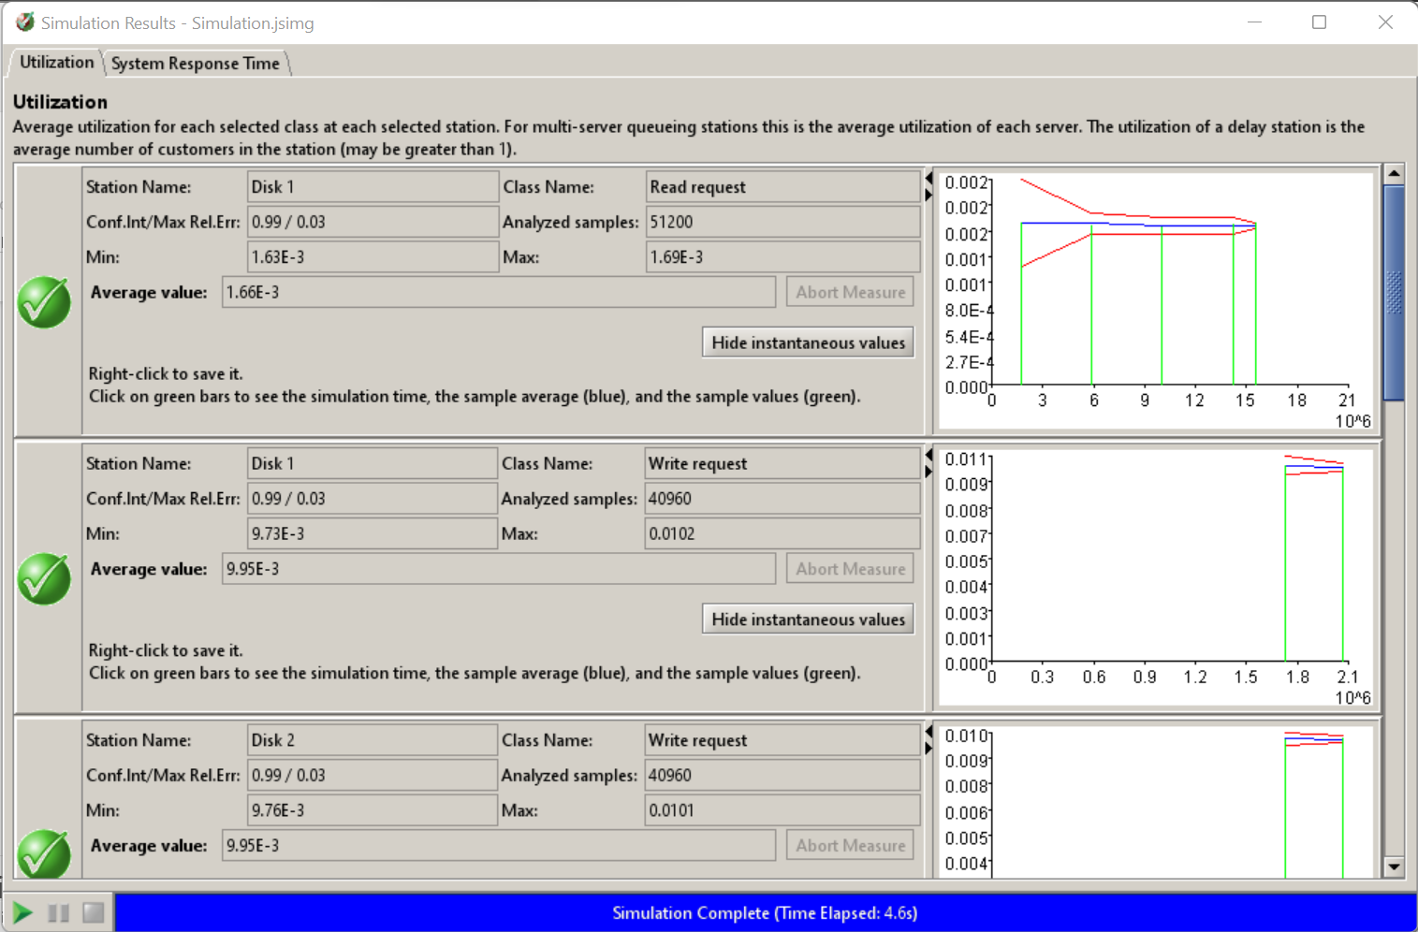
Average Utilization of the Disks

