Slide 1
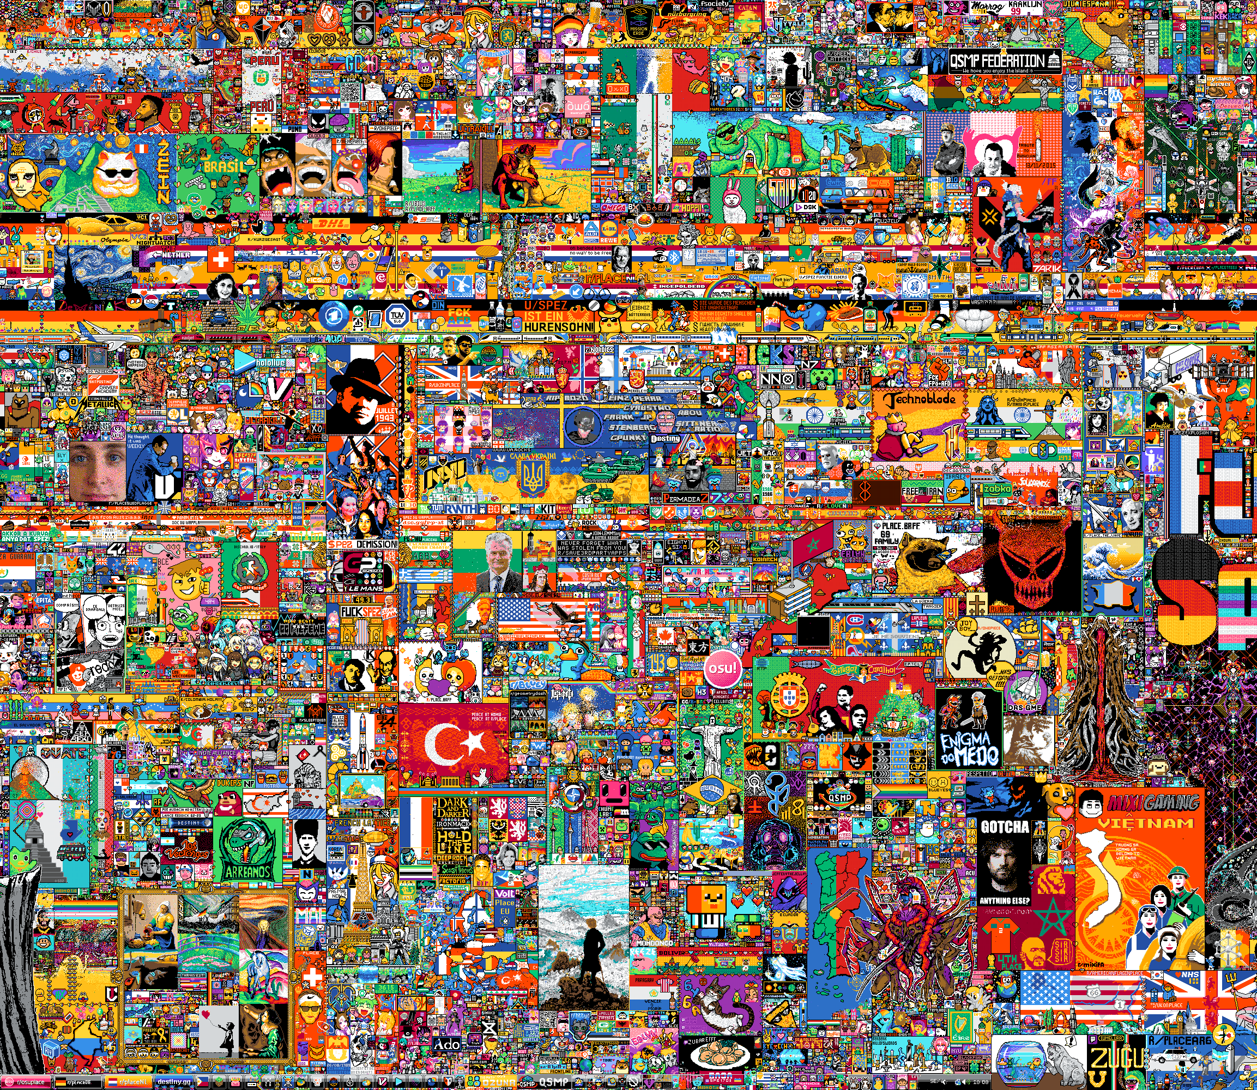

r/place
by Kaden Buckley & Brogan Pietrocini

Slide 2
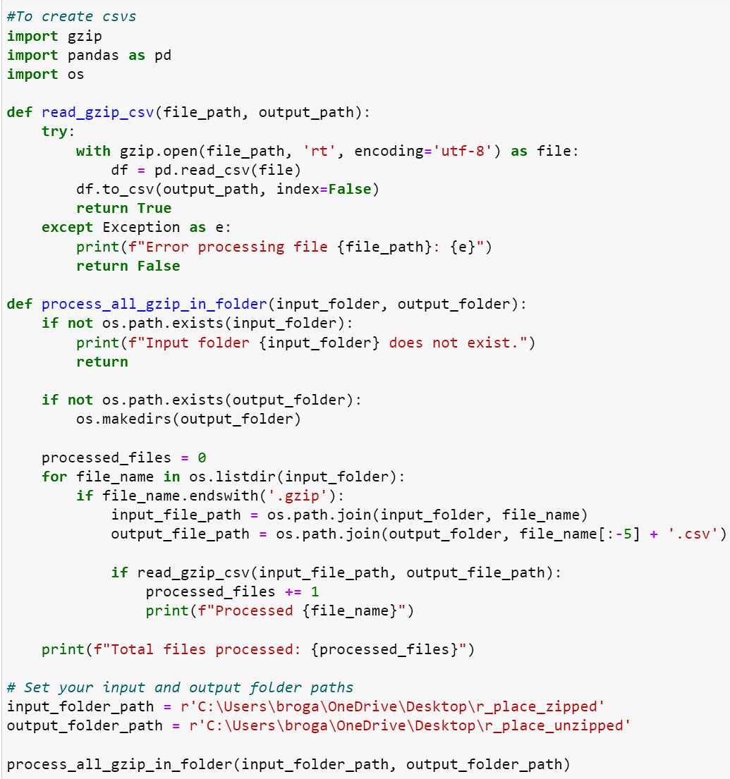
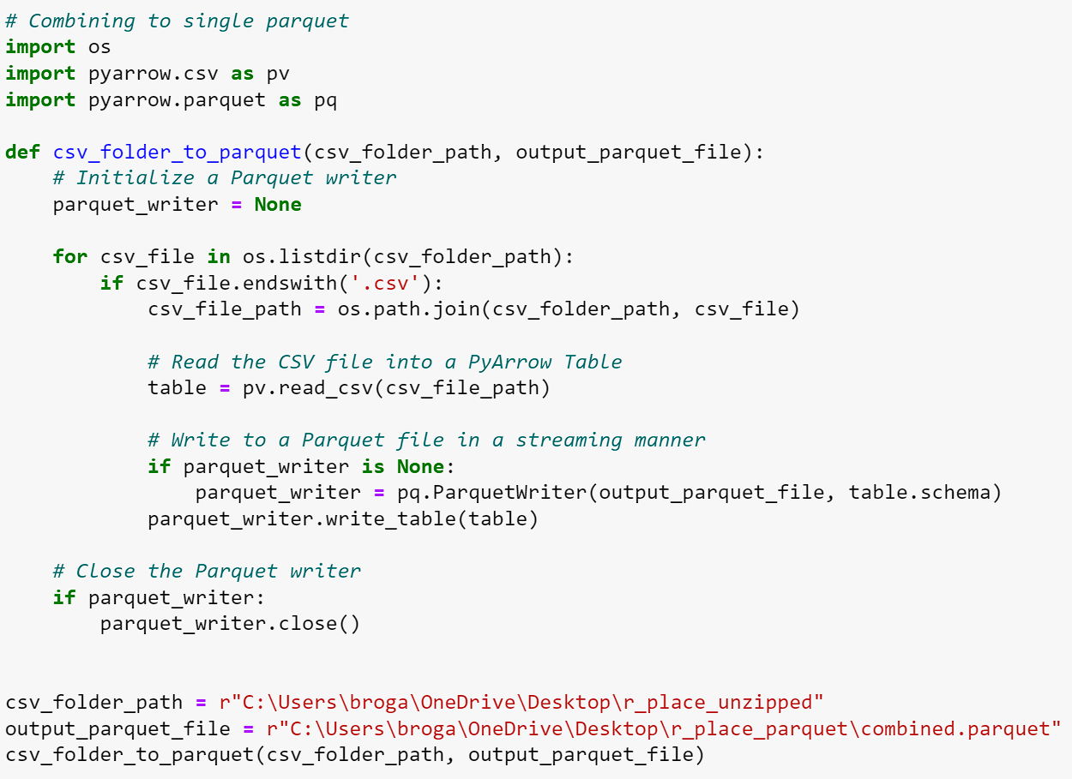
Jupyter Notebook Data Processing & Preparation
Step 1: Unzip .gzip files
Step 2: Combine .csv files into .parquet

Slide 3
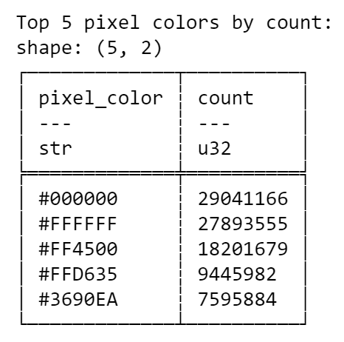
Most Popular Pixel Colors

Slide 4
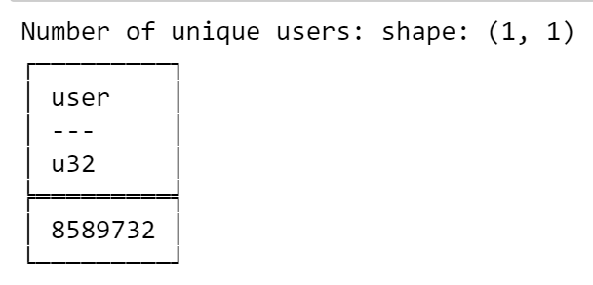
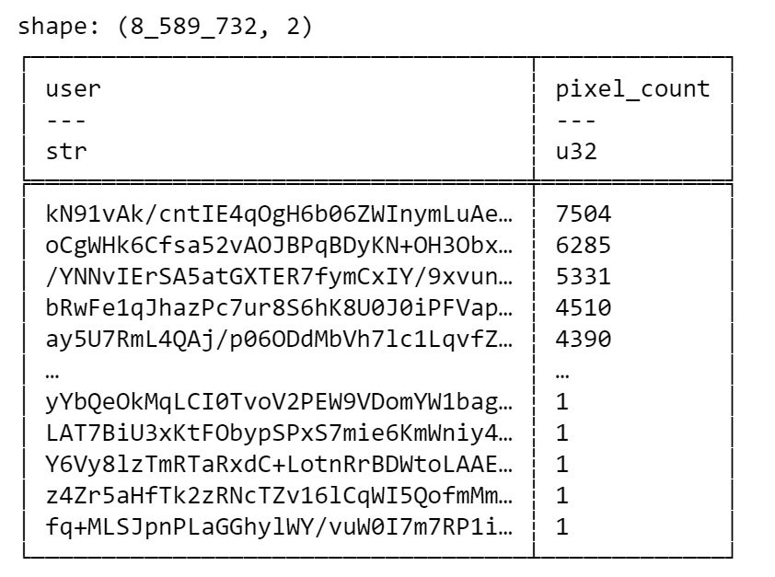
Unique Users & Total Pixels Placed by Each User

Slide 5

Suspicion and issues around Bots
r/place spanned from 7/20/23 to 7/25/23
7,200 minutes total
1,440 possible entries per user, given the 5-minute minimum
Bots ruin the integrity of a community event such as r/place
Ex: Covering Art
User LG03’s Opinion: “An increase in bot activity is an increase in activity, and that looks good to investors. The admins have no reason to do anything...”

Slide 6
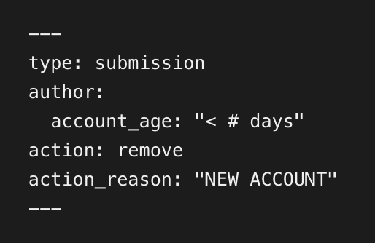
Bot Policy Recommendations
Implement a Karma requirement
Reddit Karma: User score based on contribution to Reddit Community
Brand new Reddit accounts start with 1 Karma
Account age requirement
Ex.) Accounts must be at least two weeks old
Create a minimum post requirement to use r/place
Calculate Variance of pixels placed by each user
Accounts with less variable timing between pixel placement are more likely to be bots
Subreddit
AutoModerator
(3rd Party)

