Slide 1
Reinforcement learning 2019
Group 7

Slide 2


Exercise 1 – Bandit algorithms
$ε−greedy algorithms$
$UCB$
$Optimistic Initial value$
Bandit

Slide 3
Experimental Setup
RNG seed fixed at 420 for all runs
Size of bandit reward interval fixed at 8
Interval mean ranging from 0-5
Mean picked at random

Slide 4
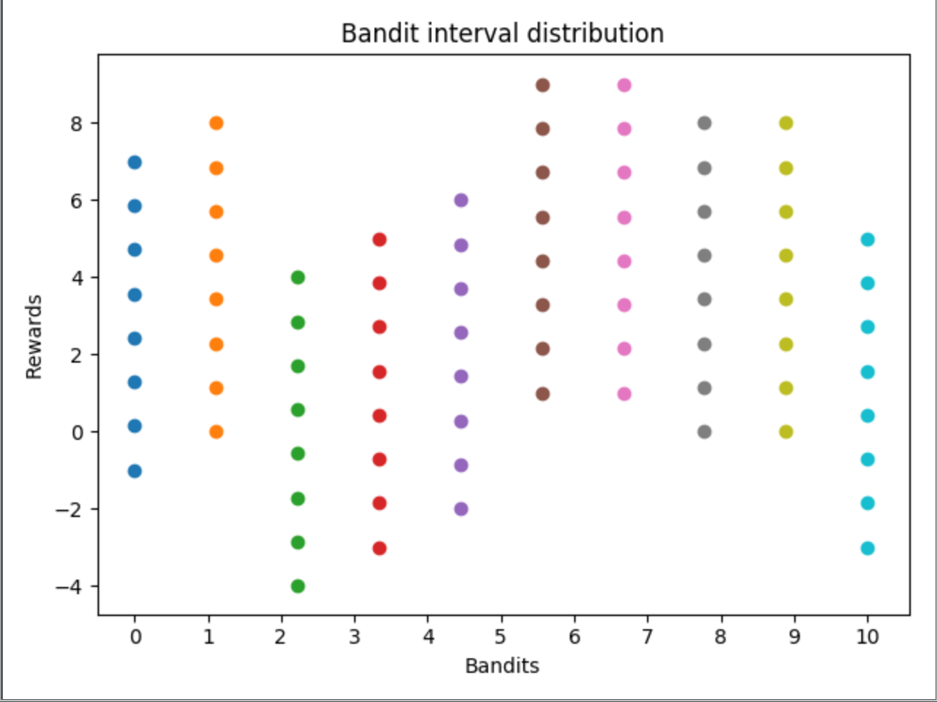
Experimental Setup

Slide 5
Experiments
Internal comparison (parameter vs parameter)
External comparison (algorithm1 vs algorithm2, fixed parameters)
Performance measure: Average reward

Slide 6
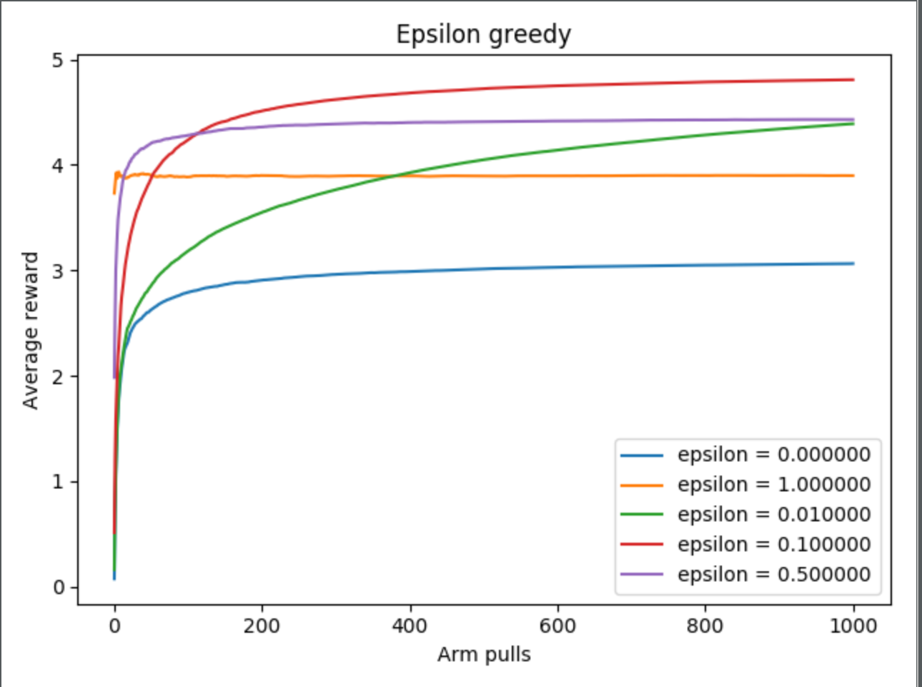
Experiment 1
10 Bandits
Fixed distribution

Slide 7
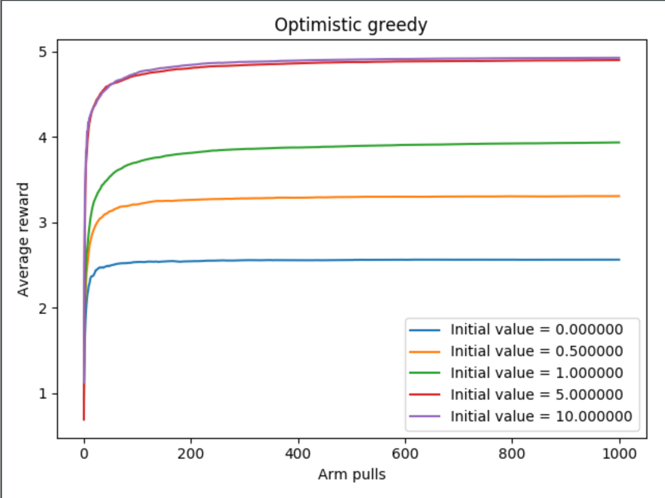
Experiment 1
10 Bandits
Fixed distribution

Slide 8
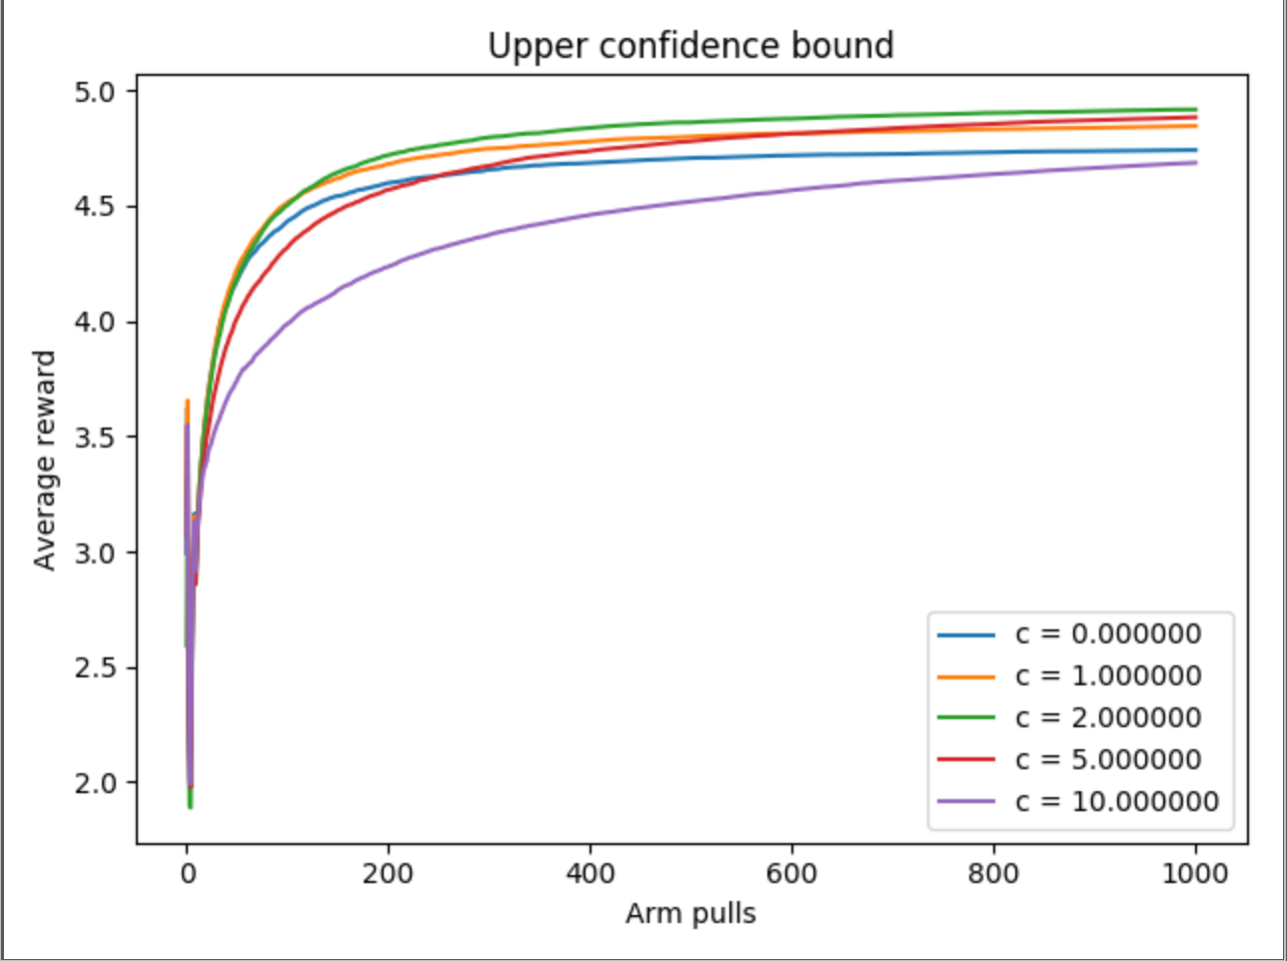
Experiment 1
10 Bandits
Fixed distribution

Slide 9
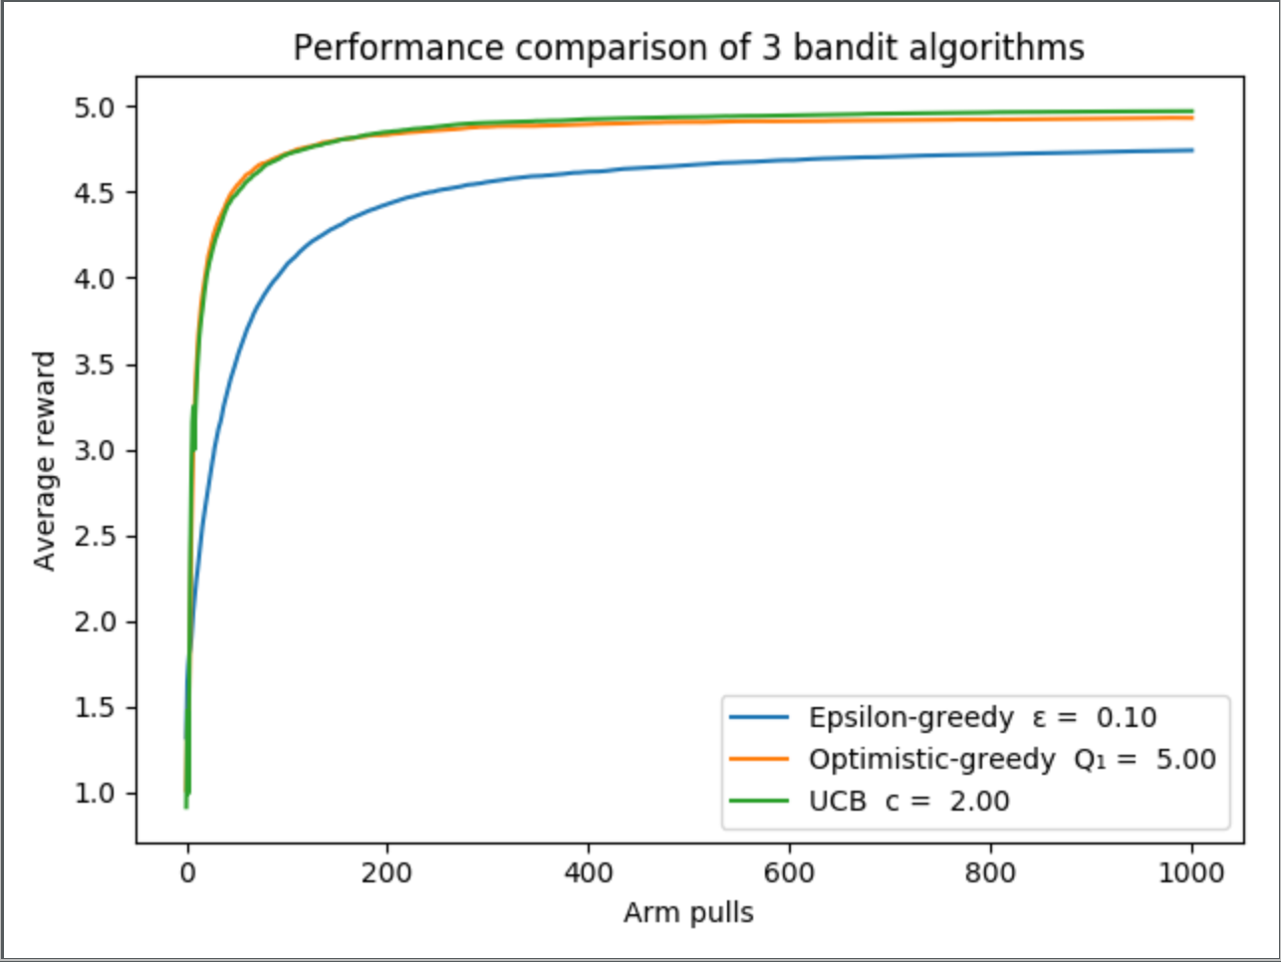
Experiment 2
Distribution 1

Slide 10
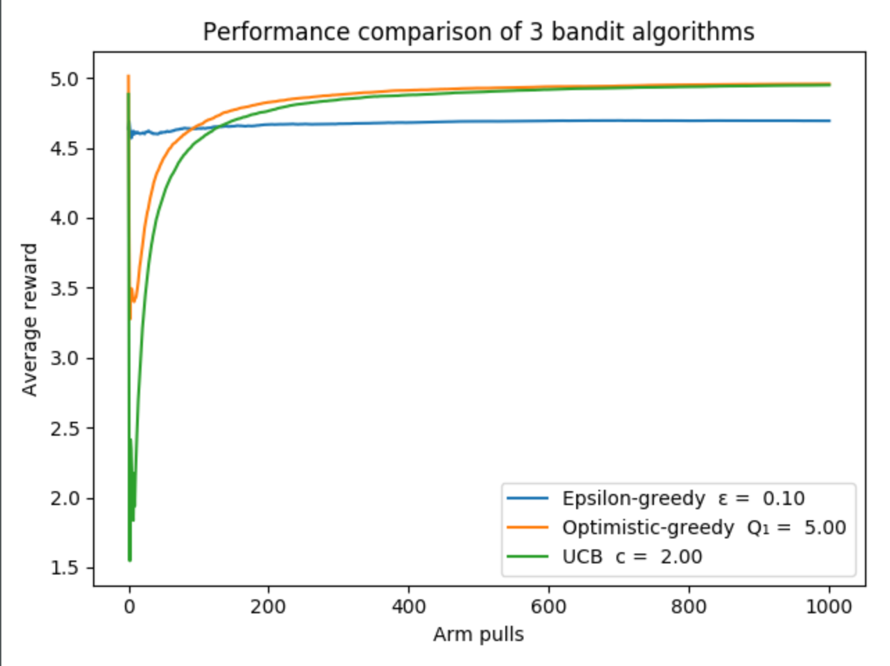
Experiment 2
Distribution 2

Slide 11
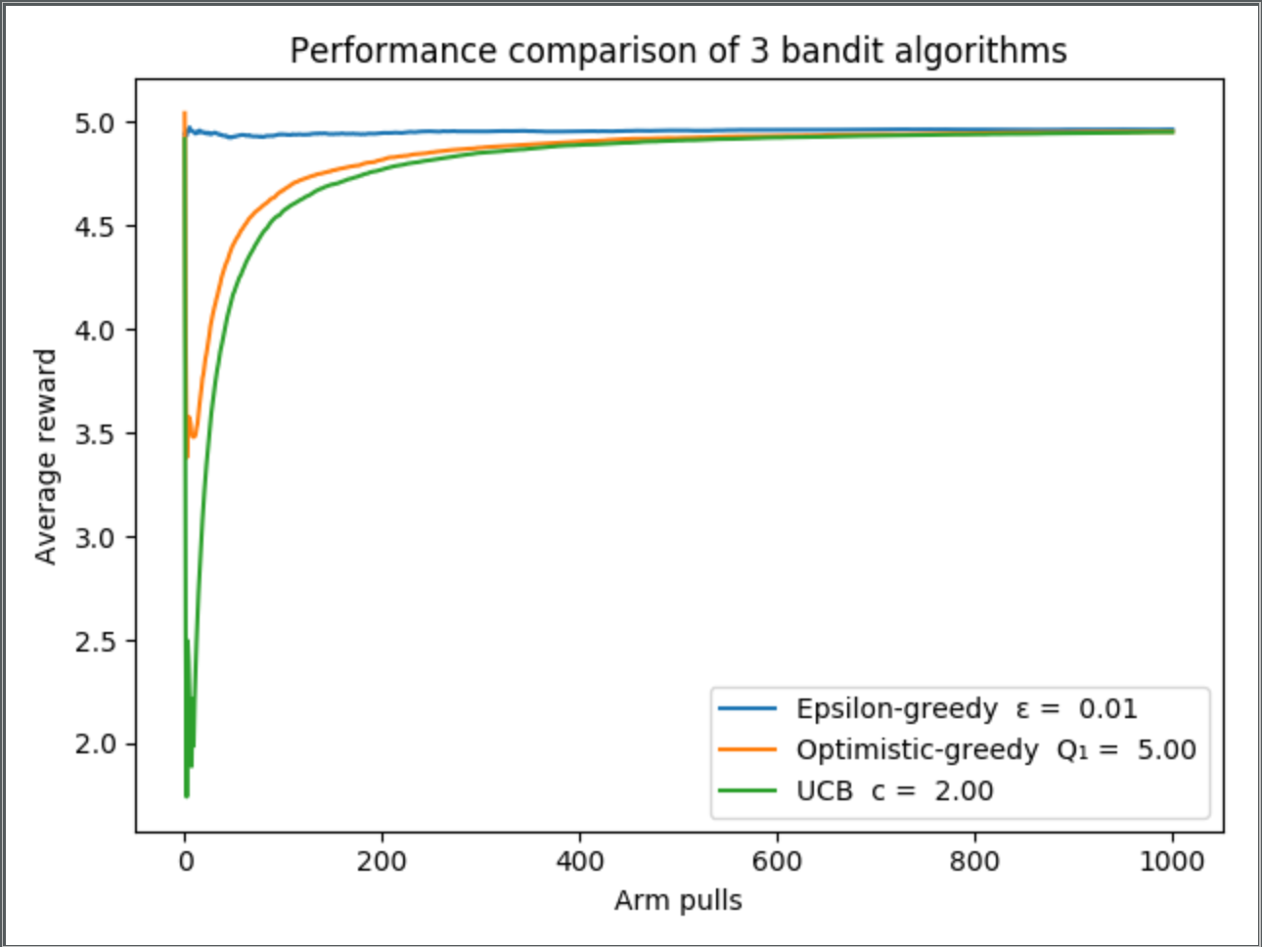
Experiment 2
Distribution 2

Slide 12
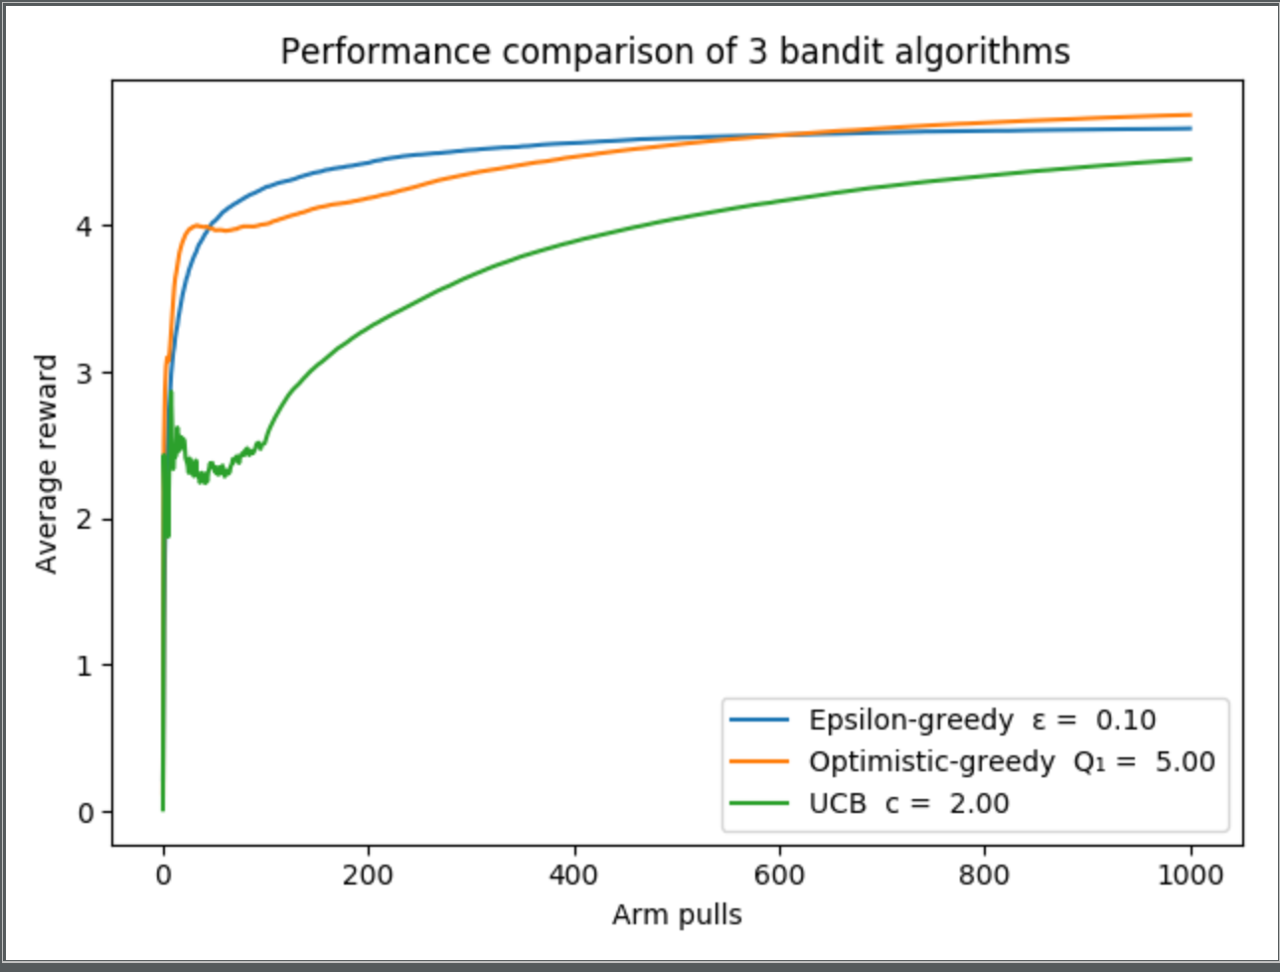
Experiment 2
Distribution 3 + 100 bandits

Slide 13
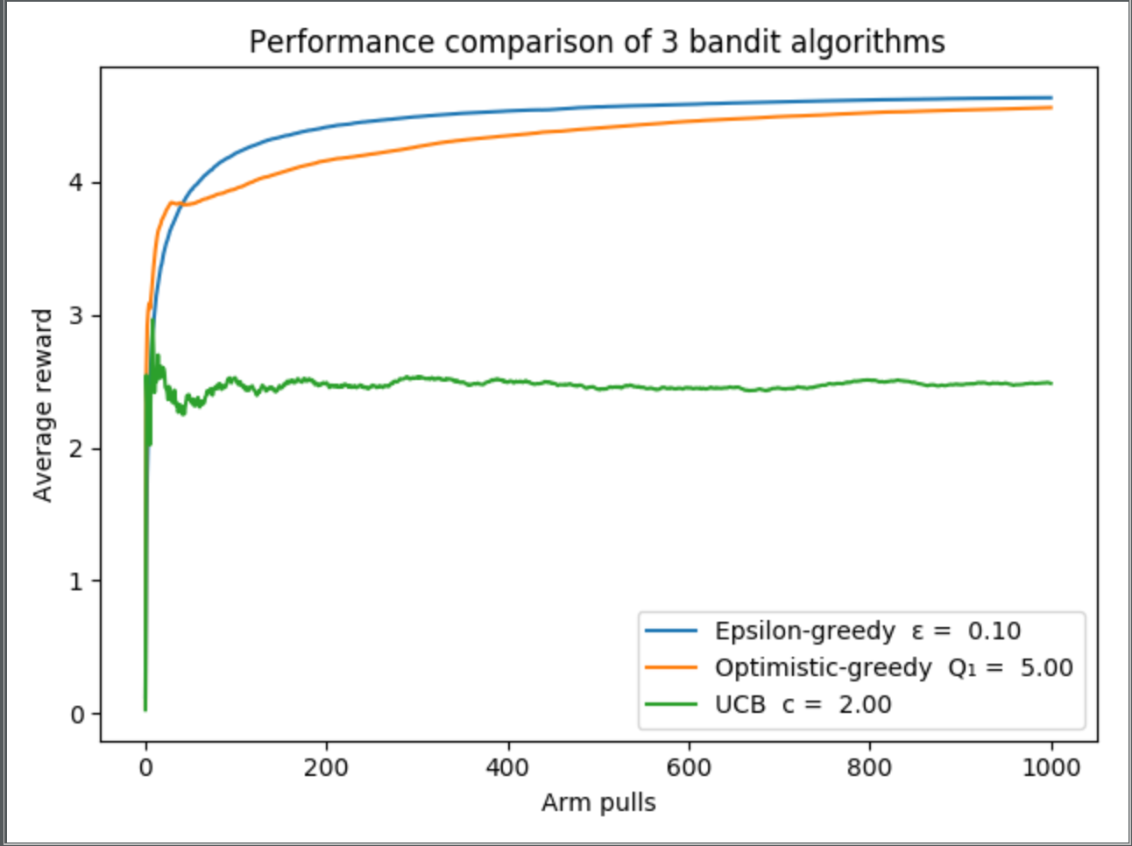
Experiment 2
Distribution 3 + 1000 bandits

Slide 14

Conclusions
Parameters ≈
ε-greedy and optimistic-greedy appear to generalize well
Can‘t conclude UBC is worse
UBC with tweaked 𝒄 might outperform the others

Slide 15


Exercise 2 – Q learning
$Key parts$
$Experimental setup$
$Result$
$Conclusion$

Slide 16


Key Parts
Policy followed --> $ϵ$ - greedy
def get_next_action(s): probability = random.random() if probability < epsilon: action = random.randint(0, 3) # Choose an action at random return action else: # Otherwise, greedily choose best action based on estimated reward of surrounding states return np.argmax(Q_matrix[s.row][s.column])

Slide 17
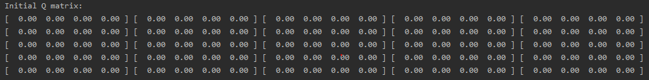

Experimental setup
Initialize Q(s,a) with arbitrarily values (in our case 0), except for the terminal state that must be equals to 0
Algorithm parameters (not the same every
time, they must be tuned)

Slide 18
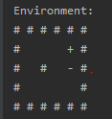
Result
Simple environment
One episode -->
BUMPS many times!!!!
At the end the Q matrix obtained is:
Start point
CAKE
MOUSE TRAP

Slide 19
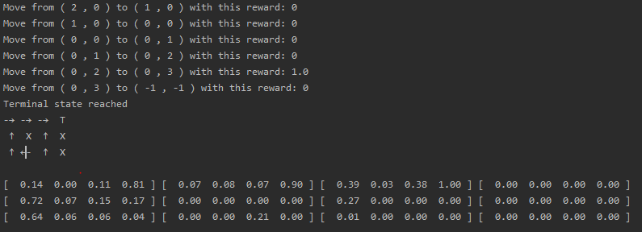
Yet with the simple environment at the end of all episodes
The estimates value propagate back from the state near the cake to the start point.

Slide 20
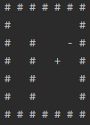
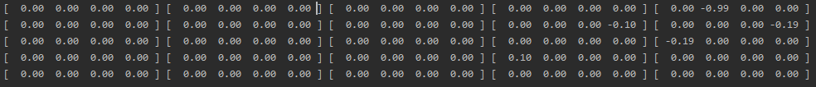
Complex environment
Also in this case, for the first episode, agent bumps
many times against a wall, obtaining at the end this
Q-matrix

Slide 21
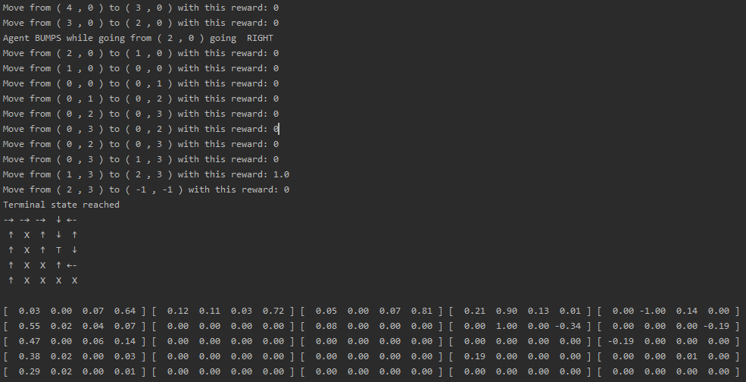
At the end we obtain, in this specific run, this result

Slide 22
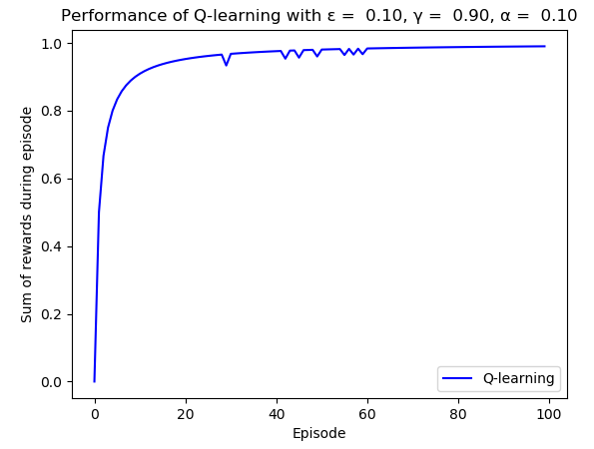
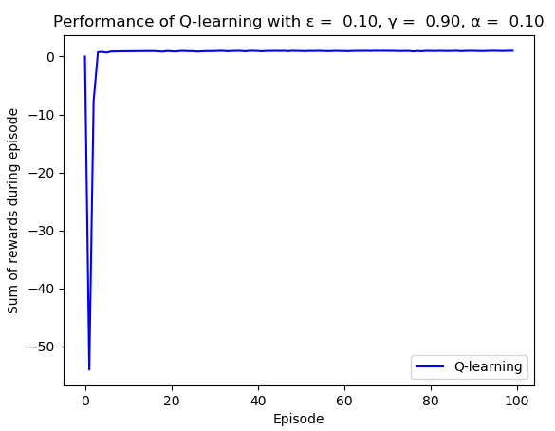

We also try to compare, with a simple plot, the sum of the reward obtained with different kind of setup (small or big environment, $α,γ,ε$)
Small environment
Big environment
We can notice how, for the complex environment, at the start of the algorithm, it takes a lot of error
before getting convergence without any errors during the path

Slide 23
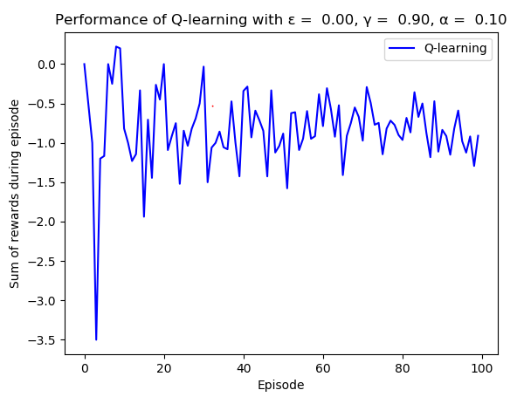
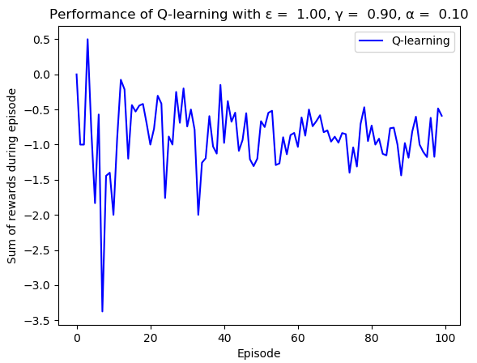
In this case we have a complete randomization
of the action choice.

Slide 24
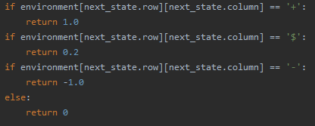
We’ve tried also to insert little reward along the way, like little cake, to encourage the agent to keep exploring. We did this in this way:
Little reward is given when a little cake is eatean.
BUT…
We weren’t able to make agent so intelligent to know the he can found the bigger cake, without get stack on little one.
We try to delete the little cake once it was eatean, but this VIOLATE the Markov Property.

Slide 25


Exercise 3 – BackPropagation XOR problem
$Single perceptron highlights$
$Key part$
$Experimental setup$
$Result$
$Conclusion$

Slide 26
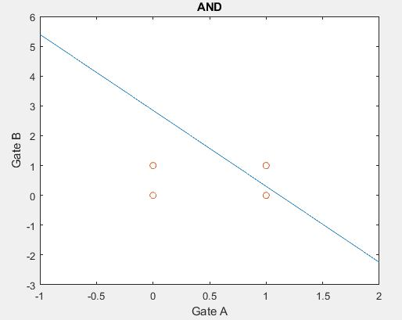
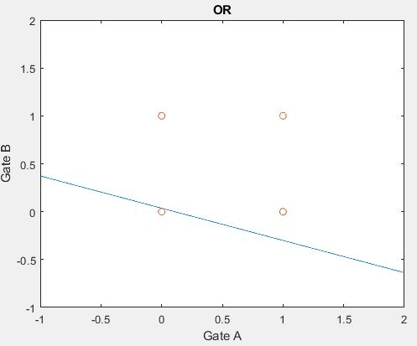
Single perceptron highlights Try simple first: && and ||
0
0
1
1

Slide 27
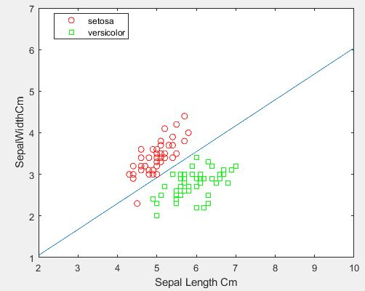
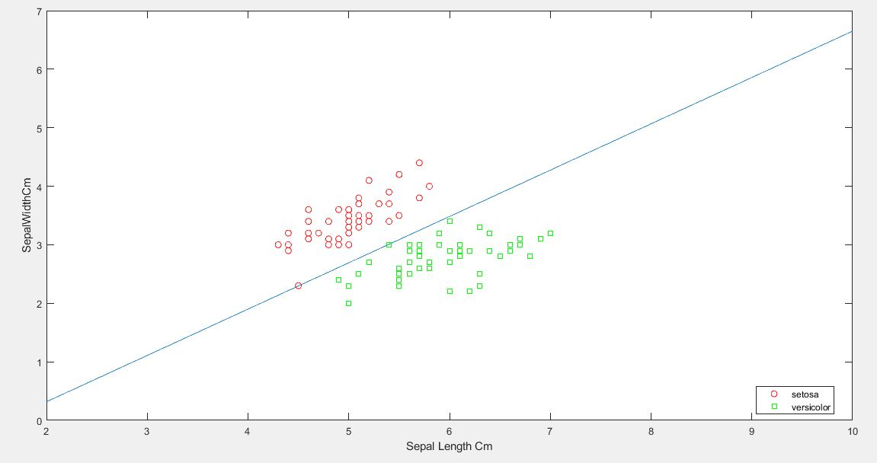
Let’s get harder… Single perceptron with irisDataset
With 50 epochs
One points of the dataset misclassificated
With 1500 epochs
All the points are correctly classified (YEAH)

Slide 28
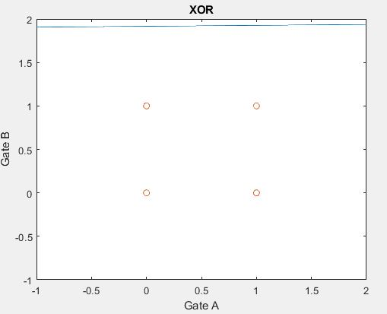
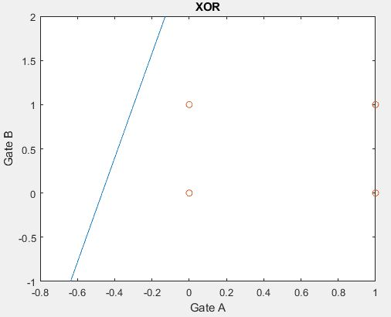
Let get more harder… XOR port!!!

Slide 29
So… We need more bound to evaluate the points, and so many neurons. So… multi layer perceptron!
Key parts:

Slide 30
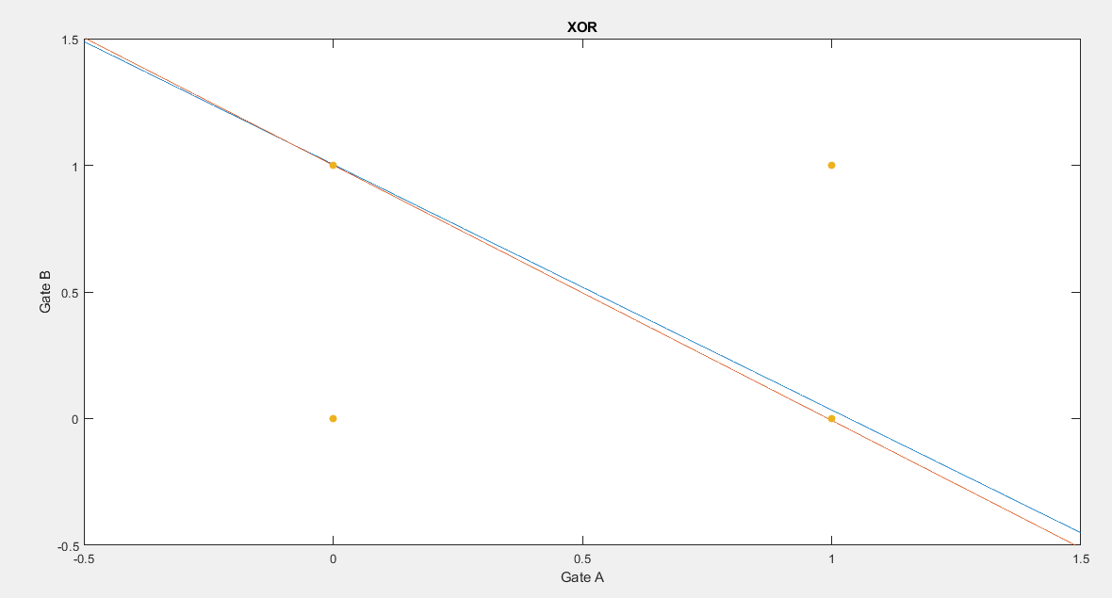

Slide 31
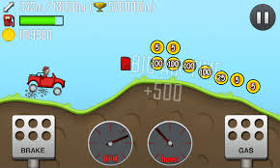
Exercise 4 – SARSA in continuous space

