Slide 1
Reinforcement learning 2019
Group 7

Slide 2


Exercise 1 – Bandit algorithms
$ε−greedy algorithms$
$UCB$
$Optimistic Initial value$
Bandit

Slide 3
Experimental Setup
RNG seed fixed at 420 for all runs
Size of bandit reward interval fixed at 8
Interval mean ranging from 0 - 5
Mean picked at random

Slide 4
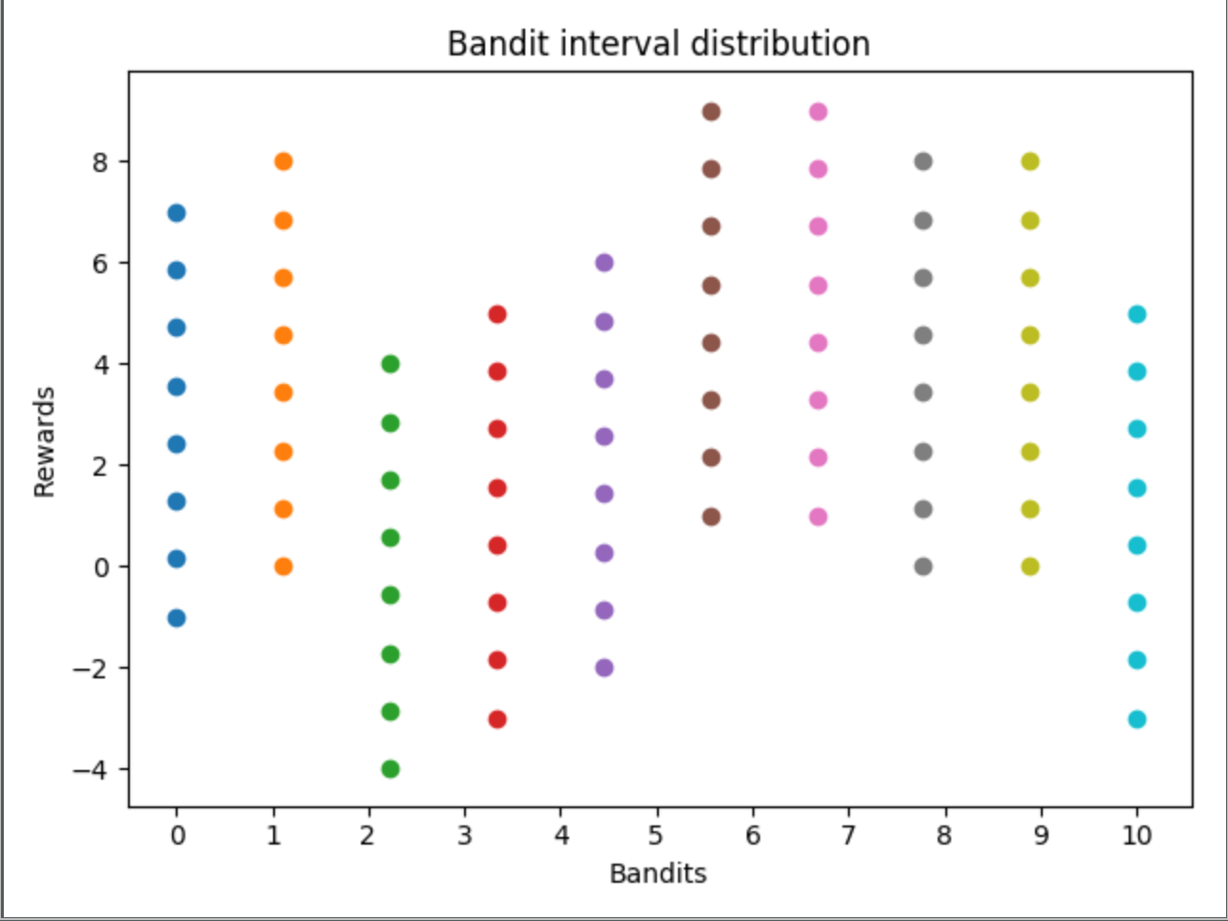

Slide 5
Experiments
Internal comparison (parameter vs parameter)
External comparison (algorithm1 vs algorithm2, fixed parameters)
Performance measure: average reward

Slide 6
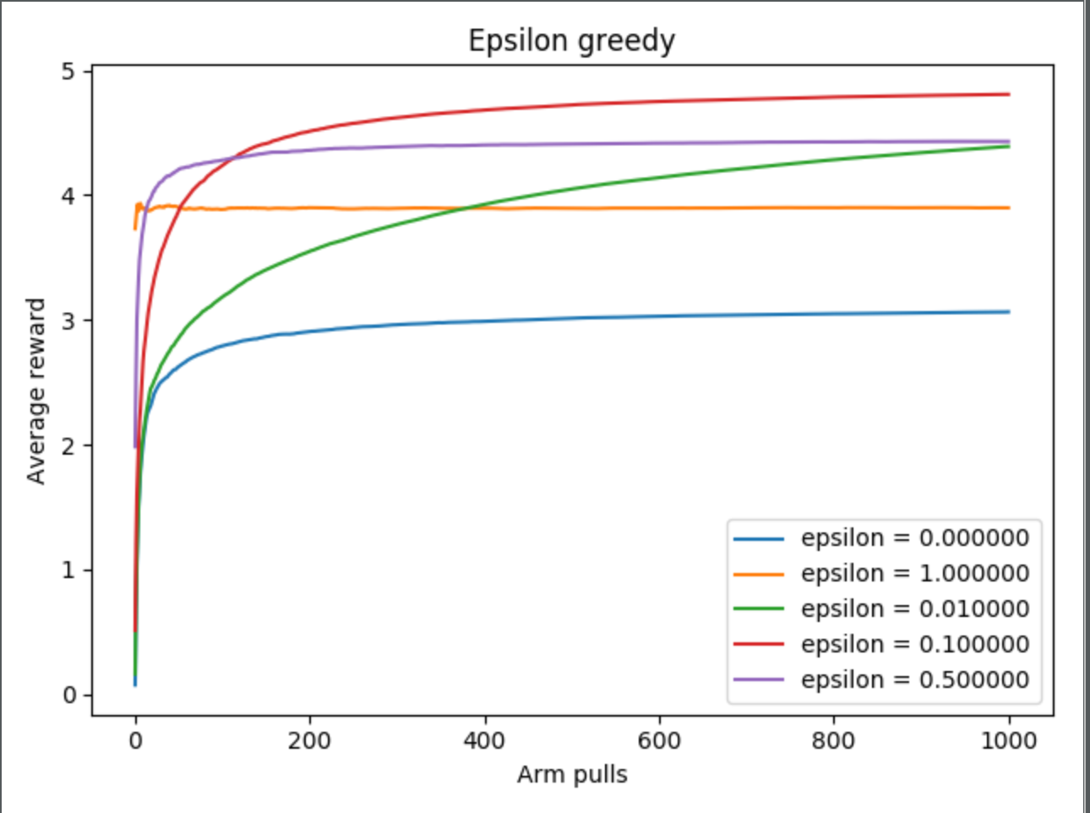
Experiment 1
10 Bandits
Fixed distribution
Notes:
It can depends on the distribution: for example, if the first bandit has highest reward, epsilon == 0 will give us the best average reward.

Slide 7
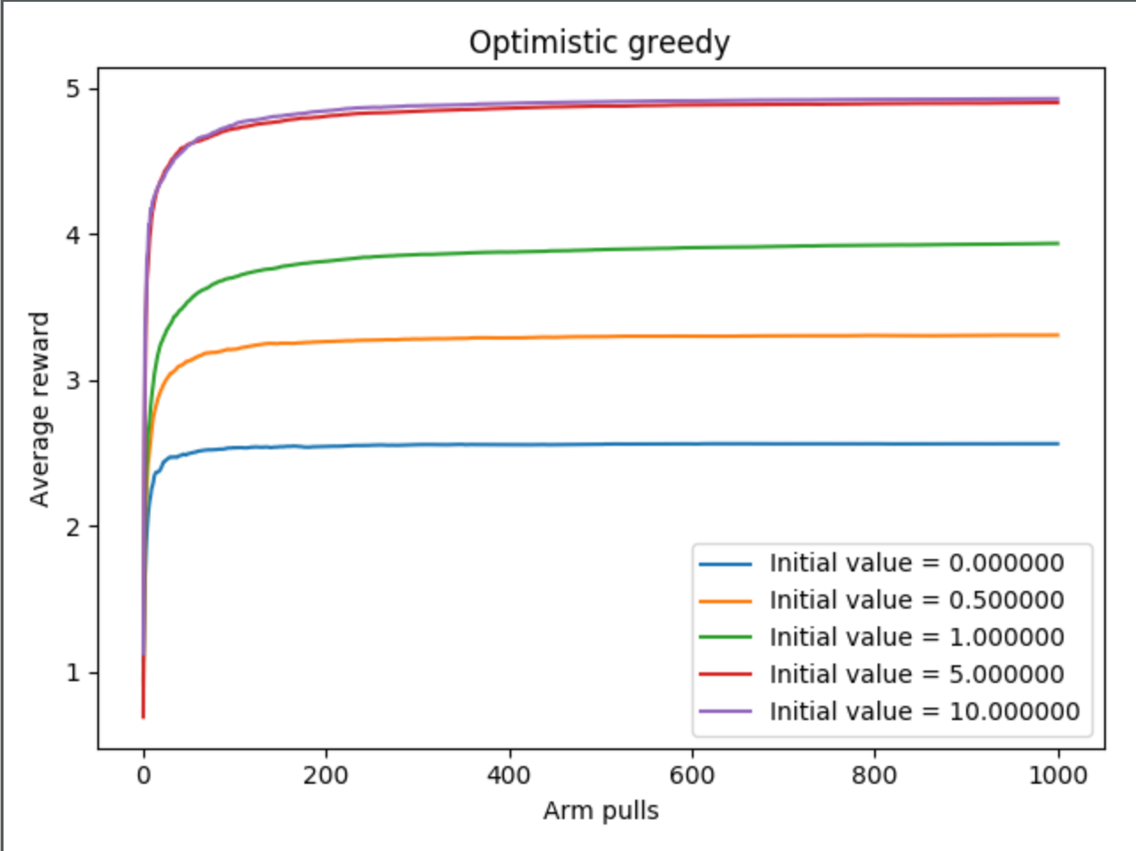
Notes:
When we set the initial value at 0, we fall in the same case of the epsilon greedy algorithm (look at the curve).

Slide 8
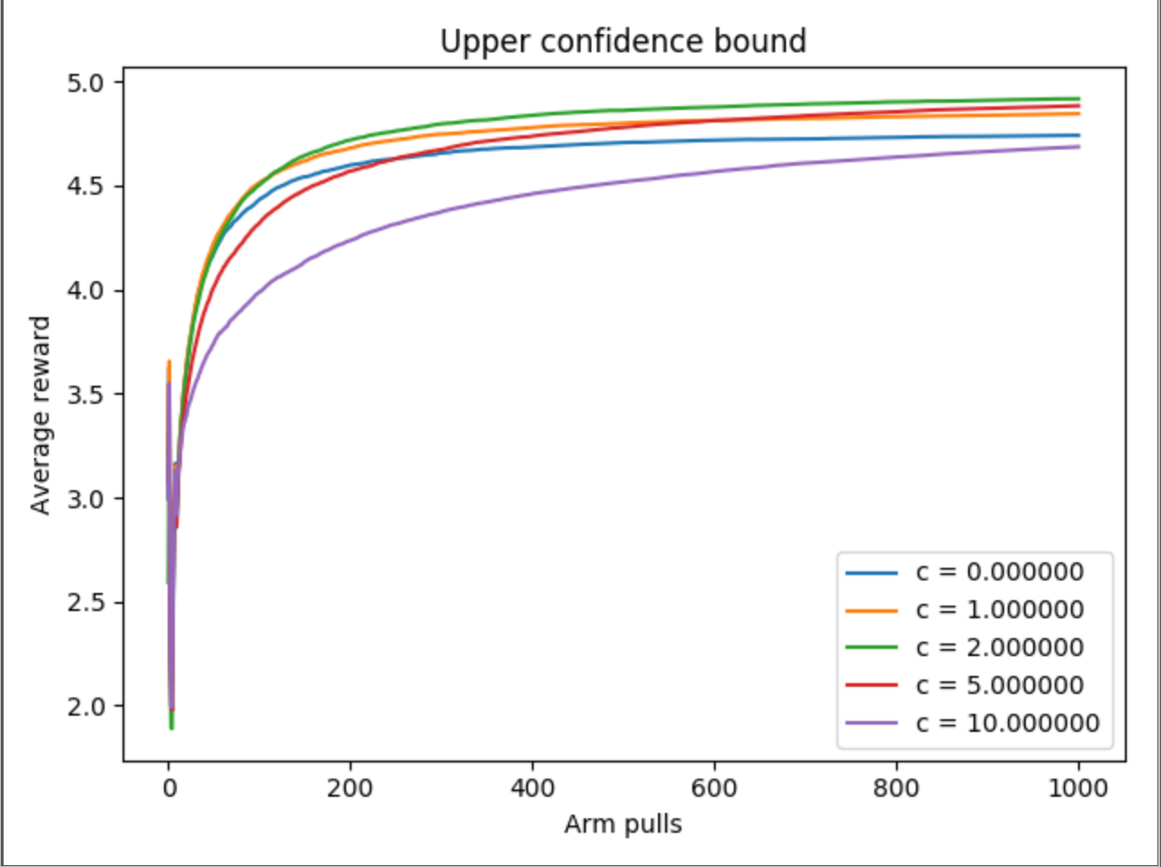
Notes:
We notice a peak on the 11° step (more or less) but we don’t know why.

Slide 9
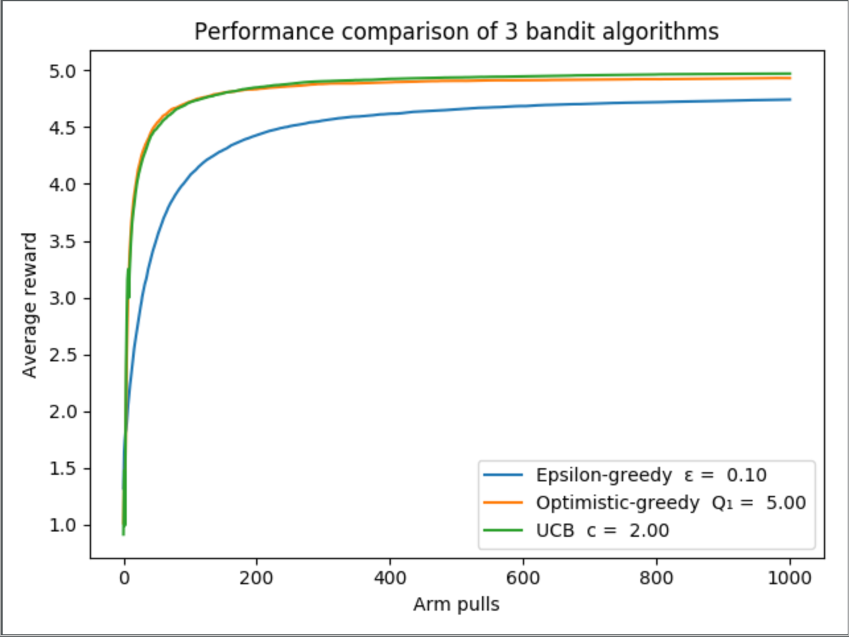
Experiment 2
Distribution 1

Slide 10
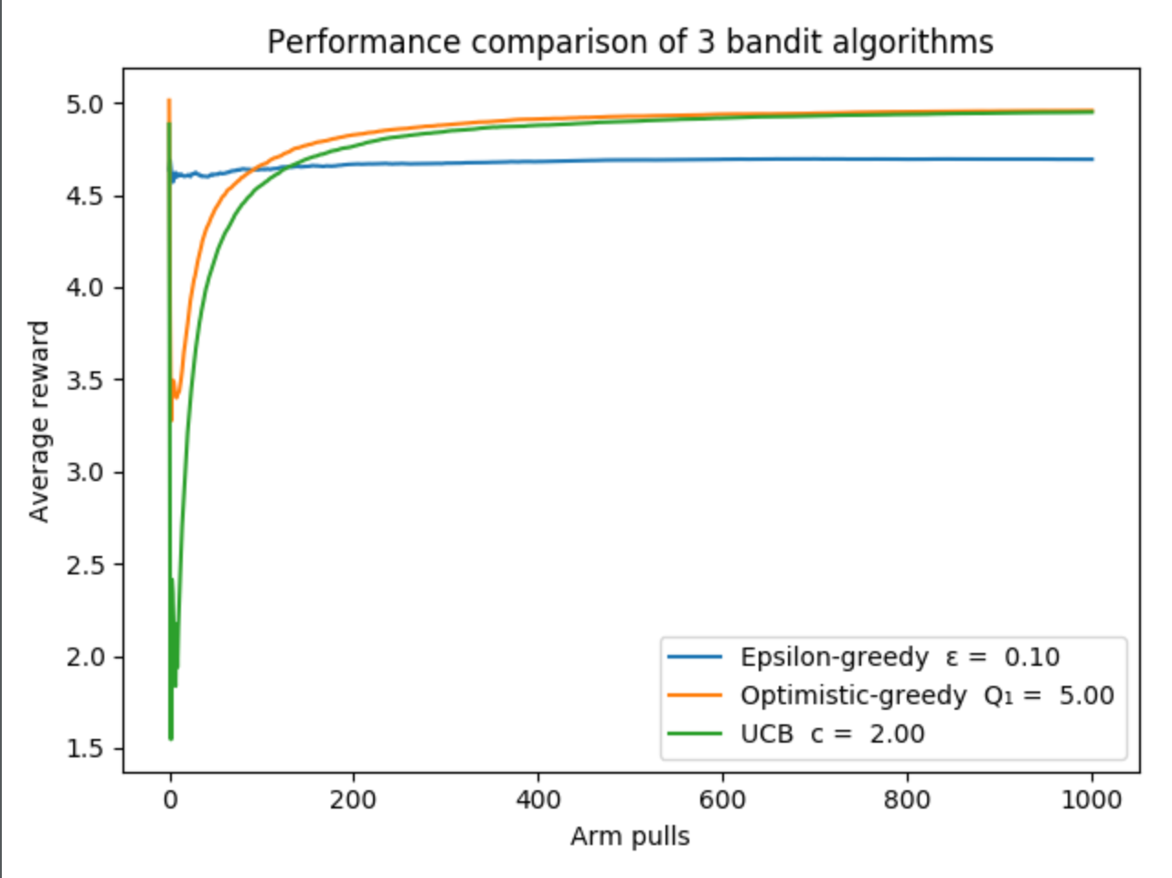
Experiment 2
Distribution 2
Notes:
Parameters are the same (as you can see in the legend)

Slide 11
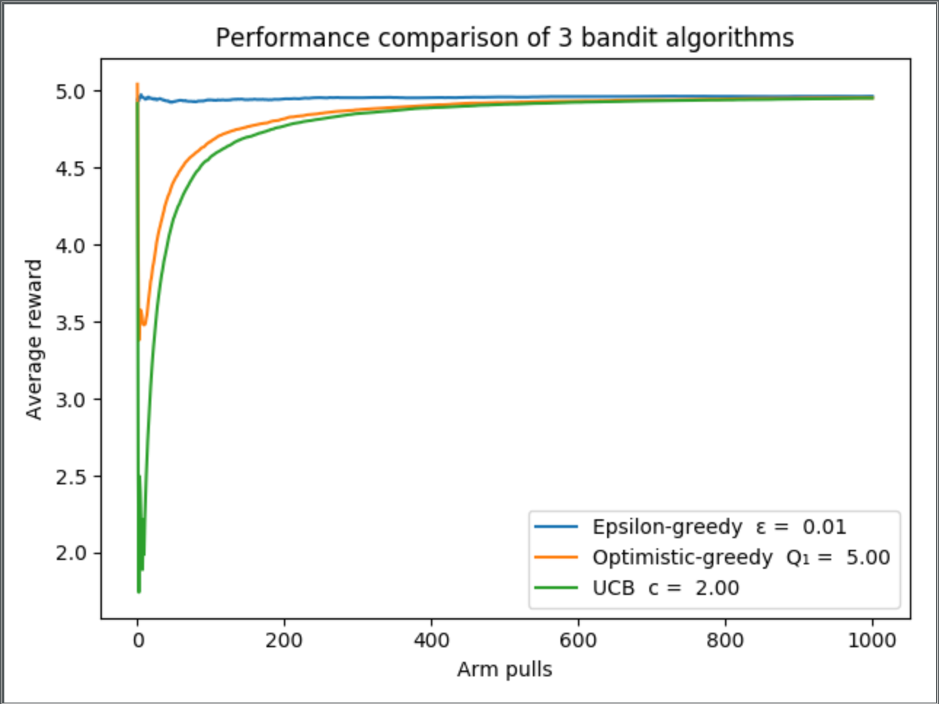
Experiment 2
Distribution 2 but
With different epsilon.
Notes:
We changed epsilon to make epsilon-greedy outperform the other algorithm.

Slide 12
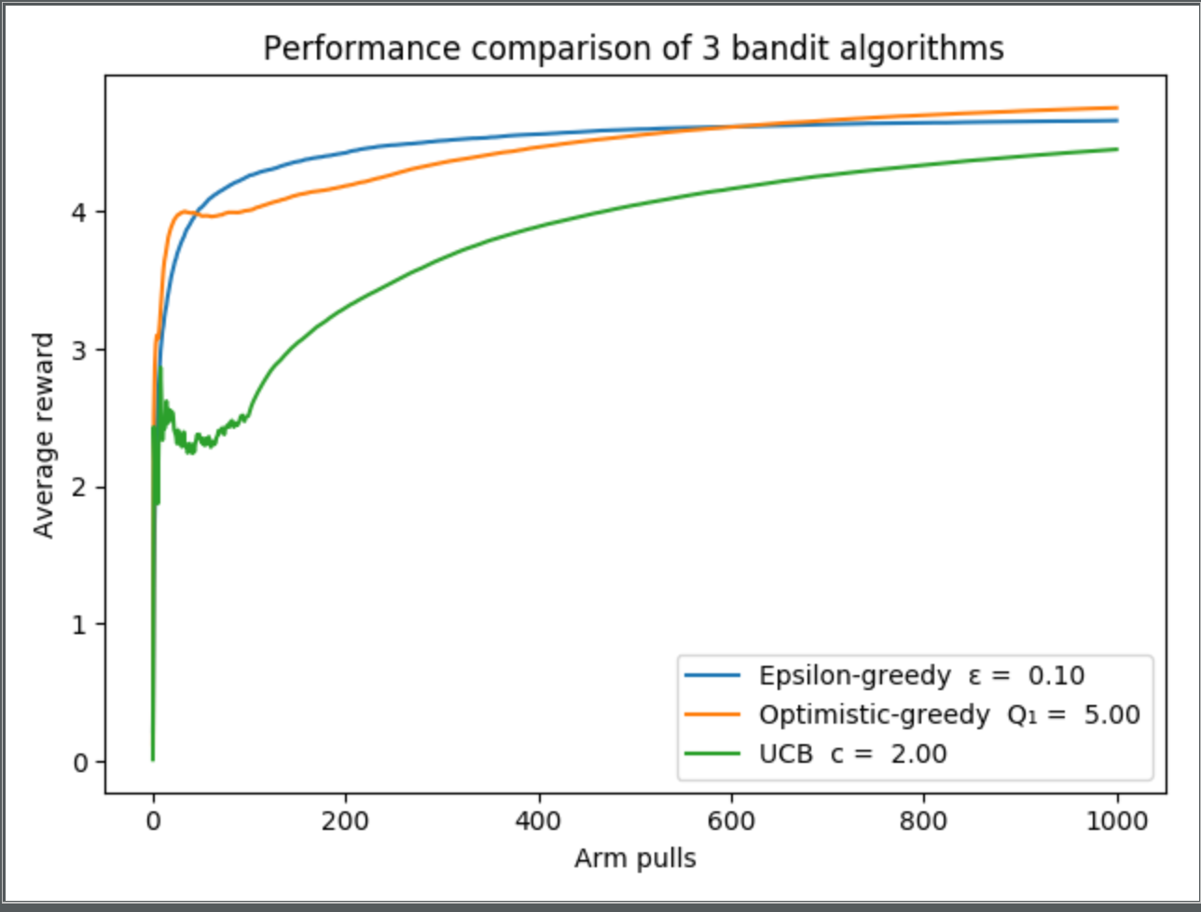
Experiment 2
Distribution 3 + 100 bandits

Slide 13
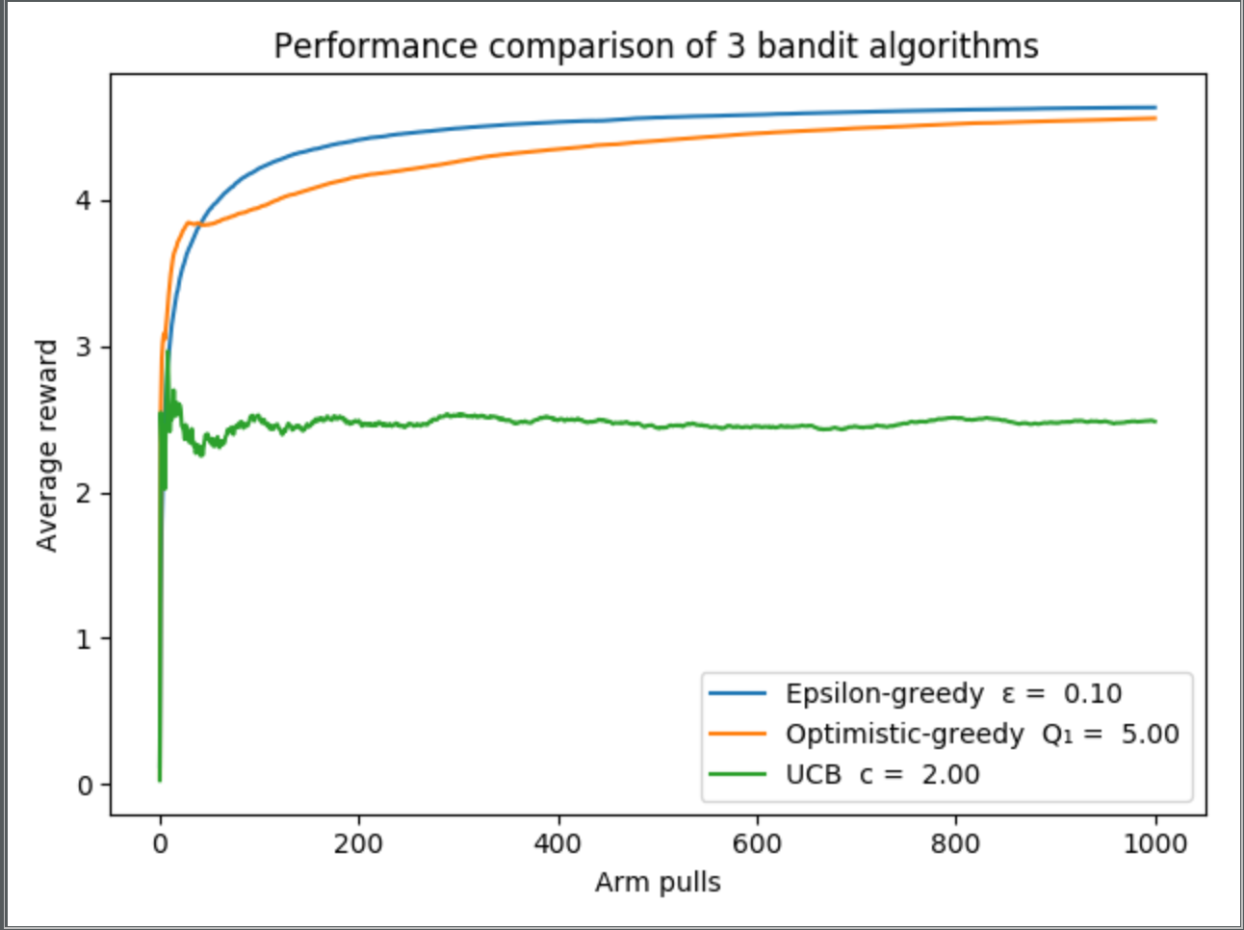
Experiment 2
Distribution 3 + 1000 bandits

Slide 14
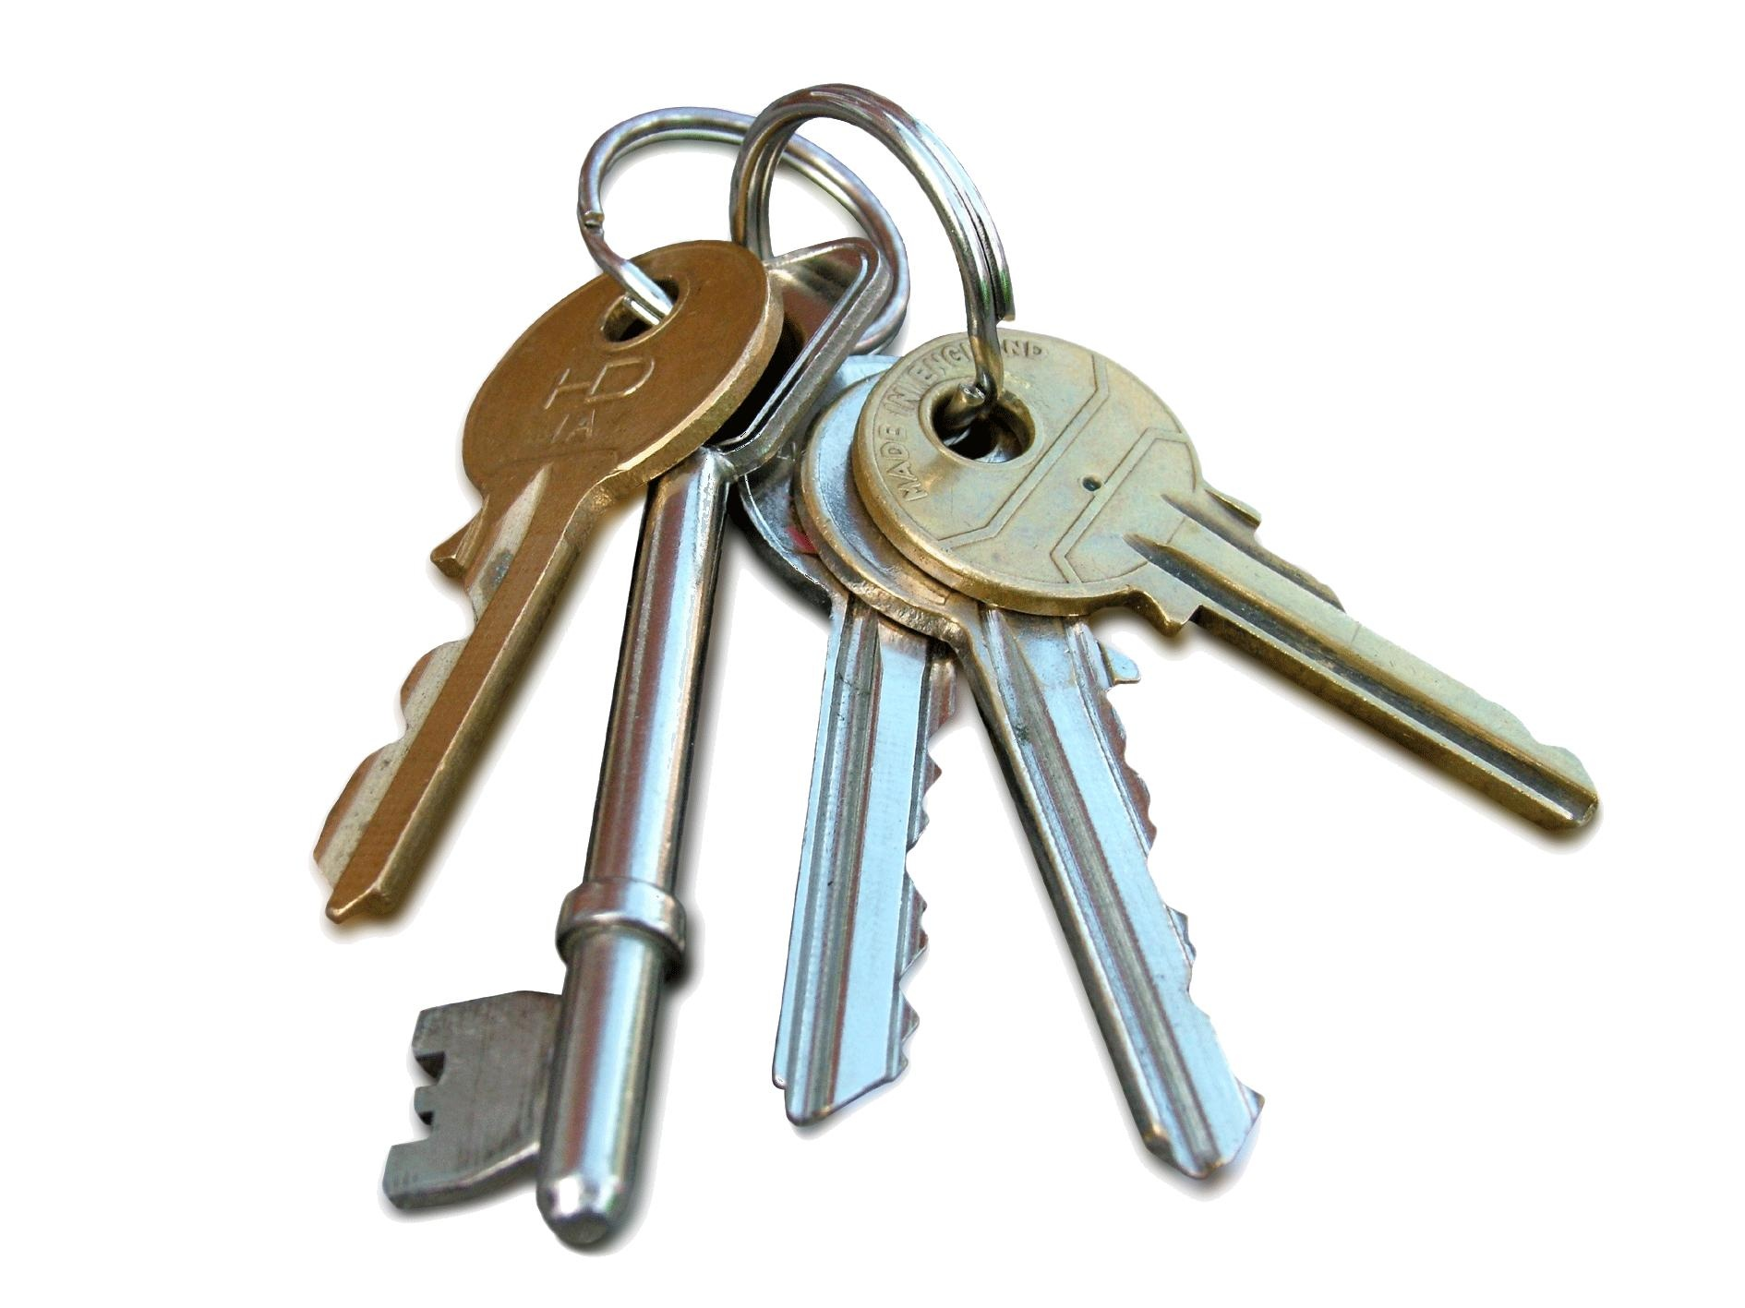
Conclusions
Parameters ≈
ε-greedy and optimistic-greedy appear to generalize well
Can‘t conclude UBC is worse
UBC with tweaked 𝒄 might outperform the others

Slide 15


Exercise 2 – Q learning
$Key parts$
$Experimental setup$
$Result$
$Conclusion$

Slide 16


Key Parts
Policy followed --> $ϵ$ - greedy
def get_next_action(s): probability = random.random() if probability < epsilon: action = random.randint(0, 3) # Choose an action at random return action else: # Otherwise, greedily choose best action based on estimated reward of surrounding states return np.argmax(Q_matrix[s.row][s.column])

Slide 17
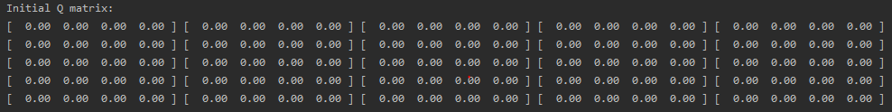

Experimental setup
Initialize Q(s,a) with arbitrary values (in our case 0), except for the terminal state that must be equal to 0
Algorithm parameters (not the same every
time, they must be tuned)

Slide 18
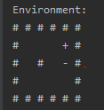
Result
Simple environment
One episode -->
BUMPS many times!!!!
At the end the Q matrix obtained is:
Start point
CAKE
MOUSE TRAP
Notes:
Q = estimate state action value = expected discounted reward

Slide 19
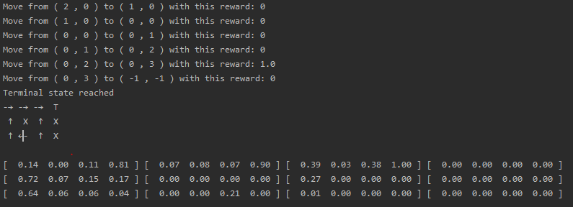
With the simple environment at the end of all episodes
The estimates value propagate back from the state near the cake to the start point.

Slide 20
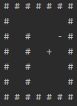
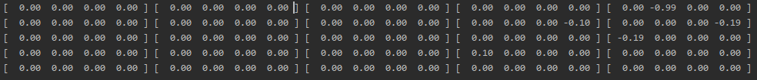
Complex environment
Also in this case, for the first episode (and some other), agent bumps many times against a wall, obtaining at the end this Q-matrix

Slide 21
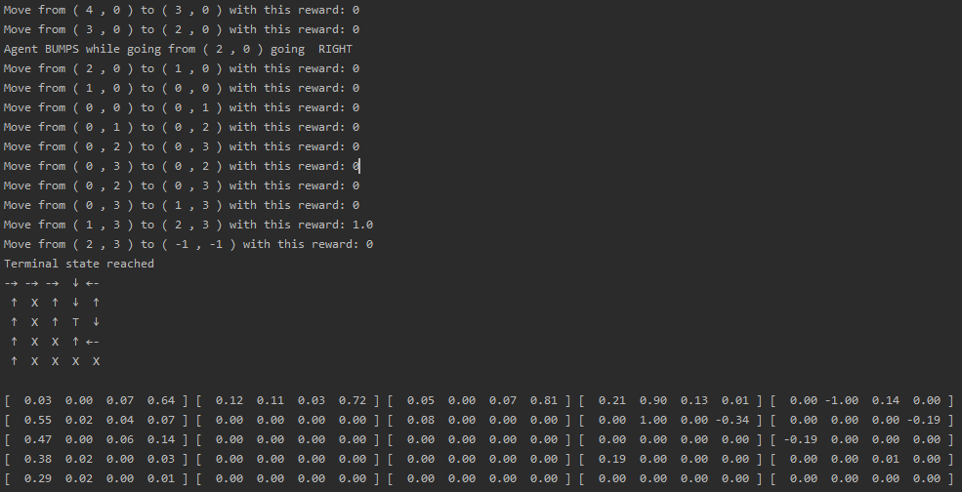
At the end we obtain this result:

Slide 22
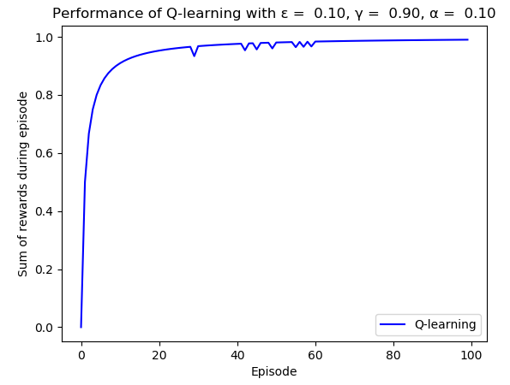
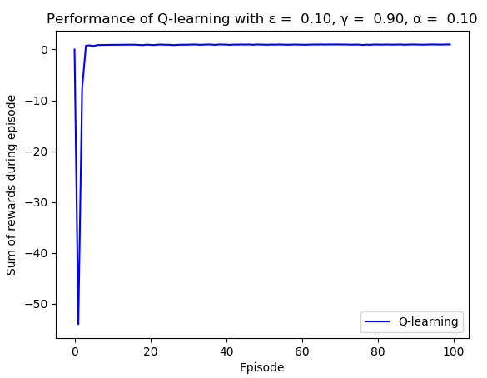

We also try to compare, with a simple plot, the sum of the reward obtained with different kind of setup (small or big environment, $α,γ,ε$)
Small environment
Big environment
We can notice how, for the complex environment, at the start of the algorithm, it takes a lot of error
before getting convergence without any errors during the path

Slide 23
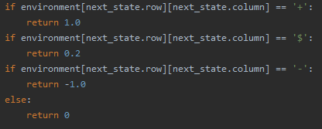
We’ve tried also to insert little reward along the way, like little cake, to encourage the agent to keep exploring. We did this in this way:
Little reward is given when a little cake is eaten.
BUT…
We weren’t able to make agent so intelligent to know that he can found the bigger cake, without get stuck on little one.
We try to delete the little cake once it was eaten, but this VIOLATES the Markov Property.

Slide 24


Exercise 3 – BackPropagation XOR problem
$Single perceptron highlights$
$Key parts$
$Result$

Slide 25
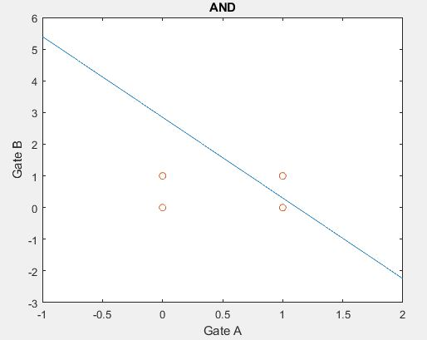
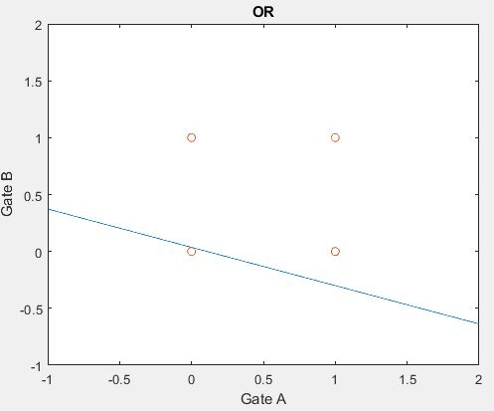
Single perceptron highlights Try simple first: && and ||
0
0
1
1

Slide 26
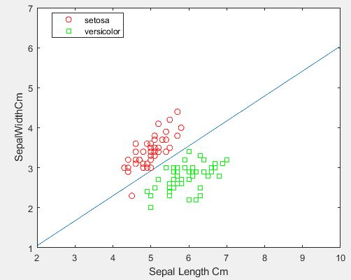
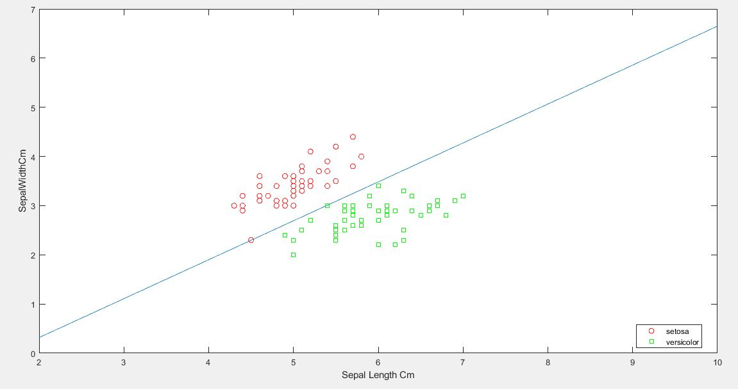
Let’s increase the difficulty… Single perceptron with irisDataset
With 50 epochs
One points of the dataset misclassificated
With 1500 epochs
All the points are correctly classified (YEAH)

Slide 27
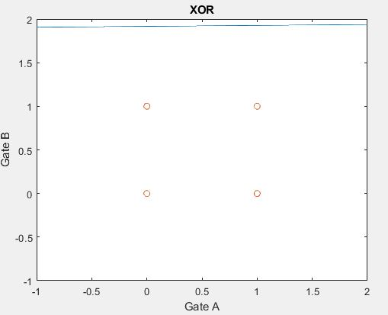
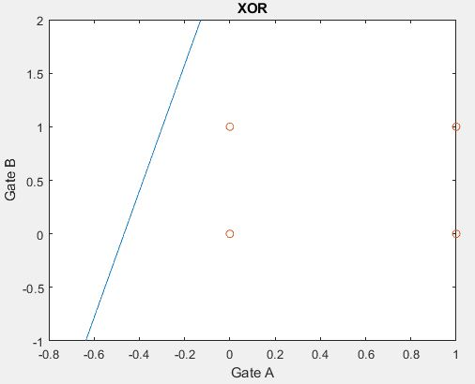
Even more difficult… XOR port!!!

Slide 28

We need another bound to evaluate the points, and so more neurons. So… multi layer perceptron!
Key parts:
Weigths stored in a matrix cause we have more neurons.
Notes:
Focus needed on the dimensionality of the matrix.

Slide 29
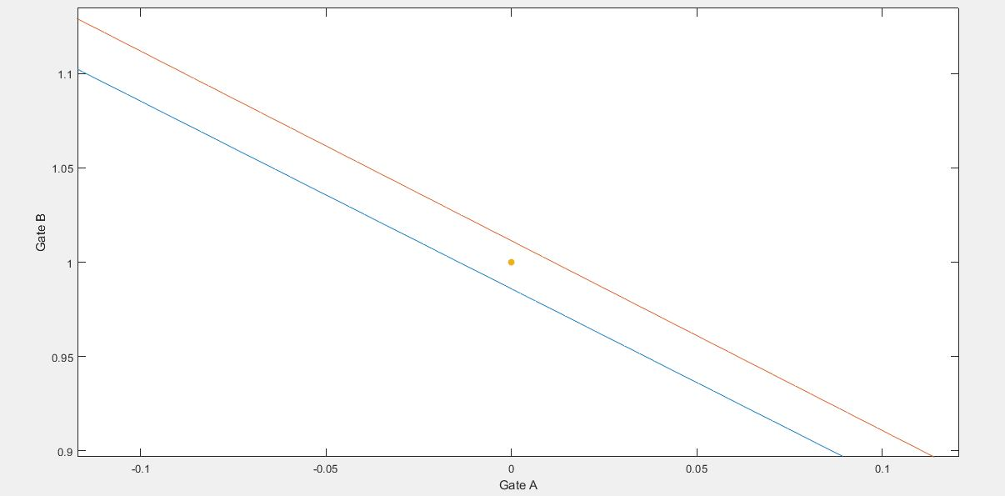
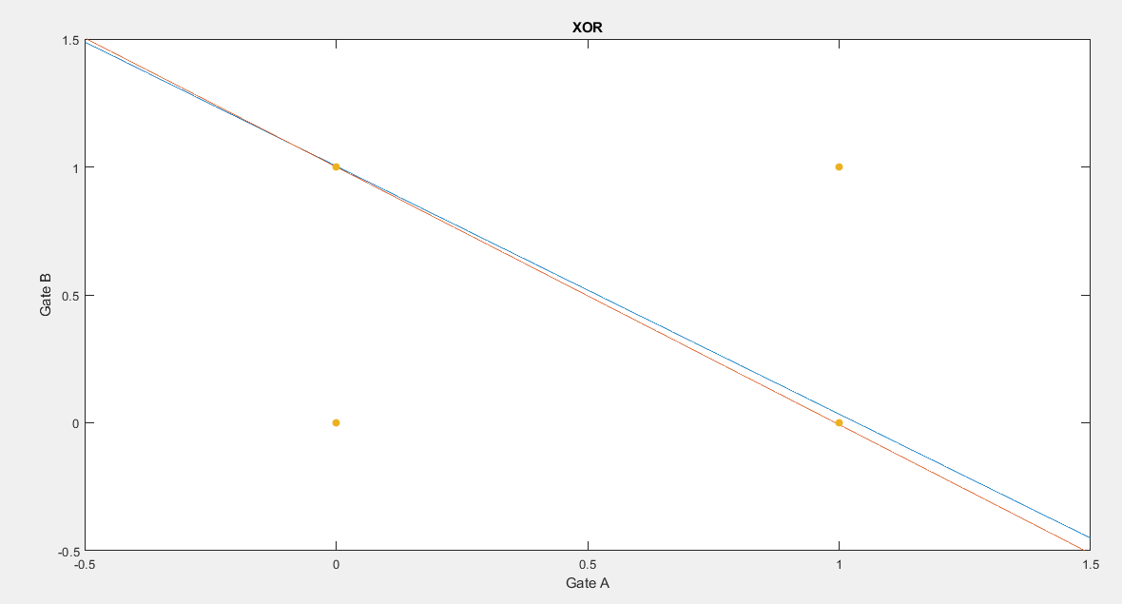
ZOOM… Correctly classified: trust us!
Result

Slide 30
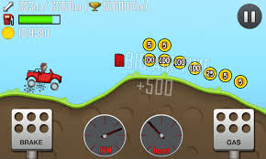

Exercise 4 – SARSA in continuous space
$Key parts$
$Result$

Slide 31
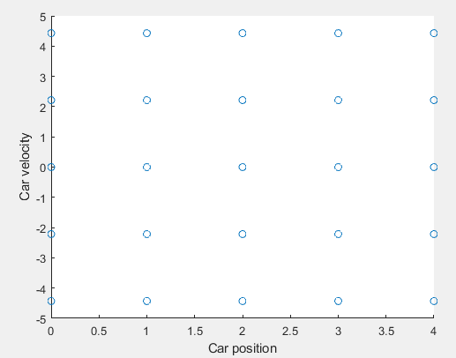


Key parts
Discretization of the state space
Randomization
NO ‘’YES’’

Slide 32
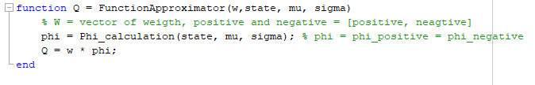
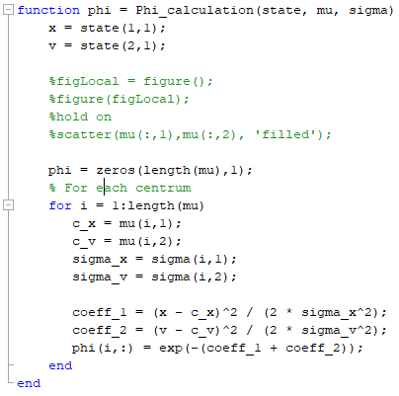
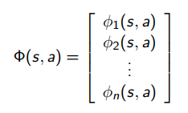

Slide 33
Video demonstration....

Slide 34
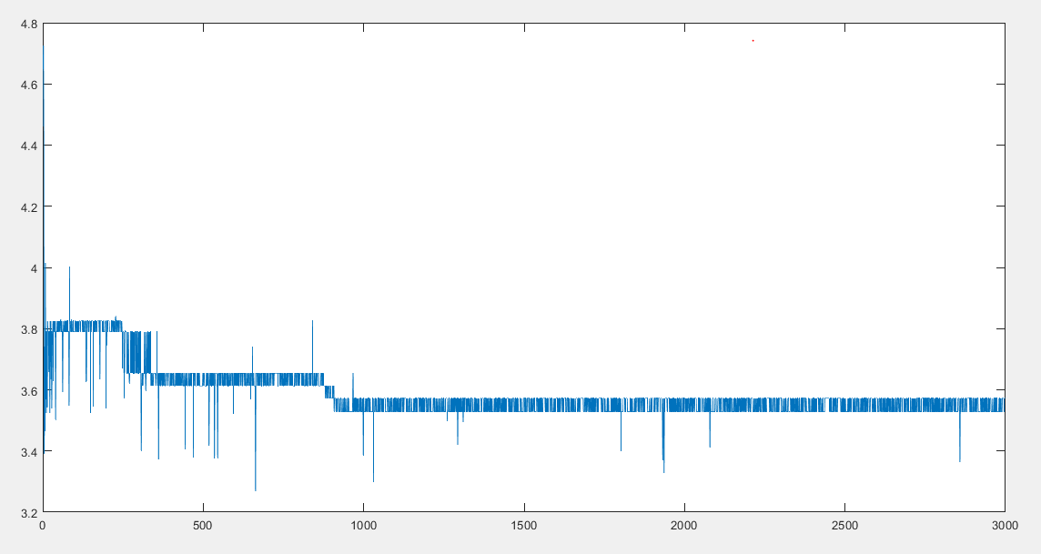
The reward obtained by the agent (the car) decreases
with the number of the episodes.

Slide 35
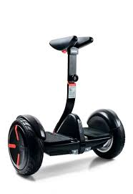
Exercise 4 – Control of invers pendulum with FD

Slide 36
Still under construction…..

Slide 37
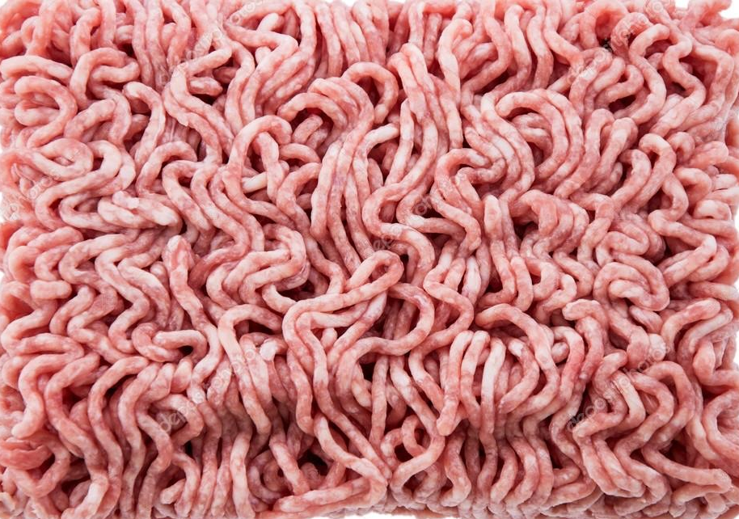
Thank you all!

