Slide 1
Reinforcement learning 2019
Group 7

Slide 2


Exercise 1 – Bandit algorithms
$ε−greedy algorithms$
$UCB$
$Optimistic Initial value$
Bandit

Slide 3
Experimental Setup
RNG seed fixed at 420 for all runs
Size of bandit reward interval fixed at 8
Interval mean ranging from 0-5
Mean picked at random

Slide 4
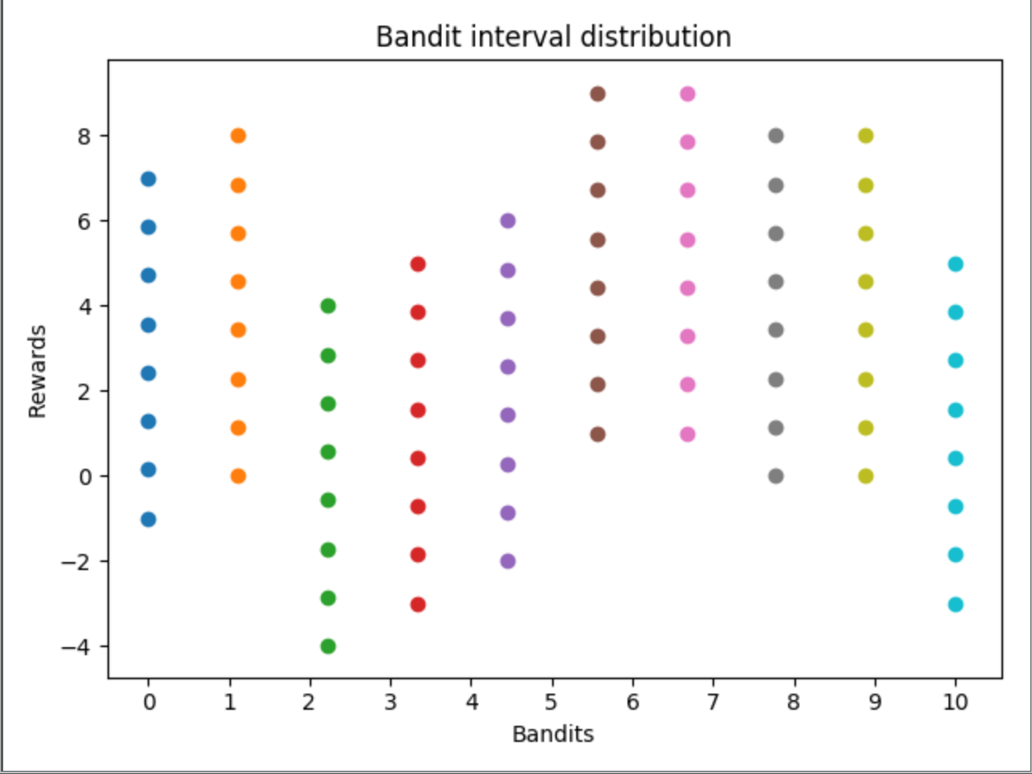
Experimental Setup

Slide 5
Experiments
Internal comparison (parameter vs parameter)
External comparison (algorithm1 vs algorithm2)
Performance measure: Average reward

Slide 6


Exercise 2 – Q learning
$Key parts$
$Experimental setup$
$Result$
$Conclusion$

Slide 7


Key Parts
Policy followed --> $ϵ$ - greedy
def get_next_action(s): probability = random.random() if probability < epsilon: action = random.randint(0, 3) # Choose an action at random return action else: # Otherwise, greedily choose best action based on estimated reward of surrounding states return np.argmax(Q_matrix[s.row][s.column])

Slide 8
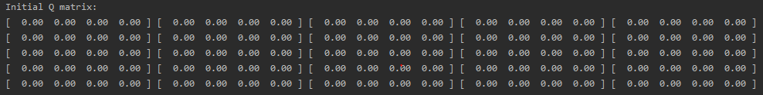

Experimental setup
Initialize Q(s,a) with arbitrarily values (in our case 0), except for the terminal state that must be equals to 0
Algorithm parameters (not the same every
time, they must be tuned)

Slide 9
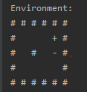
Result
Simple environment
One episode -->
BUMPS many times!!!!
At the end the Q matrix obtained is:
Start point
CAKE
MOUSE TRAP

Slide 10
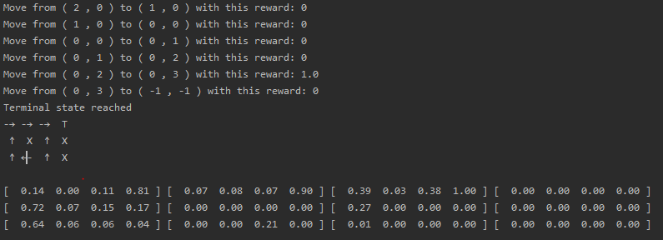
Yet with the simple environment at the end of all episodes
The estimates value propagate back from the state near the cake to the start point.

Slide 11
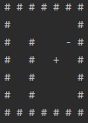
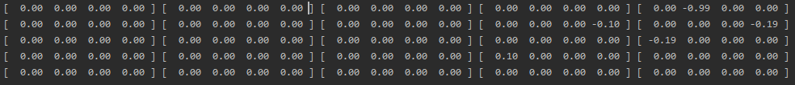
Complex environment
Also in this case, for the first episode, agent bumps
many times against a wall, obtaining at the end this
Q-matrix

Slide 12
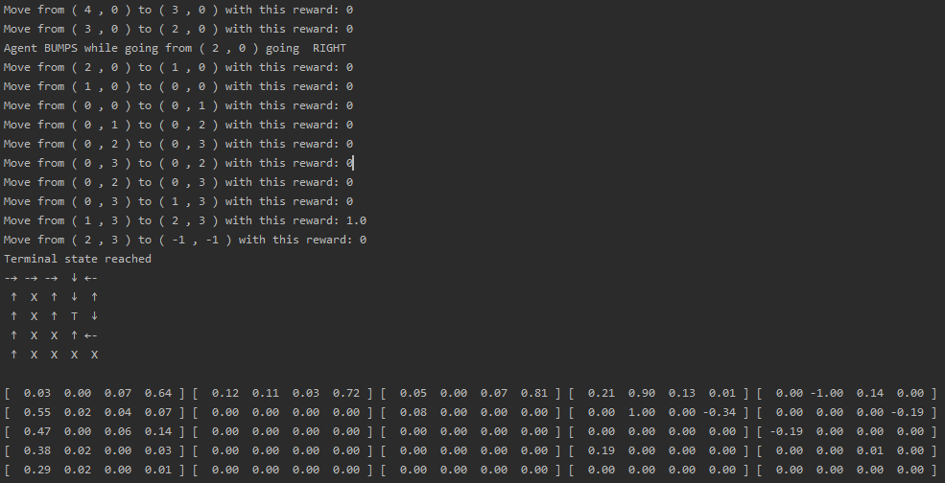
At the end we obtain, in this specific run, this result

Slide 13
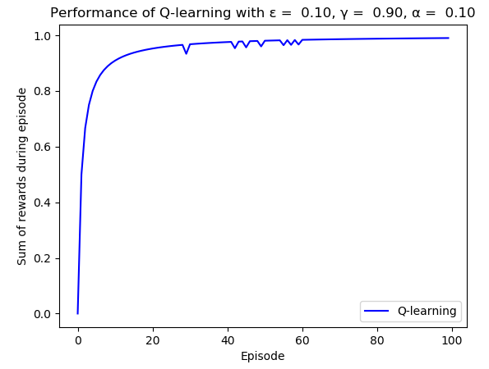
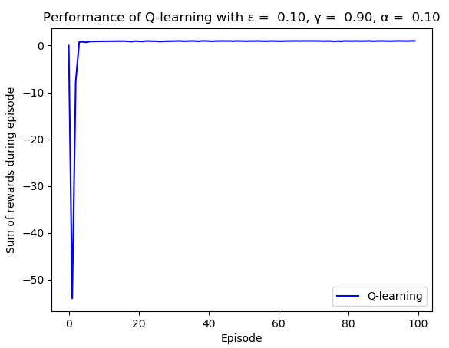

We also try to compare, with a simple plot, the sum of the reward obtained with different kind of setup (small or big environment, $α,γ,ε$)
Small environment
Big environment
We can notice how, for the complex environment, at the start of the algorithm, it takes a lot of error
before getting convergence without any errors during the path

Slide 14
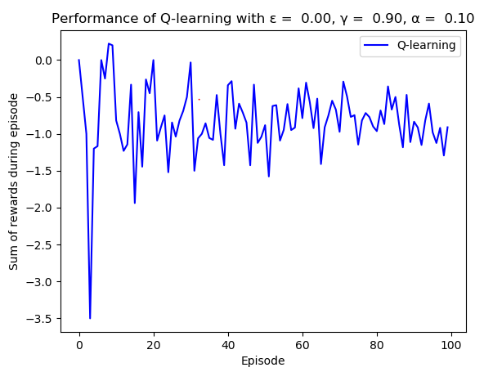
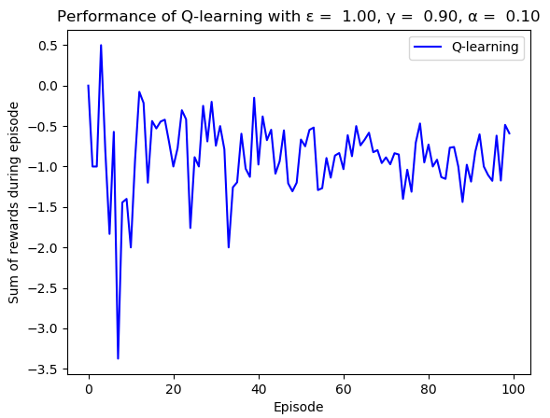
In this case we have a complete randomization
of the action choice.

Slide 15
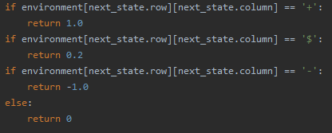
We’ve tried also to insert little reward along the way, like little cake, to encourage the agent to keep exploring. We did this in this way:
Little reward is given when a little cake is eatean.
BUT…
We weren’t able to make agent so intelligent to know the he can found the bigger cake, without get stack on little one.
We try to delete the little cake once it was eatean, but this VIOLATE the Markov Property.

Slide 16


Exercise 3 – BackPropagation XOR problem
$Single perceptron highlights$
$Key part$
$Experimental setup$
$Result$
$Conclusion$

Slide 17
Single perceptron with irisDataset

Slide 18
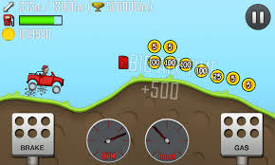
Exercise 4 – SARSA in continuous space

