Slide 1

HANDWRITTEN digit recognition using python
CSE III SEMESTER MINI PROJECT
23 - 24

Slide 2

Submitted to: Submitted by: Ms. Jyoti Ramola Mr. Karan Ray (CC-CSE-S-III-Sem) Roll. No:2318031 Guided by: CSE-S-III-Sem Ms. Jyoti Ramola Session: 2023-2024 DEPARTMENT OF COMPUTER SCIENCE AND INFORMATION TECHNOLOGY GRAPHIC ERA HILL UNVERSITY, DEHRADUN

Slide 3
Table of Content
Introduction
Import the dependencies and load dataset
Data overview
Explore the data
Build the CNN model to classify Handwritten Digits
Model Evaluation
Model prediction on unseen dataset (test data)
References

Slide 4
1 | Introduction
Handwritten Digit Recognition is the process of digitizing human handwritten digit images. It is a difficult task for the machine because handwritten digits are not perfect and can be made with a variety of flavors. To address this issue, we created HDR, which uses the image of a digit to identify the digit that is present in the image.
In this project, we developed a Convolutional Neural Network (CNN) model using Tensorflow framework to Recognition of Handwritten Digit.
Objective
The primary objective of this project is to design an efficient and robust system capable of recognizing and classifying handwritten digits from various sources, such as scanned images or digital tablets. By utilizing advanced machine learning techniques, the program aims to achieve high accuracy in digit recognition.

Slide 5
Convolutional neural network (CNN, or ConvNet)
A convolutional neural network (CNN, or ConvNet) is a Deep Learning algorithm that can take in an input image, assign learnable weights and biases to various objects in the image and be able to distinguish one from the other.
It is used to analyse visual imagery. Object detection, face recognition, robotics, video analysis, segmentation, pattern recognition, natural language processing, spam detection, topic categorization, regression analysis, speech recognition, image classification are some of the examples that can be done using Convolutional Neural Networking.

Slide 6
2 | Import the dependencies and load the dataset
We will import all the modules that we will require to train our model.
Tensorflow
TensorFlow is an open source framework developed by Google researchers to run machine learning, deep learning and other statistical and predictive analytics workloads.
Matplotlib
Matplotlib is a cross-platform, data visualization and graphical plotting library (histograms, scatter plots, bar charts, etc) for Python and its numerical extension NumPy.
Seaborn
Seaborn is a library for making statistical graphics in Python. It builds on top of matplotlib and integrates closely with pandas data structures. Seaborn helps you explore and understand your data.

Slide 7
Numpy
NumPy is a Python library used for working with arrays. It also has functions for working in domain of linear algebra, fourier transform, and matrices.
Pandas
Pandas is a Python library used for working with data sets. It has functions for analysing, cleaning, exploring, and manipulating data. The name "Pandas" has a reference to both "Panel Data", and "Python Data Analysis".
Math
Using The math Module in Python. math is a built-in module in the Python standard library that provides standard mathematical constants and functions.
Platform
The platform module in Python provides functions that access information of the underlying platform (operating system). The platform. platform() method returns a single string containing as much information about the underlying platform as feasible.

Slide 8
# This Python 3 environment comes with many helpful analytics libraries installed
# It is defined by the kaggle/python Docker image: https://github.com/kaggle/docker-python
import tensorflow as tf
import matplotlib.pyplot as plt
import seaborn as sn
import numpy as np # linear algebra
import pandas as pd # data processing, CSV file I/O (e.g. pd.read_csv)
import math
import datetime
import platform
# Input data files are available in the read-only "../input/" directory
# For example, running this (by clicking run or pressing Shift+Enter) will list all files under the input directory
import os for dirname, _, filenames in os.walk('/kaggle/input'): for filename in filenames:
(os.path.join(dirname, filename))

Slide 9
('Python version:', platform.python_version())
('Tensorflow version:', tf.__version__)
('Keras version:', tf.keras.__version__)
Python version: 3.7.12
Tensorflow version: 2.6.4
Keras version: 2.6.0
# Load the TensorBoard notebook extension.
# %reload_ext tensorboard
%load_ext tensorboard
# Clear any logs from previous runs.
!rm -rf ./.logs/
train = pd.read_csv('/kaggle/input/digit-recognizer/train.csv’)
test = pd.read_csv('/kaggle/input/digit-recognizer/test.csv')

Slide 10
3 | Data overview
The MNIST dataset contains 42,000 training images of handwritten digits from zero to nine (10 different classes) and 28,000 images for testing without the label identifier (for submission). These images are the grayscaled pixel value and are represented as a 28×28 matrix.
Dimension of train and test data
Train data
RangeIndex: 42000 entries, 0 to 41999
Columns: 785 entries, label to pixel 783
dtypes: int64(785)
memory usage: 251.5 MB
Shape - (None, (42000, 785))
Test data
RangeIndex: 28000 entries, 0 to 27999
Columns: 784 entries, pixel 0 to pixel 783
dtypes: int64(784)
memory usage: 167.5 MB
Shape - (None, (28000, 784))

Slide 11
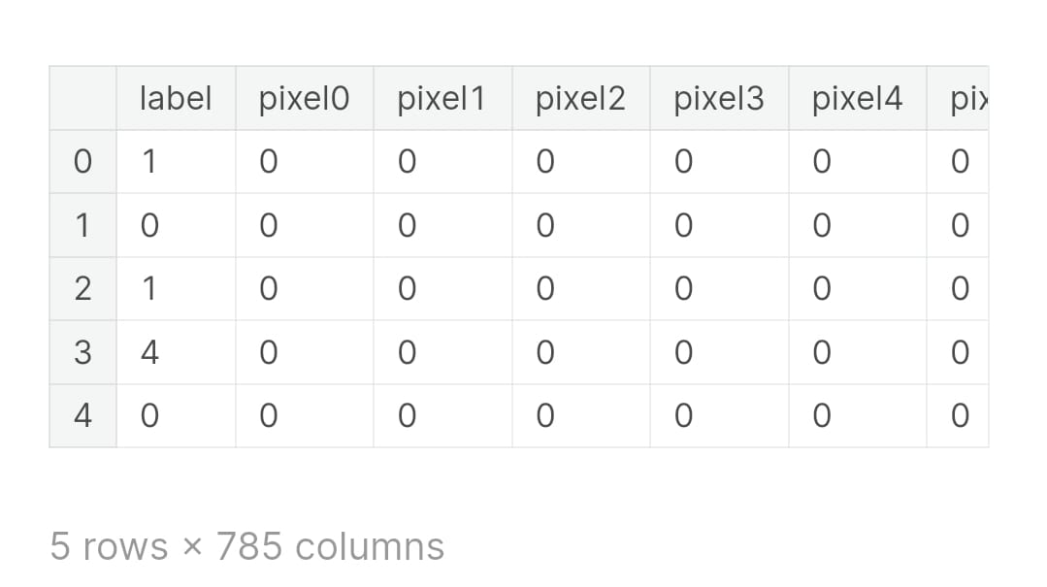
train.head()

Slide 12
train.info(), train.shape
RangeIndex: 42000 entries, 0 to 41999
Columns: 785 entries, label to pixel783
dtypes: int64(785)
memory usage: 251.5 MB
(None, (42000, 785))
test.info(), test.shape
RangeIndex: 28000 entries, 0 to 27999
Columns: 784 entries, pixel0 to pixel783
dtypes: int64(784)
memory usage: 167.5 MB
(None, (28000, 784))

Slide 13
Visualizing the data using TSNE
TSNE - t-Distributed Stochastic Neighbour embedding. This is a dimensionality reduction algorithm that is designed to keep local structure in the high dimensional data set but cares less about global structure. Here, we use it to go from the 784 pixel-dimension of the images to two dimensions. This makes plotting easier. The colour scale is the original MNIST label, and one can see that the separation of the labels is apparent.
# WARNING: running t-SNE on the full data set takes a while.
X_tsn = X/255
from sklearn.manifold
import TSNE tsne = TSNE()
tsne_res = tsne.fit_transform(X_tsn)

Slide 14
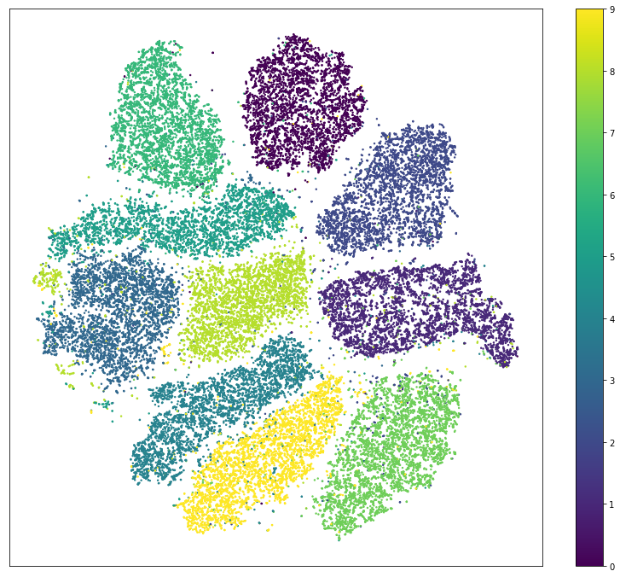
plt.figure(figsize=(14, 12))
plt.scatter(tsne_res[:,0], tsne_res[:,1], c=y, s=2)
plt.xticks([])
plt.yticks([])
plt.colorbar();

Slide 15
Splitting data into training and validation dataset
We are dividing our dataset (X) into two parts.
The training dataset (80%) is used to fit our models
The Validation dataset (20%) is used to evaluate our models
train_test_split() method returns us the training data, its labels and also the validation data and its labels.
from sklearn.model_selection
import train_test_split X_train, X_validation, y_train, y_validation = train_test_split(X, y, test_size = 0.2,random_state = 1212)

Slide 16
Dimension of training and validation data
('X_train:', X_train.shape)
('y_train:', y_train.shape)
('X_validation:', X_validation.shape)
('y_validation:', y_validation.shape)
X_train: (33600, 784)
y_train: (33600,)
X_validation: (8400, 784)
y_validation: (8400,)

Slide 17
Converting training, testing, and validation data into array
x_train_re = X_train.to_numpy().reshape(33600, 28, 28)
y_train_re = y_train.values
x_validation_re = X_validation.to_numpy().reshape(8400, 28, 28)
y_validation_re = y_validation.values
x_test_re = test.to_numpy().reshape(28000, 28, 28)

Slide 18
Dimension of training, testing, and validation data after reshaping
('x_train:', x_train_re.shape)
('y_train:', y_train_re.shape)
('x_validation:', x_validation_re.shape)
('y_validation:', y_validation_re.shape)
('x_test:', x_test_re.shape)
x_train: (33600, 28, 28)
y_train: (33600,)
x_validation: (8400, 28, 28)
y_validation: (8400,)
x_test: (28000, 28, 28)

Slide 19
# Save image parameters to the constants that we will use later for data re-shaping and for model traning.
(_, IMAGE_WIDTH, IMAGE_HEIGHT) = x_train_re.shape
IMAGE_CHANNELS = 1
('IMAGE_WIDTH:', IMAGE_WIDTH);
('IMAGE_HEIGHT:', IMAGE_HEIGHT);
('IMAGE_CHANNELS:', IMAGE_CHANNELS);
IMAGE_WIDTH: 28
IMAGE_HEIGHT: 28
IMAGE_CHANNELS: 1

Slide 20
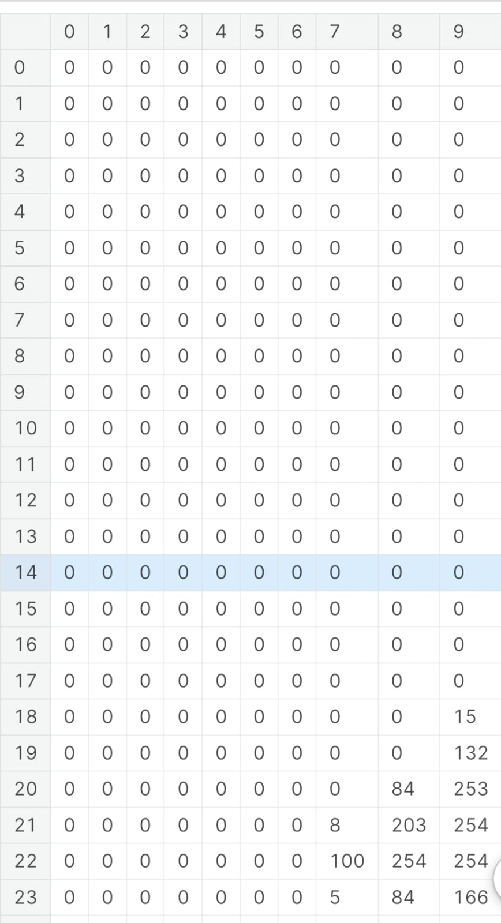
4 | Explore the Data
Here is how each image in the dataset looks like. It is a 28x28 matrix of integers (from 0 to 255) and each integer represents a color of a pixel.
pd.DataFrame(x_train_re[0])

Slide 21
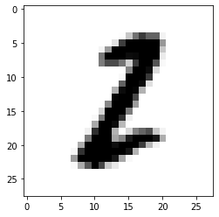
Visualize how the digits were written
This number matrix may be drawn as follows:
plt.imshow(x_train_re[0], cmap=plt.cm.binary)
plt.show()
Our first record of training data represents 2.

Slide 22
Let's print some more training examples to get the feeling of how the digits were written.
numbers_to_display = 100 num_cells = math.ceil(math.sqrt(numbers_to_display))
plt.figure(figsize=(20,20)) for i in (numbers_to_display):
plt.subplot(num_cells, num_cells, i+1)
plt.xticks([])
plt.yticks([])
plt.grid(False)
plt.imshow(x_train_re[i], cmap=plt.cm.binary)
plt.xlabel(y_train_re[i])
plt.show()

Slide 23
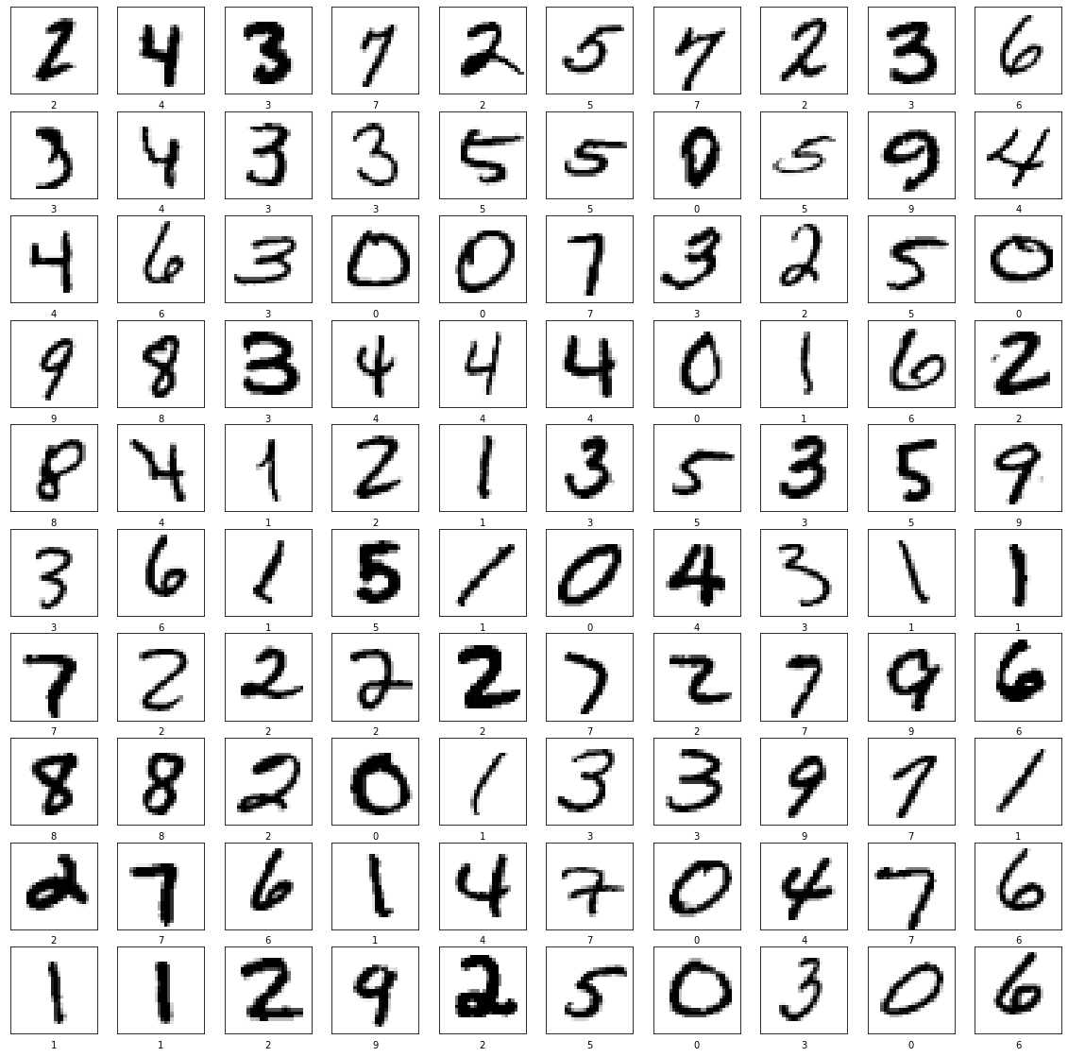

Slide 24
Reshaping train, test, and validation data
To use convolution layers, we need to reshape our data and add a color channel to it. As you've noticed currently every digit has a shape of (28, 28) which means that it is a 28x28 matrix of color values form 0 to 255. We need to reshape it to (28, 28, 1) shape so that each pixel potentially may have multiple channels (like Red, Green and Blue).
x_train_with_chanels = x_train_re.reshape( x_train_re.shape[0],
IMAGE_WIDTH, IMAGE_HEIGHT, IMAGE_CHANNELS )
x_validation_with_chanels = x_validation_re.reshape( x_validation_re.shape[0],
IMAGE_WIDTH, IMAGE_HEIGHT, IMAGE_CHANNELS )
x_test_with_chanels = x_test_re.reshape( x_test_re.shape[0], IMAGE_WIDTH,
IMAGE_HEIGHT, IMAGE_CHANNELS )

Slide 25
('x_train_with_chanels:', x_train_with_chanels.shape)
('x_validation_with_chanels:', x_validation_with_chanels.shape)
('x_test_with_chanels:', x_test_with_chanels.shape)
x_train_with_chanels: (33600, 28, 28, 1)
x_validation_with_chanels: (8400, 28, 28, 1)
x_test_with_chanels: (28000, 28, 28, 1)

Slide 26
Normalize train, test, and validation data
Here we're just trying to normalize from values range of [0...255] to [0...1].
x_train_normalized = x_train_with_chanels / 255
x_validation_normalized = x_validation_with_chanels / 255
x_test_normalized = x_test_with_chanels / 255
# Let's check just one row from the 0th image to see color chanel values after normalization.
x_train_normalized[0][10]
array([[0. ], [0. ], [0. ],
[0. ], [0. ], [0. ], [0. ], [0. ], [0. ],
[0. ], [0. ], [0. ], [0. ], [0. ],
[0.02352941], [0.99607843], [0.99607843],
[0.99607843], [0.76862745], [0. ], [0. ],
[0. ], [0. ]])

Slide 27
5 | Build the CNN to classify Handwritten Digits
A Convolutional Neural Network model generally consists of convolutional and pooling layers.
We are using Sequential Keras model which have two pairs of Convolution2D and MaxPooling2D layers. The MaxPooling layer acts as a sort of downsampling using max values in a region instead of averaging.
After that we will use Flatten layer to convert multidimensional parameters to vector.
The last layer will be a Dense layer with 10 Softmax outputs. The output represents the network guess. The 0-th output represents a probability that the input digit is 0, the 1-st output represents a probability that the input digit is 1 and so on...

Slide 28
model = tf.keras.models.Sequential()
model.add(tf.keras.layers.Convolution2D(
input_shape=(IMAGE_WIDTH, IMAGE_HEIGHT, IMAGE_CHANNELS),
kernel_size=5, filters=8, strides=1, activation=tf.keras.activations.relu,
kernel_initializer=tf.keras.initializers.VarianceScaling() ))
model.add(tf.keras.layers.MaxPooling2D( pool_size=(2, 2), strides=(2, 2) ))
model.add(tf.keras.layers.Convolution2D( kernel_size=5, filters=16, strides=1, activation=tf.keras.activations.relu, kernel_initializer=tf.keras.initializers.VarianceScaling() ))
model.add(tf.keras.layers.MaxPooling2D( pool_size=(2, 2), strides=(2, 2) ))
model.add(tf.keras.layers.Flatten())
model.add(tf.keras.layers.Dense( units=128, activation=tf.keras.activations.relu ));
model.add(tf.keras.layers.Dropout(0.2))
model.add(tf.keras.layers.Dense( units=10, activation=tf.keras.activations.softmax,
kernel_initializer=tf.keras.initializers.VarianceScaling() ))

Slide 29
Summary of the training model
model.summary()
Model: "sequential“
_________________________________________________________________
Layer (type) Output Shape Param
# =================================================================
conv2d (Conv2D) (None, 24, 24, 8) 208
_________________________________________________________________
max_pooling2d (MaxPooling2D) (None, 12, 12, 8) 0 _________________________________________________________________
conv2d_1 (Conv2D) (None, 8, 8, 16) 3216
_________________________________________________________________
max_pooling2d_1 (MaxPooling2 (None, 4, 4, 16) 0 _________________________________________________________________
flatten (Flatten) (None, 256) 0
_________________________________________________________________
dense (Dense) (None, 128) 32896
_________________________________________________________________
dropout (Dropout) (None, 128) 0
_________________________________________________________________
dense_1 (Dense) (None, 10) 1290
=================================================================
Total params: 37,610
Trainable params: 37,610
Non-trainable params: 0
_________________________________________________________________

Slide 30
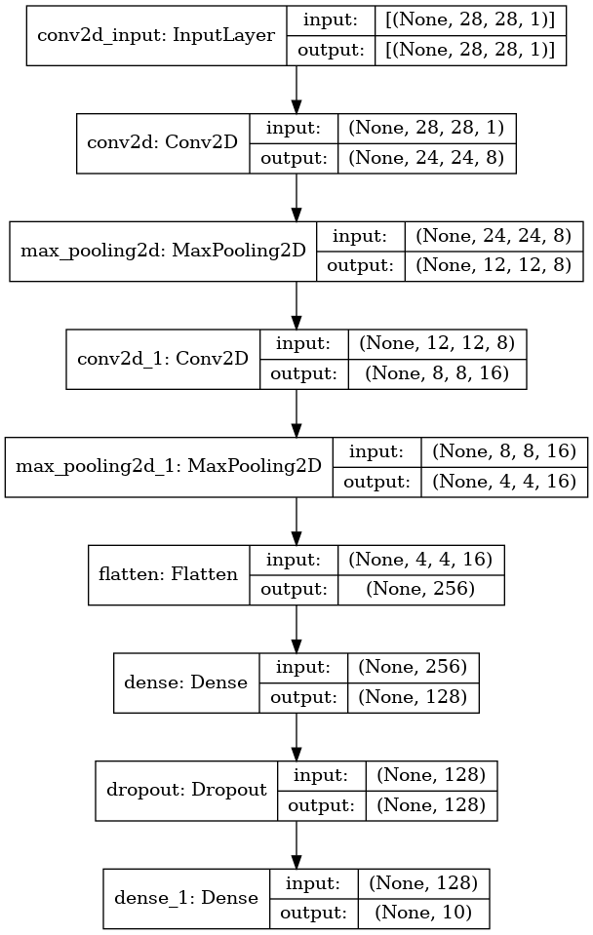
Visualization of the model
To plot the model the graphviz should be installed.
A model summary that describes the various layers defined in the model.
tf.keras.utils.plot_model( model, show_shapes=True, show_layer_names=True, )

Slide 31
Compile the model using keras.optimizers.Adam
adam_optimizer = tf.keras.optimizers.Adam(learning_rate=0.001) model.compile( optimizer=adam_optimizer, loss=tf.keras.losses.sparse_categorical_crossentropy, metrics=['accuracy'] )
Train the model
log_dir=".logs/fit/" + datetime.datetime.now().strftime("%Y%m%d-%H%M%S")
tensorboard_callback = tf.keras.callbacks.TensorBoard
(log_dir=log_dir, histogram_freq=1)
training_history = model.fit( x_train_normalized, y_train_re,
epochs=10,
validation_data=(x_validation_normalized, y_validation_re),
callbacks=[tensorboard_callback]
)
("The model has successfully trained")

Slide 32
Epoch 1/10 1050/1050 [==============================] - 8s 7ms/step - loss: 0.2722 - accuracy: 0.9155 - val_loss: 0.0906 - val_accuracy: 0.9715
Epoch 2/10 1050/1050 [==============================] - 7s 7ms/step - loss: 0.0937 - accuracy: 0.9706 - val_loss: 0.0592 - val_accuracy: 0.9805
Epoch 3/10 1050/1050 [==============================] - 8s 7ms/step - loss: 0.0677 - accuracy: 0.9780 - val_loss: 0.0538 - val_accuracy: 0.9837
Epoch 4/10 1050/1050 [==============================] - 7s 6ms/step - loss: 0.0540 - accuracy: 0.9838 - val_loss: 0.0536 - val_accuracy: 0.9826
Epoch 5/10 1050/1050 [==============================] - 7s 6ms/step - loss: 0.0444 - accuracy: 0.9857 - val_loss: 0.0581 - val_accuracy: 0.9831
Epoch 6/10 1050/1050 [==============================] - 7s 7ms/step - loss: 0.0373 - accuracy: 0.9878 - val_loss: 0.0614 - val_accuracy: 0.9835
Epoch 7/10 1050/1050 [==============================] - 7s 7ms/step - loss: 0.0332 - accuracy: 0.9891 - val_loss: 0.0505 - val_accuracy: 0.9869
Epoch 8/10 1050/1050 [==============================] - 7s 7ms/step - loss: 0.0272 - accuracy: 0.9911 - val_loss: 0.0467 - val_accuracy: 0.9873
Epoch 9/10 1050/1050 [==============================] - 7s 7ms/step - loss: 0.0246 - accuracy: 0.9920 - val_loss: 0.0493 - val_accuracy: 0.9869
Epoch 10/10 1050/1050 [==============================] - 7s 7ms/step - loss: 0.0218 - accuracy: 0.9925 - val_loss: 0.0462 - val_accuracy: 0.9882 The model has successfully trained

Slide 33
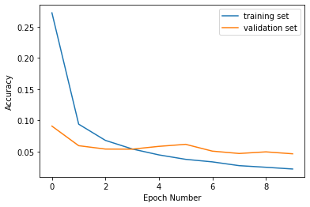
6 | Model Evaluation
Loss plot curve for training and validation
Let's see how the loss function was changing during the training. We expect it to get smaller and smaller with every next epoch.
plt.xlabel('Epoch Number’)
plt.ylabel('Accuracy’)
plt.plot(training_history.history['loss'], label='training set’)
plt.plot(training_history.history['val_loss'], label='validation set’)
plt.legend()

Slide 34
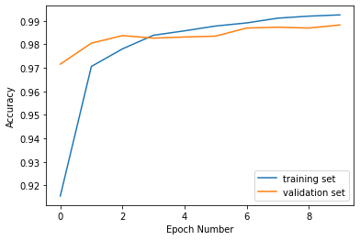
Accuracy plot curve for training and validation
plt.xlabel('Epoch Number') plt.ylabel('Accuracy’)
plt.plot(training_history.history['accuracy'], label='training set’)
plt.plot(training_history.history['val_accuracy'], label='validation set’)
plt.legend()

Slide 35
Evaluation of the model accuracy
We need to compare the accuracy of our model on training set and on valiation set. We expect our model to perform similarly on both sets. If the performance on a validation set will be poor comparing to a training set it would be an indicator for us that the model is overfitted and we have a "high variance" issue.
Performance of training dataset
%%capture
train_loss, train_accuracy = model.evaluate(x_train_normalized, y_train_re)
('Train loss: ', train_loss)
('Train accuracy: ', train_accuracy)
Train loss: 0.009457636624574661
Train accuracy: 0.997083306312561

Slide 36
Performance of validation dataset
%%capture
validation_loss, validation_accuracy = model.evaluate(x_validation_normalized, y_validation_re)
('Validation loss: ', validation_loss)
('Validation accuracy: ', validation_accuracy)
Validation loss: 0.04620610177516937
Validation accuracy: 0.9882143139839172
With a validation score of close to 99%, we proceed to use this model to predict for the test set.

Slide 37
Save and load the model
We will save the entire model to a HDF5 file. The .h5 extension of the file indicates that the model shuold be saved in Keras format as HDF5 file.
model_name = 'digits_recognition_cnn.h5’
model.save(model_name, save_format='h5')
loaded_model = tf.keras.models.load_model(model_name)
Visualise validation predicted data on how the digits were written
To use the model that we've just trained for digits recognition we need to call predict() method.
predictions_one_hot = loaded_model.predict([x_validation_normalized])
('predictions_one_hot:', predictions_one_hot.shape)
predictions_one_hot: (8400, 10)

Slide 38
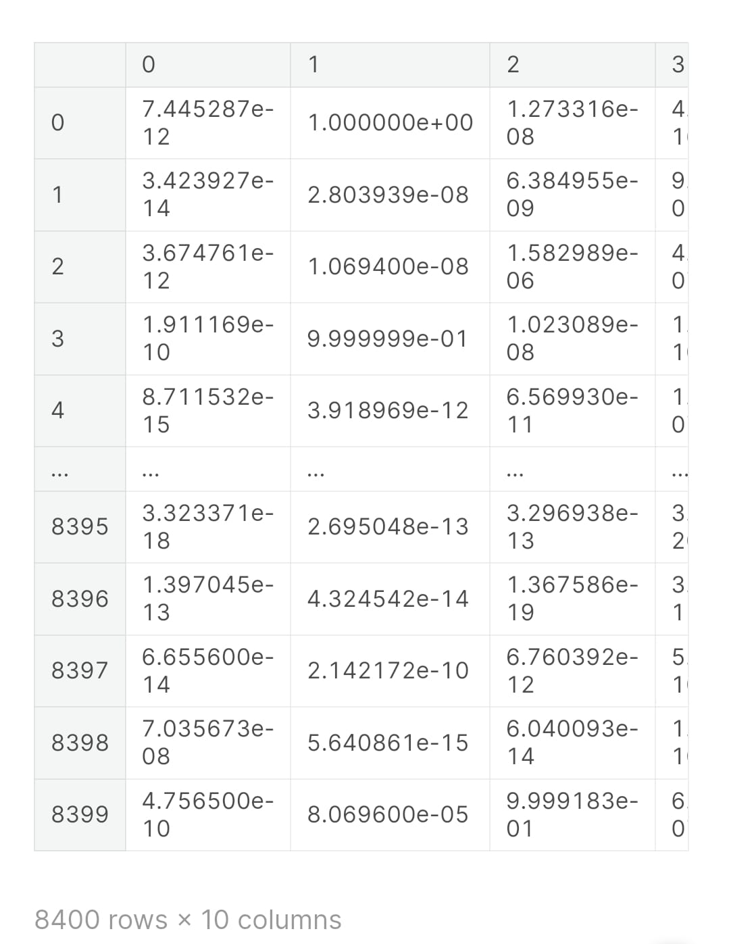
Each prediction consists of 10 probabilities (one for each number from 0 to 9). We need to pick the digit with the highest probability since this would be a digit that our model most confident with.
# Predictions in form of one-hot vectors (arrays of probabilities).
pd.DataFrame(predictions_one_hot)

Slide 39
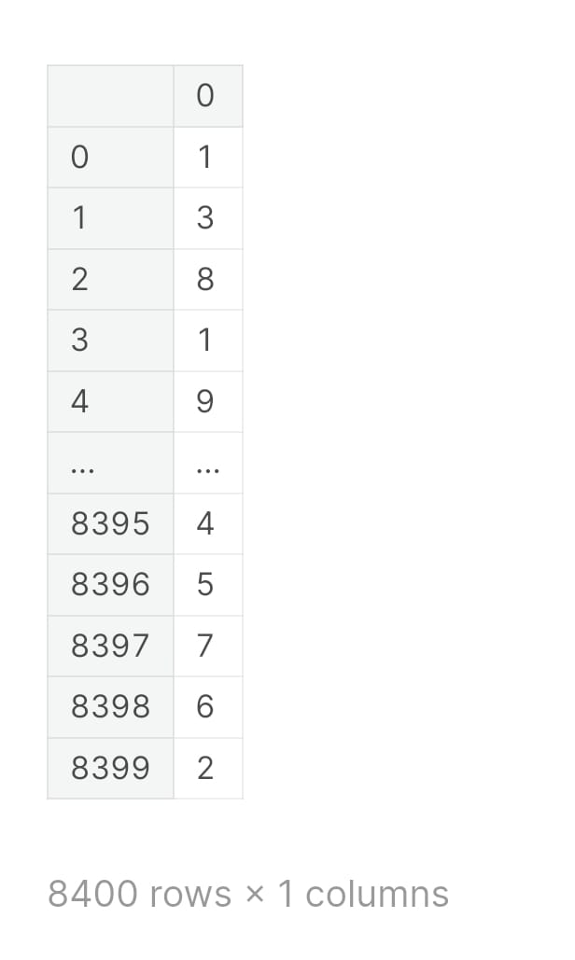
# Let's extract predictions with highest probabilites and detect what digits have been recognized.
predictions = np.argmax(predictions_one_hot, axis=1) pd.DataFrame(predictions)

Slide 40
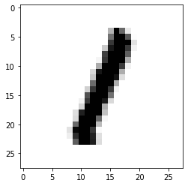
So our model is predicting that the first example from the validation set is 1.
Let's print the first image from a validation set to see if model's prediction is correct.
plt.imshow(x_validation_normalized[0].reshape((IMAGE_WIDTH, IMAGE_HEIGHT)),
cmap=plt.cm.binary)
plt.show()
We see that our model made a correct prediction and it successfully recognized digit 1. Let's print some more test examples and correspondent predictions to see how model performs and where it does mistakes.

Slide 41
numbers_to_display = 196 num_cells = math.ceil(math.sqrt(numbers_to_display))
plt.figure(figsize=(15, 15)) for plot_index in (numbers_to_display):
predicted_label = predictions[plot_index]
plt.xticks([])
plt.yticks([])
plt.grid(False)
color_map = 'Greens' if predicted_label == y_validation_re[plot_index] else 'Reds’
plt.subplot(num_cells, num_cells, plot_index + 1)
plt.imshow(x_validation_normalized[plot_index].reshape((IMAGE_WIDTH, IMAGE_HEIGHT)),
cmap=color_map)
plt.xlabel(predicted_label)
plt.subplots_adjust(hspace=1, wspace=0.5)
plt.show()

Slide 42
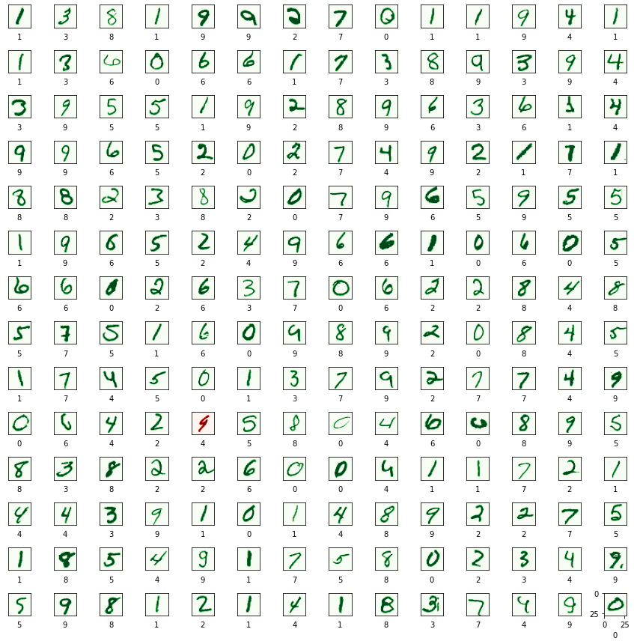

Slide 43
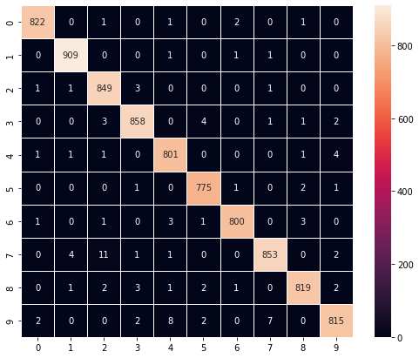
Confusion matrix of validation dataset
Confusion matrix shows what numbers are recognized well by the model and what numbers the model usually confuses to recognize correctly.
confusion_matrix = tf.math.confusion_matrix(y_validation_re, predictions) f, ax = plt.subplots(figsize=(9, 7))
sn.heatmap( confusion_matrix, annot=True, linewidths=.5, fmt="d", square=True, ax=ax ) plt.show()

Slide 44
7 | Model prediction on unseen dataset (test data)
predictions_one_hot = loaded_model.predict([x_test_normalized])
print('predictions_one_hot:', predictions_one_hot.shape)
predictions_one_hot: (28000, 10)
Each prediction has ten probabilities (one for each number from 0 to 9). We need to choose the digit with the highest probability.

Slide 45
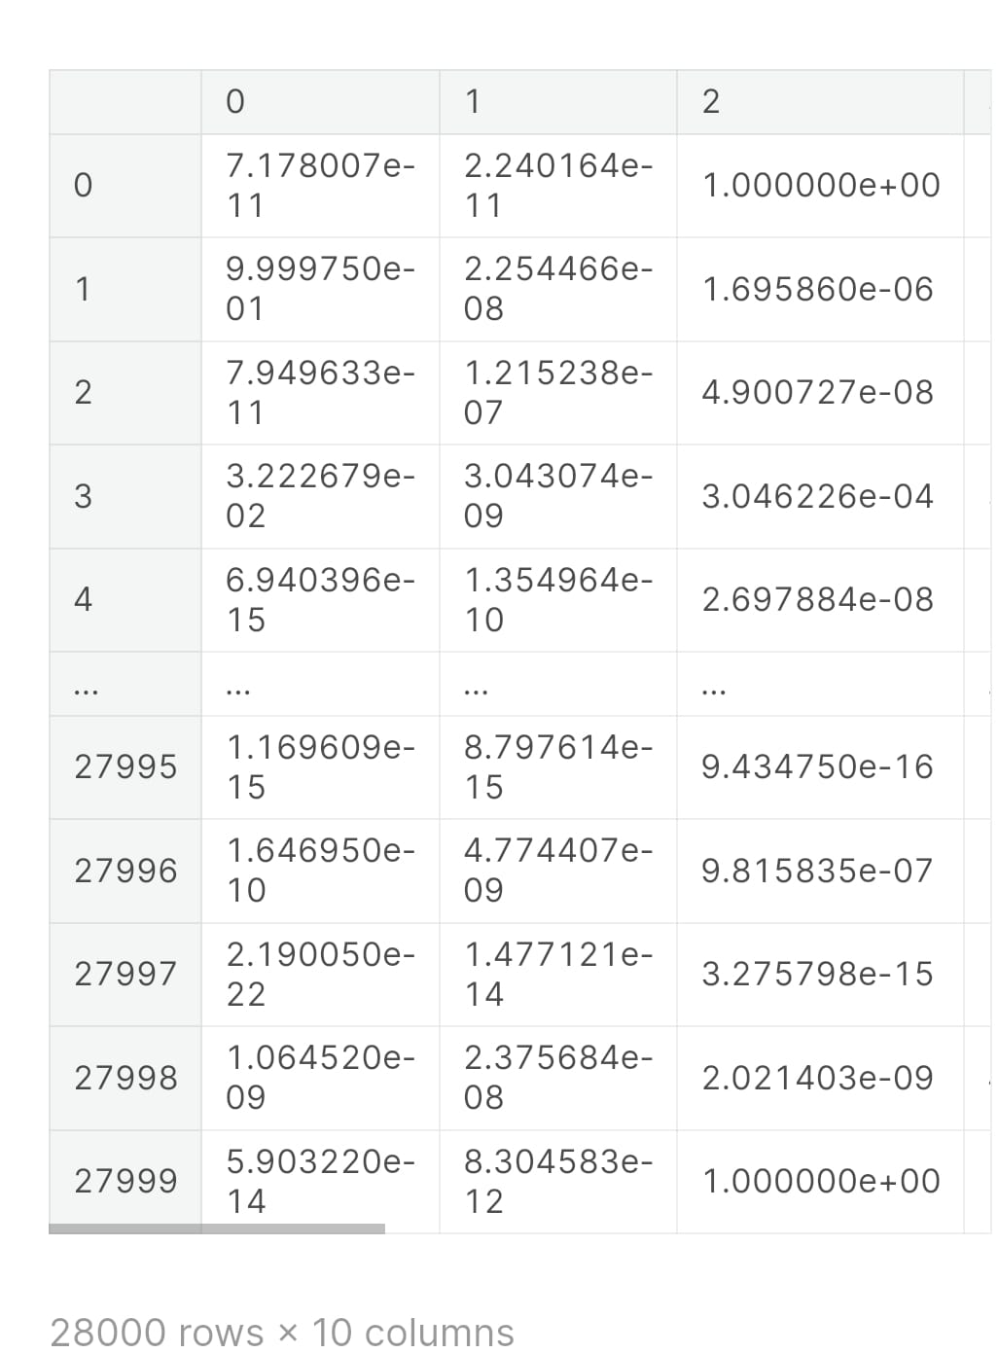
Predicted probabilities of all digits
pd.DataFrame(predictions_one_hot)

Slide 46
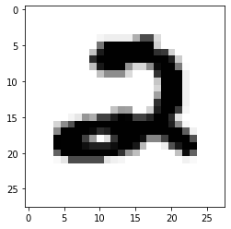
Visualise test predicted data how the digits were written
Predicted digits with highest probabilites
Actual first digit from the test data
plt.imshow(x_test_normalized[0].reshape((IMAGE_WIDTH, IMAGE_HEIGHT)), cmap=plt.cm.binary)
plt.show()
model is predicting that the first example from the test data is 2.

Slide 47
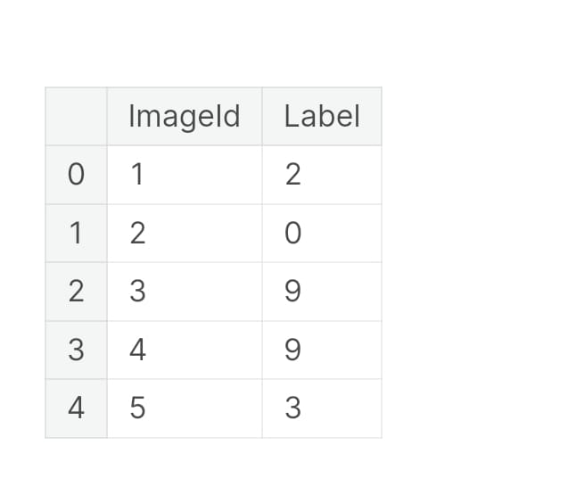
test_pred = pd.DataFrame( loaded_model.predict([x_test_normalized]))
test_pred = pd.DataFrame(test_pred.idxmax(axis = 1))
test_pred.index.name = 'ImageId’
test_pred = test_pred.rename(columns = {0: 'Label'}).reset_index() test_pred['ImageId'] = test_pred['ImageId'] + 1
test_pred.head()
test_pred.to_csv('submission.csv', index = False)

Slide 48
8 | References
https://www.kaggle.com/code/itsmohammadshahid/7-cnn-handwritten-digit-recognition
https://github.com/
https://www.codewithharry.com/
https://www.geeksforgeeks.org/courses?source=google&medium=cpc&device=c&keyword=geeksforgeeks&matchtype=e&campaignid=20039445781&adgroup=147845288105&gad_source=1&gclid=CjwKCAiAzJOtBhALEiwAtwj8ti3CY0oh0xL_6ZcoJNYe59xC598EJlxwdk2fhyDDCvdu4tvLmXXT2hoCSaAQAvD_BwE

Slide 49
THANKYOU
KARAN RAY
karan2609n@gmail.com
Rollno.: 65
Section : “S”

