Slide 1
Project 2: User Programs
Presented by
Jaishankar Sundararaman
2/22/2007

Slide 2
Till now …
All code part of Pintos Kernel
Code compiled directly with the kernel
  This required that the tests call some functions whose interface should remain unmodified
From now on, run user programs on top of kernel
  Freedom to modify the kernel to make the user programs work
Notes:
In project1, all the changes run as part of the kernel but in project 2, it would not be entirely so. In project1, since the code was compiled directly with kernel, it required that we call some kernel specific functions. But in project2, the user program could call various system calls which would then be processed by the kernel
When user programs are run, we have some issues like managing the memory and loading different user programs and scheduling them appropriately

Slide 3
Project 1 and Project 2
Project 2
Tests
User Programs
lib/user/syscall.c
int 0x30
Exceptions
Project 1
Tests
Kernel
syscall layer
exc handling
filesystem
Timer Interrupts
Other IRQs

Slide 4
Using the File system
May need to interact with file system
Do not modify the file system!
Certain limitations (till Project 4)
  No internal synchronization
  Fixed file size
  No subdirectories
  File names limited to 14 chars
  System crash might corrupt the file system
Files to take a look at: ‘filesys.h’ & ‘file.h’
Notes:
In this project, it requires to interface with the file system. We do not recommend modifying any files in file system related directory. When project4 is underway it may have to be done.
Currently the file system has certain limitations which are as listed above.
The students could take a look at files like filesys.h and file.h to get some information about the file system basics

Slide 5
Some commands
Creating a simulated disk
  pintos-mkdisk fs.dsk 2
Formatting the disk
  pintos -f –q
  This will only work after your kernel is built !
Copying the program into the disk
  pintos -p ../../examples/echo -a echo -- -q
Running the program
  pintos -q run ’echo x’
  Single command:
    pintos --fs-disk=2 -p ../../examples/echo -a echo -- -f -q run ’echo x’
$ make check – Builds the disk automatically
  Copy&paste the commands make check does!
Notes:
The slide lists some of the commands which may have to be executed for making user programs to get running

Slide 6
Various directories
Few user programs:
  src/examples
Relevant files:
  userprog/
Other files:
  threads/
Notes:
Examples directory contain some of the examples which could be run and seen
Userprog contain those files which may need to be modified for this project
Threads contain some files which may have to be modified to get project2 working

Slide 7
Requirements
Process Termination Messages
Argument Passing
System calls
Deny writes to executables
Notes:
The slide lists some of the requirements/tasks for project0

Slide 8
Process Termination
Process Terminates
  printf ("%s: exit(%d)\n",...);
  for eg: args-single: exit(0)
Do not print any other message!
Return Code
Program name
Notes:
Every user program which exits should print the program name which is invoked and the exit code before exiting. Care should be taken that no other messages are printed in kernel since it may confuse the grading scripts and may lead to marks getting reduced

Slide 9
Argument Passing
Pintos currently lacks argument passing!
Change *esp = PHYS_BASE to *esp = PHYS_BASE – 12 in setup_stack() to get started
Change process_execute() in process.c to process multiple arguments
Could limit the arguments to fit in a page(4 kb)
String Parsing: strtok_r() in lib/string.h
pgm.c
main(int argc,
char *argv[]) {
…
}
$ pintos run ‘pgm alpha beta’
argc = 3
argv[0] = “pgm”
argv[1] = “alpha”
argv[2] = “beta”
Example taken from Abdelmounaam Rezgui’s presentation
Notes:
The sample program gives a way in which a user program might be passing command line arguments to the program run under pintos
Remember to initially change the *Esp value to get programs working till argument passing is implemented
Then change process_execute() such that arguments are first separated into tokens, then given to the child process to be invoked.
These arguments should be properly pushed into stack ie stack should be setup before the program is invoked, else the kernel might crash
The function to tokenize is present in lib/string.h and is named strtok_r()

Slide 10
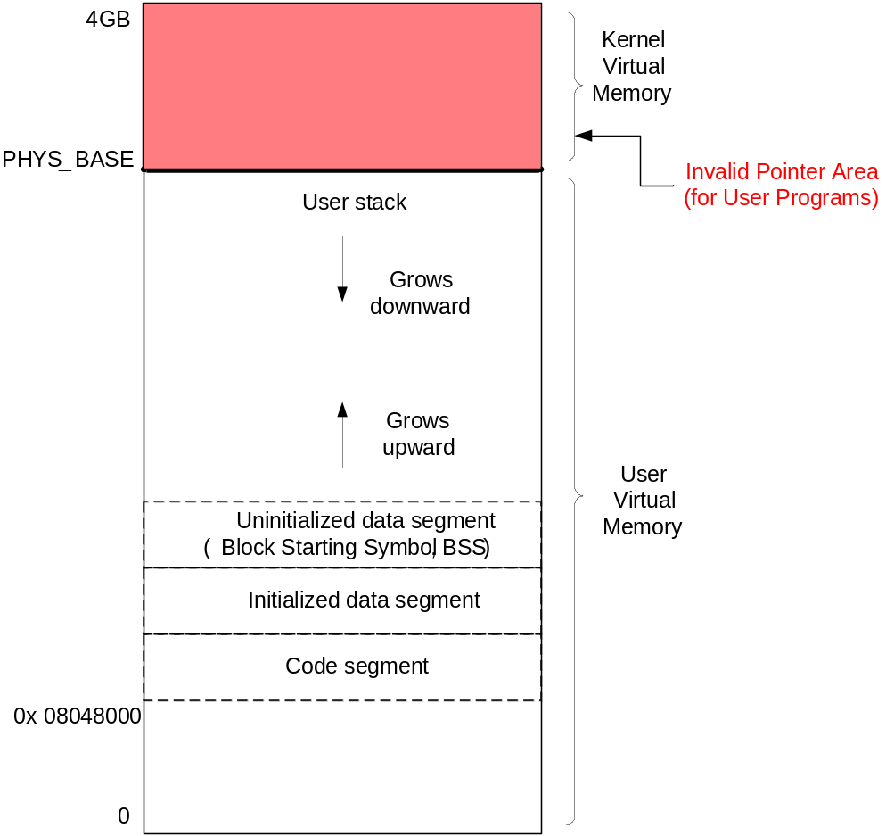
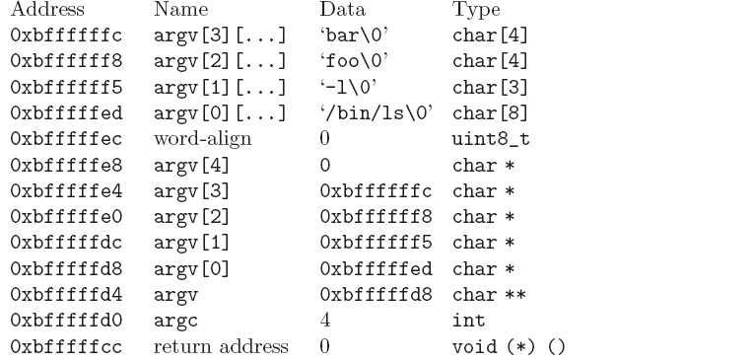
Memory layout
PHYS_BASE = 3GB
Figure taken from Abdelmounaam Rezgui’s presentation
Notes:
The slides shows the memory layout. The shaded region shows the kernel virtual memory. The user programs could access the user virtual memory. The kernel can access user virtual memory as well as kernel virtual memory. The PHYS_BASE marks the end of the user virtual memory and beginning of kernel virtual memory. This is a very important value which might be of use when getting pointers from user space to be processed by kernel space.

Slide 11
Setting up the Stack
How to setup the stack for the program - /bin/ls –l foo bar
Notes:
The slide shows the way in which a stack might have to be setup to load the user program with command line.

Slide 12
Setting up the Stack… Contd
bffffffc0 00 00 00 00 | ....|
bffffffd0 04 00 00 00 d8 ff ff bf-ed ff ff bf f5 ff ff bf |................|
bffffffe0 f8 ff ff bf fc ff ff bf-00 00 00 00 00 2f 62 69 |............./bi|
bfffffff0 6e 2f 6c 73 00 2d 6c 00-66 6f 6f 00 62 61 72 00 |n/ls.-l.foo.bar.|

Slide 13
System Calls
Syscall handler currently …
Pintos lacks support for system calls currently!
Implement the system call handler in userprog/syscall.c
System call numbers defined in lib/syscall-nr.h
Process Control: exit, exec, wait
File system: create, remove, open, filesize, read, write, seek, tell, close
Others: halt
static void
syscall_handler (struct intr_frame *f UNUSED)
{
printf ("system call!\n");
thread_exit ();
}

Slide 14
System Call Details
Types of Interrupts – External and Internal
System calls – Internal Interrupts or Software Exceptions
80x86 – ‘int’ instruction to invoke system calls
Pintos – ‘int $0x30’ to invoke system call
Notes:
As you might have seen in project1, there are 2 types of interrupts, external and internal.
In project2 we encounter software exceptions one of which could be a system call. Pintos uses int $0x30 to invoke a system call

Slide 15
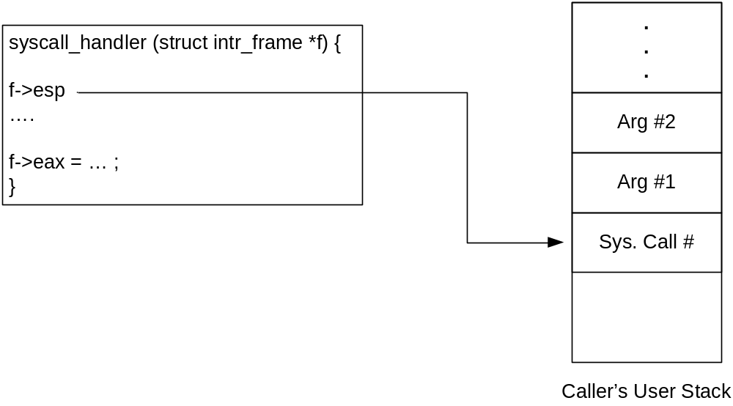
Continued…
A system call has:
  System call number
  (possibly) arguments
When syscall_handler() gets control:
System calls that return a value () must modify
f->eax
Figure taken from Abdelmounaam Rezgui’s presentation
Notes:
The slide shows how a system call might have to be processed by a system call handler

Slide 16
System calls – File system
Decide on how to implement the file descriptors
  O(n) data structures would entail no deduction !
Access granularity is the entire file system
  Have 1 global lock!
write() – fd 1 writes to console
  use putbuf() to write entire buffer to console
read() – fd 0 reads from console
  use input_getc() to get input from keyboard
Implement the rest of the system calls

Slide 17

System calls – Process Control
wait(pid) – Waits for process pid to die and returns the status pid returned from exit
Returns -1 if
  pid was terminated by the kernel
  pid does not refer to child of the calling thread
  wait() has already been called for the given pid
exec(cmd) – runs the executable whose name is given in command line
  returns -1 if the program cannot be loaded
exit(status) – terminates the current program, returns status
  status of 0 indicates success, non zero otherwise
Parent:
exec()
Parent
process
executes
Child
process
executes
Child
process
exits
Parent:
wait()
OS notifies
Figure taken and modified from Dr. Back’s lecture – CS3204 - Fall 2006
Notes:
The slide explains the description of the various system calls.

Slide 18
Process Control – continued…
Implement process_wait() in process.c
Then, implement wait() in terms of process_wait()
Cond variables and/or semaphores will help
  Think about what semaphores may be used for and how they must be initialized
Some Conditions to take care!
  Parent may or may not wait for its child
  Parent may call wait() after child terminates!
int
process_wait (tid_t child_tid UNUSED)
{
return -1;
}
main() {
int i; pid_t p;
p = exec(“pgm a b”);
// i = wait (p);
}

Slide 19
Memory Access
Invalid pointers must be rejected. Why?
  Kernel has access to all of physical memory including that of other processes
  Kernel like user process would fault when it tries to access unmapped addresses
User process cannot access kernel virtual memory
User Process after it has entered the kernel can access kernel virtual memory and user virtual memory
How to handle invalid memory access?

Slide 20
Memory Access – contd…
Two methods to handle invalid memory access
  Verify the validity of user provided pointer and then dereference it
    Look at functions in userprog/pagedir.c, threads/vaddr.h
    Strongly recommended!
  Check if user pointer is below PHYS_BASE and dereference it
    Could cause page fault
    Handle the page fault by modifying the page_fault() code in userprog/exception.c
  Make sure that resources are not leaked
Notes:
There could be 2 methods to handle invalid memory access.
We usually recommend method 1, but if method 2 is done, care must be taken to handle the page fault and return the properly to the system call handler.

Slide 21
Some Issues to look at…
Check the validity of the system call parameters
Every single location should be checked for validity before accessing it. For e.g. not only f->esp, but also f->esp +1, f->esp+2 and `f->esp+3 should be checked
Read system call parameters into kernel memory (except for long buffers)
  copy_in function recommended!

Slide 22
Denying writes to Executables
Use file_deny_write() to prevent writes to an open file
Use file_allow_write() to re enable write
Closing a file will automatically re enable writes

Slide 23
Suggested Order of Implementation
Change *esp = PHYS_BASE to *esp = PHYS_BASE – 12 to get started
Implement the system call infrastructure
Change process_wait() to a infinite loop to prevent pintos getting powered off before the process gets executed
Implement exit system call
Implement write system call
Start making other changes

Slide 24
Misc
Deadline: Mar 20, 11:59 pm
Do not forget the design document
  Must be done individually
Good Luck!

