Slide 1
Pintos overview
Operating System Project

Slide 2
Introduce Pintos
An instructional operating system
  Developed by Stanford university
    A few of the source files are derived from code used in the MIT OS course
  A real OS for 80x86 architecture (c.f. nachos)
    Run on a regular IBM-compatible PC or an x86 simulator
  The original structure and form was inspired by the nachos
  Written in C language

Slide 3
Tutorial
Environments setup
  Installation
  Configuration
  Test connection
Test execution
  Build source code
  Execution on Pintos runtime (Qemu)
Debugging Methods
Version control
  Simple process (import, checkout, commit, update)

Slide 4

Environments
Bochs
  IA-32 emulator
  We will run Pintos on this emulator
  Qemu makes it easy to develop and debug Pintos projects
Linux + Qemu
  We will use Linux(Ubuntu/Centos) machine

Slide 5
Environments - Client
SSH client
  Official client : Putty
  Other clients : SecureCRT, Xshell, etc ...
X-window server (Local – Client)
  Official server : Xming
  Other servers : Xmanager, Cygwin-X, etc ...
Connect to experiment server
  Host : ‘lab.xjton.net‘ (还在开发中…)
  SSH with X11 forwarding

Slide 6
Environments - Server
Implemented in server – Recommend using this
x86 emulator
  Bochs : 运行慢,不使用!
  QEMU (Faster than Bochs)
Pintos utilities
  Build from pintos source code
Other basic utilities
  GCC compiler set, GDB, Perl

Slide 7
Pintos set up
lab.xjton.net
  Ubuntu 16.04. 已安装qemu (请不要在服务器上重复安装qemu)
Pintos 源代码(QQ群共享)
  $tar zxvf pintos.tar.gz
Pintos 解压后
  $cd pintos/src/threads
  $make :结果是在当前目录(src/threads)中建立了一个名为build的目录。
pintos 运行
  $pintos/src/threads
  $ pintos –v -- run alarm-multiple

Slide 8
Tutorial
Environments setup
  Installation
  Configuration
  Test connection
Test execution
  Build source code
  Execution on Pintos runtime (Qemu)
Debugging Methods
Version control
  Simple process (import, checkout, commit, update)
  Git recommended!

Slide 9
Tutorial
Environments setup
  Installation
  Configuration
  Test connection
Test execution
  Build source code
  Execution on Pintos runtime (Bochs)
Debugging Methods
Version control
  Simple process (import, checkout, commit, update)

Slide 10
Debug methods
printf() – Traditional log based debug
Assertion – Using ASSERT macro
Backtraces – Find location in source
GDB – Step-by-Step debugging
  Remote debugging to localhost (need 2 console)
Modifying Qemu – Debug Triple Faults

Slide 11
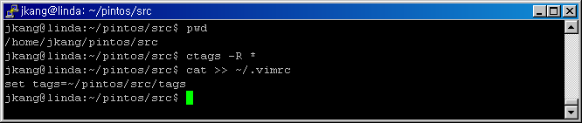
Tags - 1
可以轻松移至函数或全局变量的索引文件
Vi 集成.
Make `tags` file & set for VI

Slide 12
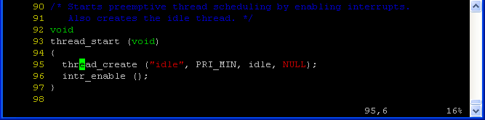
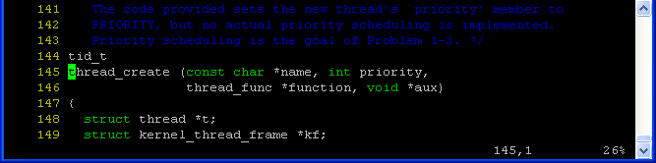
Tags - 2
Ctrl+] 取当前光标下的单词作为tag的名字并直接跳转
Ctrl+T 跳到前一次的tag处

Slide 13
gdb - 1
Pintos向现有GDB添加功能并附带方便的脚本.
--使用gdb选项运行pintos，然后在另一个终端的build目录中运行pintos-gdb.
  $pintos --gdb --gdb-port=1234 –v -- run alarm-multiple
Gdb参考网站http://www.gnu.org/software/gdb/documentation/

Slide 14
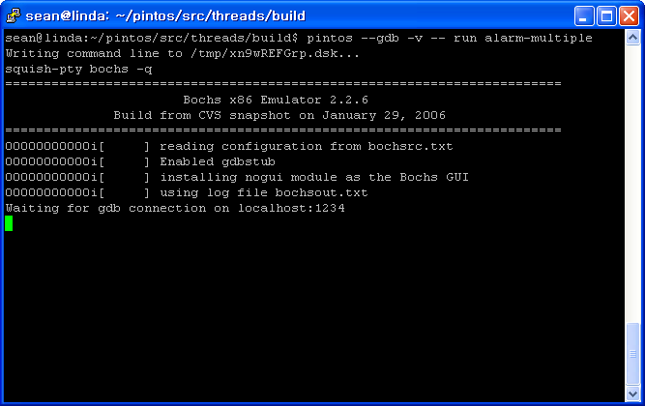
gdb - 2
Execute pintos with '--gdb' option
user@linda:~/pintos/src/threads/build$ pintos --gdb
-v --gdb-port=1234 -- run alarm-multiple
--gdb-Port=1234
通过指定端口号进行调试

Slide 15
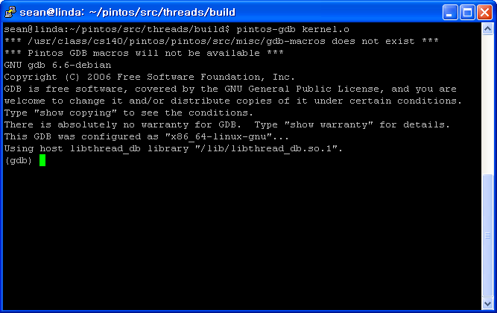
gdb - 3
Execute gdb by pintos (In another terminal)
user@linda:~/pintos/src/threads/build$ pintos-gdb kernel.o

Slide 16
gdb - 4
Connect to gdb session
  (gdb) target remote localhost:1234 ←指定的端口号
  Setup break point
  (gdb) break run_test
Continue execution of code (It will pause at breakpoint)
  (gdb) continue
端口号可能会发生冲突，因此请使用netstat验证端口是否已打开

Slide 17
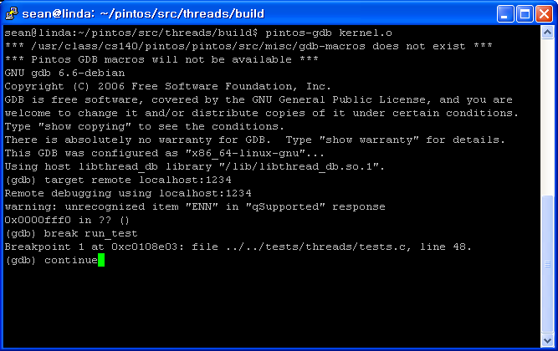
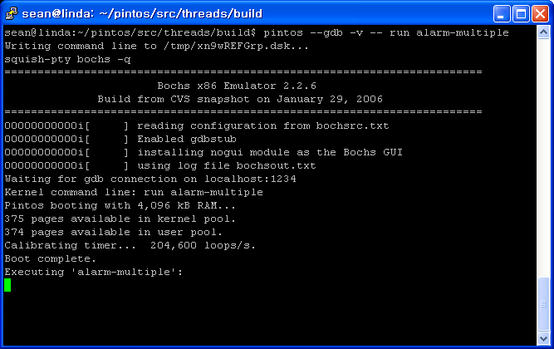
gdb - 5

Slide 18
Tutorial
Environments setup
  Installation
  Configuration
  Test connection
Test execution
  Build source code
  Execution on Pintos runtime (Bochs)
Debugging Methods
Version control
  Simple process (import, checkout, commit, update)

Slide 19
Version Control
Goal
  Cooperation development, Avoid version mixing, Improve code sharablity, Solving conflicts, Management of change histories, Blame, Automatic daily build, etc ...
CVS and Subversion (现在都用Git了!)
Keywords
  Repository, Module, Import, Checkout, Revision, Commit, Update, Lock, Tag, Branch, Release
See more information on “Revision_control” in Wikipedia

Slide 20


Slide 21
Thank you

