Slide 1
Online Banking System
Created by:
Adarsh Kedia.
Ashis Mohata.
Moumita Ghosh.
Tanaya Mondal.

Slide 2
Overview of the project
The main aim of our project is to allow individuals to perform at home , via the internet. Many provide a fully online banking without any physical existence, but in our case we have a traditional bank in “real existence” which provide the customers with the facility of NET BANKING. Here we enable our customers to perform routine transactions such as transfer funds, balance inquiries, get mini statements, and stop-payment requests, and even offer online loan applications.
Account information can be accessed anytime, day or night, and can be done from anywhere. Once information has been entered, it doesn't need to be re-entered for similar subsequent checks, and future payments can be scheduled to occur automatically.

Slide 3
Targeted Users
We aim at providing the possible online services to the following customers :
The urban customers who have an access to internet banking and already having an account at the physical bank.
People who wants to get loans including home loan, car loan, or educational loan.
Customers who are interested in transferring funds from one branch to another of the same bank .

Slide 4
Facilities provided
Similar to the specifications provided by several online banking softwares, our project aims at covering the following functionalities to serve the customers having account in our bank in a better way-
Opening new accounts.
Viewing the account details.
Getting ones accounts summary.
Obtaining mini statements.
Balance enquiry.
Transfer funds to another account in the same bank.
Request for cheque book.
Request for loan and sanctioning of the same.

Slide 5
Requirements
Hardware specifications:
1. PC with 2 GB hard-disk and 256 MB RAM
Software specifications:
1. XAMPP (version-3.1.0)
2. Apache (2.4.3(Win32) Open SSL/1.0.1c
PHP/5.4.7)
3. MySQL (5.5.27-MySQL Community Server)
4. OS (Windows7 or Windows8)
5. NetBeans (IDE 7.1)

Slide 6
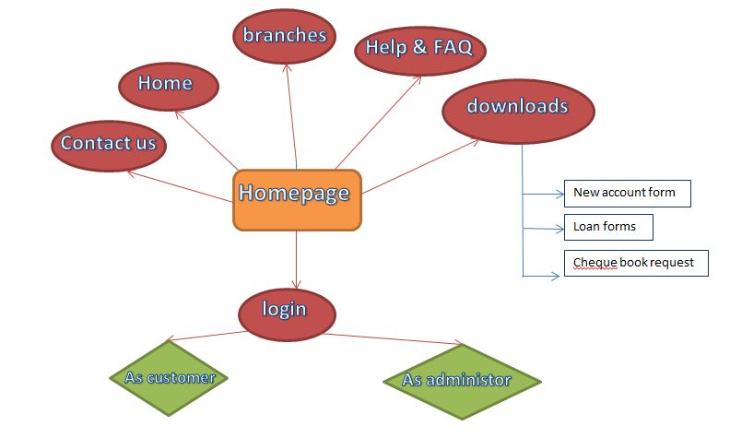
Page Flow Diagram

Slide 7
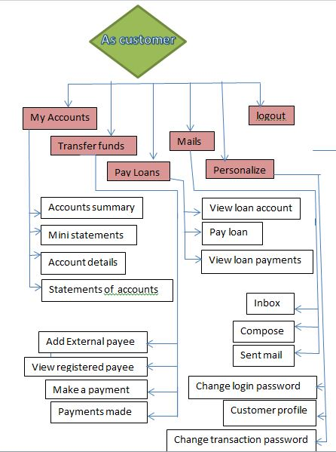
Continued..

Slide 8
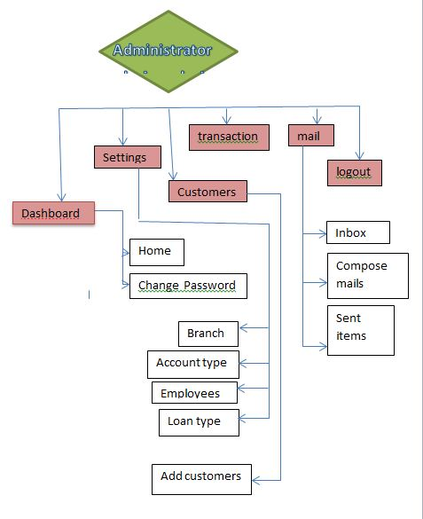
Continued..

Slide 9
Limitations
Our system aims at ultimate user satisfaction. But due to certain constraints and lack of knowledge there remains a few drawback. It does take some time to set up and get used to an online account.
A person interested in withdrawing or depositing funds has to do it manually by doing so at their respective traditional bank. Moreover for the creation of a new account, a person has to visit the bank in reality with original documents. This provision is kept to prevent the creation of fake accounts and is wholly due to safety and security purpose. The work of the administrator here is again a major concern, where he/she has to perform all the verifying activities of each account details manually.

Slide 10
Conclusion
This was a small attempt from our side to create a prototype of a system, vital nowadays in everyone’s life. In spite of its drawbacks, hope it will serve the people up to a certain extent and on our side we shall try to enhance the system for the betterment of society.

Slide 11
Thank You!!

