Slide 1
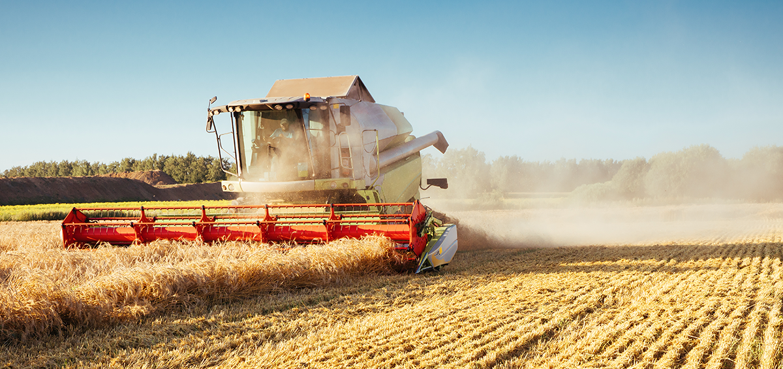
HARVEST PLANNING
Lorenzo Mastrandrea 1892793

Slide 2
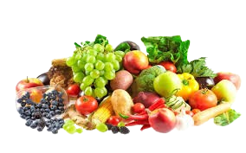
IDEA
The focus of this project is the management of different soils where each of it can contain fruits and vegetables.
The farmers are in charge of collecting these goods and carrying them to a specific depot.

Slide 3
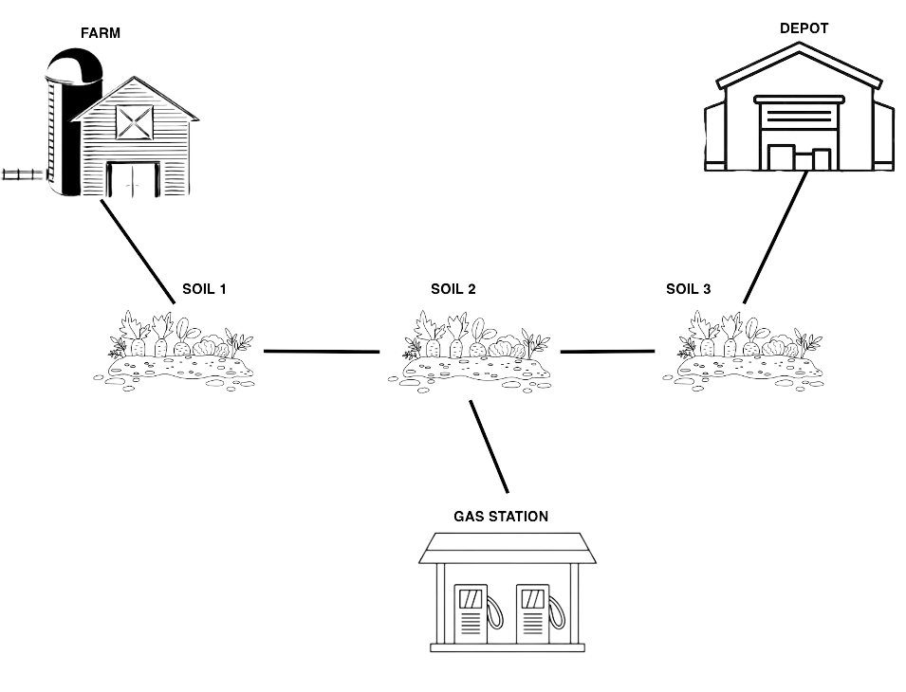
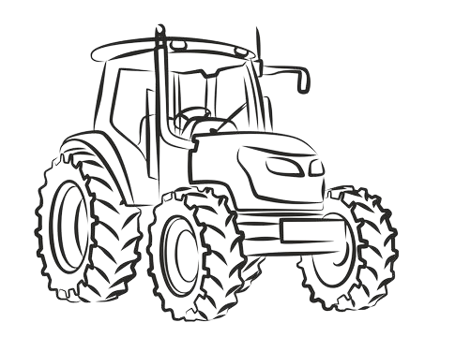
DOMAIN
The domain is composed by different places where a farmer can move through a tractor, having as scope to satisfy the demand of fruits and vegetables, leaving the requested quantity to the depot.

Slide 4
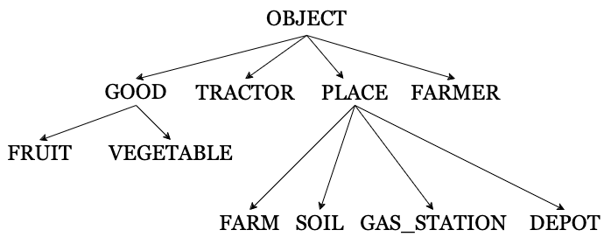
TYPES & PREDICATES
TYPES
PREDICATES
(farmer_at ?x - farmer ?y - place) : indicates the position y of the farmer x ;
(tractor_at ?x - tractor ?y - place) : indicates the position y of the tractor x ;
(farmer_on ?f - farmer ?t - tractor ) : indicates whether the farmer x is on the tractor y ;
(linked ?l1 ?l2 -place) : indicates if two places are linked.

Slide 5
FUNCTIONS
(free_capacity ?t - tractor) : indicates the left quantity of fruits and vegetables that the tractor t can carry ;
(left_fuel ?t - tractor) : indicates the left fuel of the tractor t ;
(max_fuel ?t - tractor) : indicates the max fuel of the tractor t ;
(carrying ?g - good ?t - tractor) : indicates the quantity of the good g that the tractor t is currently carrying ;
(demand_good ?g - good) : indicates how much of a good must be collected and transported to the depot;
(distance_km ?p1 ?p2 - place) : indicates the distance in km between p1 and p2;
(consume_per_km ?t - tractor) : indicates how much the tractor t consume per km ;
(contain ?x - soil ?y - good) : indicates the quantity of the good y contained in the soil x ;
(good_at_depot ?g - good ?d - depot) : indicates the current quantity of the good g at the depot d ;
(total_path) : indicates the total number of kilometers travelled by all the tractors.

Slide 6
ACTIONS
GOTO
(:action goto
:parameters (?f - farmer ?t - tractor ?p1 ?p2 - place)
:precondition (and (linked ?p1 ?p2) (farmer_at ?f ?p1) (tractor_at ?t ?p1) (farmer_on ?f ?t)
(> (left_fuel ?t) (* (distance_km ?p1 ?p2) (consume_per_km ?t))))
:effect (and
(not (farmer_at ?f ?p1)) (not (tractor_at ?t ?p1))
(farmer_at ?f ?p2) (tractor_at ?t ?p2)
(decrease (left_fuel ?t) (* (consume_per_km ?t) (distance_km ?p1 ?p2)))
(increase (total_path) (distance_km ?p1 ?p2)))
)

Slide 7
ACTIONS
GET ON
(:action get_on
:parameters (?f - farmer ?t - tractor)
:precondition (and (forall (?tr - tractor) (not (farmer_on ?f ?tr ))) (forall (?fa - farmer) (not (farmer_on ?fa ?t )))
(exists (?p - place) (and (farmer_at ?f ?p) ( tractor_at ?t ?p))))
:effect (and (farmer_on ?f ?t ))
)
GET OFF
(:action get_off
:parameters (?f - farmer ?t - tractor)
:precondition (and (farmer_on ?f ?t ))
:effect (and (not (farmer_on ?f ?t )))
)

Slide 8
ACTIONS
COLLECT GOOD
(:action collect_good
:parameters (?s - soil ?g - good ?t - tractor ?fa - farmer)
:precondition (and (forall (?t1 - tractor)(not (farmer_on ?fa ?t1))) (farmer_at ?fa ?s)
(tractor_at ?t ?s) (> (contain ?s ?g) 0)(> (free_capacity ?t) 0)(> (demand_good ?g) 0))
:effect (and
(when (and(>= (demand_good ?g) (contain ?s ?g))(>= (free_capacity ?t)(contain ?s ?g)))
(and (decrease (free_capacity ?t) (contain ?s ?g))
(decrease (demand_good ?g) (contain ?s ?g))
(increase (carrying ?g ?t) (contain ?s ?g))
(assign (contain ?s ?g) 0)))
(when (and(>= (demand_good ?g) (contain ?s ?g))(< (free_capacity ?t)(contain ?s ?g)))
(and (decrease (contain ?s ?g) (free_capacity ?t))
(decrease (demand_good ?g) (free_capacity ?t))
(increase (carrying ?g ?t) (free_capacity ?t))
(assign (free_capacity ?t) 0)))
(when (and (< (demand_good ?g) (contain ?s ?g))(>= (free_capacity ?t)(demand_good ?g)))
(and (decrease (contain ?s ?g) (demand_good ?g))
(decrease (free_capacity ?t) (demand_good ?g))
(increase (carrying ?g ?t) (demand_good ?g))
(assign (demand_good ?g) 0)))
(when (and (< (demand_good ?g) (contain ?s ?g))(< (free_capacity ?t)(demand_good ?g)))
(and (decrease (contain ?s ?g) (free_capacity ?t))
(decrease (demand_good ?g) (free_capacity ?t))
(increase (carrying ?g ?t) (free_capacity ?t))
(assign (free_capacity ?t) 0)))
)
)

Slide 9
ACTIONS
(:action get_gas
:parameters (?f - farmer ?p - gas_station ?t - tractor)
:precondition (and (farmer_at ?f ?p)(tractor_at ?t ?p)(not (farmer_on ?f ?t )))
:effect (and (increase (left_fuel ?t) (-(max_fuel ?t)(left_fuel ?t))))
)
GET GAS
RELEASE
(:action release
:parameters (?d - depot ?t - tractor ?f - farmer)
:precondition (and (farmer_on ?f ?t)(farmer_at ?f ?d) (tractor_at ?t ?d)
(exists (?g - good) (> (carrying ?g ?t) 0)))
:effect (forall (?g - good)
(when (> (carrying ?g ?t) 0)
(and (increase (good_at_depot ?g ?d) (carrying ?g ?t))
(increase (free_capacity ?t) (carrying ?g ?t))
(assign (carrying ?g ?t) 0))))
)

Slide 10
PLANNER
ENHSP, Expressive Numeric Heuristic Search Planner, is a PDDL automated planning system that supports:
Classical and Numeric Planning (PDDL2.1)
Optimal Simple Numeric Planning
Satisficing Non-Linear Numeric Planning
Planning with Autonomous Processes and Discrete Events (PDDL+)
Global Constraints and Expressive Formulas in Preconditions and Goals
For solving the following problems these three modality are used:
opt-blind: This is a baseline blind heuristic that gives 1 to state where the goal is not satisfied and 0 to state where the goal is satisfied.
sat-hadd: Greedy Best First Search with numeric hadd;
opt-hmax: AStar with hmax numeric heuristic;
https://sites.google.com/view/enhsp/
https://sites.google.com/view/enhsp/home/how-to-use-it?authuser=0

Slide 11
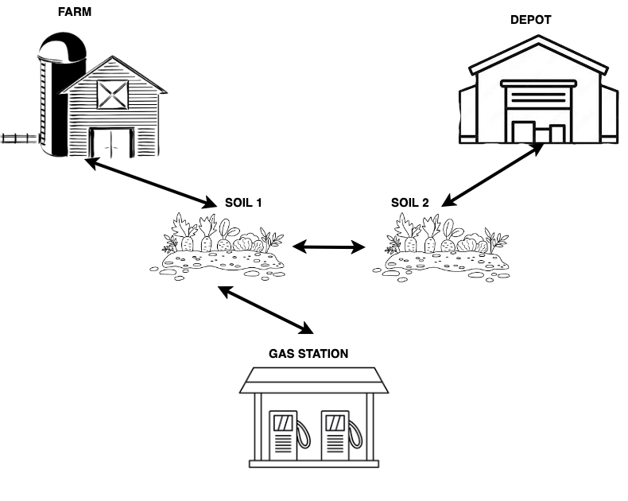
PROBLEM 1
quantity of apple in s1 = 15
quantity of eggplant in s1 = 11
quantity of apple in s2 = 5
quantity of eggplant in s2 = 6
* We are giving infinite fuel to the tractor as we are not considering it
S₀:
There is one tractor, one farmer and two soils ;
The tractor and the farmer are at the farm ;
The demanded quantity of apple is 5;
The demanded quantity of eggplant is 10;
The max capacity of the tractor is 30.
Goal:
Every demand is satisfied.

Slide 12
BLIND PLAN:
hAdd PLAN:
hMax PLAN:
(get_on f1 t1)
(goto f1 t1 farm s1)
(get_off f1 t1)
(collect_good s1 eggplant t1 f1)
(get_on f1 t1)
(goto f1 t1 s1 s2)
(get_off f1 t1)
(collect_good s2 eggplant t1 f1)
(collect_good s2 apple t1 f1)
(get_on f1 t1)
(goto f1 t1 s2 d1)
(release d1 t1 f1)
(get_on f1 t1)
(goto f1 t1 farm s1)
(goto f1 t1 s1 s2)
(get_off f1 t1)
(collect_good s2 apple t1 f1)
(get_on f1 t1)
(goto f1 t1 s2 d1)
(release d1 t1 f1)
(goto f1 t1 d1 s2)
(get_off f1 t1)
(collect_good s2 eggplant t1 f1)
(get_on f1 t1)
(goto f1 t1 s2 s1)
(get_off f1 t1)
(collect_good s1 eggplant t1 f1)
(get_on f1 t1)
(goto f1 t1 s1 s2)
(goto f1 t1 s2 d1)
(release d1 t1 f1)
(get_on f1 t1)
(goto f1 t1 farm s1)
(get_off f1 t1)
(collect_good s1 eggplant t1 f1)
(collect_good s1 apple t1 f1)
(get_on f1 t1)
(goto f1 t1 s1 s2)
(get_off f1 t1)
(collect_good s2 eggplant t1 f1)
(get_on f1 t1)
(goto f1 t1 s2 d1)
(release d1 t1 f1)

Slide 13
PROBLEM 1: RESULTS
hAdd is used with alg. GBFS
hMax is used with alg. A*

Slide 14
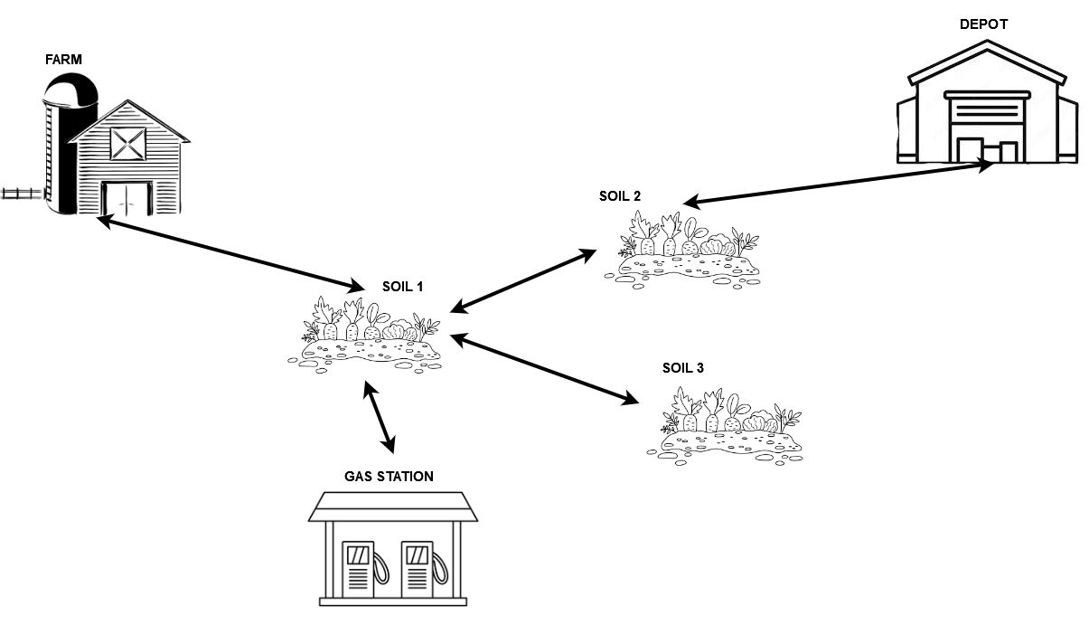
PROBLEM 2
quantity of apple in s2 = 14
quantity of eggplant in s2 = 17
quantity of apple in s1 = 12
quantity of eggplant in s1 = 16
quantity of apple in s3 = 13
quantity of eggplant in s3 = 9
* We are giving infinite fuel to the tractor as we are not considering it
S₀:
There are two tractors, two farmers and three soils ;
The tractors and the farmers are at the farm ;
The max capacity of the first tractor is 30;
The max capacity of the second tractor is 50;
The demanded quantity of apple is 22;
The demanded quantity of eggplant is 31.
Goal:
Every demand is satisfied, without exceeding the capacity of the tractors.

Slide 15
BLIND PLAN:
hAdd PLAN:
hMax PLAN:
(get_on f1 t2)
(goto f1 t2 farm s1)
(get_off f1 t2)
(collect_good s1 eggplant t2 f1)
(collect_good s1 apple t2 f1)
(get_on f1 t2)
(goto f1 t2 s1 s2)
(goto f1 t2 s2 d1)
(release d1 t2 f1)
(goto f1 t2 d1 s2)
(get_off f1 t2)
(collect_good s2 apple t2 f1)
(collect_good s2 eggplant t2 f1)
(get_on f1 t2)
(goto f1 t2 s2 d1)
(release d1 t2 f1)
(get_on f2 t2)
(goto f2 t2 farm s1)
(goto f2 t2 s1 s2)
(get_on f1 t1)
(goto f1 t1 farm s1)
(goto f1 t1 s1 s2)
(get_off f1 t1)
(collect_good s2 apple t2 f1)
(collect_good s2 eggplant t2 f1)
(goto f2 t2 s2 d1)
(get_on f1 t1)
(goto f1 t1 s2 s1)
(get_off f1 t1)
(collect_good s1 apple t1 f1)
(collect_good s1 eggplant t1 f1)
(get_on f1 t1)
(goto f1 t1 s1 s2)
(goto f1 t1 s2 d1)
(release d1 t1 f1)
(release d1 t2 f2)
(get_on f1 t2)
(goto f1 t2 farm s1)
(get_off f1 t2)
(collect_good s1 apple t2 f1)
(collect_good s1 eggplant t2 f1)
(get_on f1 t2)
(goto f1 t2 s1 s2)
(goto f1 t2 s2 d1)
(release d1 t2 f1)
(goto f1 t2 d1 s2)
(get_off f1 t2)
(collect_good s2 eggplant t2 f1)
(collect_good s2 apple t2 f1)
(get_on f1 t2)
(goto f1 t2 s2 d1)
(release d1 t2 f1)

Slide 16
PROBLEM 2: RESULTS
hAdd is used with alg. GBFS
hMax is used with alg. A*

Slide 17
PROBLEM 3
quantity of apple in s2 = 14
quantity of eggplant in s2 = 17
quantity of apple in s1 = 12
quantity of eggplant in s1 = 16
quantity of apple in s3 = 13
quantity of eggplant in s3 = 9
S₀:
There are two tractors, two farmers and three soils ;
The tractors and the farmers are at the farm ;
The max capacity of the first tractor is 30;
The max capacity of the second tractor is 50;
The demanded quantity of apple is 22;
The demanded quantity of eggplant is 31;
The first tractor consumes 1.5 quantity of fuel per km;
The second tractor consumes 3,2 quantity of fuel per km;
Left fuel of the first tractor is 50 with max fuel capacity of 100;
Left fuel of the second tractor is 60 with max fuel capacity of 150.
Goal:
Every demand is satisfied, but now we consider not only the capacity of the tractors, but also the left fuel.

Slide 18
BLIND PLAN:
hAdd PLAN:
hMax PLAN:
(get_on f1 t1)
(goto f1 t1 farm s1)
(get_on f2 t2)
(goto f2 t2 farm s1)
(get_off f2 t2)
(collect_good s1 apple t1 f2)
(collect_good s1 eggplant t1 f2)
(get_on f2 t2)
(goto f2 t2 s1 g1)
(get_off f2 t2)
(get_gas f2 g1 t2)
(get_on f2 t2)
(goto f2 t2 g1 s1)
(goto f2 t2 s1 s2)
(get_off f2 t2)
(collect_good s2 apple t2 f2)
(get_on f2 t2)
(goto f2 t2 s2 d1)
(goto f1 t1 s1 g1)
(get_off f1 t1)
(get_gas f1 g1 t1)
(get_on f1 t1)
(goto f1 t1 g1 s1)
(goto f1 t1 s1 s2)
(goto f1 t1 s2 d1)
(release d1 t2 f2)
(goto f2 t2 d1 s2)
(get_off f2 t2)
(release d1 t1 f1)
(goto f1 t1 d1 s2)
(collect_good s2 eggplant t1 f2)
(goto f1 t1 s2 d1)
(release d1 t1 f1)
(get_on f1 t1)
(goto f1 t1 farm s1)
(goto f1 t1 s1 g1)
(get_off f1 t1)
(get_gas f1 g1 t1)
(get_on f1 t1)
(goto f1 t1 g1 s1)
(get_off f1 t1)
(collect_good s1 apple t1 f1)
(collect_good s1 eggplant t1 f1)
(get_on f1 t1)
(goto f1 t1 s1 s2)
(goto f1 t1 s2 d1)
(release d1 t1 f1)
(goto f1 t1 d1 s2)
(get_off f1 t1)
(collect_good s2 eggplant t1 f1)
(collect_good s2 apple t1 f1)
(get_on f1 t1)
(goto f1 t1 s2 d1)
(release d1 t1 f1)
(get_on f1 t1)
(goto f1 t1 farm s1)
(goto f1 t1 s1 g1)
(get_off f1 t1)
(get_gas f1 g1 t1)
(get_on f1 t1)
(goto f1 t1 g1 s1)
(get_off f1 t1)
(collect_good s1 apple t1 f1)
(collect_good s1 eggplant t1 f1)
(get_on f1 t1)
(goto f1 t1 s1 s2)
(goto f1 t1 s2 d1)
(release d1 t1 f1)
(goto f1 t1 d1 s2)
(get_off f1 t1)
(collect_good s2 apple t1 f1)
(collect_good s2 eggplant t1 f1)
(get_on f1 t1)
(goto f1 t1 s2 d1)
(release d1 t1 f1)

Slide 19
PROBLEM 3: RESULTS
hAdd is used with alg. GBFS
hMax is used with alg. A*

Slide 20
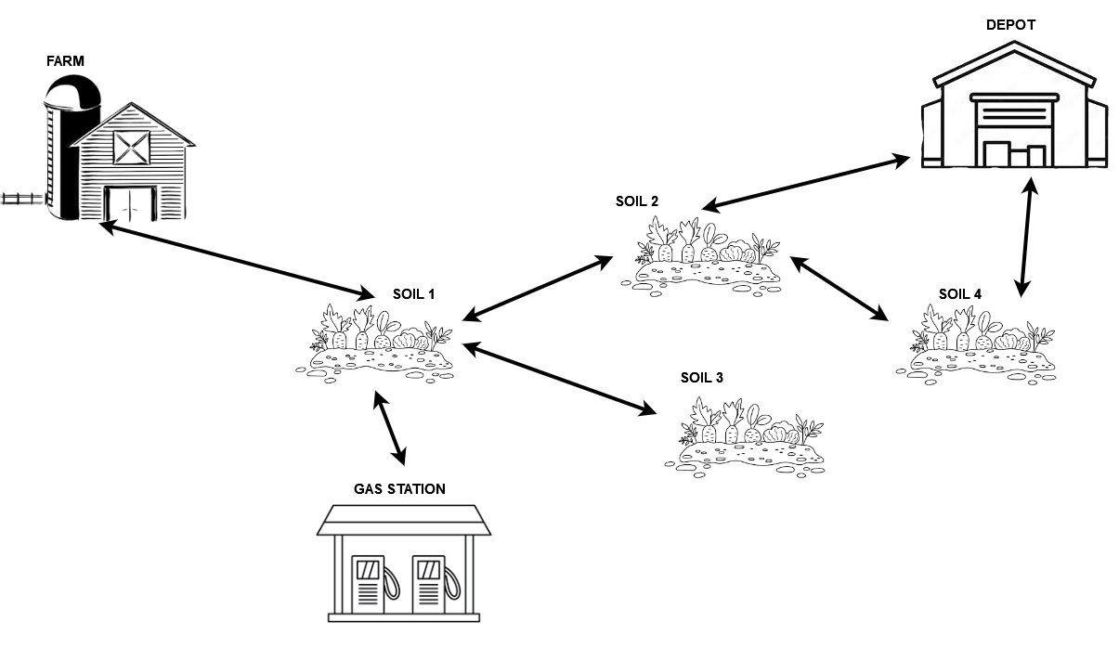
PROBLEM 4
quantity of apple in s2 = 14
quantity of eggplant in s2 = 17
quantity of banana in s4 = 0
quantity of pumpkin in s4 = 0
quantity of apple in s1 = 12
quantity of eggplant in s1 = 16
quantity of banana in s4 = 0
quantity of pumpkin in s4 = 11
quantity of apple in s4 = 0
quantity of eggplant in s4 = 0
quantity of banana in s4 = 12
quantity of pumpkin in s4 = 11
S₀:
quantity of apple in s3 = 13
quantity of eggplant in s3 = 9
quantity of banana in s3 = 0
quantity of pumpkin in s3 = 0
There are one tractor, one farmers and four soils ;
The tractor and the farmer are at the farm ;
The max capacity of the first tractor is 30;
The demanded quantity of apple is 21;
The demanded quantity of eggplant is 27;
The demanded quantity of banana is 10;
The demanded quantity of pumpkin is 9;
The tractor consumes 1.5 quantity of fuel per km;
Left fuel of the tractor is 40 with max fuel capacity of 100.
Goal:
Every demand is satisfied, but now we want to minimize the path taking care always of the capacity and the fuel of the tractor.

Slide 21
BLIND PLAN:
hAdd PLAN:
hMax PLAN:
(get_on f1 t1)
(goto f1 t1 farm s1)
(get_off f1 t1)
(collect_good s1 apple t1 f1)
(collect_good s1 eggplant t1 f1)
(get_on f1 t1)
(goto f1 t1 s1 g1)
(get_off f1 t1)
(get_gas f1 g1 t1)
(get_on f1 t1)
(goto f1 t1 g1 s1)
(goto f1 t1 s1 s2)
(get_off f1 t1)
(collect_good s2 apple t1 f1)
(collect_good s2 eggplant t1 f1)
(get_on f1 t1)
(goto f1 t1 s2 s4)
(get_off f1 t1)
(collect_good s4 banana t1 f1)
(get_on f1 t1)
(goto f1 t1 s4 d1)
(release d1 t1 f1)
(goto f1 t1 d1 s4)
(get_off f1 t1)
(collect_good s4 pumpkin t1 f1)
(get_on f1 t1)
(goto f1 t1 s4 d1)
(release d1 t1 f1)
(get_on f1 t1)
(goto f1 t1 farm s1)
(get_off f1 t1)
(collect_good s1 eggplant t1 f1)
(collect_good s1 apple t1 f1)
(get_on f1 t1)
(goto f1 t1 s1 g1)
(get_off f1 t1)
(get_gas f1 g1 t1)
(get_on f1 t1)
(goto f1 t1 g1 s1)
(goto f1 t1 s1 s2)
(get_off f1 t1)
(collect_good s2 eggplant t1 f1)
(collect_good s2 apple t1 f1)
(get_on f1 t1)
(goto f1 t1 s2 d1)
(release d1 t1 f1)
(goto f1 t1 d1 s4)
(get_off f1 t1)
(collect_good s4 pumpkin t1 f1)
(collect_good s4 banana t1 f1)
(get_on f1 t1)
(goto f1 t1 s4 d1)
(release d1 t1 f1)
(get_on f1 t1)
(goto f1 t1 farm s1)
(get_off f1 t1)
(collect_good s1 apple t1 f1)
(collect_good s1 eggplant t1 f1)
(get_on f1 t1)
(goto f1 t1 s1 g1)
(get_off f1 t1)
(get_gas f1 g1 t1)
(get_on f1 t1)
(goto f1 t1 g1 s1)
(goto f1 t1 s1 s2)
(get_off f1 t1)
(collect_good s2 apple t1 f1)
(collect_good s2 eggplant t1 f1)
(get_on f1 t1)
(goto f1 t1 s2 d1)
(release d1 t1 f1)
(goto f1 t1 d1 s4)
(get_off f1 t1)
(collect_good s4 pumpkin t1 f1)
(collect_good s4 banana t1 f1)
(get_on f1 t1)
(goto f1 t1 s4 d1)
(release d1 t1 f1)

Slide 22
PROBLEM 4: RESULTS
hAdd is used with alg. GBFS
hMax is used with alg. A*

Slide 23
PROBLEM 4: RESULTS
hAdd is used with alg. GBFS
hMax is used with alg. A*

Slide 24
PROBLEM 5
quantity of apple in s1 = 15
quantity of eggplant in s1 = 11
quantity of apple in s2 = 5
quantity of eggplant in s2 = 6
* We are giving infinite fuel to the tractor as we are not considering it
S₀:
There is one tractor, one farmer and two soils ;
The tractor and the farmer are at the farm ;
The demanded quantity of apple is 27;
The max capacity of the tractor is 30.
Goal:
Every demand is satisfied.

Slide 25

PROBLEM 5: RESULTS
PROBLEM UNSOLVABLE
hAdd is used with alg. GBFS
hMax is used with alg. A*

Slide 26
THANK YOU
for your attention

