Slide 1

Project Easy save
Pigout Corentin
Chades Martin
Bitangane Brad

Slide 2
Introduction

Slide 3
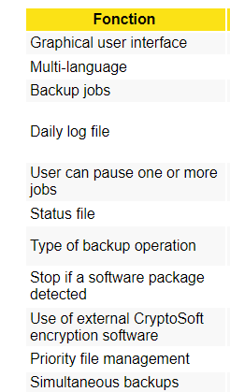
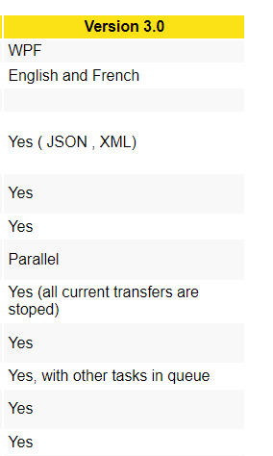
Specifications

Slide 4

Interface

Slide 5
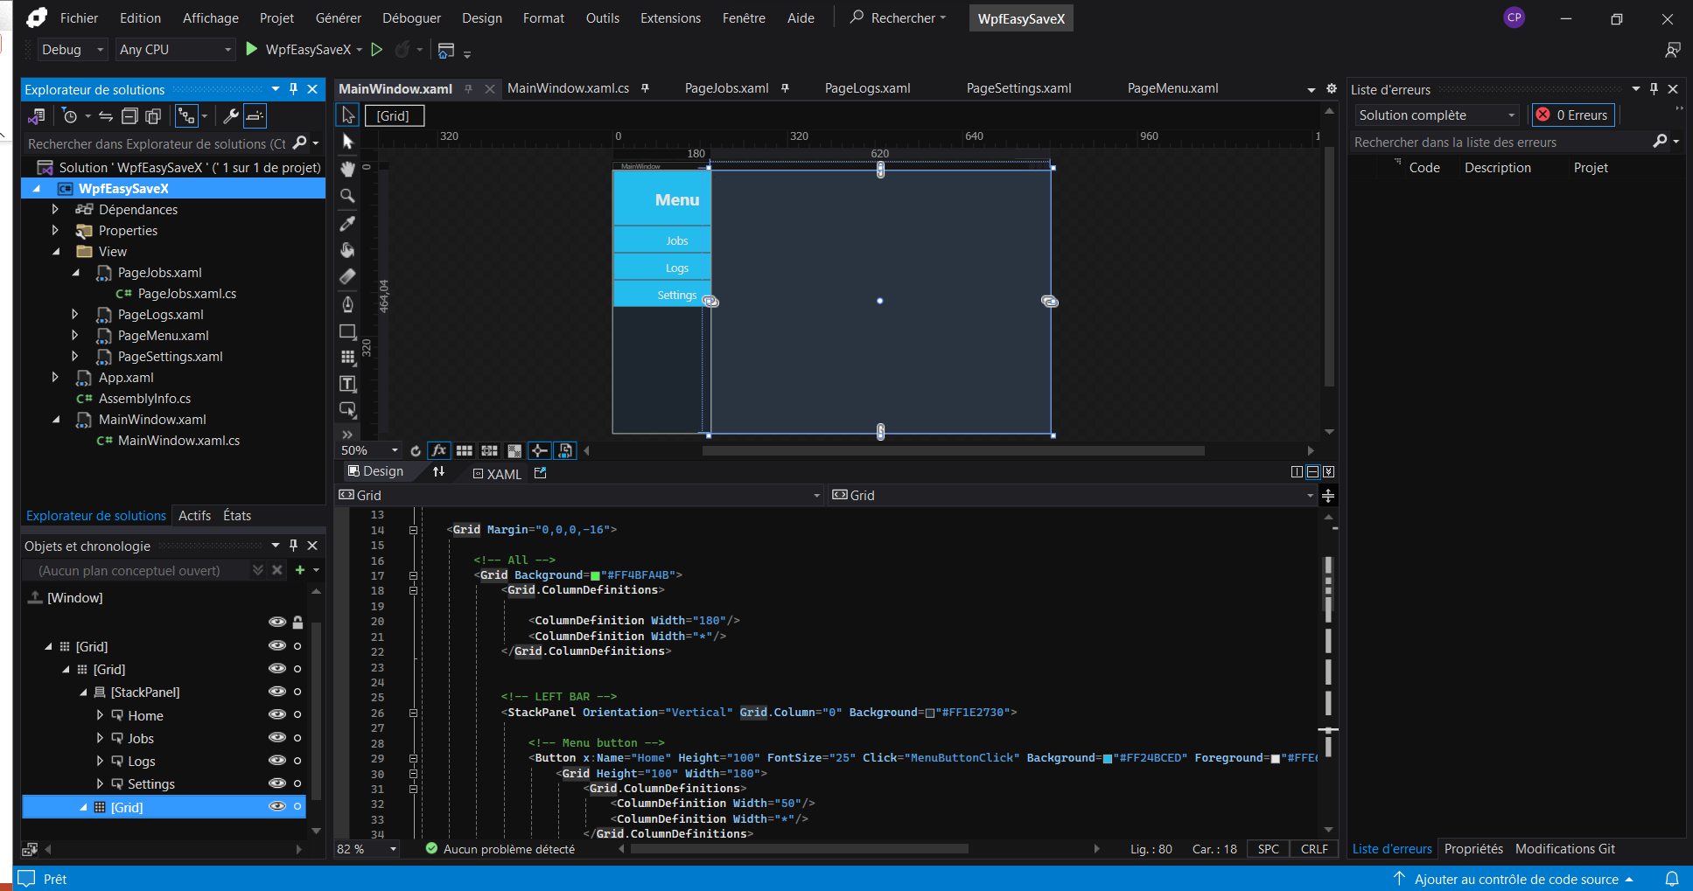

Slide 6
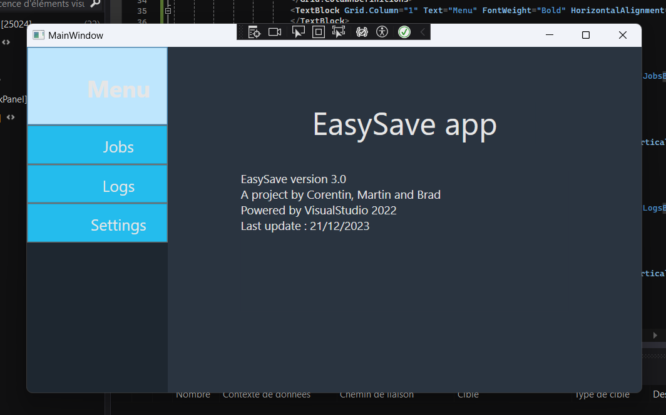

Slide 7
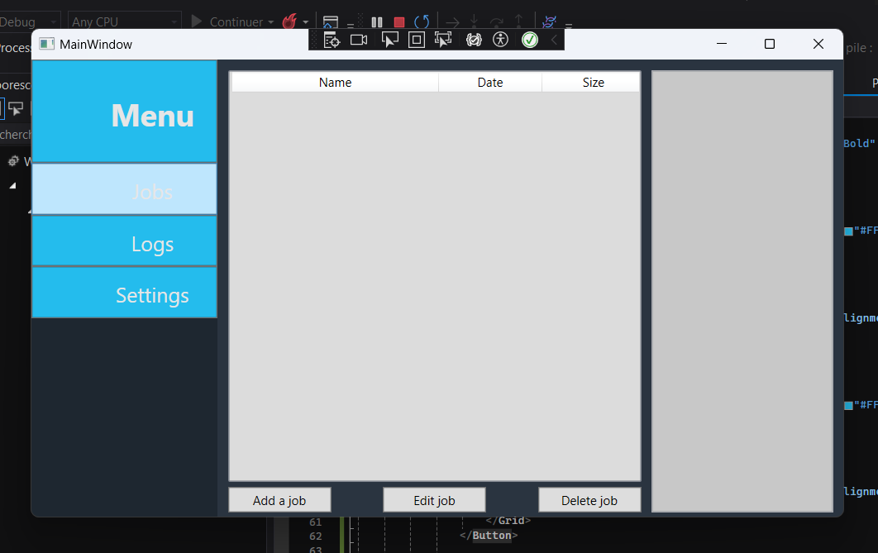

Slide 8
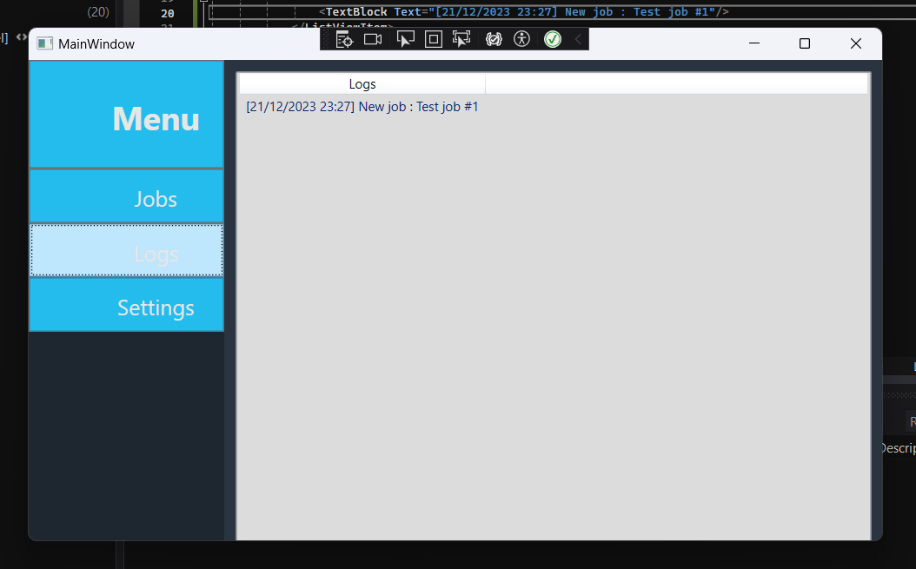

Slide 9
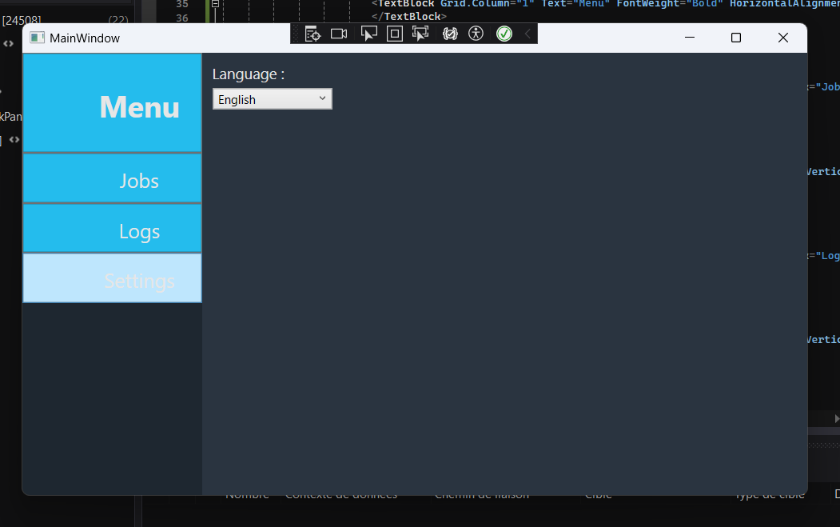

Slide 10
Main features
- language (fr,en)
Copy
logs

Slide 11


language

Slide 12
ADD jobs
Name
Source directory
Target directory
Type (full or directory)

Slide 13
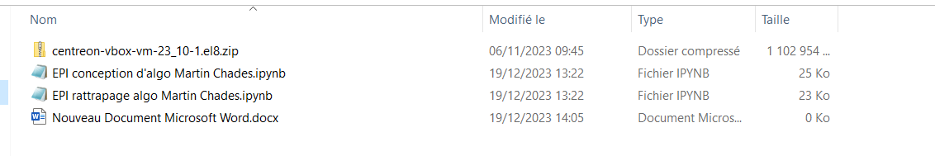
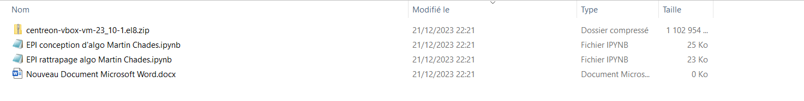
Copy
C:\Users\33624\OneDrive\Bureau\1ere année\.ipynb_checkpoints (Source Directory)
C:\Users\33624\OneDrive\Bureau\1ere année\target (Target Directory)

Slide 14
Pause play stop

Slide 15

Priority file
extension file that the user entered

Slide 16
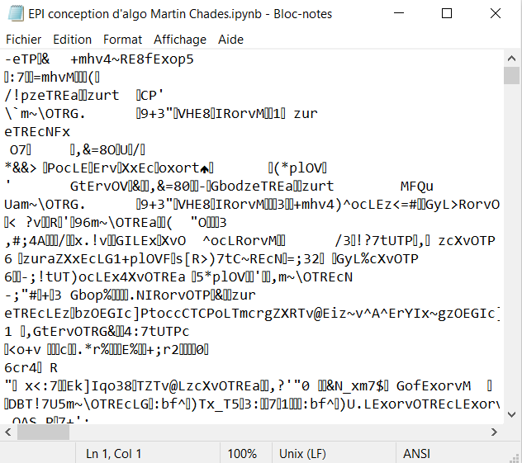
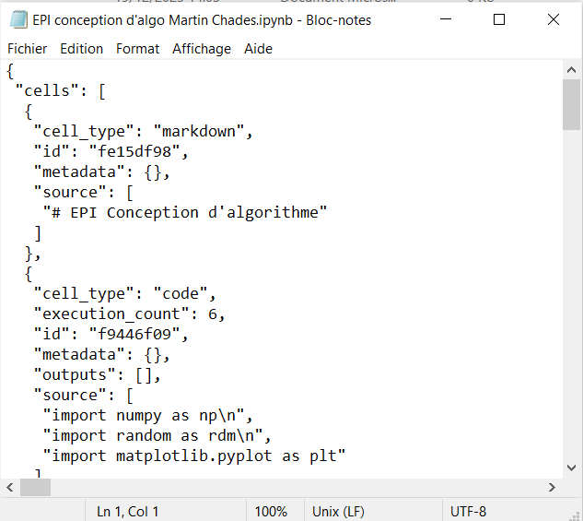
Encryption

Slide 17
Logs
the logs are implemented as soon as a folder is copied
- Time
- Name
- Source directory
- Target Directory
- Type
- Directory size
- Transfer time
- Encryption time

Slide 18
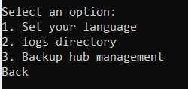
Change the log saving path
- your own path
- all files are saved in the selection folder

Slide 19
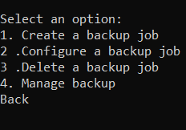
We added the modification and deletion

Slide 20

possible improvement

Slide 21
Improved Encryption:
Implement advanced encryption options to meet higher security standards.

Slide 22
Expanded Language Options:
Add support for more languages to attract a more diverse audience.

Slide 23
Multi-Platform Compatibility:
Expand app compatibility to work on different platforms (Windows, macOS, Linux).

Slide 24
Conclusion

Slide 25
Thank you for your attention

