Slide 1
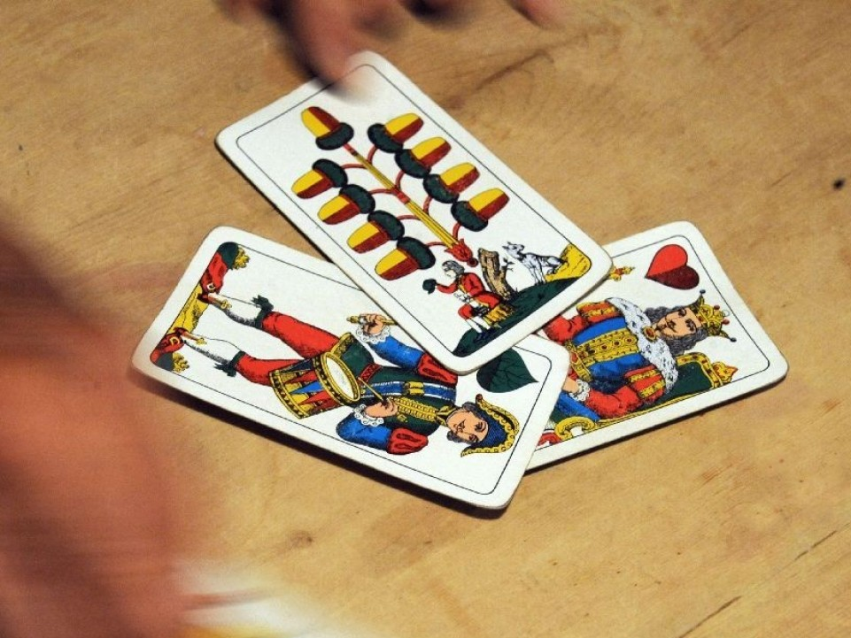
Watten – A south tyrolean card game
By Patrick Alber, Matthäus Ranigler and Peter Moser

Slide 2
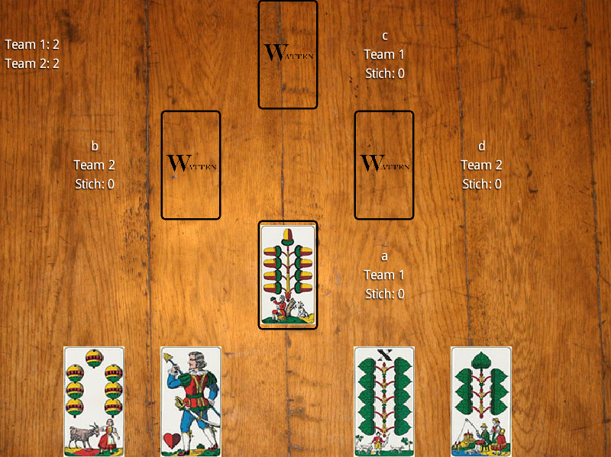
Watten – Brief introduction

Slide 3
Game Logic
State machine
Features and constraints

Slide 4
Network Architecture
Client – Server
TCP / IP (Java sockets)
XML protocol

Slide 5
Graphic Library
libGDX

Slide 6
Problems and solutions
Different projects
Divide et impera: Sharing work
From Message Objects to XML
Automated Testing

Slide 7
Thanks for your Attention!!!

Slide 8
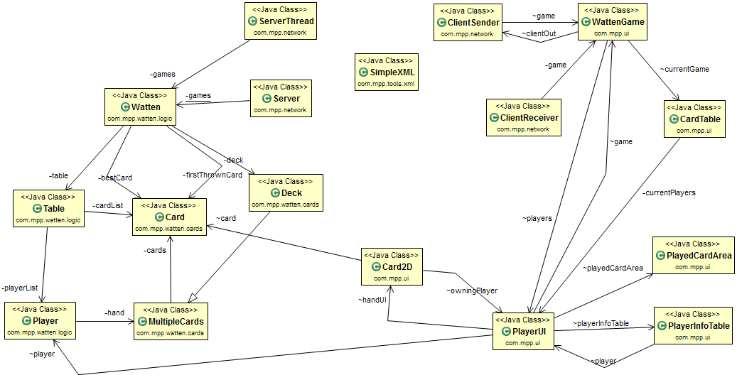
Class Diagram

Slide 9
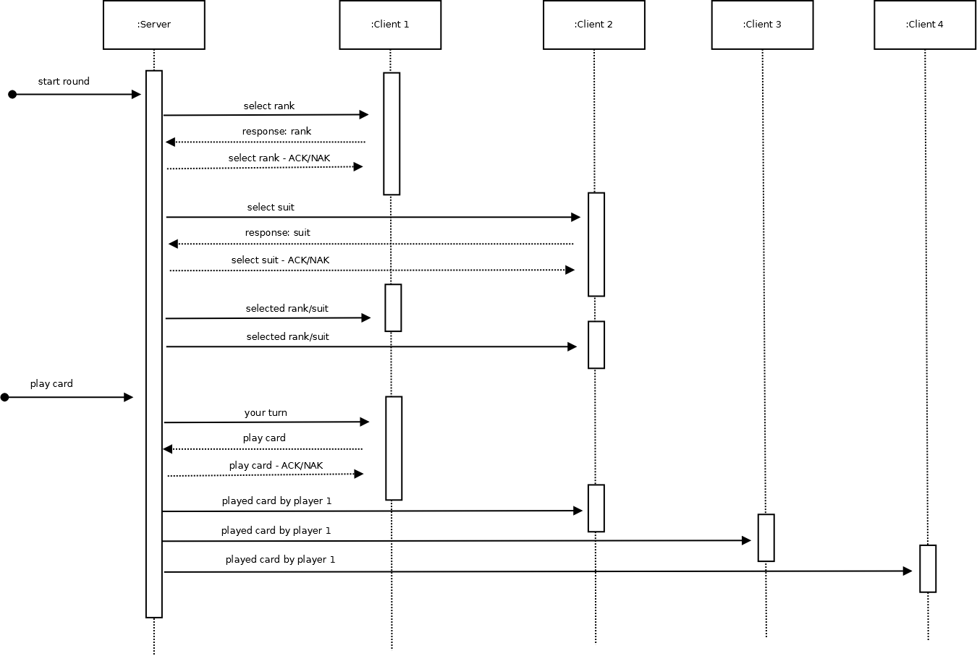
Sequence Diagram

Slide 10
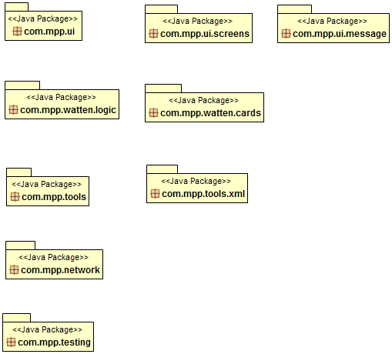
Packages

Slide 11
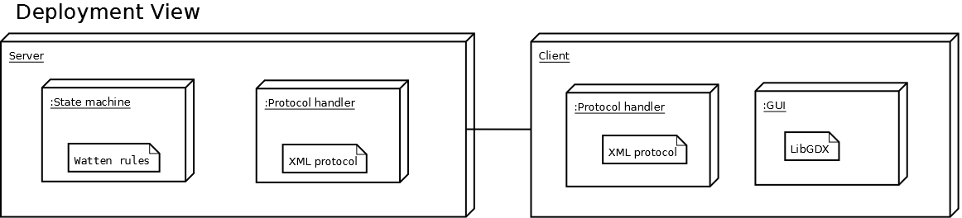
Deployment Diagram

