Slide 1
tomato

Slide 2
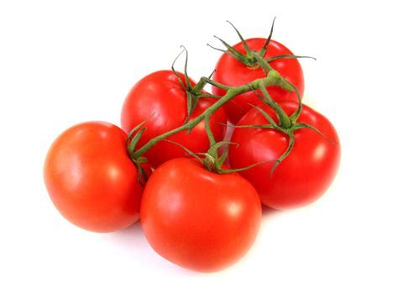
The tomato is the edible, often red, berry of the plant Solanum lycopersicum, commonly known as a tomato plant. The species originated in western South America and Central America. Numerous varieties of the tomato plant are widely grown in temperate climates across the world, with greenhouses allowing for the production of tomatoes throughout all seasons of the year.

Slide 3
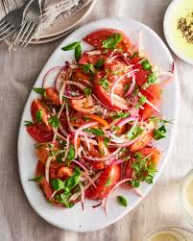
The tomato is consumed in diverse ways, raw or cooked, in many dishes, sauces, salads, and drinks

Slide 4
Soup is one of the best way to enjoy the tomato

Slide 5
Heat the oil in a large saucepan and add the onions, carrot and celery and garlic. Cover and cook gently for 10 minutes until soft.Then,Add the sugar, salt, pepper and tomatoes. Stir and cook for another 5 minutes. Finally, Add the stock, bring to the boil and simmer for 10 minutes. Liquidise until smooth. If using the basil, stir in at the end.

Slide 6
Salad is one of the best way to enjoy the tomato

Slide 7
To create a delicious salad, mix cherry or grape tomatoes with blanched green beans, chopped sweet peppers and broccoli florets. To make a simple tangy vinaigrette, whisk pesto with freshly squeezed lemon juice. Drizzle over salad and toss to coat.

Slide 8
Salsa is one of the best way to enjoy the tomato

Slide 9
Turn the diced tomato into a salsa. Use the chopped tomato to create your favorite kind of salsa, adding lemon or vinegar to acidify the tomato. By adding these acidic ingredients to a salsa, you will keep the tomato’s pH level below 4.2, which is what the FDA suggests

Slide 10
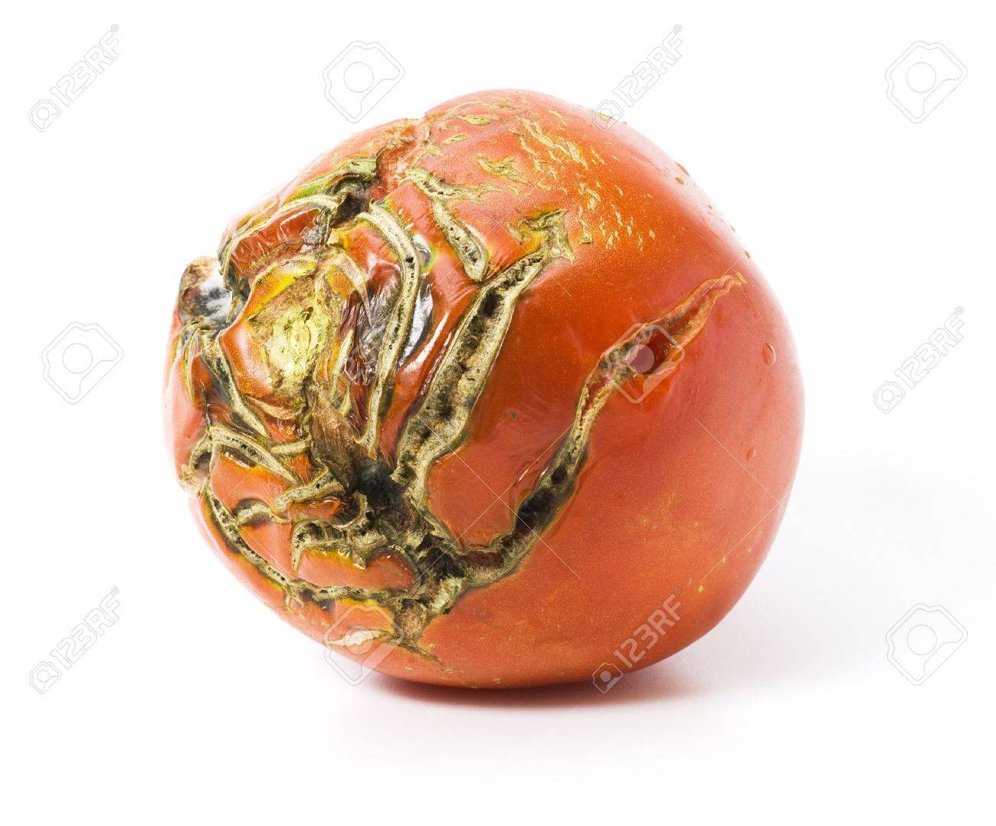
There are several poisonous substances in spoiled tomato such as mould and bacteria

Slide 11
There are several way to differentiate between good tomato and spoiled tomato

Slide 12
Before cooking tomato, you should check firstly whether the appearance of it is smooth without white mould, then you should smell to check whether the odour of it is sour or not, if it smells sour and putrefactive, it is spoiled one and you should not eat it.

