Slide 1
tomato

Slide 2
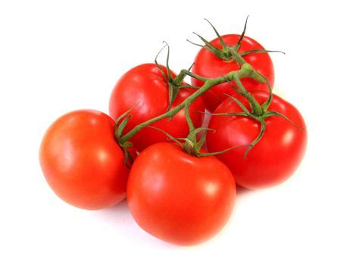
As a member of the nightshade family (along with aubergines, peppers and chillies), tomatoes are in fact a fruit, but their affinity for other savoury ingredients means that they are usually classed as a vegetable.

Slide 3
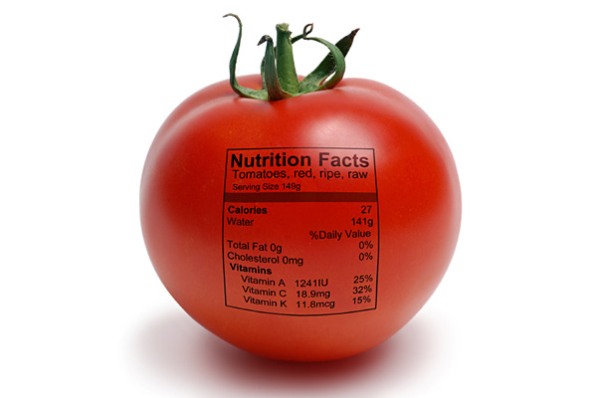
Tomato can take several benefits for your physical fitness.

Slide 4
Tomato is a good choice for person who wants to intake vitaminC and vitaminK

Slide 5
Vitamin C is a water-soluble vitamin and powerful antioxidant, and helps the body form and maintain connective tissue, including bones, blood vessels, and skin. Research also indicates that it may help protect against a variety of cancers by combatting free radicals and helping neutralize the effects of nitrites. The health benefits of vitamin K include a healthy heart, prevention of osteoporosis, relief from menstrual pain, reduced risk of cancer, protection from internal bleeding, prevention of biliary obstruction, and reduced menstrual flow.

Slide 6
Tomatoes are one of the low-calorie vegetables which hold just 18 calories per 100g

Slide 7
Several benefits are associated with a low calorie diet. Dieters normally loose 4-7 pounds (2-3 kg) per week. Low calorie diets help slow down the aging process. Improved mental acuity. Dieters learn to eat a healthy, well balanced diet. Some research shows that a low calorie diet increases the life span.

Slide 8
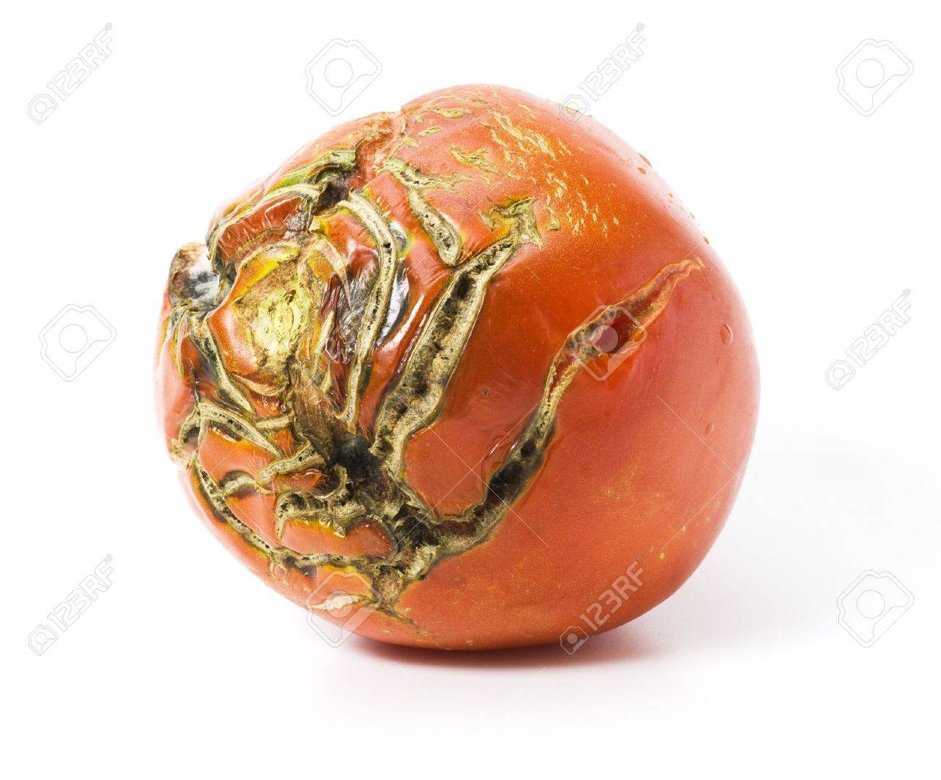
Spoiled tomato is bad for health

Slide 9
There are several way to differentiate between good tomato and spoiled tomato

Slide 10
Before cooking tomato, you should check firstly whether the appearance of it is smooth without white mould, then you should smell to check whether the odour of it is sour or not, if it smells sour and putrefactive, it is spoiled one and you should not eat it.

