Slide 1
tomato

Slide 2
Tomato is a glossy red, or occasionally yellow, pulpy edible fruit that is eaten as a vegetable or fried with other food material. It is an herbaceous, usually sprawling plant in the nightshade family that is typically cultivated for its edible fruit. It is a perennial but is usually grown outdoors in temperate climates as an annual. Tomatoes are the most common and beloved vegetable crop for home gardeners.

Slide 3
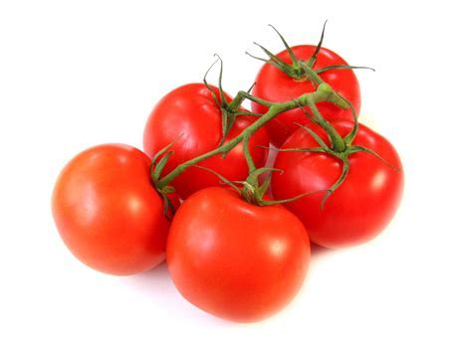

Slide 4
Tomato is very good for health

Slide 5
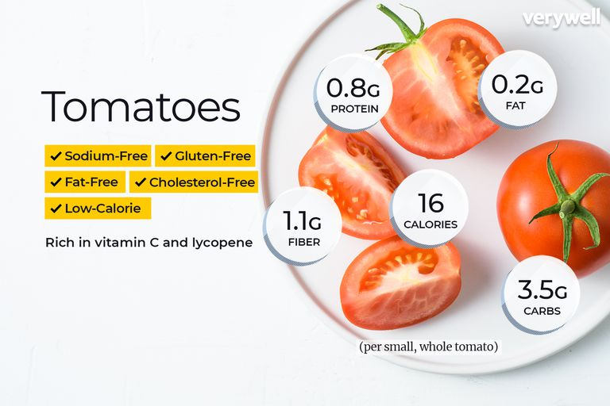

Slide 6
Tomato is a good choice for person who wants to intake vitaminC and vitaminK

Slide 7
Vitamin K is needed for blood clotting, which means it helps wounds heal properly. There's also some evidence vitamin K may help keep bones healthy. Vitamin C, or ascorbic acid, is one of the most important vitamins for immune health, aiding in the prevention of colds and other infections. Having a vitamin C deficiency is a well known cause of scurvy, which is normally associated with sailors being at sea for long periods of time.

Slide 8
Tomatoes are one of the low-calorie vegetables which hold just 18 calories per 100g

Slide 9
Very low calorie diets can have enormous health benefits. Not only do they provide fast and efficient weight-loss but can also reduce the health risks associated with being obese or overweight. If you are obese (have a BMI of 30+) then you are at risk of developing serious medical conditions such as type 2 diabetes, heart disease, certain cancers, stroke, joint and muscle pain.

Slide 10
There are several poisonous substances in spoiled tomato such as mould and bacteria

Slide 11
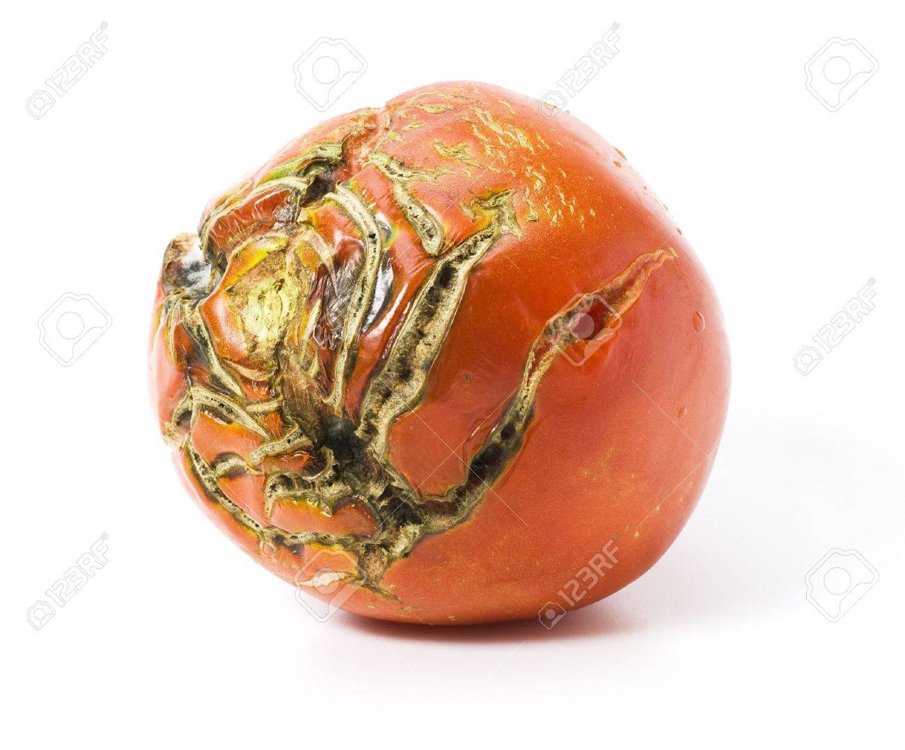

Slide 12
There are several way to differentiate between good tomato and spoiled tomato

Slide 13
Before cooking tomato, you should check firstly whether the appearance of it is smooth without white mould, then you should smell to check whether the odour of it is sour or not, if it smells sour and putrefactive, it is spoiled one and you should not eat it.

