Slide 1
­­­Crime Scene: Prediction and Analysis
PROJECT BY: PRANJAL MANE
GOPIKHA MENON
HEMANGI JADHAV
GUIDED BY: PROF. SANKET PATIL

Slide 2
INTRODUCTION
In 21st century where mobile and information technology have become an integral part of our lives. Smart cities have the combination of technology and human resources to improve the quality of life. This allows us to take steps towards implementing smart, safe cities, by using the personal mobile devices and social networks to make the people alert and aware of their surroundings Hence we are developing an android application which provides an indication of the crime to the user through an android application.
Crime is committed by people of all age groups. Earlier only males were reported committing crimes whereas now reports prove that both men and women commit crimes. There is a change in the trends of crimes and it is very challenging to find the new trends and patterns in crime [3]. Therefore, to be aware of such people and crimes we are building the Crime Scene Application.

Slide 3
System REQUIREMENTS
Software :
Android Studio
Visual Studio Code
Hardware :
Operating system: Windows 10 64bit.
CPU: Intel Core i3 Quad CPU Q6600 @ 2.40GHz .
RAM: 4 GB .
Language:
Python
Flutter Dart

Slide 4
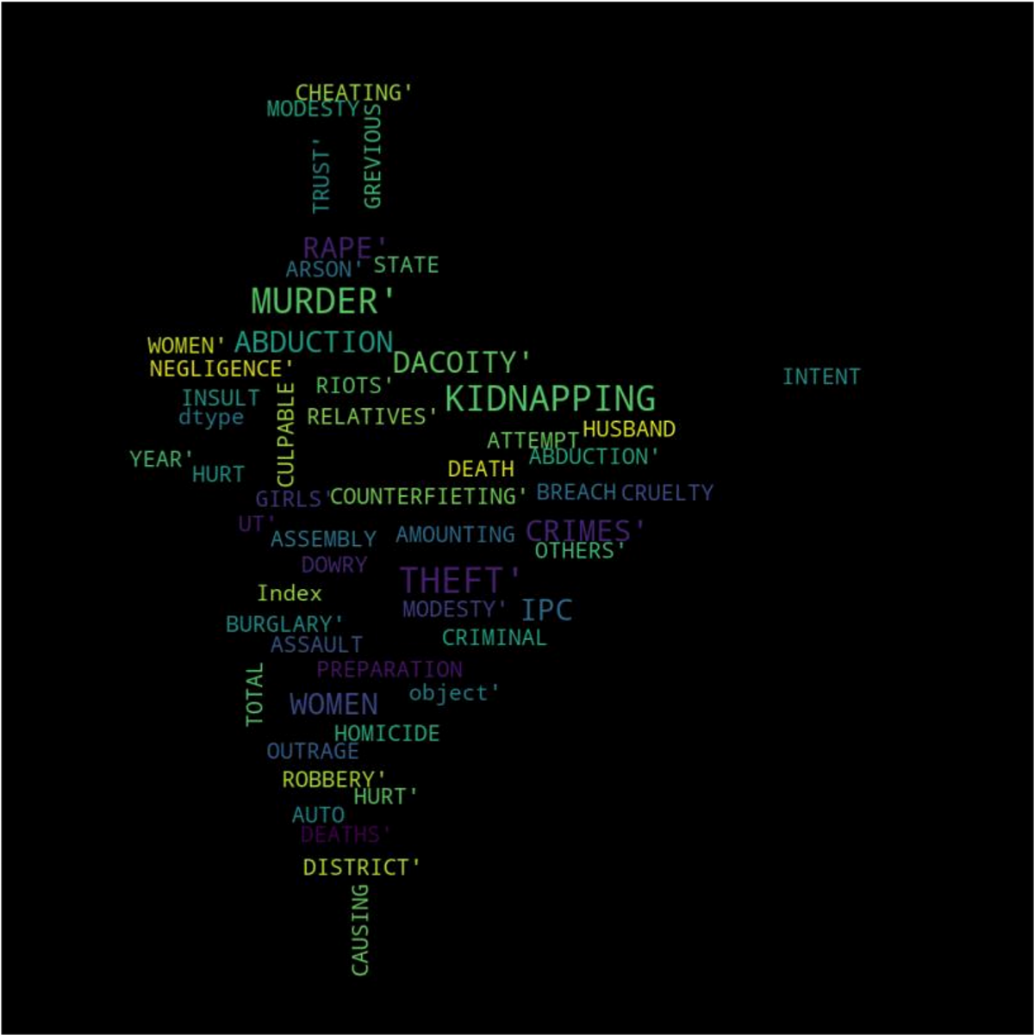
Dataset
The data set has been taken from https://data.gov.in/
It is the dataset of Indian Districts IPC Crimes from the year of 2001 to 2014.
It includes all the IPC based crimes and also the total count of the IPC crimes in every district for every year.
Furthermore the dataset has been processed to remove null values and they are merged with the Indian map dataset we got from https://gadm.org/ to visualize the analysis that will be performed.
A word-cloud to explain the dataset performed by image masking

Slide 5
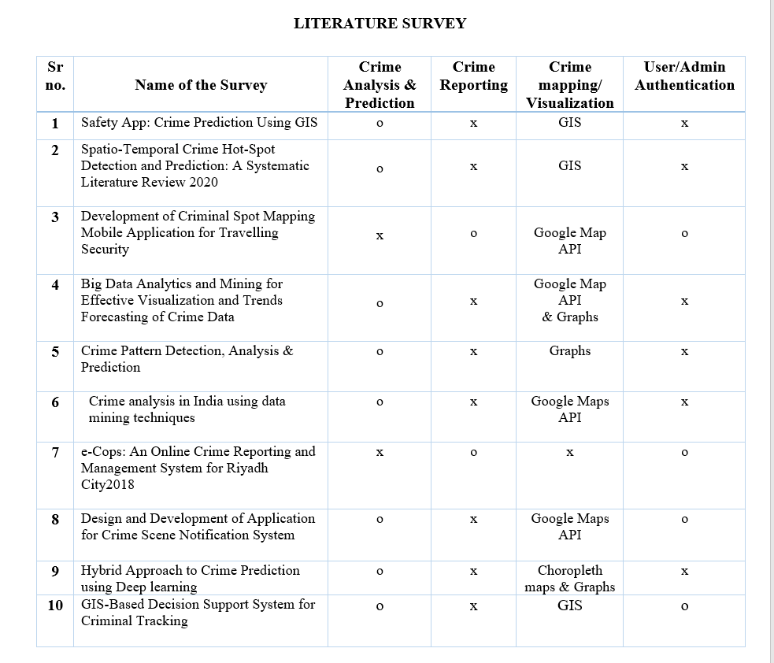
Literature Review

Slide 6
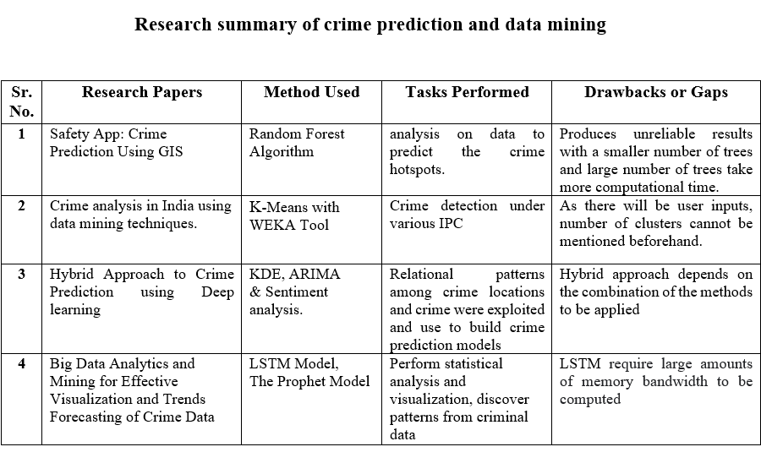

Slide 7
Problem Definition
Crimes are the significant threat to the humankind. This project aims towards common people or public to help them in their lives by notifying them the current situation of their surroundings. Developing an android application that sets forth the numerous crime hotspots all over India to the user when the location is specified accompanied with latest newsletter and effortless crime reporting. Crime analysis and prediction is a systematic approach for identifying patterns and trends in crime. The crime rate prediction strategies can be applied on historical data available in the police records by examining the data at various angles like reason of crime, frequency of similar kind of crimes at specific location with other parameters.

Slide 8

METHODOLOGY: The ensemble learning
Methodology
Ensemble learning is the process by which multiple models, such as classifiers, are strategically generated and combined to solve a particular computational intelligence problem.
Some researchers suggest that the performance of the ensembles depends on two properties, which are the individual success of the base classifiers of the ensemble and the independence of the base classifier’s results from each other, while some other researcher suggests that the accuracy of individual models, diversity among the individual models, decision making strategy, and number of base classifiers used for constructing an ensemble are among the factors responsible for the success of an ensemble. An ensemble is itself a supervised learning algorithm because it can be trained and then used to make predictions.
Ensemble methods are techniques that aim at improving the accuracy of results in models by combining multiple models instead of using a single model. The combined models increase the accuracy of the results significantly. This has boosted the popularity of ensemble methods in machine learning.

Slide 9
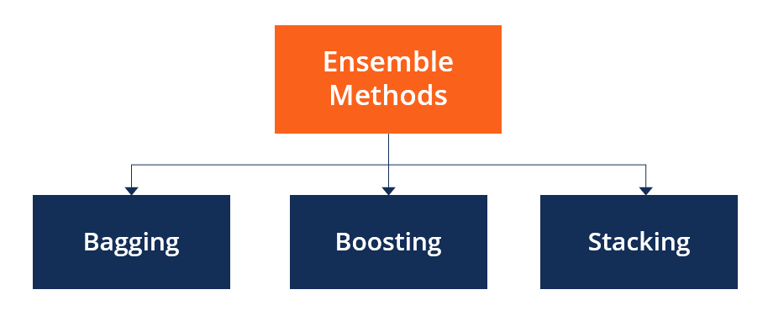
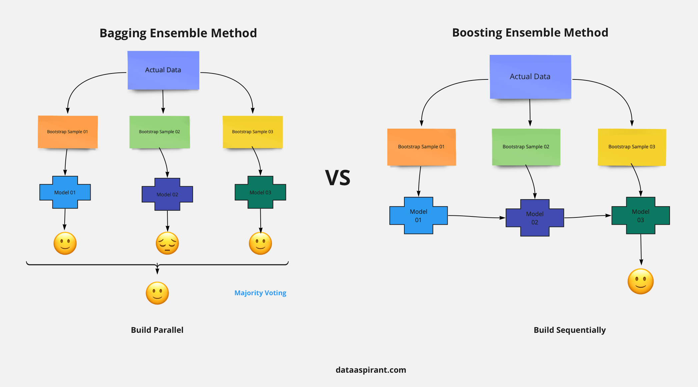
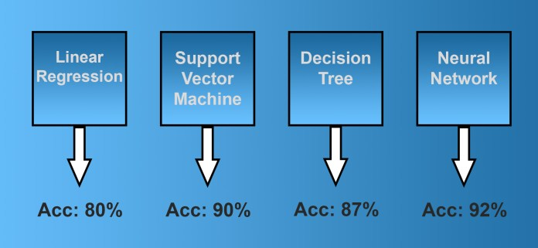
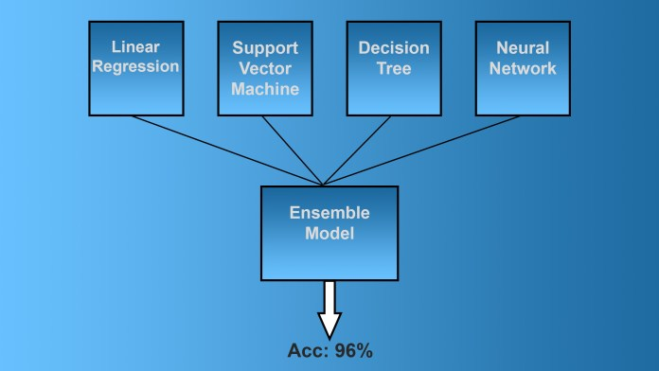

Slide 10
Bagging, the short form for bootstrap aggregating, is mainly applied in classification and regression. It increases the accuracy of models through decision trees, which reduces variance to a large extent. Bagging is classified into two types:
Bootstrapping is a sampling technique where samples are derived from the dataset using the replacement procedure. The sampling with replacement method helps make the selection procedure randomized. The base learning algorithm such as decision tree is run on the samples to complete the procedure.
Aggregation in bagging is done to incorporate all possible outcomes of the prediction and randomize the outcome. Without aggregation, predictions will not be accurate because all outcomes are not put into consideration. Therefore, the aggregation is based on the probability bootstrapping procedures or on the basis of all outcomes of the predictive models.

Slide 11
Bagging is advantageous since weak base learners are combined to form a single strong learner that is more stable than single learners. It also eliminates any variance, thereby reducing the overfitting of models.
One limitation of bagging is that it is computationally expensive. Thus, it can lead to more bias in models when the proper procedure of bagging is ignored
Ensemble methods are ideal for reducing the variance in models, thereby increasing the accuracy of predictions. The variance is eliminated when multiple models are combined to form a single prediction that is chosen from all other possible predictions from the combined models. An ensemble of models combines various models to ensure that the resulting prediction is the best possible, based on the consideration of all predictions.

Slide 12
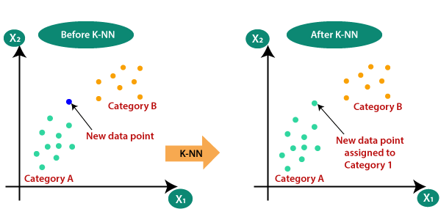
KNN(K Nearest Neighbors)
The k-nearest neighbors (KNN) algorithm: It is a simple, supervised machine learning algorithm that can be used to solve both classification and regression problems. KNN is a lazy learning, non-parametric algorithm. It uses data with several classes to predict the classification of the new sample point. KNN is non-parametric since it doesn’t make any assumptions on the data being studied, i.e., the model is distributed from the data. Purpose to use KNN: ease of interpretation and low calculation time.

Slide 13
KNN(K Nearest Neighbors) Algorithm
The K-NN working can be explained on the basis of the below algorithm:
Step-1: Select the number K of the neighbors
Step-2: Calculate the Euclidean distance of K number of neighbors
Step-3: Take the K nearest neighbors as per the calculated Euclidean distance.
Step-4: Among these k neighbors, count the number of the data points in each category.
Step-5: Assign the new data points to that category for which the number of the neighbor is maximum.
Step-6: Our model is ready.

Slide 14

Decision tree
Decision Tree
As the name says all about it, it is a tree which helps us by assisting us in decision-making. Used for both classification and regression, it is a very basic and important predictive learning algorithm.
It is different from others because it works intuitively i.e., taking decisions one-by-one.
Non-parametric: Fast and efficient.
It is a graphical representation for getting all the possible solutions to a problem/decision based on given conditions

Slide 15
Decision tree algorithm
Decision Tree algorithm
Step-1: Begin the tree with the root node, says S, which contains the complete dataset.
Step-2: Find the best attribute in the dataset using Attribute Selection Measure (ASM).
Step-3: Divide the S into subsets that contains possible values for the best attributes.
Step-4: Generate the decision tree node, which contains the best attribute.
Step-5: Recursively make new decision trees using the subsets of the dataset created in step -3. Continue this process until a stage is reached where you cannot further classify the nodes and called the final node as a leaf node.

Slide 16
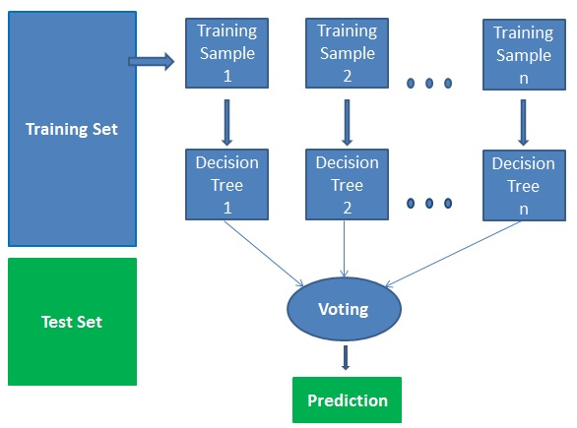
Random forest
Random Forest
Random Forests is a very popular ensemble learning method which builds a number of classifiers on the training data and combines all their outputs to make the best predictions on the test data. Thus, the Random Forests algorithm is a variance minimizing algorithm that uses randomness when making split decision to help avoid overfitting on the training data.
Random forests is considered as a highly accurate and robust method because of the number of decision trees participating in the process.
It does not suffer from the overfitting problem. The main reason is that it takes the average of all the predictions, which cancels out the biases.

Slide 17
Random forest algorithm
Random Forest Algorithm
Step1: Select random samples from a given dataset.
Step2: Construct a decision tree for each sample and get a prediction result from each decision tree.
Step3: Perform a vote for each predicted result.
Step4: Select the prediction result with the most votes as the final prediction.

Slide 18
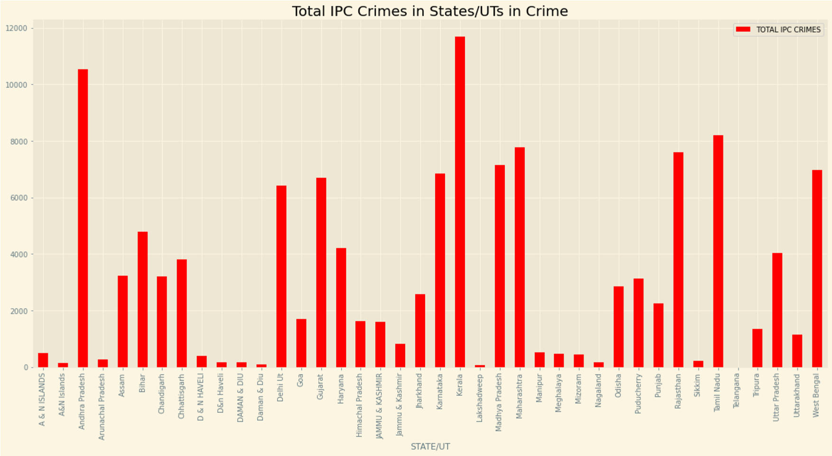
Result

Slide 19
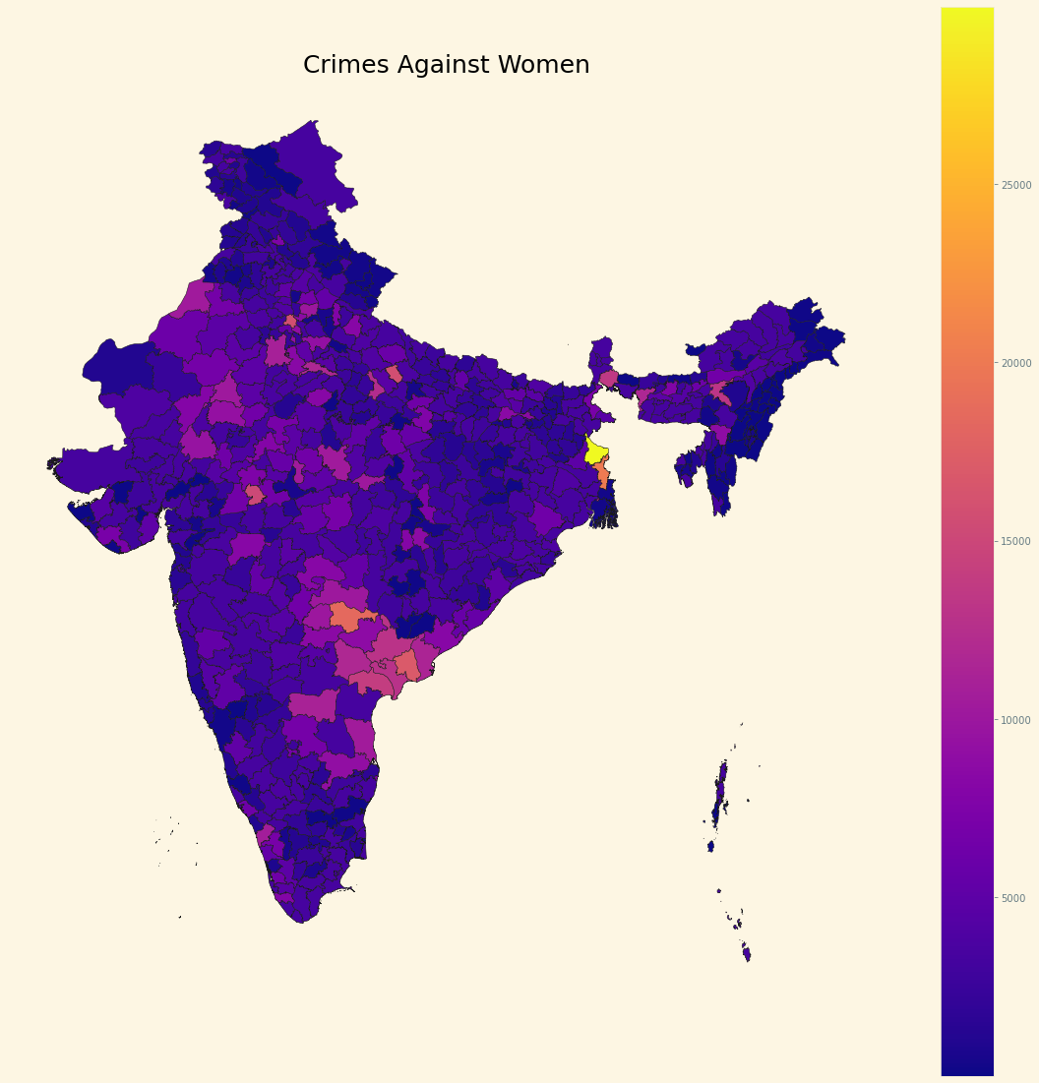
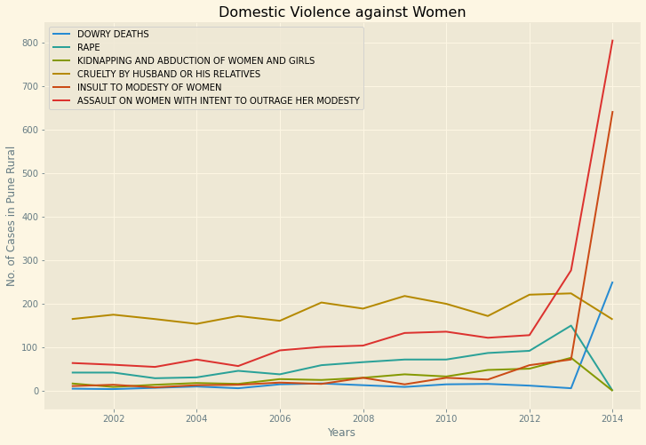

Slide 20
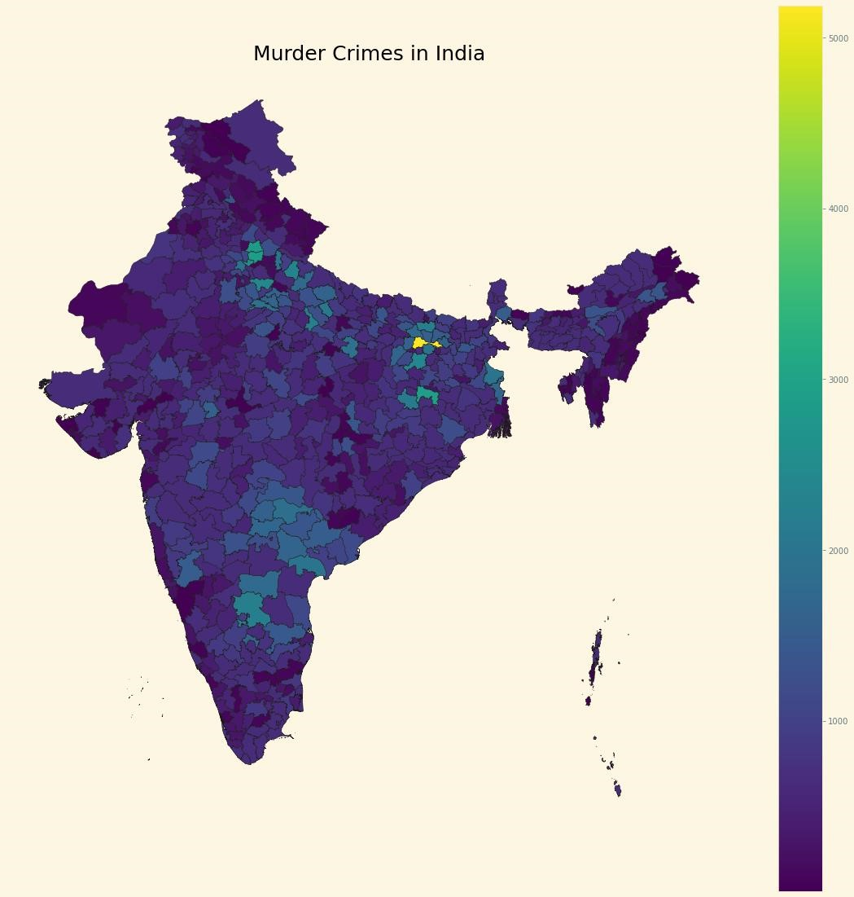
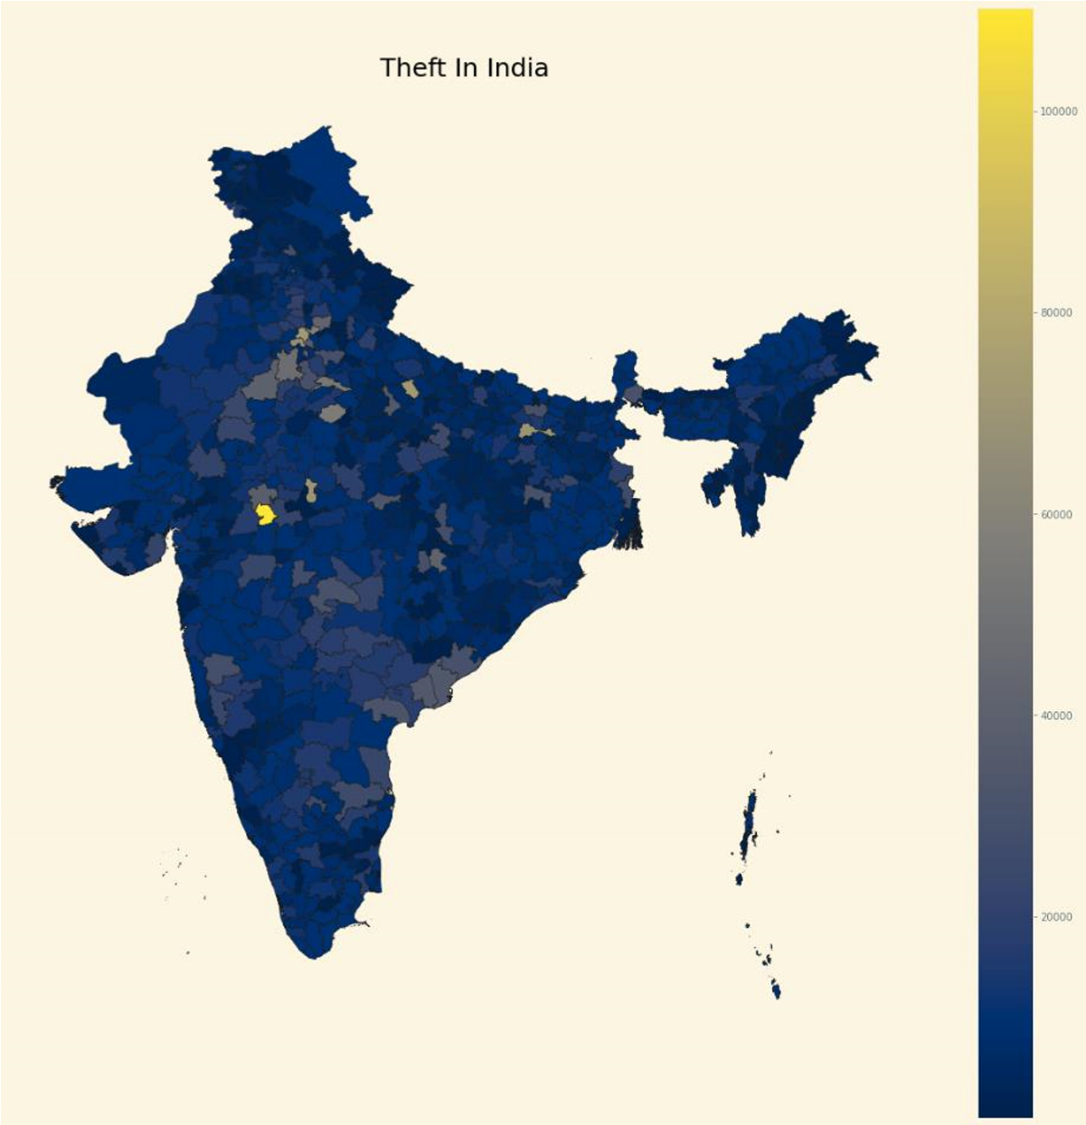

Slide 21
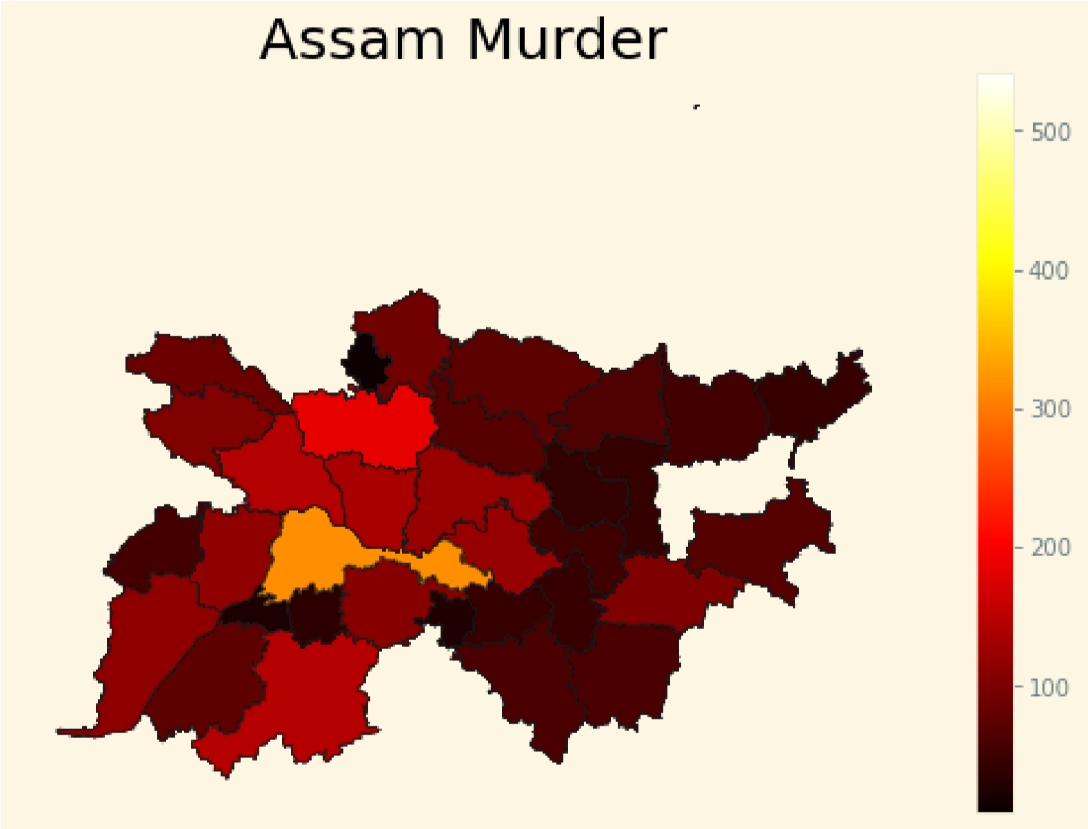
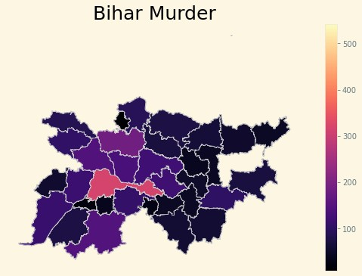

Slide 22
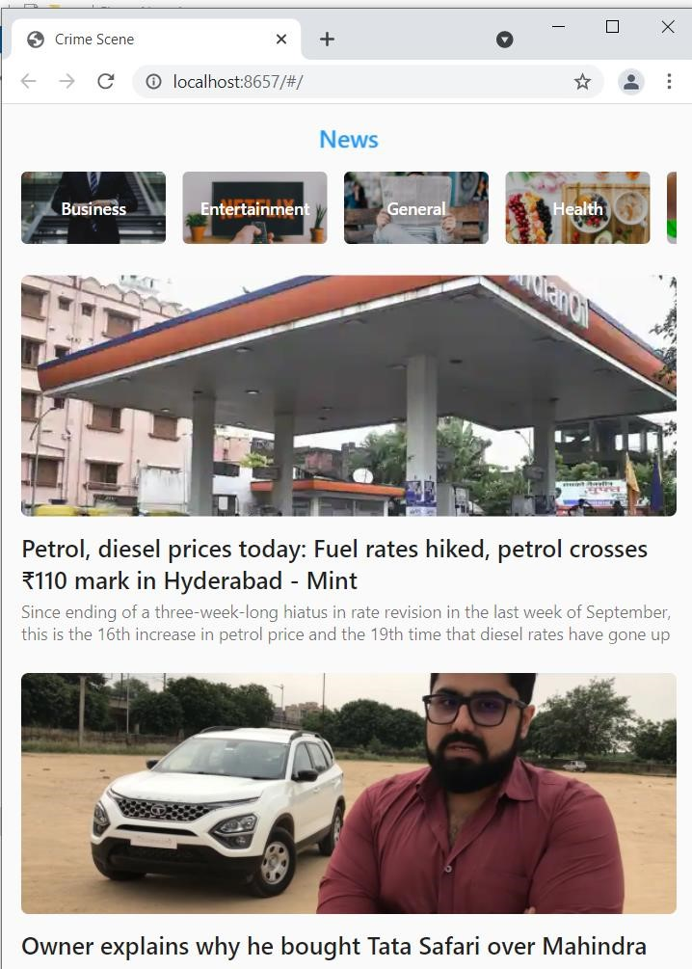
DAILY NEWS FEATURE

Slide 23
Future Scope
The goal of any society shouldn’t be to just catch criminals but to prevent crimes from happening in the first place .
Predicting Future Crime Spots: By using historical data and observing where recent crimes took place we can predict where future crimes will likely happen .
Predicting Who Will Commit a Crime: Using Face Recognition to predict if a individual will commit a crime before it happens. The system will detect if there are any suspicious changes in their behavior or unusual movements .
We can also store the finger-prints of criminals in database. This project can be enhanced that we can search criminals by matching the finger-prints and face images and also we can generate the report of all cases associated to a particular criminal.
we can also predict the estimated time for the crime to take place as a future scope. We will test the accuracy of frequent-item sets and prediction based on different test sets. So the system will automatically learn the changing patterns in crime by examining the crime patterns. Also the crime factors change over time. By shifting through the crime data we have to identify new factors that lead to crime

Slide 24
References
1.Safety App: Crime Prediction Using GIS
https://ieeexplore.ieee.org/document/9137772
2.Spatio-Temporal Crime Hot-Spot Detection and Prediction: A Systematic Literature Review
https://ieeexplore.ieee.org/stamp/stamp.jsp?arnumber=9187772
3.Development of criminal spot mapping mobile application for travelling security
https://ieeexplore.ieee.org/document/8273541

Slide 25
.Crime pattern detection, analysis & prediction
https://ieeexplore.ieee.org/document/8203676
6.Crime analysis and prediction using data mining
https://ieeexplore.ieee.org/document/6906719
7.e-Cops: An Online Crime Reporting and Management System for Riyadh City
https://ieeexplore.ieee.org/document/8441987
8.Design and development of application for crime scene notification system
https://ieeexplore.ieee.org/document/8074103
9.Hybrid approach to crime prediction using deep learning
https://ieeexplore.ieee.org/document/7275858
10.GIS-based decision support system for criminal tracking
https://ieeexplore.ieee.org/document/6523543

