Slide 1
Security and User Authentication
Basics of internet security and user authentication

Slide 2
Do you trust the internet?
You probably shouldn’t
Without taking precautions all the data you communicate over the internet is in plaintext and totally visible to someone who is looking
Just how many people are looking?
Even better? How might they be looking?
Traceroute can give us a bit more information

Slide 3
Types of security
Network Layer Security
TCP/IP (aka internet protocol suite) can be made secure with the help of cryptography
SSL (Secure Sockets Layer) or its successor TLS (Transport Layer Security) provide this for web traffic
PGP (Pretty Good Privacy) help provide this for email
IPsec for network layer security

Slide 4
TLS/SSL
A cryptographic protocol designed to provide communication security over the internet
HTTPS is HTTP layered on top of the TLS/SSL protocol
Uses Asymmetric Cryptography and Symmetric Cryptography
Who knows what this means?

Slide 5
Encryption Techniques
Symmetric Encryption?
Two parties that want to communicate both has a copy of a “secret key”
When they want to communicate, they apply this key to plaintext and get back cypher text (encrypt the message) which they can then send to the other party
When the other party wants to read, they simply apply the inverse of the operation on the cypher text and get the message (decryption)
Problems with this?
Anyone with this private key can encrypt and decrypt these messages..
How does person A give person B this private key securely?

Slide 6
Encryption Techniques
Asymmetric Encryption
The problem with symmetric encryption is exchanging the secret keys over the network
Asymmetric encryption instead of having just a private key works with a private/public key pair
Private Key: Our secret key that only we know
Public Key: A corresponding key made publicly available that works only with our private key
Any message that is encrypted with our public key can only be decrypted by using the same algorithm but with our private key

Slide 7
Pros/Cons of Asymmetric Encryption
Pros
We can now pass our public key around on the network without losing security
Cons
Asymmetric encryption is far more expensive than symmetric encryption
i.e. it takes far more processing power to verify something asymmetrically than it does to do it symmetrically

Slide 8
Analogy
We can think of public-key encryption (asymmetric) as that of a locked mail box with a mail slot
The mail slot is publicly viewable and accessible, but one something is dropped through the slot it is only viewable by the person with the correct key

Slide 9
Even Asymmetric Encryption is not perfect
There are always vulnerabilities
“Brute-force key search attach”
Impractical due to the amount of computing power needed to succeed, but theoretically possible
Both RSA and EIGamal Encryption have vulnerabilities known to be quicker than brute force
Cryptography and Security are very hard
We need to protect against every possible attack whereas attackers just need to succeed once

Slide 10
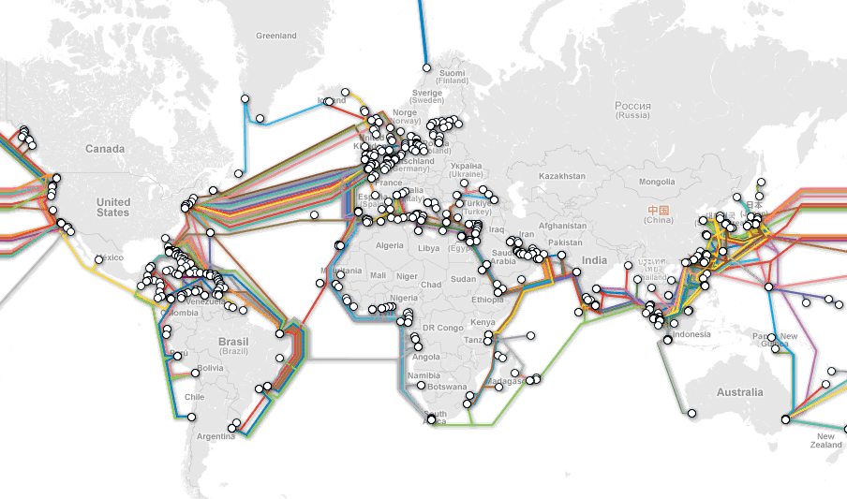
HTTPS Explained
Understanding the problem…
Whenever we make http requests, it must pass through many different networks

Slide 11

HTTPS the problem
These networks are made up of computers, routers, access points, switches, Internet Service Providers (ISPs), different organizations, servers, etc.
If a bad guy were able to get into any of these systems, he/she could potentially see everything passing through
Bad: HTTP alone is all plain text

Slide 12
HTTPS: The solution
TLS: The secure in HTTPS
Uses both asymmetric and symmetric cryptography
1 cool benefit of asymmetric cryptography
Two parties with no prior knowledge of each other can use math to create and agree upon a shared secret key for a session
Why is this cool?
Remember when I said asymmetric cryptography is expensive?
This allows us to use asymmetric crypto to create an agreed upon private key (that we never need to send over the network) such that we can later do symmetric encryption on the cheap

Slide 13
TLS: The math
The math behind this is actually very simple to calculate one way, but nearly impossible to reverse
Why? Very large prime numbers are great

Slide 14
TLS Algorithm in simple
Preface
Jimmy wants to talk to Bob securely
They agree upon a base (i.e. a small number like 2, 3, 5) and a large prime (300+ digits) both of which can be sent over the network
Both Jimmy and Bob have their own private key (100+ digits) that is never shared
Algorithm Part 1!
Jimmy’s Secret Sauce = (root^{Jimmy’s Secret}) % prime
Bob’s Secret Sauce = (root^{Bob’s Secret}) % prime
They send these calculated values to each other and then
Algorithm Part 2!
Jimmy Computes: (Bob’s Secret Sauce^{Jimmy’s Secret}) % prime
Bob Computes: (Jimmy’s Secret Sauce^{Bob’s Secret}) % prime
I Assert that the two values calculated here will be the same!
Note:
We never have to send each other’s secret key over the network
We have created a new secret session key that we can use to cheaply encrypt messages using symmetric encryption

Slide 15
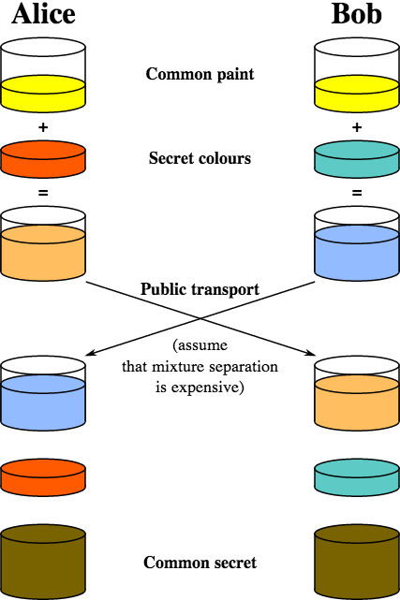
The same thing in colors!
We agree upon a small root number and very large prime
We have our own secret key’s
We mix our agreed upon root and prime with our own secret color
We pass our new secret sauce to each other over the network
We then add our own secret key to the other person’s secret sauce
Magically we end up with the same color (our secret session key)

Slide 16
But what about Authentication?
If I pick up the phone and call my friend, as of now we would be able to securely talk
BUT! How do I know my friend is who he says he is?
It turns out that we need a little something extra to solve this problem…

Slide 17
Certificates
High-Level
A certificate is a file that uses a digital signature to bind a machine’s public key with an identity
A digital signature is essentially a trusted person that vouches for that the certificate is telling the truth
Certificates associate domain names (e.g. google.com) with a particular public key
There are set of trusted Certificate Authorities that are businesses that inspect these domains and public keys to make sure the person is who they say they are
Each browser (safari, chrome, firefox, etc) comes preloaded with this list and only trusts certificates that are signed by one of these authorities

Slide 18
Certificates cont.
With certificates in place, even if a person creates a certificate and claims they are a part of facebook.com, our browser will not trust them because the certificate is not signed by a trusted authority
This is good
Great, quick read on this subject:
http://blog.hartleybrody.com/https-certificates/

Slide 19
Internet Security is Important
Today with so much of our lives documented on the internet, it is important that our private information not be publicly viewable.
Even though Facebook gives you those settings that say others can’t see your personal information, they sure as hell can. And anyone with access to their servers
And they sell your personal information for advertisements
Plus Graph Search… creepy
Edward Snowden
Now almost a pop culture reference
His leak of NSA surveillance tactics changed how many people view their internet activity

Slide 20
Recap
Just like most other things we discuss in this class, security is an incredibly deep and interesting field
HTTPS helps us secure the HTTP protocol by layer TLS underneath it such that our communication is encrypted
HTTPS works by verifying that a certificate is signed by a trusted authority and then using a single asymmetric handshake to create a secret session key that we use to encrypt our communication.
Our data and personal information is out in the open, owned by other companies, and generally not very secure.
If you like your privacy, be careful where you put your data and use encryption/online services that are encrypted

Slide 21
Fortunately People and Companies are beginning to take security seriously
Headlines
“Googlers say ‘F*** you’ to NSA, company encrypts internal network”
However, Google still reads all your email to serve ads!
“Microsoft pledges to stop reading customer emails”
“Encrypted Yahoo Messenger on its way”

