Slide 1
HTML & CSS
Introduction to markup

Slide 2
HTML
HyperText Markup Language
Written in the forms of HTML elements consisting of tags enclosed in angle brackets
<p> Some text here </p> composes a html paragraph element
In between these tags one can add text, further tags, comments, and other types of text-based content
HTML describes the structure of pages
CSS is all about making your html look nice
Browser’s interpret html and css documents and compose them into visible/audible webpages

Slide 3
Simple Article Layout
<html>
<body>
<h1>This is the Main Heading</h1>
<p>This text might be an introduction to the rest of the page.</p>
<h2>This is a Sub-Heading</h2>
<p>Many long articles have sub-headings to help the reader follow the structure of what is being written</p>
<h2>Another Sub-Heading</h2>
<p>More content</p>
</body>
</html>
The blue things are called html tags. An html element is typically made up of 2 html tags (e.g. <p> … </p>) typically called opening and closing tags
Elements are used to tell the browser something about the information between its tags

Slide 4
Tags to control text
Headings
<h1>, <h2>, <h3>, <h4>, <h5>, <h6>
<h1> is the largest. <h6> is the smallest
Paragraphs
<p>
Others
<b> … </b> : makes text bold
<i> … </i> : makes text italic
<sup> … </sup> : puts text in superscript (<sub> for subscript)
<br /> : Creates a new line (notice that it is a single tag not <br></br>)
<hr /> : Creates a horizontal rule (i.e. a horizontal line across the page)
<strong> … </strong> : acts very similarly to <b> for bold
<em> … </em> : stands for emphasis and acts very similarly to <i>
<blockquote>, <address>, <abbr>, others

Slide 5
lists
Ordered Lists
<ol>
<li>…</li>
<li>…</li>
</ol>
Creates a numbered list
Unordered Lists
<ul>
<li> … </li>
<li> … </li>
<ul>
Creates an dotted list
Note: These can be arbitrarily nested

Slide 6
hyperlinks
Links are achieved using the <a> tag.
<a href=“http://www.google.com”>Click Here!</a>
This will create a link that you see on the screen as “Click Here!” but that will send you to www.google.com if you click it
This can be used to link to locations within your own site by leaving off the http:// jazz and using the relative url
<a href=“/music”>Music</a>
This could be used in a navigation bar, for example, to redirect to /music

Slide 7
forms
HTML Forms are how user’s input information via html
Google’s homepage is essentially a single, billion-dollar html form
There are lots of tags built in to html to make forms more useful
An Example
<form action=http://www.mysite.com/login method=“post”>
<p>Username:
<input type=“text” name=“username” size=“15” />
</p>
<p>
<input type=“password” name=“password” size=“15” />
</p>
</form>
Note: input has lots of type= arguments
Radio, checkbox, text, submit, date, file, image, etc

Slide 8
Html summary
HTML stands for HyperText Markup Language
HTML describes the structure of pages
HTML is a markup language
HTML has lots of things to learn that we did not touch on
Learn more at
Code Academy
Mozilla Developer Network (MDN)

Slide 9
CSS
Cascading Style Sheets
Used for describing the look and formatting of a document written in a markup language
Designed primarily to separate a documents content from a documents presentation
HTMLholds the content
CSS holds the presentation
In basic CSS you mark html elements using CSS classes and identifiers and then define properties for those classes and identifiers

Slide 10
The key to understanding css
The key to understanding css is to imagine that there is an invisible box around every HTML element
CSS allows us to make rules that control the way that each individual box (and its contents) are displayed

Slide 11
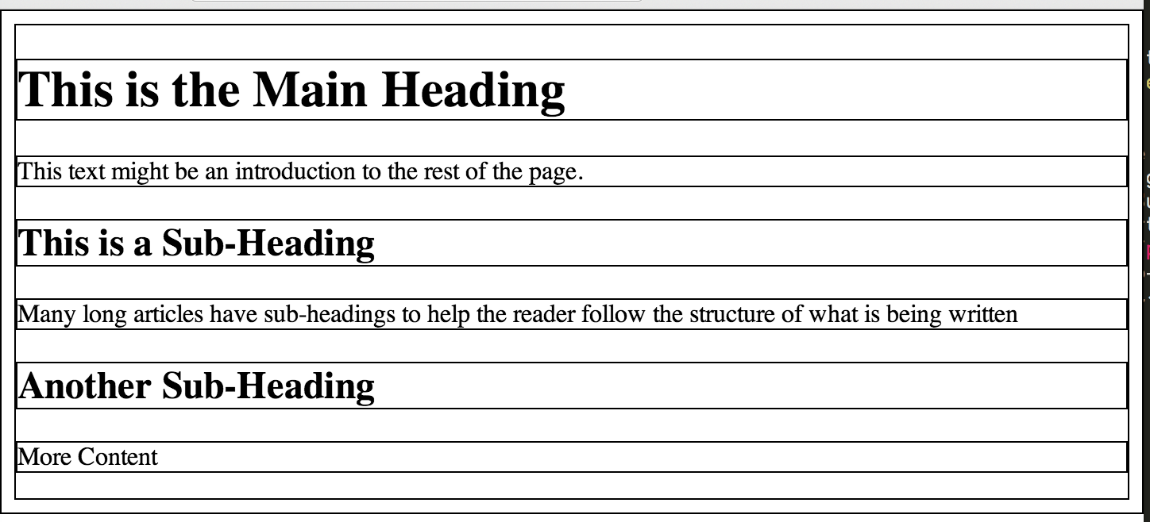
Example From earlier
Here are the invisible boxes from our simple-article.html example

Slide 12
Hows it work?
CSS associates style rules with html elements
E.G.
p {
font-family: Arial;
}
You can use element selectors (e.g. p, a, div) or you can use your own class names and identifiers
.classname { background-color: #fff; } // Defines a class name rule
#identifiername { color: yellow; } // Defines an identifier rule
div { margin-top: 10px; } // Defines a rule on all html div elements

Slide 13
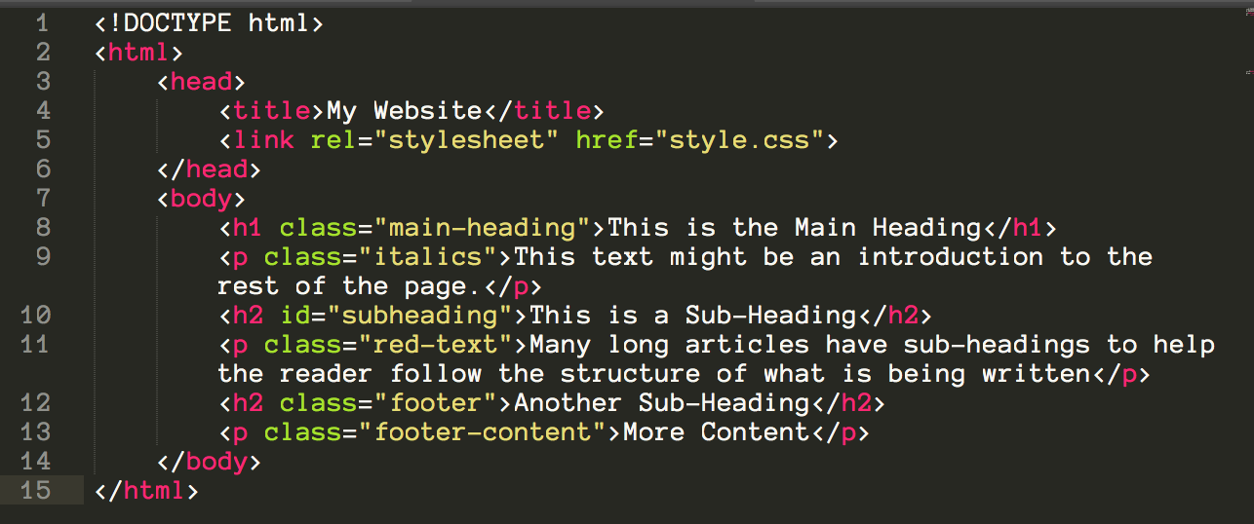
Example – the html

Slide 14
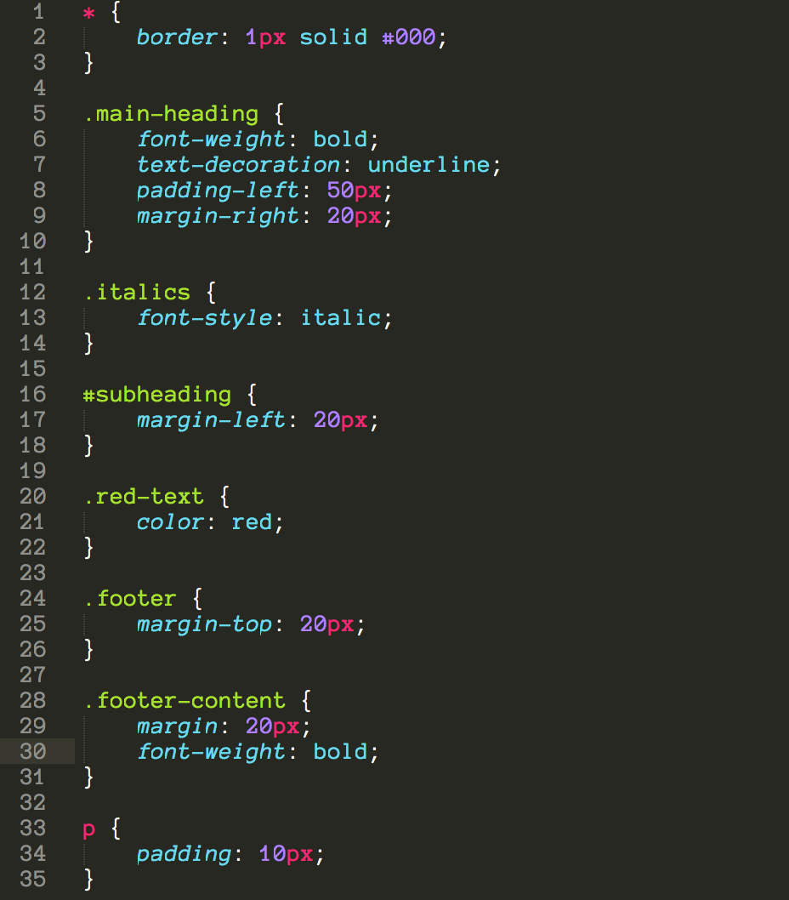
Example - The CSs

Slide 15
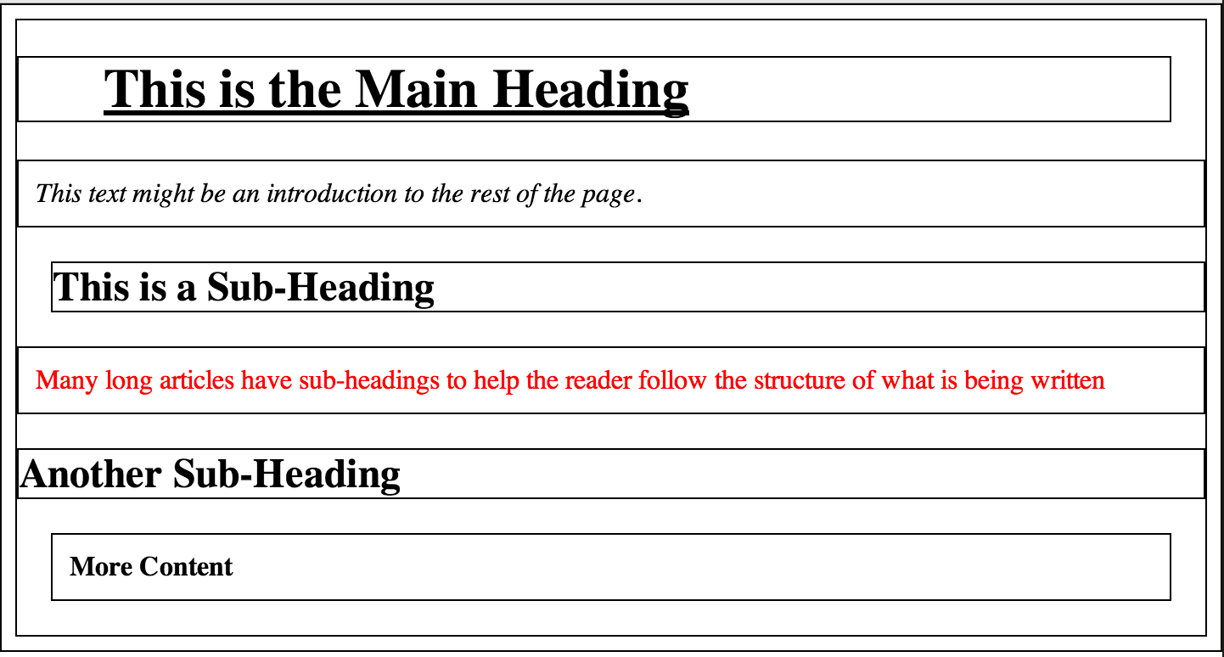
Example – what you see

Slide 16
I know it is ugly but notice
Padding: adds space on the inside of the box
Margin: adds space on the outside of the box
Border: adds space on the boundary of the box
Color: changes text color
Background-color: changes the background color
font-style: can be used to make italics instead of <em> and <i>
font-weight: can be used to make bold instead of <strong> and <b>

Slide 17
External stylesheets
Note that I put the css code in a different file than the html
This is possible because of the link tag in the html header
<link rel=“stylesheet” href=“style.css” type=“text/css” />
It is possible to put css directly in the html, but I highly recommend not doing this as having external stylesheets is much cleaner and easier to maintain
For us this means:
Ideally in your public directory you will create a css folder
This css folder will hold all your stylesheets and you will link to them using something along the lines of
<link rel=“stylesheet” href=“css/style.css” type=“text/css” />

Slide 18
Selectors
Universal Selector: * { … }
Type Selector: h1, h2, h3 { … } // targets all <h1>,<h2>, and <h3> elements
Class Selector: .note { … } // targets all class=“note” elements
ID Selector: #introduction { … } // Targets the element with id=“introduction”
Child Selector: li > a { … } // targets all <a> tags that are direct children of <li>
Descendent Selector: p a { … } // targets all <a> tags that sit inside <p> tags even if they are not direct children. i.e. arbitrarily nested
Adjacent Sibling Selector: h1+p { … } // targets the first <p> after an <h1>
General Sibling Selector: h1~p { … } // would target 2 <p>’s if they were siblings of an <h1> element

Slide 19
Learning css
Learning CSS is largely a thing of becoming familiar with the language and what it offers and diving in and using trial and error until you figure out what works
Codeplayer.com (http://thecodeplayer.com/)
This is a really cool resource for learning high quality css and html
You see people writing html and css in front of you and are able to immediately see the results on the page. Definitely check this out if you want to learn more
Mozilla Developer Network CSS(https://developer.mozilla.org/en-US/learn/css)
Another good resource to learn basic to advanced CSS

Slide 20
Bootstrap
To make our lives easier and to get professional looking website quality we are going to be using Bootstrap ( http://www.getbootstrap.com )
You may also use Foundation ( http://foundation.zurb.com/ )
It does very similar things to bootstrap
I have heard very good things about it
BUT I am not very familiar with the specifics

Slide 21
homework
Go through the bootstrap documentation http://getbootstrap.com
Start to wireframe your websites landing page
Push your bootstrapped (or foundation) page to the same Heroku URL as you entered in the google doc spreadsheet (NOTE: If you have still yet to submit your heroku url please do so now HERE)
Push your most updated code to github

Slide 22
Bootstrap example

Slide 23
Types of Elements
Block Elements

