Slide 1

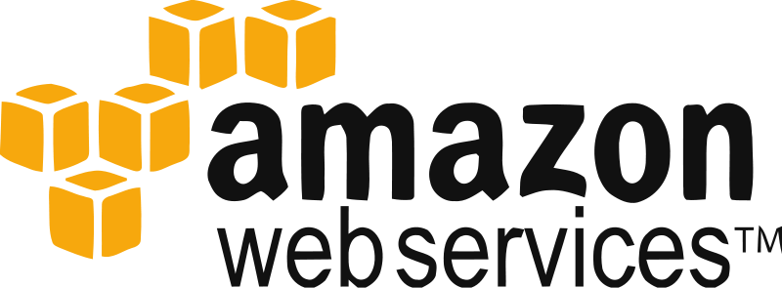
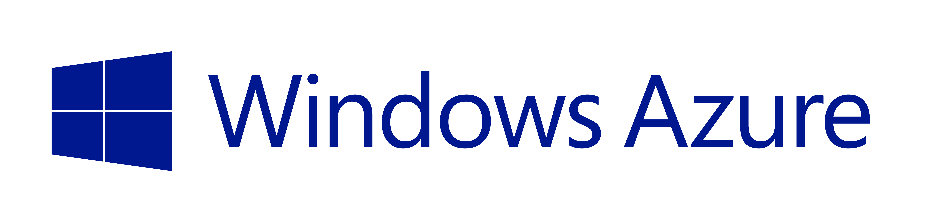

Deployment In The Cloud

Slide 2
What is the cloud
From Wikipedia:
Cloud computing is a phrase used to describe a variety of computing concepts that involve a large number of computers connected through a real-time communication network such as the internet
Another Definition from here
Cloud Computing is a general term for anything that invovles delivering hosted services over the Internet. These are broadly divided into three categories: Infrastructure-as-a-service(Iaas), Platform-as-a-service(Paas), and a Software-as-a-Service(SaaS)

Slide 3
Heroku
Heroku is a PaaS (platform as a service)
Or as they refer to themselves a “Cloud Application Platform”
Heroku allows you to reap the benefits of deploying applications in the cloud without having to worry about system/infrastructure maintenance
This is a different take on cloud computing then AWS

Slide 4
Why do we care
It is WAAYY easier to deploy something on Heroku than AWS
However, if you are not using the free tier chances are that it will be more expensive over time
Heroku offers tons of add-ons that make your life easier
Find the full list here
You deploy things to Heroku using git
Which is great because we are learning it too!

Slide 5
How does it work
Summary
Create an account on Heroku
We will install the Heroku Toolbelt on our vagrant vm’s
Login to Heroku from the command line
Add a few files and make a couple changes to the code
Create our Heroku app
Push our git repository to Heroku and let them handle the hard stuff

Slide 6
Tutorial Time!
Everything we will do today is outlined at this url:
https://devcenter.heroku.com/articles/getting-started-with-nodejs

