Slide 1
Combining SDFs in a single draw call
https://github.com/PsychedelicOrange/byoe/pull/10
- Phani Srikar

Slide 2

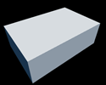
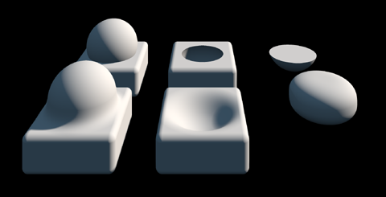
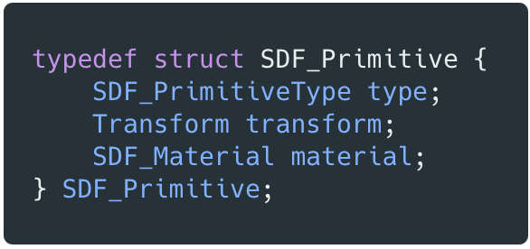
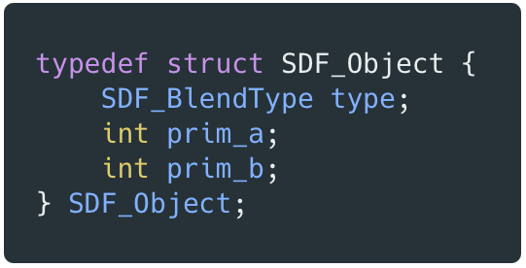
Intro: Terminology
https://github.com/PsychedelicOrange/byoe/pull/10
Primitives: single SDF function drawn in a single draw call.
Object: Made of one or more Primitives/Objects, more complex structure to combing primitives and complex SDF shapes in a single draw call.
Stores a binary hierarchy of node references and combines them using the blend operation
Primitives
Objects made of one or more primitives/objects

Slide 3
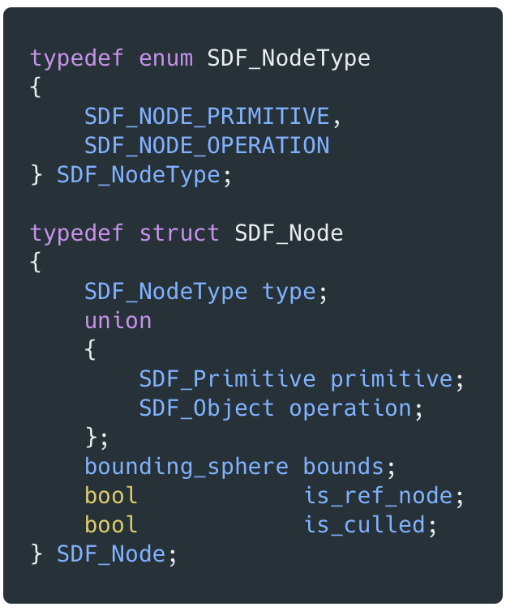
Scene storage: CPU
Scene stores a linear hierarchy of nodes (primitives/objects) on the CPU, this is uploaded to the GPU
Those marked as ref nodes will be skipped from direct draw calls
Ref nodes are used for combining nodes of an object using the blend functions from within the raymarching shader
SDF_Scene
SDF_Node []
draw | skip | skip | draw | skip | skip | skip | skip | draw | draw
prim
prim_ref
prim_ref
object
object_ref
Complex object
made of a primitive and another object

Slide 4
GPU drawing complex SDFs
curr_node_idx:
Tells what node to draw from for the draw call, kind of like bindless access to node data
Consider the following scene nodes view from the GPU’s POV
curr_node_idx
hit_info:
(global variable outside the while loop) stores the depth and material if the rays hit a surface
draw | skip | skip | draw | skip | skip | skip | skip | draw | draw
We simulate a stack on GPU to combing SDFs in a linear fashion
Let’s explore each draw call and GPU shader execution node by node
Basic ops:
Union: min(a, b)
Intersection: max(a, b)
Subtraction: max(a, -b)
+ Smooth versions of above
draw 1: primitive
stack
Scene SDF Calculation raymarch this function as usual

Slide 5
GPU drawing complex SDFs
curr_node_idx:
Tells what node to draw from for the draw call, kind of like bindless access to node data
Consider the following scene nodes view from the GPU’s POV
curr_node_idx
hit_info:
(global variable outside the while loop) stores the depth and material if the rays hit a surface
draw | skip | skip | draw | skip | skip | skip | skip | draw | draw
We simulate a stack on GPU to combing SDFs in a linear fashion
Let’s explore each draw call and GPU shader execution node by node
Basic ops:
Union: min(a, b)
Intersection: max(a, b)
Subtraction: max(a, -b)
+ Smooth versions of above
draw 1: primitive
push
Node
stack
SP = -1
Scene SDF Calculation raymarch this function as usual

Slide 6
GPU drawing complex SDFs
curr_node_idx:
Tells what node to draw from for the draw call, kind of like bindless access to node data
Consider the following scene nodes view from the GPU’s POV
curr_node_idx
hit_info:
(global variable outside the while loop) stores the depth and material if the rays hit a surface
draw | skip | skip | draw | skip | skip | skip | skip | draw | draw
We simulate a stack on GPU to combing SDFs in a linear fashion
Let’s explore each draw call and GPU shader execution node by node
Basic ops:
Union: min(a, b)
Intersection: max(a, b)
Subtraction: max(a, -b)
+ Smooth versions of above
draw 1: primitive
push
Node
stack
Scene SDF Calculation raymarch this function as usual

Slide 7
GPU drawing complex SDFs
curr_node_idx:
Tells what node to draw from for the draw call, kind of like bindless access to node data
Consider the following scene nodes view from the GPU’s POV
curr_node_idx
hit_info:
(global variable outside the while loop) stores the depth and material if the rays hit a surface
draw | skip | skip | draw | skip | skip | skip | skip | draw | draw
We simulate a stack on GPU to combing SDFs in a linear fashion
Let’s explore each draw call and GPU shader execution node by node
Basic ops:
Union: min(a, b)
Intersection: max(a, b)
Subtraction: max(a, -b)
+ Smooth versions of above
draw 1: primitive
push
SP = 0
Increment stack pointer
Node
stack
Scene SDF Calculation raymarch this function as usual

Slide 8
GPU drawing complex SDFs
curr_node_idx:
Tells what node to draw from for the draw call, kind of like bindless access to node data
Consider the following scene nodes view from the GPU’s POV
curr_node_idx
hit_info:
(global variable outside the while loop) stores the depth and material if the rays hit a surface
draw | skip | skip | draw | skip | skip | skip | skip | draw | draw
We simulate a stack on GPU to combing SDFs in a linear fashion
Let’s explore each draw call and GPU shader execution node by node
Basic ops:
Union: min(a, b)
Intersection: max(a, b)
Subtraction: max(a, -b)
+ Smooth versions of above
draw 1: primitive
push
SP = 0
Increment stack pointer
Node
stack
Scene SDF Calculation raymarch this function as usual

Slide 9
GPU drawing complex SDFs
curr_node_idx:
Tells what node to draw from for the draw call, kind of like bindless access to node data
Consider the following scene nodes view from the GPU’s POV
curr_node_idx
hit_info:
(global variable outside the while loop) stores the depth and material if the rays hit a surface
draw | skip | skip | draw | skip | skip | skip | skip | draw | draw
We simulate a stack on GPU to combing SDFs in a linear fashion
Let’s explore each draw call and GPU shader execution node by node
Basic ops:
Union: min(a, b)
Intersection: max(a, b)
Subtraction: max(a, -b)
+ Smooth versions of above
draw 1: primitive
push
pop
while sp >= 0 : sp--
stack
SP = -1
Scene SDF Calculation raymarch this function as usual

Slide 10
GPU drawing complex SDFs
curr_node_idx:
Tells what node to draw from for the draw call, kind of like bindless access to node data
Consider the following scene nodes view from the GPU’s POV
curr_node_idx
hit_info:
(global variable outside the while loop) stores the depth and material if the rays hit a surface
draw | skip | skip | draw | skip | skip | skip | skip | draw | draw
We simulate a stack on GPU to combing SDFs in a linear fashion
Let’s explore each draw call and GPU shader execution node by node
Basic ops:
Union: min(a, b)
Intersection: max(a, b)
Subtraction: max(a, -b)
+ Smooth versions of above
draw 1: primitive
hit_info
default: RAY_MAX_STEP
push
pop
Node
Node.type
while sp >= 0 : sp--
stack
SP = -1
Scene SDF Calculation raymarch this function as usual

Slide 11
GPU drawing complex SDFs
curr_node_idx:
Tells what node to draw from for the draw call, kind of like bindless access to node data
Consider the following scene nodes view from the GPU’s POV
curr_node_idx
hit_info:
(global variable outside the while loop) stores the depth and material if the rays hit a surface
draw | skip | skip | draw | skip | skip | skip | skip | draw | draw
We simulate a stack on GPU to combing SDFs in a linear fashion
Let’s explore each draw call and GPU shader execution node by node
Basic ops:
Union: min(a, b)
Intersection: max(a, b)
Subtraction: max(a, -b)
+ Smooth versions of above
draw 1: primitive
hit_info
default: RAY_MAX_STEP
push
pop
Node
Node.type
while sp >= 0 : sp--
prim
stack
SP = -1
Scene SDF Calculation raymarch this function as usual

Slide 12
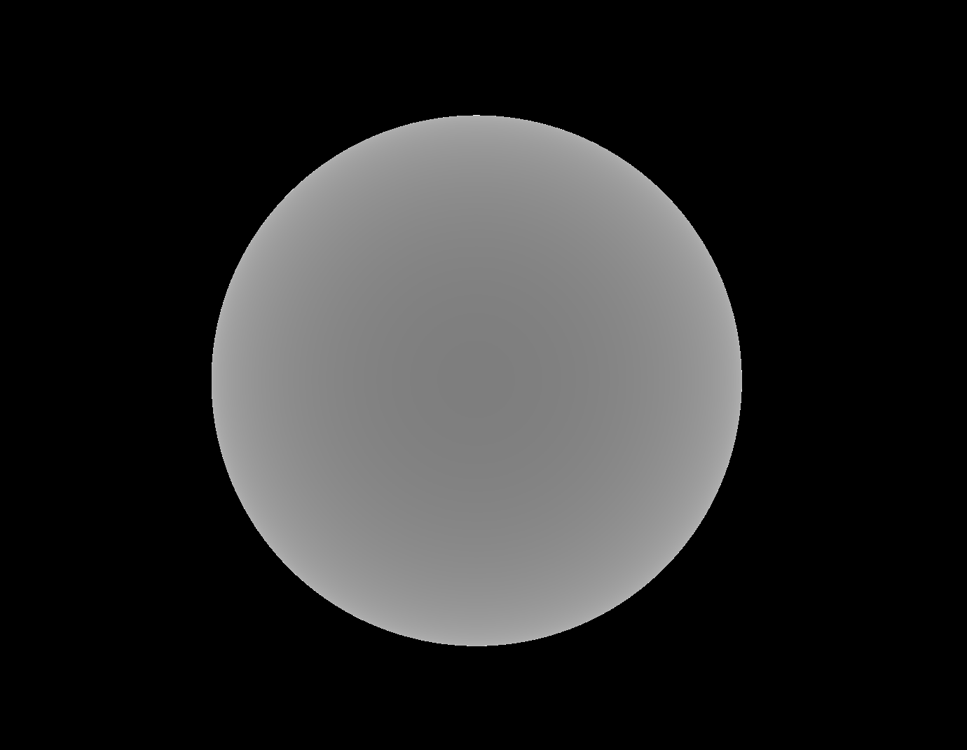
GPU drawing complex SDFs
curr_node_idx:
Tells what node to draw from for the draw call, kind of like bindless access to node data
Consider the following scene nodes view from the GPU’s POV
curr_node_idx
hit_info:
(global variable outside the while loop) stores the depth and material if the rays hit a surface
draw | skip | skip | draw | skip | skip | skip | skip | draw | draw
We simulate a stack on GPU to combing SDFs in a linear fashion
Let’s explore each draw call and GPU shader execution node by node
Basic ops:
Union: min(a, b)
Intersection: max(a, b)
Subtraction: max(a, -b)
+ Smooth versions of above
draw 1: primitive
hit_info
default: RAY_MAX_STEP
push
pop
Node
Node.type
while sp >= 0 : sp--
prim
depth = evalSDF(Node)
So, any SDF combination starts with a Union (∪) with RAY_MAX_STEP, since in this case there’s just one, we evaluate and return once sp < 0.
stack
SP = -1
Scene SDF Calculation raymarch this function as usual

Slide 13
GPU drawing complex SDFs
curr_node_idx:
Tells what node to draw from for the draw call, kind of like bindless access to node data
Consider the following scene nodes view from the GPU’s POV
curr_node_idx
hit_info:
(global variable outside the while loop) stores the depth and material if the rays hit a surface
draw | skip | skip | draw | skip | skip | skip | skip | draw | draw
We simulate a stack on GPU to combing SDFs in a linear fashion
Let’s explore each draw call and GPU shader execution node by node
Basic ops:
Union: min(a, b)
Intersection: max(a, b)
Subtraction: max(a, -b)
+ Smooth versions of above
draw 1: primitive
hit_info
default: RAY_MAX_STEP
push
pop
Node
Node.type
while sp >= 0 : sp--
prim
depth = evalSDF(Node)
So, any SDF combination starts with a Union (∪) with RAY_MAX_STEP, since in this case there’s just one, we evaluate and return once sp < 0.
stack
SP = -1
Node . blend
hit_info
= depth ∪ RAY_MAX_STEP
= depth f(sphere)
Scene SDF Calculation raymarch this function as usual

Slide 14
GPU drawing complex SDFs
curr_node_idx
draw | skip | skip | draw | skip | skip | skip | skip | draw | draw
draw 2: object
hit_info
push
Node
stack
SP = -1
Scene SDF Calculation raymarch this function as usual

Slide 15
GPU drawing complex SDFs
curr_node_idx
draw | skip | skip | draw | skip | skip | skip | skip | draw | draw
draw 2: object
hit_info
push
Node
stack
Scene SDF Calculation raymarch this function as usual

Slide 16
GPU drawing complex SDFs
curr_node_idx
draw | skip | skip | draw | skip | skip | skip | skip | draw | draw
draw 2: object
hit_info
push
SP = 0
Increment stack pointer
Node
stack
Scene SDF Calculation raymarch this function as usual

Slide 17
GPU drawing complex SDFs
curr_node_idx
draw | skip | skip | draw | skip | skip | skip | skip | draw | draw
draw 2: object
hit_info
push
Node
stack
Scene SDF Calculation raymarch this function as usual

Slide 18
GPU drawing complex SDFs
curr_node_idx
draw | skip | skip | draw | skip | skip | skip | skip | draw | draw
draw 2: object
hit_info
= RAY_MAX_STEP
push
pop
object
Node
Node.type
while sp >= 0 : sp--
stack
SP = -1
Scene SDF Calculation raymarch this function as usual

Slide 19
GPU drawing complex SDFs
curr_node_idx
draw | skip | skip | draw | skip | skip | skip | skip | draw | draw
draw 2: object
hit_info
= RAY_MAX_STEP
push
pop
object
Node
Node.type
while sp >= 0 : sp--
prim_a
push
prim_b
stack
SP = -1
Scene SDF Calculation raymarch this function as usual

Slide 20
GPU drawing complex SDFs
curr_node_idx
draw | skip | skip | draw | skip | skip | skip | skip | draw | draw
draw 2: object
hit_info
= RAY_MAX_STEP
push
pop
object
Node
Node.type
while sp >= 0 : sp--
prim_a
push
prim_b
stack
Scene SDF Calculation raymarch this function as usual

Slide 21
GPU drawing complex SDFs
curr_node_idx
draw | skip | skip | draw | skip | skip | skip | skip | draw | draw
draw 2: object
hit_info
= RAY_MAX_STEP
push
pop
object
Node
Node.type
while sp >= 0 : sp--
prim_a
push
prim_b
Node
stack
Scene SDF Calculation raymarch this function as usual

Slide 22
GPU drawing complex SDFs
curr_node_idx
draw | skip | skip | draw | skip | skip | skip | skip | draw | draw
draw 2: object
hit_info
= RAY_MAX_STEP
push
pop
object
Node
Node.type
while sp >= 0 : sp--
prim_a
Node
push
prim_b
Node
stack
Scene SDF Calculation raymarch this function as usual

Slide 23
GPU drawing complex SDFs
curr_node_idx
draw | skip | skip | draw | skip | skip | skip | skip | draw | draw
draw 2: object
hit_info
= RAY_MAX_STEP
push
pop
object
Node
Node.type
while sp >= 0 : sp--
SP = 1
prim_a
Node
push
prim_b
Node
stack
Scene SDF Calculation raymarch this function as usual

Slide 24
GPU drawing complex SDFs
curr_node_idx
draw | skip | skip | draw | skip | skip | skip | skip | draw | draw
draw 2: object
hit_info
= RAY_MAX_STEP
push
pop
object
Node
Node.type
while sp >= 0 : sp--
SP = 1
prim_a
Node
prim_b
Node
stack
Scene SDF Calculation raymarch this function as usual

Slide 25
GPU drawing complex SDFs
curr_node_idx
draw | skip | skip | draw | skip | skip | skip | skip | draw | draw
draw 2: object
hit_info
= RAY_MAX_STEP
push
pop
Node
Node.type
while sp >= 0 : sp--
SP = 1
Node
Node
stack
Scene SDF Calculation raymarch this function as usual

Slide 26
GPU drawing complex SDFs
curr_node_idx
draw | skip | skip | draw | skip | skip | skip | skip | draw | draw
draw 2: object
hit_info
= RAY_MAX_STEP
push
pop
Node
Node.type
while sp >= 0 : sp--
Node
SP = 1
Node
stack
Scene SDF Calculation raymarch this function as usual

Slide 27
GPU drawing complex SDFs
curr_node_idx
draw | skip | skip | draw | skip | skip | skip | skip | draw | draw
draw 2: object
hit_info
= RAY_MAX_STEP
push
pop
Node
Node.type
while sp >= 0 : sp--
Node
Node
stack
Scene SDF Calculation raymarch this function as usual

Slide 28
GPU drawing complex SDFs
curr_node_idx
draw | skip | skip | draw | skip | skip | skip | skip | draw | draw
draw 2: object
hit_info
= RAY_MAX_STEP
push
pop
Node
Node.type
while sp >= 0 : sp--
Node
SP = 0
Node
stack
Scene SDF Calculation raymarch this function as usual

Slide 29
GPU drawing complex SDFs
curr_node_idx
draw | skip | skip | draw | skip | skip | skip | skip | draw | draw
draw 2: object
hit_info
= RAY_MAX_STEP
push
pop
Node
Node.type
while sp >= 0 : sp--
Node
SP = 0
Node
stack
Scene SDF Calculation raymarch this function as usual

Slide 30
GPU drawing complex SDFs
curr_node_idx
draw | skip | skip | draw | skip | skip | skip | skip | draw | draw
draw 2: object
hit_info
= RAY_MAX_STEP
push
pop
Node
Node.type
while sp >= 0 : sp--
Node
prim
SP = 0
Node
stack
Scene SDF Calculation raymarch this function as usual

Slide 31
GPU drawing complex SDFs
curr_node_idx
draw | skip | skip | draw | skip | skip | skip | skip | draw | draw
draw 2: object
hit_info
= RAY_MAX_STEP
push
pop
Node
Node.type
while sp >= 0 : sp--
Node
prim
For all the nodes in the stack, as we combine the SDFs node after node, the first operations is a Union (∪) with RAY_MAX_STEP, basically the value will be itself. So, for the first node in the stack set the node.blend as ∪ and use the node.blend for the remaining of the nodes.
SP = 0
Node
depth = evalSDF(Node)
stack
Node . blend
hit_info
= hit_info ∪ depth
= depth f(sphere)
Scene SDF Calculation raymarch this function as usual

Slide 32
GPU drawing complex SDFs
curr_node_idx
draw | skip | skip | draw | skip | skip | skip | skip | draw | draw
draw 2: object
hit_info
= depth f(sphere)
push
pop
Node
Node.type
while sp >= 0 : sp--
Node
SP = 0
Node
stack
Scene SDF Calculation raymarch this function as usual

Slide 33
GPU drawing complex SDFs
curr_node_idx
draw | skip | skip | draw | skip | skip | skip | skip | draw | draw
draw 2: object
hit_info
= depth f(sphere)
push
pop
Node
Node.type
while sp >= 0 : sp--
Node
Node
stack
Scene SDF Calculation raymarch this function as usual

Slide 34
GPU drawing complex SDFs
curr_node_idx
draw | skip | skip | draw | skip | skip | skip | skip | draw | draw
draw 2: object
hit_info
= depth f(sphere)
push
pop
Node
Node.type
while sp >= 0 : sp--
Node
Node
stack
SP = -1
Scene SDF Calculation raymarch this function as usual

Slide 35
GPU drawing complex SDFs
curr_node_idx
draw | skip | skip | draw | skip | skip | skip | skip | draw | draw
draw 2: object
hit_info
= depth f(sphere)
push
pop
Node
Node.type
while sp >= 0 : sp--
Node
stack
SP = -1
Scene SDF Calculation raymarch this function as usual

Slide 36
GPU drawing complex SDFs
curr_node_idx
draw | skip | skip | draw | skip | skip | skip | skip | draw | draw
draw 2: object
hit_info
= depth f(sphere)
push
pop
Node
Node.type
while sp >= 0 : sp--
Node
prim
stack
SP = -1
Scene SDF Calculation raymarch this function as usual

Slide 37
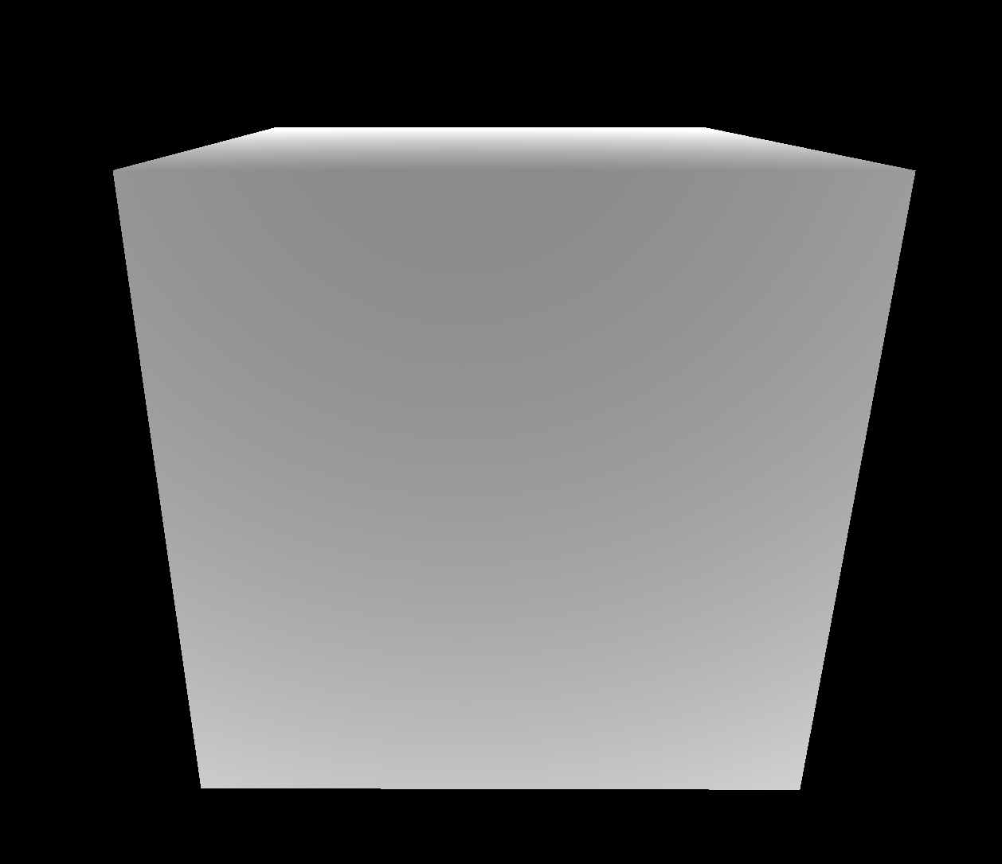
GPU drawing complex SDFs
curr_node_idx
draw | skip | skip | draw | skip | skip | skip | skip | draw | draw
draw 2: object
hit_info
= depth f(sphere)
push
pop
Node
Node.type
while sp >= 0 : sp--
Node
prim
stack
SP = -1
depth = evalSDF(Node)
hit_info
= hit_info ∩ depth f(cube)
= depth f(sphere) ∩ depth f(cube)
= max(f(sphere), f(cube))
Scene SDF Calculation raymarch this function as usual

Slide 38
GPU drawing complex SDFs
curr_node_idx
draw | skip | skip | draw | skip | skip | skip | skip | draw | draw
draw 2: object
hit_info
push
pop
Node
Node.type
while sp >= 0 : sp--
Node
prim
stack
SP = -1
depth = evalSDF(Node)
hit_info
= hit_info ∩ depth f(cube)
= depth f(sphere) ∩ depth f(cube)
= max(f(sphere), f(cube))
Scene SDF Calculation raymarch this function as usual

Slide 39
GPU drawing complex SDFs
curr_node_idx
draw | skip | skip | draw | skip | skip | skip | skip | draw | draw
draw 2: object
hit_info
= max(f(sphere), f(cube))
push
pop
Node
Node.type
while sp >= 0 : sp--
Node
prim
stack
SP = -1
depth = evalSDF(Node)
hit_info
= hit_info ∩ depth f(cube)
= depth f(sphere) ∩ depth f(cube)
= max(f(sphere), f(cube))
Scene SDF Calculation raymarch this function as usual

Slide 40
Optimizing Ray Marching shader
PS to CS: Moving the shader from a pixel shader to compute shader will results in a faster shader because a CS doesn’t follow ordered exports and can exit early if some rays don’t hit anything and can perform texture writes in any arbitrary order.
Improving Occupancy:

