Slide 1
UNIVERSITY OF NATURAL SICIENCE
REPORT
Sorting Algorithms
Data Structure and Algorithms
Faculty of Information Technology

Slide 2
Sorting Algorithms Overview
Selection sort
Insertion sort
Bubble sort
Quick sort
Merge sort
Heap sort
Radix sort
Counting sort
Shell sort
Shaker sort
Flash sort
Binary Insertion sort

Slide 3

ID: 1753025
I’m
Quoc An
CLASS 18CLC2

Slide 4
SELECTION SORT
IDEA – ALGORITHM – ALGORITHMS REVIEW
DATA STRUCTURE AND ALGORITHMS
CLASS 18CLC2

Slide 5
IDEA
Choose a smallest in N elements of an array, bring it to the first position of an array.
After that, we don’t care about this element anymore. Let see this array only have N-1 elements and start from the second position.
Repeat this process until this array has one element left.
Let summarize it following these steps.
Step 1: let i = 1;
Step 2: Find the smallest element a[min] in the current array from i to n.
Step 3: Change position of a[min] and a[i]
Step 4: If i < n then i = i +1. Repeat step 2
Otherwise: Stop (n -1 elements place on right position)
DATA STRUCTURE AND ALGORITHMS
CLASS 18CLC2

Slide 6
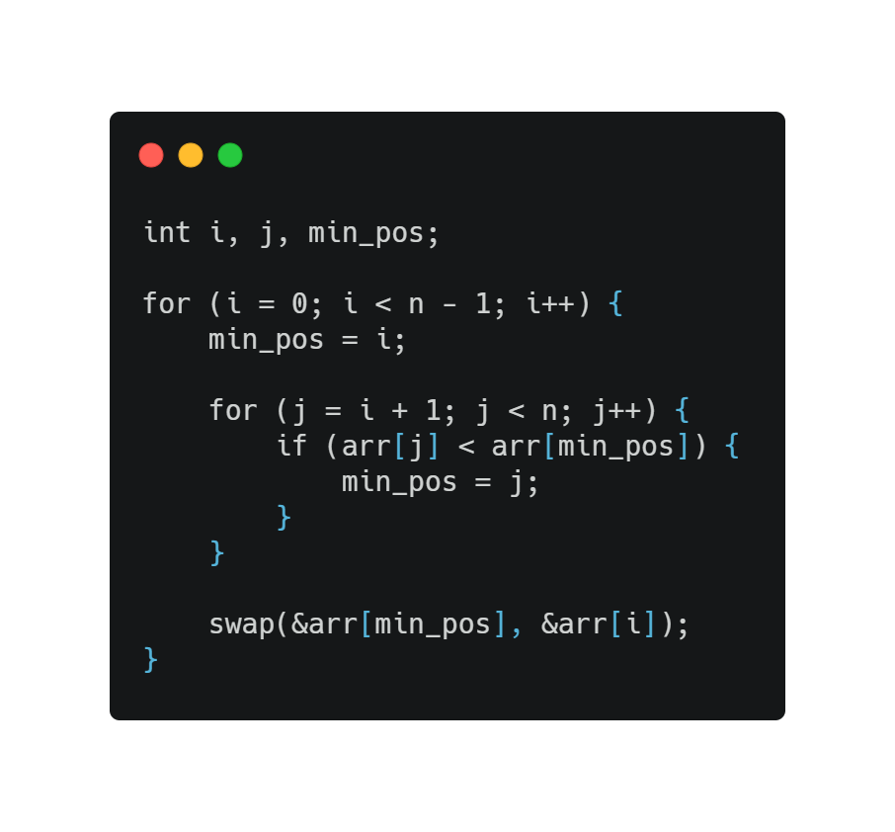
Selection Sort
ALGORITM
DATA STRUCTURE AND ALGORITHMS
CLASS 18CLC2

Slide 7
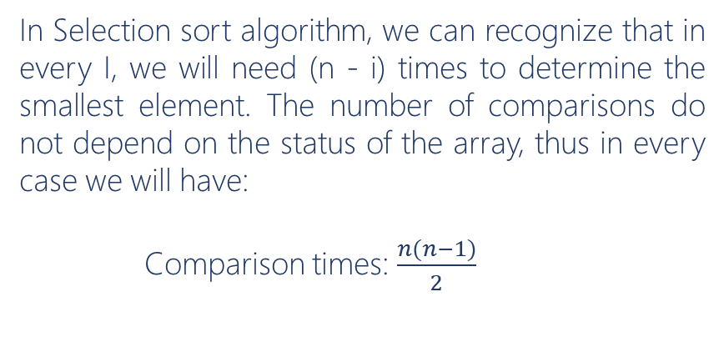
ALGORITHM REVIEW
In Selection sort algorithm, we can recognize that in every I, we will need (n - i) times to determine the smallest element. The number of comparisons do not depend on the status of the array, thus in every case we will have:
Comparison times: $\frac{n(n−1)}{2}$
Case | Time complexity
Best | O(n²)
Worst | O(n²)
It is nested two loop
DATA STRUCTURE AND ALGORITHMS
CLASS 18CLC2

Slide 8
Selection Sort
GRAPH

Slide 9
Selection Sort
GRAPH

Slide 10
Selection Sort
GRAPH

Slide 11
Selection Sort
GRAPH

Slide 12
INSERTION SORT
IDEA – ALGORITHM – ALGORITHMS REVIEW
DATA STRUCTURE AND ALGORITHMS
CLASS 18CLC2

Slide 13
IDEA
Find the way to insert a[i] into suitable position in sorted part to have a new array a₁, a₂,.., a_{n} a is orderly.. This is the position between 2 elements a_{m-1} and a_{m} with a_{m-1} <a_{i} < a_{m} (1<=m<=i)
Given an array with n elements, we can know that this array already have a₁ is sorted, then we add a₂ into the sorted part a1, then we will have a₁, a₂ is sorted. Continue doing this until add the element an into sorted part a₁, a₂ ,…a_{n-1}.
At last, we will have the sorted array with n elements.
Step 1: let i = 2; //suppose that we already had part a[1] is sorted.
Step 2: x = a[i], Find the position in sorted part a[1] to a[i-1] to insert a[i] into it.
Step 3: Displace all elements from a[pos] to a[i-1] to right 1 unit to take place for a[i] get in.
Step 4: a[pos] = x
Step 5: i = i +1;
If i<=n : Repeat step 2
Else: Stop
DATA STRUCTURE AND ALGORITHMS
CLASS 18CLC2

Slide 14
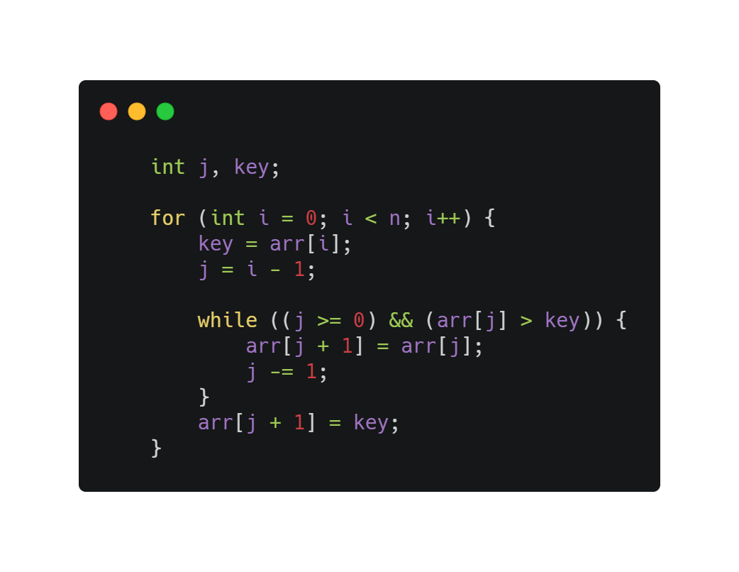
Insertion Sort
ALGORITM
DATA STRUCTURE AND ALGORITHMS
CLASS 18CLC2

Slide 15
ALGORITHM REVIEW
In Insertion sort algorithm, the comparisons appear in every while loop to find the position and every time determine the position, if the position is checking not suitable, we will displace element a[pos].
This algorithm will do n-1 while loop and the number of comparison depend on the status of the array (random, sorted, reverse or nearly sorted data).
Best case of insertion sort is O(n) when array is already sorted
Case | Time complexity
Best | O(n)
Worst | O(n²)
Average | O(n²)
DATA STRUCTURE AND ALGORITHMS
CLASS 18CLC2

Slide 16
Insertion Sort
GRAPH

Slide 17
Insertion Sort
GRAPH

Slide 18
Insertion Sort
GRAPH

Slide 19
Insertion Sort
GRAPH

Slide 20
BUBBLE SORT
IDEA – ALGORITHM – ALGORITHMS REVIEW
DATA STRUCTURE AND ALGORITHMS
CLASS 18CLC2

Slide 21
IDEA
Step 1: let i = 0;
Step 2: j = i;
When j < n -1
if a[j] > a[j + 1]: swap 2 elements
j += 1;
Step 3: i++;
If i>n-1: Stop
else do Step 2
Start from the begin or the end of the array, change the position of pair elements to bring the smaller (bigger) element to the beginning of the array or the end of the array.
Continue doing this until we have a sorted array.
DATA STRUCTURE AND ALGORITHMS
CLASS 18CLC2

Slide 22
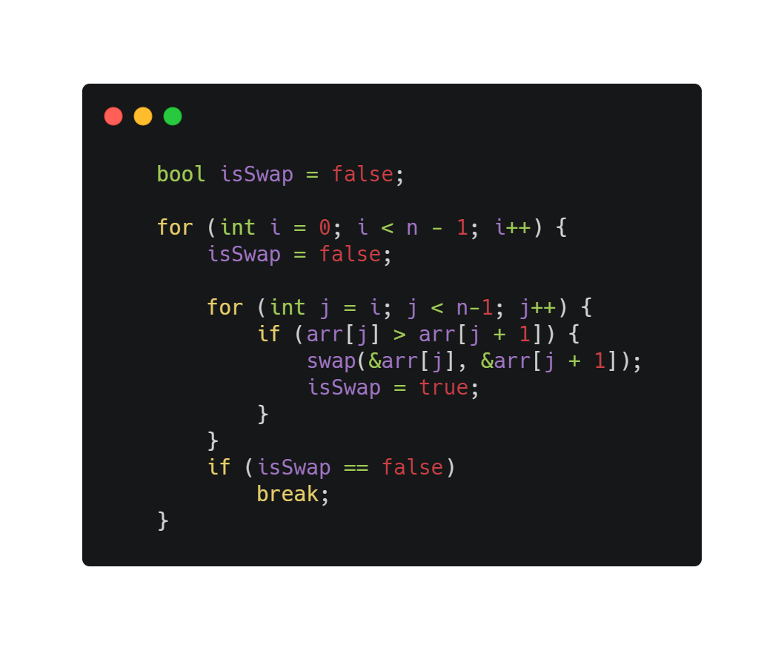
Bubble Sort
ALGORITM
DATA STRUCTURE AND ALGORITHMS
CLASS 18CLC2

Slide 23
ALGORITHM REVIEW
In bubble sort algorithm, the number of comparisons do not depend on the status of the array.
Disadvantage: Can not recognize the sorted array
But we can add one variable: bool isSwap= false, if we don’t do any swap in the first run, we will break because the array is already sorted.
So, we can reduce the running time in this case.
Case | Time complexity
Best | O(n)
Worst | O(n²)
Average | O(n²)
DATA STRUCTURE AND ALGORITHMS
CLASS 18CLC2

Slide 24
Bubble Sort
GRAPH

Slide 25
Bubble Sort
GRAPH

Slide 26
Bubble Sort
GRAPH

Slide 27
Bubble Sort
GRAPH

Slide 28
QUICK SORT
IDEA – ALGORITHM – ALGORITHMS REVIEW
DATA STRUCTURE AND ALGORITHMS
CLASS 18CLC2

Slide 29
IDEA
Step 1: choose pivot as a random a[k] in array, left < k < right.
pivot = a[k], l = left, r = right;
Step 2: Find out and fix a[l], a[r] in wrong place.
a. When a[l] < pivot, i++;
b. When a[r] > pivot, j--;
c. If l<r and a[l] > a[r], swap(a[l], a[r]);
Step 3:
if l < r: repeat step 2;
if l >= r: stop
Quick sort is a divide-and-conquer algorithm, it will partition the array into 2 parts:
Part 1: Include elements a₁,..,a_{i} smaller than x
Part 2: Include elements a_{i},..,a_{n} bigger than x
X is a pivot as we chose, after partition, the array will be separated to 3 parts:
a_{k} < x
a_{k} = x
a_{k} > x
DATA STRUCTURE AND ALGORITHMS
CLASS 18CLC2

Slide 30
Quick Sort
ALGORITM
DATA STRUCTURE AND ALGORITHMS
CLASS 18CLC2

Slide 31
ALGORITHM REVIEW
In Quick sort algorithm, we can choose any elements as a pivot. Usually we will choose a middle pivot = (l+r)/2.
If we choose the first or last elements in the array, the worst case would happen when the data is sorted, reverse or nearly sorted. So in these cases, we should choose the pivot as the middle element to solve this problem.
Case | Time complexity
Best | O(n.logn)
Worst | O(n²)
Average | O(n.logn)
DATA STRUCTURE AND ALGORITHMS
CLASS 18CLC2

Slide 32
Quick Sort
GRAPH

Slide 33
Quick Sort
GRAPH

Slide 34
Quick Sort
GRAPH

Slide 35
Quick Sort
GRAPH

Slide 36
MERGE SORT
IDEA – ALGORITHM – ALGORITHMS REVIEW
DATA STRUCTURE AND ALGORITHMS
CLASS 18CLC2

Slide 37
IDEA
Step 1: let m= (left + right) /2;
Step 2: Separate an array into 2 sub-array
array 1: from left to m
array 2: from m+1 to right
Step 3: if (left < right) do step 2;
else stop separating and move to step 4
Step 4: Merge these sub-array to create a sorted list by compare each elements in sub-arrays to place in right position
Merge sort is a divide-and-conquer algorithm based on idea of breaking down a list into several sub-lists until each sub-list contain single element.
After that, we will merge these sub lists together to create a new sorted list.
DATA STRUCTURE AND ALGORITHMS
CLASS 18CLC2

Slide 38
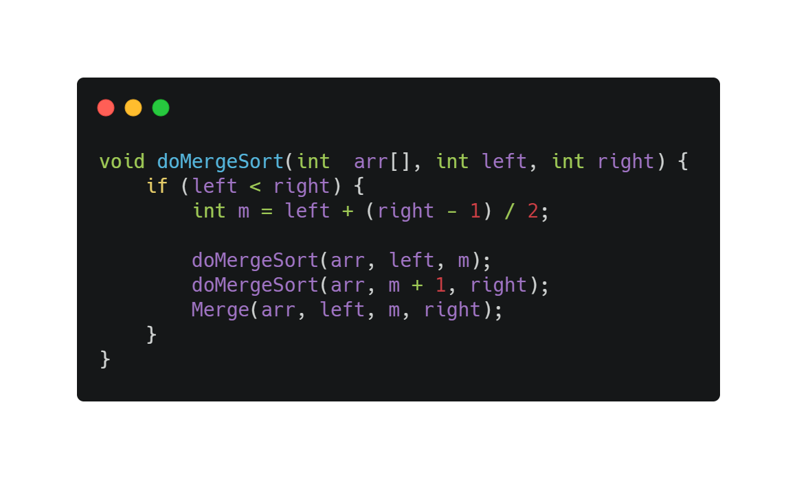
Merge Sort
ALGORITM
DATA STRUCTURE AND ALGORITHMS
CLASS 18CLC2

Slide 39
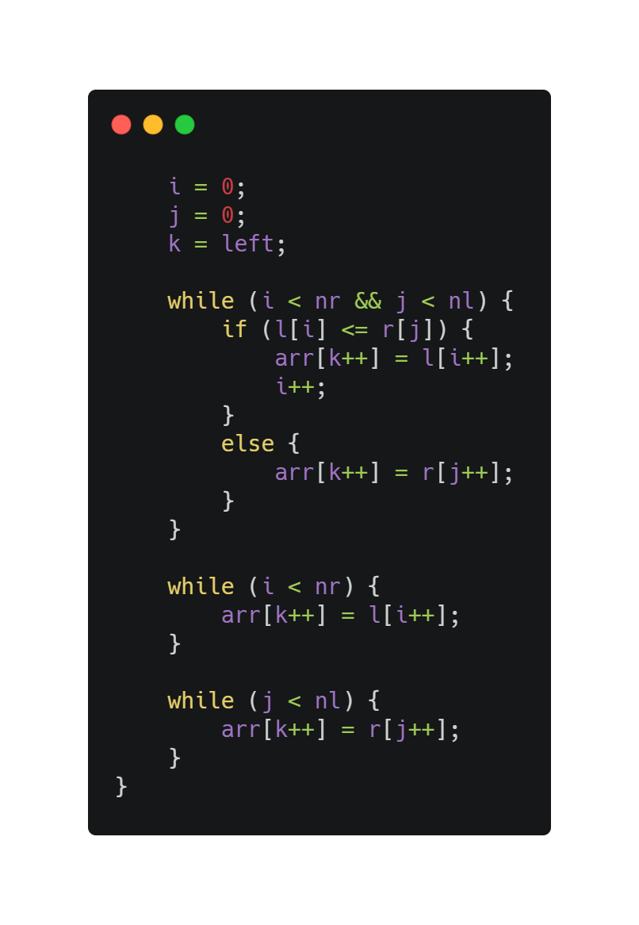
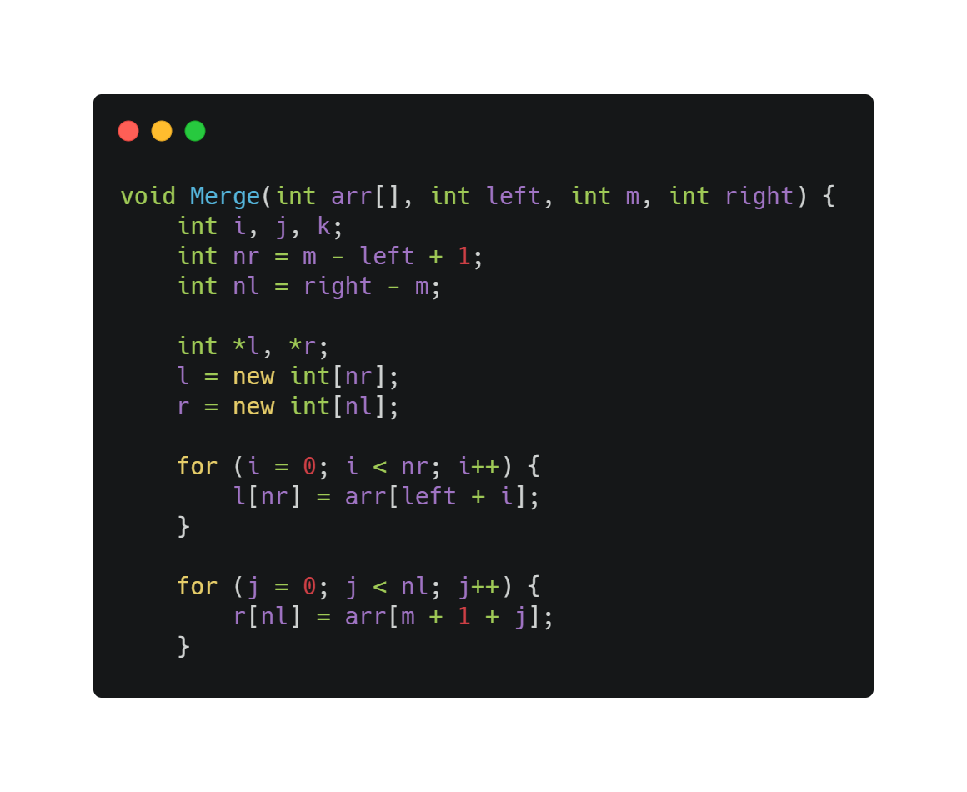
Merge Sort
ALGORITM
Merge Function
DATA STRUCTURE AND ALGORITHMS
CLASS 18CLC2

Slide 40
ALGORITHM REVIEW
In Merge sort algorithm, the cost when we use Merge Sort always is O(nlog₂n) because it don’t care about the status of this array (sorted, reverse, …)
So this is a disadvantage of Merge sort. In real life, less people use this merge sort, people use the improved version of this merge sort called Natural Merge Sort.
Case | Time complexity
Best | O(nlog₂n)
Worst | O(nlog₂n)
Average | O(nlog₂n)
DATA STRUCTURE AND ALGORITHMS
CLASS 18CLC2

Slide 41
Merge Sort
GRAPH

Slide 42
Merge Sort
GRAPH

Slide 43
Merge Sort
GRAPH

Slide 44
Merge Sort
GRAPH

Slide 45
HEAP SORT
IDEA – ALGORITHM – ALGORITHMS REVIEW
DATA STRUCTURE AND ALGORITHMS
CLASS 18CLC2

Slide 46
IDEA
Step 1: Build a max-heap (min-heap)
Step 2: let i = n-1
Max-heap: swap the biggest element to the end of an array and rebuild max-heap with size (n-1)
Min-heap: swap the smallest element to the end of an array and rebuild min-heap with size (n-1)
Step 3: Continue doing step 2 until i = 0;
//end of array
Sorting our data by using heap structure(max-heap and min-heap).
With max-heap we will have ascending data when sorting data using this structure.
And min-heap will create a descending data.
DATA STRUCTURE AND ALGORITHMS
CLASS 18CLC2

Slide 47
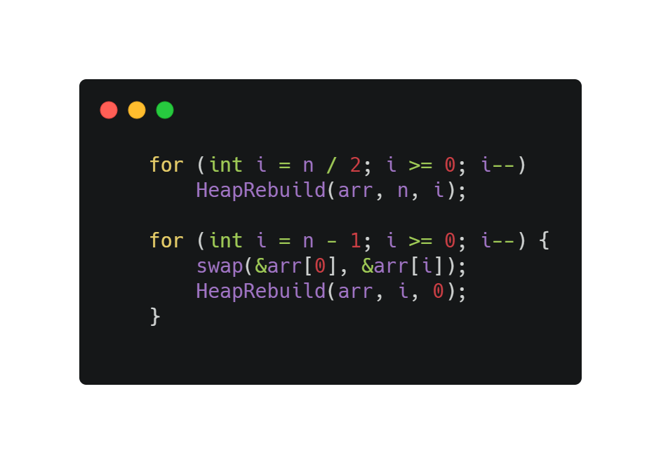
Heap Sort
ALGORITM
DATA STRUCTURE AND ALGORITHMS
CLASS 18CLC2

Slide 48
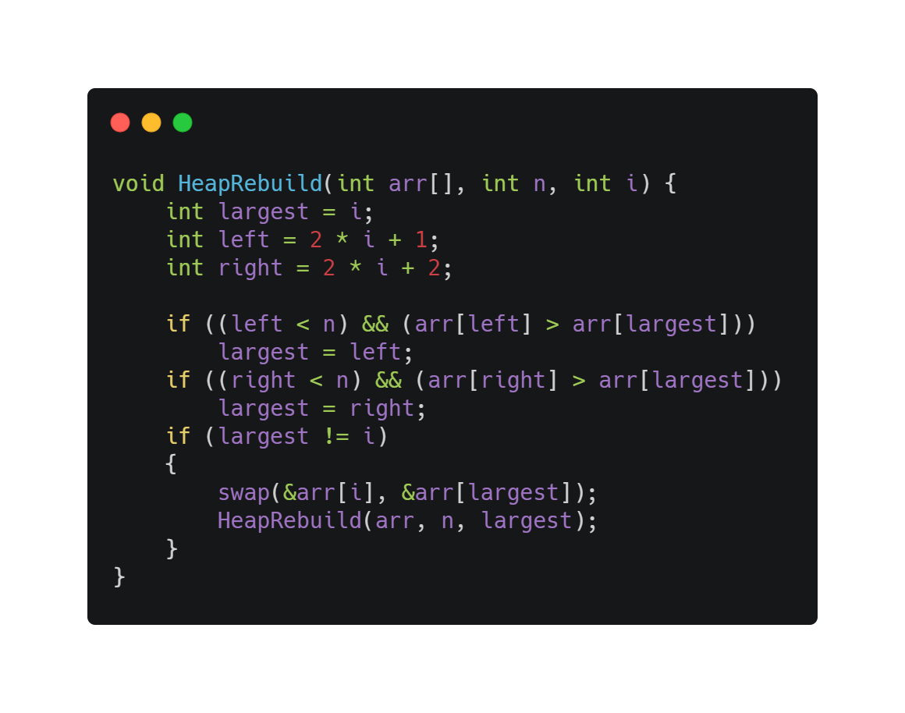
Heap Sort
ALGORITM
DATA STRUCTURE AND ALGORITHMS
CLASS 18CLC2

Slide 49
ALGORITHM REVIEW
In Heap sort algorithm, HeapRebuild has complexity O(logn), build max-heap has complexity O(n) and we run HeapRebuild (n-1) times in heap_sort func, therefore complexity of heap_sort function is O(nlogn).
Case | Time complexity
Best | O(nlogn)
Worst | O(nlogn)
Average | O(nlogn)
DATA STRUCTURE AND ALGORITHMS
CLASS 18CLC2

Slide 50
Heap Sort
GRAPH

Slide 51
Heap Sort
GRAPH

Slide 52
Heap Sort
GRAPH

Slide 53
Heap Sort
GRAPH

Slide 54
RADIX SORT
IDEA – ALGORITHM – ALGORITHMS REVIEW
DATA STRUCTURE AND ALGORITHMS
CLASS 18CLC2

Slide 55
IDEA
For each digit where varies from the least significant digit to the most significant digit of a number.
Sort input array using count sort algorithm according to nth digit.
Step 1: Find max in this array
Step 2: Sort the input array according to the one's digit.
Step 3: Sort according to the ten's digit.
Step 3: Continue sorting to nth digit of max value
Step 4: At the sorting nth time, we will get the sorted array.
Radix sort is not a comparison based sorting algorithm, it is based on the principle of mail classification. Thus, it also has another call Postman’s sort.
And the idea of Radix sort is to extend the Counting Sort algorithm to get a better time complexity.
DATA STRUCTURE AND ALGORITHMS
CLASS 18CLC2

Slide 56
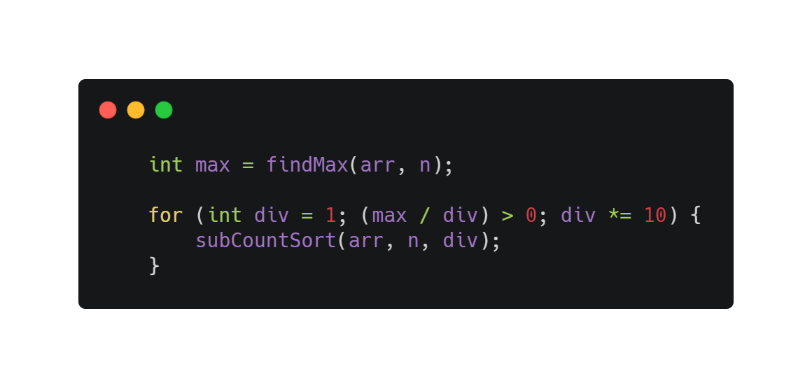
Radix Sort
ALGORITM
DATA STRUCTURE AND ALGORITHMS
CLASS 18CLC2

Slide 57
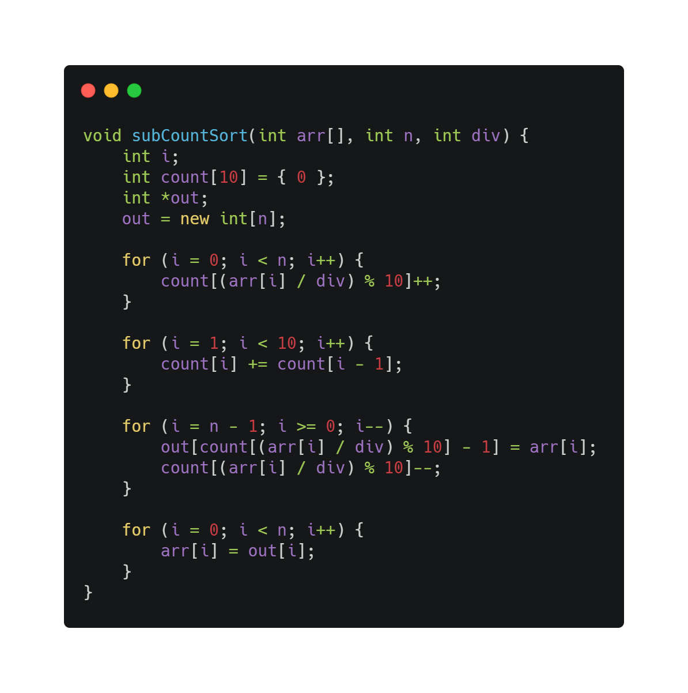
Radix Sort
ALGORITM
DATA STRUCTURE AND ALGORITHMS
CLASS 18CLC2

Slide 58
ALGORITHM REVIEW
With an array have n elements and each elements have k digits. The radix sort will do k times to place the number into the sub array following it digits. So the cost for this is O(2nk) = O(n).
The complexity of this algorithm is linear, so it is efficiency when we sort the huge array.
This algorithm do not have worst case and best case. Every element will be placed into the array with the same cost if they have same digits.
Case | Time complexity
Best | O(d(n+k))
Worst | O(d(n+k))
DATA STRUCTURE AND ALGORITHMS
CLASS 18CLC2

Slide 59
Radix Sort
GRAPH

Slide 60
Radix Sort
GRAPH

Slide 61
Radix Sort
GRAPH

Slide 62
Radix Sort
GRAPH

Slide 63
COUNTING SORT
IDEA – ALGORITHM – ALGORITHMS REVIEW
DATA STRUCTURE AND ALGORITHMS
CLASS 18CLC2

Slide 64
IDEA
The basic idea of Counting sort is finding the max value in the array and create a new array with max elements.
Purpose to count the appearance times of a[i] value in the array.
Following the new created array, we will have a sorted array.
Step 1: Find max and create new array “count array” with max elements
Step 2: Counting the appearance of each value in unsorted array in “count array”
Step 3:
Add up the values in the populated “count array”
Create a new array to store our sorted array
Step 4: Copy to our old array with sorted data from new created array.
DATA STRUCTURE AND ALGORITHMS
CLASS 18CLC2

Slide 65
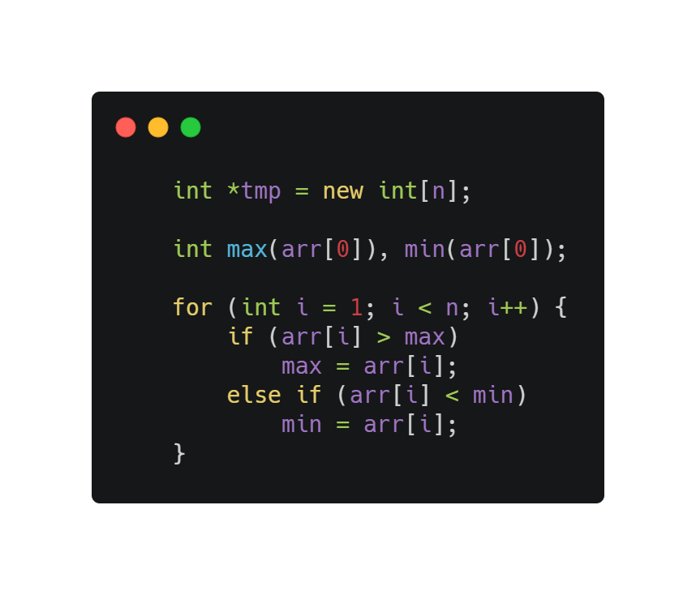
Counting Sort
ALGORITM
DATA STRUCTURE AND ALGORITHMS
CLASS 18CLC2

Slide 66
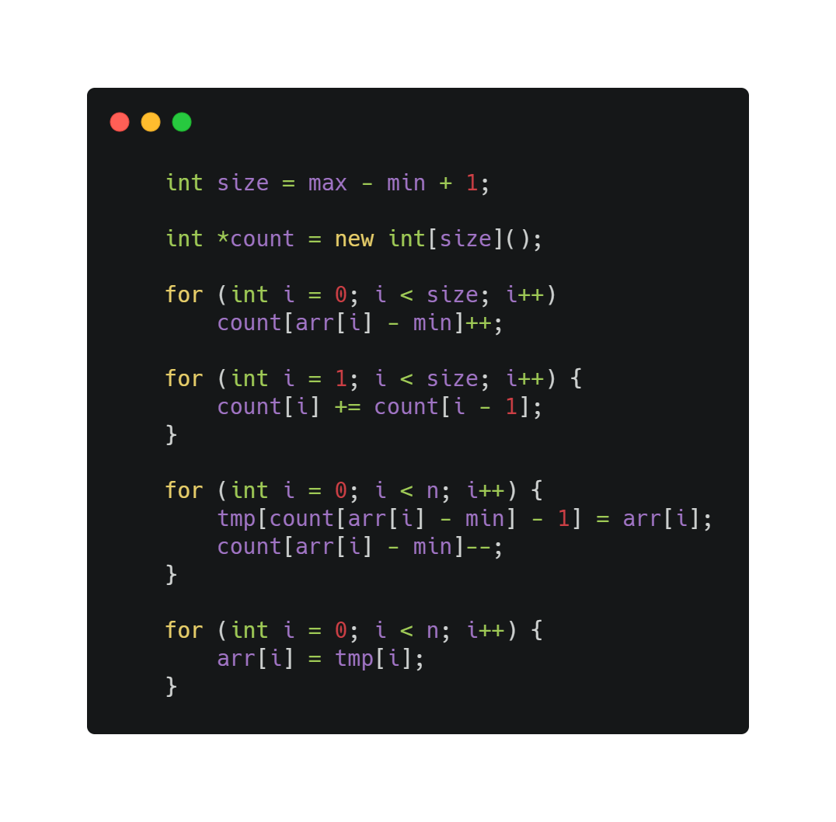
Counting Sort
ALGORITM
DATA STRUCTURE AND ALGORITHMS
CLASS 18CLC2

Slide 67
ALGORITHM REVIEW
Counting sort operates only on integers.
Counting sort assumes that you know the range of your input (the integers you are trying to sort).
Counting sort works best if the range of the integers to be sorted isn’t to wide, that is to say , not greater than the number of items to be sorted .
Generally, it works at its best on smaller integers.
**If we only have 5 elements to sort but the range is to wide(between 0 and 10000), counting sort wouldn’t work well, since it has to create “count” array.
Case | Time complexity
Best | O(n+k)
Worst | O(n+k)
DATA STRUCTURE AND ALGORITHMS
CLASS 18CLC2

Slide 68
Counting Sort
GRAPH

Slide 69
Counting Sort
GRAPH

Slide 70
Counting Sort
GRAPH

Slide 71
Counting Sort
GRAPH

Slide 72
SHELL SORT
IDEA – ALGORITHM – ALGORITHMS REVIEW
DATA STRUCTURE AND ALGORITHMS
CLASS 18CLC2

Slide 73
IDEA
Shell sort is an improved version of Insertion sort.
The main idea of this algorithm is dividing the array into sub arrays with k apart.
The method starts by sorting pairs of elements far apart from each other, then progressively reducing the gap between elements to be compared. Starting with far apart elements, it can move some out-of-place elements into position faster than a simple nearest neighbor exchange.
DATA STRUCTURE AND ALGORITHMS
CLASS 18CLC2

Slide 74
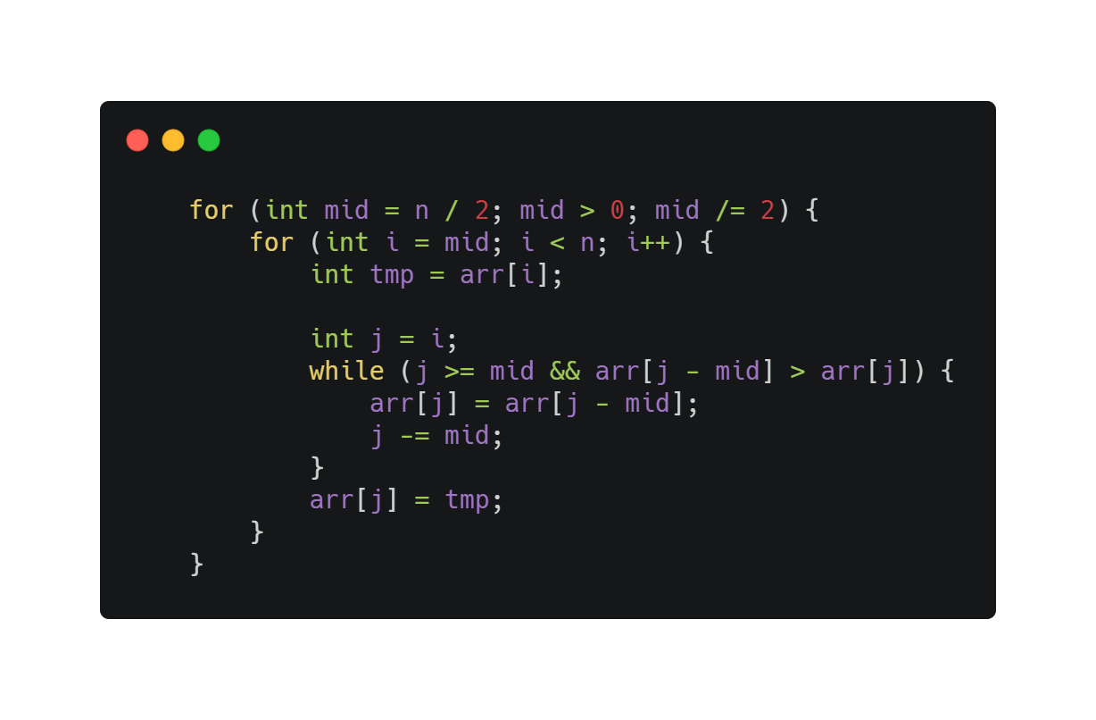
Shell Sort
ALGORITM
DATA STRUCTURE AND ALGORITHMS
CLASS 18CLC2

Slide 75
ALGORITHM REVIEW
Analyzing Shell sort is very complicated, and efficiency of Shell sort depend on the length is chosen.
O(n²) (worst known worst case gap sequence)
O(n log₂n) (best known worst case gap sequence)
O(nlogn) (best-case performance - most gap sequences)
O(n log₂n) (best known worst-case gap sequence)
Case | Time complexity
Best | O(n²)
Worst | O(nlogn)
DATA STRUCTURE AND ALGORITHMS
CLASS 18CLC2

Slide 76
Shell Sort
GRAPH

Slide 77
Shell Sort
GRAPH

Slide 78
Shell Sort
GRAPH

Slide 79
Shell Sort
GRAPH

Slide 80
SHAKER SORT
IDEA – ALGORITHM – ALGORITHMS REVIEW
DATA STRUCTURE AND ALGORITHMS
CLASS 18CLC2

Slide 81
IDEA
Step 1: let left = 0, right = n- 1
Step 2: run i from left to right
if (a[i] > a[i+1]) swap
update right
Step 3: run i from right to left
if(a[i] < a[i+1]) swap
update left
Step 4: if (left < right) continue step 2;
else stop
Shaker sort is an improved version of Bubble sort.
After bringing the smallest to the top of the array, then we will bring the biggest to the end of the array.
It try to fix the disadvantage of Bubble sort.
DATA STRUCTURE AND ALGORITHMS
CLASS 18CLC2

Slide 82
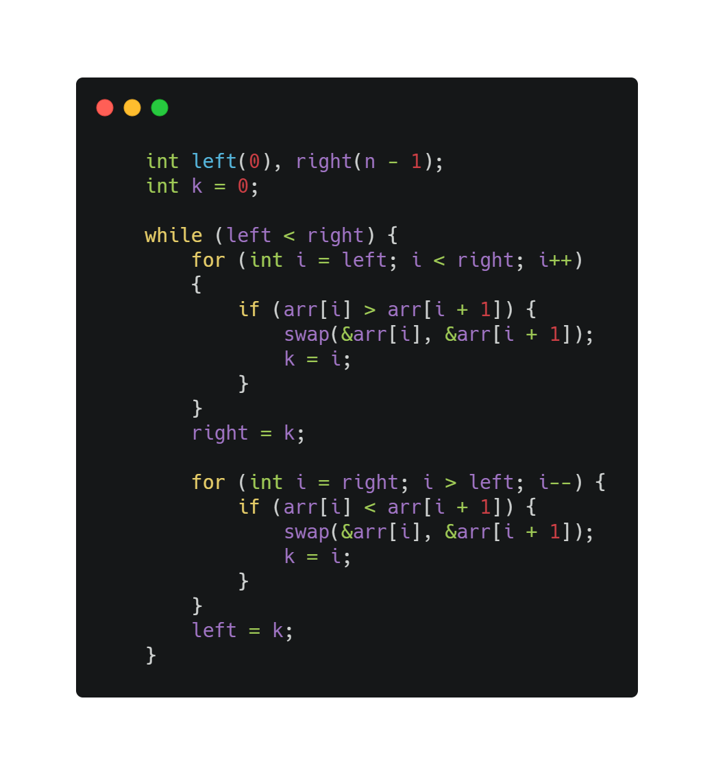
Counting Sort
ALGORITM
DATA STRUCTURE AND ALGORITHMS
CLASS 18CLC2

Slide 83
ALGORITHM REVIEW
The complexity of the shaker sort in big O notation is for both O(n²) in the worst case and the average case, but it becomes closer to O(n) if the list is mostly ordered before applying the sorting algorithm.
Case | Time complexity
Best | O(n)
Average | O(n²)
Worst | O(n²)
DATA STRUCTURE AND ALGORITHMS
CLASS 18CLC2

Slide 84
Shaker Sort
GRAPH

Slide 85
Shaker Sort
GRAPH

Slide 86
Shaker Sort
GRAPH

Slide 87
Shaker Sort
GRAPH

Slide 88
BINARY-INSERTION SORT
IDEA – ALGORITHM – ALGORITHMS REVIEW
DATA STRUCTURE AND ALGORITHMS
CLASS 18CLC2

Slide 89
IDEA
Step 1: let i = 2; //suppose that we already had part a[1] is sorted.
Step 2: x = a[i], Find the position in sorted part a[1] to a[i-1] to insert a[i] into it.
Step 3:
Using Binary search to find location of x in sorted part array.
Displace all elements from a[location] to a[i-1] to right 1 unit to take place for a[i] get in.
Step 4: a[location] = x
Step 5: i = i +1;
If i<=n : Repeat step 2
Else: Stop
Binary-insertion sort is an improved version of Insertion sort.
Binary insertion sort employs a binary search to determine the correct location to insert new elements.
DATA STRUCTURE AND ALGORITHMS
CLASS 18CLC2

Slide 90
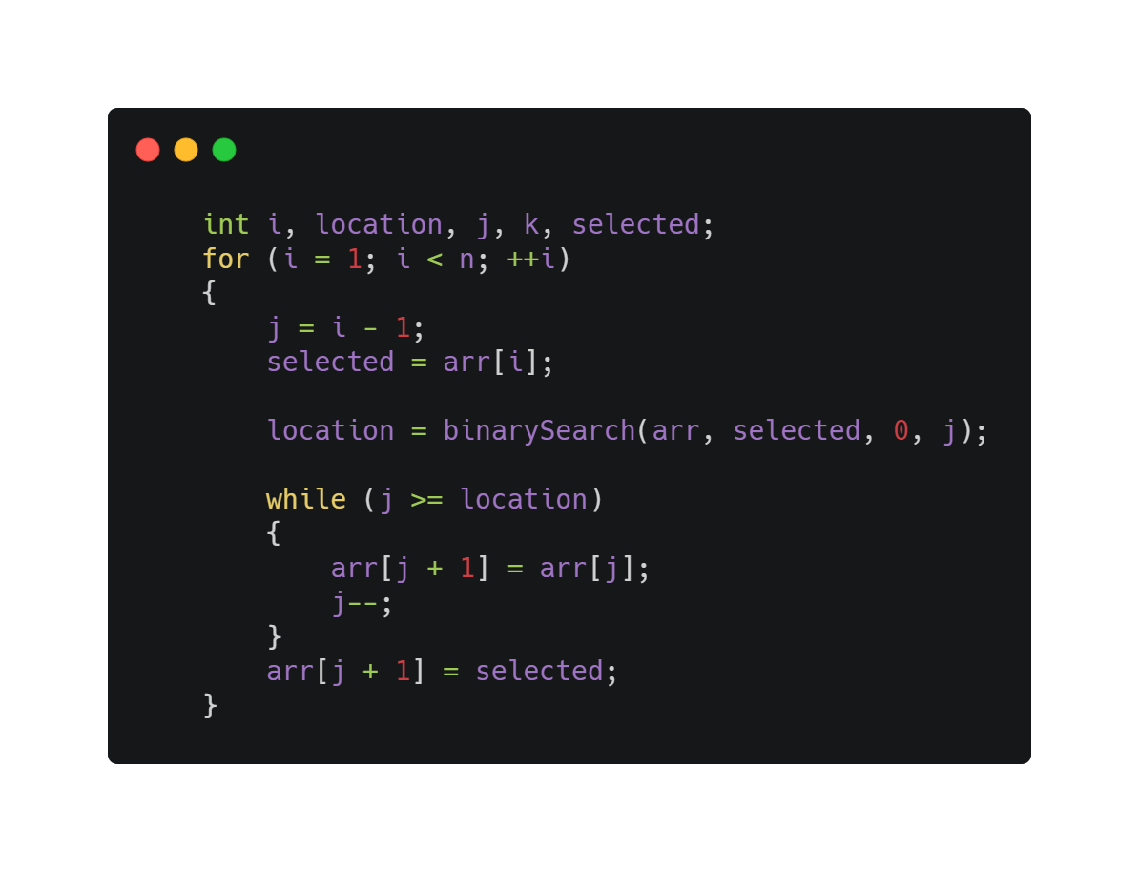
Binary-insertion Sort
ALGORITM
DATA STRUCTURE AND ALGORITHMS
CLASS 18CLC2

Slide 91
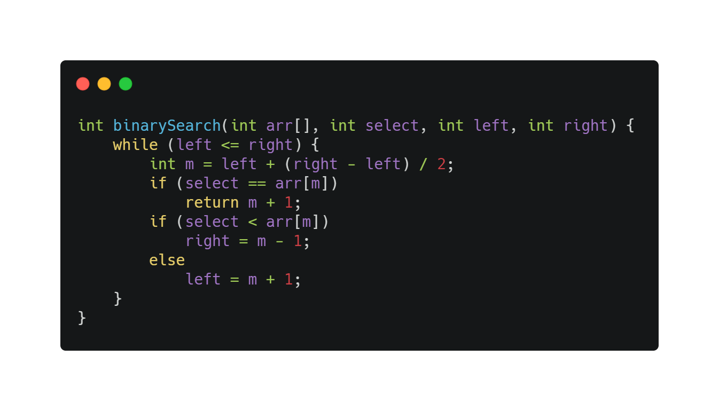
Binary-insertion Sort
ALGORITM
DATA STRUCTURE AND ALGORITHMS
CLASS 18CLC2

Slide 92
ALGORITHM REVIEW
The binary-insertion sort performs ⌈log₂n⌉ comparisons in the worst case, which is O(n log n). The algorithm as a whole still has a running time of O(n²) on average because of the series of swaps required for each insertion.
Case | Time complexity
Best | O(nlogn)
Average | O(n²)
Worst | O(n²)
DATA STRUCTURE AND ALGORITHMS
CLASS 18CLC2

Slide 93
Binary-insertion Sort
GRAPH

Slide 94
Binary-insertion Sort
GRAPH

Slide 95
Binary-insertion Sort
GRAPH

Slide 96
Binary-insertion Sort
GRAPH

Slide 97
FLASH SORT
IDEA – ALGORITHM – ALGORITHMS REVIEW
DATA STRUCTURE AND ALGORITHMS
CLASS 18CLC2

Slide 98
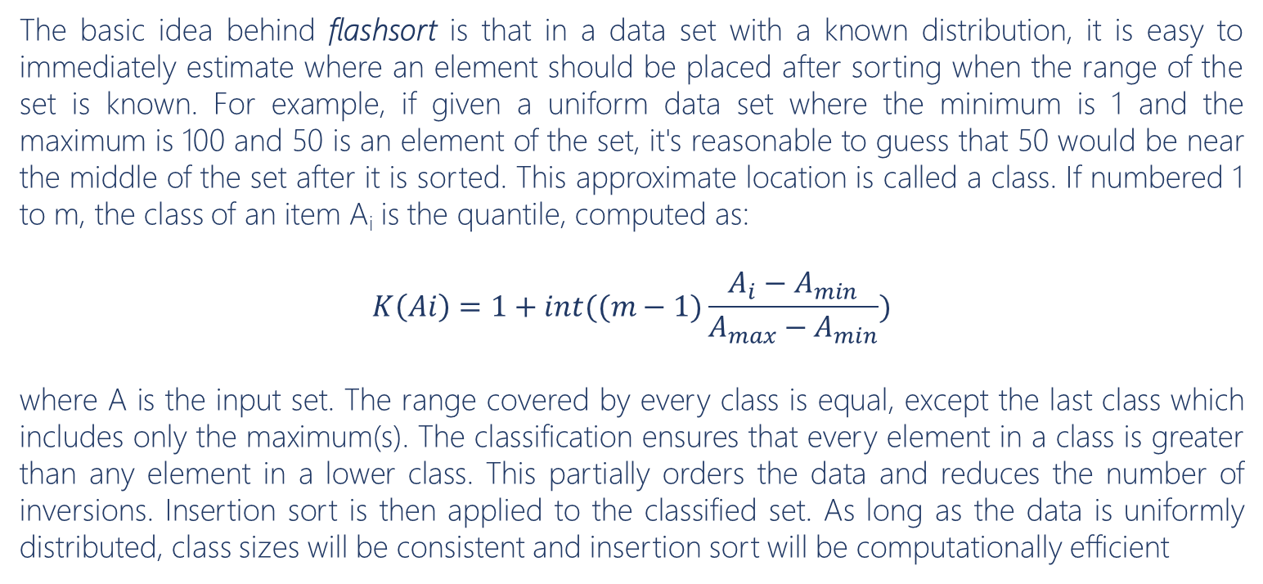
IDEA
The basic idea behind flashsort is that in a data set with a known distribution, it is easy to immediately estimate where an element should be placed after sorting when the range of the set is known. For example, if given a uniform data set where the minimum is 1 and the maximum is 100 and 50 is an element of the set, it's reasonable to guess that 50 would be near the middle of the set after it is sorted. This approximate location is called a class. If numbered 1 to m, the class of an item A_{i} is the quantile, computed as:
$$K\left(Ai\right)=1+int((m−1)\frac{A_{i}−A_{min}}{A_{max}−A_{min}})$$
where A is the input set. The range covered by every class is equal, except the last class which includes only the maximum(s). The classification ensures that every element in a class is greater than any element in a lower class. This partially orders the data and reduces the number of inversions. Insertion sort is then applied to the classified set. As long as the data is uniformly distributed, class sizes will be consistent and insertion sort will be computationally efficient
DATA STRUCTURE AND ALGORITHMS
CLASS 18CLC2

Slide 99
Flash Sort
ALGORITM
CODE REFERENCE
DATA STRUCTURE AND ALGORITHMS
CLASS 18CLC2

Slide 100
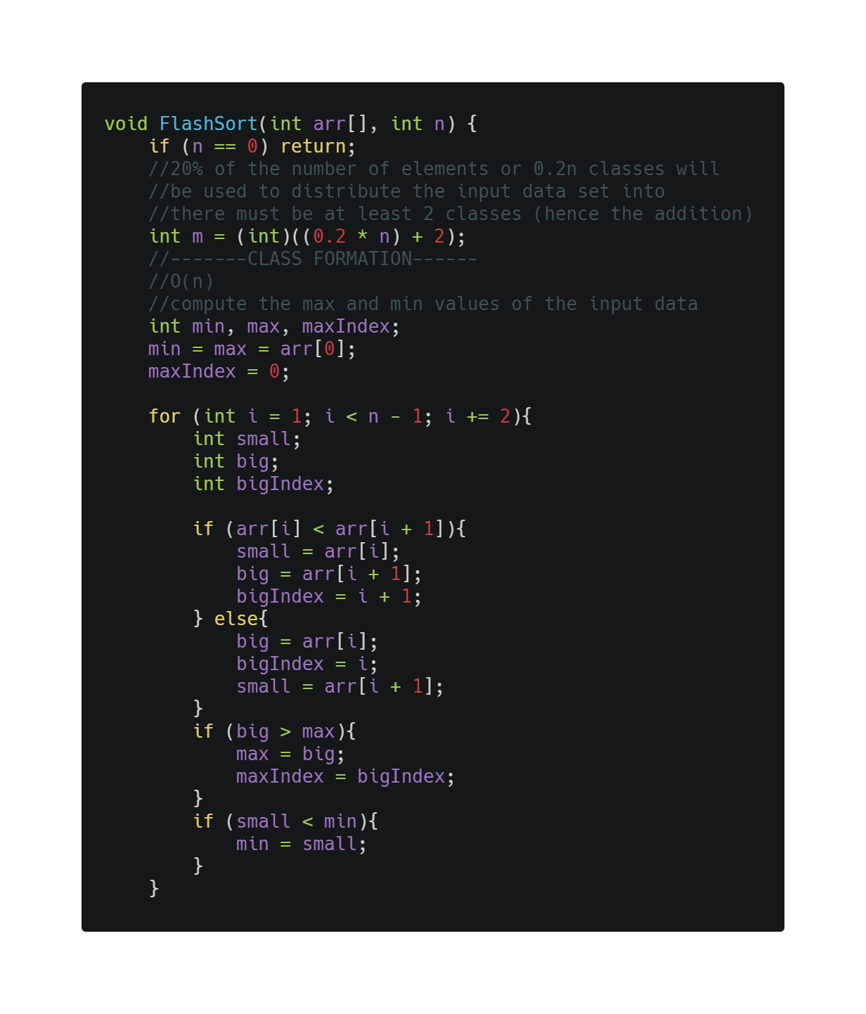
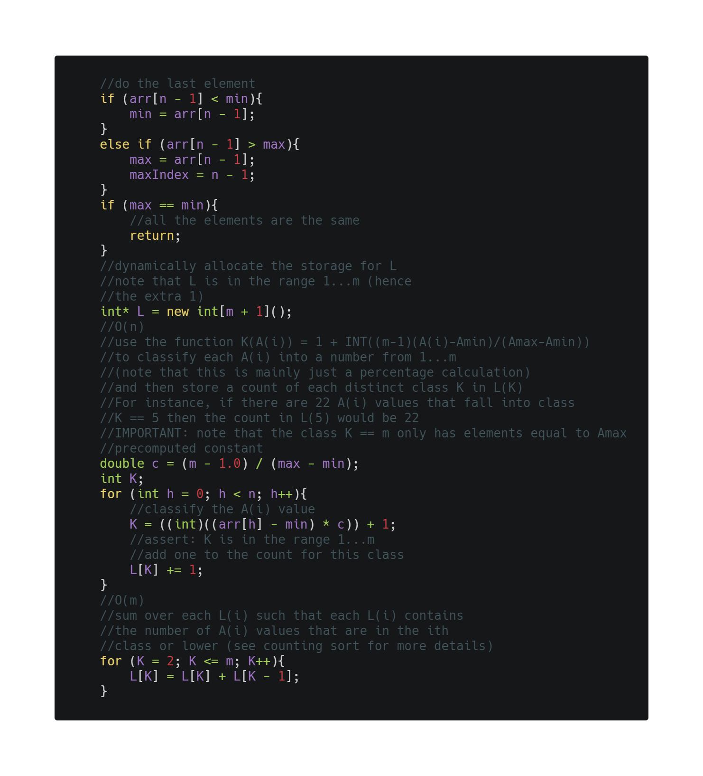
Flash Sort

Slide 101
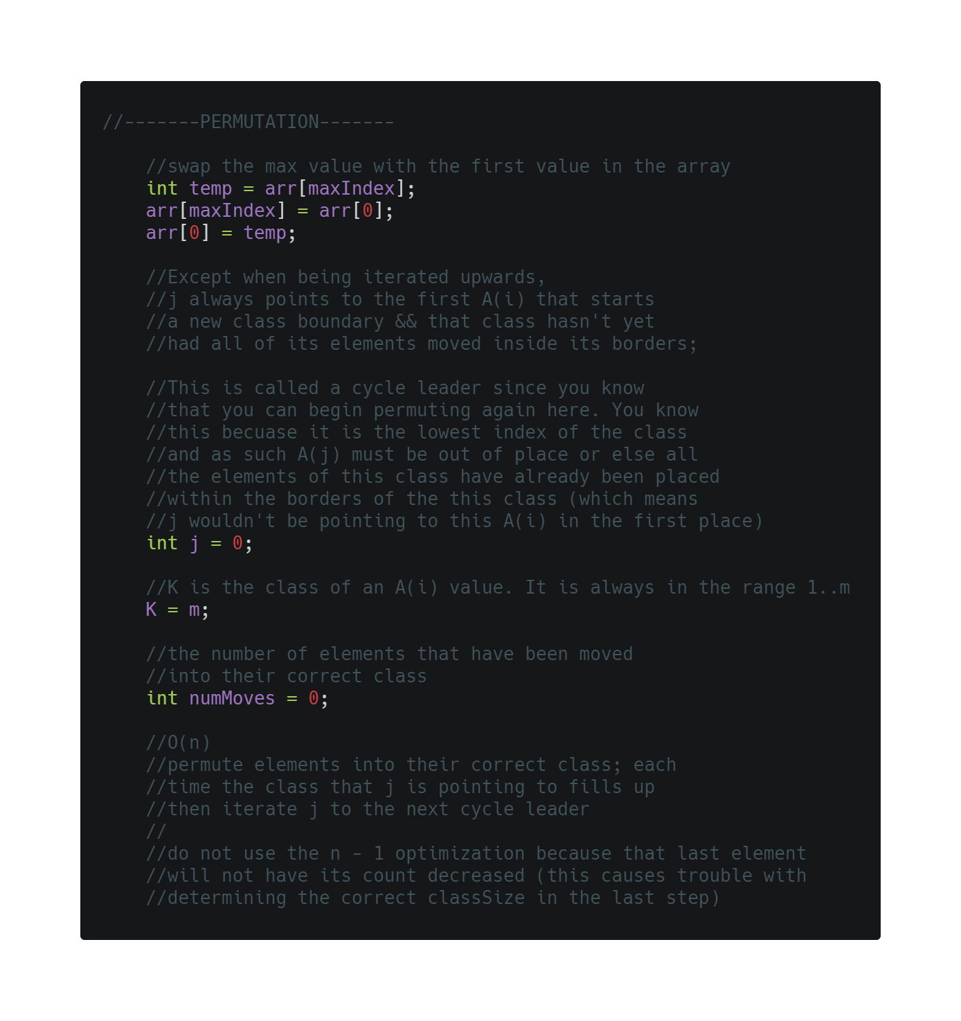
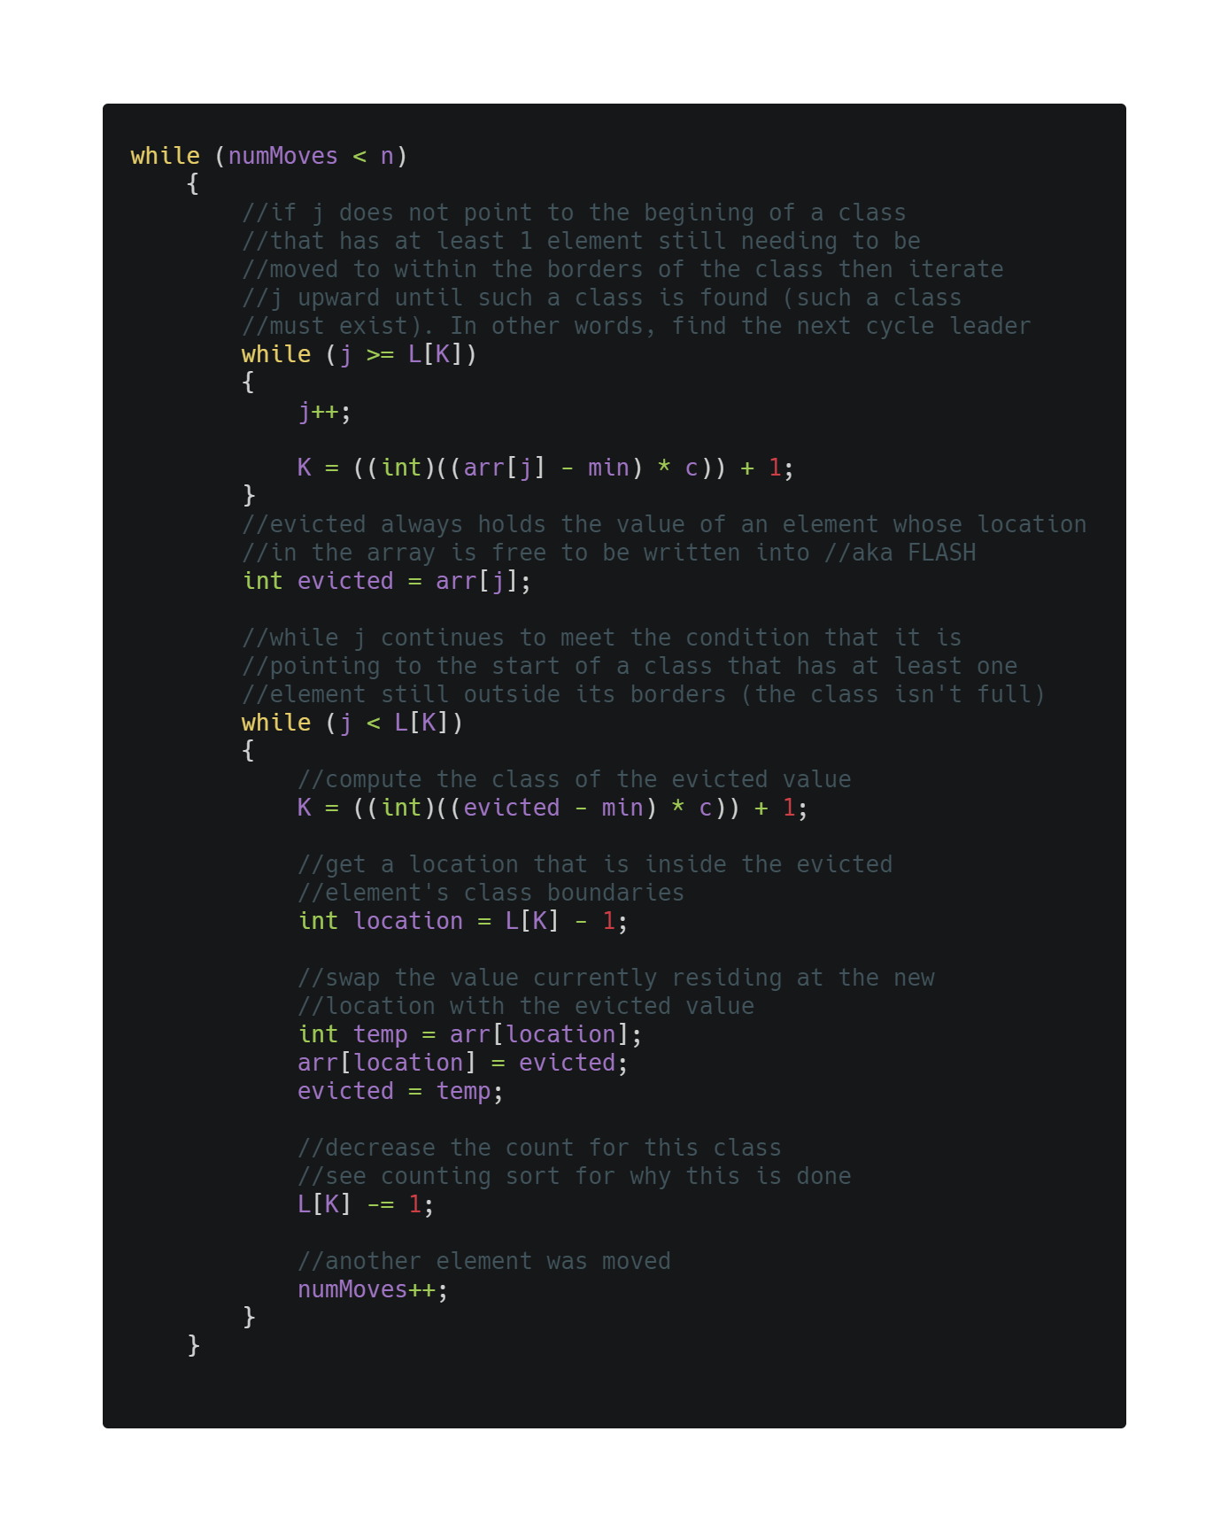
Flash Sort

Slide 102
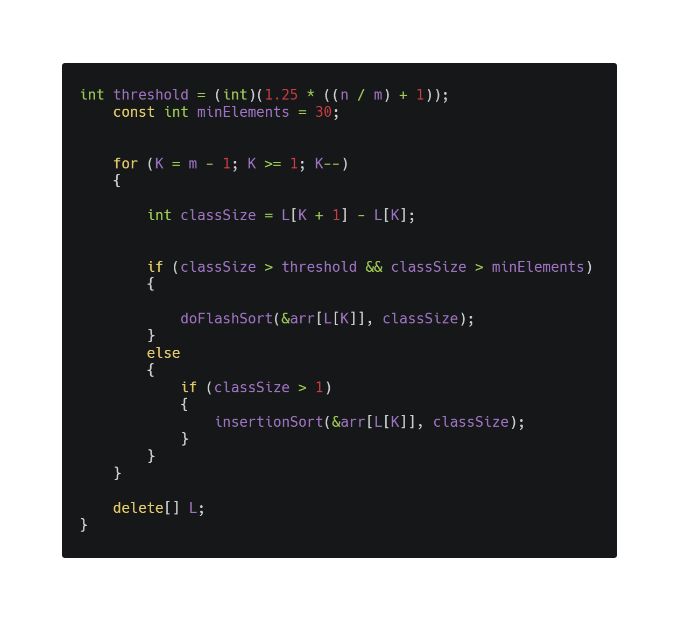
Flash Sort

Slide 103
ALGORITHM REVIEW
Flashsort avoids the overhead needed to store classes in the very similar bucketsort. For m=0.1n with uniform random data, flashsort is faster than heapsort for all n and faster than quicksort for n>80. It becomes about as twice as fast as quicksort at n=10000.
Due to the in situ permutation that flashsort performs in its classification process, flashsort is not stable. If stability is required, it is possible to use a second, temporary, array so elements can be classified sequentially. However, in this case, the algorithm will require O(n) space.
Time complexity
O(n)
DATA STRUCTURE AND ALGORITHMS
CLASS 18CLC2

Slide 104
Flash Sort
GRAPH

Slide 105
Flash Sort
GRAPH

Slide 106
Flash Sort
GRAPH

Slide 107
Flash Sort
GRAPH

Slide 108
SUMMARIZE
DATA STRUCTURE AND ALGORITHMS
CLASS 18CLC2

Slide 109
Sorting Algorithms
GRAPH

Slide 110
Sorting Algorithms
GRAPH

Slide 111
Sorting Algorithms
GRAPH

Slide 112
Sorting Algorithms
GRAPH

