Slide 1

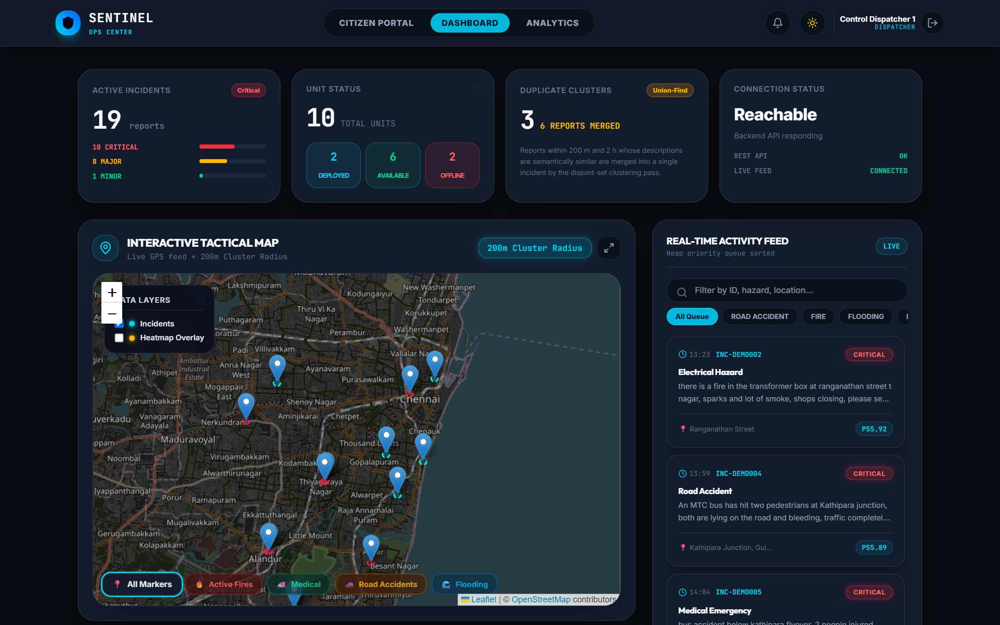
R.M.K. ENGINEERING COLLEGE
Department of Computer Science and Engineering
SENTINEL
AI-Powered Citizen Incident Reporting and Intelligent Emergency Dispatch System
Team
Latheshkumar S (111724102105)
Madesh S (111724102108)
Jeffrin A (111724102083)
Kamalesh Balaji D N (111724102089)
Guided by
Ms. Sumitha T
Assistant Professor, CSE
Live dispatcher dashboard — Chennai
24ME511 Product Development Lab – 2 · Final Review · October 2026
Notes:
Introduce the team and the guide. One line pitch: Sentinel lets any citizen report a hazard with photo, voice and GPS, and uses AI to verify, de-duplicate and prioritise reports so dispatchers can send the nearest responder faster.

Slide 2
Agenda
01
Problem & motivation
02
Existing vs proposed system
03
Literature survey
04
System architecture
05
AI pipeline & algorithms
06
Implementation & tech stack
07
Live demo screens
08
Results, testing & future work

Slide 3




Emergency reporting still runs on voice calls
When a citizen sees a fire, accident or flooded road, the only option is to call 100, 101, 108 or 112 and describe it.
No visual evidence
Vague locations
Duplicate reports
Manual prioritisation
A phone call cannot carry a photo or video, so severity is guessed from a panicking caller’s words.
“Near the signal by the temple” — operators interpret landmarks and responders search for the spot.
One visible fire at T. Nagar triggers dozens of calls, each handled as a brand-new case.
Calls are served in arrival order, not by severity; finding the nearest unit relies on memory.
Notes:
Every minute between noticing a hazard and dispatching a responder matters. The existing channel loses evidence, location accuracy and time to duplicates.

Slide 4
Existing system vs Sentinel
Aspect | Existing system | Sentinel (proposed)
Reporting channel | Voice call to a helpline | PWA form: category, text, photo, video, voice
Location | Verbal landmark | Exact GPS from the phone, EXIF cross-check
Evidence | None | YOLOv8 on images & video keyframes, Whisper on voice
Duplicates | Each call is a new case | Union-Find merges reports ≤200 m, ≤2 h, similar text
Prioritisation | First come, first served | Weighted score: severity, corroboration, wait, category
Dispatch | Operator memory + radio | k-d tree nearest available responder, one click
Citizen feedback | None — people call again | Tracking ID with 7-stage live status

Slide 5



Sentinel in three steps
1. Report
2. AI triage
3. Dispatch
Citizen picks a hazard type, describes it, attaches photo / video / voice and shares GPS. Gets a tracking ID instantly.
Vision, EXIF, speech and a local LLM analyse the report; duplicates are merged and a priority score is assigned.
Dispatcher sees a live map and priority queue, gets the nearest available responders, and dispatches in one click.
Report to verified, prioritised incident in ≈ 7 seconds on a single laptop GPU — no cloud AI, citizen data stays local.

Slide 6
Literature survey — what we build on
Paper | Key finding | Gap / how Sentinel uses it
Sakaki et al., WWW 2010 | Citizens as real-time sensors detect events faster than official channels | Noisy posts, no precise GPS, no dispatch
Imran et al., ACM CSUR 2015 | Crisis data suffers from overload and duplicates | Rarely integrated with responder tools
Alam / Ofli et al., 2018–20 | Images + text together describe damage better | Offline classification only
Redmon et al., CVPR 2016 (YOLO) | Single-pass real-time object detection | Used for media evidence
Radford et al., ICML 2023 (Whisper) | Robust multilingual speech recognition | Used for voice notes
Reimers & Gurevych, EMNLP 2019 | Sentence embeddings for semantic similarity | Used for duplicate detection
Bentley, CACM 1975 (k-d tree) | Fast nearest-neighbour search in 2-D | Used for responder lookup

Slide 7
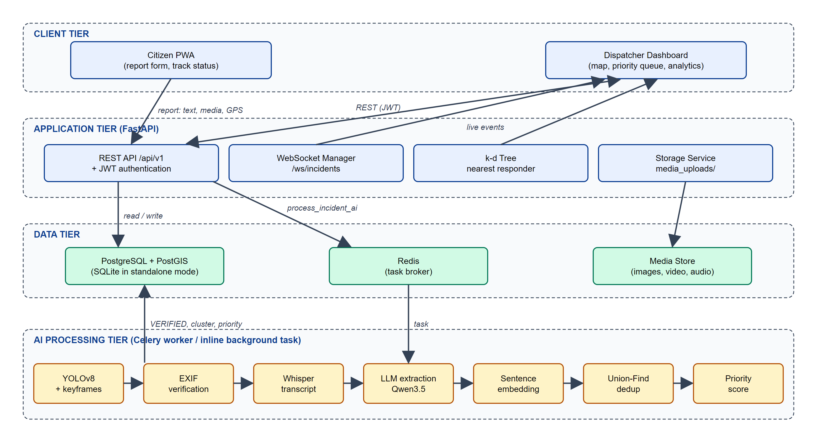
System architecture
Client tier
Citizen PWA + dispatcher dashboard (React, Leaflet)
Application tier
FastAPI REST + JWT, WebSocket live feed, k-d tree
Data tier
PostgreSQL + PostGIS, Redis broker, media store
AI tier
Celery worker: vision → EXIF → speech → LLM → embed → dedup → priority

Slide 8








AI pipeline — every report, every model, honestly recorded
YOLOv8
EXIF
Whisper
Qwen3.5 LLM
MiniLM
Union-Find
Priority
Objects in photos & 3 video keyframes
Photo GPS/time vs reported spot
Voice note → text
JSON: hazard, severity, summary
384-dim sentence embedding
Merge duplicate reports
Weighted score → queue
Honest degradation If a model is missing, Sentinel says so instead of inventing a severity. Each incident stores ai_provenance — e.g. vision: yolov8, llm: llama-server, embedding: all-MiniLM-L6-v2 — and duplicates are never merged on fallback vectors.

Slide 9

Core algorithms
Union-Find dedup
Weighted priority score
k-d tree responder search
Two reports are the same event when:
≤ 200 m apart (Haversine)
≤ 2 hours apart
cosine similarity ≥ 0.55
Path compression + union by rank → near O(1) merges
Priority = 0.40 × Severity
+ 0.30 × Corroboration
+ 0.20 × Time in queue
+ 0.10 × Category weight
Binary heap: top incident in O(log n)
2-D tree over available responders
Alternates latitude / longitude splits
Latitude-aware pruning bound
Returns k nearest with distance in km
O(log n) average query

Slide 10
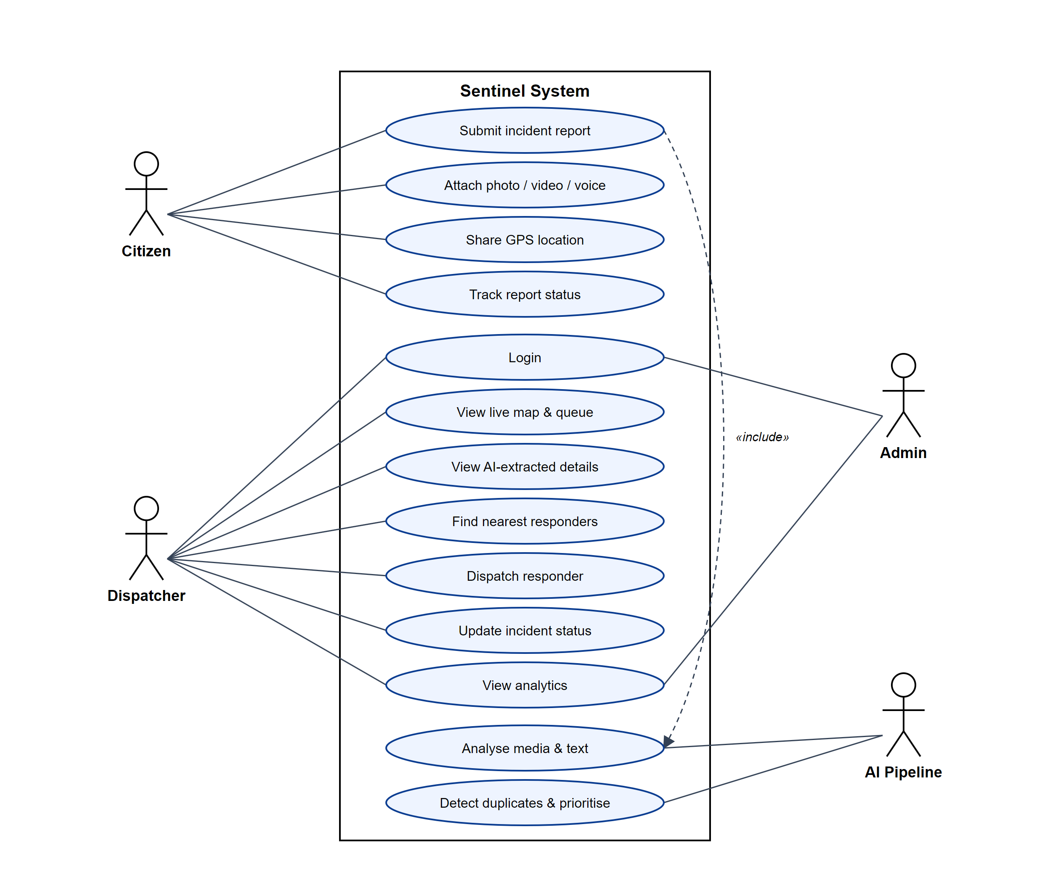
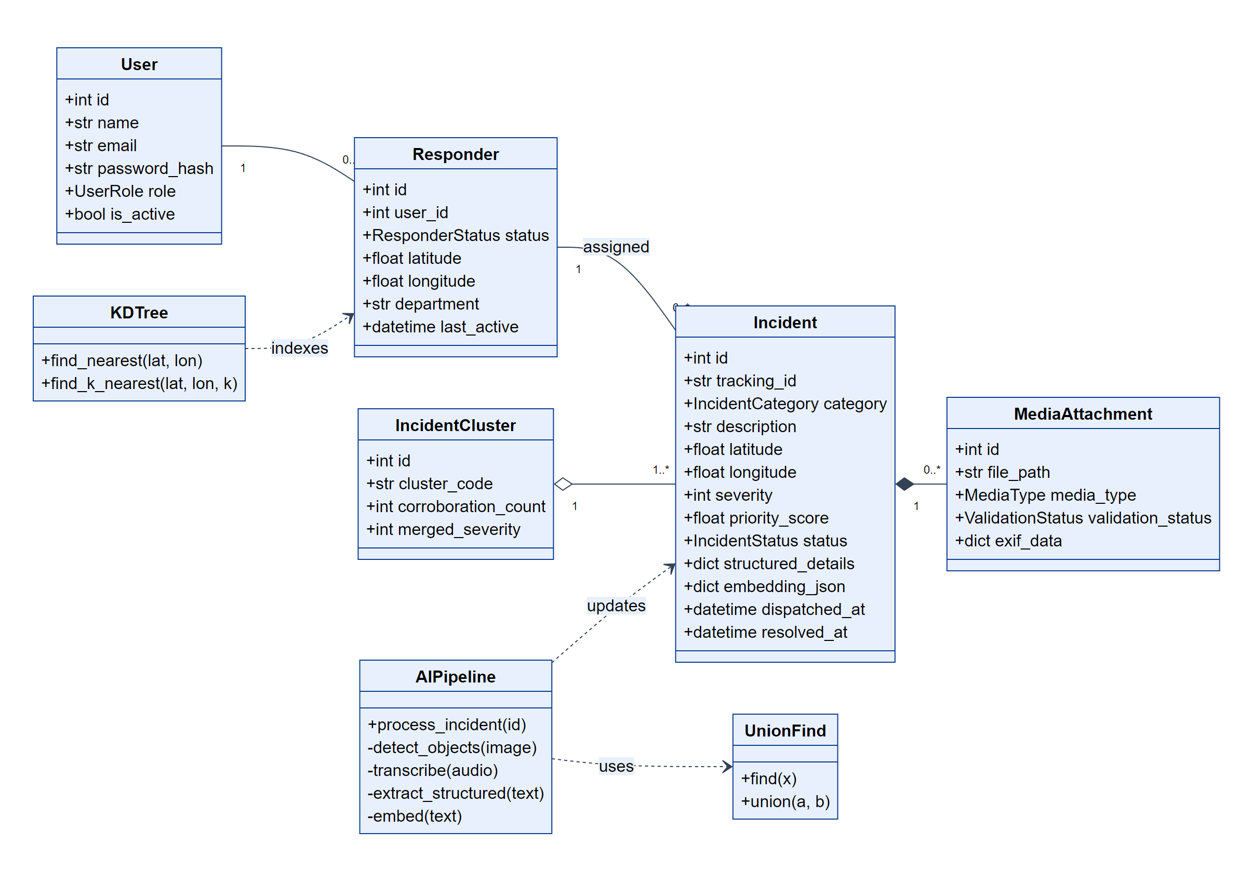
Use cases and data model
Use case diagram — Citizen, Dispatcher, Admin, AI Pipeline
Class diagram — Incident, Cluster, Media, Responder, algorithms

Slide 11




Technology stack
Frontend
Backend
AI models
Data & ops
React 18 + Vite PWA
Tailwind CSS v4
Leaflet + OpenStreetMap
WebSocket client
FastAPI (async)
SQLAlchemy 2.0 ORM
JWT + bcrypt auth
Celery workers
YOLOv8n (Ultralytics)
OpenAI Whisper
Qwen3.5 via llama.cpp
all-MiniLM-L6-v2
PostgreSQL + PostGIS
Redis broker
Docker Compose
pytest · Vitest · Playwright
100% open source · runs on one laptop (RTX 4060) · standalone mode with SQLite when Docker is unavailable

Slide 12
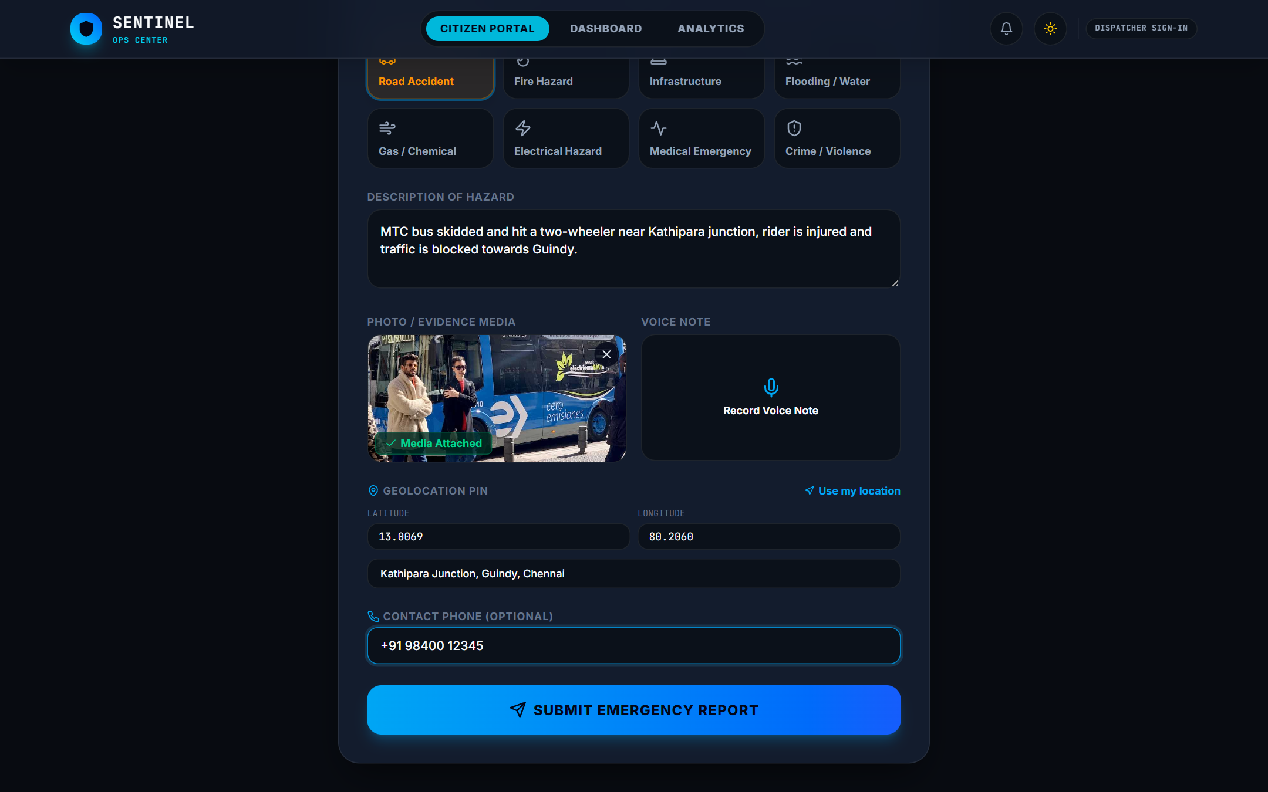
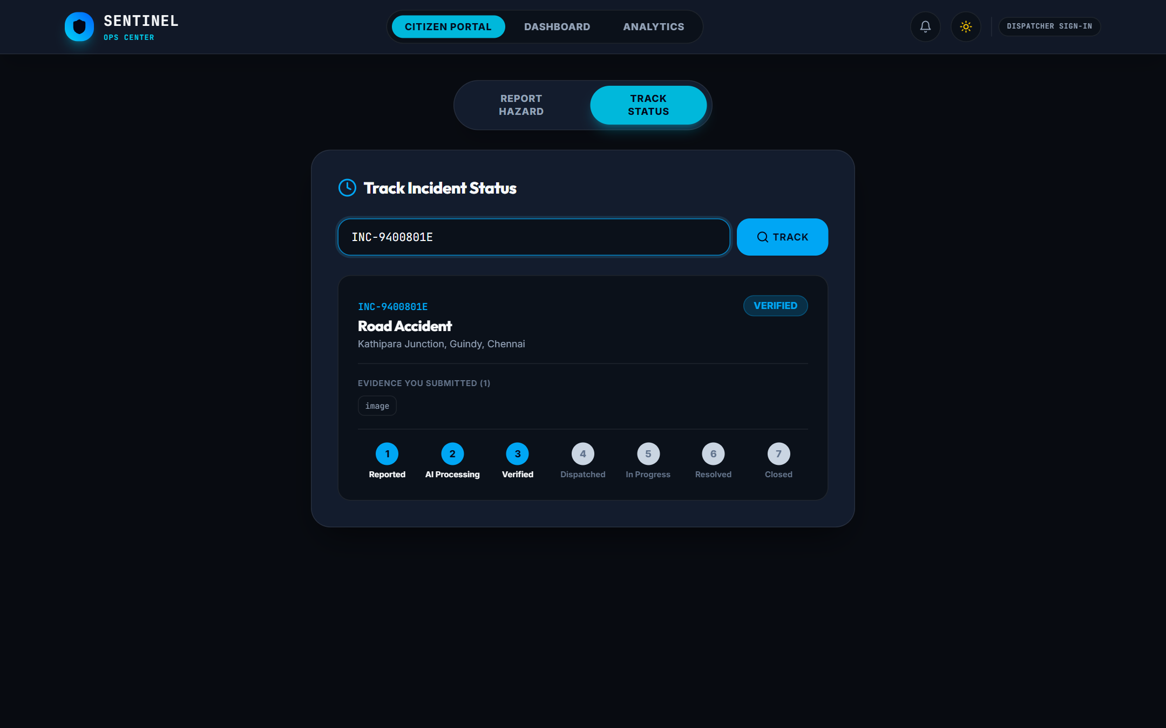
Citizen app — report in under a minute
Report: hazard type, description, photo of the bus, GPS 13.0069, 80.2060 at Kathipara junction
Track: tracking ID INC-9400801E moves through Reported → AI Processing → Verified → Dispatched → Resolved

Slide 13

Dispatcher dashboard — Chennai at a glance
Live map
18 incidents from Ennore to Tambaram with heatmap and 200 m radius
3 clusters
7 reports merged into 3 events by Union-Find
Real-time
WebSocket feed sorted by priority, 15 s poll fallback

Slide 14
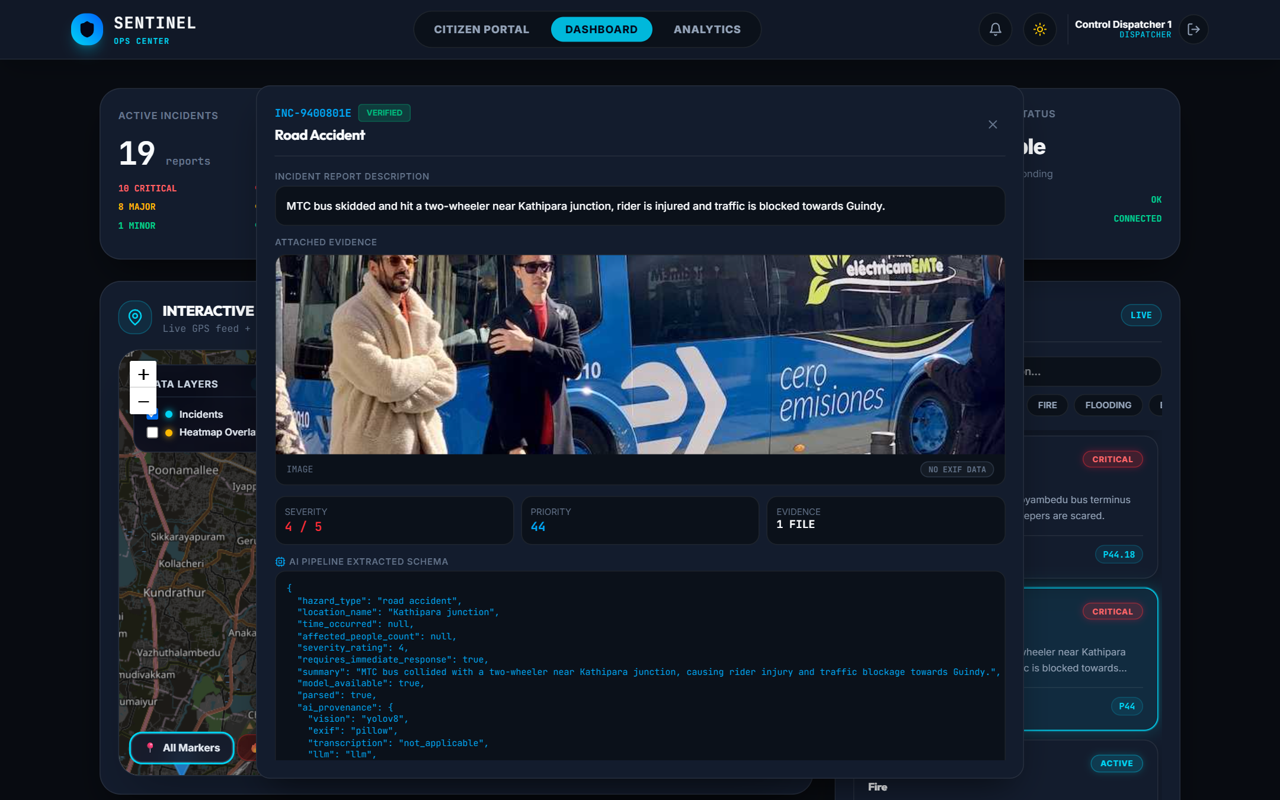
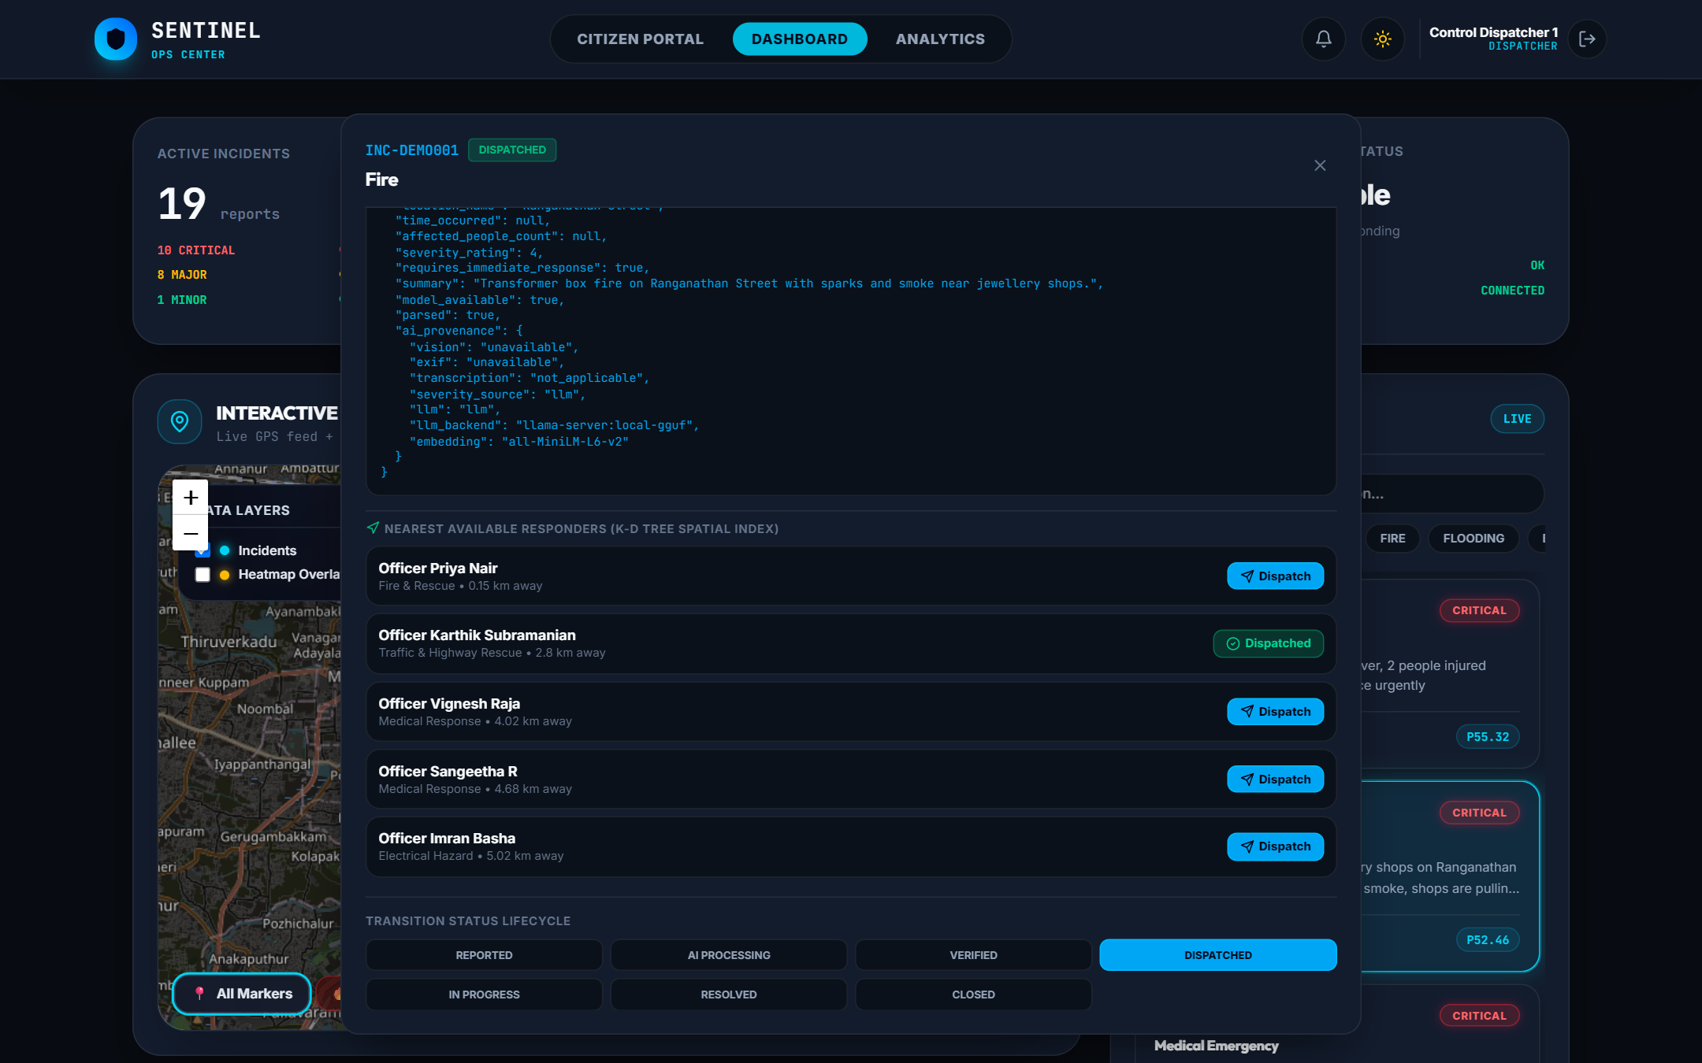
AI analysis and one-click dispatch
AI analysis: YOLOv8 saw the bus, the LLM extracted “road accident, Kathipara junction, severity 4” and a summary
Dispatch: k-d tree ranks responders — Officer Priya Nair, Fire & Rescue, 0.15 km from the T. Nagar fire

Slide 15
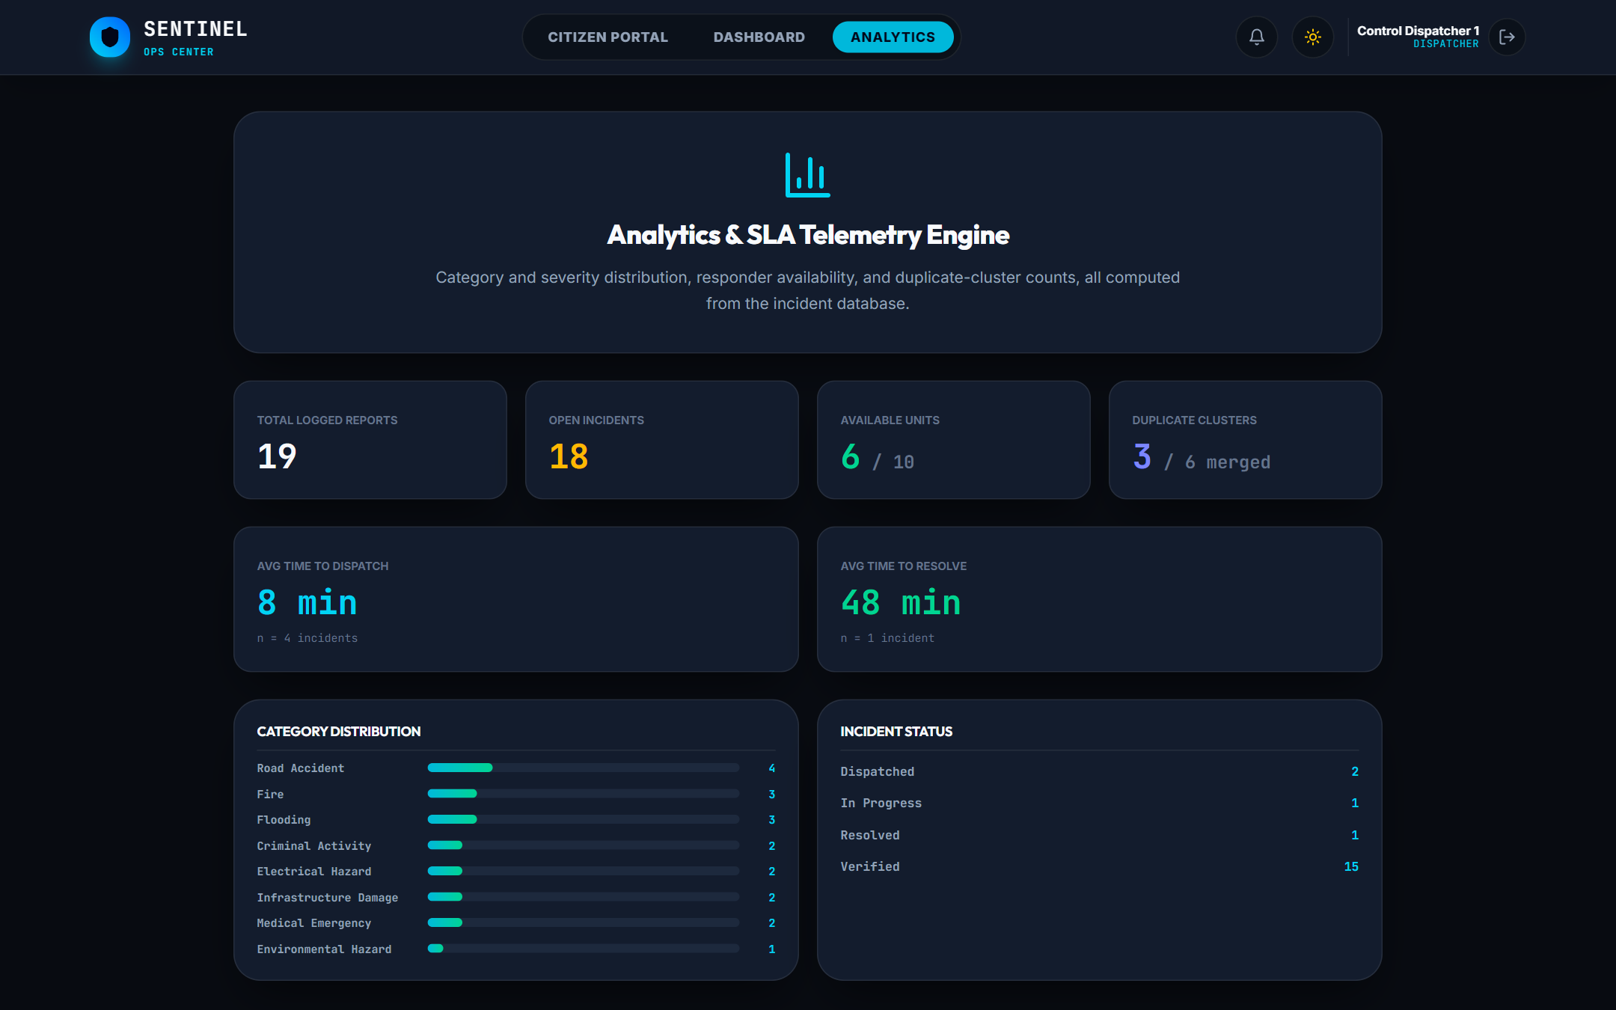
Results on the Chennai demonstration dataset
18
citizen reports processed through the real pipeline
3 / 3
duplicate groups merged correctly (T. Nagar, Kathipara, Velachery)
≈ 7 s
average AI triage per report on a laptop GPU
111
automated tests passing
Analytics: category and status distribution, average time to dispatch (8 min) and resolve (48 min) on seeded data

Slide 16
Testing
Unit
Haversine (Chennai Central → Egmore ≈ 1.9 km), Union-Find, priority, k-d tree vs brute force
Functional
Submit, track, list, status lifecycle, nearest responders, dispatch, analytics
Integration
Real FastAPI app on in-memory SQLite; full pipeline clusters two matching reports
Black / white box
Invalid input, auth guards, every model fallback path, LLM output parsing

Slide 17






Conclusion and future enhancements
Future enhancements
What Sentinel delivers
Citizens report with evidence and exact GPS in under a minute
AI verifies, summarises and scores every report locally
Duplicates merged — dispatchers handle each event once
Nearest responder suggested and dispatched in one click
Every stage time-stamped for response-time analytics
Integrate with 112 / ERSS control rooms
Tamil and multilingual reporting
Responder mobile app with live location
Fine-tuned hazard detection on Indian data
Hotspot prediction for monsoon flooding
Offline queueing and SMS fallback

Slide 18
Thank you
Questions?
Latheshkumar S · Madesh S · Jeffrin A · Kamalesh Balaji D N
Guided by Ms. Sumitha T · R.M.K. Engineering College

