Slide 1
Analyzing LatentQGAN
A Hybrid Quantum-Classical GAN with Autoencoders
Vieloszynski, et al. LatentQGAN: A Hybrid QGAN with Classical Convolutional Autoencoder, 2024.
Gregorio Piqué
18/02/2025

Slide 2
LatentQGAN
Vieloszynski, et al.
18/02/2025
Introduction
generative models aim to learn the underlying data distribution and generate new, realistic samples
applications include image synthesis, natural language processing, anomaly detection, and data augmentation
GANs (Generative Adversarial Networks) use adversarial training between a generator and a discriminator to create high-quality synthetic data
despite their success, GANs face challenges like unstable training, mode collapse, and high computational costs

Slide 3

LatentQGAN
Vieloszynski, et al.
18/02/2025
Classical GANs
Background Concepts
two adversarial models: a generator (G) synthesizes data, and a discriminator (D) distinguishes real from generated samples
training as a min-max optimization problem, where both models iteratively improve by competing against each other
$$\min_{G}\max_{D}{ℒ\left(D,G\right)= 𝔼_{x∼p_{data}(x)}\left[\log{D\left(x\right)}\right]+𝔼_{z∼p_{z}(z)}\left[\log{(1 −D\left(G\left(z\right)\right)}\right]}$$
training convergence to a theoretical equilibrium when the generator produces samples indistinguishable from real data, but in practice this is rarely achieved
training GANs is highly unstable due to factors like discriminator dominance, mode collapse, and weak gradient signals for G
techniques to stabilize training include label smoothing, avoiding zero-gradient operations, modifying loss functions, and using different optimizers for D and G

Slide 4
LatentQGAN
Vieloszynski, et al.
18/02/2025
QuantumML based Approaches
Background Concepts
approaches based on quantum mechanics, a theory that describes the behavior of particles
quantum machine learning (QML) may offer significant advantages over classical approaches by leveraging the principles of quantum physics
uses qubits, leveraging quantum mechanics’ principles to perform computations beyond classical capabilities
superposition: qubits can exist in multiple states simultaneously, enabling parallel processing and representiation of complex data distributions with few qubits
entanglement: creates strong correlations between qubits, allowing non-classical interactions
measurement causes quantum states collapse into classical values, making repeated sampling necessary for reliable results

Slide 5
LatentQGAN
Vieloszynski, et al.
18/02/2025
QuantumML based Approaches
Background Concepts
quantum computation enables encoding of high-dimensional data and fast sampling from probability distributions, crucial for QML
quantum circuits are built with quantum gates to manipulate qubits
challenges include qubit decoherence, gate errors, and connectivity constraints, limiting scalability and reliability of quantum hardware
quantum error correction techniques use redundancy to mitigate errors
the studied model, LatentQGAN, addresses these challenges by designing shallow quantum circuits to minimize the impact of hardware limitations

Slide 6
LatentQGAN
Vieloszynski, et al.
18/02/2025
Similar Methods
Related Works
GANs typically introduce autoencoders to compress data into a lower-dimensional latent space: an encoder extracts features, and a decoder reconstructs the original input
classical LatentGAN integrates autoencoders into GANs, training the generator on latent representations instead of high-dimensional data, improving efficiency and reducing overfitting
Q-PatchGAN is a hybrid quantum-classical model, using a quantum generator composed of multiple sub-circuits to generate image patches, but struggles with scalability and mode collapse
MosaiQ incorporates PCA for dimensionality reduction, allowing a quantum generator to operate in a lower-dimensional space while a classical discriminator evaluates both real and generated data

Slide 7
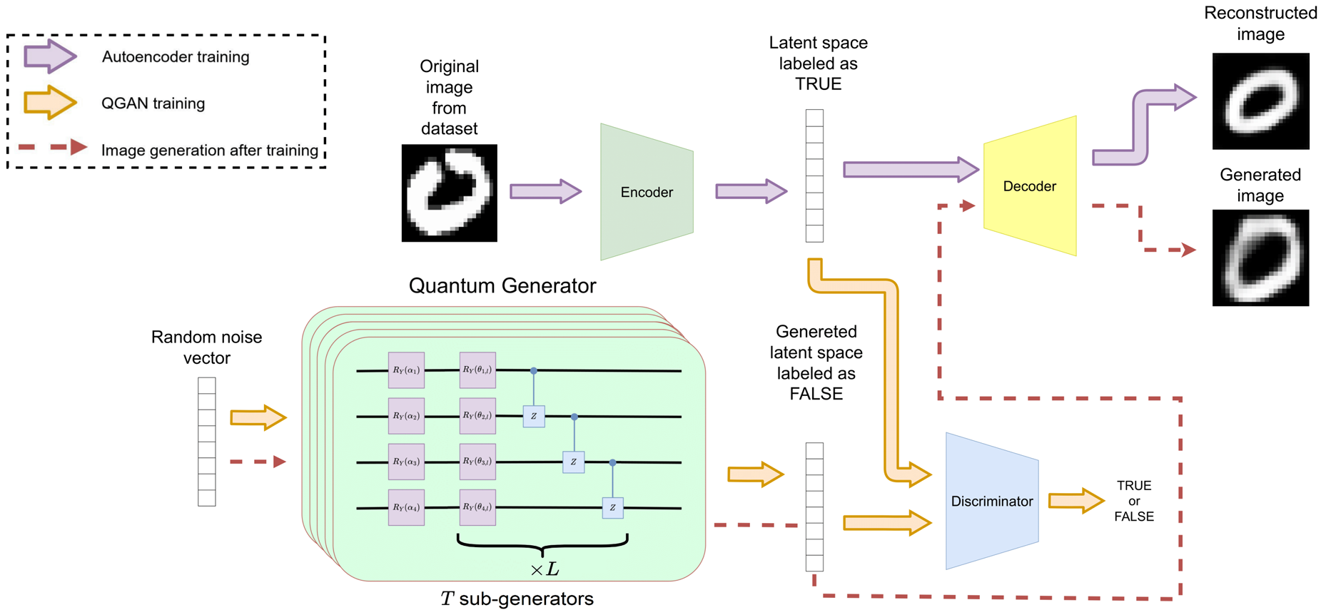
LatentQGAN
Vieloszynski, et al.
18/02/2025
LatentQGAN
LatentQGAN Architecture
combines an autoencoder and hybrid q-GAN
autoencoder maps pixel-space with compressed latent-space
q-GAN generates new latent samples

Slide 8
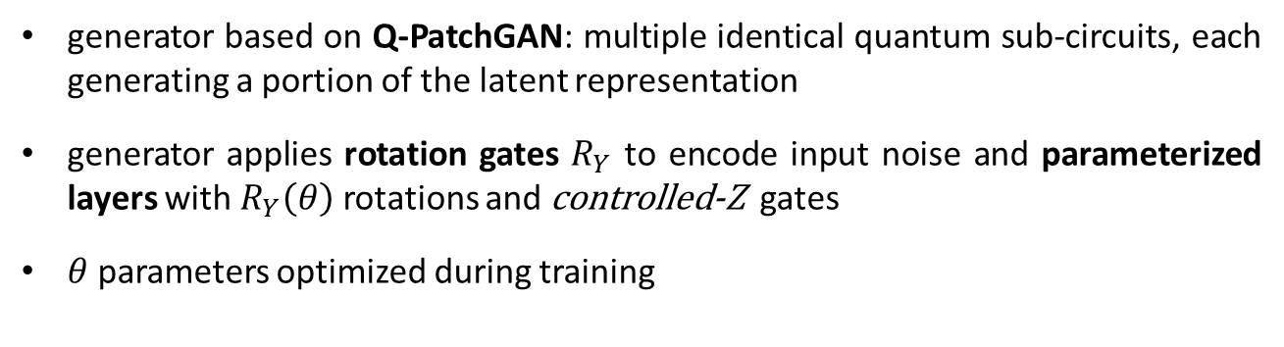
LatentQGAN
Vieloszynski, et al.
18/02/2025
Q-GAN
LatentQGAN Architecture
generator based on Q-PatchGAN: multiple identical quantum sub-circuits, each generating a portion of the latent representation
generator applies rotation gates $R_{Y}$ to encode input noise and parameterized layers with $R_{Y}\left(θ\right)$ rotations and $\text{controlled}\text{-}\text{Z}$ gates
$θ$ parameters optimized during training

Slide 9

LatentQGAN
Vieloszynski, et al.
18/02/2025
Q-GAN
LatentQGAN Architecture
post-selection in generator introduces non-linearity by keeping only results of measurement where ancilla qubit is $|0⟩$
final normalization step to ensures output represents a valid probability distribution
classical discriminator as a set of fully-connected linear layers, evaluates latent representation of real and fake data
new images generated with q-generator forward pass, and latent result mapped to pixel-space with decoder
generator gradients computed with analytical method of parameter-shift rule, leveraging macroscopic parameter shifts (numerical differentiation and automatic differentiation are impractical for quantum circuits)

Slide 10
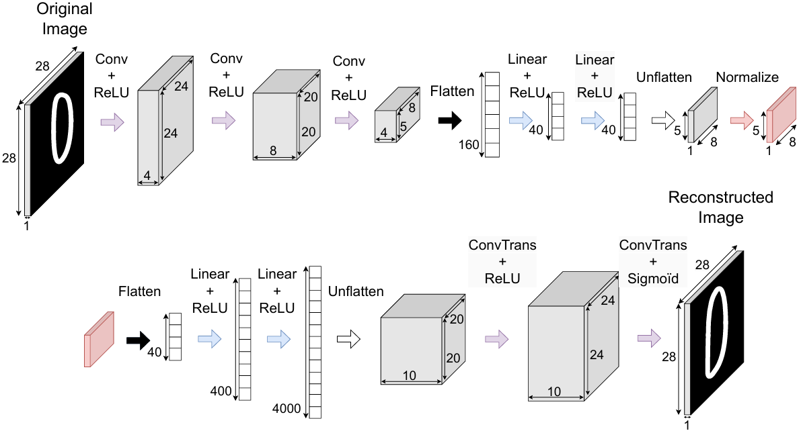
LatentQGAN
Vieloszynski, et al.
18/02/2025
Autoencoder
LatentQGAN Architecture
CNN-based encoder and decoder, extracts latent representation and reconstructs input images
encoder applies per-line normalization, to be compatible with generator output

Slide 11

LatentQGAN
Vieloszynski, et al.
18/02/2025
Experiment Settings
Tests
tests on simulators and real quantum computers, 2048-shot experiments
MNIST dataset: $28×28$ grey-scale handwritten digits
autoencoder compresses images into a $(5×8)$ latent space
q-generator with 5 sub-circuits, 4 qubits each, and 140 trainable parameters
autoencoder trained first, minimizing MSE as reconstruction loss
q-GAN trained using the SGD optimizer and BCE loss
evaluation with Fréchet Inception Distance (FID): high-level full-reference metric, compares distributions of generated and real images
LatentQGAN compared to both quantum (QPatchGAN and MosaiQ) and classical methods (LatentGAN and RandomDecoder)

Slide 12
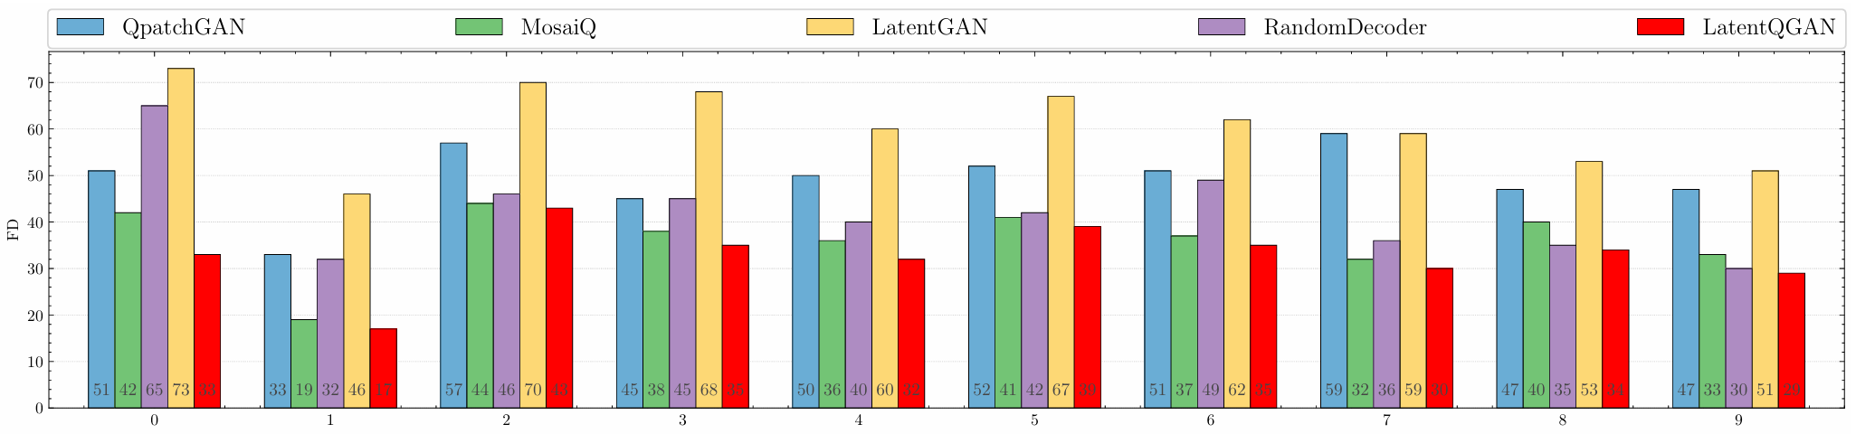
LatentQGAN
Vieloszynski, et al.
18/02/2025
Results
Tests
LatentQGAN achieves best FID between 350 and 700 iterations
it outperforms quantum methods like QPatchGAN and MosaiQ
other QGAN models perform well in simulations but are impractical on current NISQ devices as they require significantly more parameters and iterations
LatentQGAN outperforms classical LatentGAN with same number of parameters, emphasizing the advantages of the quantum generator

Slide 13
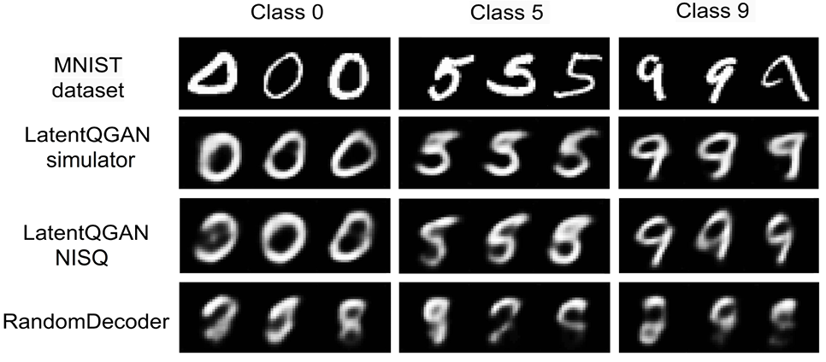
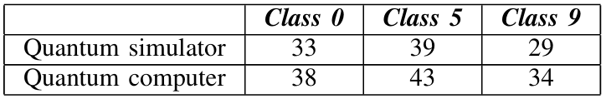
LatentQGAN
Vieloszynski, et al.
18/02/2025
Results
Tests
autoencoder is crucial but the generator ensures meaningful latent space representations: RandomDecoder fails without it
results on real quantum hardware show slightly lower FID due to noise, but generated images remain visually recognizable

Slide 14
LatentQGAN
Vieloszynski, et al.
18/02/2025
Conclusions
LatentQGAN
hybrid quantum-classical GAN: classical discriminator, quantum generator
autoencoder to project to and from lower-dimensional space
uses shallow quantum-circuits to allow efficient use of NISQ devices
Limitations
quantum noise and hardware limitations could limit deployment beyond small-scale tests
scalability to larger datasets (more complex, high-resolution) uncertain, especially given quantum hardware limitations
Future work
explore extending LatentQGAN to a full quantum implementation
application to other tasks, like time-series data processing and anomaly detection

Slide 15
LatentQGAN
Vieloszynski, et al.
18/02/2025
References
Vieloszynski, S., Cherkaoui, O., Ahmad, J.-F., Laprade, O., Nahman-Lévesque, A., Aaraba, & Wang, S. (2024). LatentQGAN: A Hybrid QGAN with classical convolutional autoencoder.
Bank, D., Koenigstein, N., & Giryes, R. (2021). Autoencoders.
Fedus, W., Rosca, M., Lakshminarayanan, B., Dai, A. M., Mohamed, S., & Goodfellow, I. (2018). Many paths to equilibrium: GANs do not need to decrease a divergence at every step.
Goodfellow, I. J., Pouget-Abadie, J., Mirza, M., Xu, B., Warde-Farley, D., Ozair, S., Courville, A., & Bengio, Y. (2014). Generative adversarial networks.
Heusel, M., Ramsauer, H., Unterthiner, T., Nessler, B., & Hochreiter, S. (2018). GANs trained by a two time-scale update rule converge to a local Nash equilibrium.
Huang, H.-L., Du, Y., Gong, M., Zhao, Y., Wu, Y., Wang, C., Li, S., Liang, F., Lin, J., Xu, Y., Yang, R., Liu, T., Hsieh, M.-H., Deng, H., Rong, H., Peng, C.-Z., Lu, C.-Y., Chen, Y.-A., Tao, D., Zhu, X., & Pan, J.-W. (2021). Experimental quantum generative adversarial networks for image generation. Physical Review Applied, 16(2).
Adedoyin, A. J., Ambrosiano, J., Anisimov, P., Casper, W., Chennupati, G., Coffrin, C., Djidjev, H., Gunter, D., Karra, S., Lemons, N., Lin, S., Malyzhenkov, A., Mascarenas, D., Mniszewski, S., Nadiga, B., O’Malley, D., Oyen, D., Pakin, S., Prasad, L., ... Lokhov, A. Y. (2022). Quantum algorithm implementations for beginners. ACM Transactions on Quantum Computing, 3(4).
Kingma, D. P., & Welling, M. (2013). Auto-encoding variational Bayes.
Nation, P. D., Kang, H., Sundaresan, N., & Gambetta, J. M. (2021). Scalable mitigation of measurement errors on quantum computers. PRX Quantum, 2(4).
Novais, E., & Baranger, H. U. (2006). Decoherence by correlated noise and quantum error correction. Physical Review Letters, 97(4).
Preskill, J. (2018). Quantum computing in the NISQ era and beyond. Quantum, 2, 79.
Prykhodko, O., Johansson, S., Kotsias, P.-C., Bjerrum, E., Engkvist, O., & Chen, H. (2019). A de novo molecular generation method using latent vector-based generative adversarial network.
Schuld, M., Bergholm, V., Gogolin, C., Izaac, J., & Killoran, N. (2019). Evaluating analytic gradients on quantum hardware. Physical Review A, 99(3).
Schuld, M., & Petruccione, F. (2021). Machine Learning with Quantum Computers. Springer Nature.
Silver, D., Patel, T., Cutler, W., Ranjan, A., Gandhi, H., & Tiwari, D. (2023). MosaiQ: Quantum generative adversarial networks for image generation on NISQ computers.
Piqué, G. Pikerozzo / qml_latentqgan. url: https://github.com/Pikerozzo/qml_latentqgan. (accessed: 13.02.2025).

