Slide 1
Stack and Subroutine
Presented by:
Dr. Sk Babar Ali
Associate Professor
ECE department, Aliah University

Slide 2
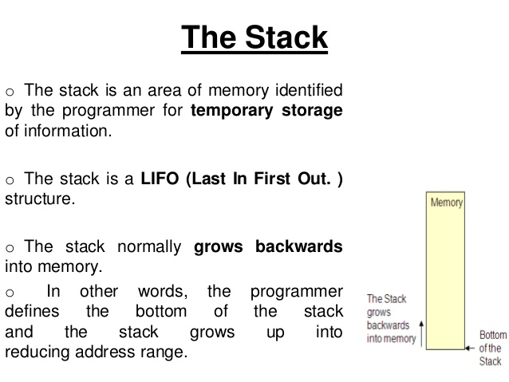

Slide 3
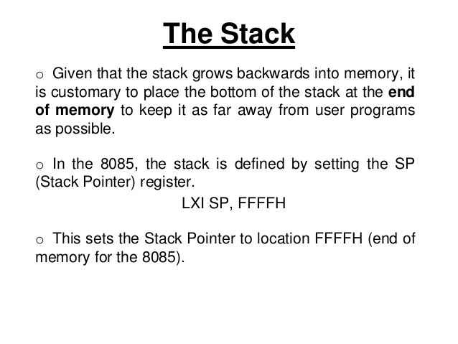

Slide 4
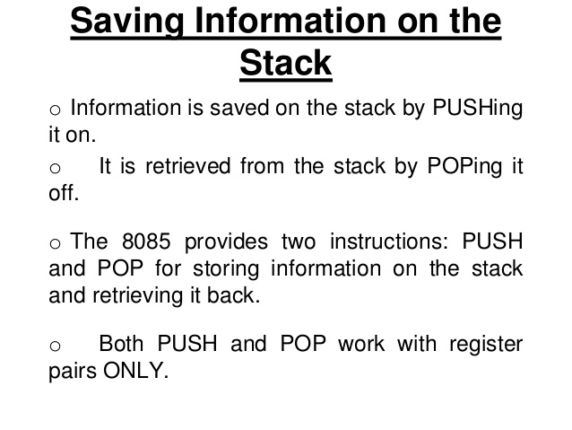

Slide 5
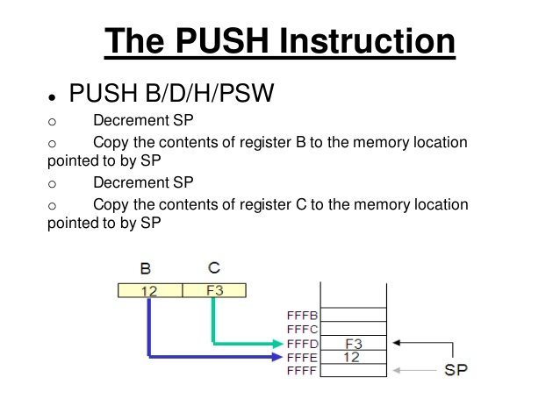

Slide 6
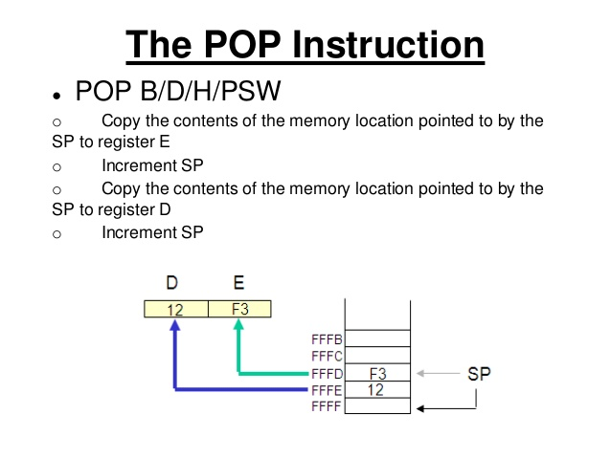

Slide 7
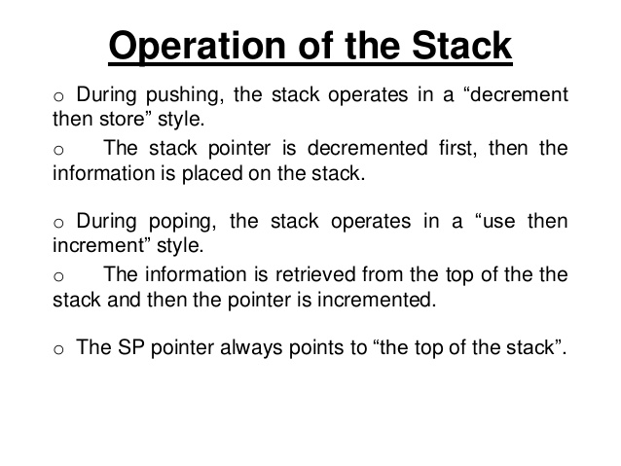

Slide 8
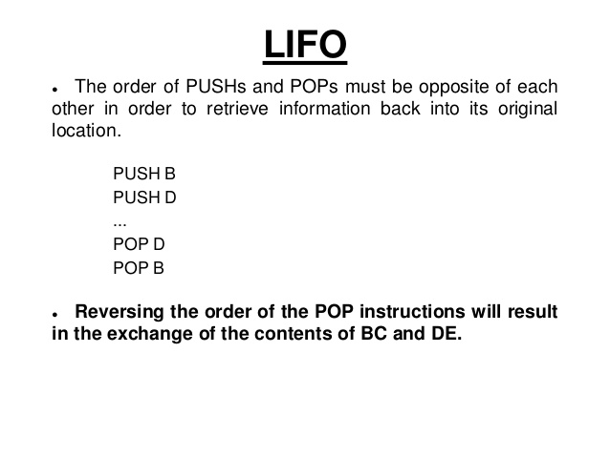

Slide 9
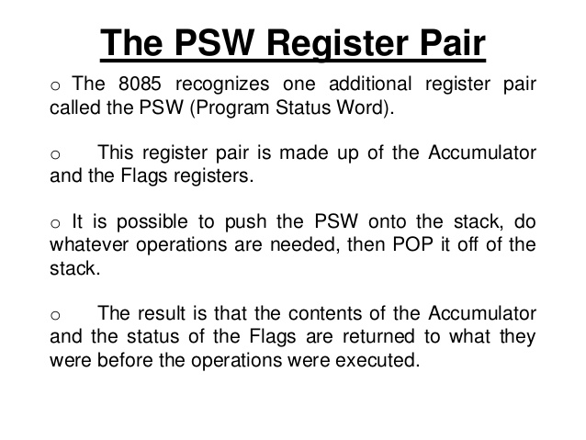

Slide 10
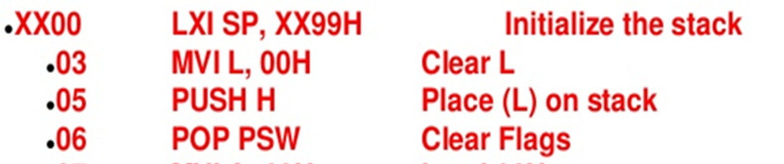
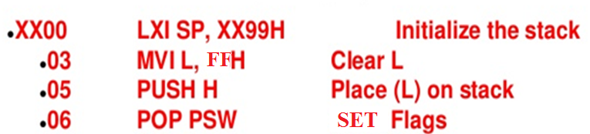
Write a program to clear the all flags.
Write a program to set the all flags.

Slide 11
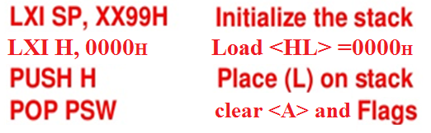
Write a program to clear the all flags and content of accumulator.

Slide 12
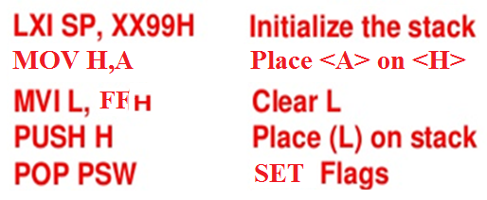
Write a program to set the all flags with out effected the content of accumulator.

Slide 13
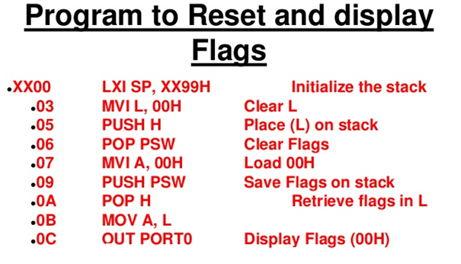

Slide 14
Any questions…….

