Slide 1
Stack and Subroutine
Presented by:
Dr. Sk Babar Ali
Associate Professor
ECE department, Aliah University

Slide 2
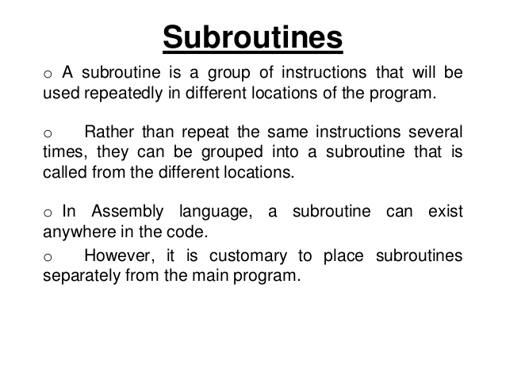

Slide 3
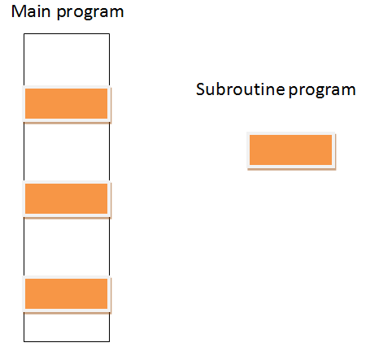

Slide 4
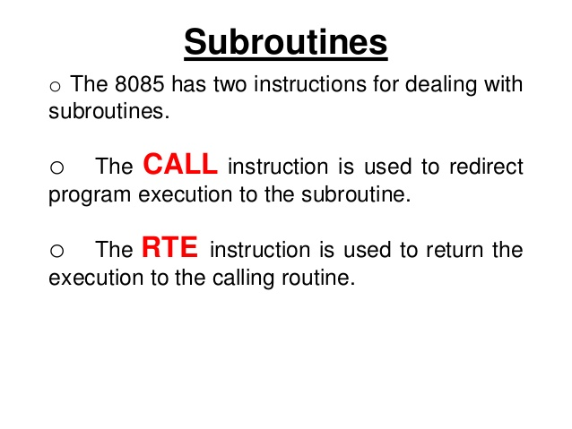

Slide 5
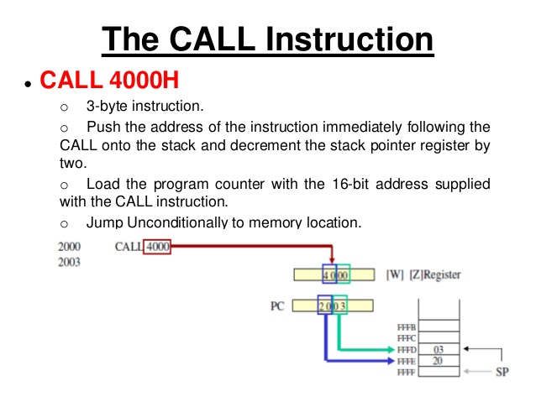

Slide 6
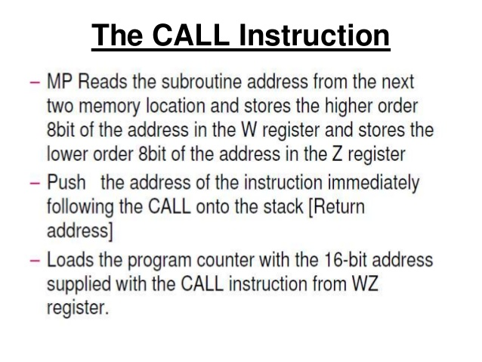

Slide 7
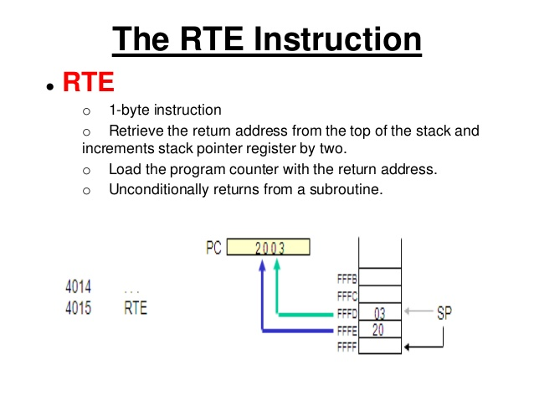

Slide 8
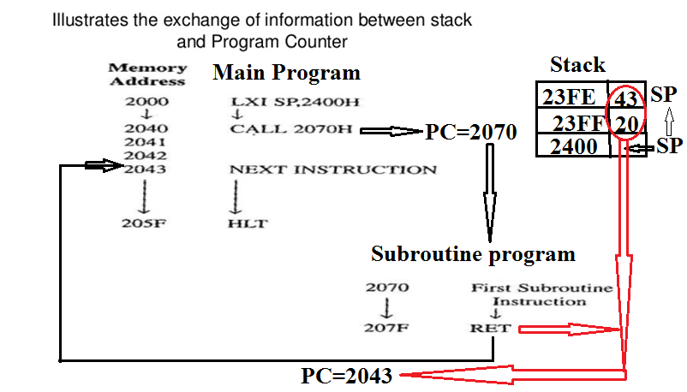

Slide 9
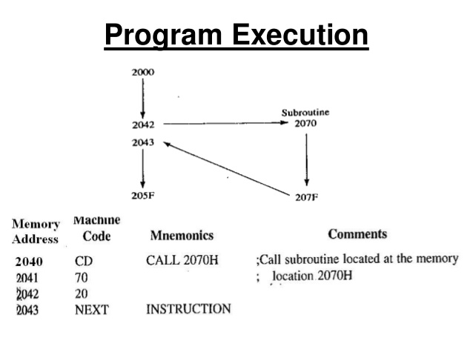

Slide 10
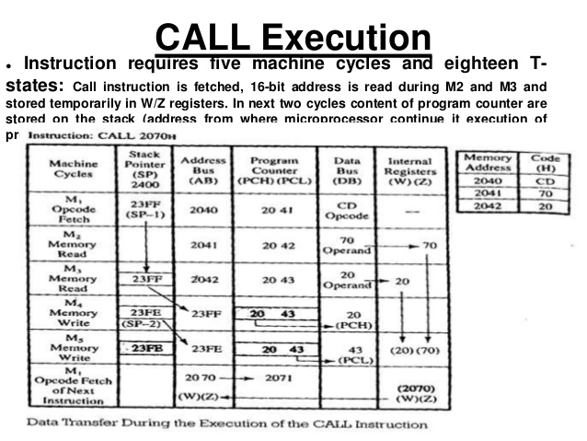

Slide 11
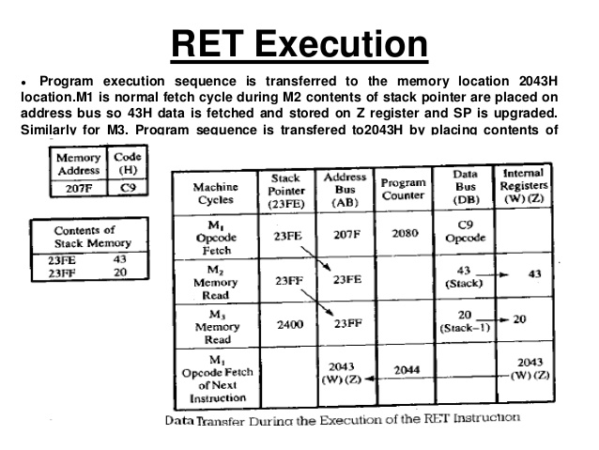

Slide 12
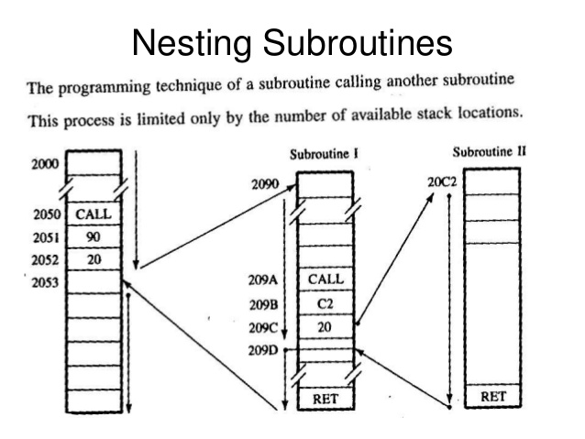

Slide 13
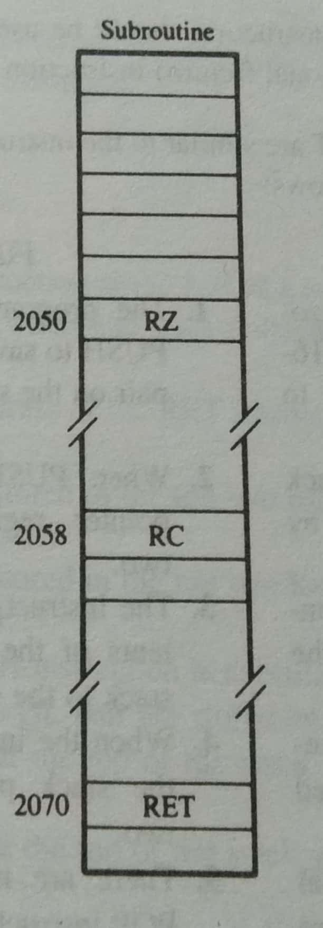
Multiple Ending Subroutine
The subroutine has conditional return and one unconditional return (RET)
If condition is true then return to the main program other wise return to the main program with RET instruction.

Slide 14
Any questions…….

