Slide 1
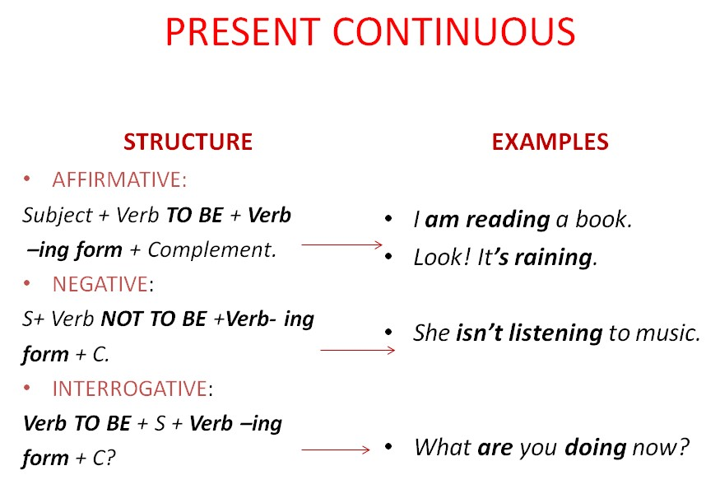

Slide 2
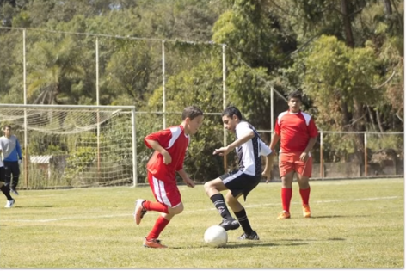
This picture shows a group of teenagers playing soccer football on a sunny day.
I can see 4 or 5 teenage boys, divided in two teams.
In the background, I can see the goal and the goalkeeper, as well as a lot of vegetation, especially trees.

Slide 3
Thank you !

