Slide 1


Containers, containers, containers
<your name goes here>

Slide 2
Virtual Machines vs Containers
App A
App A
App B
Dependencies
Dependencies
Dependencies
VM
App A
App A
App B
Guest OS
Guest OS
Guest OS
Container
Dependencies
Dependencies
Hypervisor
Container Engine
Host OS
Host OS
Server
Server
Virtual Machines
Containers

Slide 3
Docker
Writeable Container
COPY somefiles
RUN apt-get install –y nodejs npm git git-core
RUN apt-get update
Base Image: Ubuntu
Read only images
Docker Hub

Slide 4
Dockerfile
FROM ubuntu:14.04 RUN apt-get update RUN apt-get install -y nodejs npm git git-core
# Bundle app source COPY . /src
EXPOSE 8080 CMD ["nodejs", "/src/server.js"]

Slide 5
Docker Demo

Slide 6
Containers:
Means to an end
(just one piece of the puzzle)

Slide 7

Notes:
Describe the services that cloud foundry provides.
Explain CF version 2.0 uses Warden not docker for the container.

Slide 8
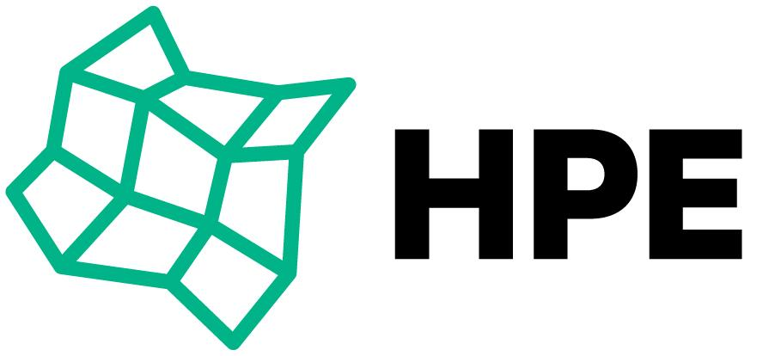
Helion Stackato
Notes:
Value is in the ecosystem

Slide 9
HPE Helion Stackato Demo

Slide 10
Diego

Slide 11
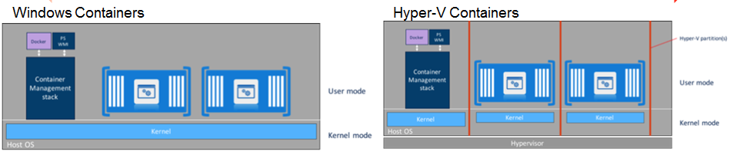
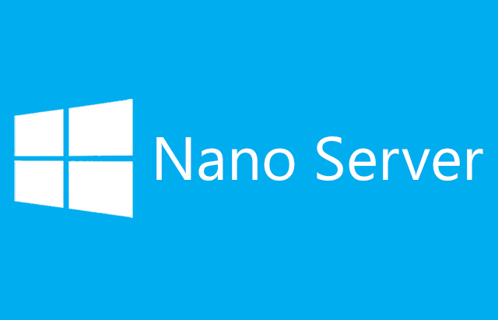
Diego
& Windows

Slide 12
Hands on links
Helion Stackato VirtualBox or VMware Fusion/Player
Download for free at: www.hpe.com/helion/developers

