Slide 1
MIPS ALU

Slide 2
Building from the adder to ALU
ALU – Arithmetic Logic Unit, does the major calculations in the computer, including
  Add
  And
  Or
  Sub
  …
In MIPS, the ALU takes two 32-bit inputs and produces one 32-bit output, plus some additional signals
Add is only one of the functions, and in this lecture, we are going to see how an full ALU is designed

Slide 3
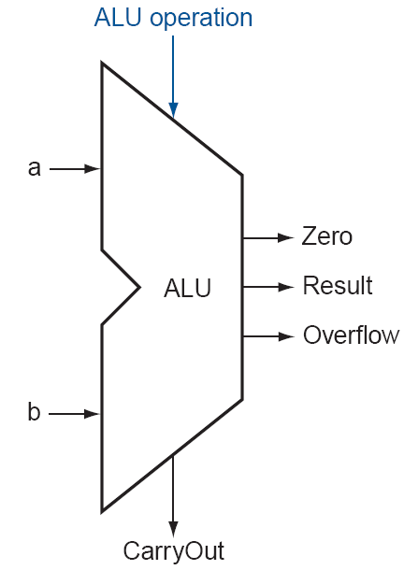
ALU

Slide 4
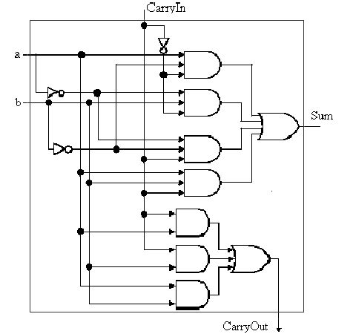
Review
1-bit full adder

Slide 5
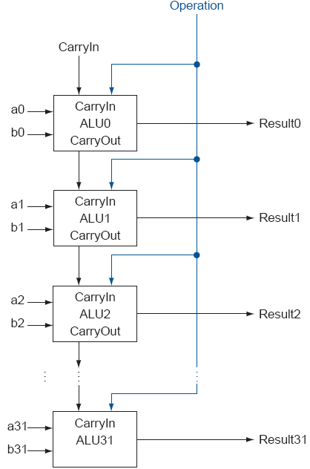
32-bit adder

Slide 6
Building 32-bit ALU with 1-bit ALU
Build 32-bit ALU with 1-bit ALU.
Deal with the easy ones first – “and” and “or”

Slide 7
And and Or operations
And
a
And result
b
Or
a
Or result
b

Slide 8
Putting them together
Sometimes the instruction is add, sometimes it is or, sometimes is and, how to “put them together?”
In MIPS instructions, there are many fields: op, funct, rs, rt, rd, shamt…

Slide 9
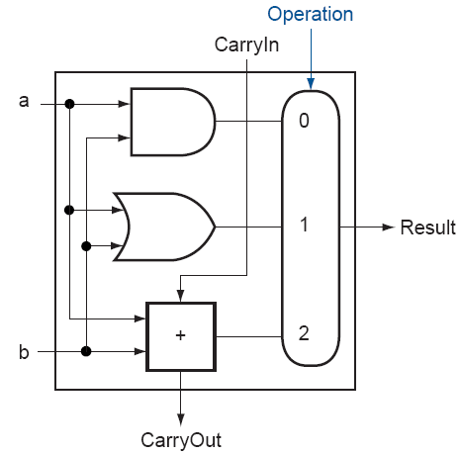
Putting them together
Just do everything (add, and, or) and then select one AS the output with a selector.

Slide 10
Subtraction?
How to implement subtraction?

Slide 11
Subtraction
Using two’s complement representation, we can implement subtraction through addition
The reason is that a negative number -b in 2’s complement is actually 2^{n}-b. So if you do a+2^{n}-b and take only the lower n bits, it becomes a-b because 2^{n} is a one bit at bit n (bit indices are 0,1,2,…, n-1, n).
What do we need to add to the ALU we have in order to be able to perform subtraction?

Slide 12
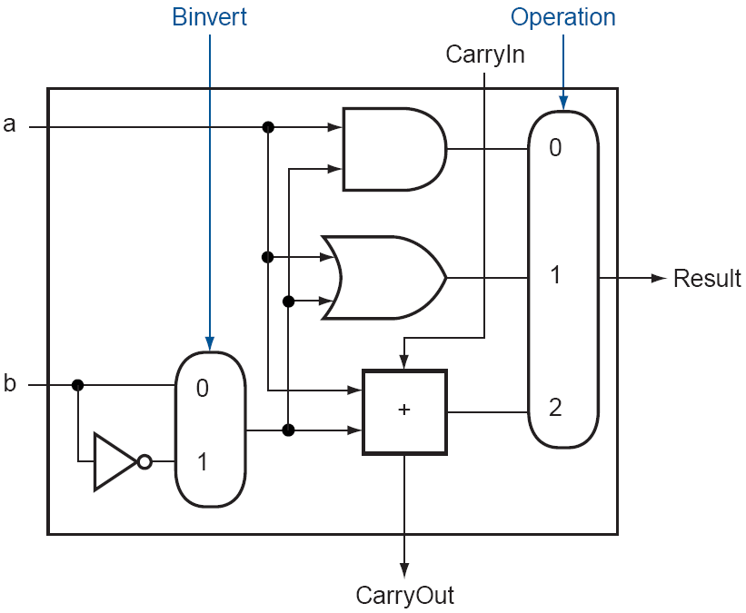
1-Bit ALU That can Do Subtraction
To do a-b, three things:
  Invert every bit of b.
  Add 1.
  Add with a.
So, if it is a subtraction, invert the second operand, set the CarryIn of the last one-bit full adder to be 1, then select the adder output.

Slide 13
Subtraction
Notice that every time we want the ALU to subtract, we set both CarryIn and Binvert to 1. For add or logical operations, we want both control lines to be 0. We can therefore simplify control of the ALU by combining the CarryIn and Binvert to a single control line called Bnegate.

Slide 14

Supporting Branch Instructions
We need to be able to test if two numbers are the same

Slide 15

Supporting Set Less Than
Set less than instruction produces 1 if rs < rt, and 0 otherwise
  It needs to set all but the least significant bit to 0
  The least significant bit is set according to the comparison
    Which can be done using subtraction
    That is, do a subtraction, check the sign bit (bit 31).

Slide 16
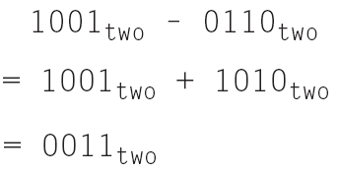
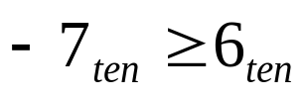
Complication
If we only use the sign bit of the adder, sometimes we will be wrong
  For the following example (using 4 bits only), we have
  Then we have , which is clearly wrong

Slide 17
Overflow
The problem is that sometimes we have overflow.
  If we have only 4 bits, a number greater than 7 or a number less than -8 will cause an overflow because it cannot be represented in 4 bits.
  In the previous example, -7-6=-13, overflowed.

Slide 18
Dealing with overflow
Overflow happens when the two numbers are of the same sign.
  If they are of different signs, the addition result will be less than the larger one (the absolute value) and should be still within the range, assuming the two original numbers are within the range.

Slide 19
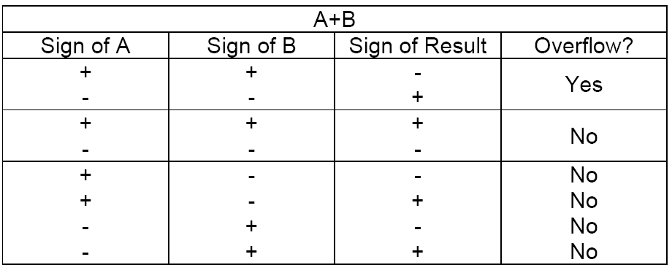
Overflow Detection
  One way to detect overflow is to check whether the sign bit is consistent with the sign of the inputs when the two inputs are of the same sign – if you added two positive numbers and got a negative number, something is wrong, and vice versa.

Slide 20
Dealing with overflow
For two positive numbers, after the addition,
  The carryout of ALU31 must be 0, because in 2’s complement, positive numbers go from 000…1 to 011..1. The largest number is 011…1 and adding two 011…1 will lead to 111…10, the carry out is still 0.
  if no overflow, the sign bit (bit 31) should be 0, because the result is a positive number.
  If overflowed, the sign bit (bit 31) will be 1, caused by a carryin to ALU31.

Slide 21
Dealing with overflow
For two negative numbers, after the addition,
  The carryout of ALU31 must be 1, because in 2’s complement, negative numbers go from 100…0 to 111..1. Even if you are just adding two 100…0, you will have 1000…00, the carry out is 1.
  if no overflow, the sign bit (bit 31) should be 1, because the result is a negative number.
  If overflowed, the sign bit (bit 31) will be 0, caused by having no carryin to ALU31.

Slide 22
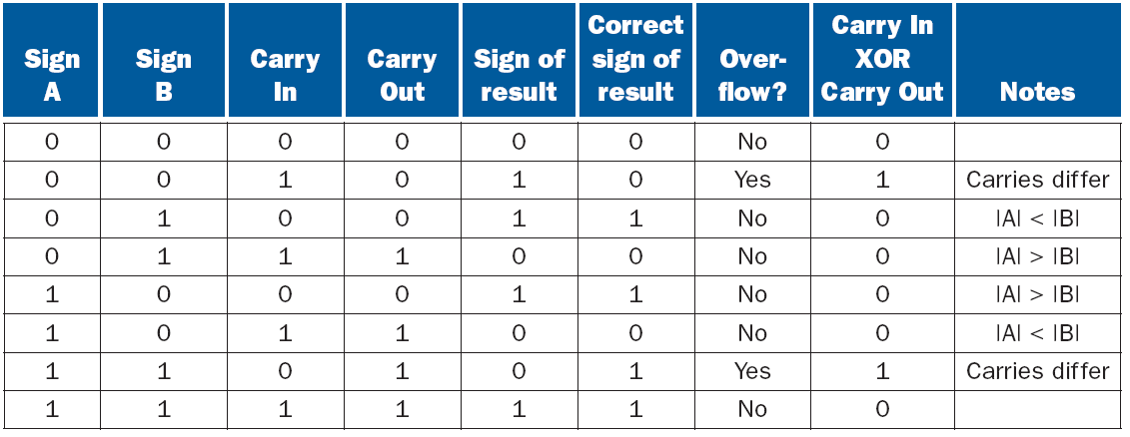
Overflow Detection
So, we can detect the overflow by checking if the CarryIn and CarryOut of the most significant bit are different

Slide 23
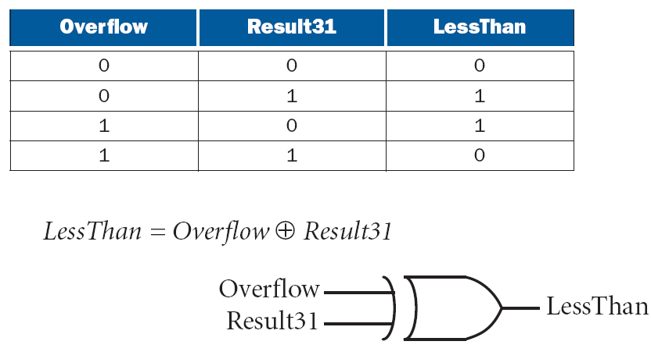
Overflow
The sign bit is correct if there is no overflow
If there is overflow, the sign bit will be wrong and needs to be inverted

Slide 24
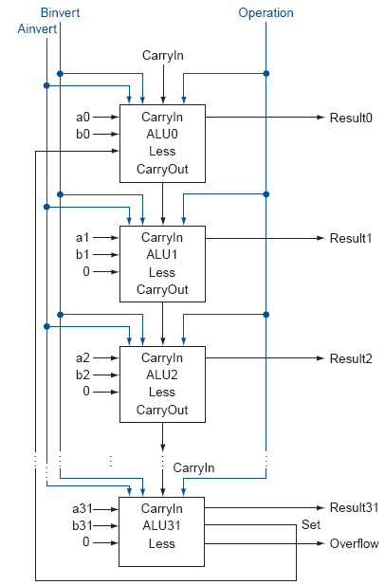
32-bit ALU that Supports Set Less Than

Slide 25
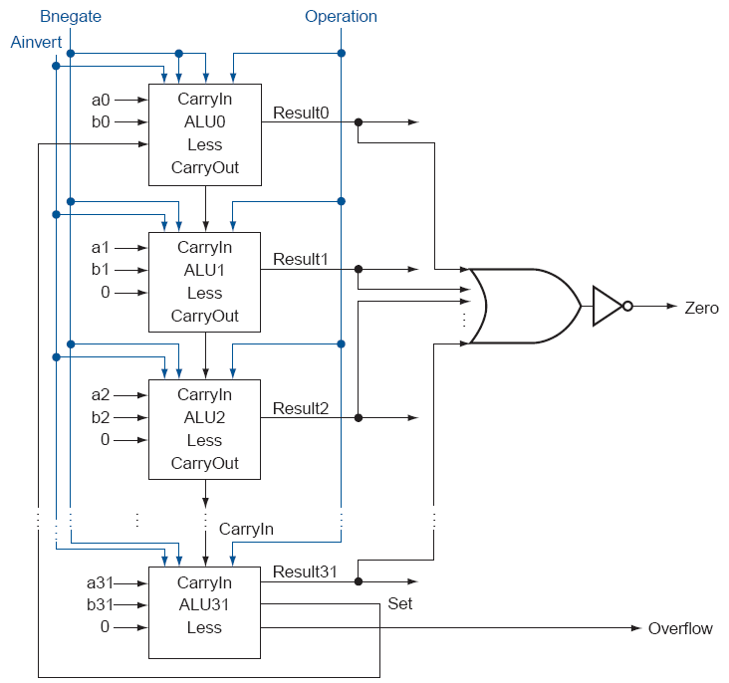
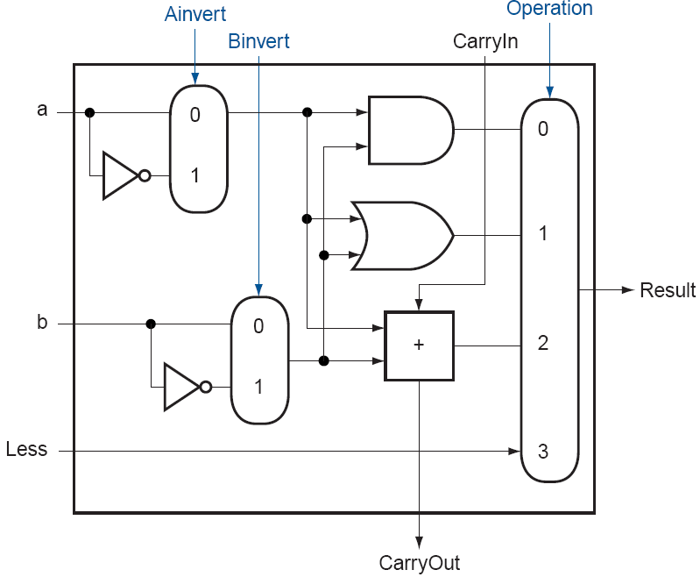
Final
32-Bit
ALU

Slide 26
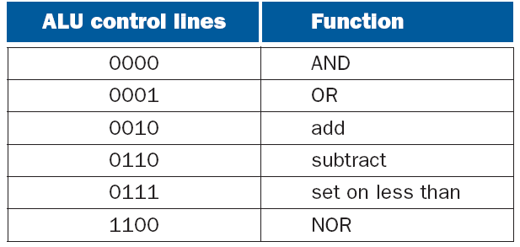
Final 32-Bit ALU
ALU control lines are 1-bit Ainvert line, 1-bit Bnegate line, and 2-bit operation lines

Slide 27
ALU Symbol

