Slide 1
eBPF for Mesh
Network Monitoring
Advisor
Supervisor
Carlos Tiago Gomes Pinto
Rui Pedro de Magalhães Claro Prior
Eduardo Filipe Amaral Soares

Slide 2
Motivation
Find the causes for changes in a mesh network.
Use eBPF as it grants access to the whole kernel.
Objective: Create a tool that can detect changes in a mesh network and associate them to the packets that caused them for later analysis.

Slide 3
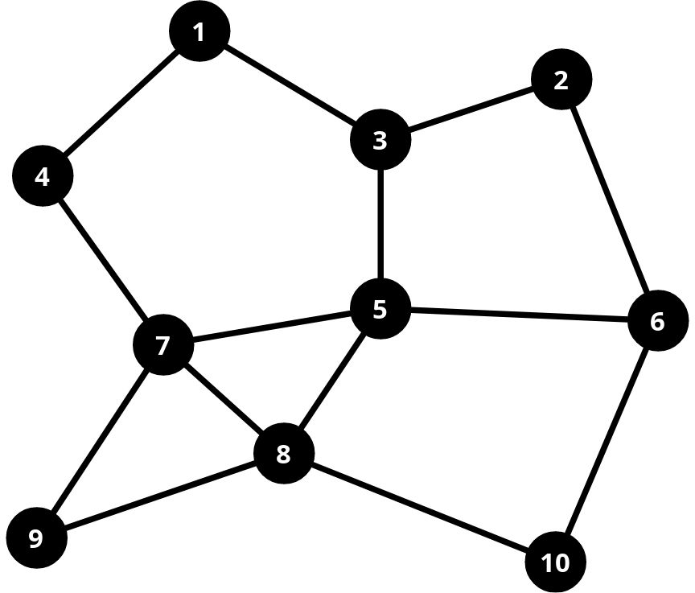
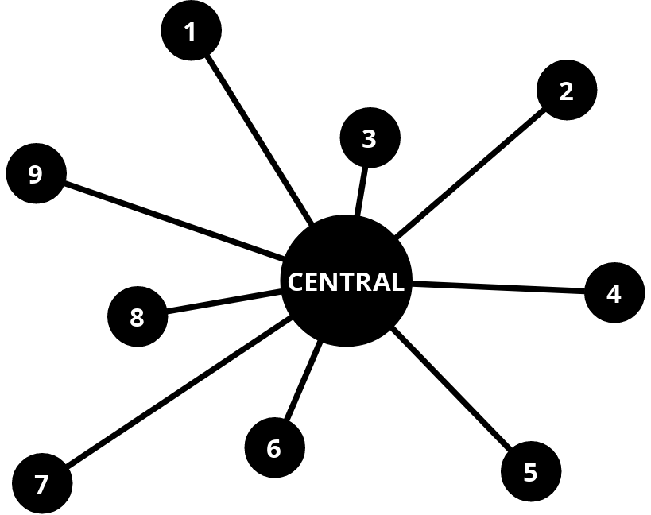
Mesh Networks
Conventional Network
Mesh Network
Source: IEEE Standard for Information Technology – Part 11: Wireless LAN Medium Access Control (MAC) and Physical Layer (PHY) Specifications (1)

Slide 4
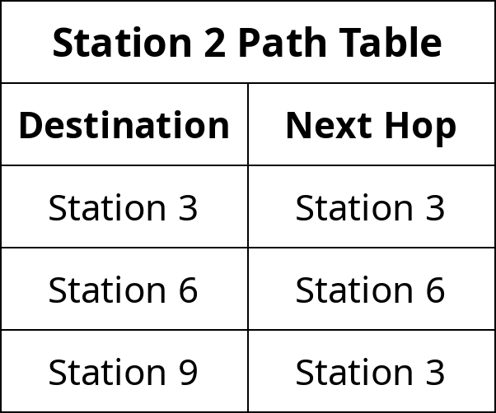
Mesh Networks
Mesh Network
Source: IEEE Standard for Information Technology – Part 11: Wireless LAN Medium Access Control (MAC) and Physical Layer (PHY) Specifications (1)

Slide 5
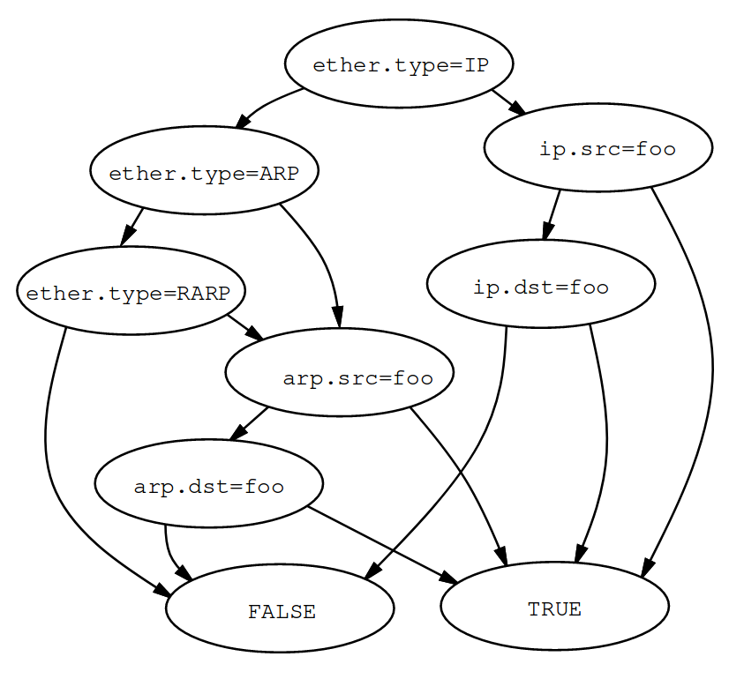
BPF
Originally a tool to write packet filters.
Better performance than the other alternatives at the time.
Source: The BSD Packet Filter: A New Architecture for User-Level Packet Capture (2)

Slide 6
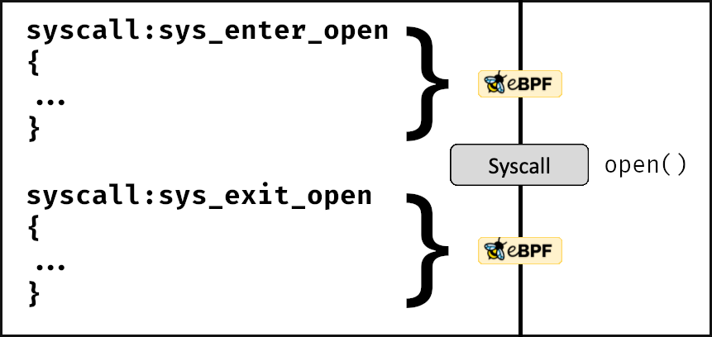
eBPF
Adapted from BPF by Alexei Starovoitov, runs programs inside the kernel.
Received improvements like arithmetic operations and ability to use pointers.
Programs are executed on kernel events, like functions calls and I/O operations.
Storage of information in BPF maps.
Source: A thorough introduction to eBPF (3)

Slide 7



eBPF Tools
BCC
bpftrace
libbpf + CO-RE

Slide 8
eBPF Tools
BCC
bpftrace
libbpf + CO-RE
+
+
-
A lot of documentation and tutorials
Needs kernel header packages
Programs are recompiled on every run
Simple to use
Needs kernel header packages
No easy way to send data to other programs
Little documentation
Single-time compilation
Doesn’t need kernel header packages
Kernel needs to be compiled with BTF support
-
+
-
-
+
-
-

Slide 9
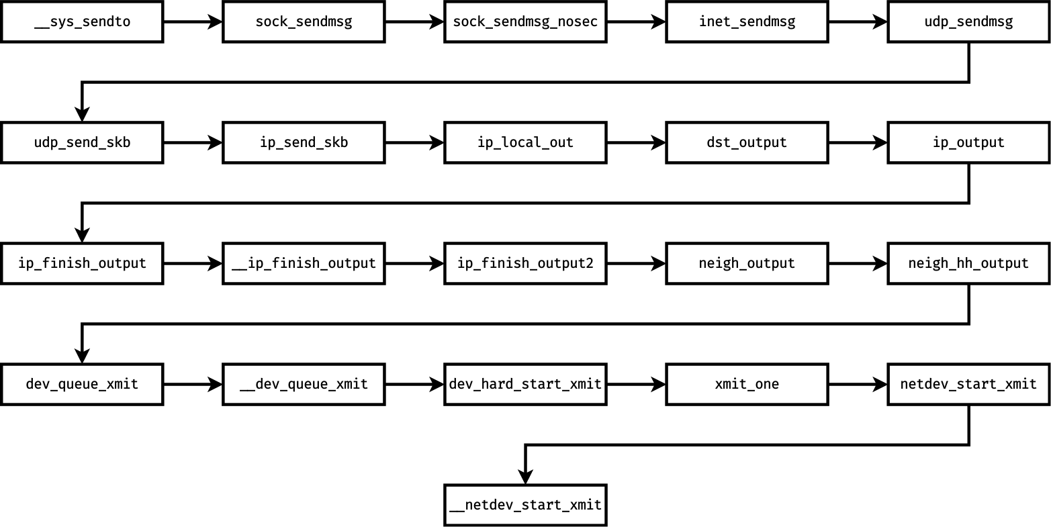
Kernel Analysis
sendto Call Stack

Slide 10
Kernel Analysis
sendto Call Stack

Slide 11
Kernel Analysis
sendto Call Stack

Slide 12
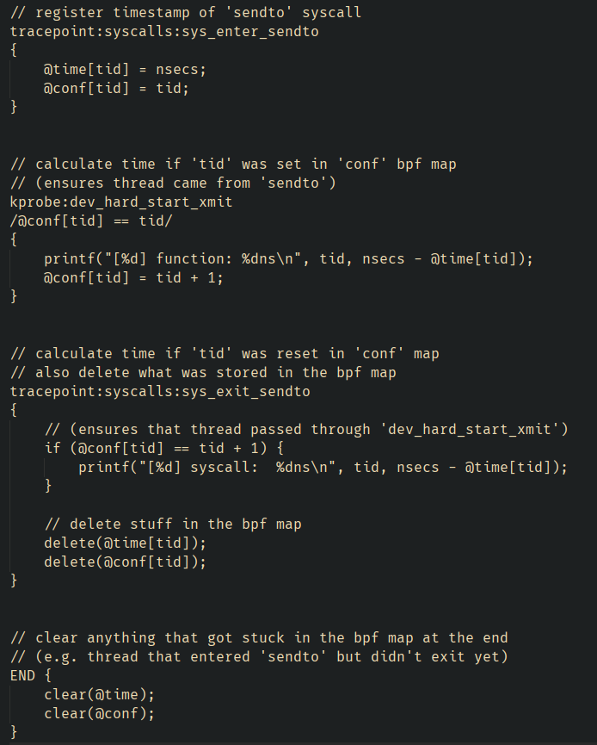
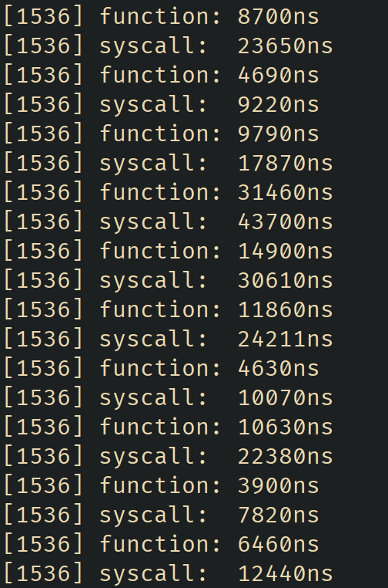
Kernel Analysis

Slide 13
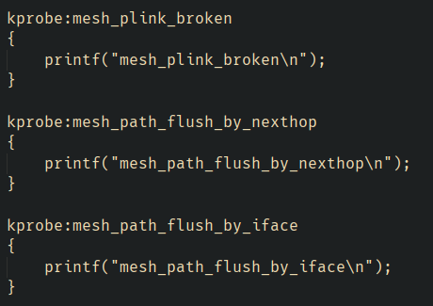
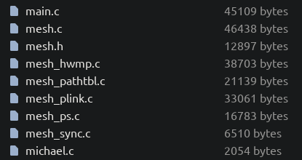
Mesh Functions Analysis

Slide 14
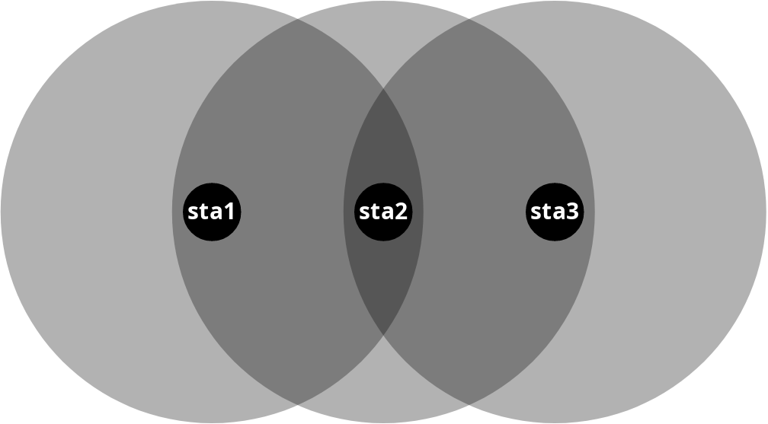
Mesh Functions Analysis
Functions of interest:
mesh_path_add
mesh_path_assign_nexthop
mesh_path_del
Topology Used

Slide 15
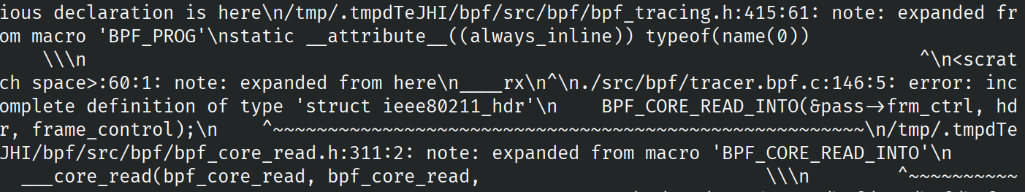
BCC vs. CO-RE
Tried using CO-RE. Problem with the file generated by:
bpftool btf dump file /sys/kernel/btf/vmlinux format c > src/bpf/vmlinux.h
Tried using BCC. Worked on the first try.

Slide 16
Information Capture
Capture of packet data:
Not available in the mesh functions.
Need to find other functions or tracepoints where the packet data is available (sk_buff).
Capture of mesh path information:
mesh_path_add
mesh_path_assign_nexthop
mesh_path_del
Using the functions’ arguments.

Slide 17
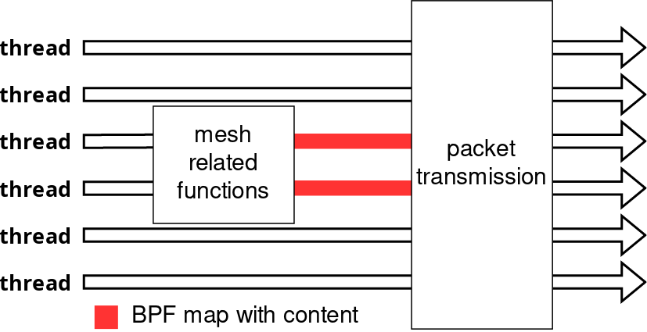
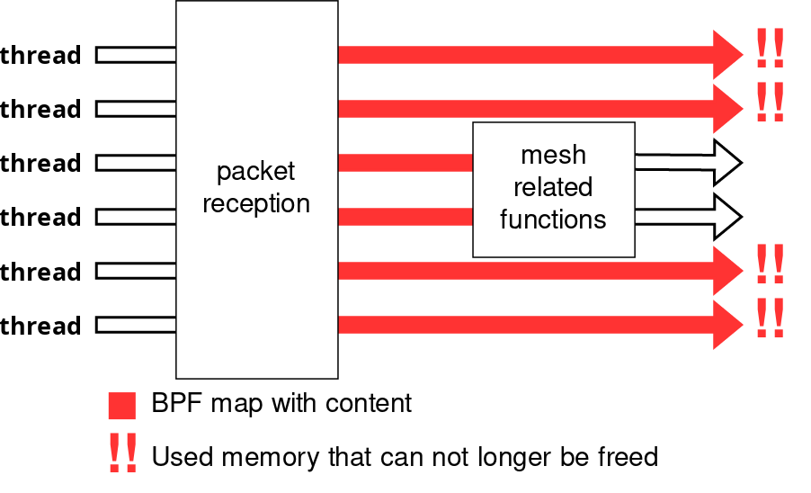
Information Capture
Packet Transmission
Packet Reception
Solution: ieee80211_mesh_rx_queued_mgmt

Slide 18
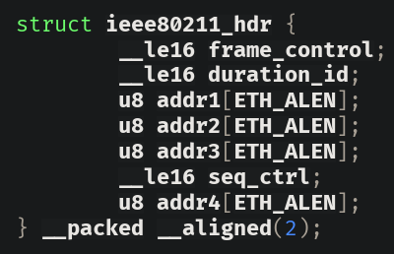
Information Capture
Structure used to retrieve packet information

Slide 19
BCC vs. CO-RE (leaving the emulated environment)
After finishing the first version of the working program, we tried testing with hardware (a tower PC, two laptops, and a Raspberry Pi), but faced some problems:
Kernel headers packages of most Linux distributions don’t provide all the headers, so we ran into “unknown structure definition” errors in all systems except for the tower PC.
Tried CO-RE again, and this time it worked.
  There are more files in /sys/kernel/btf/, one for each kernel module, and using the mac80211 one solved our issue from before.
Raspberry Pi didn’t work because its kernel wasn’t compiled with BTF support.

Slide 20
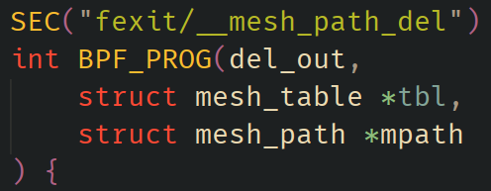
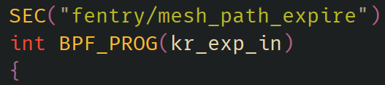
BCC vs. CO-RE (leaving the emulated environment)
With the switch from BCC to CO-RE, the code needed to be updated:
User-space portion of the code was rewritten from Python to Rust.
One of the fields we captured in mesh_path_del wasn’t being captured with CO-RE.
  Found the existence of __mesh_path_del and switched to it.
  This new function is called from more places, like mesh_path_expire, so we included probes for that

Slide 21
Events
Path Addition
Path Deletion
mesh_path_add
__mesh_path_del
Path Expiration
mesh_path_expire
Path Modification
mesh_path_assign_nexthop

Slide 22
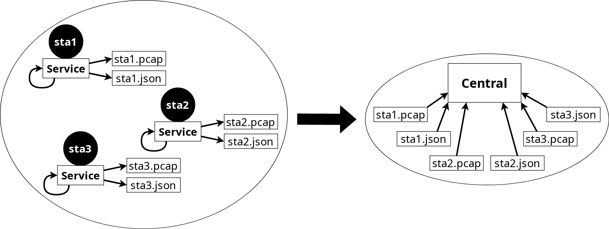
Tool Developed
Usage of the tool

Slide 23
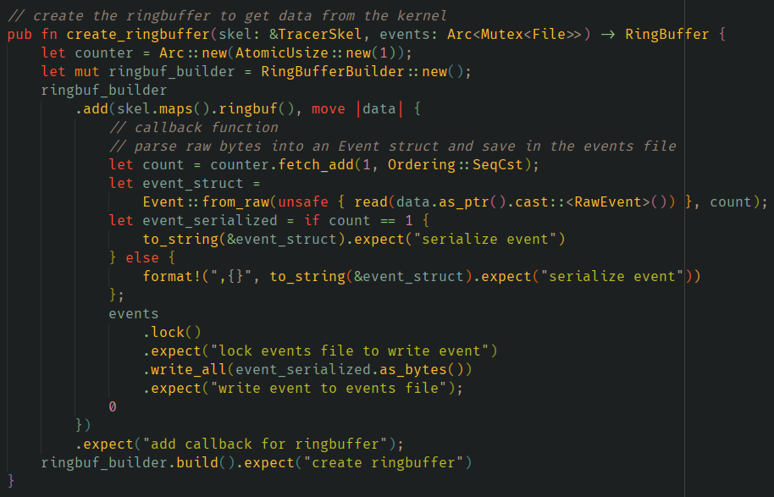
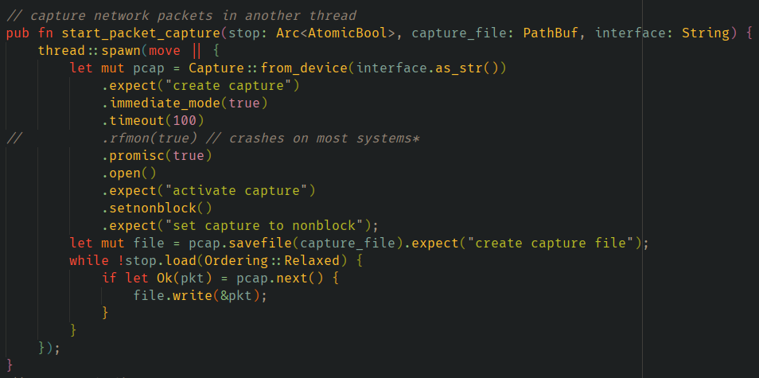
Tool Developed (Service)
Event Capture Thread
Packet Capture Thread

Slide 24
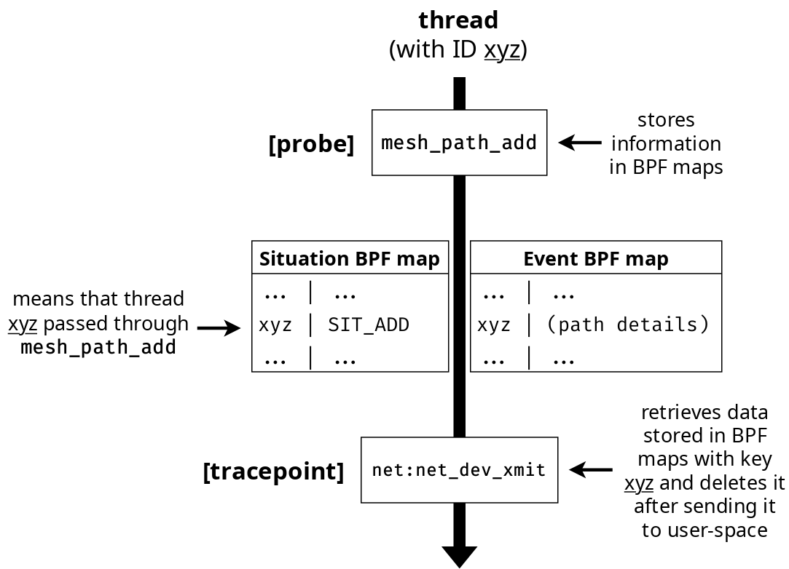
Tool Developed (Service)

Slide 25
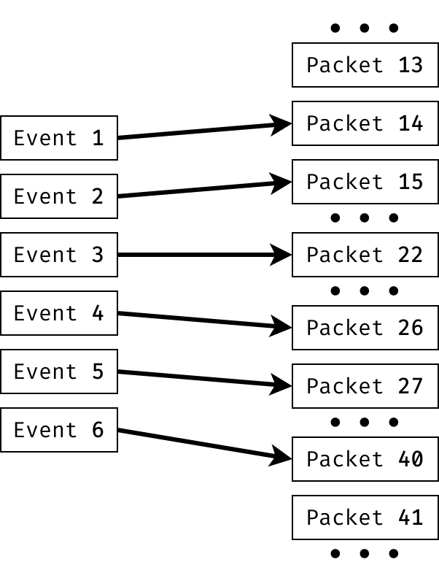
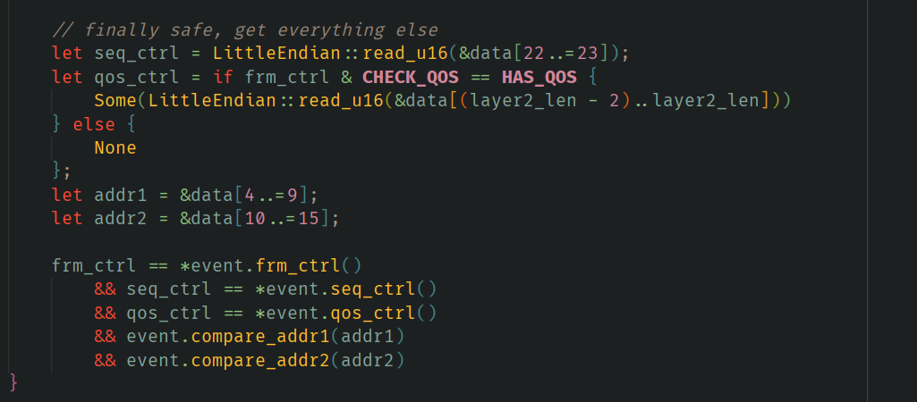
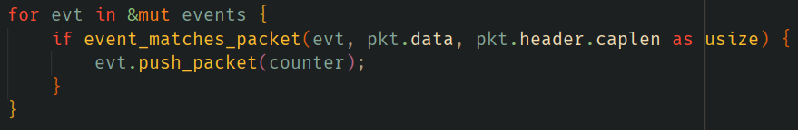
Tool Developed (Service)
Packet ↔ Event Relation

Slide 26
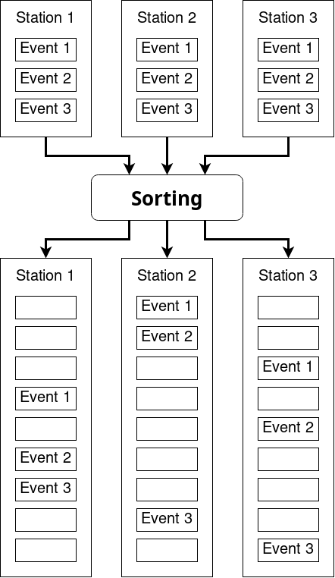
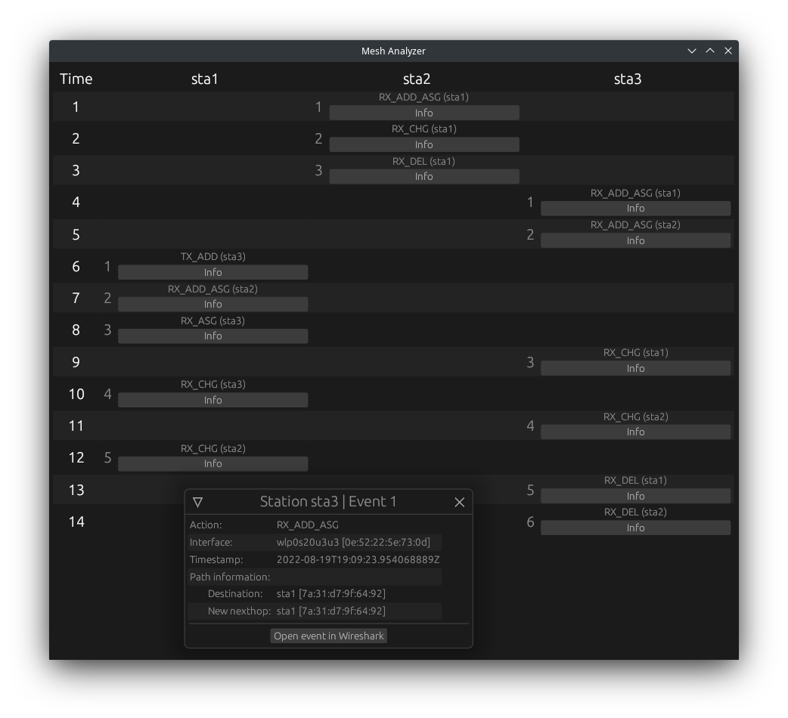
Tool Developed (Central)

Slide 27
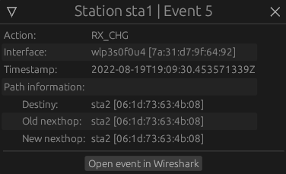
Testing
In tests with hardware nodes, we found some unexpected events that supposedly didn’t change any fields. After some inspection, we determined that fields we were not capturing were being changed.
Captured event shown by the tool

Slide 28
Conclusion
Success in creating a tool to detect changes in a mesh network using eBPF.
Tool can be further improved:
  Capture more information about paths.
  Use packet ordering in addition to timestamps to improve event ordering.
  Automatic submission of the output files to a server on termination.

Slide 29
References
IEEE Standard for Information Technology–Telecommunications and Information Exchange between Systems - Local and Metropolitan Area Networks–Specific Requirements - Part 11: Wireless LAN Medium Access Control (MAC) and Physical Layer (PHY) Specifications
[ISBN: 9781504472838]
Steven McCanne and Van Jacobson. ‘The BSD Packet Filter: A New Architecture for User-Level Packet Capture’. In: Proceedings of the USENIX Winter 1993 Conference Proceedings on USENIX Winter 1993 Conference Proceedings
A thorough introduction to eBPF: https://lwn.net/Articles/740157/ (2022-09-27)

