Slide 1
DoConnect Project (Moderate Q&A Platform)
Presented By:
Pilli Veda Satya Suma

Slide 2
Abstract
Moderated Q&A platform for posting questions, answers, and images
Admin role ensures content quality and compliance
Features: Secure authentication, role-based access, optimized database
Testing strategies to maintain reliability and accuracy
Covers: Problem statement, objectives, system design, testing, and deployment
Future enhancements: Real-time notifications, AI-driven moderation, mobile app

Slide 3
Introduction
Knowledge sharing & community engagement
Overcomes limitations of existing platforms (Stack Overflow, Quora)
Features:
Moderated discussion environment
Secure authentication & role-based access
Optimized database performance
Responsive Angular interface
API-driven architecture for scalability

Slide 4
Problem Definition
Existing Q&A platforms lack:
No strong moderation
Poor database optimization
Weak authentication methods
Limited API integration
Challenges: High hosting costs, complex maintenance, poor performance in niche use cases

Slide 5
Existing System
Popular Q&A platforms: Stack Overflow, Quora
Limitations:
High cost
No detailed moderation
Complex to maintain
Performance problems

Slide 6
Proposed System
JWT authentication & role-based moderation
Image upload for questions and answers
Search with pagination for better performance
Unit & integration testing (xUnit, Moq)
Responsive Angular UI for better user experience
API-driven architecture for scalability
Optimized database with indexing for speed
Secure data handling with encryption

Slide 7
Frontend Layer – Angular SPA
Responsive Single Page Application
Component-based: Login, Dashboard, Q&A
JWT Authentication & Route Guards
Search, rich-text editor, and image uploads
Status notifications
Styled with Bootstrap, Angular Material, and custom CSS
Seamless navigation with Angular Router

Slide 8
Backend Layer – API & Server
Built with ASP.NET Core / .NET 9
RESTful APIs for Q&A, user management, and image uploads
JWT Authentication & role-based access control
Business logic for moderation, approvals, and notifications
Unit & Integration Testing with xUnit & Moq
Scalable & maintainable architecture

Slide 9
Database Layer – SQL Server
Built with ASP.NET Core / .NET 8
RESTful APIs for Q&A, user management, and image uploads
JWT Authentication & role-based access control
Business logic for moderation, approvals, and notifications
Unit & Integration Testing with xUnit & Moq
Scalable & maintainable architecture

Slide 10
Technology Stack Summary
Frontend: Angular, Bootstrap, TypeScript
Backend: ASP.NET Core Web API, C#
Database: Microsoft SQL Server
ORM: Entity Framework Core(Code First Approach)
Authentication: JWT tokens
Testing: xUnit & Moq (unit & integration tests)

Slide 11
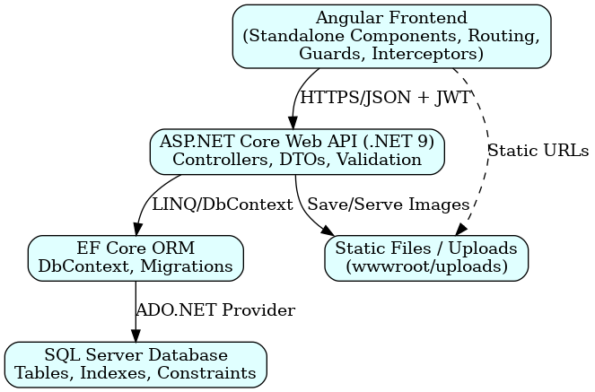
System Architecture

Slide 12
System Components
Frontend (Angular SPA)
Login & Registration
Dashboard & Q&A Module
Rich-Text Editor & Image Upload
Search & Pagination
Notifications & Route Guards
Backend (ASP.NET Core API)
User & Q&A Management APIs
Image Upload Handling
Moderation & Approval Logic
Search & Pagination Logic
JWT Authentication & Authorization
Notification Service

Slide 13
API Design
Authentication & User APIs
POST /api/auth/login – User login & JWT (No auth)
POST /api/auth/register – Register new user (No auth)
Question APIs
GET /api/questions – Get all approved questions (Auth required)
GET /api/questions/{id} – Get question details (Auth required)
POST /api/questions – Post new question (Pending, Auth required)
Answer APIs
POST /api/answers – Add answer to question (Auth required)
Admin APIs
PUT /api/admin/questions/{id}/approve – Approve question (Admin)
PUT /api/admin/questions/{id}/reject – Reject question (Admin)
PUT /api/admin/answers/{id}/approve – Approve answer (Admin)

Slide 14
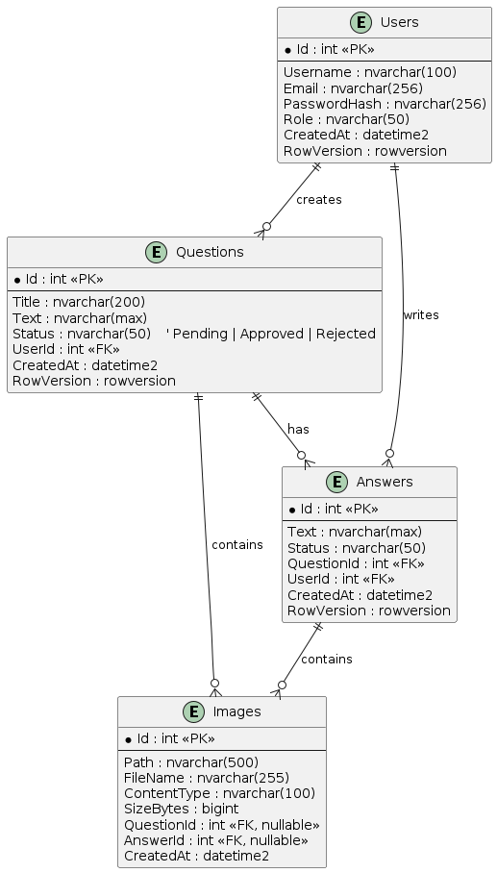
Entity Relationship Diagram
Users can post multiple questions & answers
Questions can have multiple answers
Questions can have multiple images
Answers can have multiple images
One-to-many relationships between Users → Questions/Answers, Questions → Answers/Images, Answers → Images

Slide 15
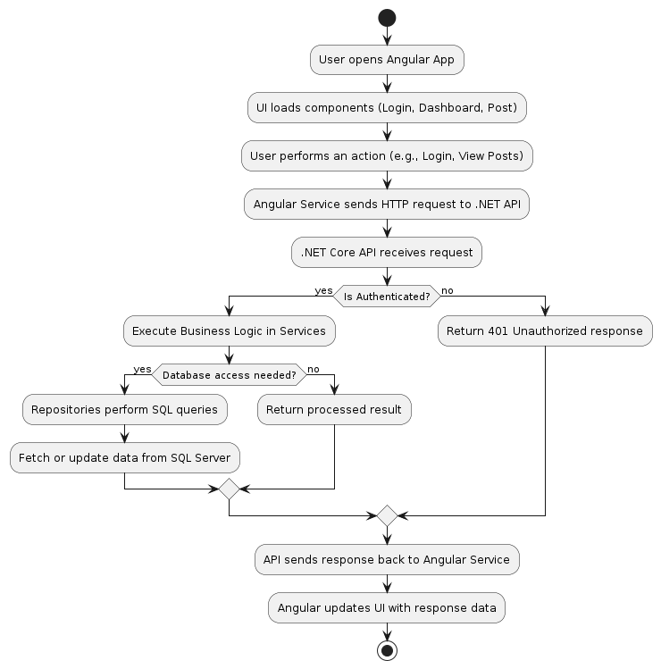
Process Flow Diagram

Slide 16
Environment Setup
Backend Setup:
Open backend project in Visual Studio
Restore NuGet packages: “dotnet restore”
Apply migrations: “dotnet ef database update”
Start API server: “dotnet run (https://localhost:5108)”
Frontend Setup:
Navigate to Angular frontend folder
Install dependencies: “npm install”
Start development server: “ng serve --open (http://localhost:4200)”

Slide 17
Testing
Verify feature correctness and data integrity
Detect and fix defects early
Validate authentication & authorization
Unit Testing: Backend (xUnit & Moq), Frontend (Angular components/services)
Integration Testing: API endpoints, workflows, UI updates
Continuous Testing: Automated CI/CD, builds fail if tests fail

Slide 18
Future Enhancements
Real-time notifications for users
AI-driven content moderation
Mobile application support
Advanced search with filters and tags
Analytics dashboard for admins

Slide 19
Conclusion
DoConnect is a secure and scalable moderated Q&A platform that enables users to post questions and answers with images, supports role-based moderation, efficient search, and pagination. Its responsive frontend and robust backend APIs ensure smooth functionality, while comprehensive testing guarantees reliability. The system is designed for maintainability and is ready for future enhancements like real-time notifications, AI moderation, and mobile support.

Slide 20
Thank You

